Slide 1
HAP Cloud

Slide 2
基础开发环境
JDK8
Maven
MySQL
Redis
RabbitMQ

Slide 3
运行HAP Cloud
https://rdc.hand-china.com/gitlab/HAPCloud/hap-cloud-parent

Slide 4
HAP Cloud知识
内部培训PPT

Slide 5
基础开发环境
Nodejs
Git
WebStore or VSCode or Atom or Sublime

Slide 6
模板项目
clone代码
git clone https://github.com/alicoding/react-webpack-babel
安装依赖
npm install
启动
npm start

Slide 7
学习知识点
Webpack
Glup
ES6语法
React
React Router V4
Mobx
Axios

Slide 8
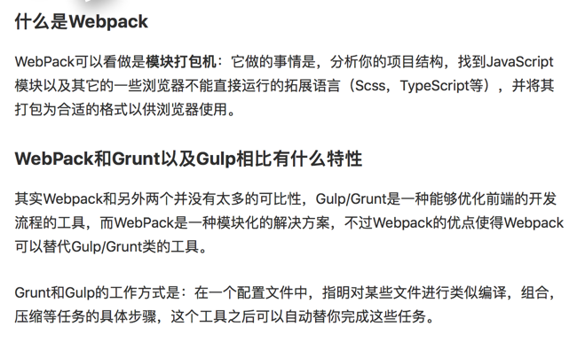
Webpack
https://segmentfault.com/a/1190000007914129

Slide 9

Gulp
http://www.gulpjs.com.cn/docs/getting-started/

Slide 10
ES6语法
变量声明
const 和 let
模板字符串
默认参数
箭头函数
模块的 Import 和 Export
ES6 对象和数组
析构赋值
对象字面量改进
Spread Operator
Promises
装饰器
https://rdc.hand-china.com/gitlab/1924/training/blob/master/README.md
http://es6.ruanyifeng.com/#docs/async

Slide 11
React
JSX
State,Props,Context
Component
Container
https://rdc.hand-china.com/gitlab/1924/training/blob/master/README.md

Slide 12
React Router V4
HashRouter
BroswerRouter
Switch
Route
https://medium.com/@pshrmn/a-simple-react-router-v4-tutorial-7f23ff27adf

Slide 13
Mobx
http://cn.mobx.js.org/refguide/autorun.html

Slide 14
Axios
https://github.com/mzabriskie/axios

Slide 15

Questions…

