Slide 1





Dr Yasemin Mustafa
Data Analytics Portfolio
Data Analyst

Slide 2
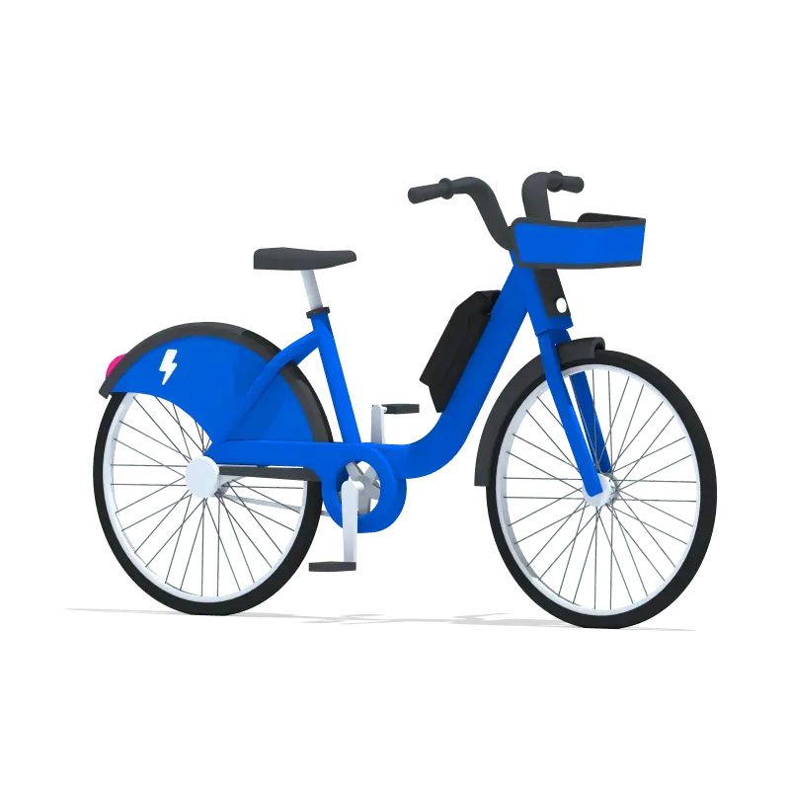
Citi Bikes Data Project
2

Slide 3




Citi Bikes
Citi Bikes Data Project
Context:
Citi Bike, New York City’s bike-sharing programme, aimed to understand early rider behaviour to inform future service improvements and expansion strategies.
Objective:
Conducted exploratory and cluster analysis to uncover patterns in rider behaviour and identify distinct user groups based on trip duration, age, and time of day.
Citi Bikes Data Project
Data Source:
https://www.kaggle.com/datasets/ryanmcummings/citi-bike-data/data via Kaggle.
Data Analysis Method:
Data Wrangling – Exploratory Analysis – Geographic Visualisations – Time Series Analysis – Regression Modelling – Unsupervised Machine Learning (Clustering) – Open Source Data Integration
Tools Used:
3

Slide 4
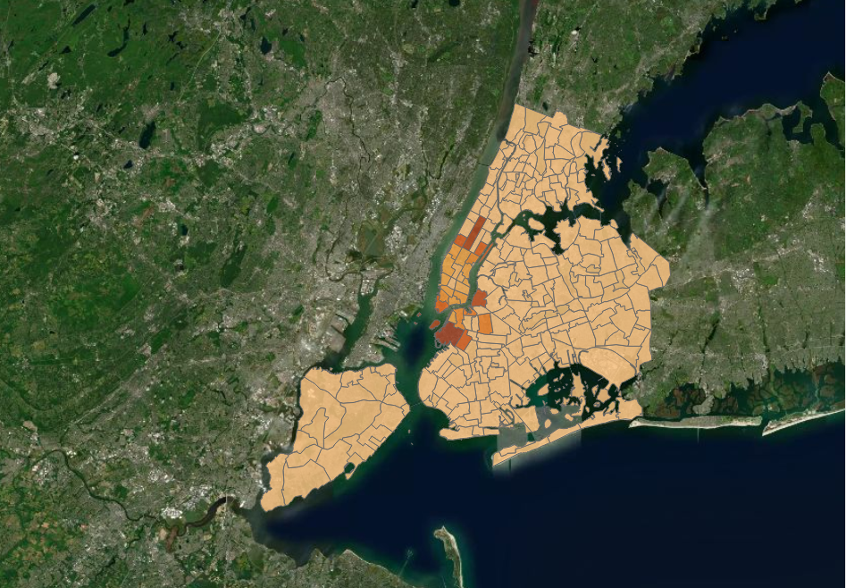
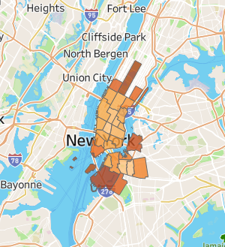
Citi Bikes
What Can 2013 Citi bike Data Reveal About User Behaviour?
Launched in 2013, Citi Bike quickly became a key part of New York City's transport network. This dataset captures its earliest rides, offering a snapshot of how residents and visitors first engaged with bike sharing.
Though historical, these insights remain relevant—informing station planning, service design, and user experience today.
This case study explores patterns in trip duration, start times, and rider age. The choropleth maps reveal how average trip durations vary by neighbourhood—highlighting spatial trends in behaviour.
Tableau Link: https://public.tableau.com/app/profile/leyla.efe/viz/CitiBikes_17509249164740/Story1?publish=yes
GitHub Link: https://github.com/YLMustafa/citi_bikes/blob/main/README.md

Slide 5
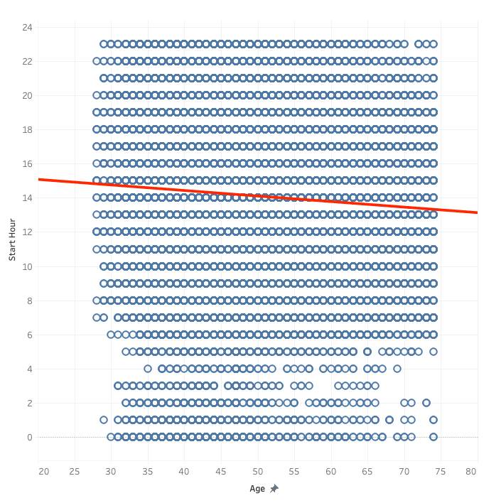
Citi Bikes
Early Birds? Exploring the Age–Start Time Relationship with Linear Regression
For exploration, I tested several variable pairs for linear trends and found the strongest relationship between Age and Start Hour.
The scatterplot shows widely scattered points, and correlations revealed an extremely weak negative relationship.
This suggests older riders might start trips slightly earlier than younger ones.
To investigate this, I fitted a simple linear regression model predicting Start Hour from Age.
The results showed age explained only about 0.4% of the variation in start times—meaning that while a slight trend exists, age alone isn’t a reliable predictor of when someone will ride.
Tableau Link: https://public.tableau.com/app/profile/leyla.efe/viz/CitiBikes_17509249164740/Story1?publish=yes
GitHub Link: https://github.com/YLMustafa/citi_bikes/blob/main/README.md

Slide 6
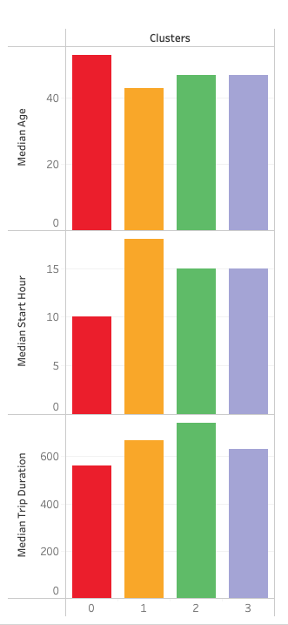
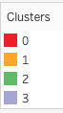
Citi Bikes
Clustering Riders by Age and Start Hour: Who Rides When?
After exploring linear relationships, I applied clustering to reveal hidden patterns, grouping riders into four distinct segments.
The oldest riders tend to start trips early, around 10 AM, taking shorter rides averaging 562 seconds—likely retirees or morning commuters.
The youngest group rides much later, around 6 PM, with moderate trip durations of 668 seconds, possibly reflecting after-work travel.
Mid-aged riders start around 3 PM and take the longest trips, averaging 741 seconds, suggesting leisure or flexible schedules.
A similar mid-aged cluster shares the same start time but takes shorter trips (632 seconds), indicating more local or routine travel behaviour.
Tableau Link: https://public.tableau.com/app/profile/leyla.efe/viz/CitiBikes_17509249164740/Story1?publish=yes
GitHub Link: https://github.com/YLMustafa/citi_bikes/blob/main/README.md

Slide 7
Citi Bikes
Recommendations & Limitations
Distinct user segments revealed clear behavioural patterns:
Older riders start earlier and take shorter trips, likely retirees or morning commuters.
Younger riders travel later with moderate trip lengths, suggesting after-work trips.
Mid-aged riders ride late afternoon with the longest trips, possibly leisure or flexible schedules.
A similar mid-aged group rides late afternoon but with shorter trips, indicating local or routine travel.
Future analysis should incorporate additional behavioural and contextual variables to improve the accuracy and clarity of clustering and predictive insights.
Available data lacked sufficient behavioural and contextual variables, reducing the accuracy and interpretability of the clustering and predictive models.
Tableau Link: https://public.tableau.com/app/profile/leyla.efe/viz/CitiBikes_17509249164740/Story1?publish=yes
GitHub Link: https://github.com/YLMustafa/citi_bikes/blob/main/README.md

