Slide 1
Activation Functions: Comparison of Trends in Practice and Research for Deep Learning
Chigozie Enyinna Nwankpa, Winifred Ijomah, Anthony Gachagan, and Stephen Marshall
arXiv:1811.03378v1 [cs.LG] 8 Nov 2018
Citation - 270
Team 7
Ye Lin Tun (2019311683)
Chu Myaet Thwal (2019310177)
Pyae Sone Aung (2019310179)
Date : 2020/10/21

Slide 2
Outline
Introduction
Desirable features of an activation function
Sigmoid
Tanh
Softmax
Softsign
ReLU
Softplus
ELUs
Maxout
Swish
ELiSH

Slide 3
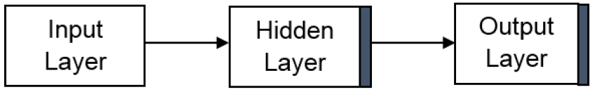




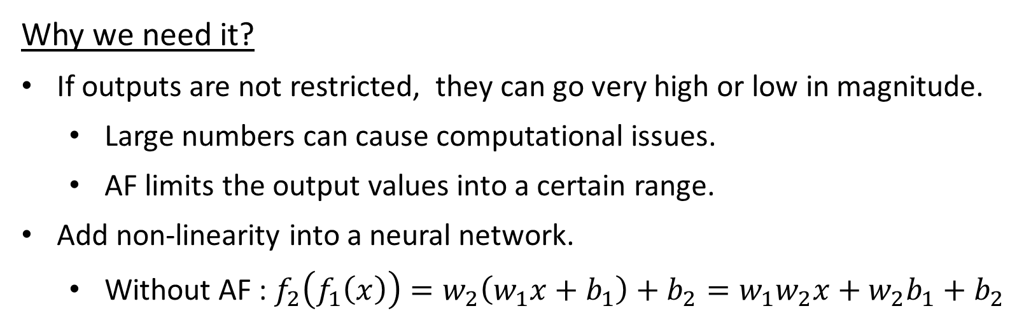
Introduction
Activation function (AF)
Helps the network learn complex patterns in the data.
Output : $f(x)=w^{T}x+b$
After applying AF : $f(x)=α(w^{T}x+b$)
AF
Why we need it?
If outputs are not restricted, they can go very high or low in magnitude.
Large numbers can cause computational issues.
AF limits the output values into a certain range.
Add non-linearity into a neural network.
Without AF : $f_{2}\left(f_{1}\left(x\right)\right)=w_{2}\left(w_{1}x+b_{1}\right)+b_{2}=w_{1}w_{2}x+w_{2}b_{1}+b_{2}$
$$w$$
$$b$$

Slide 4
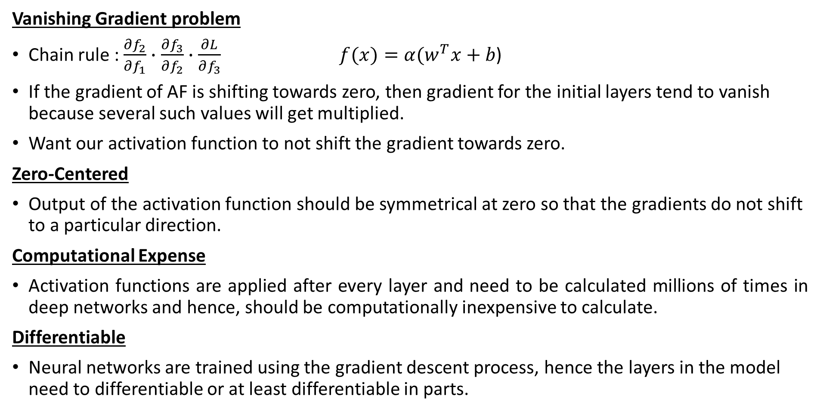
Desirable features of an activation function
Vanishing Gradient problem
Chain rule : $\frac{∂f_{2}}{∂f_{1}}∙\frac{∂f_{3}}{∂f_{2}}∙\frac{∂L}{∂f_{3}}$ $f(x)=α(w^{T}x+b$)
If the gradient of AF is shifting towards zero, then gradient for the initial layers tend to vanish because several such values will get multiplied.
Want our activation function to not shift the gradient towards zero.
Zero-Centered
Output of the activation function should be symmetrical at zero so that the gradients do not shift to a particular direction.
Computational Expense
Activation functions are applied after every layer and need to be calculated millions of times in deep networks and hence, should be computationally inexpensive to calculate.
Differentiable
Neural networks are trained using the gradient descent process, hence the layers in the model need to differentiable or at least differentiable in parts.

Slide 5
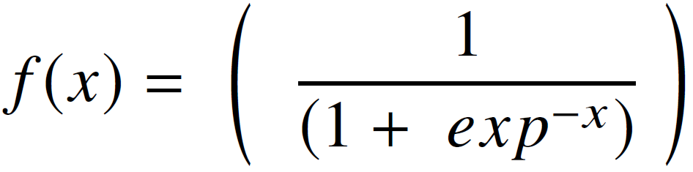
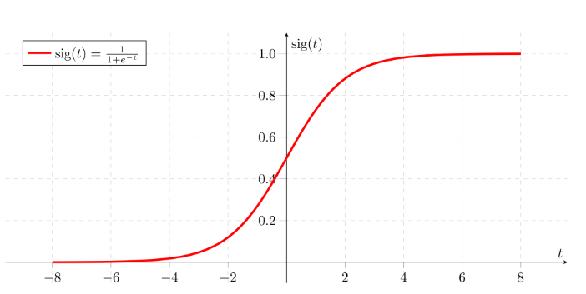

A. Sigmoid Function
Logistic function or squashing function.
Produces values in the range of 0-1
Used as the final layer in classification.
Positive derivatives.
Drawbacks
Vanishing gradient problem.
Mostly used in shallow networks.
Slow convergence
Not zero-centered.
: torch.nn.functional.sigmoid
Notes:
Used for Prediction probability based output
Applications
Binary classification problems
Modeling logistic regression tasks as well as other neural network domains

Slide 6
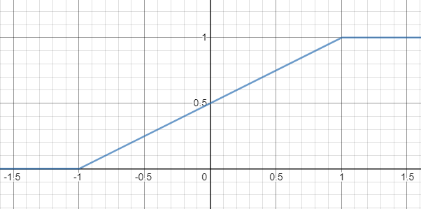
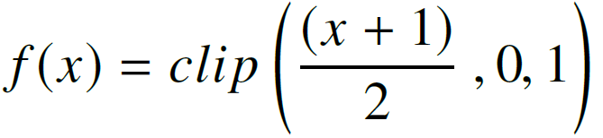
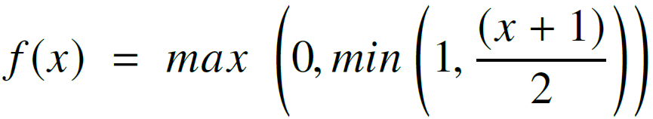
1) Hard Sigmoid Function
Lesser computation cost than soft sigmoid when implemented both in a specialized hardware or software form.
: torch.nn.functional.hardsigmoid

Slide 7
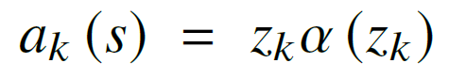
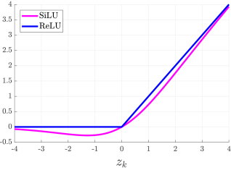
2) Sigmoid-Weighted Linear Units (SiLU)
Computed as Sigmoid multiplied by its input.
Only for reinforcement learning based systems.
SiLU outperformed the ReLU.
: torch.nn.SiLU

Slide 8
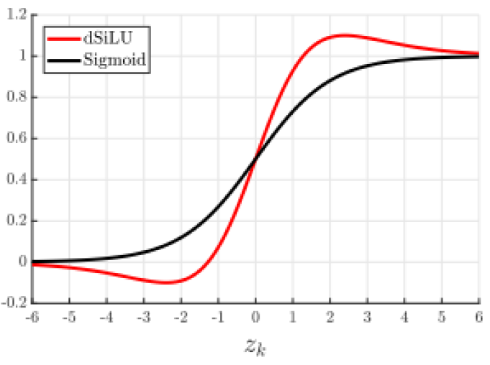
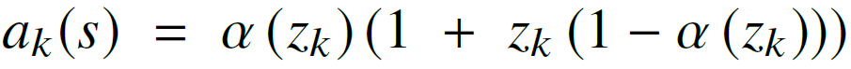
3) Derivative of Sigmoid-Weighted Linear Units (dSiLU)
Gradient of the SiLU function.
dSiLU outperformed the standard Sigmoid function significantly.
Notes:
Used for gradient-descent learning updates for the neural network weight parameters

Slide 9
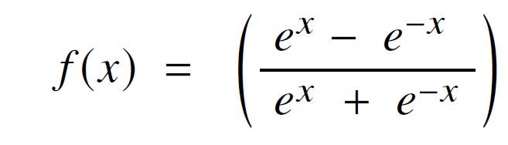
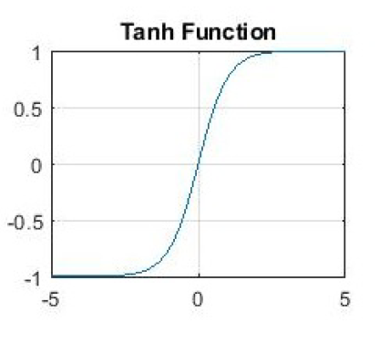
B. Hyperbolic Tangent Function (Tanh)
Zero-centered function.
Output range lies between -1 to 1.
Could not solve the vanishing gradient problem suffered by the sigmoid functions as well.
: torch.nn.functional.tanh
Notes:
Drawbacks
It can only attain a gradient of 1, only when the value of the input is 0, that is when x is zero.
This makes the tanh function produce some dead neurons during computation.
Dead Neuron is a condition where the activation weight, rarely used as a result of zero gradient.
To resolve the problem, it birthed the ReLU AF.
Applications
Natural Language Processing
Speech Recognition tasks

Slide 10
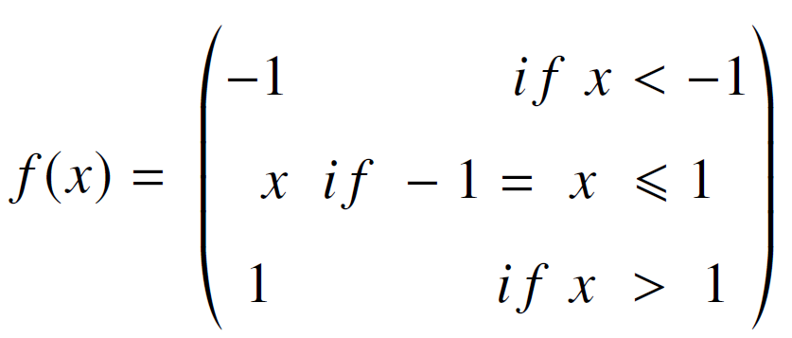
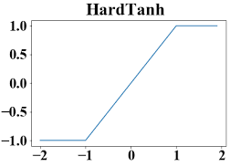
1) Hard Hyperbolic Function
Hardtanh function.
Cheaper and more computational efficient version of tanh.
Output lies within the range of -1 to 1.
: torch.nn.functional.hardtanh
Notes:
Applications
Deep Learning Applications
Natural Language Processing (provide both speed and accuracy improvements

Slide 11
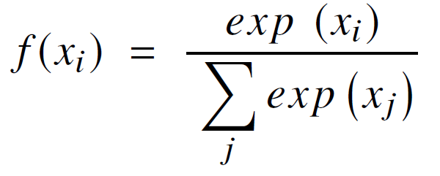
C. Softmax Function
Compute probability distribution from a vector of real numbers.
Produces outputs which is a range of values between 0 and 1, with the sum of the probabilities been equal to 1.
Used in multi-class classification where it returns probabilities of each class.
: torch.nn.functional.softmax
Notes:
Applications
Neural Computing
Multivariate Classification tasks (Sigmoid >> binary classification)

Slide 12
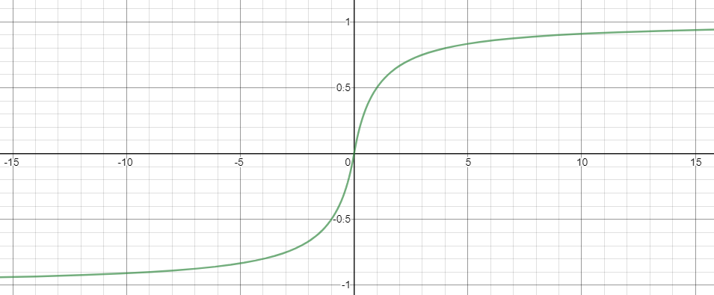
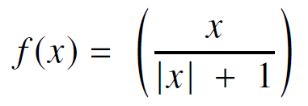
D. Softsign
Softsign converges in polynomial form unlike the tanh function which converges exponentially.
Mostly in regression computation problems and also in DL based text to speech systems.
: torch.nn.functional.softsign
Notes:
Converges in polynomial form (Tanh >> converges exponentially)
Applications
Regression Computation Problems
DL based test to speech systems

Slide 13
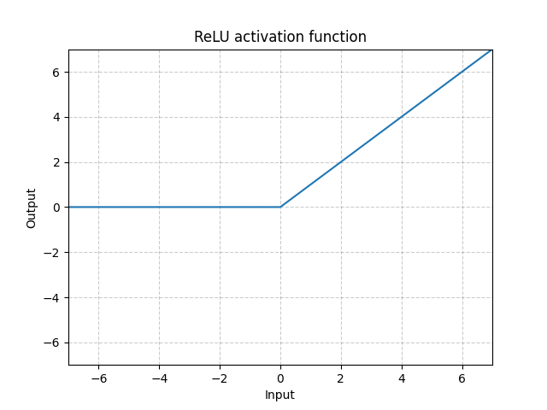
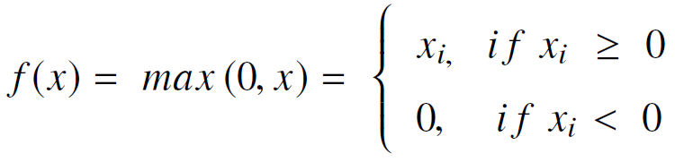
E. Rectified Linear Unit (ReLU) Function
Fast learning AF.
Better performance and generalization compared to the Sigmoid and tanh functions.
Represents a nearly linear function.
Used within the hidden units of the neural networks, with another AF used in the output layers.
Squishes the values between zero to maximum.
Drawbacks
Easily overfits compared to the sigmoid function.
Dropout can reduce the effect of overfitting .
During training, gradients can die.
: torch.nn.functional.relu
Notes:
Dead neurons during training causing the weight updates not to activate in future data points
To solve this, the leaky ReLU was proposed.

Slide 14
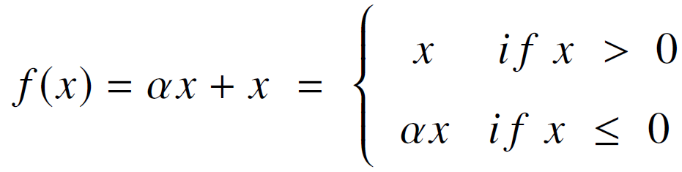
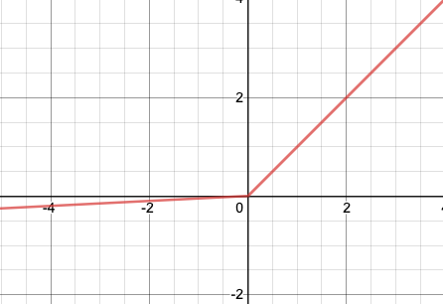
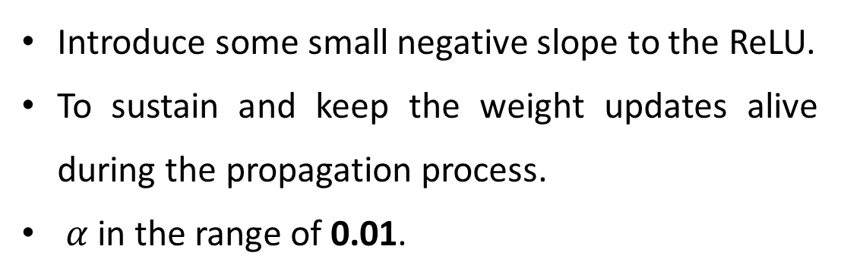
1) Leaky ReLU (LReLU)
Introduce some small negative slope to the ReLU.
To sustain and keep the weight updates alive during the propagation process.
$α$in the range of 0.01.
: torch.nn.functional.leaky_relu
Notes:
No significant result improvement except in sparsity and dispersion

Slide 15
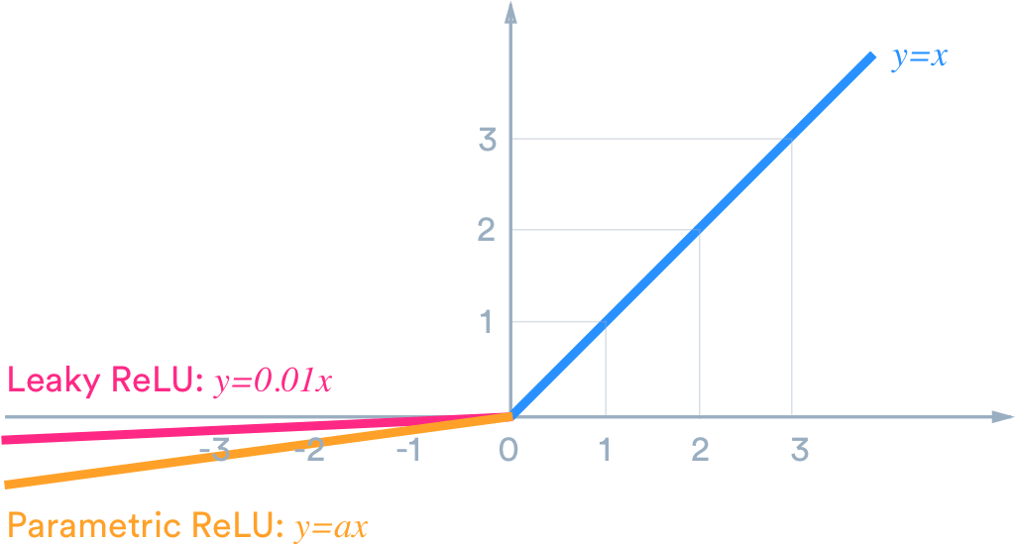
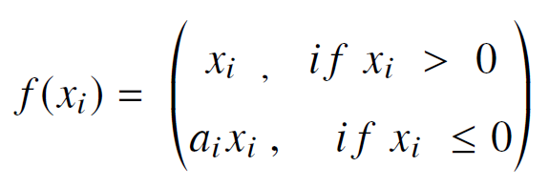
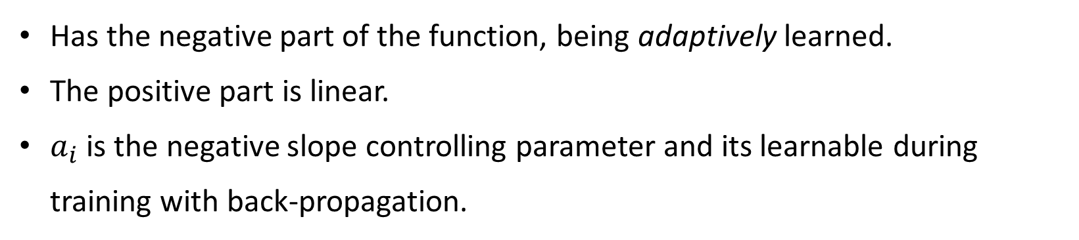
2) Parametric Rectified Linear Units (PReLU)
Has the negative part of the function, being adaptively learned.
The positive part is linear.
$a_{i}$ is the negative slope controlling parameter and its learnable during training with back-propagation.
: torch.nn.functional.prelu
Notes:
PReLU > ReLU in large scale image recognition and these results from the PReLU was the first to surpass human-level performance on visual recognition challenge.

Slide 16
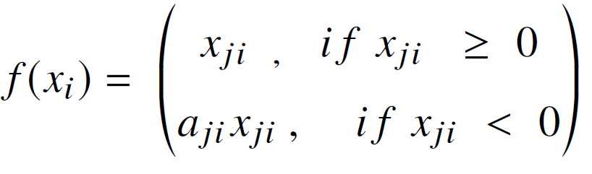
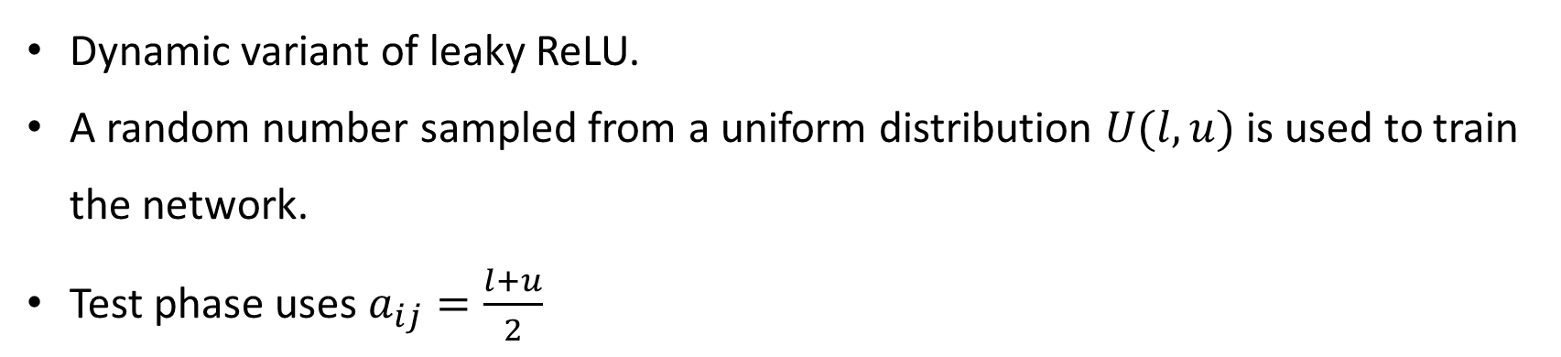
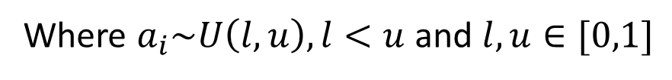
3) Randomized Leaky ReLU (RReLU)
Where $a_{i}\sim U\left(l,u\right), l<u$ and $l,u∈[0,1]$
Dynamic variant of leaky ReLU.
A random number sampled from a uniform distribution $U(l,u)$ is used to train the network.
Test phase uses $a_{ij}=\frac{l+u}{2}$
: torch.nn.functional.rrelu

Slide 17
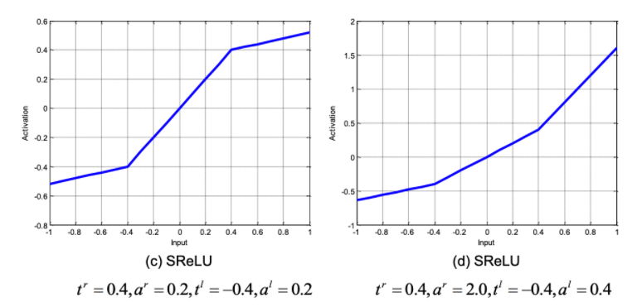
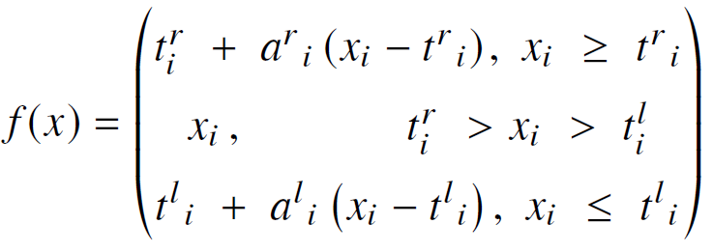
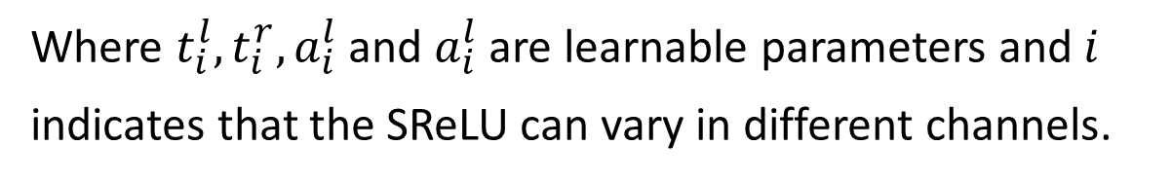
4) S-shaped ReLU (SReLU)
Used to learn both convex and nonconvex functions.
Consists of three-piece wise linear functions, formulated by four learnable parameters.
Where $t_{i}^{l},t_{i}^{r},a_{i}^{l}$ and $a_{i}^{l}$ are learnable parameters and $i$ indicates that the SReLU can vary in different channels.
https://github.com/digantamisra98/Echo/blob/master/echoAI/Activation/Torch/srelu.py
Notes:
t = threshold
a = slope
SReLU was tested on some of the award-winning CNN architectures, Network architecture alongside GoogLeNet, image recognition tasks alongside CIFAR-10, ImageNet, MNIST standard datasets and it show improved results, compared to the other AFs.

Slide 18
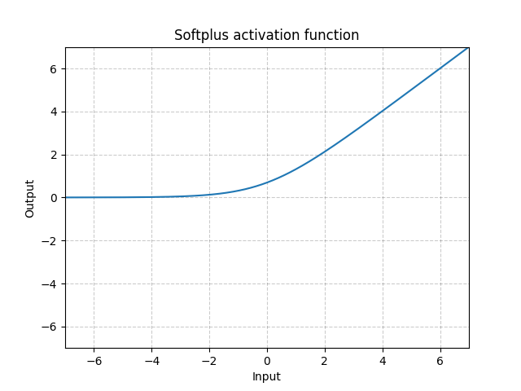
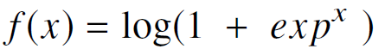
F. Softplus Function (Smooth ReLU)
Smooth version of the ReLU function.
Enhancing the stabilization and performance of deep neural network.
: torch.nn.functional.softplus
Notes:
Showed an improved performance with lesser epochs to convergence during training, using the Softplus function than ReLU & Sigmoid in statistical applications
Applications
Speech Recognition Systems

Slide 19
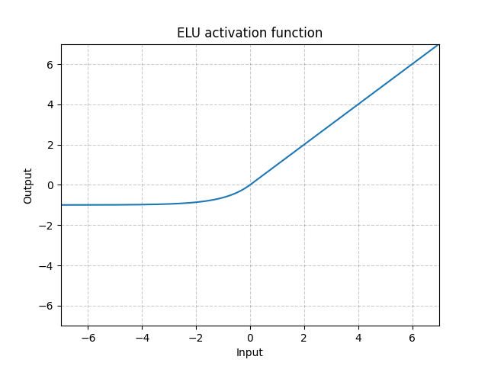
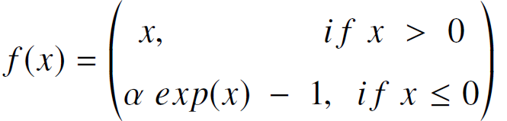
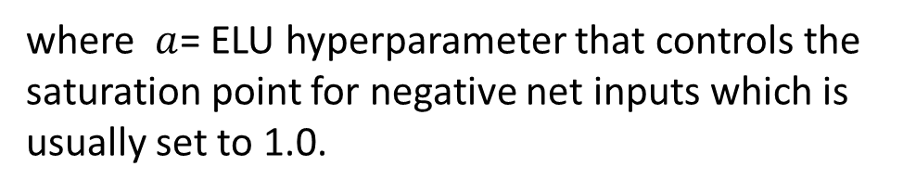
G. Exponential Linear Units (ELUs)
where $a$= ELU hyperparameter that controls the saturation point for negative net inputs which is usually set to 1.0.
Can alleviate the vanishing gradient problem.
Gives identity for positive values.
Have negative values which allows for pushing of mean unit activation closer to zero thereby reducing computational complexity and thus, improving learning speed.
: torch.nn.functional.elu
Notes:
Drawbacks
ELU does not centre the values at zero, and the parametric ELU was proposed to address this issue

Slide 20
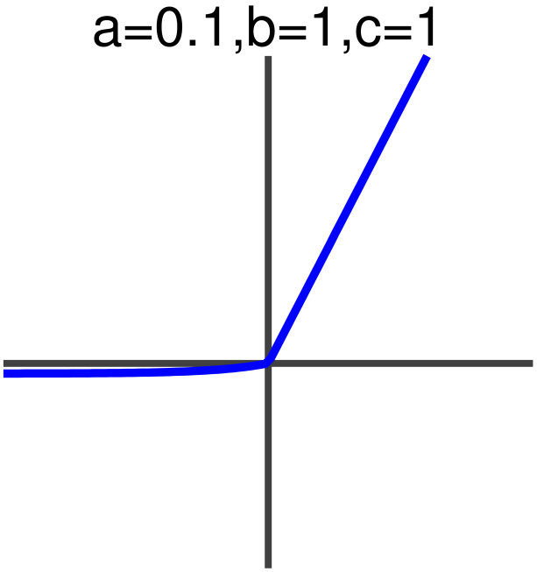
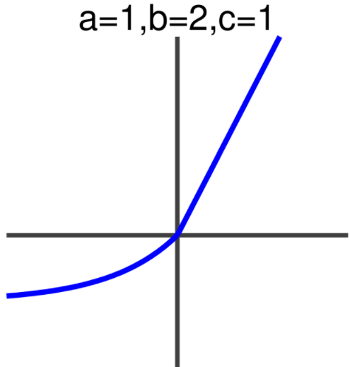
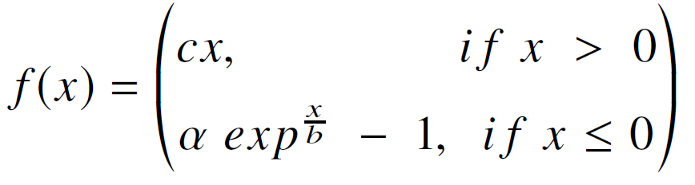
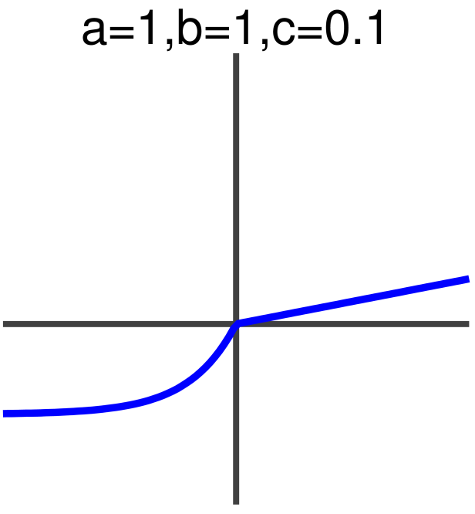
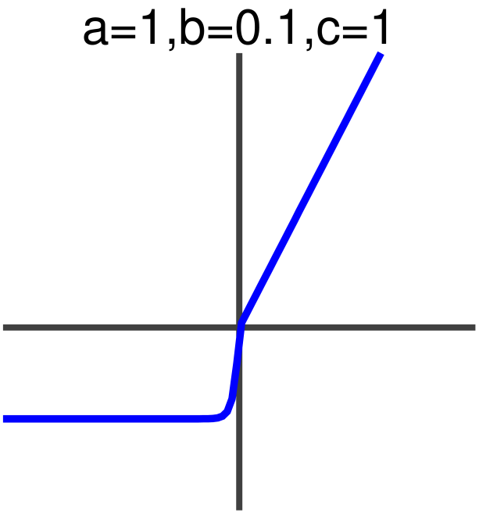
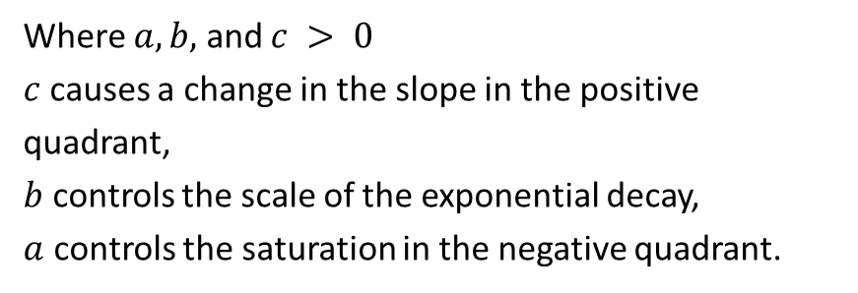
1) Parametric Exponential Linear Unit (PELU)
Where $a, b,$ and $c > 0$
$c$ causes a change in the slope in the positive quadrant,
$b$ controls the scale of the exponential decay,
$a$ controls the saturation in the negative quadrant.
Parameterized version of ELU.
Address the zero center issue found in the ELUs.
Two additional parameters compared to the ELU.
https://github.com/InzamamRahaman/PELU

Slide 21
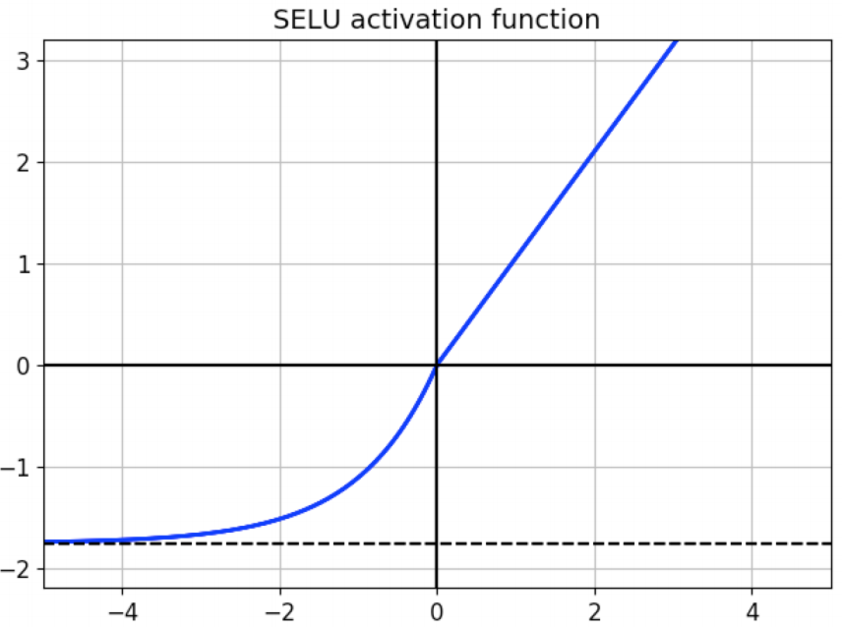
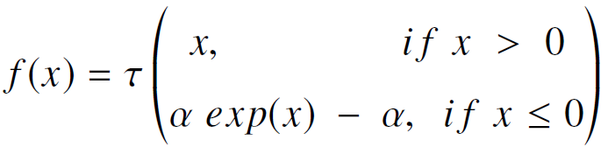
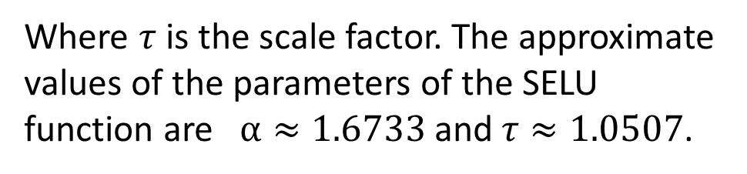
2) Scaled Exponential Linear Units (SELU):
Where $τ$ is the scale factor. The approximate values of the parameters of the SELU function are $α≈1.6733$ and $τ≈1.0507$.
Introduced as a self-normalising neural network.
Has a property of inducing self-normalising properties.
Has a close to zero mean and unit variance.
: torch.nn.functional.selu
Notes:
Applications
Classification tasks alongside some deep genetic mutation computation

Slide 22
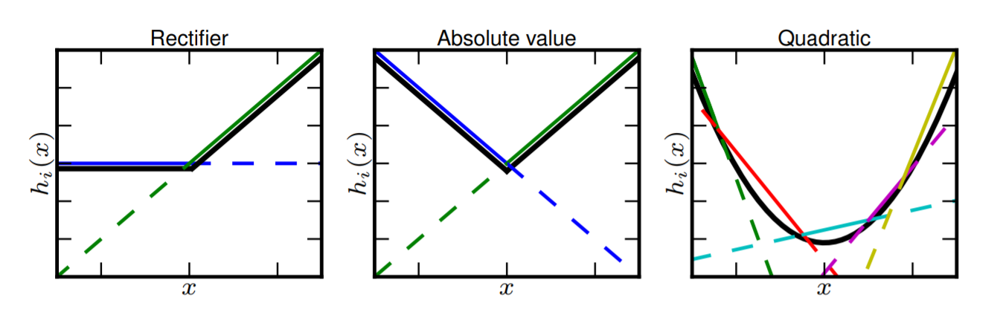
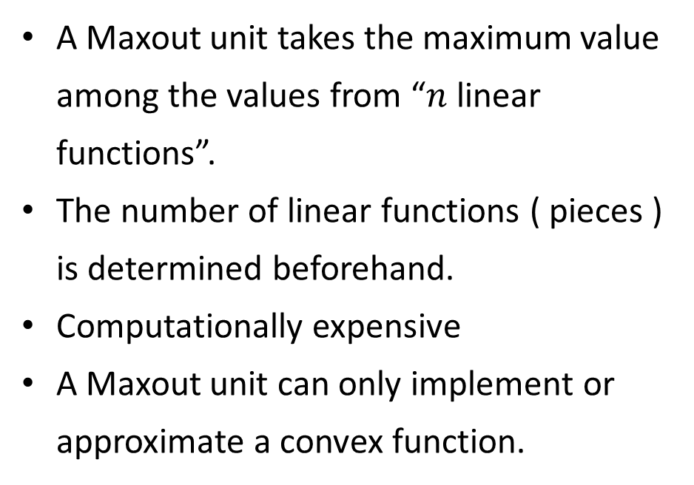
H. Maxout Function
A Maxout unit takes the maximum value among the values from “$n$ linear functions”.
The number of linear functions ( pieces ) is determined beforehand.
Computationally expensive
A Maxout unit can only implement or approximate a convex function.
The Maxout has implemented ReLU with 2 linear functions, and quadratic curve with 4 linear functions.
https://github.com/pytorch/pytorch/issues/805
Notes:
https://medium.com/@rahuljain13101999/maxout-learning-activation-function-279e274bbf8e
Drawback
It is computationally expensive as it doubles the parameters used in all neursons thereby increasing the number of parameters to compute by the network
Applications
Phone recognition applications

Slide 23
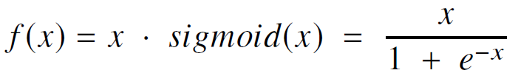

I. Swish Function
Compound AF.
Combination of the sigmoid AF and the input function.
Smooth, non-monotonic, bounded below and unbounded in the upper limits.
Smoothness allows better optimization and generalization results.
https://discuss.pytorch.org/t/implementation-of-swish-a-self-gated-activation-function/8813
Notes:
Main advantages
Simplicity and improved accuracy as the Swish does not suffer vanishing gradient problems
Outperforms ReLU on deep learning classification tasks

Slide 24

J. Exponential linear Squashing Function (ELiSH)
Shares common properties with the Swish function.
Made up of the ELU and Sigmoid functions.
Sigmoid part improves information flow.
The Linear parts eliminates the vanishing gradient issues.
https://echo-ai.readthedocs.io/en/latest/#torch-elish

Slide 25

1) HardELiSH:
Multiplication of the HardSigmoid and ELU in the negative part and a multiplication of the Linear and the HardSigmoid in the positive.
https://echo-ai.readthedocs.io/en/latest/#torch-hard-elish
Notes:
Tested on ImageNet classification dataset

Slide 26
Conclusion
The most notable observation on the use of AFs for DL applications is that the newer activation functions seem to outperform the older AFs like the ReLU, yet even the latest DL architectures rely on the ReLU function.
Current practices does not use the newly developed state-of-the-art AFs but depends on the tested and proven AFs.
The newer activation functions are rarely used in practice.
Thank You !
Any Questions?

