Slide 1
^{Project Presentation}
^{Team 7}
Ye Lin Tun (2019311683)
Chu Myaet Thwal (2019310177)
Pyae Sone Aung (2019310179)
Date : 2020/11/23
https://github.com/yelintun1996/stl_10_classifier

Slide 2
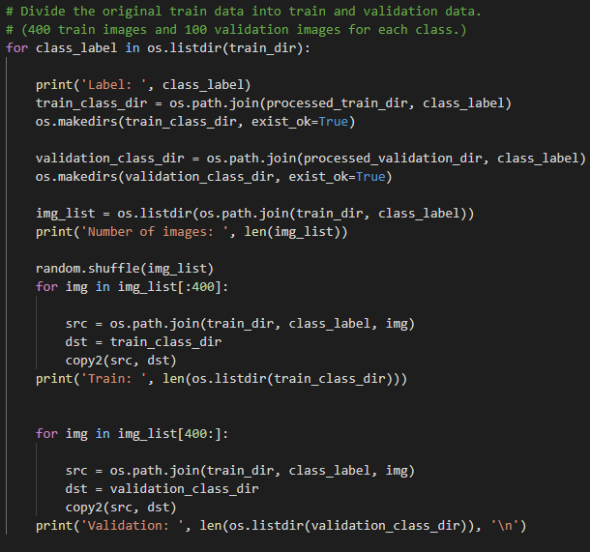

Validation Set
data_helper.ipynb
Original training data is divided into train and validation datasets.
For training, each class contains 400 images.
For validation, each class contains 100 imags.

Slide 3
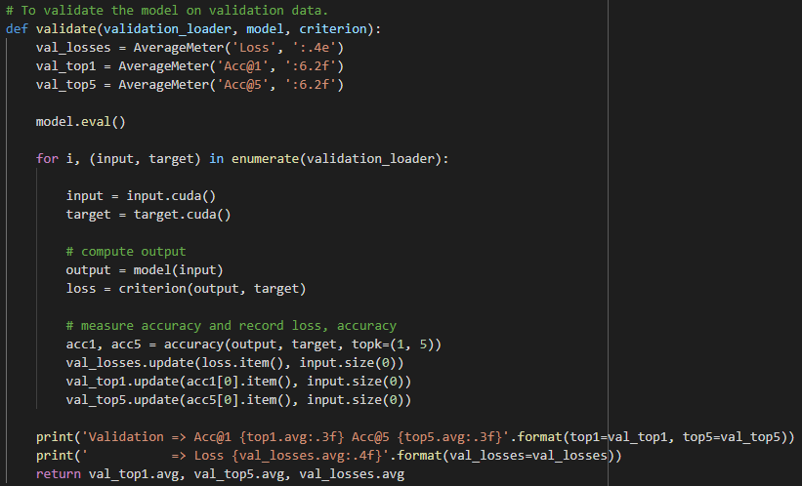
Model Selection
baseline.ipynb is used to take advantage of validation set.

Slide 4
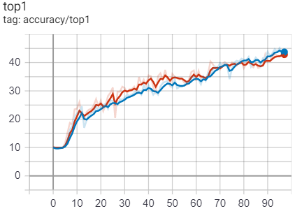
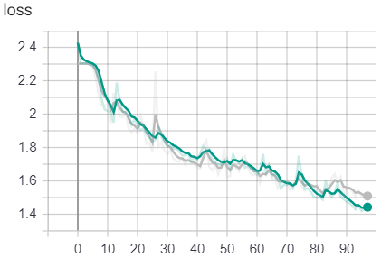
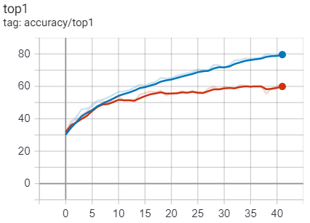
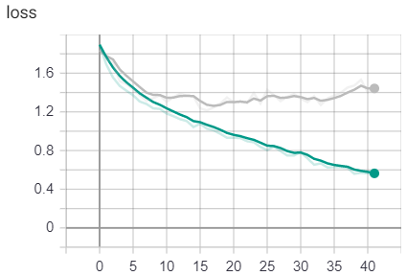
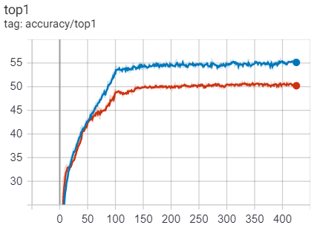
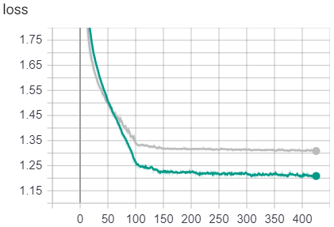
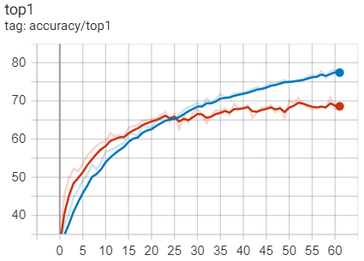
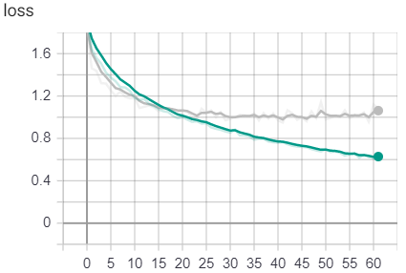
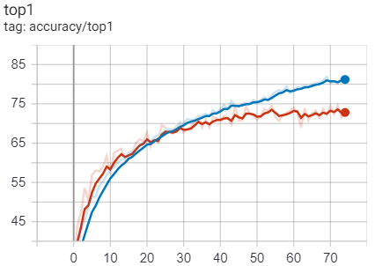
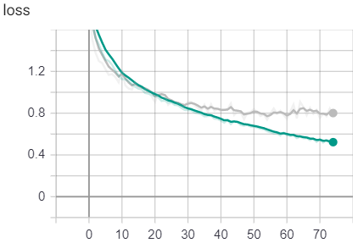
Model Selection (Cont’d)
LeNet
Image size : 96 x 96
DenseNet
ResNet
Image size : 32 x 32
Image size : 32 x 32
Image size : 96 x 96
Image size : 96 x 96

Slide 5
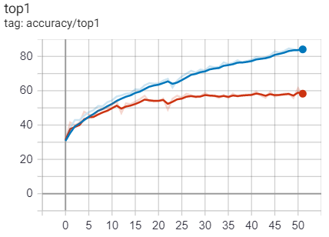
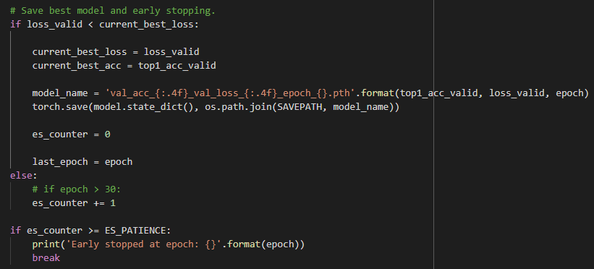
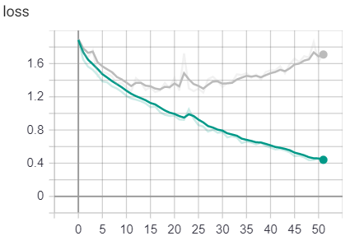
Early Stopping
A form of regularization used to avoid overfitting when training a model.
DenseNet
Image size : 32 x 32

Slide 6
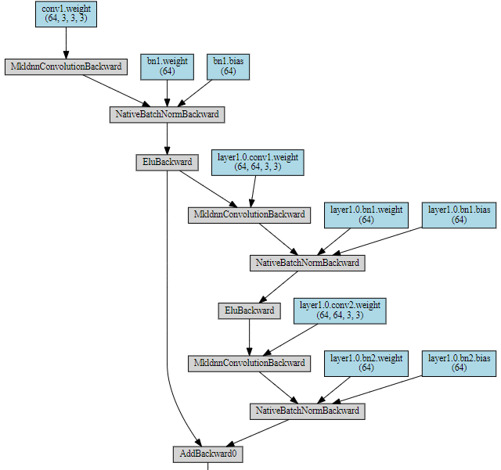
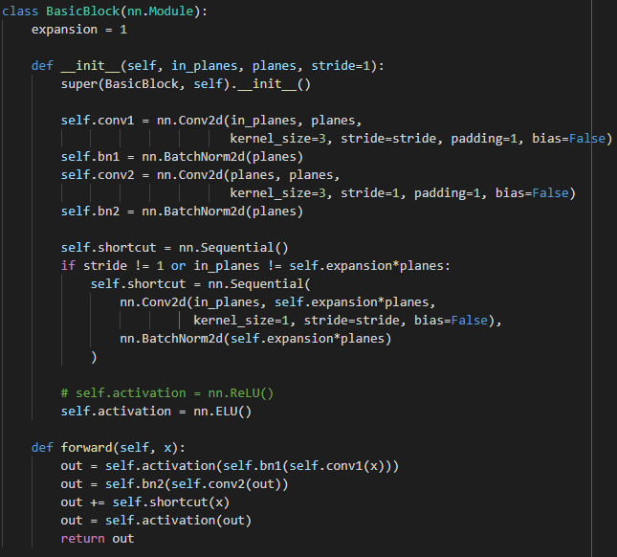
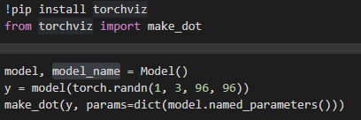
Model
Number of parameters: 1999202

Slide 7
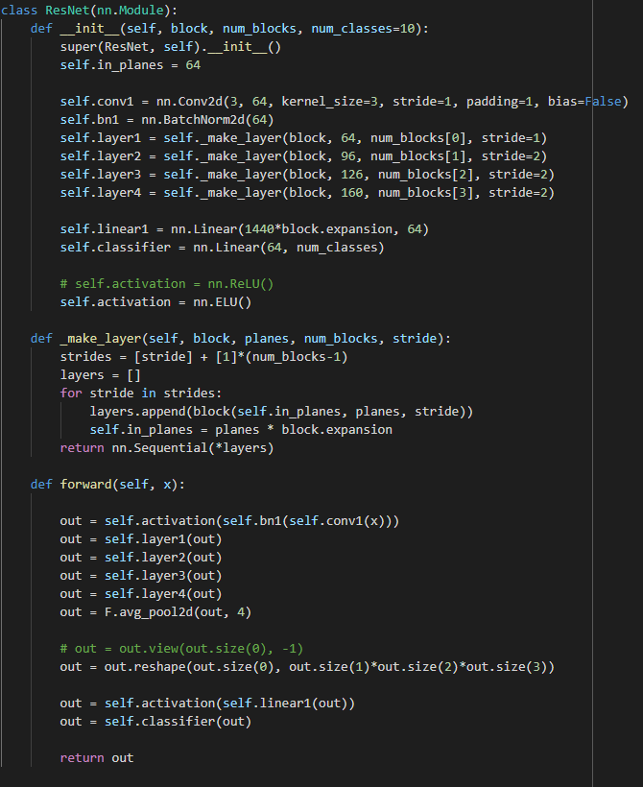
Model
BATCHSIZE = 64
EPOCHS = 1840
LR = 1e-4
optimizer = torch.optim.Adam(model.parameters(), lr=LR)
criterion = torch.nn.CrossEntropyLoss()

Slide 8
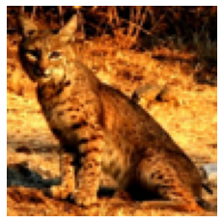
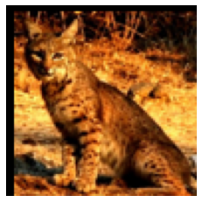
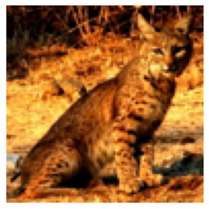
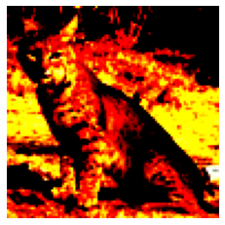
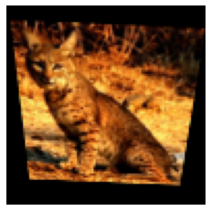
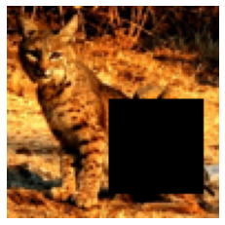
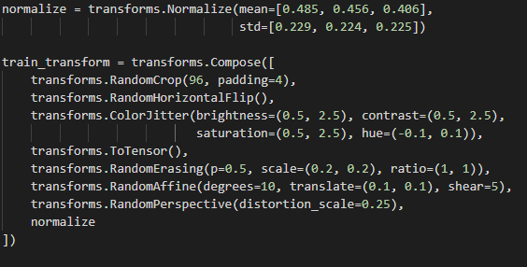
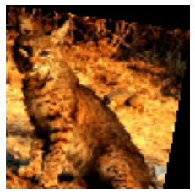
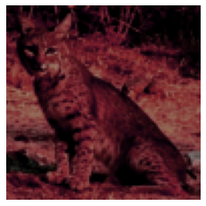
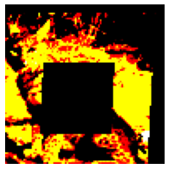
Augmentations
Original
Crop
Horizontal Flip
Normalize
Perspective
Erasing
Affine
ColorJitter
All combined

Slide 9
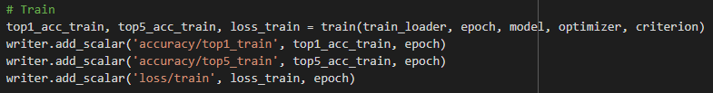

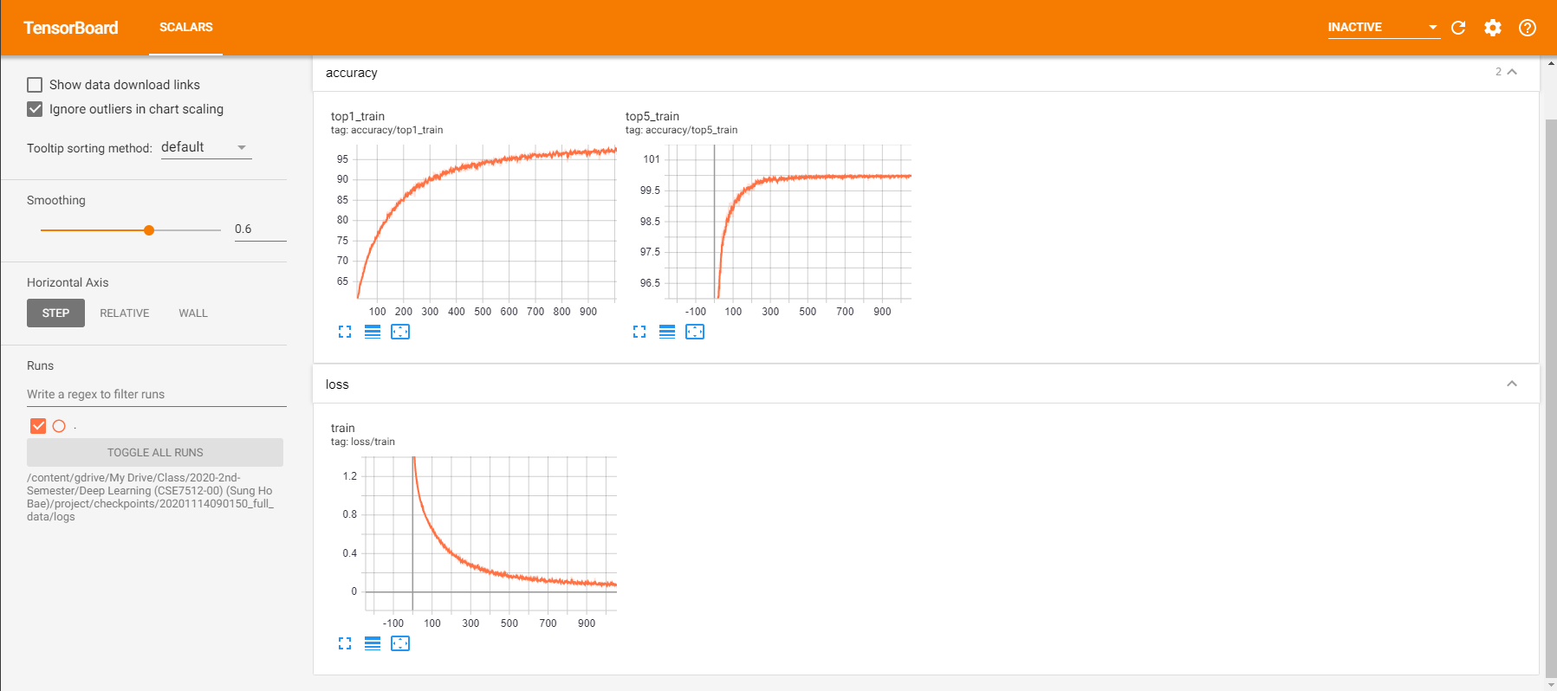
Tensorboard

Slide 10
Thank You !
Any Questions?

