Slide 1
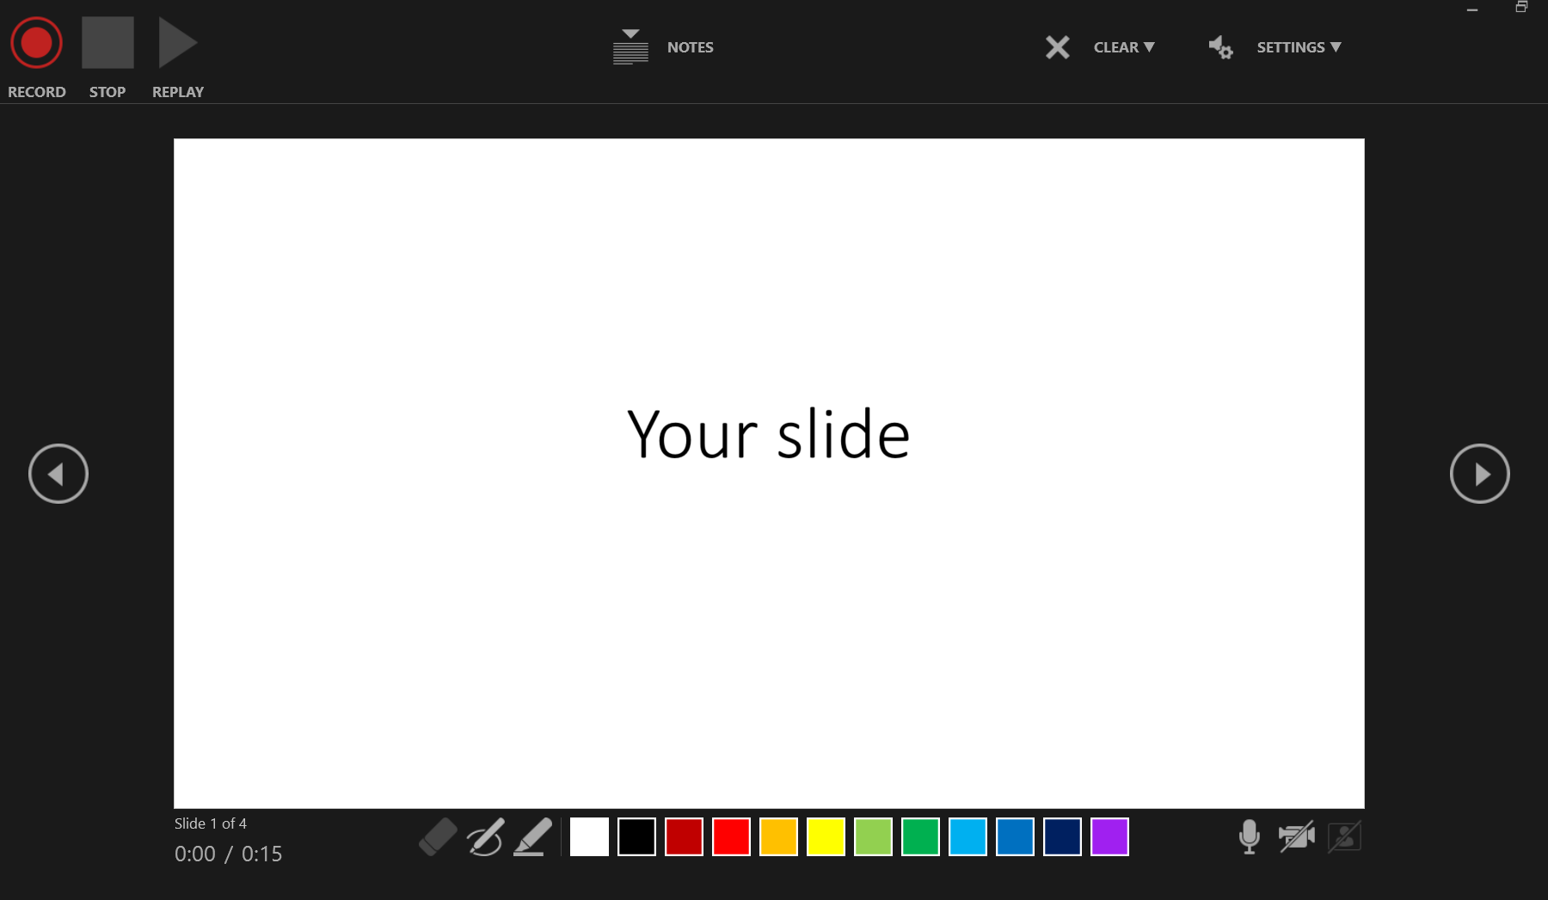

Click to record, stop and play the recoding in this slide
Clear the record

Slide 3


Slide 4
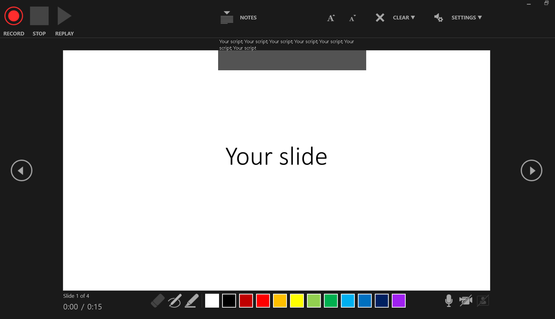
If you write notes for this slide, click “NOTES” to show it. The notes window would remain open during the whole recording.
Time of this slide/ Time of the whole presentation

Slide 5
