Slide 1

Cervical Cancer Classification
Yashar Mansouri

Slide 2
Introduction
13,000 women in the United States are diagnosed with cervical cancer each year
One of the leading causes among female cancer deaths in the modern age
Preventable with vaccination and appropriate screening
A Pap/HPV co-test is recommended for women 30 and over
The dataset was collected at 'Hospital Universitario de Caracas' in Caracas, Venezuela.
The dataset comprises demographic information, habits, and historic medical records of 858 patients.

Slide 3
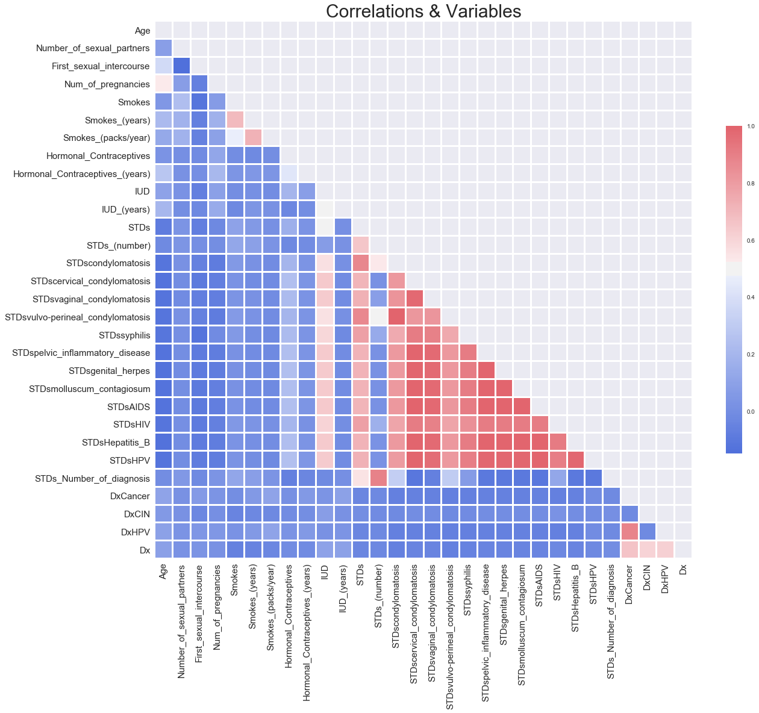
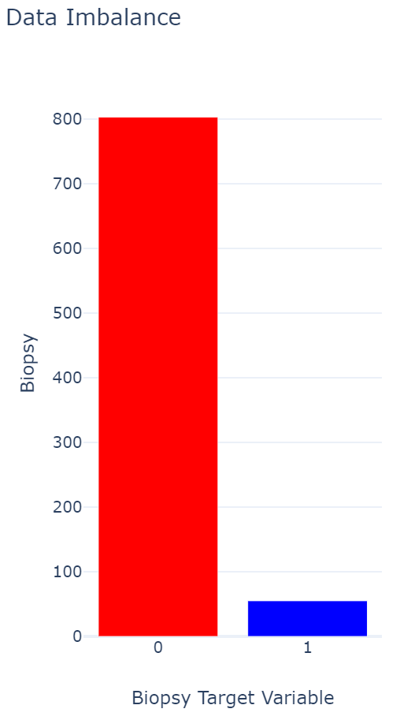
Dataset
Kelwin Fernandes, Jaime S. Cardoso, and Jessica Fernandes. 'Transfer Learning with Partial Observability Applied to Cervical Cancer Screening.' Iberian Conference on Pattern Recognition and Image Analysis. Springer International Publishing, 2017.

Slide 4
Methodology
Question: Can we accurately predict cancer based on risk factors?
Balancing the Data: Oversampling, Undersampling, SMOTE*
Classification via Logistic Regression
Grid Search for Optimizing the Model
Testing Model by Confusion Matrix
*Synthetic Minority Oversampling Technique

Slide 5
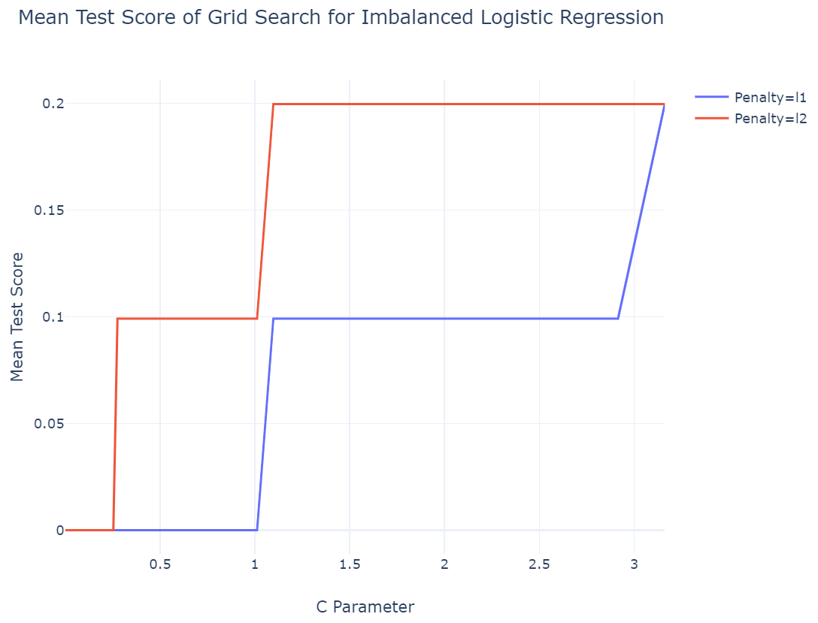
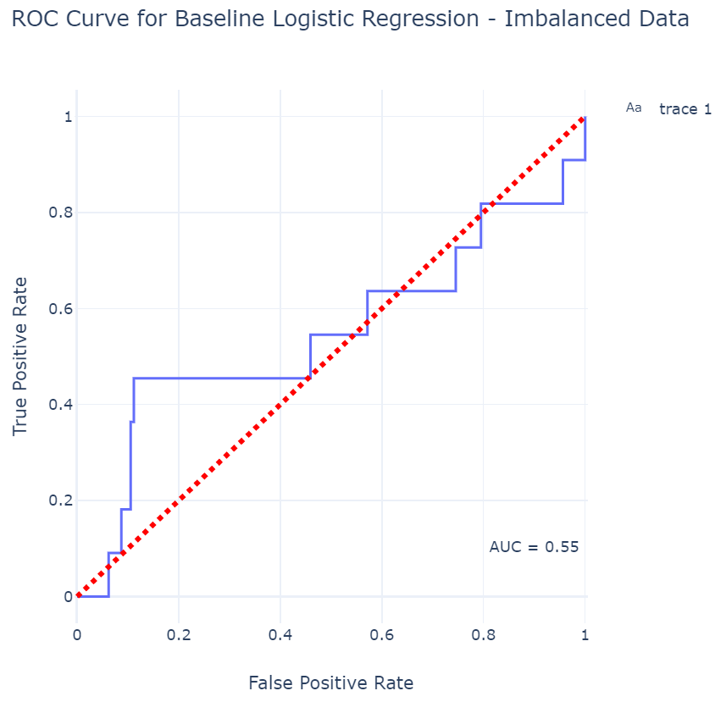
Baseline Model
'C': 1.0974987654930557, 'penalty': 'l2'}, 0.19

Slide 6
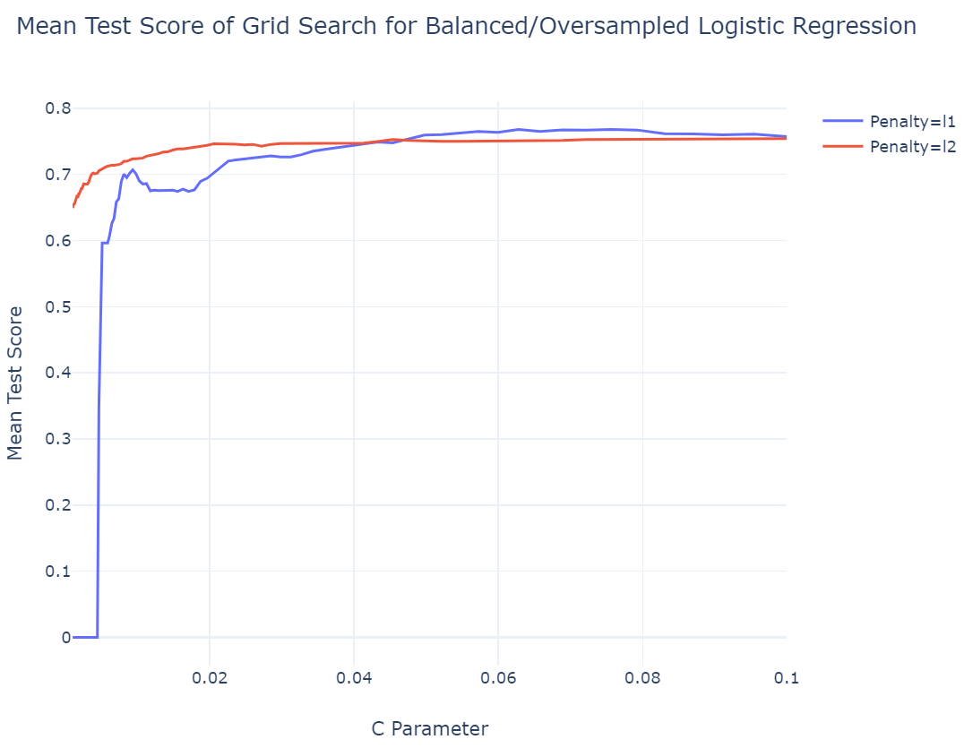
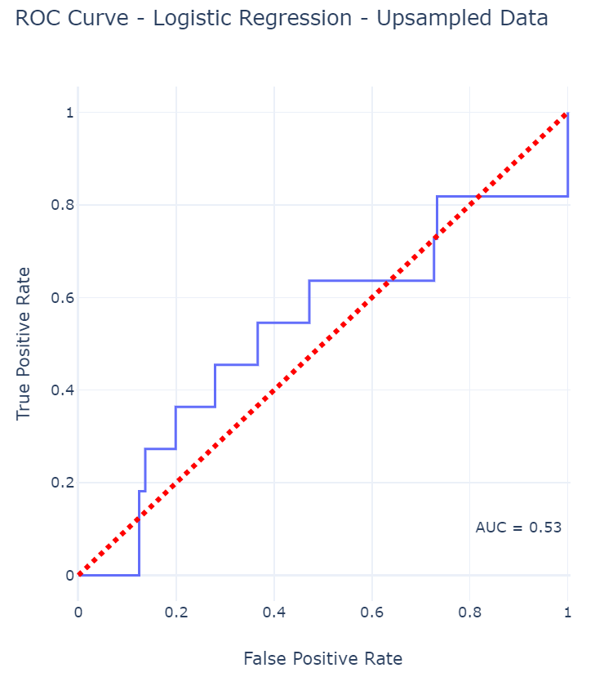
Upsampled Model
'C': 0.07564633275546291, 'penalty': 'l1'}, 0.76

Slide 7
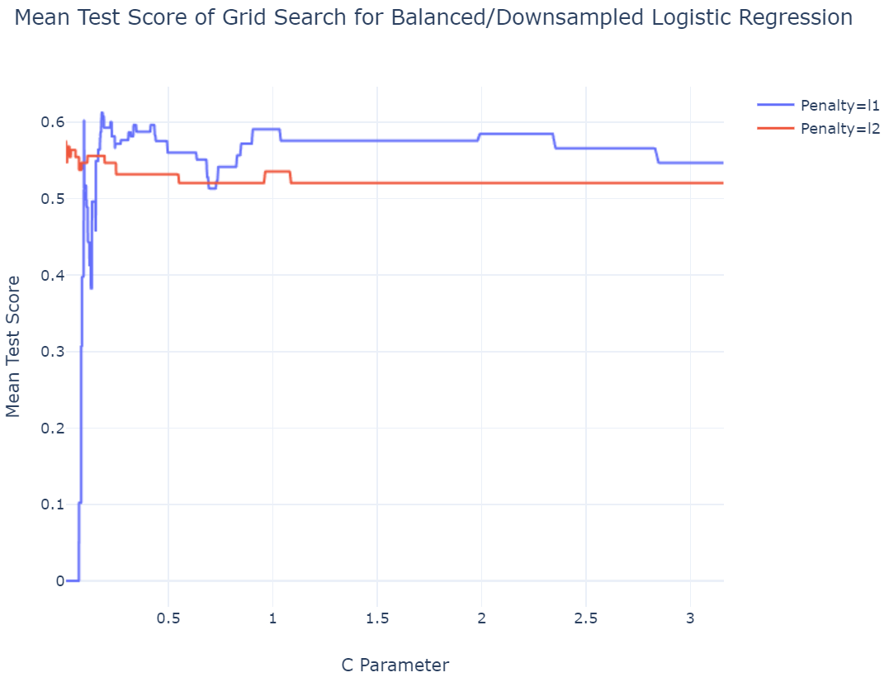
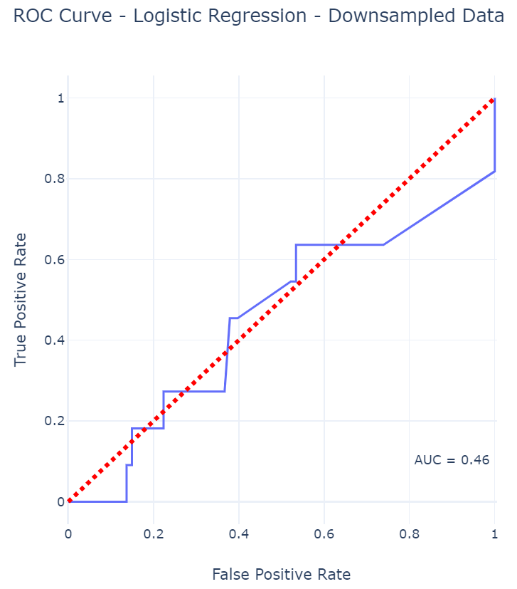
Downsampled Model
'C': 0.1814507462924242, 'penalty': 'l1'}, 0.61

Slide 8
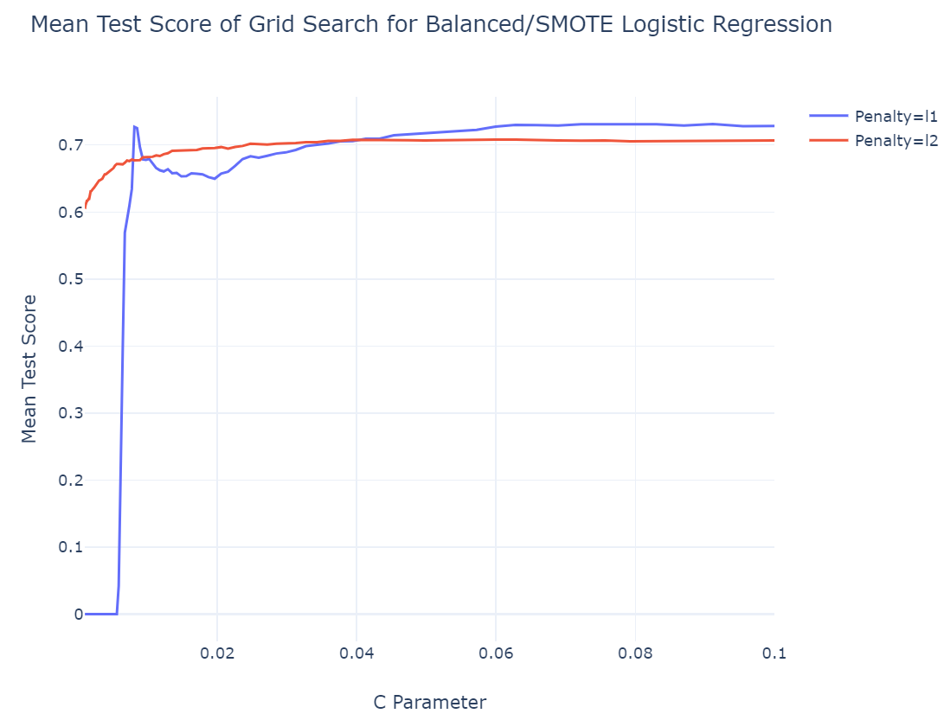
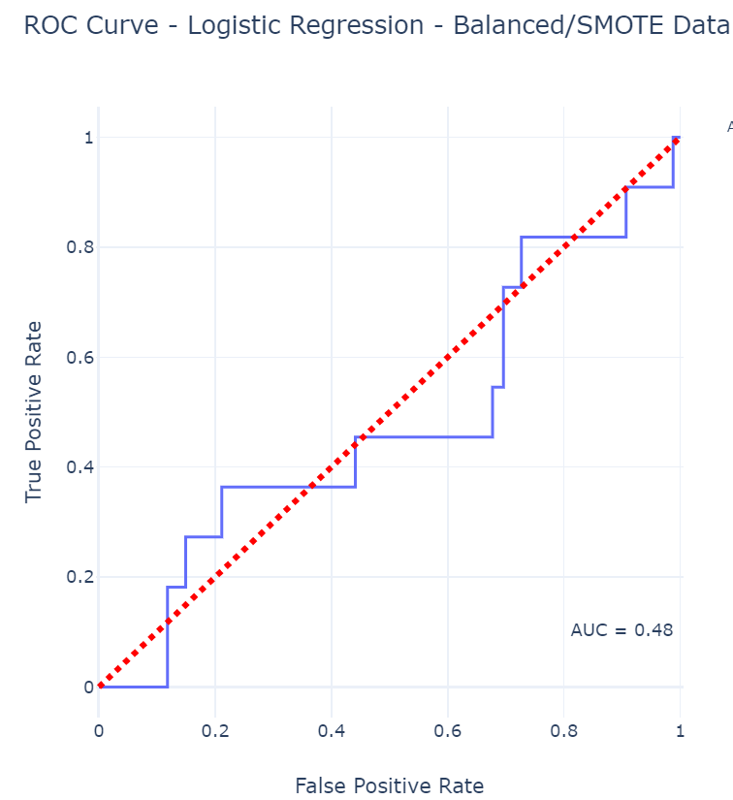
SMOTE Model
'C': 0.09111627561154896, 'penalty': 'l1'}, 0.73

Slide 9
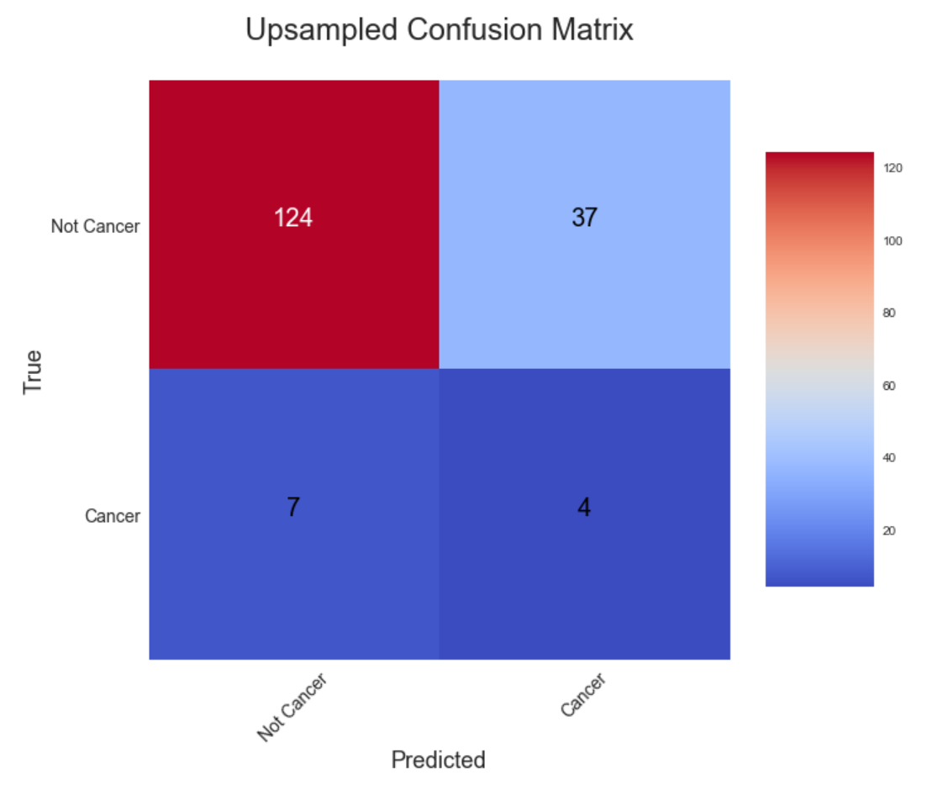
Results

Slide 10
Next Steps
More (Balanced) Data
More Complex Models Like Decision Tree and Random Forest Modeling for Better Prediction Accuracy
Feature Analysis
NCBI Gene Expressions Data

