Slide 1
Deep Learning and its Vision Applications
Pytorch Tutorial
TA : 1114611 張育銘
2023/03/01

Slide 2
Outline
What is Pytorch?
Training & Testing Neural Networks in Pytorch
Dataset & Dataloader
Tensors
torch.nn: Models, Loss Functions
torch.optim: Optimization
Save/load models
Notes:
OutLine大致說明說整個教學的流程

Slide 3
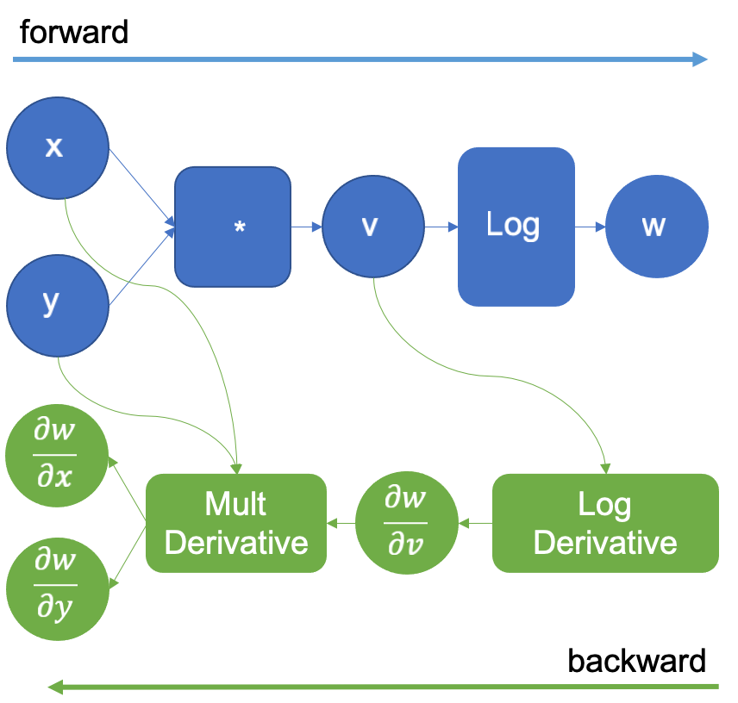

What is Pytorch?
An machine learning framework in Python.
Two main feature.
Tensor computing (like NumPy) with strong acceleration via GPU.
Automatic differentiation for training deep neural networks.
Figure 1. Pytorch icon[1]
Figure 2. Autograd figure [2]
Notes:
Framework的定義需要說明
自動微分機制

Slide 4
Training Neural Networks
Define
Neural Networks
Loss Function
Optimizer
Algorithm
Load
Data
Training

Slide 5
Training & Testing Neural Networks
Training
Validation
Testing
1 epoch

Slide 6
Training & Testing Neural Networks - in Pytorch
Load
Data
Training
Validation
Testing
1 epoch

Slide 7

Dataset & DataLoader
Dataset : stores data samples and preprocess
Dataloader : group data in batches, enables multi-porcessing
DataLoader
Dataset
__getitem__(0)
0
__getitem__(1)
1
Batch size = 4
__getitem__(2)
2
__getitem__(3)
3
Notes:
Dataset 最基本的class，負責儲存資料包含可能影像路徑，前處理Operation，還是說有其他要記錄的。
Dataloader就是將資料以批次或整說整批的方式包裝起來

Slide 8
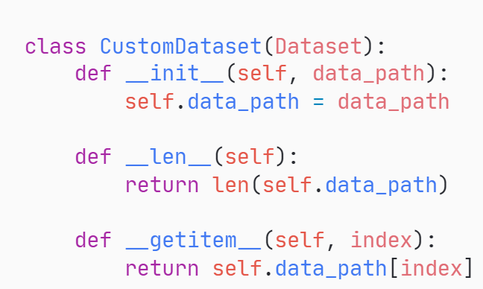
Dataset & DataLoader
Read Data
Return the size of the dataset
Return one sample at a time
Data augmentation is usually performed.

Slide 9
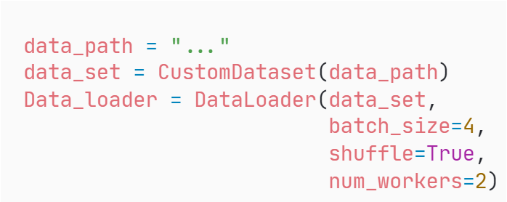
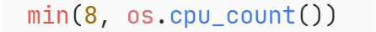
Dataset & DataLoader
Your Dataset
Test : False
Train : True
Number of subprocess
Notes:
Dataloader參數說明 名字

Slide 10
Tensors
High-dimensional matrices (arrays)
1-D Tensor
e.g. vector, audio
2-D Tensor
e.g. gray image, matrix
3-D Tensor
e.g. RGB image

Slide 11
Tensors – Shape of Tensors
High-dimensional matrices (arrays)
4
5
5
3
5
4
[5]
[4, 5]
[5, 4, 3]
Dim 0
Dim 0
Dim 1
Dim 0
Dim 1
Dim 2

Slide 12

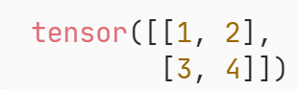
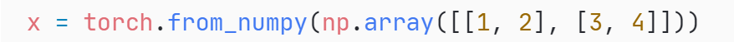
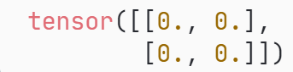


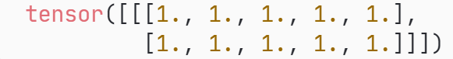

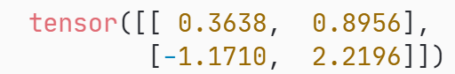
Tensors - Create Tensors
Directly from data (list or numpy.ndarray)
Create Constant or Random Tensor
shape

Slide 13





Tensors - Common Operations
Add
Summation
Subtraction
Mean
Power

Slide 14
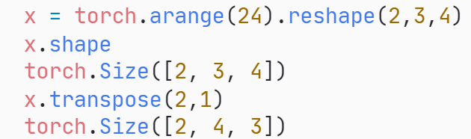
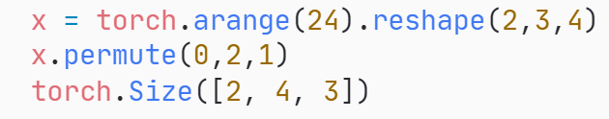
Tensors - Common Operations
Transpose: can only swap two specific dimension
0
4
8
0
1
2
3
2
12
16
20
2
12
13
14
15
4
3
3
4
Permute: can swap all the dimensions

Slide 15
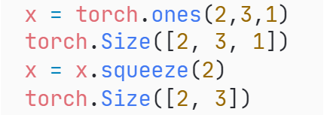
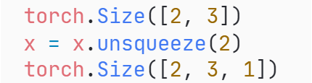
Tensors - Common Operations
Squeeze: Remove all dimensions with length 1.
1
2
3
Unsqueeze
Squeeze
Unsqueeze: Insert the new dimensions with length 1.
2
3

Slide 16
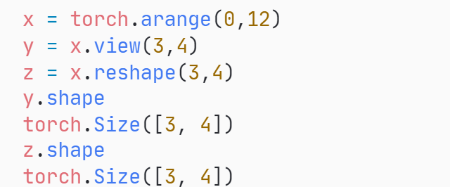
Tensors - Common Operations
Reshape & view: Reshape the tensor to specific size(shape).
0 | 1 | 2 | 3 | 4 | 5 | 6 | 7 | 8 | 9 | 10 | 11
View(-1)
Reshape(-1)
Reshape or View
0 | 1 | 2 | 3
4 | 5 | 6 | 7
8 | 9 | 10 | 11

Slide 17
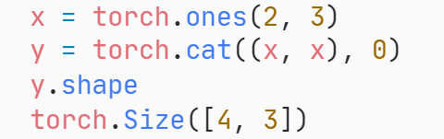
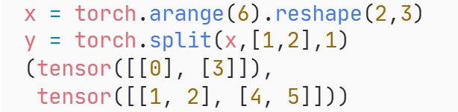
Tensors - Common Operations
Cat: Concatenate tensors in the given dimension.
2
4
2
3
Split: Insert the new dimensions with length 1.
0 | 1 | 2
3 | 4 | 5
0 | 1 | 2
3 | 4 | 5

Slide 18
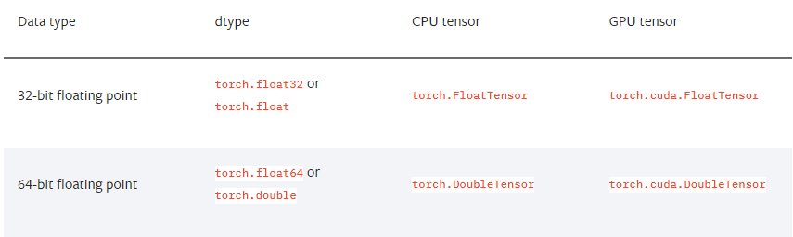
Tensors – Data Type
Using different data types for model and data will cause errors
see official documentation for more information on data types.

Slide 19
Tensors – Pytorch vs Numpy
Similar attributes
Similar Operation
PyTorch | NumPy
x.shape | x.shape
x.dtype | x.dtype
PyTorch | NumPy
x[:, None] x.unsqueeze(1) | x[:, None] np.expand_dims(x, 1)
x.squeeze() | x.squeeze()
You can reference on this website
GitHub - wkentaro/pytorch-for-numpy-users: PyTorch for Numpy users. https://pytorch-for-numpy-users.wkentaro.com

Slide 20
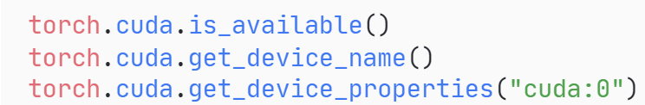
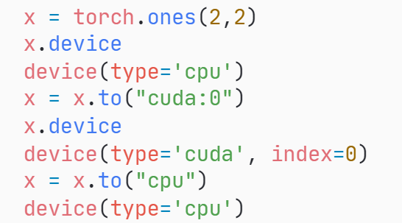
Tensors – Tensors dtype device
Tensors & modules will be computed with CPU by default.
Use .to() to move tensors to appropriate device.

Slide 21
Tensors – Autograd
Autograd will remember all the operation of tensors it executed.
In the backward phase, it will replay the operation.

Slide 22
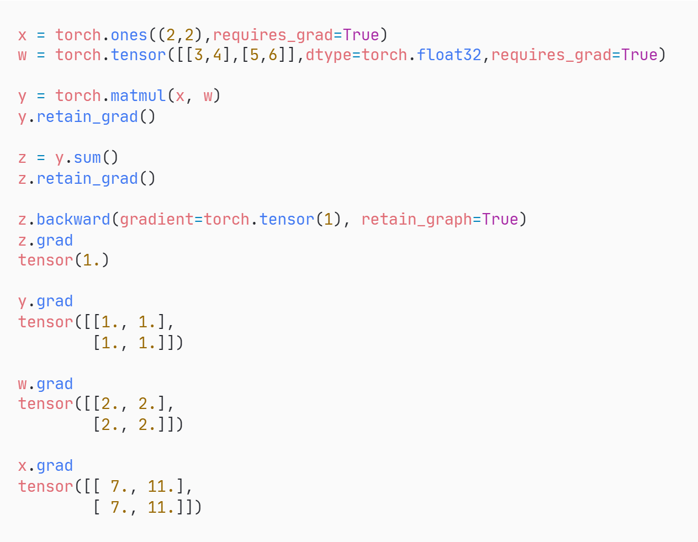
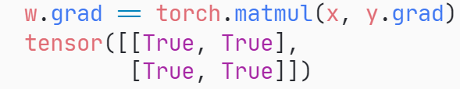
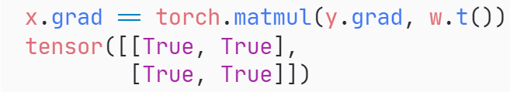







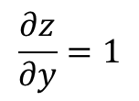





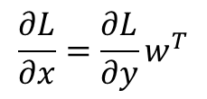


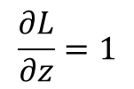
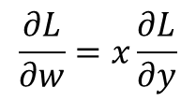
Tensors – Autograd Example
$$x=\left[\begin{aligned}1 1 \\ 1 1\end{aligned}\right]$$
$$w=\left[\begin{aligned}3 4 \\ 5 6\end{aligned}\right]$$
$$x$$
$$w$$
$$x$$
$$w$$
$$\frac{∂L}{∂x}=\frac{∂L}{∂y}w^{T}$$
$$\frac{∂L}{∂w}=x\frac{∂L}{∂y}$$
$$×$$
$$×$$
$$y$$
$$y$$
$$\frac{∂z}{∂y}=1$$
$$sum$$
$$sum$$
$$z$$
$$z$$
$$\frac{∂L}{∂z}=1$$

Slide 23

Training & Testing Neural Networks-in Pytorch
Define
Neural Networks
Loss Function
Optimizer
Algorithm
Load
Data
Training
Testing

Slide 24
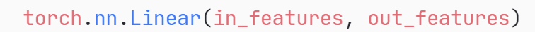

torch.nn – Network layer
Linear Layer (Fully-connected Layer)
Input Tensor
[*, 32]
nn.Linear(32,64)
Output Tensor
[*, 64]
* can be any shape, but the last dimension must be the same as the input feature.
x
Weight
Bias
y
$$y=xW^{T}+b$$

Slide 25
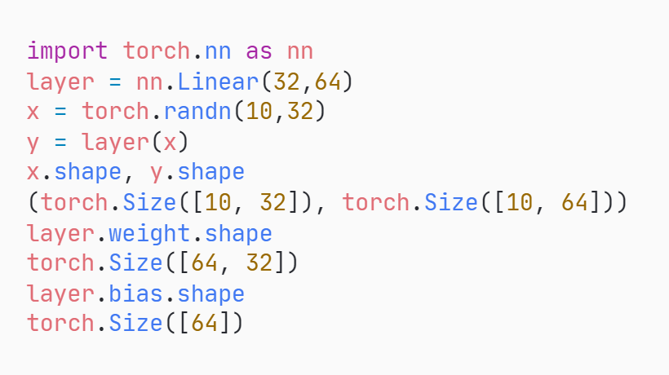
torch.nn – Network layer
Linear Layer (Fully-connected Layer)

Slide 26
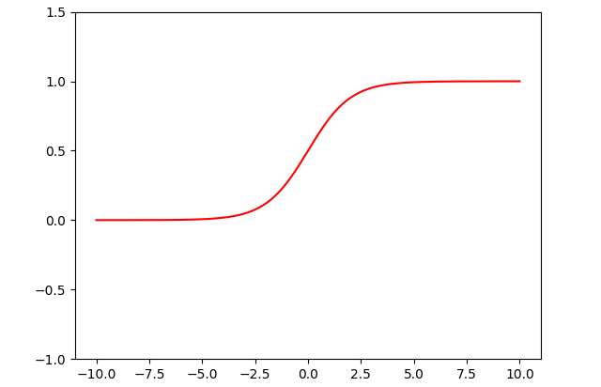
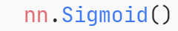
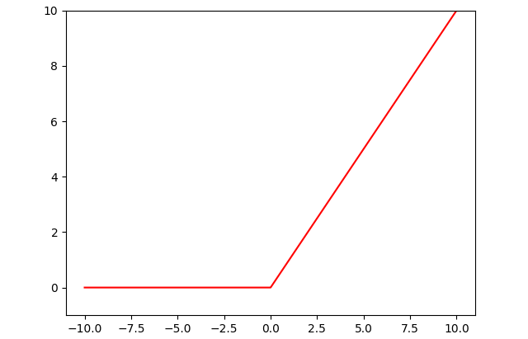
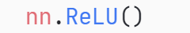
torch.nn – Non-Linear Activation Functions
Sigmoid
ReLU

Slide 27
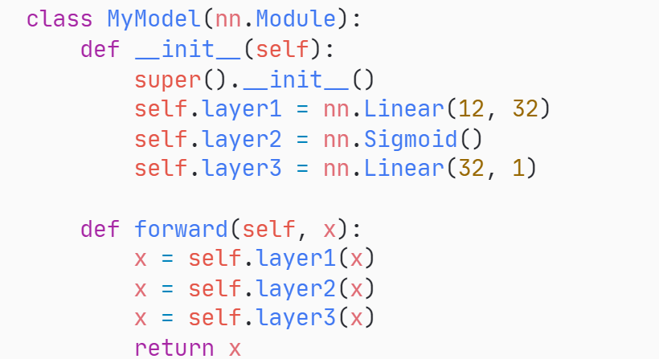
torch.nn – Build your own neural network
Inheritance from nn.Module
Parameters
train(), eval()
Python Constructor

Slide 28
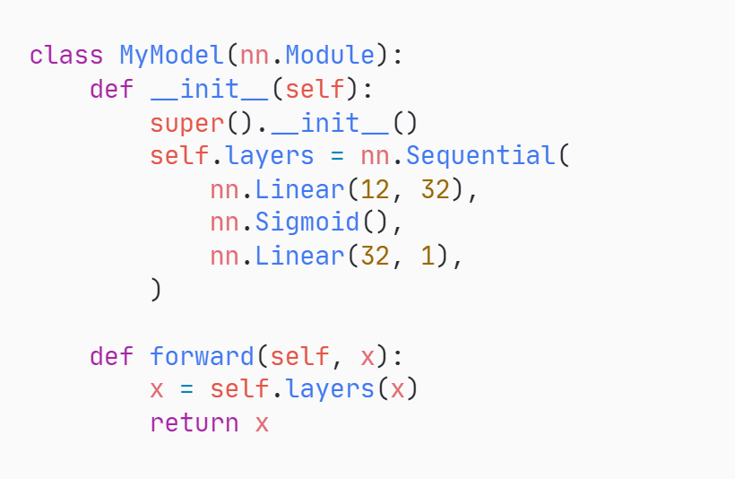
torch.nn – Build your own neural network
Build the Sequential model,
It will automatically forward all sub-model in it

Slide 29
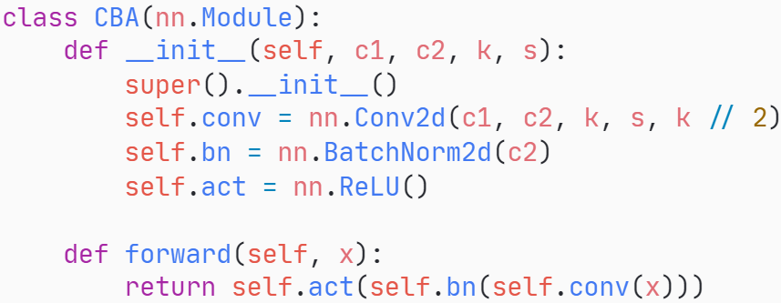
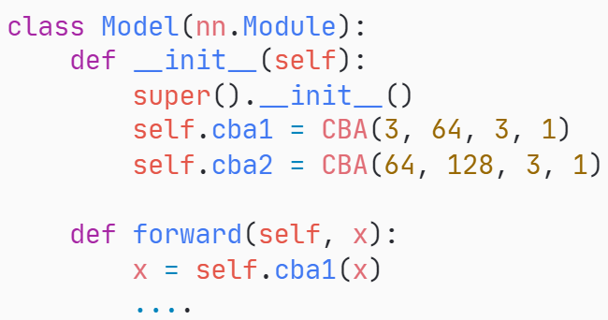
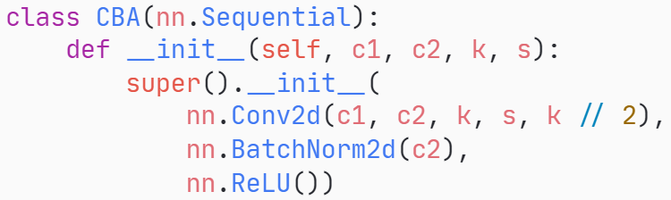
torch.nn – Nested Structure
Sub-model
Model

Slide 30
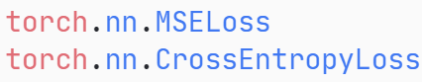
Training & Testing Neural Networks-in Pytorch
Define
Neural Networks
Loss Function
Optimizer
Algorithm
Load
Data
Training
Testing

Slide 31
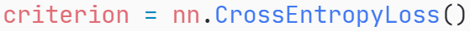
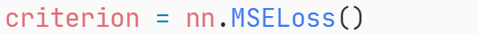
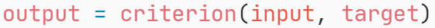
torch.nn – Loss Functions
Cross Entropy (for classification tasks)
Mean Squared Error (for regression tasks)

Slide 32
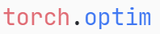
Training & Testing Neural Networks-in Pytorch
Define
Neural Networks
Loss Function
Optimizer
Algorithm
Load
Data
Training
Testing

Slide 33
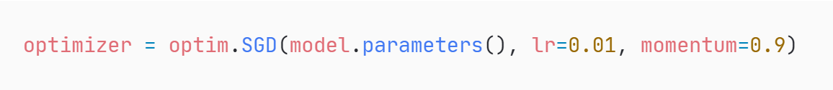
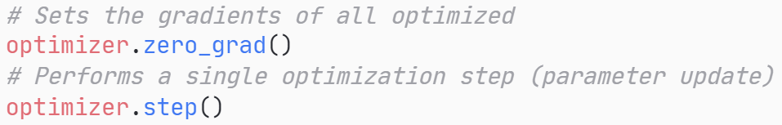
torch.optim
Gradient-based optimization algorithms that adjust network parameters to reduce error.

Slide 34
Training & Testing Neural Networks-in Pytorch
Define
Neural Networks
Loss Function
Optimizer
Algorithm
Load
Data
Training
Testing
Entire Procedure Code

Slide 35
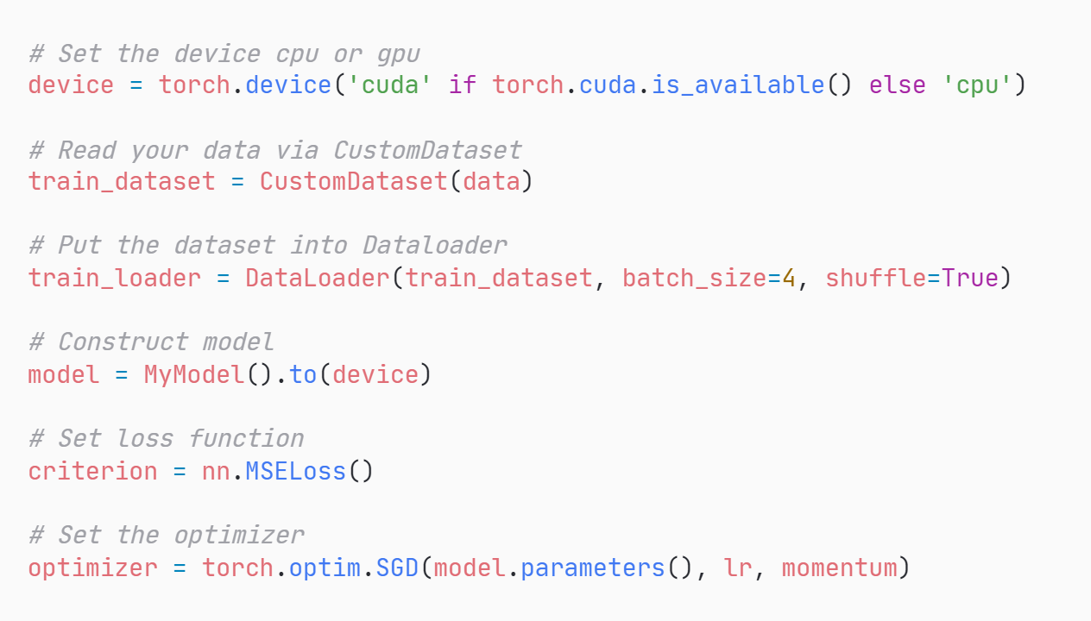
Neural Network Training Setup

Slide 36
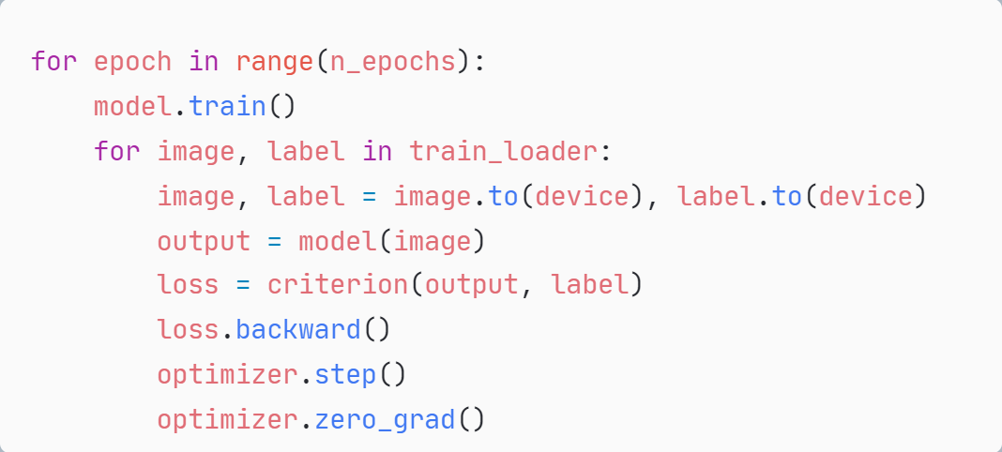
Neural Network Training Loop
Iterate epoch
Set model to train state
Iterate data loader
Move data to device
Forward pass
Compute loss
Compute gradient
Update weight
Set gradient to zero

Slide 37
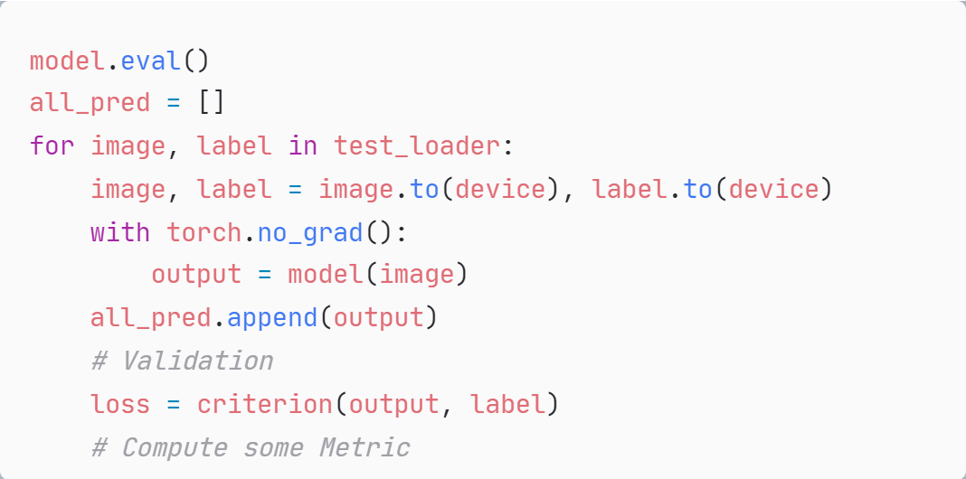
Neural Network Validation or Test Loop
evaluation model
Iterate dataloader
Move data to device
Disable gradient calculation
Forward pass
Collect prediction
Compute loss

Slide 38
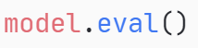
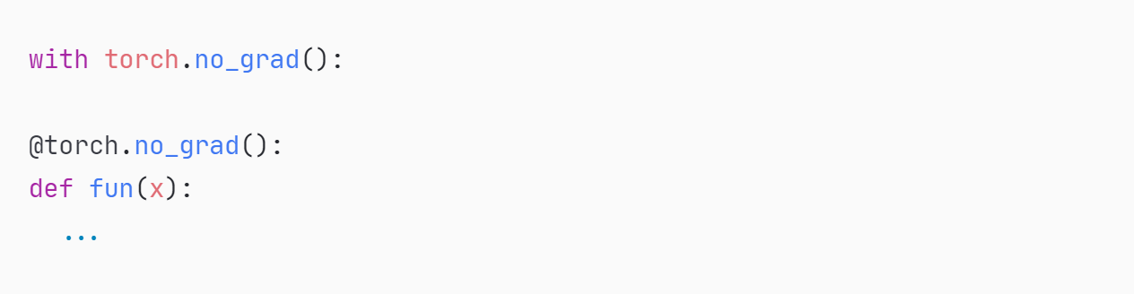
Notice – model.eval(), torch.no_grad()
Switch for some specific layers/parts of the model that behave differently during training and inference (evaluating) time. Example: Dropout, Batchnorm
Disabled gradient calculation

Slide 39
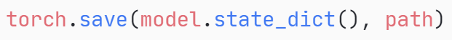

Save/Load Trained Model
Save
Load

Slide 40
More About Pytorch
Torchvision – contain pretrained model, dataset, image transformation
https://pytorch.org/vision/stable/index.html
Official Pytorch Tutorials
Welcome to PyTorch Tutorials — PyTorch Tutorials 1.13.1+cu117 documentation

Slide 41
Any questions?

Slide 42
Reference
https://pytorch.org/
https://pytorch.org/blog/overview-of-pytorch-autograd-engine/
https://speech.ee.ntu.edu.tw/~hylee/ml/ml2022-course-data/Pytorch%20Tutorial%201.pdf

