Slide 2

Introduction to Personalised News Aggregator
A personalised news aggregator using the MERN stack allows users to curate their news sources, receive tailored content, and enjoy a seamless reading experience.

Slide 3
Problem Statement: Why Personalized News Aggregator is Essential
Information Overload
Filter Bubble
Time Efficiency
Enhanced Engagement
Traditional news platforms create echo chambers, limiting exposure to diverse viewpoints.
Personalized aggregators save time by delivering tailored news without the need for extensive searching.
Users are overwhelmed by the sheer volume of news and struggle to find relevant content.
Users are more likely to engage with content that matches their specific interests and preferences.

Slide 4
Why use MERN stack for building a news aggregator?
Modularity
Full JavaScript Ecosystem
Rich Ecosystem of Libraries
MERN stack allows for a modular approach, with each component separable and replaceable.
MERN consists of JavaScript-based technologies, ensuring a consistent environment for both front-end and back-end.
There is a wide range of libraries and tools available within the MERN stack, offering solutions for various development requirements.
This makes it easier to maintain and scale the application.
Developers can seamlessly transition between different layers of the application.
This streamlines the development process and reduces the need to reinvent the wheel.

Slide 5
Solution Overview: How Personalized News Aggregator Works
AI-Powered Curation
Content Personalization
Real-Time Updates
Utilizes artificial intelligence to analyze user preferences and curate news tailored to individual interests.
Delivers up-to-the-minute news and articles aligned with users' evolving interests and preferences.
Enables customization of news feed based on specific topics, sources, and preferred content formats.
Ensures diverse content to mitigate filter bubble effects.

Slide 6
Features of the personalised news aggregator
Customized Content
Multi-source Aggregation
Users can personalize their news feed based on their interests and preferences.
The aggregator pulls news from multiple sources to provide a comprehensive view.
Real-time Updates
Smart Filtering
Users receive the latest news and updates in real-time as they happen.
Utilizes advanced algorithms to filter out irrelevant or duplicate news content.

Slide 7

Front-end Development using React
1
Component-Based
2
Virtual DOM
3
State Management
Creating reusable and modular UI components for a seamless user experience.
Efficiently updating the UI without re-rendering the entire page.
Managing the state of components to ensure smooth interactivity.

Slide 8

Back-end Development using Node.js
Scalable APIs
Middleware Support
Event-Driven Architecture
Building robust and scalable APIs to handle the application's functionality and data.
Utilizing middleware to enhance the functionality of the server-side application.
Implementing an event-driven architecture for handling asynchronous operations.

Slide 9
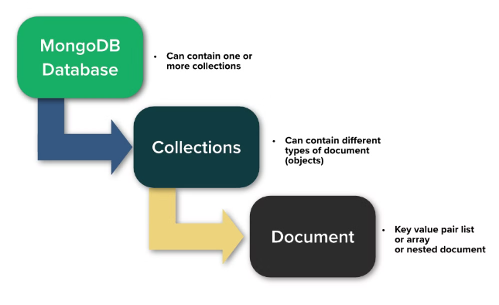
Database Management with MongoDB
MongoDB is a NoSQL database, known for its flexibility and scalability. It allows for the storage of large amounts of unstructured data.
Its document-oriented model is great for managing dynamic data and changing schemas.
Flexible schema
Scalable for large data sets
Supports sharding and replication

Slide 10
User Registration and Authentication
Create an Account
1
Users provide basic details and create a secure login credential.
2
Verify Email/Phone
Confirmation step to ensure the user's contact information is valid.
Implement Authentication
3
Set up secure access and session management for user accounts.

Slide 11
Implementing News Scraping and Aggregation
1
Data Collection
Gathering news articles and data from various sources and outlets.
2
Data Processing
Organizing and cleaning the collected data for better usability.
3
Content Aggregation
Compiling and presenting news content tailored to user preferences.

Slide 12



Personalised News Recommendations
Interest-based Filtering
1
Customized news based on user preferences
Behavioral Analysis
2
Adapting to user reading habits and interests
Real-time Updates
3
Immediate delivery of relevant news content

Slide 13
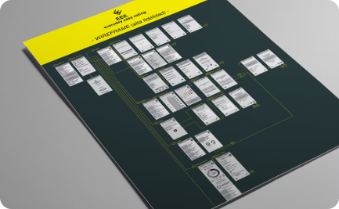
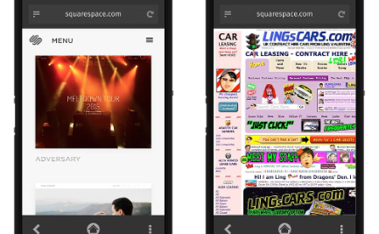
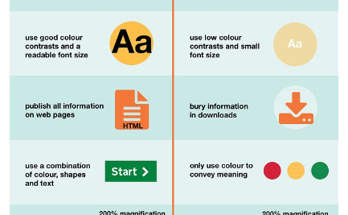
Designing the User Interface
Wireframing
Prototyping
UI Principles
Creating structural blueprints and layout designs for the user interface.
Developing interactive prototypes to visualize the final UI design.
Implementing design principles to ensure a seamless and intuitive user experience.

Slide 14


Conclusion
A personalized news aggregator built with the MERN stack offers a comprehensive solution for users to access tailored news content. By leveraging MongoDB, Express.js, React, and Node.js, it provides a dynamic and responsive platform. With features like user profiling, content recommendation, and real-time updates, it enhances the news consumption experience. Its scalability, efficiency, and user-centric design make it a compelling choice for modern news consumption needs.

