Slide 1
Literature Review for Si nanostructure and light trapping
Ziyu

Slide 2
The Main Light-Trapping Approaches
Non-diffractive Techniques
Maximizing the surface-to-volume ratio
Silicon nanowires
plasmonic resonance of metal nanoparticles
particle dimensions are a key parameter for the tuning of the resonance condition
Thin and transparent dielectric coatings
Refractive Approaches
Diffractive Approaches

Slide 3
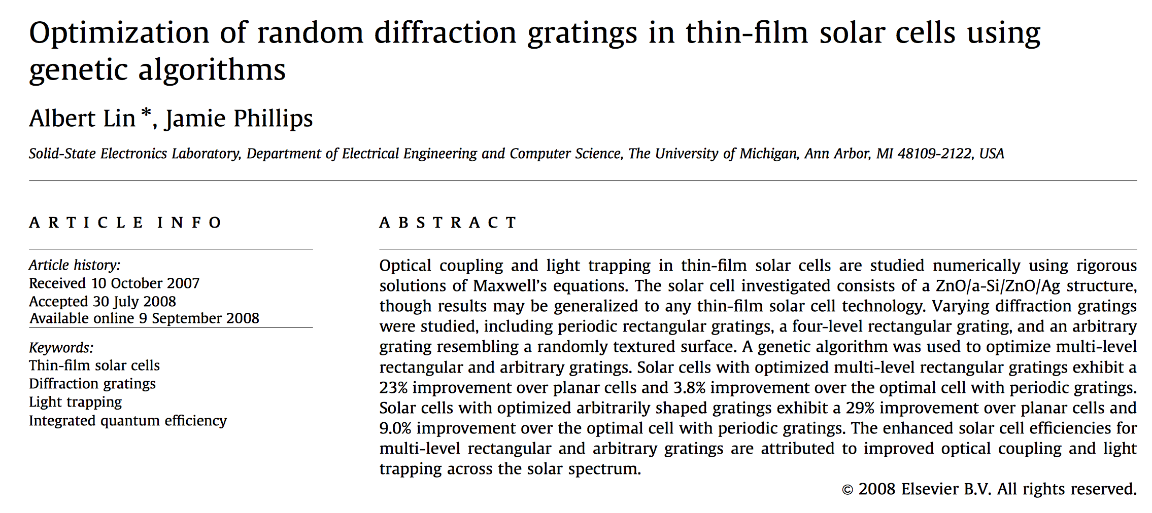

Slide 4
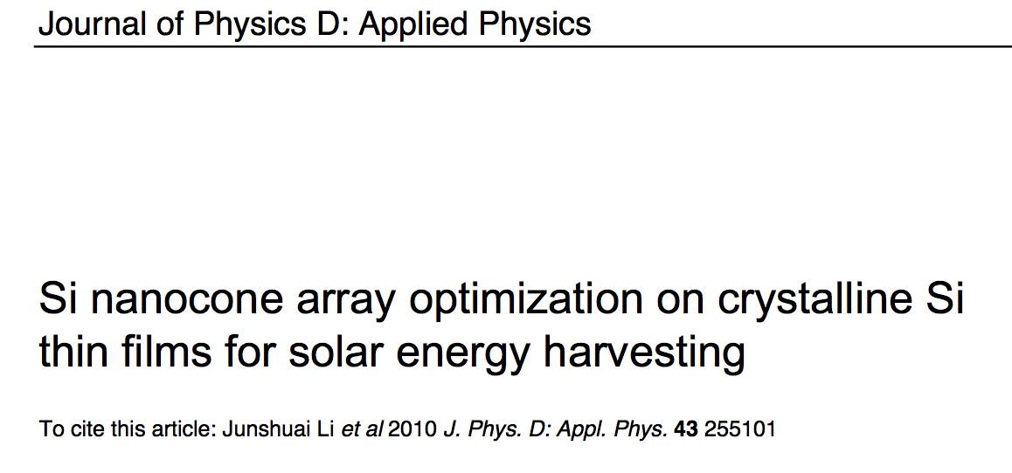

Slide 5
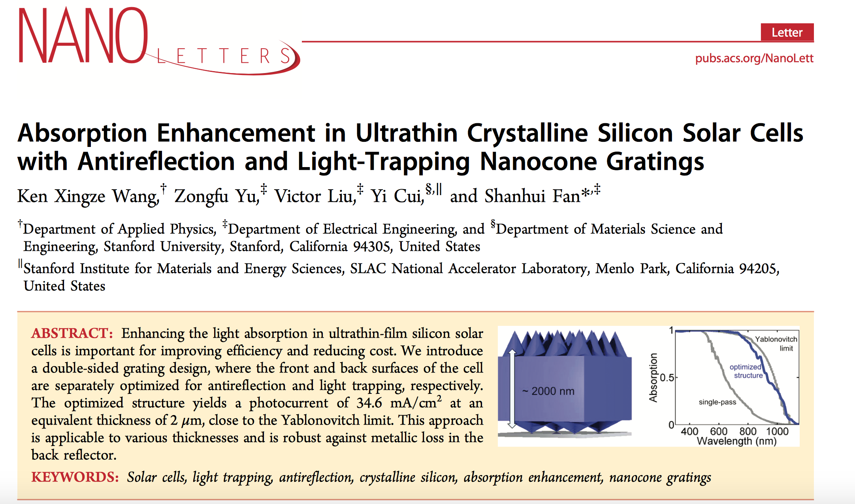
Si nanostructure

