Slide 1
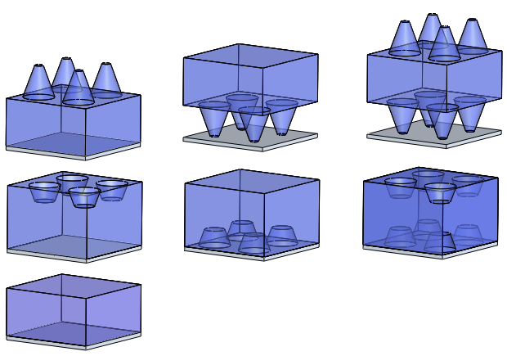
rtop
a
H
(a)
rtop
a
rbottom
H
T
T
rtop
rtop
a
rbottom
T
a
H
H
rbottom
rbottom
(b)
rtop
rtop
a
a
H
H
rbottom
T
T
rbottom
T
rtop
a
rtop
a
H
H
rbottom
rbottom
(c)
EffectiveThickness
PEC

Slide 2
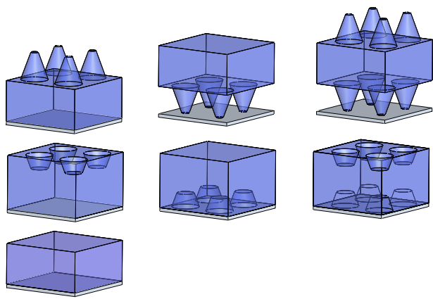
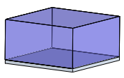
d_{top1}
a₁
h₁
(a)
d_{top1}
a₁
d_{bot1}
h₁
t
t
d_{top2}
d_{top2}
a₂
a₂
d_{bot1}
t
h₂
h₂
d_{bot2}
d_{bot2}
d_{top1}
a₁
d_{top1}
a₁
h₁
h₁
d_{bot2}
d_{bot1}
t
t
t
d_{top2}
a₂
d_{top2}
a₂
h₂
h₂
d_{bot2}
d_{bot2}
t_{eff}

Slide 3
r_{top1}
a₁
h₁
(A)
r_{top1}
(B)
(C)
a₁
r_{bot1}
h₁
t
t
r_{top2}
r_{top2}
a₂
a₂
r_{bot1}
t
h₂
h₂
r_{bot2}
r_{bot2}
(D)
r_{top1}
(E)
(F)
r_{top1}
a₁
a₁
h₁
h₁
r_{bot1}
t
t
r_{bot1}
t
r_{top2}
a₂
r_{top2}
a₂
h₂
h₂
r_{bot2}
r_{bot2}
(A). Cone on front (B). Cone on back (C). Cone on both
(D). Cone hole on front
(E). Cone hole on back
(F). Cone hole on top and bottom
t_{eff}

Slide 4
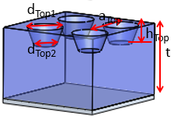
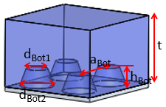
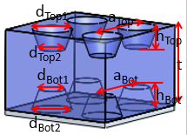
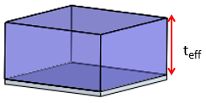

Slide 5
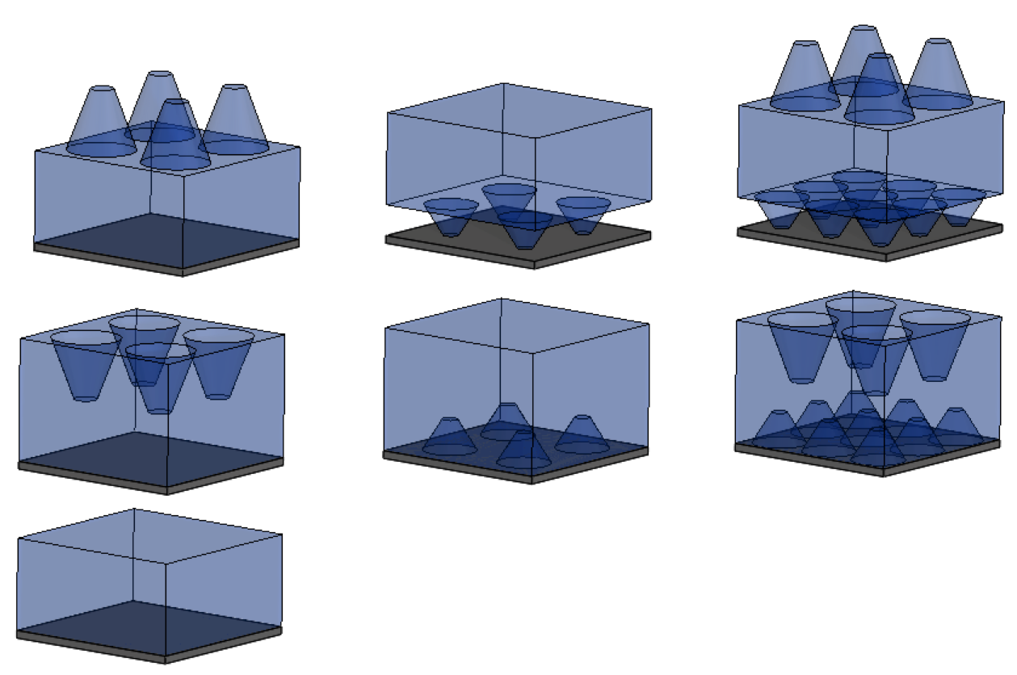
r_{top1}
a₁
(a)
(b)
(c)
r_{top1}
a₁
h₁
h₁
r_{bot1}
t
t
r_{bot1}
r_{top2}
r_{top2}
a₂
t
a₂
h₂
h₂
r_{bot2}
r_{bot2}
(d)
(e)
(f)
r_{top1}
a₁
r_{top1}
a₁
h₁
h₁
r_{bot1}
t
t
r_{top2}
a₂
t
r_{top2}
a₂
r_{bot1}
h₂
h₂
r_{bot2}
r_{bot2}
(g)
t_{eff}

