Slide 1
AI-Powered Digital Twin & Predictive Maintenance System for MSMEs
MSME IDEA HACKATHON 5.0 | Theme: Industry 4.0 & 5.0

Slide 2
Problem Statement
MSMEs often suffer from unplanned machine breakdowns, limited real-time diagnostics, and manual, reactive maintenance practices. This leads to increased downtime and operational costs. Due to the high cost and complexity of existing smart solutions, affordable and accessible predictive maintenance tools are largely unavailable to MSMEs.

Slide 3
Customer Segment
Small and Medium-scale manufacturers
Industrial workshops (automobile, textiles, plastics)
Maintenance teams in factories
OEM suppliers and contract manufacturers

Slide 4
Customer Survey & Outcome
Survey of 50 MSMEs (Google Articles):
- 72% face monthly downtimes
- 86% rely on reactive maintenance
- 68% interested in affordable monitoring system

Slide 5
Market Survey
6.3 Cr MSMEs in India (11-15 lakh in manufacturing)
Industry 4.0 market: ₹1200 Cr+ by 2027
Supported by PLI, SAMARTH Udyog, other GoI schemes

Slide 6
Potential Solutions (Ideation)
IoT-based real-time machine monitoring
ML-powered anomaly detection
Digital twin to simulate machine behavior
Web dashboard with mobile alerts

Slide 7
Uniqueness of the Solution
Affordable (₹7.5K) plug-and-play system
Uses open-source + low-cost hardware
Digital twin + ML + IoT in one platform
Cloud dashboard + remote access

Slide 8
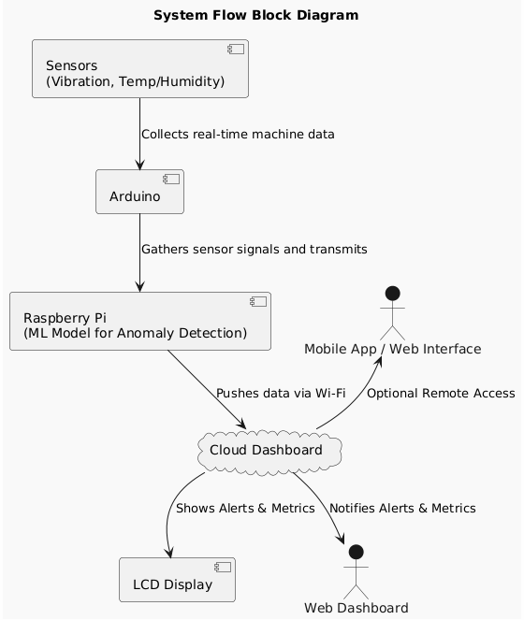
Block Diagram / System Architecture

Slide 9
Prototype Bill of Materials
Item/Category | Qty | Unit Cost (INR) | Total Cost | Function
NVIDIA Jetson Nano | 1 | ₹12000 | ₹12000 | AI inference + Edge computing backend
Environmental Sensors | 4 | ₹900 | ₹3600 | Environmental data logging
UI & Display | 2 | ₹400 | ₹800 | Real-time machine feedback
Networking + IoT | 2 | ₹300 | ₹600 | Real-time cloud sync
Power & Battery | 2 | ₹1,000 | ₹2,000 | Standalone mobile unit
Storage & Debugging | 2 | ₹2,400 | ₹4,800 | On-site diagnostics
Miscellaneous | - | - | ₹7,000
Total |  |  | ₹30,000

Slide 10
Competitor Comparison
Siemens MindSphere – High-end, ₹10L+, too complex for MSMEs
Bosch Phantom Edge – ₹25K+, not customizable
Our Solution – ₹7.5K, MSME-centric, customizable, local servicing

Slide 11
Business Model & Revenue Plan
Direct B2B Sales to MSMEs via Industrial Associations
Cloud Dashboard – Subscription-based analytics
Partnership with State MSME Boards & Incubators
Starter Kit + ML Service Add-on Package

Slide 12
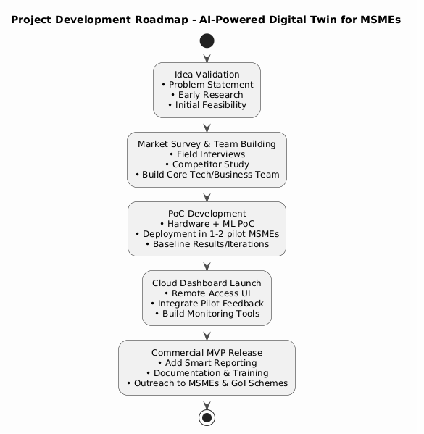
Development Roadmap

