Slide 1
TEAM 8

Slide 2
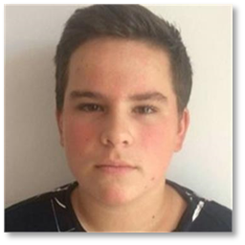
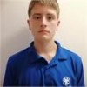
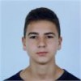
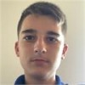
Our team
Dimitar Vasilev 9A
Backend Developer
Pavel Yordanov 9A
Frontend Developer
Yoan Panov 9A
Scrum Trainer
Ivan Chelebiev 9B
Designer

Slide 3




Stages of work
1
2
3

Slide 4
Our idea

Slide 5






Used Technologies

