Slide 1
AGRITECH · IoT · MACHINE LEARNING
Agrios
Smart Farm
AI-powered soil monitoring and crop recommendation platform
FSA Agadir
Ibn Zohr University
Strategic Pitch | Souss-Massa Region | 2025–2026
Supervisor: Pr. Abdessamad AMAL
AGRIOS TEAM
Yassine Maarouf (IISE – IoT) | Fatima Ezzahrae Baiha (ADIA – Backend & ML) | Hasna Hamdani (IL – Dev & UI/UX)

Slide 2
The Problem
Souss-Massa is Morocco's agricultural engine, but farms face serious challenges.
01
02
VISION
Critical water stress
Blind crop decisions
Put field data
in the hands of
small farmers.
Traditional irrigation wastes scarce water. Farmers lack real-time soil moisture data.
Crop choices are made without accurate NPK, pH, humidity and temperature readings.
03
04
Agrios turns soil readings into clear recommendations — fewer guesses, less waste, smarter agriculture.
Low digital adoption
Yield & income risk
Existing Agritech tools are too expensive, complex, or poorly adapted to small farms.
Wrong crop choices reduce revenue, damage soil health and raise seasonal costs.
Agrios Smart Farm | FSA Agadir — Ibn Zohr University | Supervisor: Pr. Abdessamad AMAL
2 / 10

Slide 3
The Agrios Solution
An end-to-end platform: sensors → AI analysis → farmer decisions.
IoT | ESP32
ML | Python
Web | React
1
2
3
Sensor Layer
Analysis Engine
Farmer Dashboard
Collects humidity, temperature, NPK and pH data from the field and sends measurements through Wi-Fi.
A Flask API and Random Forest model recommend the crop best suited to real soil conditions.
A responsive dashboard displays live metrics, alerts and clear recommendations for the farmer.
→
→
Connected sensors
Random Forest model
Decision dashboard
Agrios Smart Farm | FSA Agadir — Ibn Zohr University | Supervisor: Pr. Abdessamad AMAL
3 / 10

Slide 4
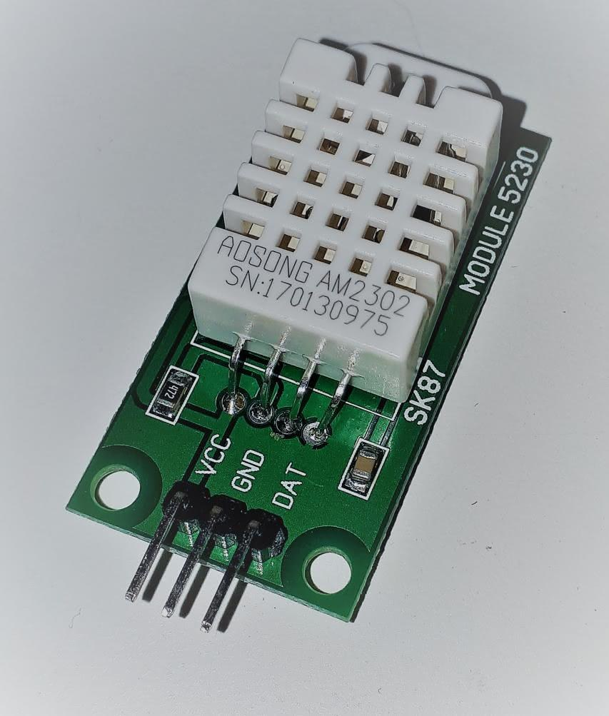
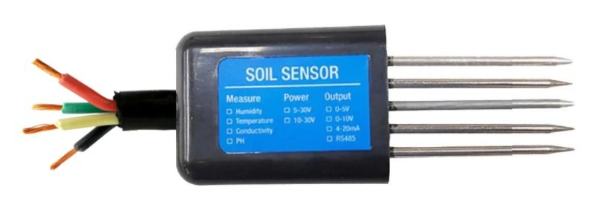
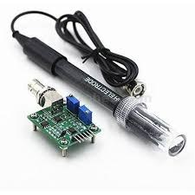
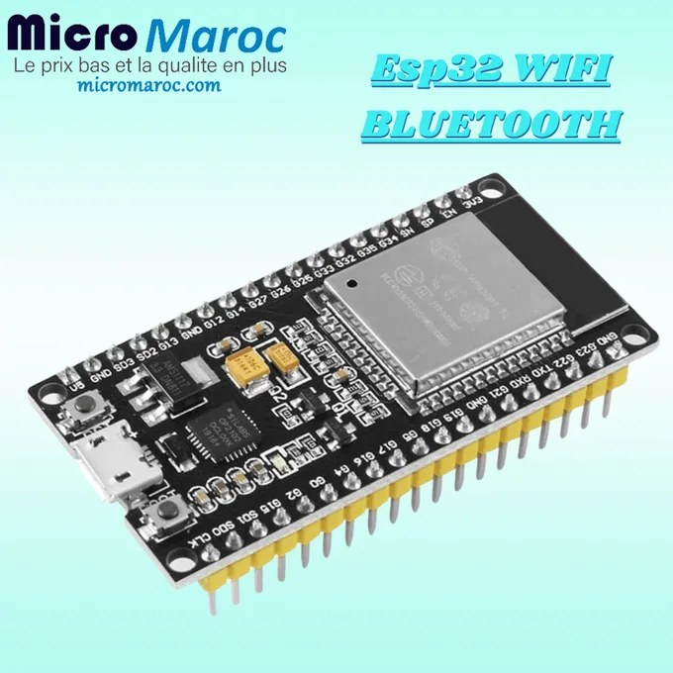
System Architecture
From field measurements to a recommendation in a few seconds.
Soil Sensors
ESP32
Flask API
Random Forest
Dashboard
→
→
→
→
DHT22, NPK, pH
Wi-Fi / HTTP
Python backend
soil_model.pkl
React + Vite
Integrated Sensor Kit
DHT22
Multi-Soil Probe
pH Probe
ESP32 Wi-Fi
Air humidity & temperature
Moisture, conductivity & NPK
Soil acidity monitoring
Low-cost data collection
Agrios Smart Farm | FSA Agadir — Ibn Zohr University | Supervisor: Pr. Abdessamad AMAL
4 / 10

Slide 5
Market Analysis: TAM / SAM / SOM
Bottom-up view using public agriculture and innovation ecosystem references.
TAM
SAM
SOM
WHY NOW?
✓ Generation Green 2020–2030 prioritizes digitization
≈ 1.2B MAD
≈ 180M MAD
≈ 9M MAD
✓ Active Agrotech cluster in Agadir
Total Market
Serviceable Market
Obtainable Market
Potential Moroccan IoT Agritech market: smart irrigation, sensors and decision-support software.
Vegetable and citrus farms in Souss-Massa that can adopt connected sensors in the short term.
Realistic 3–5 year target: about 5% of SAM through cooperatives and local partners.
✓ Souss-Massa innovation ecosystem supports pilots
✓ Water stress creates economic urgency
✓ ESP32 and sensor costs keep falling
Agrios Smart Farm | FSA Agadir — Ibn Zohr University | Supervisor: Pr. Abdessamad AMAL
5 / 10

Slide 6
SWOT Analysis
Strategic diagnosis of the Agrios Smart Farm project.
Strengths
Weaknesses
• Modular IoT + ML + Web architecture
• Sensors still simulated in Wokwi
S
• Open technologies and low hardware cost
W
• ML model trained on generic dataset
• Multidisciplinary team: IL, ADIA and IISE
• No field validation yet
• Functional prototype: Wokwi, Flask & React
• Mobile app still to be developed
Opportunities
Threats
• Generation Green and Intelaka support
• International players: CropX and Sencrop
O
• Agrotech cluster and Technopark Agadir
T
• Slow adoption by small farmers
• Strong need for precision irrigation
• Connectivity cost in rural areas
• Cooperative and exporter partnerships
• Price sensitivity of imported hardware
Agrios Smart Farm | FSA Agadir — Ibn Zohr University | Supervisor: Pr. Abdessamad AMAL
6 / 10

Slide 7
Blue Ocean Strategy: ERRC Grid
Escaping price competition against generic Agritech solutions.
ELIMINATE
OUR BLUE OCEAN
E
Expensive software subscriptions and proprietary hardware lock-in.
Accessible
Smart Farm
REDUCE
R
Installation complexity and dependence on specialized on-site technicians.
A low-cost IoT kit plus an AI assistant that speaks the farmer's problem: what to plant, when to react and how to save water.
Targets: cooperatives, young farmers and exporters.
RAISE
R
Data transparency, language accessibility and local support.
CREATE
C
AI crop recommendations based on real soil conditions and Souss-Massa climate needs.
Agrios Smart Farm | FSA Agadir — Ibn Zohr University | Supervisor: Pr. Abdessamad AMAL
7 / 10

Slide 8
Porter's Five Forces
Competitive pressure in the Souss-Massa Agritech sector.
New Entrants
High
Low technical barriers allow new Moroccan and Maghreb Agritech startups.
Agritech
Souss-Massa
Suppliers
Medium
Customers
High
Imported ESP32 boards and probes create dependence on small supplier base.
Small farmers are price-sensitive; cooperatives have strong negotiation power.
Substitutes
Medium
Traditional agronomy, manual kits and public support services.
Agrios Smart Farm | FSA Agadir — Ibn Zohr University | Supervisor: Pr. Abdessamad AMAL
8 / 10

Slide 9
Business Model & Roadmap
From university prototype to real field adoption.
Business Model
Roadmap
IoT Kit Sale
2025
Prototype
Preconfigured sensors and ESP32 at an accessible one-time price.
Simulated IoT in Wokwi, ML API and React dashboard completed.
SaaS Subscription
2026 H1
Field Pilot
Dashboard and AI recommendations at ~99 MAD per farm per month.
10 pilot farms in Souss-Massa using real sensors.
Partnerships
2026 H2
Mobile App
Cooperatives, ORMVA and exporters for grouped deployments.
React Native app with SMS and WhatsApp alerts.
Agronomic Data
2027
Scale-up
Anonymized B2B insights for insurers and agro-industrial partners.
200+ farms through cooperative partnerships.
Agrios Smart Farm | FSA Agadir — Ibn Zohr University | Supervisor: Pr. Abdessamad AMAL
9 / 10

Slide 10
Grow better,
with less.
Agrios brings IoT and AI to Moroccan soil, helping farms become more profitable, sustainable and data-driven. View UI Prototype →
Thank you
AGRIOS TEAM
Yassine Maarouf | Fatima Ezzahrae Baiha | Hasna Hamdani
FSA Agadir — Ibn Zohr University | github.com/YMR693/Agrios-Smart-Farm
Supervisor: Pr. Abdessamad AMAL

