Slide 1
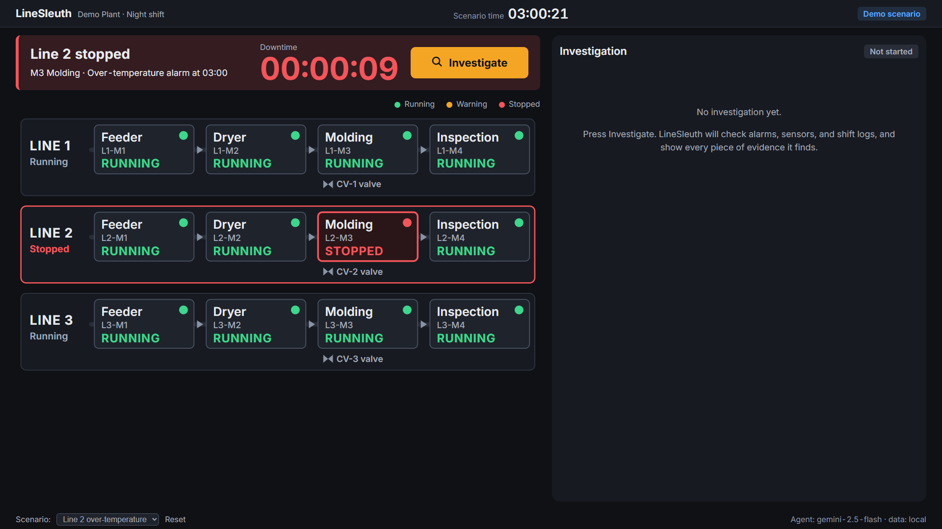
Live prototype (Cloud Run, gemini-2.5-flash) · simulated plant data
LineSleuth
Root-cause investigations for small factories, with evidence you can check.
AI Builder Cup 2026 · Manufacturing
Hung Che Nick Lai
Notes:
On screen while we are introduced. Nothing to say.

Slide 2
THE PROBLEM
03:00
Line2_temps.xlsx
PLC_export_0300.csv
Line 2 stops.
shift_log.xlsx
Every hour of downtime costs X*
Finding the cause: ~40 min* of Excel and PLC logs
The night supervisor is alone
alarms_L2.csv
* pending validation: plant-manager interviews not yet completed.
Notes:
Script Segment 1 (0:00-0:15). If numbers are still unvalidated, drop the X line and keep the footnote on 40 min. Switch to the live app at about 0:15.

Slide 3
CUSTOMER
Who we serve
Night-shift supervisor
“China plus one” is moving production south
Contract manufacturer, 50–300 staff*
Vietnam
Thailand
No MES; data lives in Excel sheets and PLC CSV exports
At night, decides alone; engineers are off site
Every stoppage is a manual log hunt
Malaysia
Taiwan
Small plants the big industrial platforms don't reach.
* plant size pending interviews · China+1 trend: public source to verify.
Notes:
Submission only. Target plant size comes from the PRD and still needs interview confirmation. Add a public source for China+1 before use.

Slide 4
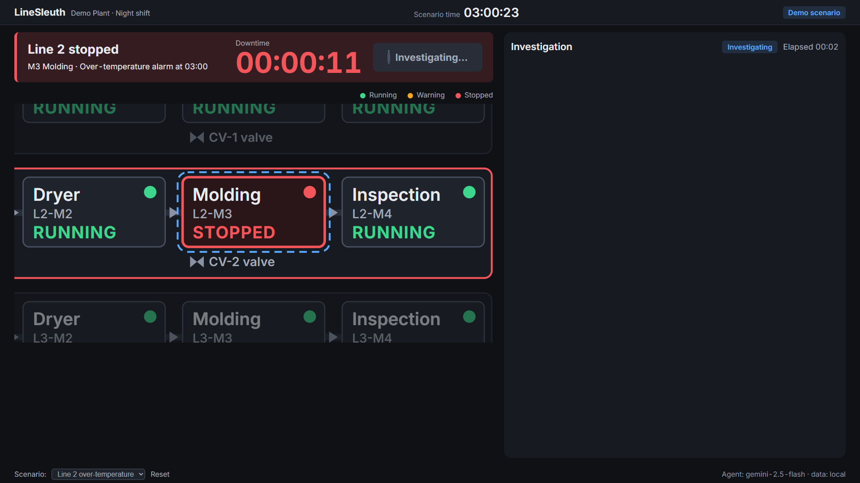
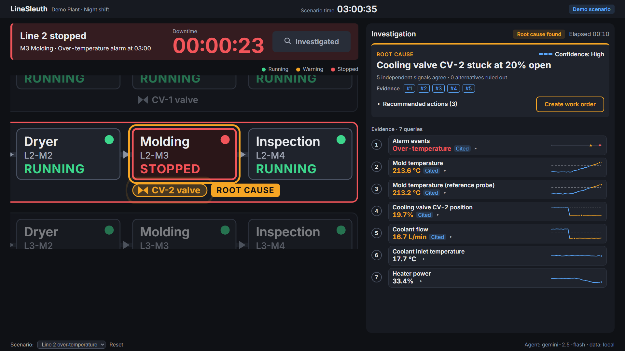
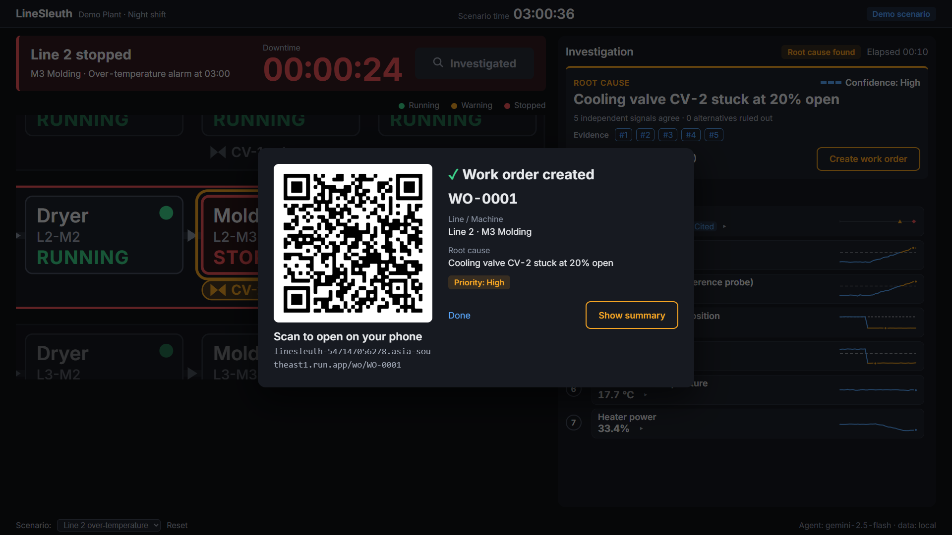
SOLUTION
Live prototype (Cloud Run, gemini-2.5-flash) · simulated plant data
One button: evidence, root cause, work order
1
Press Investigate
2
Evidence → root cause
3
Work order by QR
No chat box, no prompt
Every card traces back to source rows
On the technician's phone
Gemini picks from 5 fixed, tested queries — it never writes SQL. Confidence is scored by the server.
Notes:
Submission only. In the live pitch the app shows this itself.

Slide 5

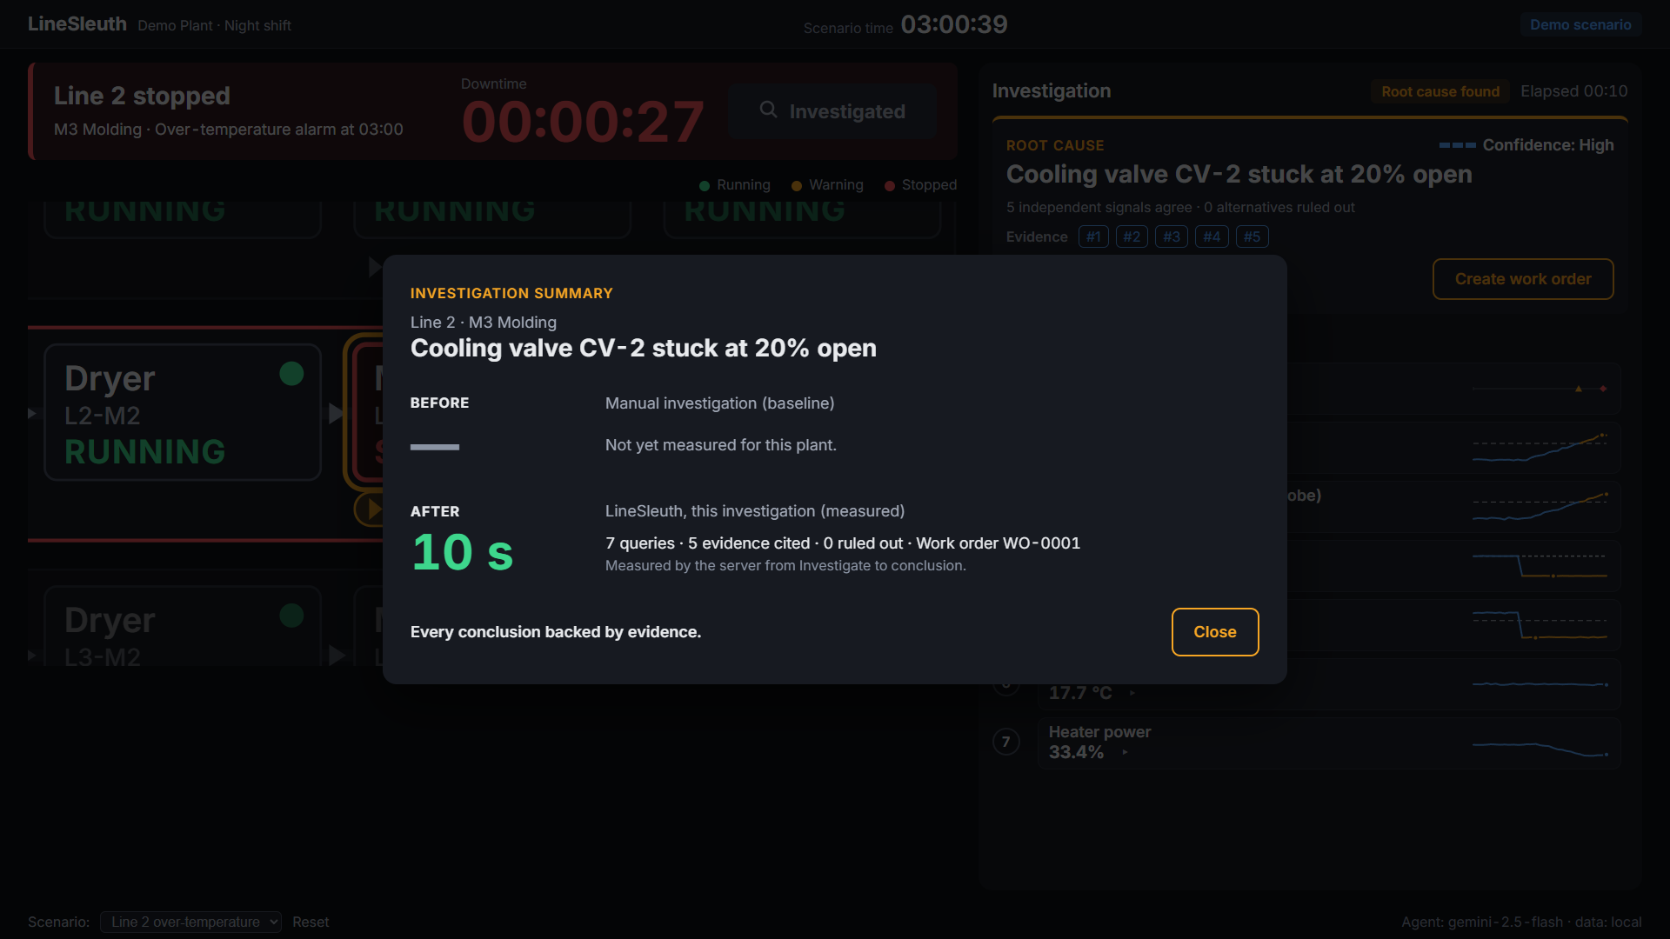
DEMO
Live prototype (Cloud Run, gemini-2.5-flash) · simulated plant data
Live: Line 2, 03:00
1
03:00 — Line 2 stops.
2
One click. No prompt.
3
Every number traces back to BigQuery.
4
Root cause + confidence + what was ruled out.
5
Before → after*
Backup video: stored on the laptop, not streamed.
* before-time pending interviews; after-time pending measurement.
Notes:
Script Segments 2-5. Only shown if the live app fails.

Slide 6
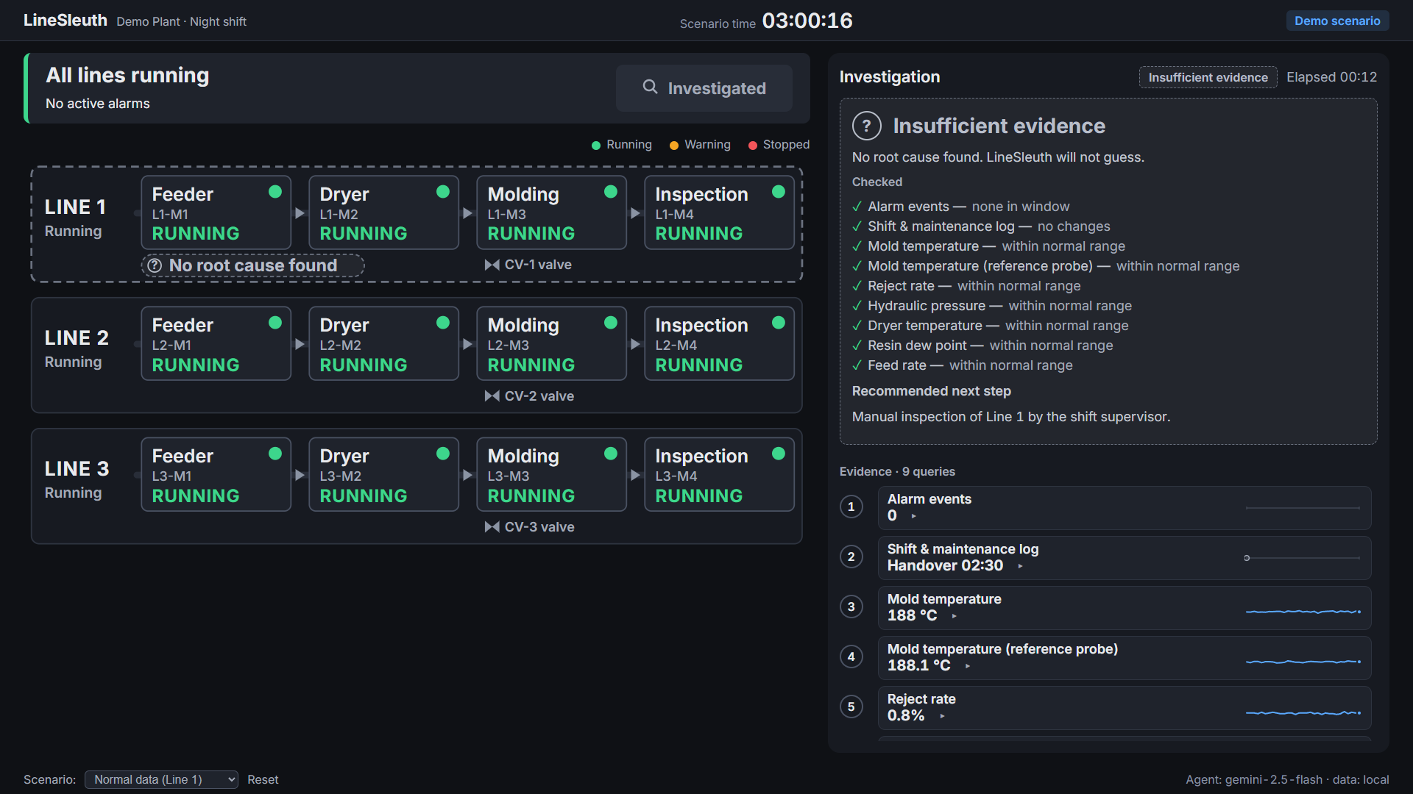
TRUST
Live prototype (Cloud Run, gemini-2.5-flash) · simulated plant data
No evidence, no conclusion
On healthy data LineSleuth answers “Insufficient evidence”, lists what it checked, and hands the decision back to a human.
Gemini can only call fixed queries with checked parameters
Numbers on cards come from source rows, not the model
A root cause needs 2+ evidence cards
Logs treated as untrusted data (prompt-injection tested)
Notes:
Script Segment 6 is the live version. For the submission deck this is the trust argument; keep it.

Slide 7
ARCHITECTURE
Built on Google Cloud
Vertex AI Gemini
Function calling · 5 fixed queries · temp 0
Browser · Phone
Cloud Run
BigQuery
Supervisor screen, QR work order
UI + API · asia-southeast1
Plant data · work orders
Cloud Logging
Every query replayable
IAM least privilege
Secret Manager*
Budget alerts 50/90/100%
Rate limits
* show Secret Manager only if the presenter key is stored there at submission. Model name only after it is verified.
Notes:
Spoken during Segment 3 of the live pitch. Name the Gemini model only after verifying it in Model Garden; otherwise just say Gemini.

Slide 8
POSITIONING
How we're different
 | Siemens Industrial Copilot | Cognite | Google MDE | LineSleuth
Built for | Large plants in the Siemens ecosystem† | Asset-heavy enterprises with data teams† | Plants building a data platform on Google Cloud† | Small contract manufacturers without MES
Starts from | Automation / MES data† | Industrial data platform† | Connected factory data† | Excel sheets and PLC CSV exports
Job to be done | Broad industrial assistant | Industrial data operations | Data engine | Why did this line stop — with evidence
Pricing | Enterprise | Enterprise | Platform | Onboarding fee + per-line monthly
Google MDE is the platform our customers can grow into.
† competitor descriptions to verify against current public vendor material.
Notes:
Script Segment 7. Check every competitor cell against current public material. Never disparage.

Slide 9
REVENUE
Business model
ONE-TIME
PER LINE / MONTH
X*
X*
Onboarding: turn Excel / PLC exports into clean data
Subscription, priced below the downtime and labour it saves
Value per line per month
incidents / month × time saved × downtime cost / hour × share of time spent searching
* all amounts pending plant-manager interviews (model: docs/finance/roi-model.csv). Buyer: plant manager or owner — to confirm.
Notes:
Script Segment 8. Inputs are assumptions; show no numbers unless they come from interviews. Do not show gross margin: Gemini and GCP costs not yet estimated.

Slide 10
WHAT'S NEXT
Roadmap
NOW · prototype
NEXT
LATER
One plant, simulated data
Main story + grey-card test
English work order via QR
Regression set, 10 known root causes
Design-partner pilots on de-identified data
Excel / PLC CSV import
Vietnamese and Thai work orders
Accounts and permissions
Multiple lines and plants
Multiple root causes per investigation
Push notifications
Early warning before a stoppage
No dates on Next / Later: they depend on design partners. Vietnamese work order is a concept, not in the prototype.
Notes:
Script Segment 9. Do not promise Vietnamese support beyond 'roadmap'.

Slide 11
40 min → 90 sec*
Every conclusion backed by evidence.
Hung Che Nick Lai
hongchelai@gmail.com · Live prototype: [Cloud Run URL / QR]
* 40 min pending interviews · 90 sec pending measurement
Notes:
Script Segment 10. Stay on this slide during Q&A.

Slide 12
APPENDIX
Validation status
Regression set (10 known root causes, 3 distractors; bar ≥ 9/10, 3 runs each)
[to measure] / 10
Healthy data returns “Insufficient evidence”
[to measure]
Median time to conclusion
[to measure] s
Plant-manager interviews completed
[pending interviews]
Notes:
Use in Q&A for 'does it really work?' and 'did you talk to customers?'. Only show measured results.

Slide 13
APPENDIX
Known limitations
DATA
SCOPE
Simulated data; no live PLC / MES connection yet
One root cause per investigation
LANGUAGE
SECURITY
English only
No login in the prototype; not ready for real customer data
Notes:
Being upfront about limits builds trust. Details in docs/manual/user-manual.md Section 11.

