Slide 1
Comparative Evaluation of Feature Reduction Techniques for Intrusion Detection on IoMT Edge Devices
Yaoquan Ma(25298835), Wang Ning(25298832)
Supervisor: Dr. Priyanka Verma

Slide 2
CONTENTS
01
Introduction
02
Related Work and Contribution
03
System Assumptions and Proposed Approach
04
Workflow and Technical Detail
05
Results
06
Conclusion and Future Work
07
Google Docs QRCode
Notes:
bc11bbc0-1aac-4a0a-8fae-0ad76c7f3707.source.7.zh-Hans

Slide 3

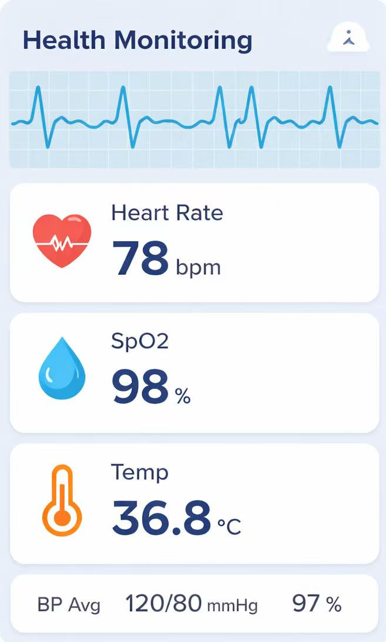
Introduction
Background
IoMT enables continuous healthcare monitoring and supports modern medical services.
However, the increasing number of connected devices significantly expands the attack surface.
Motivation
Although AI-based IDS can strengthen security, IoMT devices have limited computation, memory, storage, and bandwidth.
Therefore, it is important to study deployment strategies and feature processing methods from an overhead perspective.
Notes:
Although AI-based IDS can strengthen security, IoMT devices have limited computation, memory, storage, and bandwidth.
总是感觉怪怪的, 应该说重点是资源受限, 限制了AI-based edge device或者IOMT设备上部署.
攻击手段的
另一个Motivation, 目前Cloud-based或者hybrid framework的AI-based IDS, 目前上报流量较大, 可以达到上百G的流量 (这个信息可以说直接来着我的, 我可以直接表明我是做云计算的, 承载云上IDS).

Slide 4
Research Gaps and Contributions
GAP
Contribution
Accuracy Focus
We shift the focus from accuracy alone to deployment feasibility under resource constraints.
Existing studies mainly focus on accuracy improvement in edge-based, cloud-based, or federated IDS.
Hybrid Feasibility
We shift the focus from accuracy alone to deployment feasibility under resource constraints.
The practical feasibility of edge–cloud hybrid framework deployment remains insufficiently evaluated for resource-constrained IoMT devices.
Feature transmission
We shift the focus from accuracy alone to deployment feasibility under resource constraints.
We assess an edge–cloud hybrid framework under realistic resource limitations.
Notes:
GAP: Hybrid Framework 实际上主要关注在通过Hybrid Framework 提高accuracy. 并没有评估hybrid framework所使用feature extraction 的资源开销.
Contribution, 我们这次评估的方法, 通过模拟edge和cloud分离, 系统评估edge端的feature extraction网络, CPU, 内存.
Feature transmission我认为不用单独写了.

Slide 5
Related work
Federated Learning
Lightweight ML
Hybrid Framework
Federated learning preserves data privacy by keeping raw data on local IoMT devices and only sharing model updates.
Prior studies used approaches such as FL + XGBoost, FedAvg-based DNN, and FedAGRU to improve detection performance.
However, these methods usually require repeated local training and multiple communication rounds, which can still be costly for resource-constrained IoMT devices.
Lightweight ML methods aim to support on-device or edge-side intrusion detection with lower computational cost.
Existing work shows that models such as SVM, DT, NB, and lightweight CNNs can improve feasibility in constrained environments.
Their limitation is that they often focus on single-device or edge-only deployment, without studying edge–cloud split inference or the cost of transmitting intermediate features.
Hybrid frameworks combine lightweight edge processing with stronger cloud-side analysis.
Prior work has explored ResNeXt-based IoT–cloud IDS and adaptive lightweight SVM with dynamic feature pruning.
Although these methods improve detection or efficiency, most of them do not systematically evaluate communication overhead, split deployment cost, or practical feasibility under resource constraints.
01
02
03
Notes:
不用写很多文字, Federated Learning不要去提具体算法. 你这个PPT只是要讲7分钟左右.直接明了的说, 大家都在想办法提高Federated Learning的accuracy, 降低训练开销和传输开销.
提高Lightweight ML 提高accuracy, 而且也没有真正CPU, memory的评估开销. 只是认为lightweight ML就可以部署在edge上. 在 GPU / server或者用高性能机器 上跑,
Hybrid Framework 缺乏网络开销的评估.

Slide 6







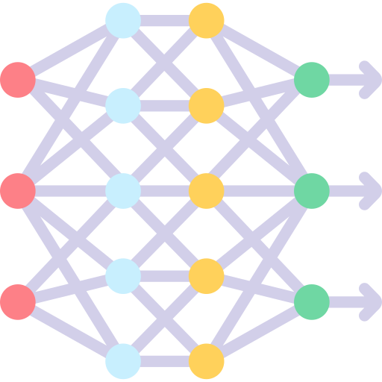







Methodology: System Overview
Firewall
Load Balance
Cloud layer
Healthcare
Professional
Security Operator
Alter, Security policy
AI + IDS
Storage
Servers
Network
flow-level, logs, event
medical sensitive data
Edge Computing layer
Feature encoding
Feature encoding
Feature encoding
Feature encoding
Feature Selection
Feature Selection
Feature Selection
Feature Selection
IoMT-Based Wearable Devices
…..

Slide 7
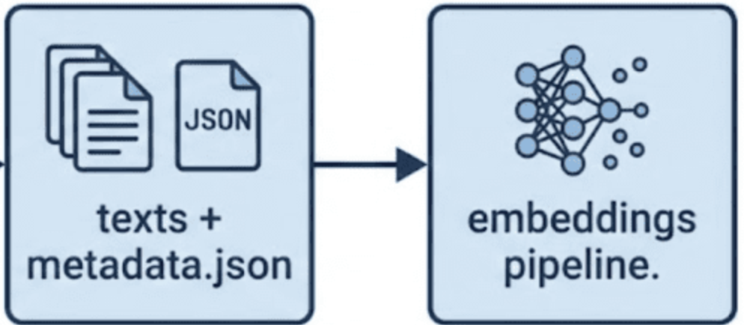
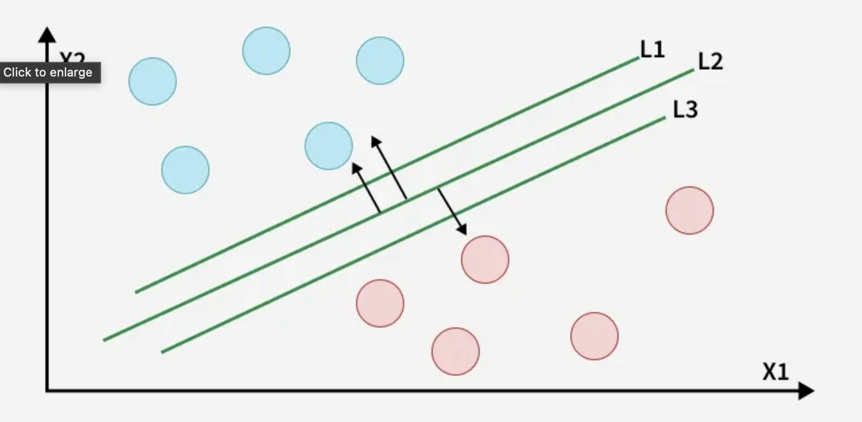
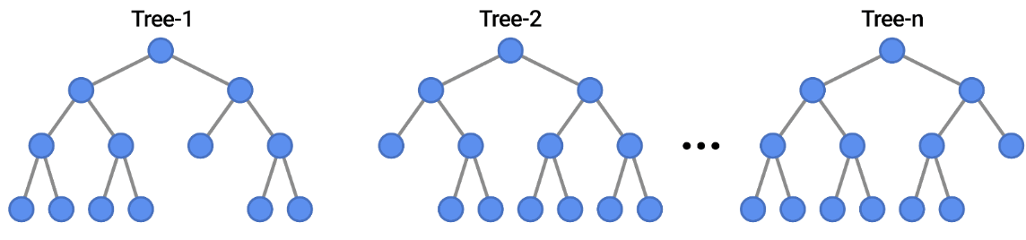
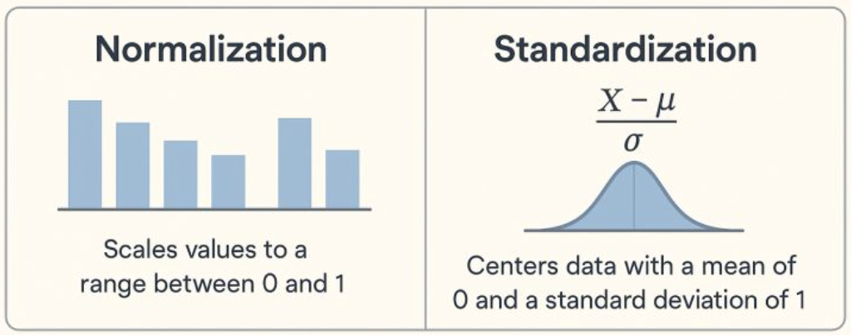
Methodology: Proposed Simulation Framework
Cloud Simulation
normal
Feature Encoding
attack
Classifer Model
attack
attack
Classification result
Train
Accuracy
F1 score
Train
Test
Test
Network traffic
Edge Simulation
Feature Selection
Feature extraction
DataSet
CPU
Memory
Feature scaling
PCA, AutoEncoder, ResNeXt

Slide 8
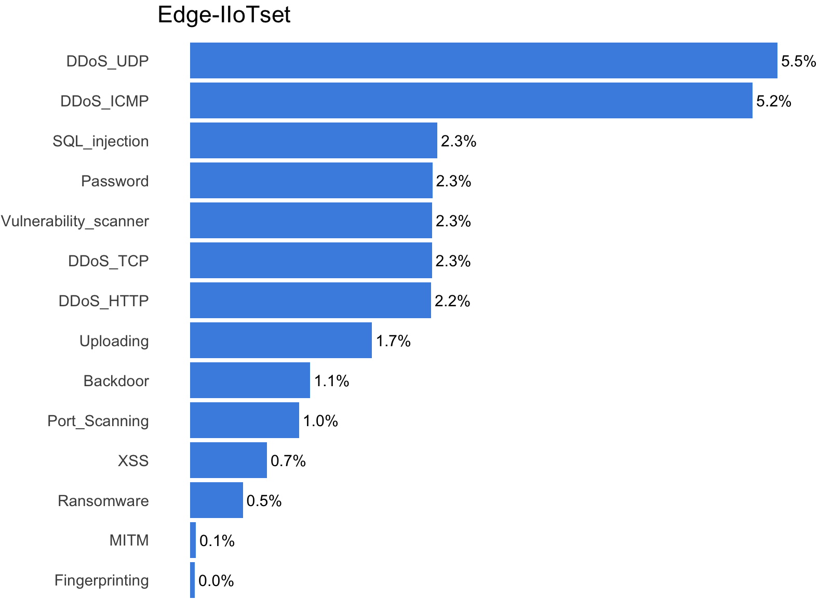
Methodology: Dataset & Feature Reduction technique
Edge-IIoTset (2022)
Realistic edge-based IoT traffic
Labelled data (normal vs. attack)
Suitable for IDS evaluation in edge environments
Recent dataset reflecting modern traffic patterns
flow-level data
Feature Reduction Technique
Feature Selection (manual/statistical)
PCA (traditional dimensionality reduction)
Autoencoder / ResNeXt (deep representation)
Goal: reduce features while preserving information

Slide 9
Results: Detection Performance
Compare FS, PCA, Autoencoder
Accuracy / Precision / Recall results
Performance differences observed

Slide 10
Results: Resource & Efficiency
CPU and memory usage comparison
Processing time analysis
Identify most efficient method for edge

Slide 11
Conclusion
Feature reduction techniques, including PCA, AutoEncoder, and ResNeXt, generally lead to a decrease in model performance, particularly in terms of accuracy and F1 score.
If a certain degree of performance degradation is acceptable, more aggressive dimensionality reduction can be applied to significantly reduce feature size and computational cost.
ResNeXt introduces high CPU overhead when applied to low-dimensional flow-level data, without improving accuracy or F1 score, making it unsuitable for deployment on edge devices. In contrast, PCA and AutoEncoder show no significant resource bottlenecks and are more suitable for edge-based IDS.
Feature reduction reduces performance but improves efficiency; PCA and AutoEncoder are edge-friendly, while ResNeXt is computationally expensive and ineffective for low-dimensional data.

Slide 12
References
IoMT Security Papers
IDS and ML/DL Papers
Feature Reduction Techniques
Relevant academic sources

