Slide 1
Comparative Evaluation of Feature Reduction Techniques for Intrusion Detection on IoMT Edge Devices
Yaoquan Ma(25298835), Wang Ning(25298832)
Supervisor: Dr. Priyanka Verma

Slide 2
CONTENTS
01
Introduction
02
Related Work and Contribution
03
System Assumptions and Proposed Approach
04
Workflow and Technical Detail
05
Results
06
Conclusion and Future Work
07
Google Docs QRCode

Slide 3

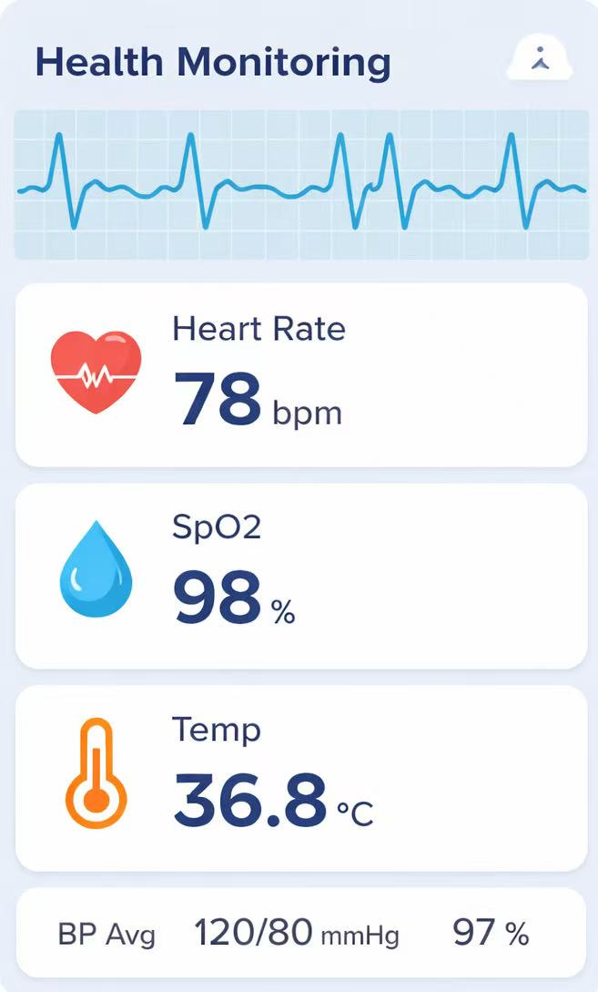
Introduction
Background
IoMT enables continuous healthcare monitoring and supports modern medical services.
However, the increasing number of connected devices significantly expands the attack surface.
Motivation
Although AI-based IDS can strengthen security, limited computation, memory, storage, and bandwidth make direct deployment on IoMT edge devices challenging.
Cloud-based and hybrid AI-based IDS may introduce significant communication overhead, making efficient deployment strategies and feature processing methods important to study.
Notes:
Here I introduce the background and motivation of our study.
First, IoMT enables continuous healthcare monitoring and supports modern medical services. However, as the number of connected devices increases, the attack surface also becomes larger.
Second, although AI-based IDS can strengthen security, direct deployment on IoMT edge devices is still challenging because these devices have limited computation, memory, storage, and bandwidth.
In addition, cloud-based and hybrid AI-based IDS may introduce significant communication overhead. Therefore, it is important to study efficient deployment strategies and feature processing methods. This is the main motivation of our work.

Slide 4
Research Gaps and Contributions
Gap 1 — Accuracy-Oriented Research
Contribution 1 — Deployment-Aware Evaluation
Existing edge-based, cloud-based, and hybrid IDS studies mainly focus on improving detection accuracy, with limited evaluation of whether the resource demands are practical for edge devices.
We extend the evaluation beyond accuracy by assessing CPU, memory, and network overhead under resource-constrained deployment settings.
GAP 1
Contribution 1
GAP 2
Contribution 2
GAP 2 — Unresolved Transmission Overhead
Contribution 2 — Edge–Cloud Split Assessment
In cloud-based and hybrid settings, large volumes of flow-level features, logs, and events may need to be uploaded, yet few studies evaluate how to reduce this transmission cost or whether the edge can sustain the resulting overhead.
We simulate split deployment between the edge and the cloud, and evaluate whether edge-side feature extraction can reduce traffic while keeping the resource overhead manageable.
Notes:
First, many existing IDS studies focus mainly on accuracy improvement, but they often do not evaluate whether the resource cost is practical for edge devices. So, our first contribution is to evaluate not only accuracy, but also CPU, memory, and network overhead.
Second, in cloud-based and hybrid settings, a lasimulaterge amount of data may need to be uploaded, including flow-level features, logs, and events. However, only limited work studies how to reduce this transmission cost or whether the edge can support it. So, our second contribution is to edge–cloud split deployment and examine whether edge-side feature extraction can reduce traffic with acceptable overhead

Slide 5
Related work
Federated Learning
Lightweight ML
Hybrid Framework
Focus
Focus
Focus
Keeps raw data local and protects privacy by sharing model updates instead of patient data.
Uses smaller models to make edge-side intrusion detection more feasible under limited resources.
Combines lightweight edge processing with stronger cloud-side analysis to balance efficiency and detection capability.
Limitation
Limitation
Limitation
Still requires repeated local training and multiple communication rounds, which remain costly for resource-constrained IoMT devices.
Many studies assume that “lightweight” means deployable, but do not systematically evaluate real CPU or memory overhead, and often remain in edge-only settings.
Existing hybrid work often improves accuracy, but lacks clear evaluation of network overhead, split deployment cost, and practical feasibility.
01
02
03
Representative refs: Ghourabi and Alkhalil (2025); Popoola et al. (2022); Chen et al. (2020)
Representative refs: Ali et al. (2025); Doriguzzi-Corin et al. (2020); Kalakoti et al. (2022)
Representative refs: Wu et al. (2025); Rguibi et al. (2025); Huma et al. (2021)
Notes:
The first direction is Federated Learning. Its main focus is to protect privacy by keeping raw data on local devices and sharing model updates instead of patient data. However, it still requires repeated local training and multiple communication rounds, which can be costly for resource-constrained IoMT devices.
The second direction is Lightweight ML. It uses smaller models to make edge-side intrusion detection more feasible. But many studies assume that lightweight means deployable, while they do not carefully evaluate real CPU or memory overhead.
The third direction is Hybrid Framework. It combines lightweight edge processing with stronger cloud-side analysis. This is a promising direction, but existing work still lacks clear evaluation of network overhead, split deployment cost, and practical feasibility.

Slide 6







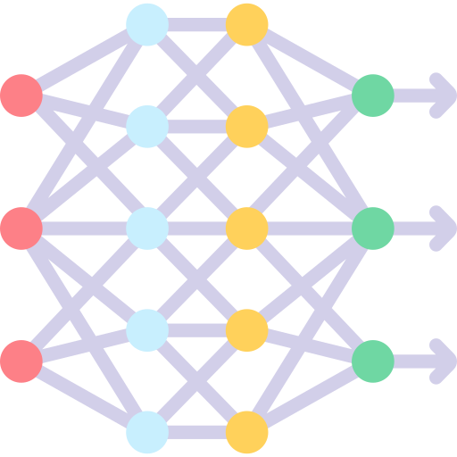







Methodology: System Overview
Firewall
Load Balance
Cloud layer
Healthcare
Professional
Security Operator
Alter, Security policy
AI + IDS
Storage
Servers
Network
flow-level, logs, event
medical sensitive data
Edge Computing layer
Feature encoding
Feature encoding
Feature encoding
Feature encoding
Feature Selection
Feature Selection
Feature Selection
Feature Selection
IoMT-Based Wearable Devices
…..
Notes:
This slide presents the overall system architecture of our framework.
The whole framework can be understood in three layers: the IoMT device layer at the bottom, the edge computing layer in the middle, and the cloud layer at the top.
At the bottom, we have IoMT-based wearable devices. These devices continuously generate both medical data and network-related data. Because they are resource-constrained, we do not place the full intrusion detection task directly on them.
In the middle is the edge computing layer. Here, the system mainly performs lightweight operations, such as feature encoding and feature selection. The edge also has some basic blocking capability, so it can react to simple suspicious behaviour. However, it may not recognise more advanced or complex attacks.
For this reason, the edge keeps sending flow-level features, logs, and events to the cloud. In the cloud layer, the AI-based IDS performs the main classification and deeper security analysis, because the cloud has stronger computation, storage, and network resources.
When the cloud identifies a complex attack, it sends the result or security policy back to the edge. Then the edge uses this information to block the attack locally. So, the cloud is mainly responsible for advanced detection, while the edge is responsible for lightweight processing, reporting, and local enforcement.
On the left side, the Security Operator represents the security management role. This means alerts and security policies can be reviewed and adjusted through the cloud system.
On the right side, the figure highlights the healthcare context of the framework. The uploaded information may include medical sensitive data, so the system is not only protecting network traffic, but also protecting healthcare-related data and services. The Healthcare Professional represents the real application side that depends on this secure system.

Slide 7
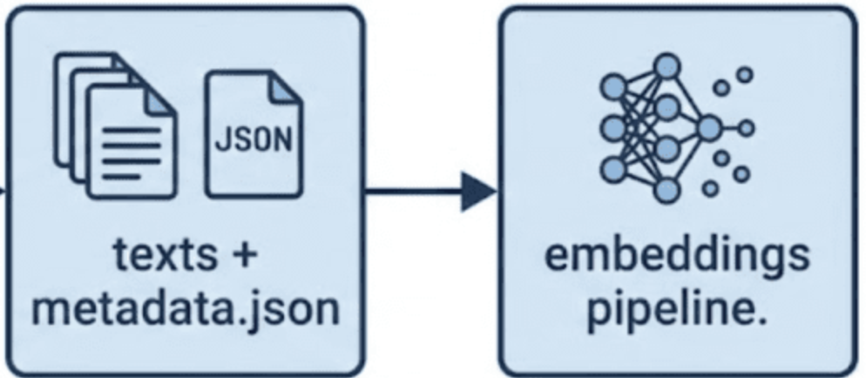
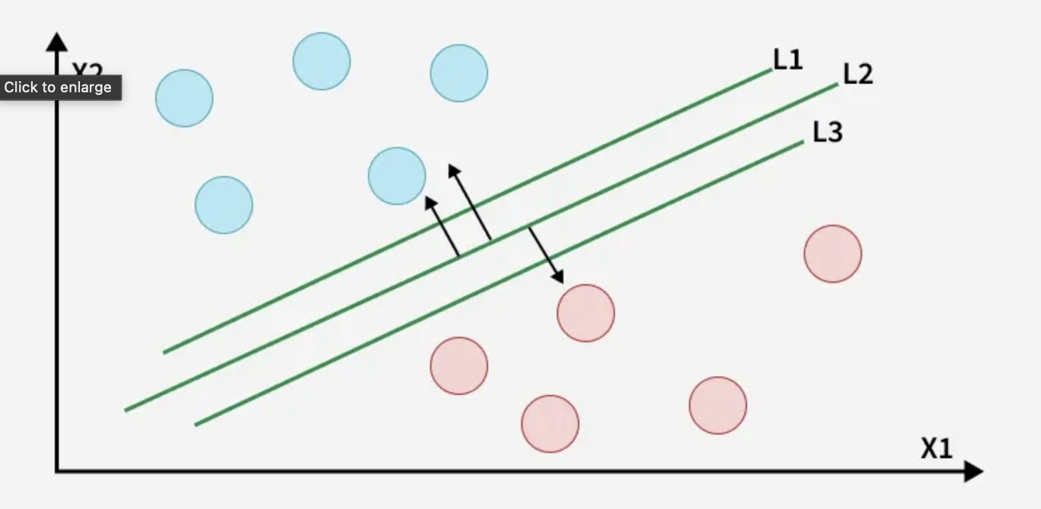
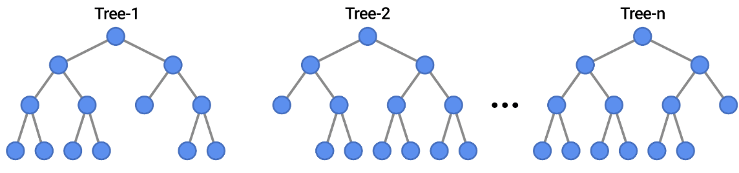
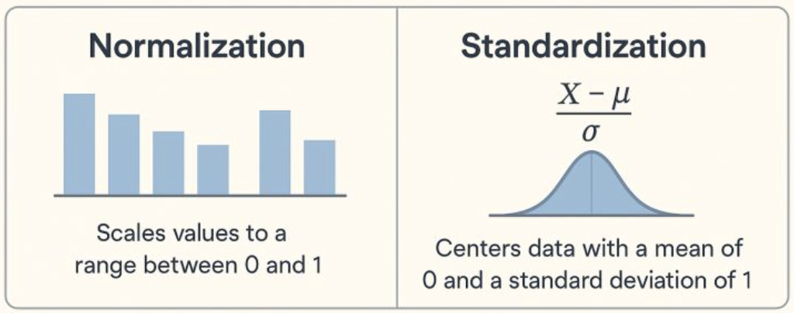
Methodology: Proposed Simulation Framework
Cloud Simulation
normal
Feature Encoding
attack
Classifer Model
attack
attack
Classification result
Train
Accuracy
F1 score
4
Test
5
Train
Test
3
Network traffic
Edge Simulation
Feature Selection
Feature extraction
DataSet
CPU
Memory
Feature scaling
1
2
PCA, AutoEncoder, ResNeXt
Notes:
In our implementation, we conduct experiments on an ARM platform to simulate a realistic edge environment. So, we do not use GPU acceleration or MPS, and all computations are performed on CPU.
Since we evaluate a hybrid framework, we simulate both edge and cloud components.
In the edge simulation, we first read data from the dataset, then apply feature scaling and feature selection to remove redundant or less informative features. After that, we perform feature extraction using methods such as PCA, AutoEncoder, or ResNeXt, and transmit the processed features to the cloud.
On the cloud side, the received data is reshaped based on metadata and then split into training and testing datasets. The data is then fed into a classification model for training and evaluation.
During this process, we monitor and record CPU and memory usage at the edge during feature extraction, as well as network traffic. We also evaluate model performance using metrics such as accuracy and F1 score.

Slide 8
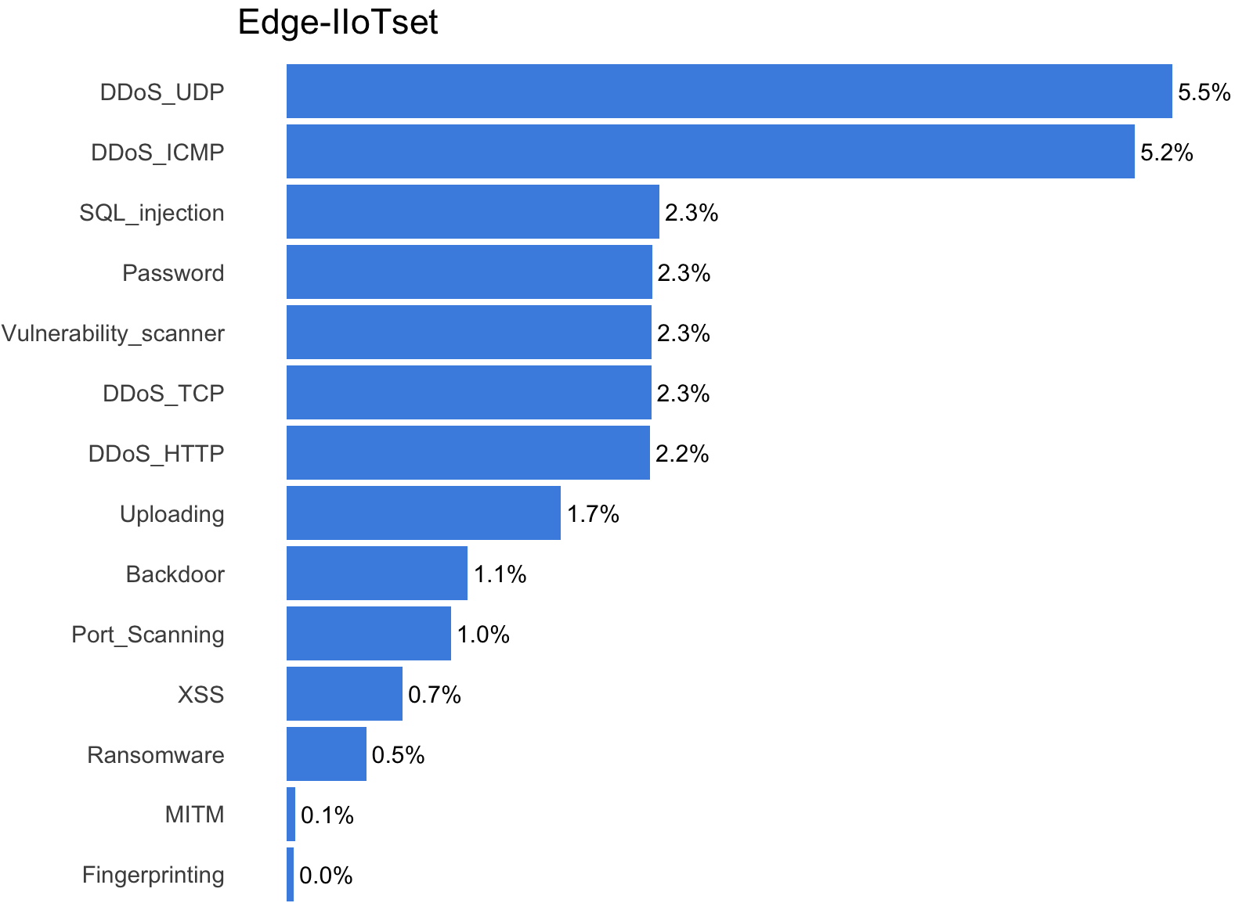
Methodology: Dataset & Feature Reduction technique
Edge-IIoTset (2022)
Realistic edge-based IoT traffic
Labelled data (normal vs. attack)
Suitable for IDS evaluation in edge environments
Recent dataset reflecting modern traffic patterns
flow-level data
Feature Reduction Technique
Feature Selection (manual/statistical)
PCA, Autoencoder (traditional dimensionality reduction)
ResNeXt1D , DNN (deep representation)
Notes:
In terms of we use the Edge-IIoTset dataset, which is a recent dataset designed for edge-based IoT environments(publish in 2022). It contains realistic network traffic and includes labelled data for both normal and attack behaviours, making it suitable for evaluating intrusion detection systems. In addition, the data is provided at the flow level, which aligns well with our system design.
For feature reduction, we investigate several approaches. First, we apply feature selection methods based on feature value ranges and their importance for prediction, in order to remove redundant or less informative features. Then, we use PCA and AutoEncoder as a traditional dimensionality reduction technique to project the data into a lower-dimensional space. Finally, we explore deep learning-based methods, including ResNeXt1D, and DNN to learn more complex feature representations.
-------
The main objective is to reduce the number of features while preserving the most important information, so that we can improve efficiency without significantly reducing classification performance.

Slide 9
Methodology: Dataset & Feature Reduction technique
ResNeXt1D Feature Extraction
Reshape input
Transform X from [N, D] to [N, 1, D]
Pass batch through stem layer
- Conv1D(1 → 64, kernel=4, stride=2, padding=3)
- BatchNorm1D
- ReLU
- MaxPool1D(kernel=3, stride=2, padding=1)
Pass through Layer 1 and Layer 2
- ResNeXt1D Block
- ResNeXt1D Block
Pass through head
- Adaptive Average Pooling
- Flatten
- Linear layer to embedding_dim
Output: Embedding matrix Z (n × embedding_dim)
DNN Feature Extraction
Input: Flow-level data X (n × d)
Pass X through the encoder
- Linear (input_dim->64)
- ReLU
- Linear (64->32)
- ReLU
Encode X into low-dimensional latent vectors
- Linear (32 -> embedding_dim)
Output: Embedding matrix Z (n × embedding_dim)
Notes:
In this part, we compare two feature extraction methods: ResNeXt1D and a lightweight DNN.
Since ResNeXt is not suitable for Flow-level data,
For ResNeXt1D, we first reshape the input data from a tabular format into a 1D format. Then, the data is passed through a stem layer, which includes convolution, batch normalisation, ReLU, and max pooling. This step helps extract basic features.
After that, the data goes through several ResNeXt blocks to learn more complex features. Finally, we use pooling, flattening, and a linear layer to generate a fixed-size embedding.
For the DNN method, the input data is directly passed through fully connected layers with ReLU activation. The model gradually reduces the feature size and produces a compact embedding.
Compared to ResNeXt1D, the DNN is simpler, more efficient, and more suitable for tabular data and edge environments.

Slide 10
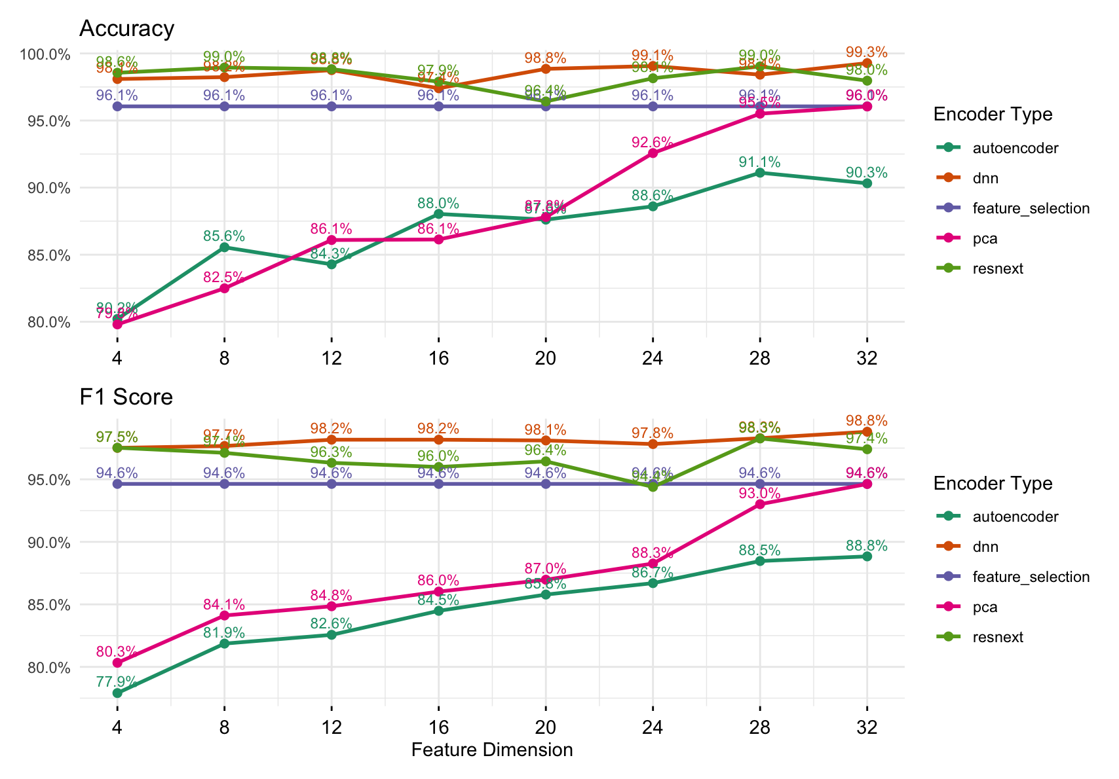
Results: Detection Performance
Notes:
In this section, we evaluate the detection performance using accuracy and F1 score across different feature dimensions.
After Feature selection remains 52 features and achieves accuracy and F1 score approximetly 96%
From the results, we can see that the DNN model consistently achieves the best performance, with accuracy and F1 score close to 99%.
ResNeXt also performs well, but it does not show clear improvement compared to DNN, especially considering its higher computational cost.
For PCA and AutoEncoder, the performance is lower when the feature dimension is small, and gradually improves as the dimension increases. This means that some important information is lost during dimensionality reduction.
Overall, these results show that for low-dimensional flow-level data, a simple DNN model is sufficient and more effective than more complex models.

Slide 11
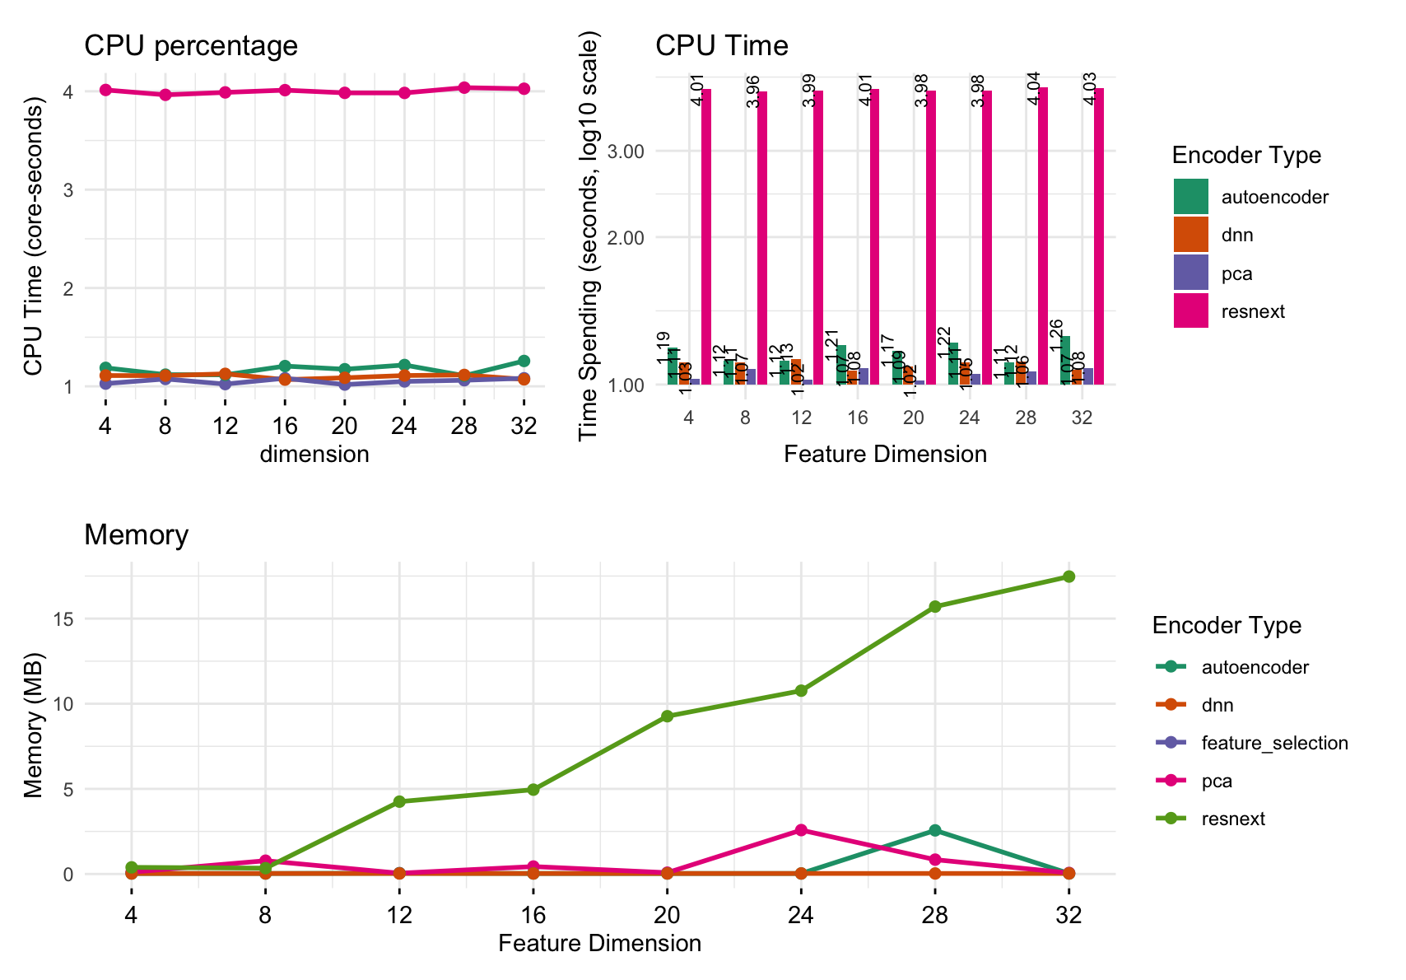
Results: Detection Performance
Notes:
In this section, we evaluate the computational cost using CPU and memory.
From the CPU usage, we can see that ResNeXt has good parallel capability due to grouped convolution. However, even with this parallelism, the inference time is still much higher compared to other methods.
For memory usage, the results are not completely stable because Python memory management can introduce fluctuations. However, overall, the memory increase during inference is relatively small, generally below 10 MB.
When we consider both CPU time and memory usage together, ResNeXt has significantly higher computational cost, making it less suitable for edge deployment.
In contrast, PCA, AutoEncoder, and DNN have much lower overhead and are more efficient for edge-based IDS.

Slide 12
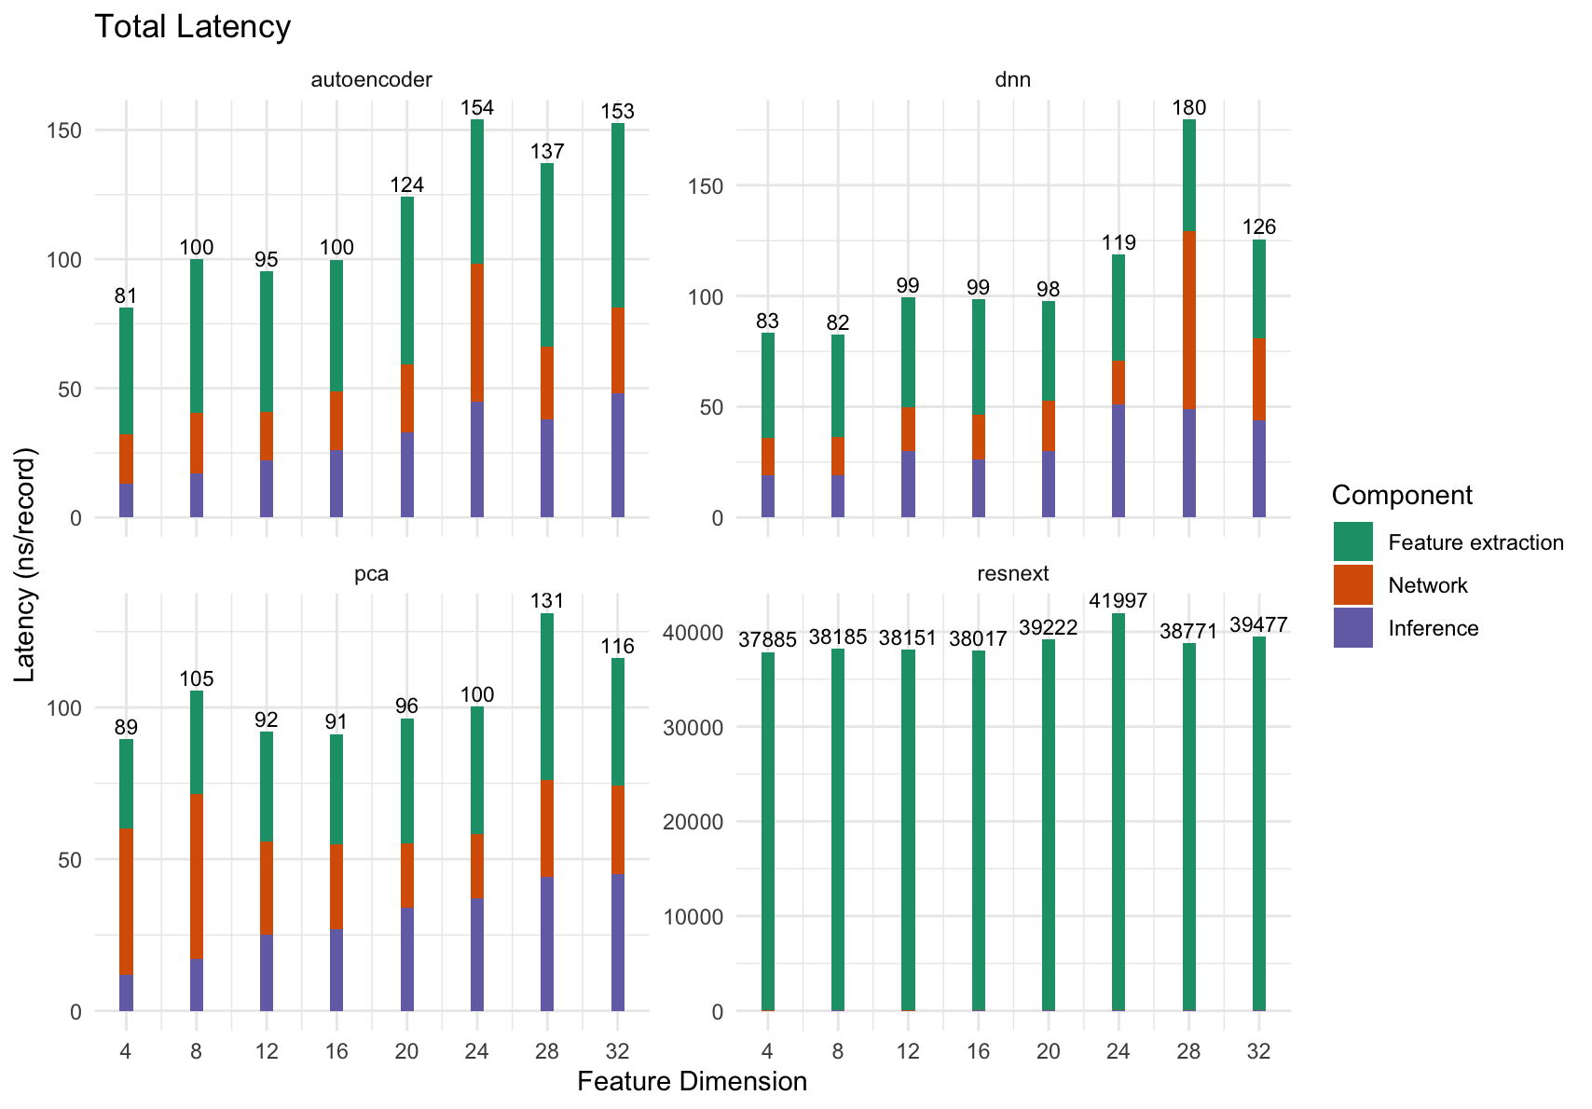
Results: Detection Performance
Notes:
In this section, we evaluate the total latency of different methods. The latency is divided into three parts: feature extraction, network transmission, and inference.
For AutoEncoder, DNN, and PCA, the total latency is relatively low, generally between 60 and 150 milliseconds. Among them, DNN and AutoEncoder show stable performance across different feature dimensions.
However, for ResNeXt, the latency is significantly higher, reaching over 37,000 nanoseconds. This is mainly because the feature extraction stage is very expensive.
This result shows that although ResNeXt can extract complex features, its computational cost is too high for real-time applications.
In contrast, PCA, AutoEncoder, and DNN provide much lower latency and are more suitable for edge-based intrusion detection systems.

Slide 13
Conclusion & Future work
Conclusion :
Traditional dimensionality reduction techniques, such as PCA and AutoEncoder, can reduce the feature dimension by about 35% without significant loss in accuracy and F1 score.
For low-dimensional flow data, lightweight DNNs are more efficient and better suited for edge deployment than ResNeXt.
ResNeXt introduces high computational overhead and is not suitable for edge deployment, while PCA, AutoEncoder, and DNN are more efficient for edge-based IDS.
Future work:
Extend more classifiers, such as LightGBM and XGBoost, to test whether our features work well with different models.
Move beyond flow-level classification by incorporating temporal and multi-flow detection, to better reflect real-world DDoS detection scenarios.
Improve the explainability of the model by using methods like SHAP or permutation importance to understand which features are important.

Slide 14
References
J. A. Alzubi, O. A. Alzubi, I. Qiqieh, and A. Singh, “A Blended Deep Learning Intrusion Detection Framework for Consumable Edge-Centric IoMT Industry,” IEEE Transactions on Consumer Electronics, vol. 70, no. 1, pp. 2049–2057, 2024. doi:10.1109/TCE.2024.3350231
F. Nabi and X. Zhou, “Enhancing intrusion detection systems through dimensionality reduction: A comparative study of machine learning techniques for cyber security,” Cyber Security and Applications, vol. 2, 2024, Art. no. 100033.
V. Harit, R. Dahiya, and U. Garg, “An Efficient Hybrid Autoencoder-LSTM Based Deep Learning Framework for Intrusion Detection in IoT Networks,” in Proc. 2025 2nd Int. Conf. Advanced Computing and Emerging Technologies (ACET), 2025.
J. Wu, S. Fu, and M. Sarabi, “Introducing a hybrid intrusion detection method for IoT-cloud environments based on ResNeXt and improved Ebola optimization search algorithm,” Scientific Reports, vol. 15, Art. no. 37612, 2025.
B. Ghimire and D. B. Rawat, “Recent advances on federated learning for cybersecurity and cybersecurity for federated learning for Internet of Things,” IEEE Internet of Things Journal, vol. 9, no. 11, pp. 8229–8249, 2022. doi:10.1109/JIOT.2022.3150363

