Slide 1

/dev/boot
Pierre Pfister | VPP Infrastructure Libraries
FD.io /dev/boot Training
31 May – 03 June | Télécom ParisTech

Slide 2

VPP Infrastructure Libraries
Warning: Extreme C coding

Slide 3
vppinfra structures
Sub-agenda

Slide 4
types.h
We use:
u8, u16, u32, u64, u32x4 (intrinsics)
i8, …
f32, f64
uword

Slide 5
vec.h
A vector is an auto-resized C array with some meta data:
Parameters: Type T, header size, element alignment
T e[5];
//Default alignment
//No header
T *v1 = 0; //Init
vec_add1(v1, &e[0]); //Add 1
vec_add2(v1, &e[1], 4); //Add 4
v1
//Header of 8 bytes
//Alignement of 16 bytes
T *v2 = 0; //Init
vec_add2_ha(v2, &e[0], 5, 8, 16);
vec_header(v2, 8);
vec_len(v1); //length safe when v1==0
_vec_len(v1) = 0; //length unsafe
//increase length to Ith elmt.
//Set new elements to 0.
vec_validate(V,I);
// Allocate for N more elements (but does not change length)
vec_alloc(V,N);
vec_free(v); //Free memory and set v to 0
vec_reset_length(v); //set length to 0 (safe)
vec length
v1[0]
v1[1]
v1[2]
…
header
vec length
v1[0]
Allocation only increases.
Vector origin pointer may changer !
Store Indexes (not pointers) !
Align pad
v1[1]
Align pad
v1[2]
Align pad
…

Slide 6
bitmap.h
Set and get bits with indexes. Lots of them.
Implemented as a uword vector.
uword *bitmap = 0;
//Allocate bitmap for 100 bits
clib_bitmap_alloc(bitmap, 100);
//Make room for 201 bits
clib_bitmap_validate(bitmap, 200);
clib_bitmap_set(bitmap, 33, 1);
clib_bitmap_get(bitmap, 33);
//Get bits from 3 to 12 included
uword a = clib_bitmap_get_multiple
(bitmap, 3, 10);
clib_bitmap_set_multiple …
uword clib_bitmap_first_set (uword * ai);
uword clib_bitmap_first_clear (uword * ai);
uword clib_bitmap_next_set (uword * ai, uword i);
uword clib_bitmap_next_clear (uword * ai, uword i);
uword clib_bitmap_count_set_bits (uword * ai);
…
vec length
0..63 b
64..127 b
…

Slide 7
pool.h
typedef struct {
uword * free_bitmap;
u32 * free_indices;
} pool_header_t;
Fixed sized element allocator.
Based on a vec and a bitmap.
Keeps track of element allocation
Free bitmap
pool header
Free indices
Used for fast re-allocation
T *pool = 0;
T *e;
pool_get(pool, e);
//pool_get_aligned(pool, e, 4);
//Query if element is free
pool_is_free(pool,e);
pool_is_free_index(pool, e – pool);
//Unalloc element
pool_put(pool,e);
//Free the whole pool
pool_free(pool);
// Allocated element count
pool_elts(pool);
vec length
pool[0]
pool[1]
Not alloc.
pool[3]
…
Sparse memory assignment.
Avoids memory fragmentation.
Fast.

Slide 8
heap.h
Variable element size allocator.
T *heap = 0;
T *e;
//Allocate 4xT.
U32 handle;
u32 offset = heap_alloc(heap, 4, handle);
//Allocated heap[offset] – heap[offset + 4]
//Object size
heap_size(heap, handle);
//Deallocate
heap_dealloc(heap, handle);
Rarely used (pools are faster).
Still efficient.
To be used if you need variably sized allocations.
e.g. classifier

Slide 9
bihash.h
Hashing table on steroïd.
Heart of the ipv6 fib
bihash_8_8.h
bihash_24_8.h
bihash_template.h
Key size
Value size
Code with macro magic to add your own bihash
(define BIHASH_TYPE as X_Y and include the header)

Slide 10
vppinfra Parse’n’print
Sub-agenda

Slide 11
format.h
Printing and Scanning has never been so easy.
Format == write from data to strings
typedef u8 * (format_function_t) (u8 * s, va_list * args);
u8 * va_format (u8 * s, char * format, va_list * args);
u8 * format (u8 * s, char * format, ...);
struct {
u32 v1, v2;
} example;
u8 *format_example (u8 *s, va_list *args) {
struct example *e = va_arg (*va, struct example *);
return format(s, “(%d, %d)”, e->v1, e->v2);
}
u8 *format_example_with_u32(u8 *s, va_list *args) {
struct example *e = va_arg (*va, struct example *);
u32 v3 = va_arg (*va, u32);
return format(s, “%U with %d”, format_example, e, v3);
}
struct example e = {1, 2};
u8 *str = format(0, “%U“ , format_example_with_u32, &e, 5);
clib_warning(“%s“, str);
vec_free(str);
Supports ‘most’ of printf syntax.

Slide 12
format.h
Printing and Scanning has never been so easy.
Unformat == get from string to data
typedef uword (unformat_function_t) (unformat_input_t * input, va_list * args);
uword unformat (unformat_input_t * i, char * fmt, ...);
uword va_unformat (unformat_input_t * i, char * fmt, va_list * args);
struct {
u32 v1, v2;
} example;
uword unformat_example (unformat_input_t *i, va_list *args) {
struct example *e = va_arg (*va, struct example *);
return unformat(i, “(%d, %d)”, &e->v1, &e->v2);
}
uword unformat_example_with_u32(unformat_input_t *i, va_list *args) {
struct example *e = va_arg (*va, struct example *);
u32 *v3 = va_arg (*va, u32 *);
return unformat(i, “%U with %d”, unformat_example, e, v3);
}
struct example e; u32 v;
const char *str = “(1, 2) with 3 foo bar”;
unformat_input_t i;
unformat_init_string(&i, str, strlen(str));
unformat(i, “%U“ , unformat_example_with_u32, &e, &v);
Supports ‘most’ of scanf syntax.
Returns wether unformat was succesfull.
In case of success, the data is consumed in the unformat_input.
Otherwise, the data is left untouched.

Slide 13
format.h
Printing and Scanning has never been so easy.
Parsing CLI input example
From vnet/vnet/l2tp/l2tp.c
Arguments can be in any order.
client <ip6_addr> our <ip6_addr> local-cookie <long> remote-cookie <long> …
if (! unformat_user (input, unformat_line_input, line_input))
return 0;
while (unformat_check_input (line_input) != UNFORMAT_END_OF_INPUT) {
if (unformat (line_input, "client %U",
unformat_ip6_address, &client_address))
client_address_set = 1;
else if (unformat (line_input, "our %U",
unformat_ip6_address, &our_address))
our_address_set = 1;
else if (unformat (line_input, "local-cookie %llx", &local_cookie))
;
else if (unformat (line_input, "remote-cookie %llx", &remote_cookie))
;
else if (unformat (line_input, "local-session-id %d",
&local_session_id))
;
else if (unformat (line_input, "remote-session-id %d",
&remote_session_id))
;
else if (unformat (line_input, "l2-sublayer-present"))
l2_sublayer_present = 1;
else
return clib_error_return (0, "parse error: '%U'",
format_unformat_error, line_input);
}

Slide 14
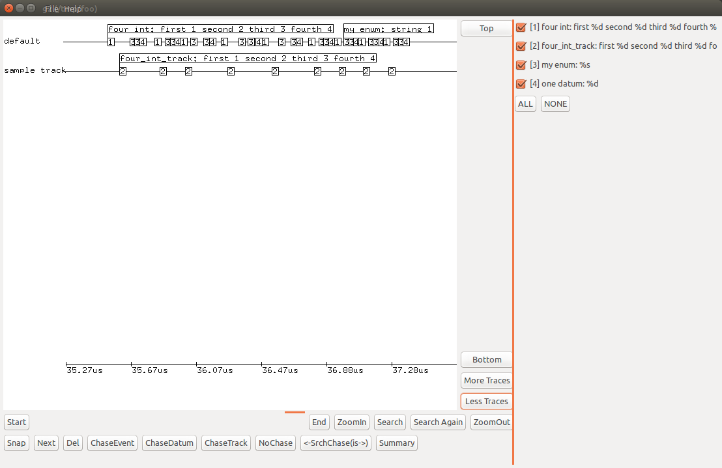
vppinfra Event Logger
Sub-agenda

Slide 15
elog.h
High speed event logging
https://wiki.fd.io/view/VPP/elog
Event-logging enabled in .../vlib/vlib/main.c:vlib_main(...)
Use the elog_main_t in vlib_global_main, aka &vlib_global_main.elog_main
Default ring size 128K events
Thread safe—lock-free atomic increment to dole out event slots
Each event-slot is 32 bytes: u64 time-in-cpu-clocks, u16 event-id, u16 track, 20 bytes of data
Logging an event costs less than 100ns
Observer effect: at most a couple of events per node, per frame at speed
Cf. Dave Barach’s presentation:
https://docs.google.com/presentation/d/1C_1zM5Z3sTibOj1e2pe_YDbiMCytwZspK541fPElyWM

Slide 16
vppinfra The rest
Sub-agenda

Slide 17
Things you may or may not learn by yourself
fheap.h Fibonacci heap…
graph.h Graph Implementation
hash.h Hash table
phash.h Again
qhash.h Again
longjmp.h We actually use it !
Etc…

Slide 18
Lessons from vppinfra
Store indexes, not pointers (arrays get resized).
Macros do change parameters (and not only pointers).
Format and unformat functions are usefull.
Alignement can be important for multi-thread efficiency.

Slide 19
Congratulation !

Slide 20
vlib
Sub-agenda

Slide 21
Vlib Overview
VPP is based on 2 main ideas:
Vectors (0 to 256 buffers bundled together)
Nodes (in a graph) performing actions and passing the vectors.
vlib is where all this abstract model is defined. Outside of any networking considerations (No IP, no ethernet, etc…).
It also includes:
Counters
CLI
Scheduler (main loop).
A few other things...

Slide 22
Vlib nodes
Sub-agenda
i-am-a-vlib-node

Slide 23
Vlib nodes - node.h – node_funcs.h
typedef enum {
VLIB_NODE_TYPE_INTERNAL,
VLIB_NODE_TYPE_INPUT,
VLIB_NODE_TYPE_PRE_INPUT,
VLIB_NODE_TYPE_PROCESS,
VLIB_N_NODE_TYPE,
} vlib_node_type_t;
Nodes have:
A name dpdk-rx, ip6-forward, tapcli-tx, …
An index Uniquely identifies a node
A function Node callback to operate on vectors
A type
A set of next nodes Identified by index & counters
A set of errors With names & counters
VLIB_REGISTER_NODE (l2input_node) = {
.function = l2input_node_fn,
.name = "l2-input",
.vector_size = sizeof (u32),
.format_trace = format_l2input_trace,
.format_buffer = format_ethernet_header_with_length,
.type = VLIB_NODE_TYPE_INTERNAL,
.n_errors = ARRAY_LEN(l2input_error_strings),
.error_strings = l2input_error_strings,
.n_next_nodes = L2INPUT_N_NEXT,
.next_nodes = {
[L2INPUT_NEXT_LEARN] = "l2-learn",
[L2INPUT_NEXT_FWD] = "l2-fwd",
[L2INPUT_NEXT_DROP] = "error-drop",
},
};
Each node has a registration data (vlib_node_registration_t) and a runtime data (vlib_node_t).
Nodes are created with constructors at initialization.
It is possible to dynamically add next nodes.
always_inline uword
vlib_node_add_next (vlib_main_t * vm, uword node, uword next_node);

Slide 24
Vlib nodes - VLIB_NODE_TYPE_INTERNAL
Most typical node receiving buffer vectors, performing operations.
Includes tx nodes.

Slide 25
Vlib nodes - VLIB_NODE_TYPE_INPUT
Typically device input nodes.
Create frames from scratch and dispatch to internal nodes.
typedef enum {
VLIB_NODE_STATE_POLLING,
VLIB_NODE_STATE_INTERRUPT,
VLIB_NODE_STATE_DISABLED,
VLIB_N_NODE_STATE,
} vlib_node_state_t;
Constantly called
Called once when interrupted
Not called
u32 input_main_loops_per_call;
Throttle polling

Slide 26
Vlib nodes - VLIB_NODE_TYPE_PRE_INPUT
Called before input nodes.
Not used as far as I know.

Slide 27
Vlib nodes - VLIB_NODE_TYPE_PROCESS
Thread-like function.
Can be suspended, wait for events, be resumed… (based on setjump/longjump).
static uword ip6_icmp_neighbor_discovery_event_process (vlib_main_t * vm, vlib_node_runtime_t * node, vlib_frame_t * frame)
{
uword event_type;
ip6_icmp_neighbor_discovery_event_data_t * event_data;
while (1) {
vlib_process_wait_for_event_or_clock (vm, 1. /* seconds */);
event_data = vlib_process_get_event_data (vm, &event_type);
if(!event_data) {
ip6_neighbor_process_timer_event (vm, node, frame);
} else {
switch (event_type) {
case ICMP6_ND_EVENT_INIT:
break;
case ~0:
break;
default:
ASSERT (0);
}
if (event_data)
_vec_len (event_data) = 0;
}
}
return frame->n_vectors;
}
Wait for an event
always_inline f64
vlib_process_wait_for_event_or_clock (
vlib_main_t * vm, f64 dt)
Send an event
always_inline void
vlib_process_signal_event (vlib_main_t * vm,
uword node_index,
uword type_opaque, uword data);

Slide 28
Vlib/unix
Sub-agenda

Slide 29
Vlib and file descriptors
Example from vnet/unix/tapcli.c
unix_file_t template = {0};
template.read_function = tapcli_read_ready;
template.file_descriptor = dev_net_tun_fd;
ti->unix_file_index = unix_file_add (&unix_main, &template);
Vlib implements a poll – event-loop-like node.
Listens for fd events and execute callbacks.
Somehow slow due to node->input_main_loops_per_call
typedef struct unix_file {
u32 file_descriptor;
u32 flags;
#define UNIX_FILE_DATA_AVAILABLE_TO_WRITE (1 << 0)
#define UNIX_FILE_EVENT_EDGE_TRIGGERED (1 << 1)
uword private_data;
unix_file_function_t * read_function, * write_function, * error_function;
} unix_file_t;
static clib_error_t * tapcli_read_ready (unix_file_t * uf)
{
vlib_main_t * vm = vlib_get_main();
tapcli_main_t * tm = &tapcli_main;
uword * p;
vlib_node_set_interrupt_pending (vm, tapcli_rx_node.index);
…
return 0;
}
uword unix_file_add (unix_main_t * um, unix_file_t * template);
See more at vlib/unix/unix.h

Slide 30
Plugins vlib/unix/plugin.h
static int
load_one_plugin (plugin_main_t *pm, plugin_info_t *pi, int from_early_init)
{
void *handle, *register_handle;
clib_error_t * (*fp)(vlib_main_t *, void *, int);
clib_error_t * error;
void *handoff_structure;
handle = dlopen ((char *)pi->name, RTLD_LAZY);
[…]
pi->handle = handle;
register_handle = dlsym (pi->handle, "vlib_plugin_register");
if (register_handle == 0) {
dlclose (handle);
return 0;
}
fp = register_handle;
handoff_structure = vnet_get_handoff_structure();
if (handoff_structure == 0)
error = clib_error_return (0, "handoff structure callback returned 0");
else
error = (*fp)(pm->vlib_main, handoff_structure, from_early_init);
if (error) {
clib_error_report (error);
dlclose (handle);
return 1;
}
clib_warning ("Loaded plugin: %s", pi->name);
return 0;
}
Plugins are loaded at VPP init:
$ vpp plugin_path <path>
Vpp tries to load all libraries present in the path.
vlib_plugin_register must exist and return 0.
’constructor’ functions are also executed.
clib_error_t * constr_example (vlib_main_t * vm);
VLIB_INIT_FUNCTION (constr_example);

Slide 31
CLI
To be explained in more details in CLI and API session

Slide 32
Vlib buffers
Sub-agenda
Or not
That is the question

Slide 33
Vlib buffers – vlib/buffer.[ch] vlib/dpdk_buffer.c
vlib_buffer_t is VPP’s ‘packet’ basic structure (equivalent to DPDK’s rte_mbuf).
When DPDK == 1, vlib_buffer_t is encapsulated within rte_mbuf.
Struct rte_mbuf—DPDK buffer metadata
Vlib_buffer_t—vpp buffer metadata, as rte_mbuf pvt data
Data Area / DMA target
...
...
...
#define vlib_buffer_from_rte_mbuf(x) ((vlib_buffer_t *)(x+1))
#define rte_mbuf_from_vlib_buffer(x) (((struct rte_mbuf *)x) - 1)

Slide 34
Vlib buffers
i16 current_data;
u16 current_length;
u32 flags;
Signed offset in data[], pre_data[]
Nbytes between current data and the end of this buffer.
#define VLIB_BUFFER_IS_TRACED (1 << 0) #define VLIB_BUFFER_LOG2_NEXT_PRESENT (1) #define VLIB_BUFFER_NEXT_PRESENT \ (1 <<VLIB_BUFFER_LOG2_NEXT_PRESENT) #define VLIB_BUFFER_IS_RECYCLED (1 << 2) #define VLIB_BUFFER_TOTAL_LENGTH_VALID \ (1 << 3) #define VLIB_BUFFER_HGSHM_USER_INDEX_VALID (1 << 4) #define VLIB_BUFFER_REPL_FAIL (1 << 5) #define LOG2_VLIB_BUFFER_FLAG_USER(n) (32 - (n))

Slide 35
Vlib buffers
u32 free_list_index;
u32 total_length_not_including_first_buffer;
u32 next_buffer;
u32 trace_index;
u32 clone_count;
vlib_error_t error;
u32 opaque[8];
Barely used
End of vlib_buffer_init_for_free_list() init
Buffer index of next buffer (if present)
Valid if buffer traced
If non-zero, xmit copy and recycle the original buffer u16 error_node, error_code – set to arrange counter bump
subgraph metadata, see .../vnet/vnet/buffer.h

Slide 36
Vlib buffers
u32 opaque2[16];
u8 pre_data[VLIB_BUFFER_PRE_DATA_SIZE];
u32 data[0];
Barely used
Rewrite space, 128 bytes Aligned DMA target. Certain hardware devices DMA into data[n], e.g. n=6.

Slide 37
Vlib buffers
vnet_buffer_opaque_t – union of types which contain ‘subgraph’ metadata
8x32 bits
vnet_buffer(b)->sw_if_index[VLIB_RX, VLIB_TX] are common
From driver level: vnet_buffer(b)->sw_if_index[VLIB_RX] set to RX (physical) interface vnet_buffer(b)->sw_if_index[VLIB_TX] = ~0
ip4/6-lookup use VLIB_TX as FIB index override.
These are like node input/output metadata (e.g. ip-frag).

Slide 38
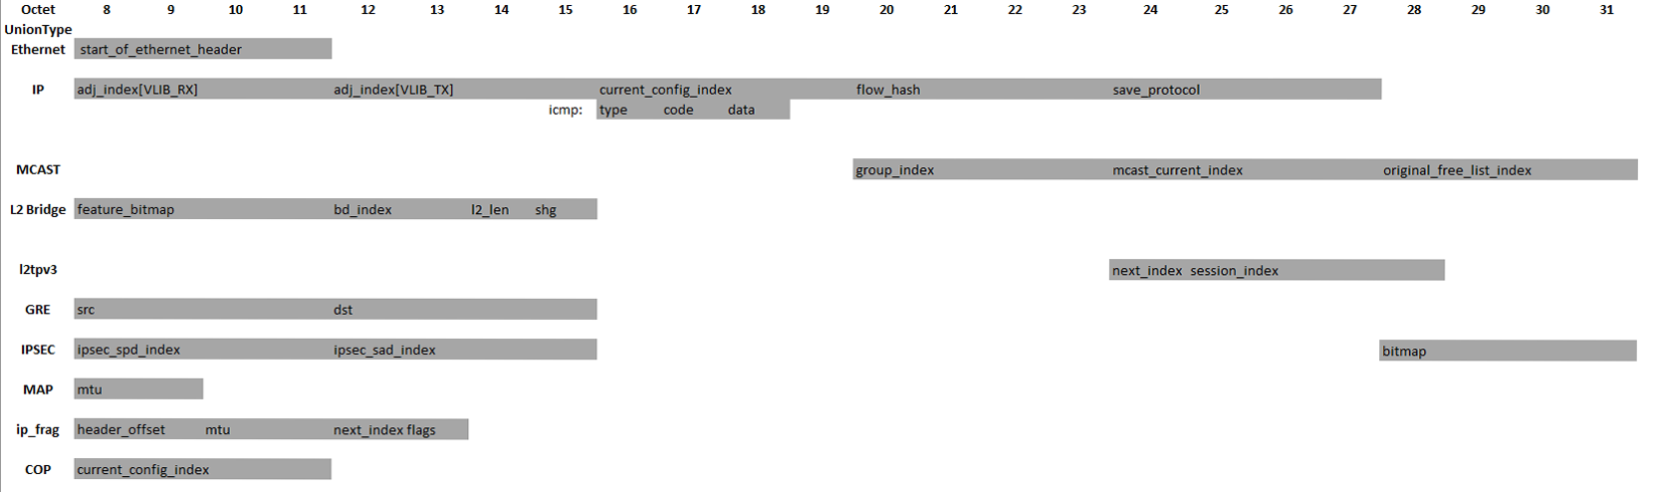
Vnet_buffer_opaque_t intersection analysis

Slide 39
You nailed it !

