Slide 1
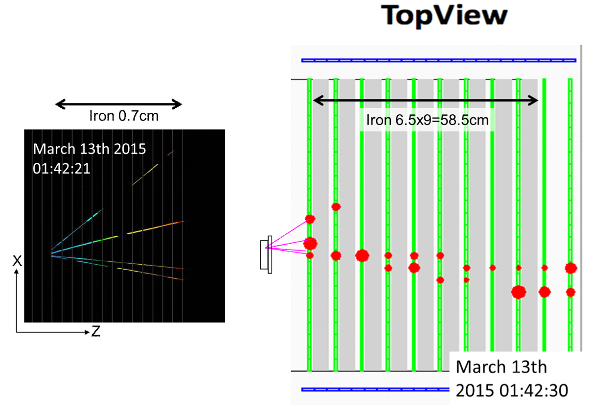
T2K on-axis near detector
(INGRID)
Nuclear emulsion detector

