Slide 1

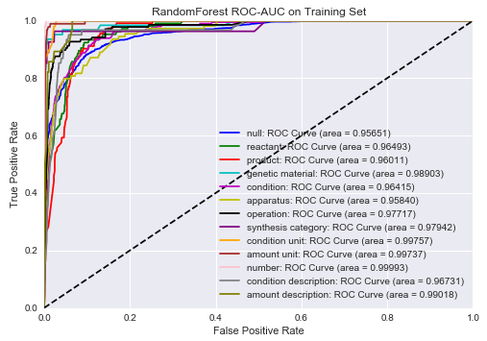
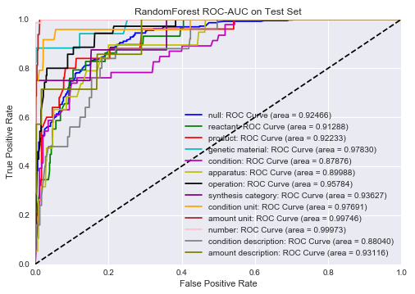
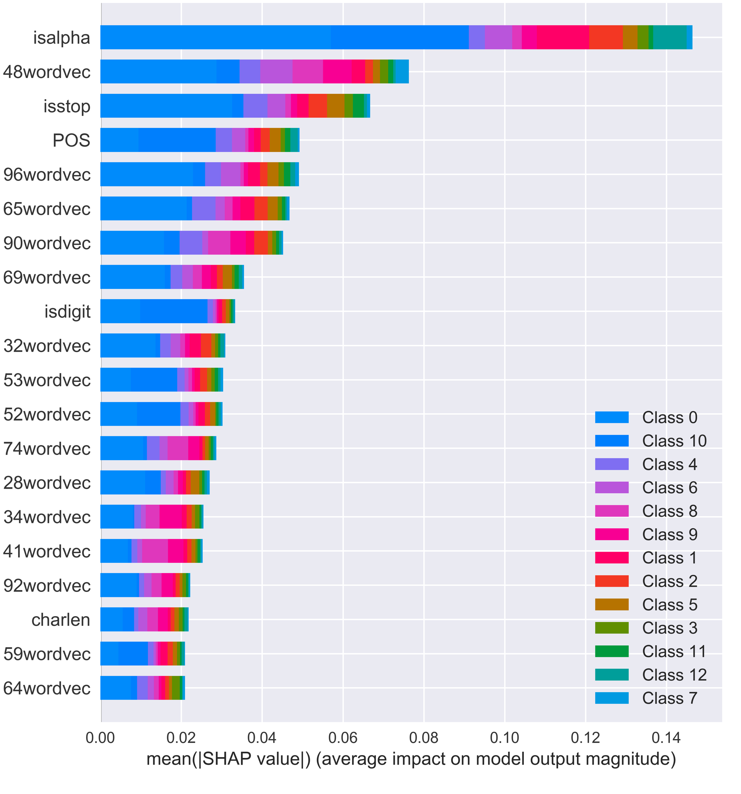
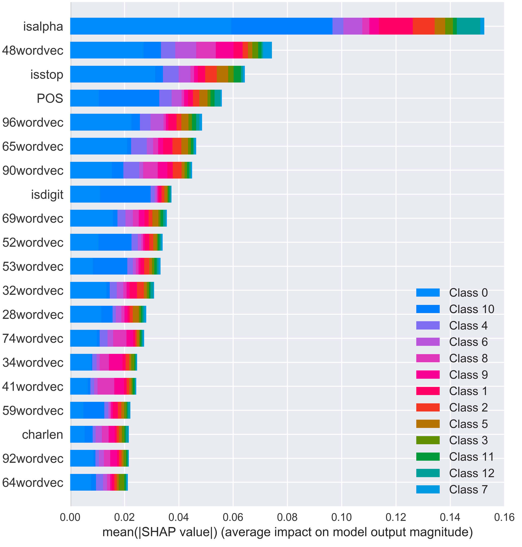
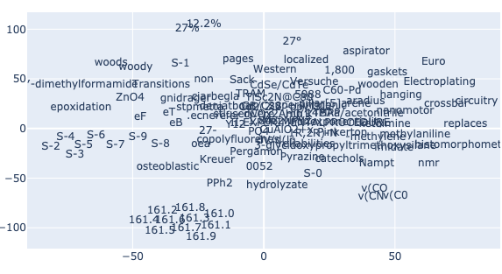
Word Based Text Parser and Route Extractor for Chemistry Abstracts
Yannan Yuan, Langkun Chen, Runbo Jiang
University of Pittsburgh
Objective
Models and Results
Our goal is to build a model to parse and extract information from scientific articles of chemistry which is related to synthesis.
The model will predict the categories of words in text, such as reactants, products, solvents, conditions, numbers, and units in a synthesis process, then extract this information to directly show the synthesis process.
Work pipeline: data retrieval → paragraph classification → word labeling and modeling → word extraction.
We trained three models for label prediction: Support Vector Machine, Random forest, and LightGBM.
Based on our best model (RF), we used hyperopt for hyper-tuning, the result became less overfitting. The ROC-AUC curve was plot below:
SHAP summary plot for training and test set. In general, heuristic features take more effect for label prediction than word embeddings.
Models | Accuracy |  | Micro-AUC
 | Train | Test | Train | Test
SVM | 0.671 | 0.671 | 0.977 | 0.958
RF | 0.766 | 0.740 | 0.986 | 0.969
RF Hyperopt | 0.744 | 0.725 | 0.983 | 0.968
LightGBM | 0.806 | 0.750 | 0.989 | 0.967
Text Data Preprocessing
APIs were used to obtain a large amount of abstracts (>10000) from Elsevier.
A simple paragraph classifier was trained to get the abstracts that are related to chemical synthesis exclusively.
In feature engineering, 152 features for each paragraph were created, where 100 features were word count features, 52 features were heuristic rules like keywords and length of paragraph.
Apply the well-trained classifier to larger data to get more synthesis abstracts as our further samples.
Support Vector Machine was used to train the classifier, which gave 0.99 and 0.97 AUC scores on training and test set respectively.
Feature Engineering
Tokenize the paragraphs to get words as samples and label all words by our defined categories, which is listed in the table.
Features were created based on words. The main feature is the word embedding which is obtained from a pre-trained Word2Vec model.
Word embeddings are positioned in the vector space such that words that share common contexts in the corpus are located close to one another in the space.
Some heuristic features, such as the part-of-speech and chemical entity were involved. ChemDataExtractor and NLTK were used for these rules. These results were transformed into binary feature.
Extractor
Word Embedding TSNE
0 | Null
1 | Reactant
2 | product
3 | Genetic material
4 | condition
5 | apparatus
6 | operation
7 | Synthesis category
8 | Condition unit
9 | Amount unit
10 | Number
11 | Condition description
12 | Amount description
Word | Zn(NO3)2•6H2O | 0.297g | 1 | mmol | were | dissolved | in | 70 | mL
Label | reactant | null | number | amount unit | null | operation | null | number | amount unit
Word | of | deionized | water | and | sealed | in | the | steel | autoclave
Label | null | null | condition | null | null | null | null | null | apparatus
Word | and | heated | into | 120 | ˚C | After | the | reaction | the
Label | null | operation | null | number | condition unit | null | null | null | null
Word | autoclave | was | cooled | to | room | temperature
Label | apparatus | null | operation | null | condition | condition
Future Work
Build context relevant models
Find better rule features in feature engineering
Learn patterns and knowledge from chemical synthesis
Reference
Kim, E., et al. (2017). Machine-learned and codified synthesis parameters of oxide materials. Sci. Data, 4, 170127
Swain, M. C. et al. (2016). ChemDataExtractor: a toolkit for automated extraction of chemical information from the scientific literature. J. Chem. Info. Model, 56(10), 1894-1904.

