Slide 1
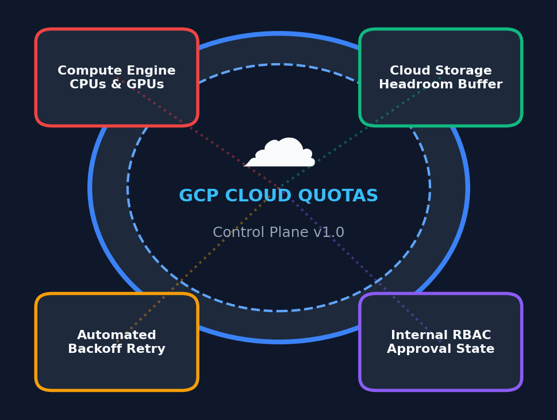
GOOGLE CLOUD HACKATHON 2026
Quota Management &
Increase Request Planning
An Enterprise FinOps & Infrastructure Control Plane for Real-Time Telemetry Ingestion, Dynamic Risk Analysis, and Programmatic GCP Quota Scaling.
PROJECT TEAM MEMBERS:
• YADAMAKANTI NAVANEETH REDDY [2400030020]
• SHIVAM KUMAR SAW [2400039056]
• NIKET KUMAR [2400033292]
• ALLAM SAHITHI [2400033195]
Google Cloud Hackathon 2026 | Quota Management Control Plane • Slide 1 of 17 • Team: Y. Navaneeth Reddy, Shivam Kumar, Niket Kumar, Allam Sahithi

Slide 2
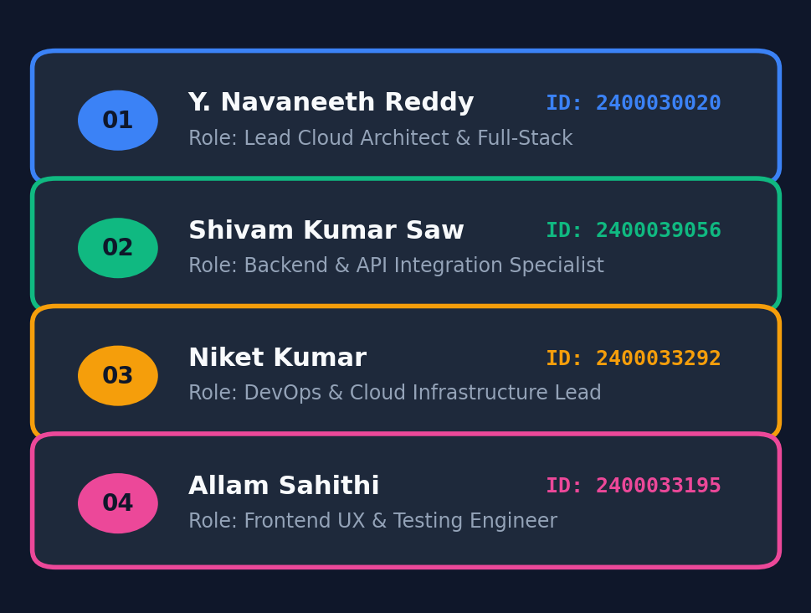
CORE ENGINEERING TEAM
Project Team Roster & Architectural Responsibilities
Specialized cross-functional engineering contributions across the full stack.
• Yadamakanti Navaneeth Reddy (2400030020)
Lead Cloud Architect & Full-Stack Lead: Designed core architecture, state machine workflow, and end-to-end GCP integration.
• Shivam Kumar Saw (2400039056)
Backend & API Integration Specialist: Built Express REST gateway, Zod validation schemas, Morgan logging, and error handling layers.
• Niket Kumar (2400033292)
DevOps & Cloud Infrastructure Lead: Provisioned Terraform IaC, Docker multi-stage containers, GitHub Actions CI/CD, and Cloud Build.
• Allam Sahithi (2400033195)
Frontend UX & Testing Engineer: Implemented Tailwind design system, WCAG 2.1 AA accessibility, and automated Jest test suites.
Google Cloud Hackathon 2026 | Quota Management Control Plane • Slide 2 of 17 • Team: Y. Navaneeth Reddy, Shivam Kumar, Niket Kumar, Allam Sahithi

Slide 3
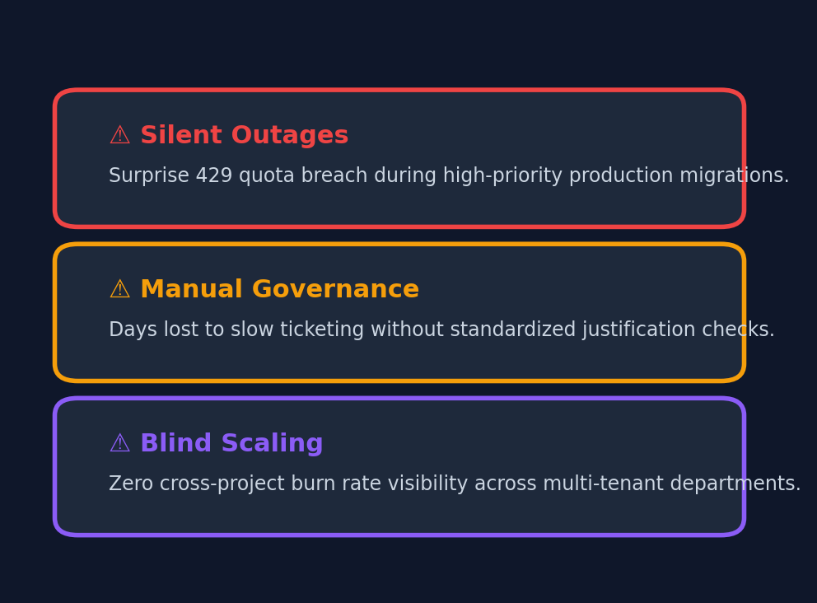
THE CHALLENGE
The Enterprise Quota Bottleneck in Google Cloud
Why hard quota ceilings trigger production outages and operational friction.
• Silent Production Blockers
Engineers encounter sudden quota exhaustion during high-stakes deployments, batch jobs, or auto-scaling spikes.
• Manual Console Overhead
Requesting increases involves navigating deep GCP console menus, manual ticket logging, and prolonged wait times.
• Zero Predictive Visibility
Traditional monitoring only reflects past usage; engineering leaders lack visibility into burn rate velocity and time-to-exhaustion.
• Governance & Audit Deficits
Organizations lack central approval gates, audit trails, and multi-tenant quota utilization visibility across environments.
Google Cloud Hackathon 2026 | Quota Management Control Plane • Slide 3 of 17 • Team: Y. Navaneeth Reddy, Shivam Kumar, Niket Kumar, Allam Sahithi

Slide 4
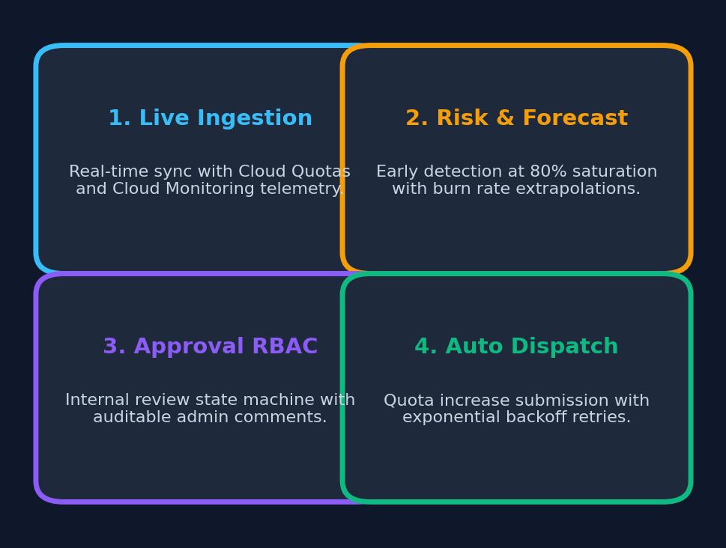
THE SOLUTION
Intelligent Quota Governance & Scaling Control Plane
A centralized, proactive platform unifying telemetry, forecasting, and automated adjustments.
• Continuous Telemetry Ingestion
Automated background sync pulling live quota ceilings from Cloud Quotas API and consumption metrics from Cloud Monitoring.
• Early Saturation Warning (>=80%)
Real-time risk classifier flagging at-risk resources before service disruption occurs.
• Mathematical Forecasting & Sizing
Linear demand extrapolation, days-to-breach dates, and explainable AI approval confidence scoring (0-100).
• One-Click GCP Cloud Dispatch
Authenticated submission of quota preferences directly to Google Cloud APIs with exponential backoff retries.
Google Cloud Hackathon 2026 | Quota Management Control Plane • Slide 4 of 17 • Team: Y. Navaneeth Reddy, Shivam Kumar, Niket Kumar, Allam Sahithi

Slide 5
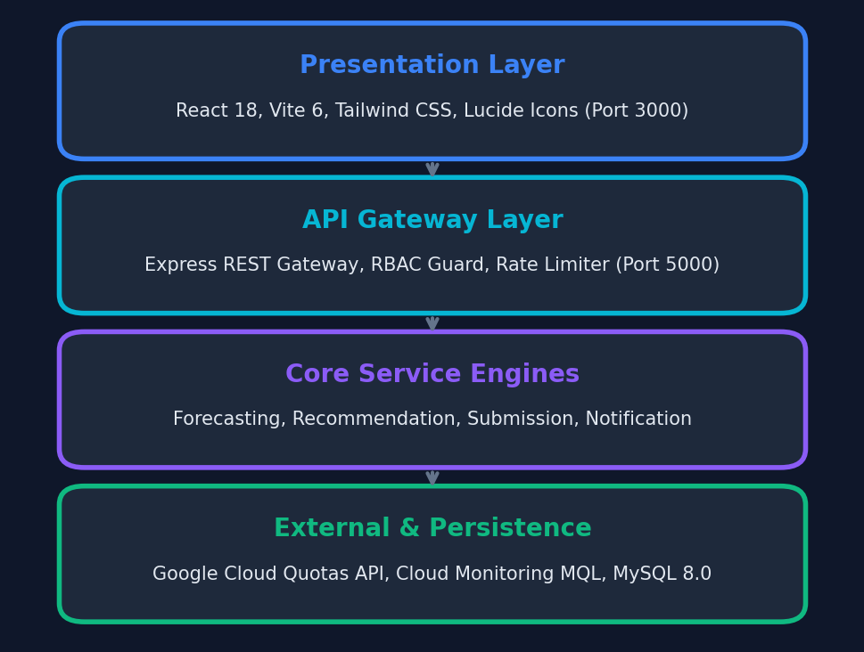
SYSTEM BLUEPRINT
Full-Stack Control Plane Architecture
Modern decoupled architecture engineered for enterprise scalability and reliability.
• Frontend Client (Port 3000)
React 18 + Vite 6 + Tailwind CSS SPA featuring 9 views, interactive data tables, confidence meters, and dark mode UI.
• API Gateway Core (Port 5000)
Express REST framework with sliding-window rate limiting, strict CORS, OWASP security headers, and Morgan logging.
• Dual-Tier Persistence Layer
MySQL 8.0 schema with Prisma ORM and seamless automatic in-memory fallback for offline resilience.
• Google Cloud Platform Integration
Google Auth Library (ADC tokens), Cloud Quotas REST API, Cloud Monitoring MQL timeseries, and Cloud Run.
Google Cloud Hackathon 2026 | Quota Management Control Plane • Slide 5 of 17 • Team: Y. Navaneeth Reddy, Shivam Kumar, Niket Kumar, Allam Sahithi

Slide 6
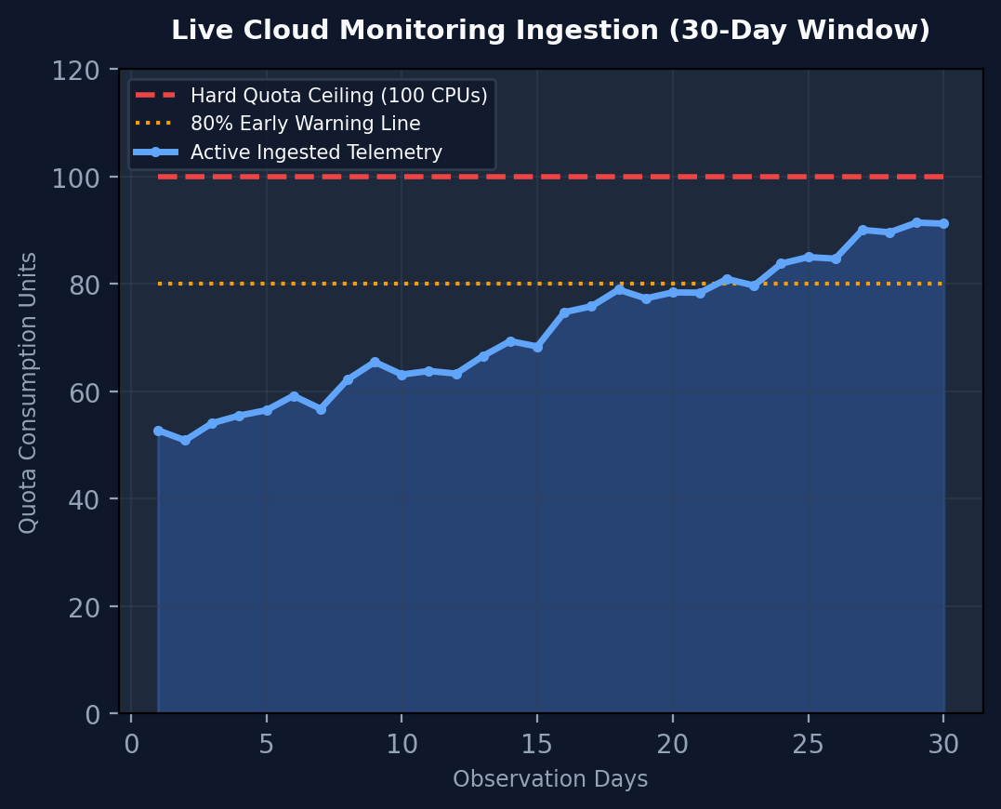
TELEMETRY PIPELINE
Live Quota Retrieval & Cloud Monitoring Ingestion
Harmonizing quota limits and usage time-series into a single pane of glass.
• Cloud Quotas API Integration
Polls Google Cloud Quotas API to discover active resource ceilings across Compute Engine, GPUs, Disks, and Vertex AI.
• Cloud Monitoring Time-Series
Ingests MQL telemetry observations to compute current utilization percentages and 30-day usage trends.
• Automated Cron Scheduler
node-cron daemon executes recurring ingestion cycles with configurable frequency (Manual, Hourly, Daily).
• Resilient Telemetry Fallback
Gracefully serves verified telemetry mocks if operating offline or without live GCP credentials.
Google Cloud Hackathon 2026 | Quota Management Control Plane • Slide 6 of 17 • Team: Y. Navaneeth Reddy, Shivam Kumar, Niket Kumar, Allam Sahithi

Slide 7
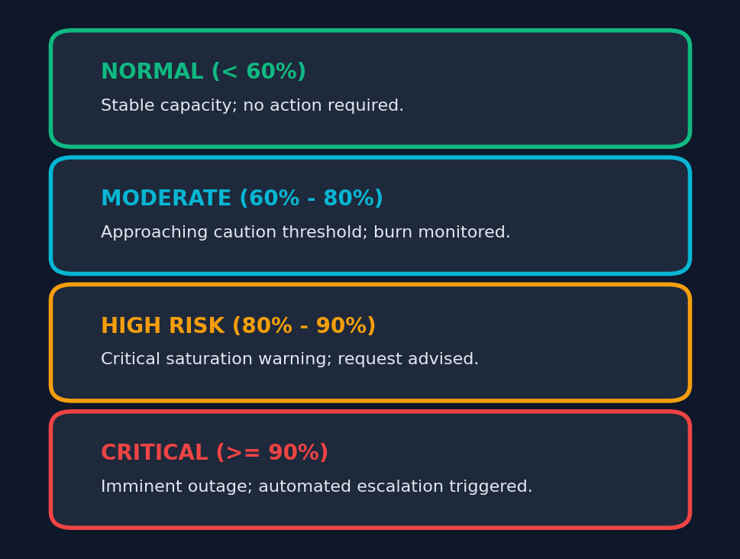
RISK INTELLIGENCE
Real-Time Saturation Detection & Classification
Proactive risk classification preventing unexpected quota starvation.
• Multi-Tier Risk Classification
Categorizes all quota metrics into 4 distinct risk tiers: Normal (<60%), Moderate (60-80%), High Risk (80-90%), Critical (>=90%).
• 80% Saturation Alert Boundary
Automatically triggers high-priority warning banners and suggests immediate increase planning upon reaching 80% capacity.
• Top Burn Rate Ranking
Calculates daily percentage burn rates to highlight the fastest-growing quotas in the executive dashboard.
• Multi-Threshold Table Filtering
Allows administrators to filter hundreds of metrics by threshold cutoffs (>60%, >80%, >90%) instantly.
Google Cloud Hackathon 2026 | Quota Management Control Plane • Slide 7 of 17 • Team: Y. Navaneeth Reddy, Shivam Kumar, Niket Kumar, Allam Sahithi

Slide 8
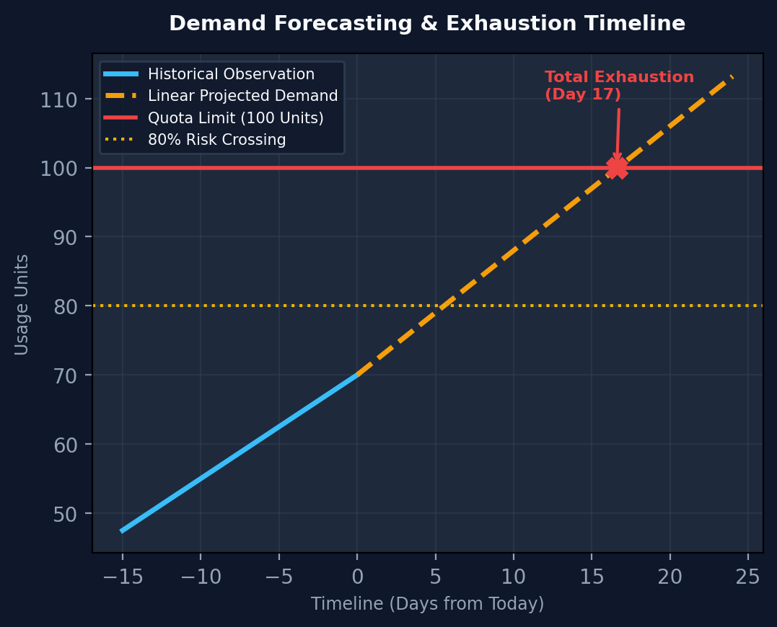
PREDICTIVE ANALYTICS
Linear Demand Forecasting & Exhaustion Timelines
Extrapolating consumption velocity into actionable calendar crossing dates.
• Velocity-Based Linear Model
Evaluates recent historical burn rates to project future demand over configurable horizons (30, 60, 90, 180 days).
• Days to 80% Threshold Breach
Calculates exact calendar days remaining until cautionary threshold is exceeded.
• Days to 100% Total Exhaustion
Pinpoints the exact predicted date when quota capacity will be completely depleted without intervention.
• Data Sufficiency & Uncertainty
Evaluates observation count and variance to flag uncertainty flags on nascent resources.
Google Cloud Hackathon 2026 | Quota Management Control Plane • Slide 8 of 17 • Team: Y. Navaneeth Reddy, Shivam Kumar, Niket Kumar, Allam Sahithi

Slide 9
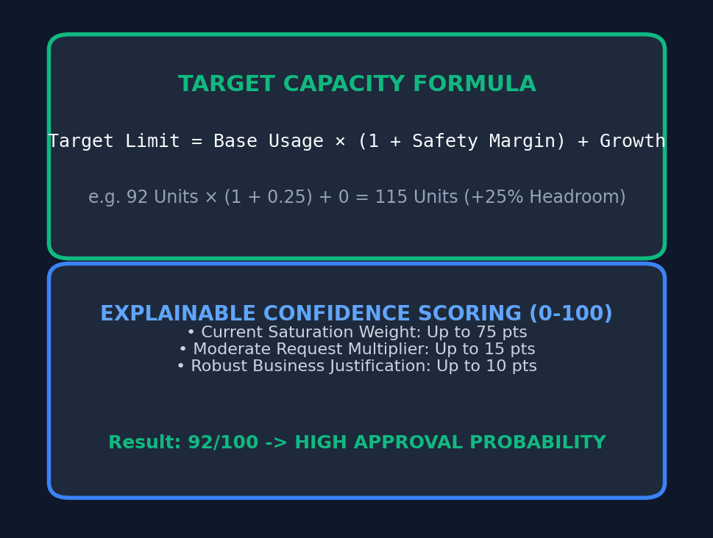
AI CAPACITY BUFFER
Algorithmic Headroom Sizing & Explainable Scoring
Calculating optimal target limits that balance operational safety with FinOps discipline.
• Safety Margin Sizing
Applies configurable safety buffers (+25%, +50%, +100%) on top of baseline demand to absorb traffic spikes.
• Headroom Calculation Formula
Target Limit = Base Demand × (1 + Safety Margin %) + Projected Workload Growth.
• Explainable Confidence Score (0-100)
Dynamic algorithmic score evaluating current saturation weight (75 pts), multiplier scale (15 pts), and justification depth (10 pts).
• Advisory Governance Disclaimer
Every recommendation includes transparent factor breakdowns and official GCP disclaimer notices.
Google Cloud Hackathon 2026 | Quota Management Control Plane • Slide 9 of 17 • Team: Y. Navaneeth Reddy, Shivam Kumar, Niket Kumar, Allam Sahithi

Slide 10
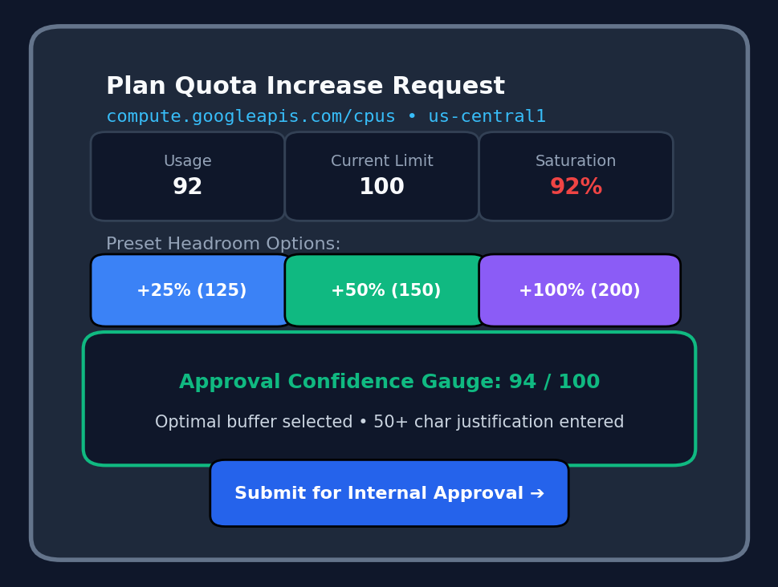
PLANNER INTERFACE
Interactive Quota Increase Planning Experience
Empowering engineers to formulate compliant, justified capacity adjustments.
• Contextual Telemetry Header
Displays current consumption, active ceiling, and saturation percentage for the selected quota metric.
• Live Confidence Gauge
Dynamic client-side score preview that recalculates instantly as target limits and justifications are edited.
• Preset Headroom Shortcuts
One-click buttons for rapid selection of recommended buffer increments (+25%, +50%, +100%).
• Strict Validation Enforcement
Validates that proposed limits strictly exceed current limits and enforces minimum 20-character business rationale.
Google Cloud Hackathon 2026 | Quota Management Control Plane • Slide 10 of 17 • Team: Y. Navaneeth Reddy, Shivam Kumar, Niket Kumar, Allam Sahithi

Slide 11
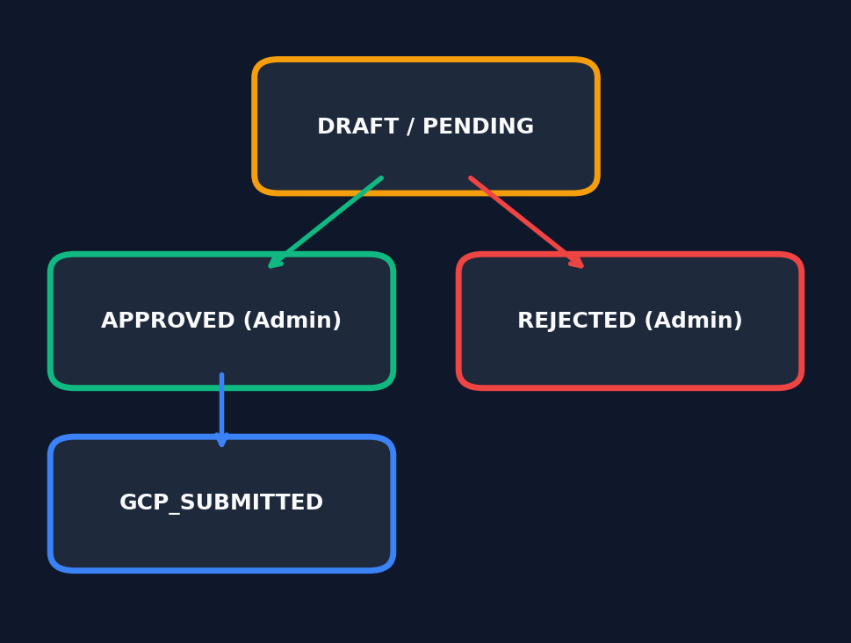
GOVERNANCE WORKFLOW
Auditable Request Lifecycle & State Machine
Rigorous internal review process separating request drafting from administrative approval.
• Strict State Transitions
Enforces formal transitions across lifecycle states: PENDING -> APPROVED | REJECTED -> GCP_SUBMITTED.
• RBAC Role Isolation
Developers can draft requests; only authorized Cloud Administrators can execute approval or rejection mutations.
• Mandatory Rejection Rationale
Admin rejection requires mandatory rationale, logged permanently in the governance audit trail.
• Central Approval Center
Unified dashboard view where administrators review pending requests, confidence scores, and business justifications.
Google Cloud Hackathon 2026 | Quota Management Control Plane • Slide 11 of 17 • Team: Y. Navaneeth Reddy, Shivam Kumar, Niket Kumar, Allam Sahithi

Slide 12
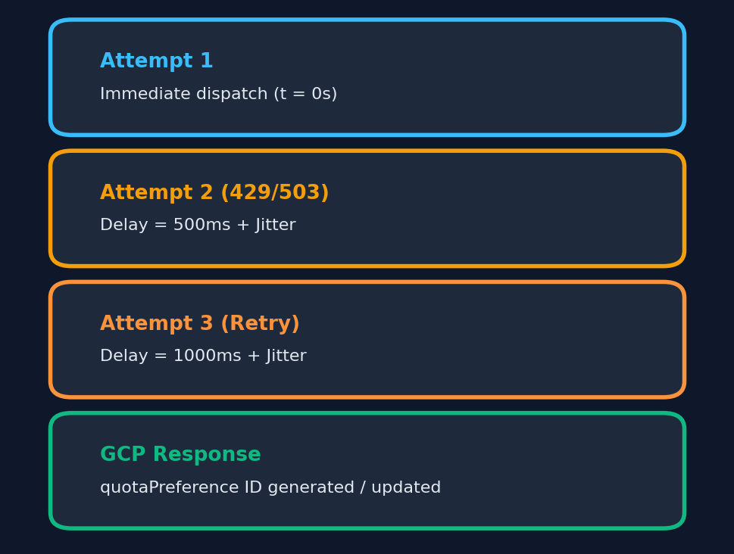
GCP CLOUD DISPATCH
Outbound Quota Preferences & Resilient Retry Engine
Direct programmatic integration with Google Cloud Quotas API.
• Google Cloud Quota Preferences API
Compiles approved adjustments into standard GCP quotaPreferences payloads with preferredValue and justification.
• Exponential Backoff with Full Jitter
Handles transient network timeouts and rate limits (429/503) using truncated exponential backoff (t = min(t_max, t_base × 2^attempt) + jitter).
• Application Default Credentials (ADC)
Authenticates securely via Google OAuth2 service account tokens without hardcoded credentials.
• Status Synchronization
Updates internal request state to GCP_SUBMITTED upon successful API dispatch, logging preference ID.
Google Cloud Hackathon 2026 | Quota Management Control Plane • Slide 12 of 17 • Team: Y. Navaneeth Reddy, Shivam Kumar, Niket Kumar, Allam Sahithi

Slide 13
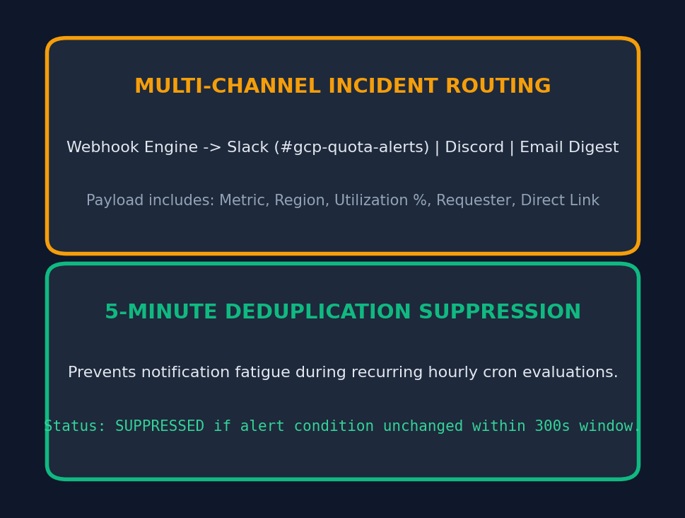
ALERT DISPATCHER
Multi-Channel Alerting & 5-Minute Deduplication
Broadcasting urgent capacity events without overwhelming engineering teams.
• Multi-Channel Webhook Routing
Dispatches rich incident notifications to Slack channels (#gcp-quota-alerts), Discord, and email digests.
• 5-Minute Deduplication Suppression
Intelligent suppression window prevents repetitive alert spam for unchanged saturation conditions during hourly cron evaluations.
• Live In-App Notification Ledger
Exposes GET /api/v1/notifications for real-time in-app alert viewing and audit logs.
• Configurable Alert Channels
Administrators can enable or disable email, webhook, and Slack channels dynamically in System Settings.
Google Cloud Hackathon 2026 | Quota Management Control Plane • Slide 13 of 17 • Team: Y. Navaneeth Reddy, Shivam Kumar, Niket Kumar, Allam Sahithi

Slide 14
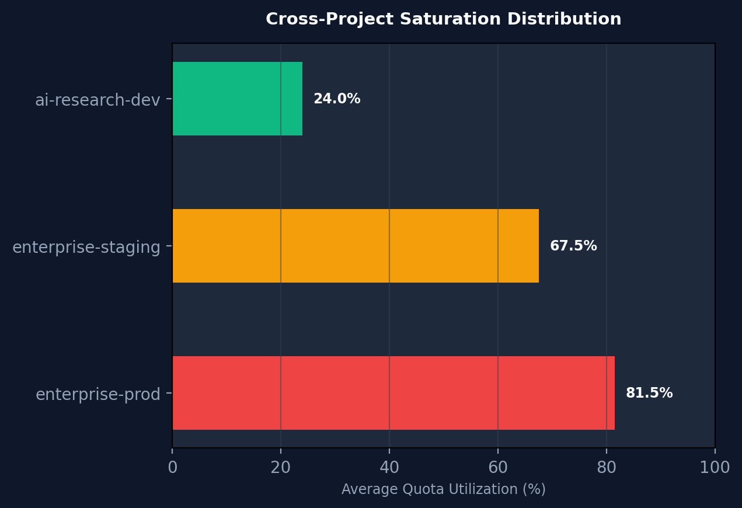
MULTI-TENANT CONTROL
Multi-Project Management & FinOps Governance
Unified governance across multiple Google Cloud projects and environments.
• Instant Project Switching
Sidebar dropdown allows seamless switching between enterprise-prod-finance, staging, and AI research projects.
• Cross-Project Saturation Summary
GET /api/v1/projects/summary/aggregate computes organization-wide saturation averages and total at-risk quotas.
• Environment Isolation
Clear separation between PRODUCTION, STAGING, and DEVELOPMENT environments with visual badges.
• FinOps Portfolio Visibility
Enables Cloud Architects to balance capacity allocations and spot idle headroom across different business units.
Google Cloud Hackathon 2026 | Quota Management Control Plane • Slide 14 of 17 • Team: Y. Navaneeth Reddy, Shivam Kumar, Niket Kumar, Allam Sahithi

Slide 15
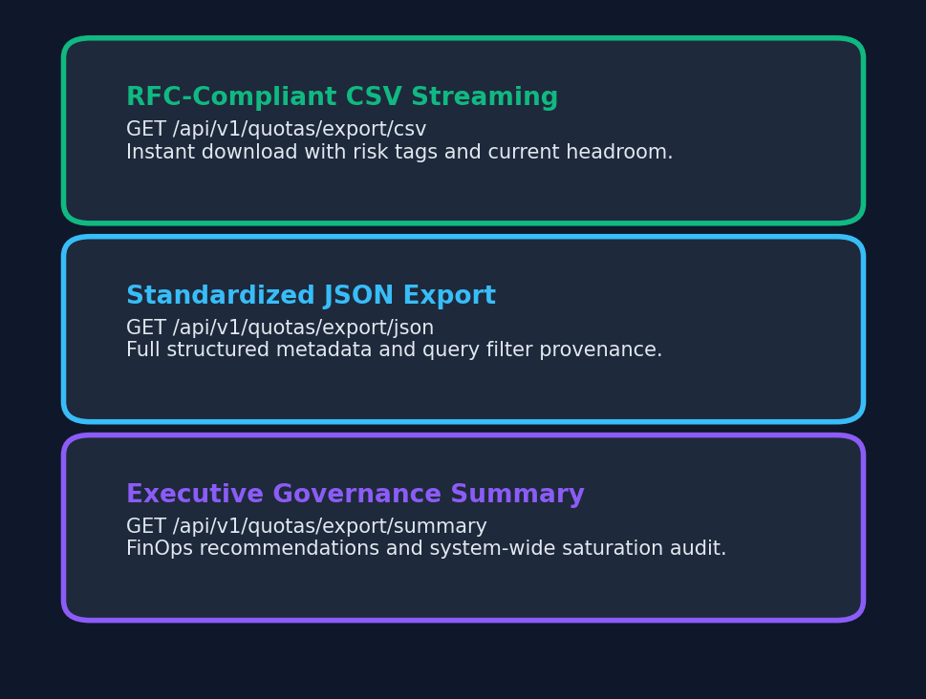
COMPLIANCE & AUDITING
Governance Reporting & Standardized Data Export
Delivering executive-ready compliance artifacts for architectural reviews.
• RFC-Compliant CSV Streaming
GET /api/v1/quotas/export/csv streams real-time telemetry tables directly into CSV files with attachment headers.
• Standardized JSON Export
GET /api/v1/quotas/export/json outputs structured payloads including query filter provenance and risk classifications.
• Executive Governance Summary
GET /api/v1/quotas/export/summary delivers aggregated FinOps summaries and actionable quota increase recommendations.
• Audit Download Tracking
Logs all export requests in an administrative audit trail to maintain data governance compliance.
Google Cloud Hackathon 2026 | Quota Management Control Plane • Slide 15 of 17 • Team: Y. Navaneeth Reddy, Shivam Kumar, Niket Kumar, Allam Sahithi

Slide 16
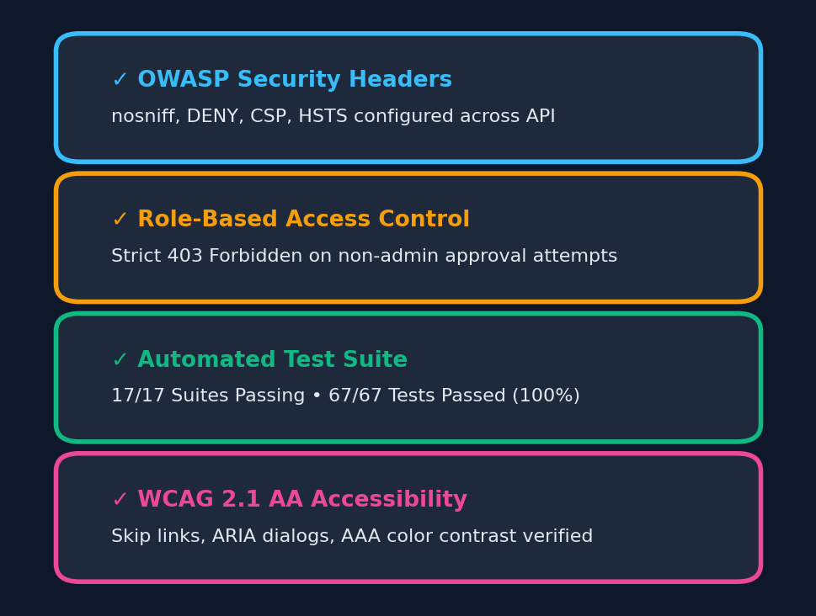
ENTERPRISE QUALITY
Security Hardening, Testing & WCAG 2.1 AA
Engineered to strict enterprise security standards and inclusive accessibility guidelines.
• OWASP Security Hardening
Protected by nosniff, DENY, CSP, and HSTS headers; sliding-window rate limiting (200 req/15min); 1MB payload caps.
• Automated Testing Suite (100% Pass)
17 test suites spanning 67 test cases validating math models, state machines, and security barriers with >73% coverage.
• WCAG 2.1 AA Accessibility
Semantic landmarks, accessible skip-to-content links, ARIA modal dialogs, and AAA contrast ratios (>13:1).
• 60-Second Response Caching
In-memory sliding TTL cache on quota endpoints returning X-Cache: HIT/MISS headers to optimize response times.
Google Cloud Hackathon 2026 | Quota Management Control Plane • Slide 16 of 17 • Team: Y. Navaneeth Reddy, Shivam Kumar, Niket Kumar, Allam Sahithi

Slide 17
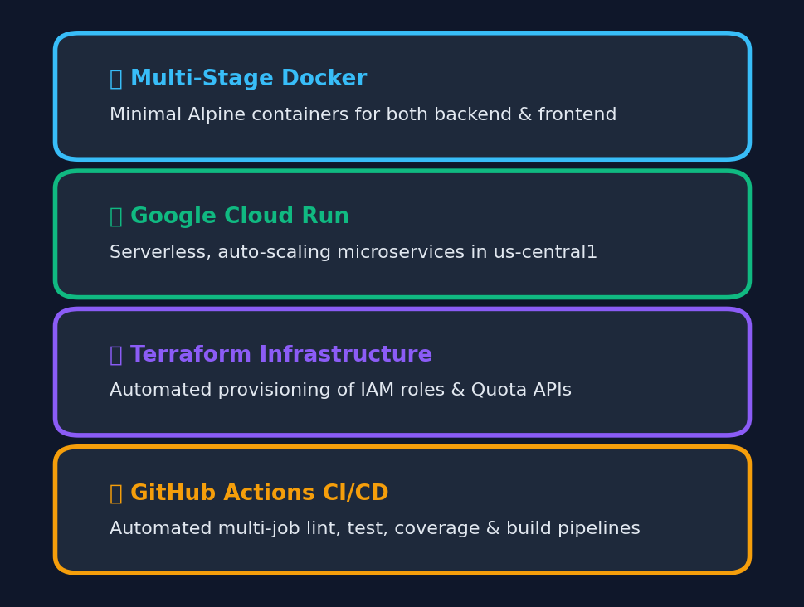
CLOUD DEPLOYMENT & SUMMARY
Production Ready & Verified
The Quota Management and Increase Request Planning Control Plane is fully built, tested, and running locally with live endpoints:
• Frontend Dashboard: http://localhost:3000
• Backend REST Gateway: http://localhost:5000/api/v1
• Health & Diagnostics: http://localhost:5000/api/v1/health/detailed
• Containerization: Multi-Stage Docker & docker-compose
• Cloud Deployment: Google Cloud Run & Cloud Build
• IaC Provisioning: Terraform (APIs, IAM, Service Accounts)
Thank You! Ready for Questions & Live Demonstration.
Google Cloud Hackathon 2026 | Quota Management Control Plane • Slide 17 of 17 • Team: Y. Navaneeth Reddy, Shivam Kumar, Niket Kumar, Allam Sahithi

