Slide 1
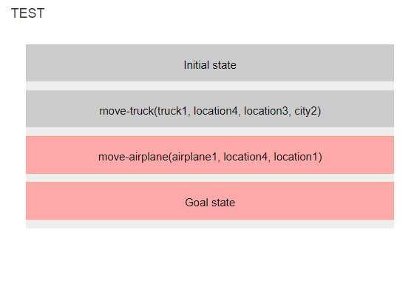
The test visualization helps you identify errors in your plan. Starting from the initial state, it shows you which actions were not executed and why.

Slide 2
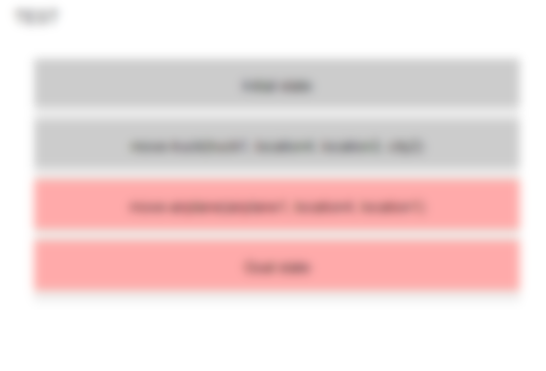
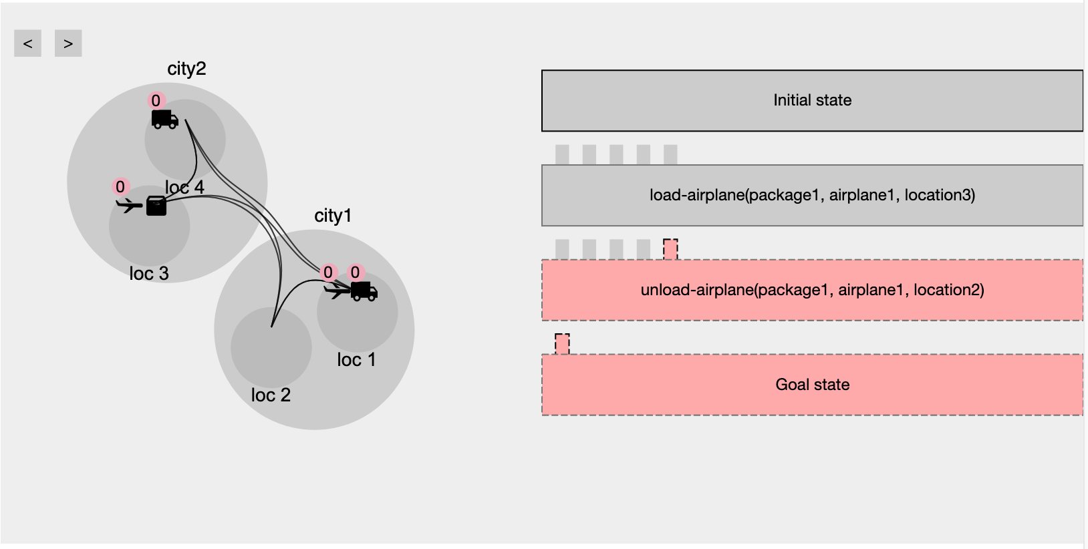
Correct actions will appear gray with no highlights.

Slide 3
Incorrect actions will be highlighted in red. These are not executed in the plan.

Slide 4
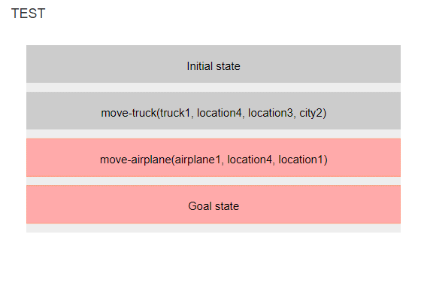
You must ensure each precondition is satisfied and all issues are resolved for an action to execute.

Slide 5
If the entire plan is gray and the goal is achieved, you can proceed to submit the plan.

