Slide 1
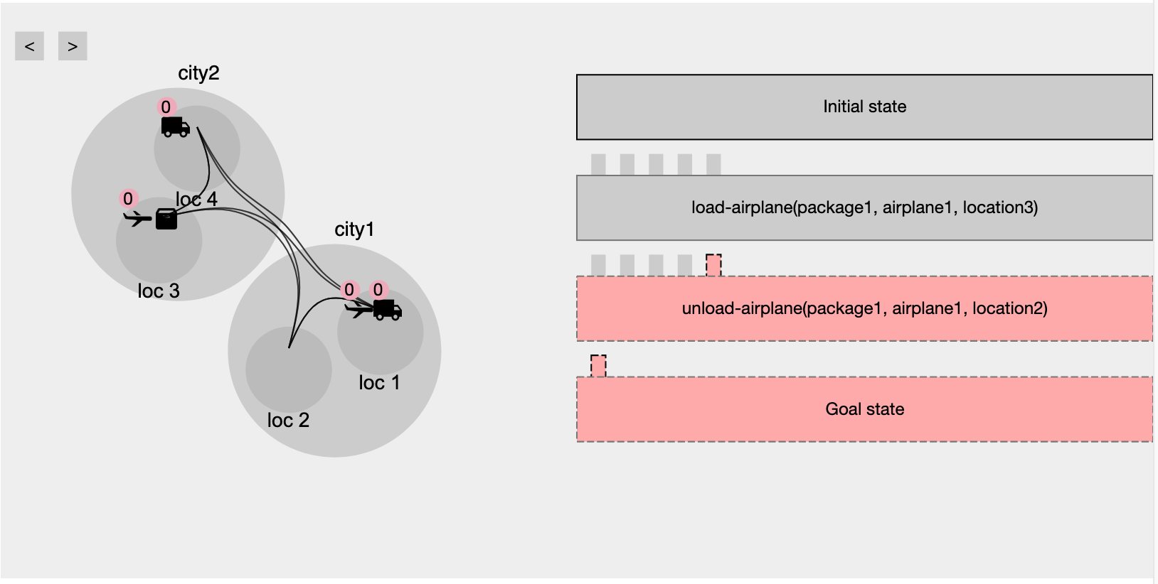
This visualization helps you identify errors in your plan. Starting from the initial state, it shows you which actions were not executed and why.

Slide 2
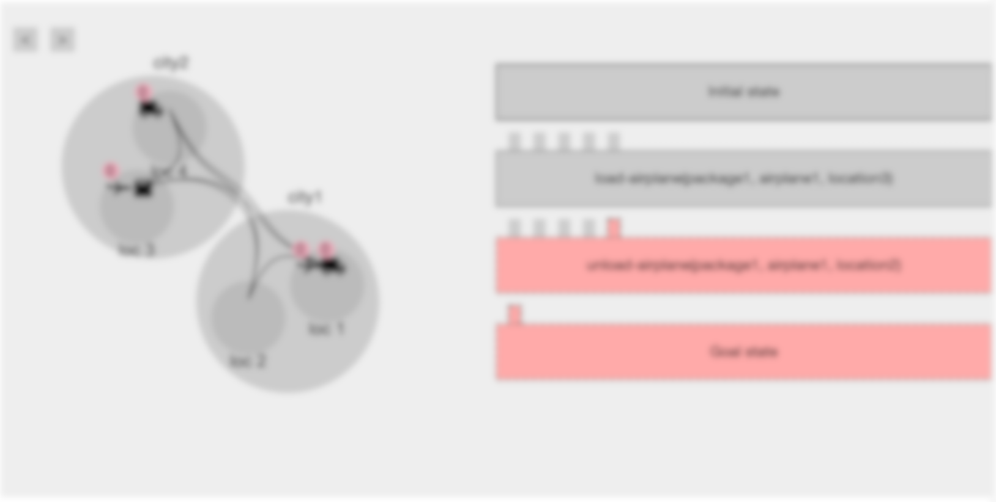
Correct actions will appear gray with no highlights.

Slide 3
Incorrect actions will be highlighted in red and have a dotted boundary. These are not executed in the plan.

Slide 4
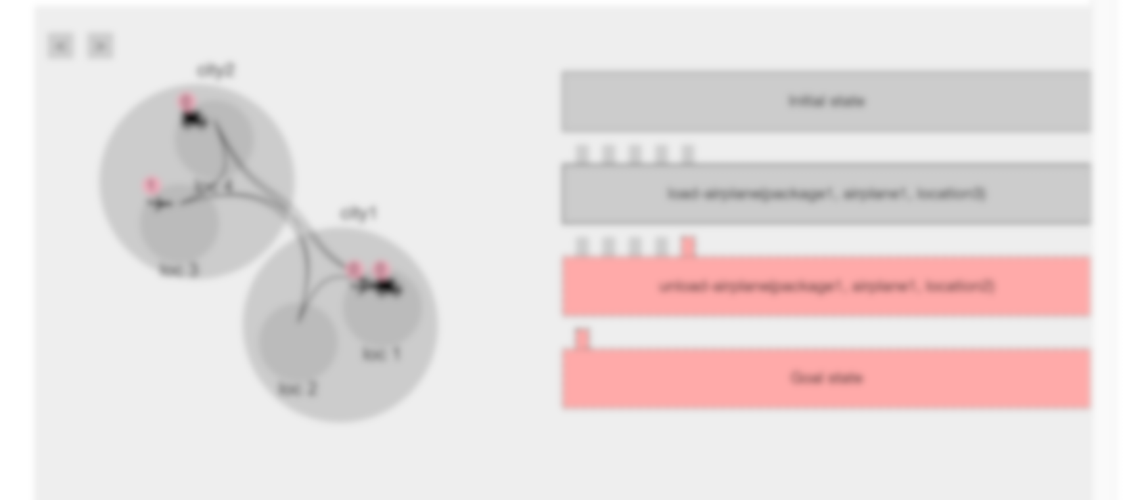
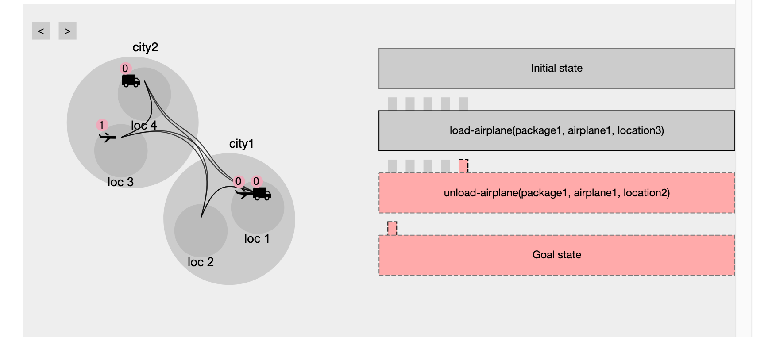
This image representation displays the current state of the world.

Slide 5
Clicking any action shows the state of the world after that action is performed.

Slide 6

You can also move forward and backwards using the arrows.

Slide 7
For each action, its required preconditions are shown as small rectangles above the action.

Slide 8
Gray rectangles are satisfied preconditions, while the ones highlighted in red are missing.

Slide 9
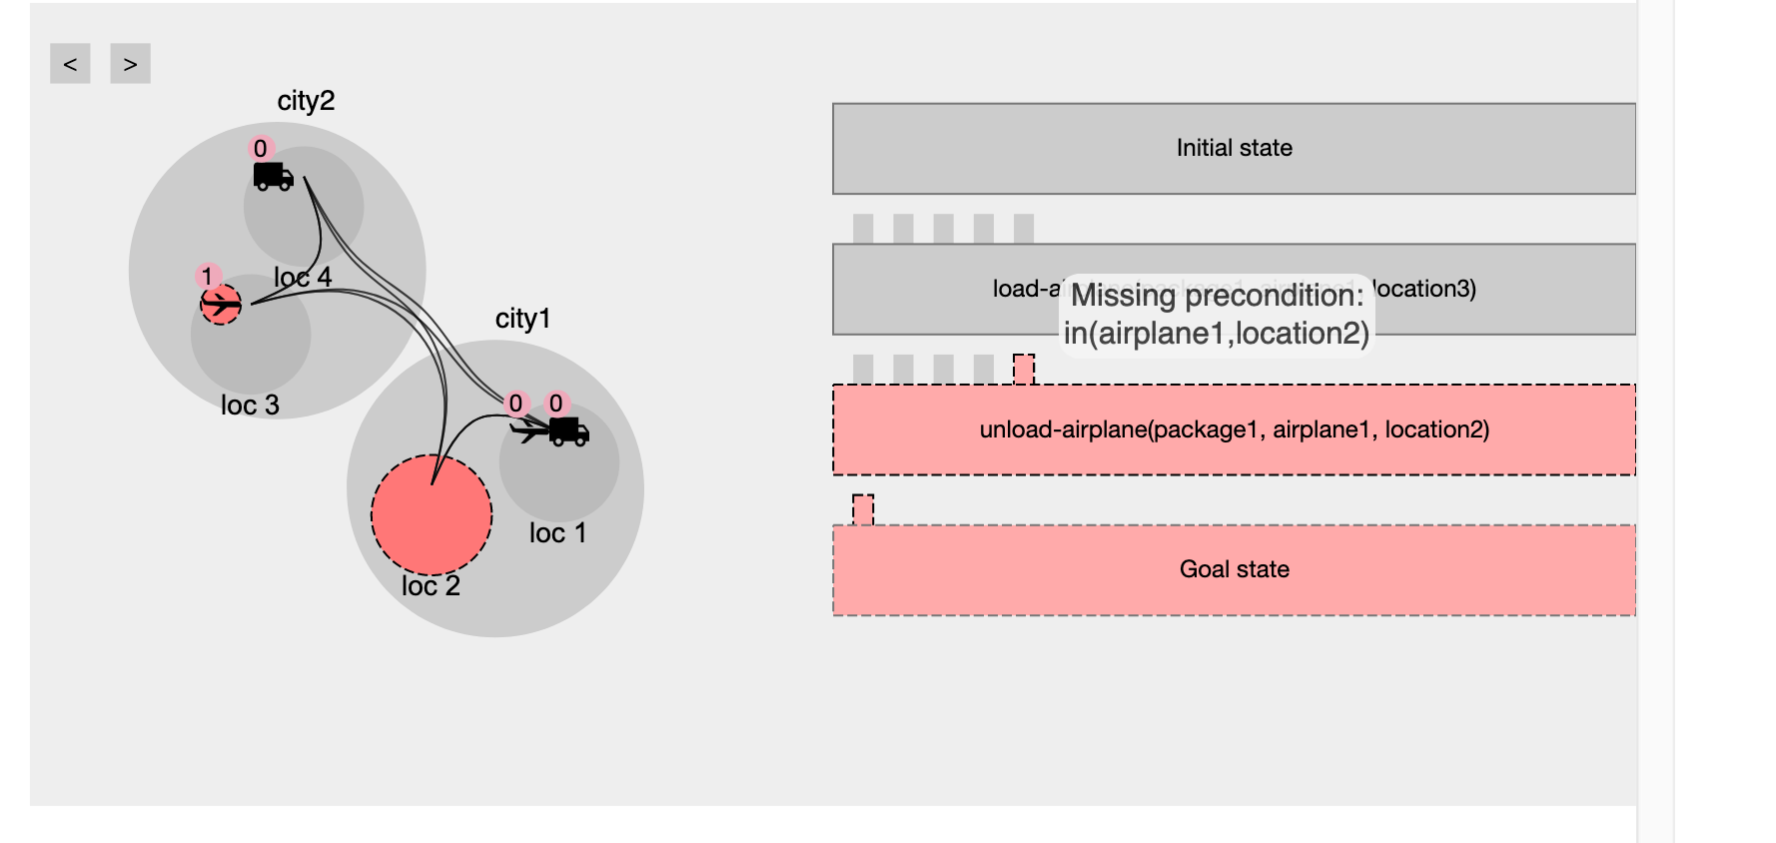
Any issues are highlighted in red, and hovering over them displays the predicate text.

Slide 10
You must ensure each precondition is satisfied and all issues are resolved for an action to execute.

Slide 11
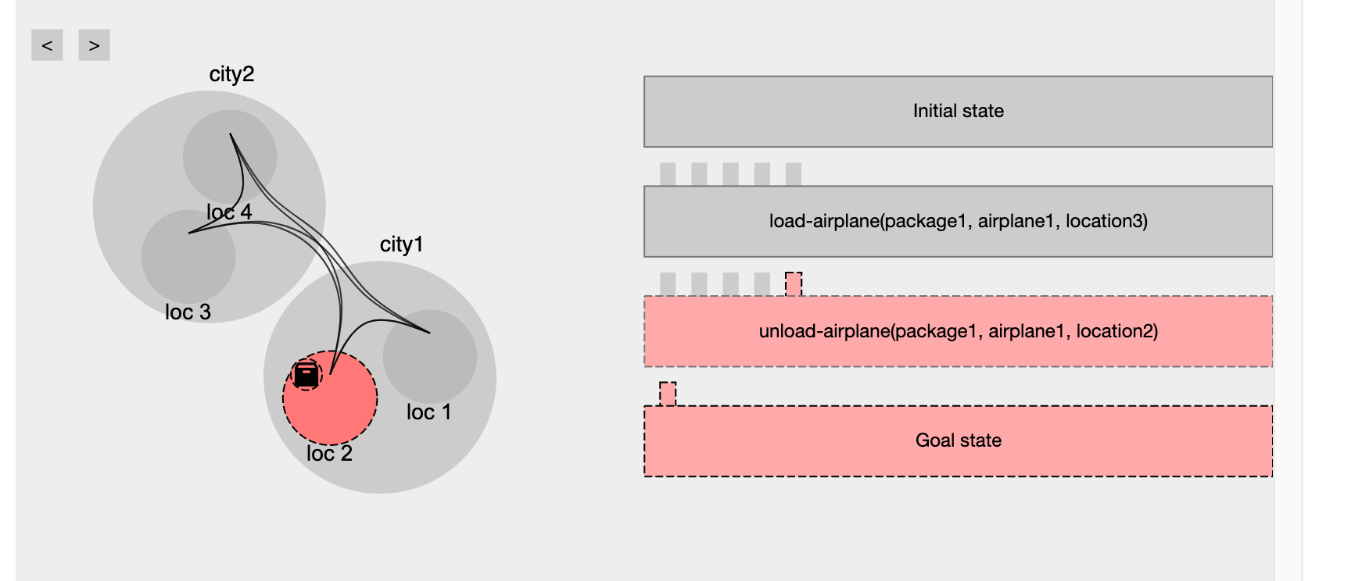
Clicking on the Goal step shows the desired goal state.

Slide 12
If the entire plan is gray and the goal is achieved, you can proceed to submit the plan.

