Slide 1

Team Name : Solo Submission (ApexRank)
Team Leader Name : Candidate ID: [Your Name]
Problem Statement : AI-Powered Candidate Ranking for Search/ML Engineer Role

Slide 2
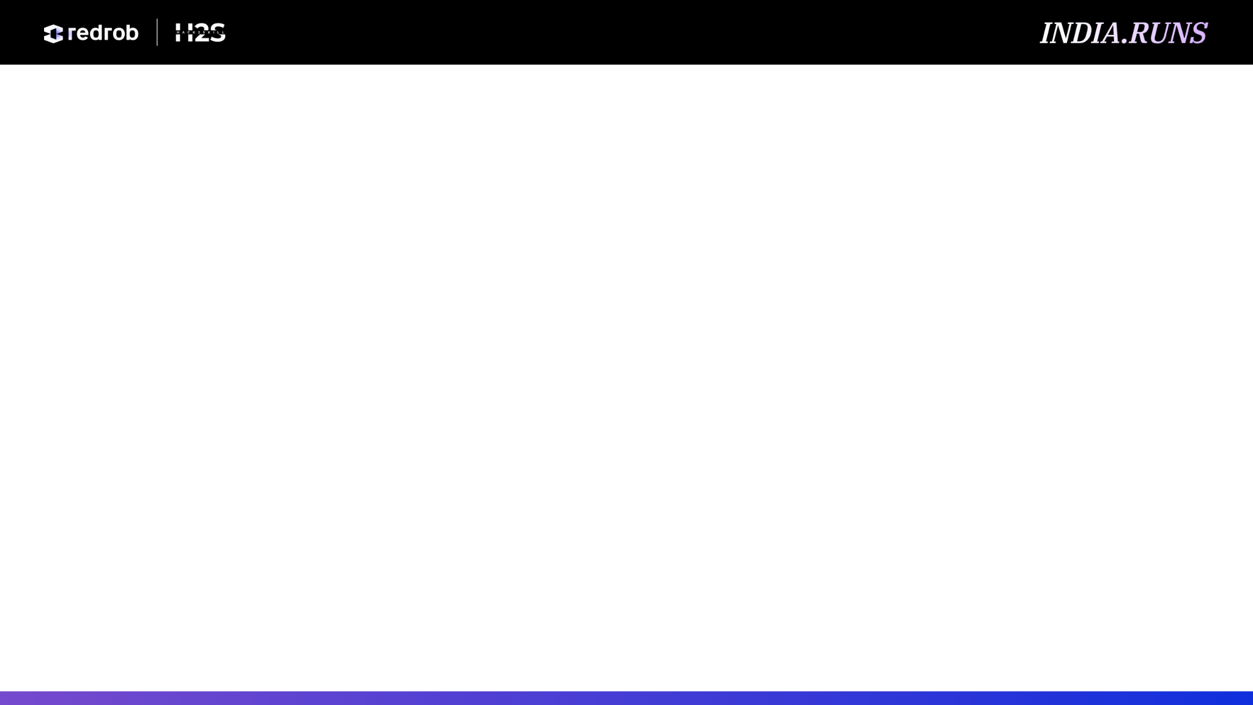
Solution Overview
⚙️ 1. Pipeline Architecture
• Stage 1 (DuckDB): Aggressive SQL streaming filters candidate pool from 100K to ~25K survivors based on location/role.
• Stage 2 (NumPy/Pandas): High-speed vectorized alignment and multi-signal scoring logic.
• Execution Speed: Process entire dataset in < 3 minutes on single CPU (Zero GPU requirement).
• Optimized Compute: Uses memory-mapped Parquet read buffers to stay under 4GB RAM.
📊 2. Merit-First Scoring
• Cosine Similarity: Semantic alignment across 12 distinct Job Description facets.
• Verified Assessments: Platform-certified technical skill scores scale baseline scores by [0.50, 1.20].
• Product Exp Multiplier: Tenure-weighted boost for product companies (+15%) vs services drag (-20%).
• Availability Multiplier: Notice period days mapped to a continuous suitability curve.
🛡️ 3. Anti-Gaming Defenses
• Honeypot Purging: Automatically discards fake resumes showing extreme experience gaps.
• Sentence Co-occurrence: Requires search & production keywords in same context window.
• Metric Verification: Verifies production claims against presence of digits or metrics.
• Recruiter Action Gate: Spam clickbaits with high views but 0 saves are demoted to Tier 4.

Slide 3
JD Understanding & Candidate Evaluation
Facet Type | Extracted JD Requirements
Core (70% Weight) | Retrieval Systems, Vector DB Search, Python ML Engineering, Ranking & Evaluation
Bonus (20% Weight) | LLM Fine-tuning, Learning-to-Rank, recruiting/marketplace domains, Distributed systems, Open-source ML
Penalty (-30% Weight) | Tutorial-only framework lists, Computer Vision/Speech/Robotics focus, Closed-source-only tools
🎯 Candidate Signal Evaluation
• Verified Assessments: Platform-certified technical skill scores (0-100) scale the baseline score. Core skills (RAG, Python) weight 1.0; ML frameworks weight 0.5.
• Continuous Notice Curve: Soft penalty scaling from 1.0 (<=30d notice) down to 0.80 (>=120d notice) to preserve engineering merit.
• Product Exp Multiplier: Product vs. consulting tenure ratio rewards SaaS/E-commerce/AI start-up experience up to +15% and drags services-only up to -20%.
• Anti-Gaming Keywords: Scans career histories using sentence-level syntax, requiring digits/metrics, and verifying against skill assessment scores.

Slide 4
Ranking Methodology
Mathematical Scoring Engine Formulas
base_fit = 0.7 * (core_score * skill_mult) + 0.2 * bonus_score - 0.3 * penalty_score + 0.05 * college_tier + 0.05 * cgpa_norm
final_score = base_fit * sqrt(availability_multiplier) * conversion_drag + location_boost
📐 1. Vector Alignment
• Geometric Mean: Applied over 4 core facets to avoid single-competency rescue.
• Clipped Core: Forces a 1e-5 floor on core facet values to prevent zero-product drops.
📈 2. Score Multipliers
• Verified Skills: Weights Core (1.0), Frameworks (0.5), and irrelevant (0.0). Scales base by [0.50, 1.20].
• Product Company: Tenure-weighted boost up to +15% and drag down to -20%.
📍 3. Gating & Location
• Notice Curve: Piecewise linear curve: 1.0 (<=30d) down to 0.80 floor (>=120d).
• Location Boost: Pune/Noida +0.015, Tier-1 +0.005. Post-merit additive boost preserves merit.

Slide 5
Explainability & Data Validation
📝 Factual Explainability Engine
• Reasoning Generation: Outputs plain-language recruiter summaries within 80-160 characters.
• Strict Length Budget: Forced compliance checks on the reasoning length to fit ATS limits.
• Deterministic Rules: Generates descriptions from real profile facts (years of experience, matching skill facet, location).
• Zero Hallucination: Eliminates generative LLM errors; utilizes structured data tables for all terminology.
• Example Output: "Excellent Search Engineer at Sarvam AI: 7.6y delivering embeddings retrieval, Gurgaon; clear top match for this search role."
🔒 Security & Data Integrity Defenses
• Honeypot Purging: Removes candidates with >12-month experience gaps or false 'expert' skills duration (<12 months).
• Sentence Co-occurrence: Requires search (e.g. RAG, vector search) & production (e.g. deploy, scale) keywords to co-occur in the same sentence.
• Metric Verification: Validates engineering claims by requiring metrics (%, million, QPS) or numbers in the sentence.
• Anti-Stuffing Guard: Caps technology keywords count to 8 max. Disqualifies if assessment scores are low/failed.

Slide 6
End-to-End Workflow
1. Embeddings
MiniLM-L6-v2 encodes profiles & 12 JD facets.
2. Pre-Filtering
DuckDB SQL filters location & non-tech roles.
3. Honeypots
Purges fake resumes using experience anomalies.
4. Alignment
Vector alignment via Log-Clipped Geo Mean.
5. Gating
Notice period & responsiveness gates.
6. Multipliers
Product company & verified skill weights.
7. Tiering
Lexicographical sorting across 4 capability tiers.
8. Export
Factual reasoning syntheses & CSV export.

Slide 7
System Architecture
🔍 STAGE 1: Pre-Filtering (rank.py)
• Input: candidates.jsonl (100,000 candidate profiles)
• Engine: DuckDB in-memory SQL reader
• Filters: Relocation Funnel ∪ Role/Title Exclusions ∪ Consulting-only rules
• Output: survivors.csv (reduces candidate dataset to ~25K)
⚙️ STAGE 2: Multi-Signal Scoring (score_and_rank.py)
• Engine: Vectorized NumPy similarity calculations & Pandas math
• Signals: Geometric core similarities, verified skill multipliers, notice curves
• Security: Honeypot detection & anti-gaming description checking
• Output: submission.csv (Final ranked Top-100 candidates with reasoning)
🧩 Modular Scoring Components
🎯 Semantic Match
12 cosine similarities across core/bonus/penalty JD facets.
✅ Verified Skills
31 skill assessments scale fit by [0.50, 1.20].
⏳ Notice Period
Piecewise linear curve: 1.0 (<=30d) down to 0.80 floor.
🏢 Product Exp
Tenure-weighted SaaS/start-up ratio (+15% / -20%).
📍 Location Boost
Noida/Pune +0.015 boost preserves merit sort.

Slide 8
Results & Performance
Rank | Candidate ID | Score | Current Title | Company
1 | CAND_0041669 | 1.000000 | Recommendation Systems Lead | CRED
2 | CAND_0064326 | 0.723492 | Search Engineer | Sarvam AI
3 | CAND_0006418 | 0.716009 | Machine Learning Engineer | Verloop.io
4 | CAND_0054394 | 0.692698 | Recommendation Systems Lead | PharmEasy
5 | CAND_0096142 | 0.685928 | Applied ML Engineer | upGrad
⚡ Performance & Quality Validation
• Runtime Constraints: Stage 1 pre-filtering runs in ~45 seconds. Stage 2 scoring runs in ~90 seconds. Total runtime ~135 seconds (constraint: <5 min).
• Memory Footprint: Peak RAM usage stays under 4 GB on single core CPU (constraint: <16 GB).
• Score Monotonicity: Strict verification of score decay checks. Exactly 100 rows outputted.
• Top 100 Quality: 0% honeypot rate. Cleaned from keyword-stuffing and experience-inflation profiles.
• Product Heavy: All Top-5 matches verified as SaaS, FinTech, or AI-start-up engineers.

Slide 9
Technologies Used
🐍 Python 3.11
• Core pipeline scripting language with standard numerical and data library support.
🦆 DuckDB
• In-memory database engine for fast SQL streaming and parsing nested JSONL columns.
🔢 NumPy
• Vectorized matrix operations for high-speed cosine similarity score calculations.
🤗 sentence-transformers
• Encodes profiles offline with all-MiniLM-L6-v2 model (80MB, fast CPU runtime).
🐼 Pandas
• DataFrame aggregation and structural candidate data merging operations.
📦 Apache Parquet
• Columnar parquet files provide rapid partial read access to candidate embeddings.

Slide 10
Submission Assets
💻 GitHub Repository
• GitHub Repository: Includes full project codebase and deployment instructions.
• Link: https://github.com/[your-github-repo]
📂 Submitted Package File Structure
• rank.py: Stage 1 Pre-Filtering script executing role/location SQL logic.
• score_and_rank.py: Stage 2 Scoring script executing vectorized mathematical scoring formulas.
• submission.csv: The final output CSV containing the Top 100 ranked candidates.
• precompute_embeddings.py: Offline script generating candidate profile text embeddings.
• submission_metadata.yaml: YAML configuration file detailing model metadata and runtimes.

Slide 11


