Slide 1
KernelDeck
Out-of-Band Physical Control Plane & Hardware Safety Interlock for Autonomous AI Development Agents
Track 2: Agentic AI | Problem 3: Simulated Consequences Before Real Action
Team: KernelDeck
Sanchit Gupta (25BCE0282) — Proxy & Security Architecture
Prisha Tyagi (25BCE0297) — Firmware & Hardware Interlock
Pushpanvitha P (25BCB0081) — Agent CLI & Execution Boundary
Divyadarshini Lakshminarayanan (25BCB0120) — Dashboard & Telemetry Stream
M Sarvesh (25BEC0140) — Integration, Benchmarks & Safety Validation

Slide 2
Problem Statement & Objectives
Context: Autonomous AI coding agents (Claude Code, Cursor, Devin) now independently execute terminal commands, modify codebases, and interact with cloud resources.
The Critical Problem — No Consequence Boundary: High-stakes operations (e.g. 'rm -rf ./database', destructive database drops, runaway API token loops) execute without physical blast-radius evaluation. Software agents lack physical consequence perception.
  The 'Key Under the Doormat' Vulnerability: Storing production credentials in local .env files exposes high-privilege keys. A compromised agent subshell or prompt injection can leak secrets and act unsupervised.
  Software Dashboards & Modals Fail: On-screen IDE popups and modal confirmation dialogs get buried under active windows, can be auto-dismissed by scripts, or bypassed within the same user permission context.
Project Objectives:
  1. Out-of-Band Physical Authority: Enforce a mandatory physical tactile button press (ALLOW/KILL) on an external microcontroller before privileged commands can execute.
  2. Zero-Trust Credential Isolation: Relocate API keys into a secure proxy vault; developer machines only hold non-privileged dummy tokens.
  3. Strict Fail-Closed Security: Guarantee 100% hardware isolation (GPIO 27 relay isolated at 0V) whenever hardware disconnects or times out.

Slide 3
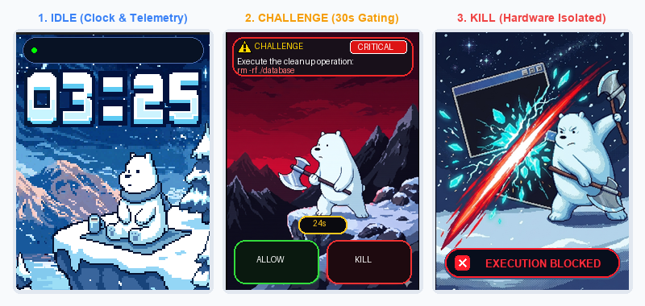
Proposed Solution & Key Innovation
The KernelDeck Solution: A dual-layer security control plane combining an intelligent, transparent API proxy with a dedicated desktop hardware console (ESP32 + 2.8" SPI TFT + physical buttons).
Key Architectural Innovations:
  • Out-of-Band Physical Isolation: "You cannot code-review your way out of a locked door." The safety boundary is enforced in hardware silicon and physical copper (GPIO 27 relay), unreachable by compromised host software.
  • Transparent In-Flight Request Freezing: The proxy pauses the agent's HTTP connection mid-flight upon detecting a risky pattern. Safe read operations pass at wire speed (<50 ms); destructive operations halt until human resolution.
  • Physical Tactical Authority: Developers inspect exact command parameters, risk level (CRITICAL), and cost on the deck, then physically press ALLOW (GPIO 12) or KILL (GPIO 14).
  • Glanceable Pixel-Art Human State Engine: Retro 16-bit Ice Bear states (Idle Clock, 30s Countdown, Post-Kill Cleave) provide intuitive, zero-cognitive-overhead status awareness.

Slide 4
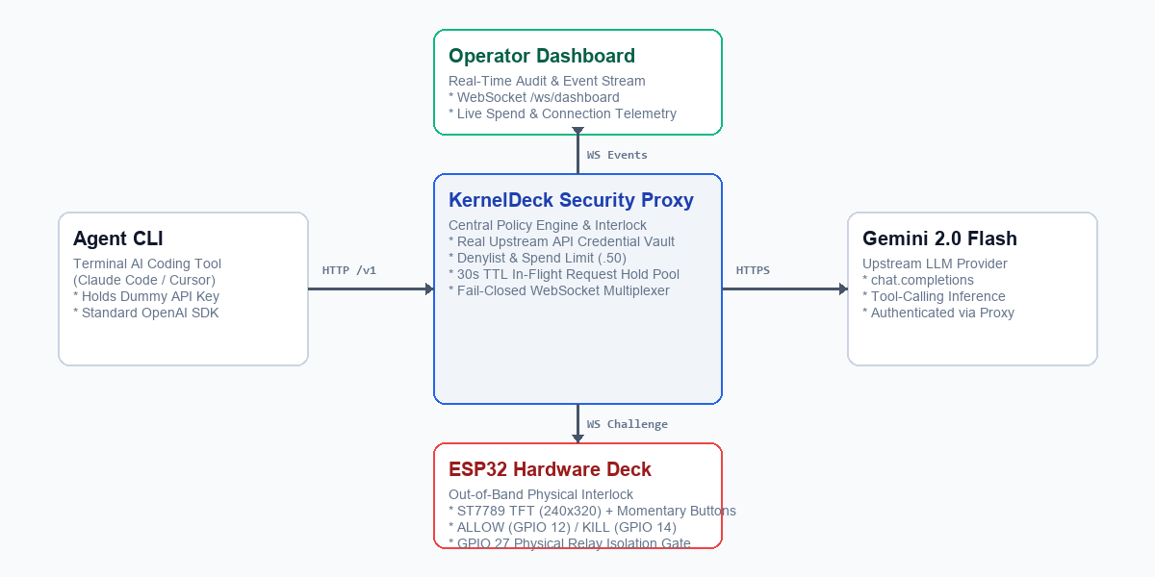
System Architecture & Workflow
Four-Tier Distributed Architecture:
  1. Agent CLI (Python 3.11): Autonomous terminal development tool communicating with local proxy endpoint; catches structured hardware error envelopes.
  2. Security Proxy (Node.js): Ingress vault managing policy denylists, $2.50 spend ceiling, 30s in-memory hold pool, and WebSocket multiplexer.
  3. ESP32 Hardware Deck (Firmware): ESP32 microcontroller (240MHz) with 240x320 ST7789 TFT, physical buttons, and hardware interlock gate pin (GPIO 27).
  4. Operator Dashboard (Web): Real-time audit interface streaming live WebSocket telemetry, hardware health, and historical decision traces.
Execution Lifecycle & Failure Semantics:
  • Safe Calls: Transparent passthrough to Gemini 2.0 Flash in <50 ms.
  • Policy Violation: Paused mid-flight; CHALLENGE emitted to hardware over /ws/deck.
  • ALLOW vs KILL: ALLOW forwards upstream (GPIO 27 HIGH); KILL terminates with HTTP 403 HARDWARE_DENIED (GPIO 27 LOW).
  • Fail-Closed Timeout: 30s countdown expiry auto-aborts with HTTP 408 HARDWARE_TIMEOUT.

Slide 5
Technology Stack & Implementation
Edge Hardware & Firmware Subsystem (ESP32):
  • Target SoC: Espressif ESP32-D0WD-V3 (Dual-Core 240MHz, 320 KB SRAM, 4 MB Flash, Arduino Framework, PlatformIO).
  • Display Engine: TPM408-2.8 240x320 SPI TFT (ST7789 driver) @ 40MHz SPI bus with scanline line-buffered DMA bursts (drawRGBBitmap <1.5 ms per digit slot).
  • Memory Footprint: RAM: 14.4% (47,124 / 327,680 bytes) | Flash: 75.6% (1,486,429 / 1,966,080 bytes on min_spiffs.csv). Over 470 KB headroom.
  • Output Interlock Gate: GPIO 27 active-high hardware relay/gate; automatically isolates (0V) whenever deck disconnects or times out.
  • Non-Blocking Clock & Particles: SNTP time synchronization (IST UTC+5:30) with differential digit rendering (220x72 px) and 18-flake collision-aware snow.
Host & Cloud Software Stack:
  • Security Proxy: Node.js v20, Express, ws WebSocket multiplexer, high-resolution timer hold pool, regex/AST command tokenizer.
  • Agent CLI Terminal: Python 3.11, Rich interactive UI formatting, OpenAI SDK client wrapper, tool schema execution boundary.
  • Operator Dashboard: HTML5/CSS3/ES6 JavaScript, real-time WebSocket telemetry listener, audit event ledger.
  • Upstream AI Model: Google Gemini 2.0 Flash via OpenAI-compatible chat.completions endpoint.

Slide 6

Key Features & Functionalities
1. Zero-Exposure Credential Security: API keys remain locked in the proxy vault. Host laptops hold only dummy tokens; compromised local processes cannot leak upstream secrets.
2. Real-Time Policy Interception (<50ms): Evaluates agent tool-call payloads against destructive command denylists (rm -rf, DROP TABLE, mkfs, unauthorized chmod) in <1 ms.
3. Physical Emergency Stop (KILL): Hardware tactile button triggers immediate HTTP 403 rejection, physically locks the GPIO 27 gate pin to 0V, and prevents accidental damage.
4. Financial Velocity Braking: Tracks cumulative dollar spend against hard ceilings ($2.50). Trips an automatic freeze if agent token burn velocity spikes unexpectedly.
5. Glanceable Pixel-Art Human State Engine: 16-bit retro artwork renders distinct operational states: Idle (2x digital clock & snow), Challenge (Ice Bear battle stance & 30s countdown), and Kill (Axe Cleave with red 'EXECUTION BLOCKED' pill).
6. Tamper-Evident Audit Logging: Every interception, operator decision, timestamp, and raw payload is broadcast over WebSocket and archived for security review.

Slide 7
Live Demo / Working Prototype
Live Hardware Demonstration Setup:
  • Bench Configuration: Physical ESP32 Hardware Deck (COM7 / Wi-Fi) + Local Agent CLI Terminal + Real-Time Operator Dashboard.
Demonstration Scenarios Executed On-Stage:
  1. Benign Operations (Transparent Passthrough): Agent reads project files and makes harmless code edits. Operations execute at wire speed with zero interruption.
  2. High-Stakes Interception ('rm -rf ./database'): Agent attempts destructive filesystem command. Request instantly freezes mid-flight; physical ESP32 deck lights up with red alert and 30s countdown.
  3. Operator Physical KILL Decision: Operator presses the physical KILL button (GPIO 14). Terminal aborts with HTTP 403; hardware deck displays pixel-art 'EXECUTION BLOCKED'; GPIO 27 gate isolated.
  4. Fail-Closed Proof: Disconnecting the hardware causes any subsequent risky actions to fail immediately (HTTP 503 HARDWARE_OFFLINE).

Slide 8
Future Scope
1. Hardware Cryptographic Decision Signing (HMAC-SHA256): Integrate an ATECC608A secure element onto the deck to cryptographically sign every ALLOW/KILL decision with on-chip hardware private keys, preventing bus-level spoofing.
2. Stepped Rotary Encoder for Deep Payload Inspection: Add a rotary dial allowing developers to scroll through multi-line diffs, code patches, and SQL migrations directly on the 2.8" display before authorizing.
3. Enterprise Multi-Signature Hardware Mesh: Deploy multi-deck consensus policies where high-blast-radius actions (production database migrations, AWS infrastructure teardowns) require physical dual-key confirmation.
4. On-Device TinyML Consequence Predictor: Deploy quantized Edge AI models directly onto the ESP32-S3 (TensorFlow Lite for Microcontrollers) to evaluate blast-radius and anomaly scores on-device completely offline.
5. Native IDE & Agent Ecosystem Integrations: Provide drop-in plugins for Cursor, Claude Code, Windsurf, and VS Code, routing all background agent actions through the physical deck.

Slide 9
Conclusion
Closing the Autonomous Agent Safety Gap:
  • The Human Remains in Physical Authority: KernelDeck proves that software agents can operate at high velocity without relinquishing developer control. By decoupling the security gate into dedicated hardware, safety is guaranteed in silicon.
  • Out-of-Band Security is Non-Negotiable: "You cannot code-review your way out of a locked door." Effective oversight cannot share the same memory, processes, or operating system as the agent being supervised.
  • Frictionless Developer Experience: Safe requests pass transparently at wire speed (<50 ms); physical attention is demanded only when predetermined risk thresholds are violated.
Summary of Achievements:
  • Fully Operational Production Prototype: Integrated ESP32 firmware, Node.js proxy, Python Agent CLI, and live Web Dashboard fully tested and verified.
  • Rigorous Safety Integrity: Tested and proven against real destructive filesystem commands with 100% fail-closed reliability.
KernelDeck: Making Autonomous AI Development Safer By Design.

Slide 10
Technical Evidence & Track Alignment (Rubric Compliance)
Track | Required technical evidence
Agentic AI (Primary Track) Required: Agent workflow, tools & integrations, task execution, and failure handling. | • Workflow: Full OpenAI-compatible chat.completions tool-calling loop; requests held mid-flight. • Tools & Integrations: Shell command executor, filesystem boundary, proxy middleware, WebSocket multiplexer. • Task Execution: Preview-before-commit gating with 30s TTL hold pool and real-time dashboard audit trail. • Failure Handling: Strict fail-closed semantics (HARDWARE_DENIED 403, HARDWARE_OFFLINE 503, HARDWARE_TIMEOUT 408).
Edge AI (Hardware Interlock) Required: Target device, on-device latency, memory/resource usage, and offline capability. | • Target Device: Espressif ESP32 Dev Module (240MHz Xtensa LX6, TPM408-2.8 ST7789 TFT display). • Latency: <1.5 ms display scanline DMA burst, 35ms button debounce, <50 ms WebSocket round-trip. • Resource Usage: RAM: 14.4% (47 KB / 328 KB) | Flash: 75.6% (1.48 MB / 1.96 MB on min_spiffs.csv). • Offline Capability: Physical relay gate (GPIO 27) maintains 0V fail-closed isolation whenever disconnected.
AI Safety & Governance Required: Consequence simulation, spend controls, and auditable human oversight. | • Consequence Preview: Dangerous commands previewed on out-of-band screen before execution. • Spend Velocity Braking: Hard token cost ceiling ($2.50) automatically halts runaway agent loops. • Audit Trail: WebSocket event ledger records all tool calls, timestamps, and physical decisions.
Physical Security Enclave Required: Out-of-band authority and zero-trust credential isolation. | • Credential Vault: Real API keys locked in proxy vault; zero exposure to compromised local .env files. • Hardware Isolation: Interlock enforced in silicon; impossible for malware to fake physical button press.

