Slide 1

DATABASE
Army Institute of Technology
c
Made By
SAURABH SINGH

Slide 2
“OPTIMISATION OF DATABASE FOR DISTRIBUTED COMPUTING IN ANALYTICS ”
TOPIC

Slide 3
1
2
3
NEED OF NOSQL
DATABASE
APPROACH & FEATURES OF SELECTED DATABASE
PROTOTYPE (BASIC WEBAPP VIEW OF SELECTED DATABASE)
In the box!

Slide 4
NEED OF NoSQL DATABASE !!!

Slide 5
“ NOSQL is not about performance , scaling , dropping ACID or hating SQL –
Its about choice . Our aim of choosing
Database is to provide a much more convenient system for a broader range
Of use-cases which is fast enough for all cases ”
Jan Lenhardt
(CouchDB)

Slide 6
NoSQL EVOLUTION
1. WORKING ON RDBMS FOR VERY LONG TIME .
2. CLOUD EVOLUTION
3. BIGDATA STORAGE AND ANALYSIS .
4. REPLICATION : DATA CENTRES IN VARIOUS COUNTRIES .
5. GLOBALLY DISTRIBUTED SYSTEM .
SO , WE NEED FOR MORE SPECIALISED DATABASE .

Slide 7

Proposed System
Solution

Slide 8
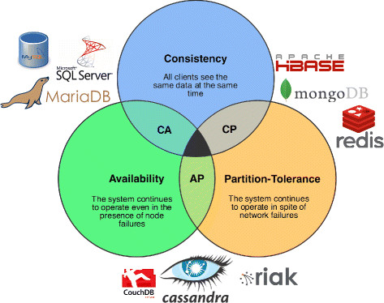
CAP THEOREM
Its is impossible for a distributed computing system
to simultaneously provide all the three of the following gurantees .
. Consistency : Every data you read is most recent
write or an error .
. Availability : Even when one node goes down ,
we can access the data.
. Partition Tolerence : The system continues to work
despite arbitrary partioning due to
network failure .

Slide 9
WHAT WE ARE LEFT WITH ???

Slide 10
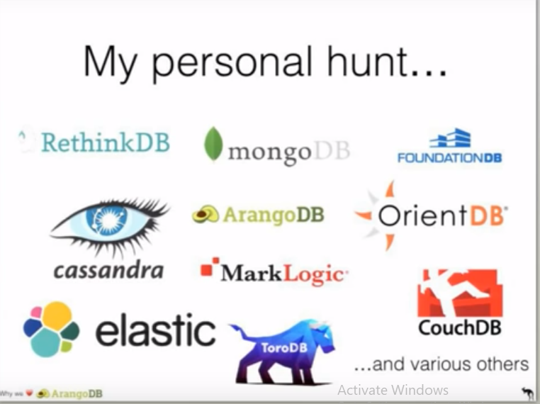
SOLUTIONS

Slide 11
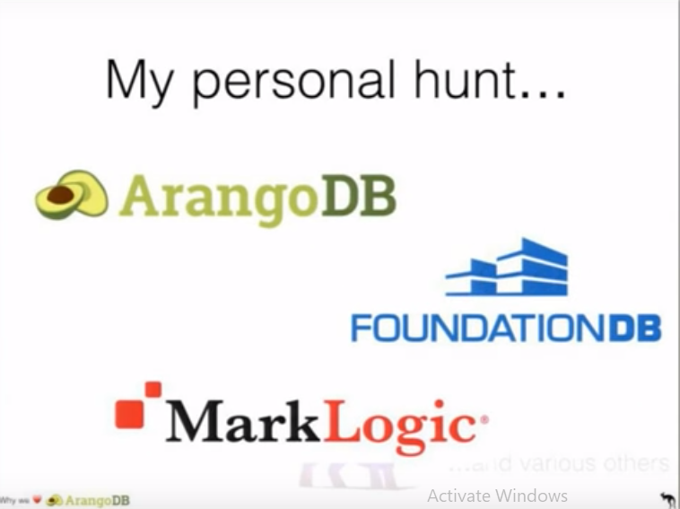

Slide 12
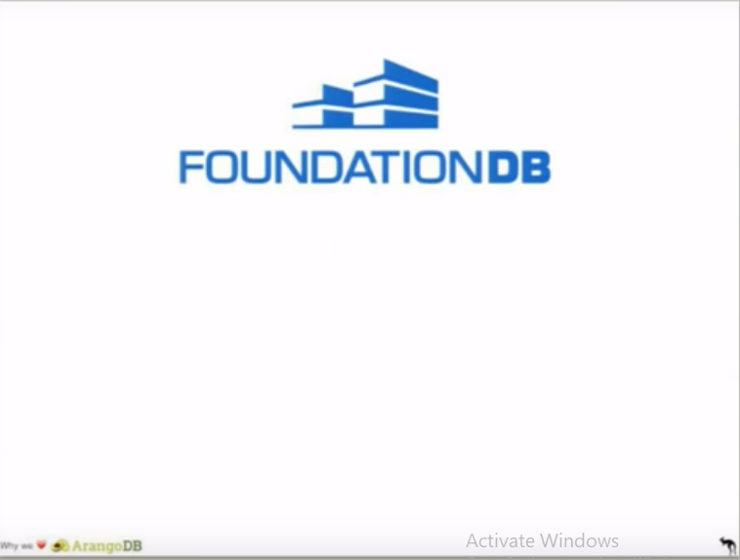

Slide 13
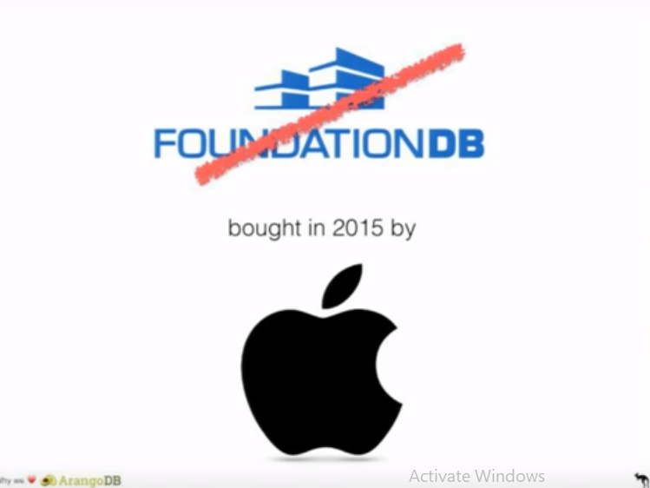

Slide 14
NEXT “ MARK LOGIC ” THE HIGH-END $$$$$ SOLUTION

Slide 15
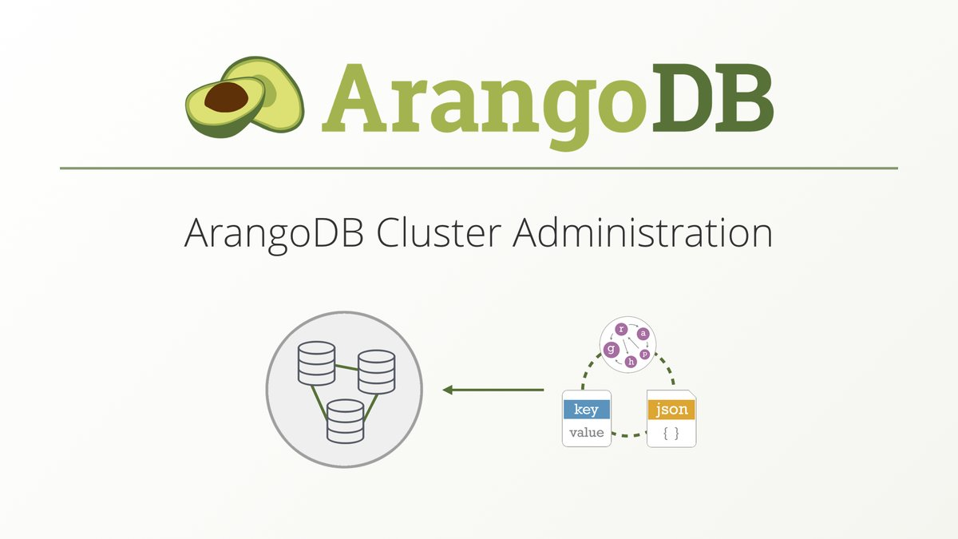
MOST RELIABLE SOLUTION

Slide 16
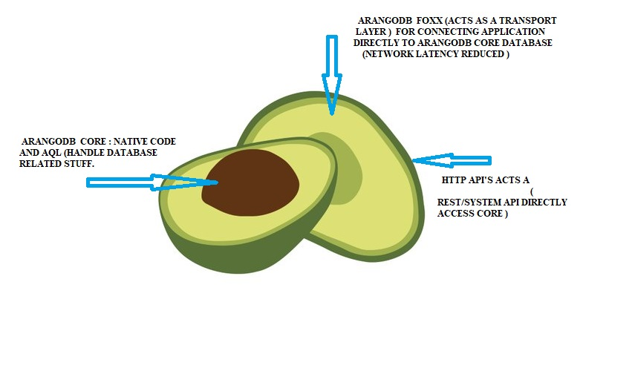
GENERAL STRUCTURE FOR READER

Slide 17
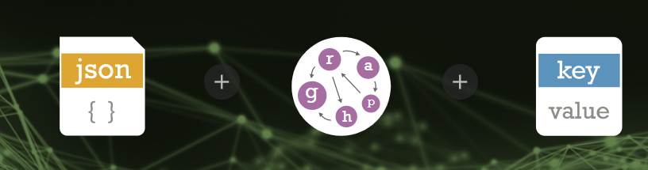
GENERAL FEATURE
1. MULTI – MODEL DATABASE
2. Document Store (JSON) : JOINS, SECONDARY INDEX
ACID TRANSACTIONS .
3. KEY –VALUE
4. GRAPH DATABASE : RICH GRAPH QUERY OPERATION

Slide 18

FOXX FRAMEWORK
1. Implements your own REST micro-services directly with JavaScript
running inside ArangoDB .
Unified data storage logic . (JS code directly access the database data ) .
Reduced network overhead .
Use full JS Stack .
Built in Job queues.
e.g: router. Get( (res,req) => {
res.write(
‘ HELLO Database. ‘) } )

Slide 19
AQL : One Query language
AQL = Arango Query Language .
Declarative , human readable DSL ( least prefer to JSON )
Document Queries , Graph Queries , Joins and all combined in one
statements.
ACID support with multi-collection transaction .
Easy to understand with some SQL background.

Slide 20
AQL QUERY FORMAT
for u IN users
for f IN friends
FILTER u.active == true && f.active ==true && u.id ==f.userID
Return u.name
Collection
SQL Join condition
“ INSERT { _from: u._id _to: p._id } in friends ”
is AQL insert query

Slide 21
GRAPH QUERY
WITH managers, usersHaveManagers
FOR v,e p in OUTBOUND ‘users/1’ GRAPH ‘userGraph’
RETURN { v , e , p }

Slide 22
JSON QUERY
FOR u IN users
FILTER u.active == true
LIMIT 0 , 4
FOR f IN relations
FILTER f.type == “ friends” && f.friendOF == u.userID
RETURN {
“user” : u.name
“ friendID ” : f.thisUser
}

Slide 23
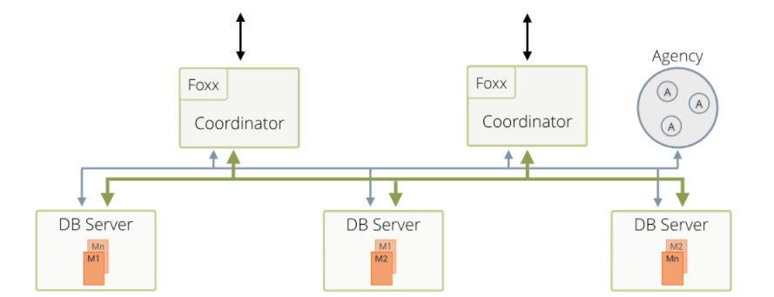
CLUSTER , REPLICATION & SHARDING
Agency (high-avail resilence key/value store , Raft Consensus Protocol ) .
Cordinators
Primary Database Servers
Secondaries
Asynchronous / synchronous replication with automatic fail –over .
Notes:
SHARDING : Process of storing data across multiple machines . (Horizontal multi split Partioning ) – small data read/update/delete fast .

Slide 24
Finally , NoSQL PERFORMANCE BENCHMARK 2018

Slide 25
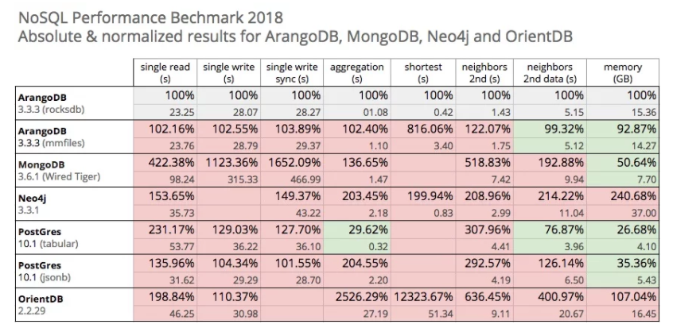

Slide 26
AN “E-COMMERCE APP ” BUILT ON TOP OF A MULTI- MODEL

Slide 27
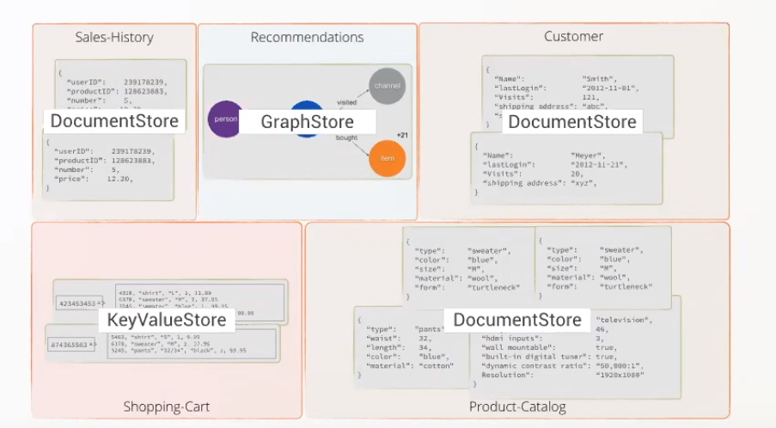

Slide 28

PHASE III
WEB APP

Slide 29
