Slide 1


K.RAMAKRISHNAN COLLEGE OF TECHNOLOGY
(AUTONOMOUS), TRICHY
NEWS PORTAL SYSTEM
PRESENTED BY SUPERVISOR
YOGA S Mr.MALARMANNAN M.E.,
2303811710422186 AP/CSE.
Notes:
1

Slide 2
PRESENTATION OVERVIEW
Objective
Project Introduction
Problem Statement
Methodologies (Programming concepts relevant to problem statement)
Architecture of the proposed system
List of Modules
7. Merits
8. Results and Discussion
9. Queries
Notes:
2

Slide 3
OBJECTIVE
To Create a simple Java-based news portal where users can register, log in, and view news articles. Implement a basic admin panel where administrators can add, remove or update articles. Articles should be categorized (e.g., "Politics", "Sports"), and users can select a category to view.
2/7/20

Slide 4
PROJECT INTRODUCTION
The News Portal System is a basic content management system designed to allow users to view, add and remove news articles in a categorized structure. It simulates a simple news portal where there are two types of users: regular users and admin users.
2/7/20

Slide 5
PROBLEM STATEMENT
Provide User Registration and Authentication
Facilitate News Viewing by Category
Offer Admin Control for Managing News Articles
2/7/20

Slide 6
METHODOLOGIES
AWT: It is used for creating the graphical user interface (GUI) components like Frame, 1 Panel, Button, Label, TextField, Choice, TextArea, and List.
Event Handling: Event listeners, specifically ActionListener, are used to handle user actions (e.g., clicking buttons). ItemListener is used for handling item selections in Choice components and list selections.
HashMap: Used for storing users, roles, and articles. The keys are String types, and values are appropriate data types like String (password, role) or ArrayList (list of articles). ArrayList: Used to manage dynamic lists of articles for each category. List: A GUI component used for displaying articles.

Slide 7
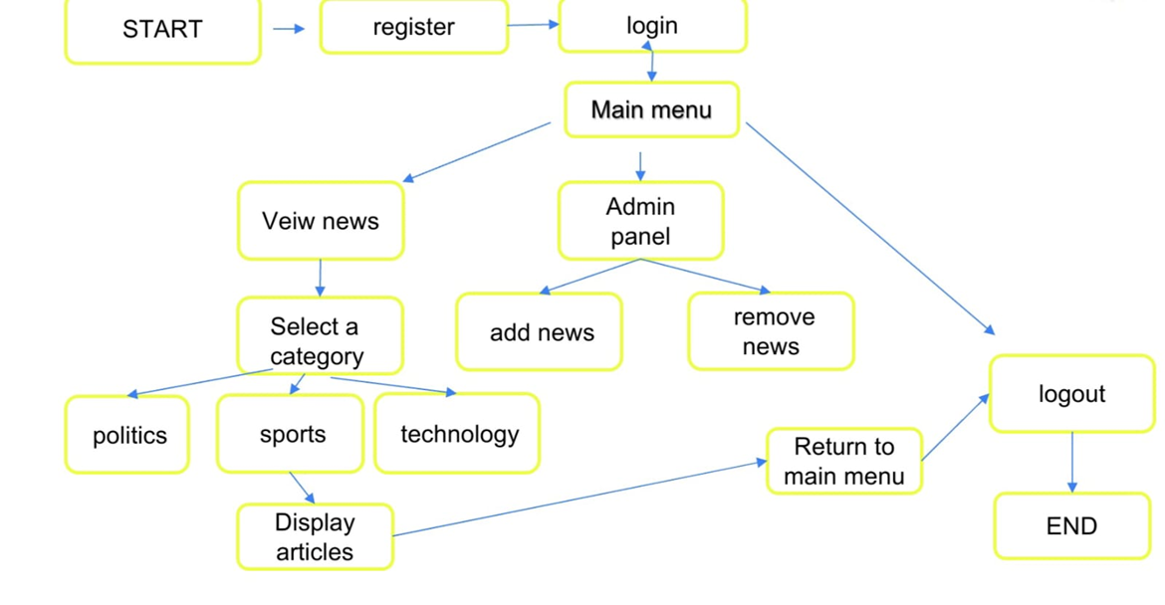
ARCHITECTURE OF THE PROPOSED SYSTEM
2/7/20

Slide 8
LIST OF MODULES
User Authentication and Registration Module
User Dashboard Module
Admin Management Module
Article Management Module
User Interface and Event Handling Module
2/7/20

Slide 9
MERITS
Simplifies viewing news by category.
Ensures secure user account management.
Provides a user-friendly and intuitive GUI.
Supports multiple users and admins efficiently.
2/7/20

Slide 10
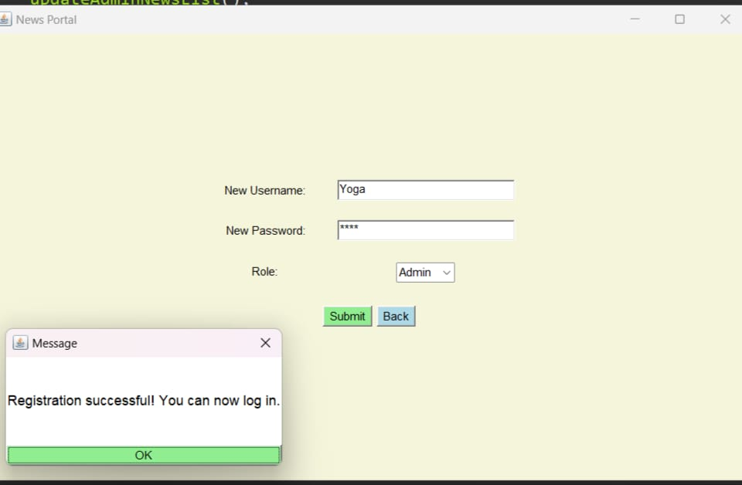
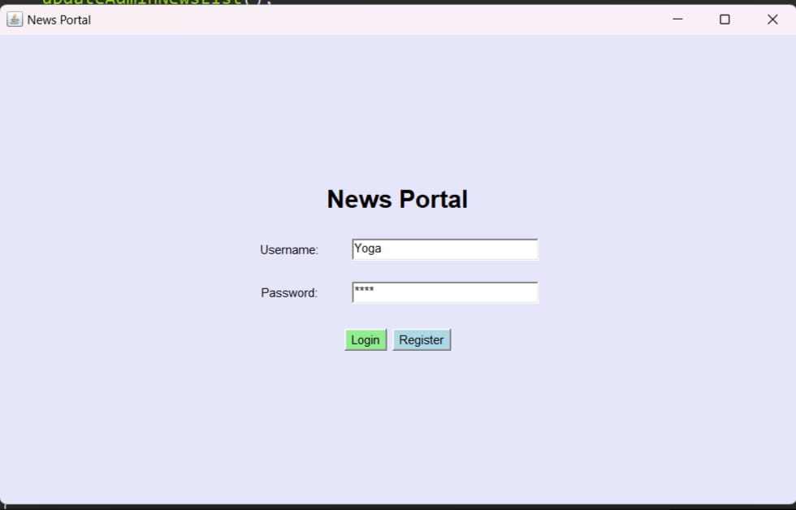
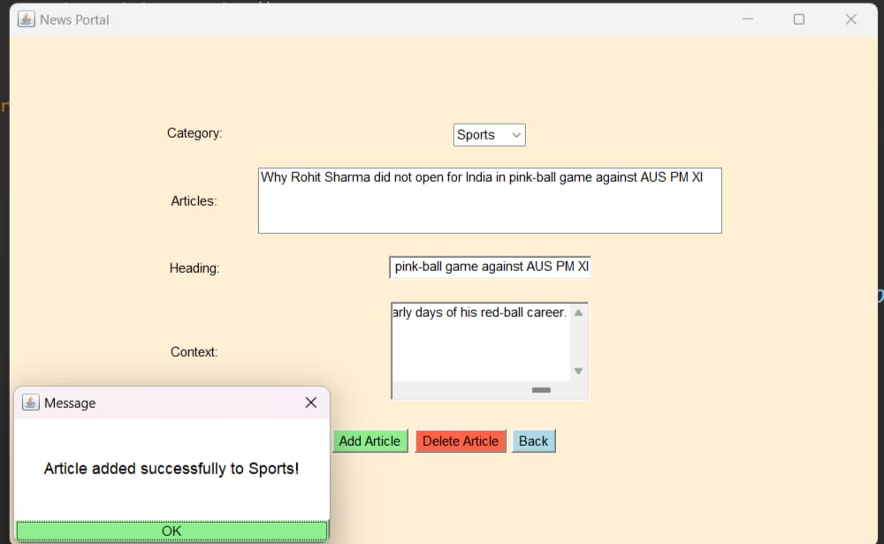
RESULTS AND DISCUSSION
2/7/20

Slide 11
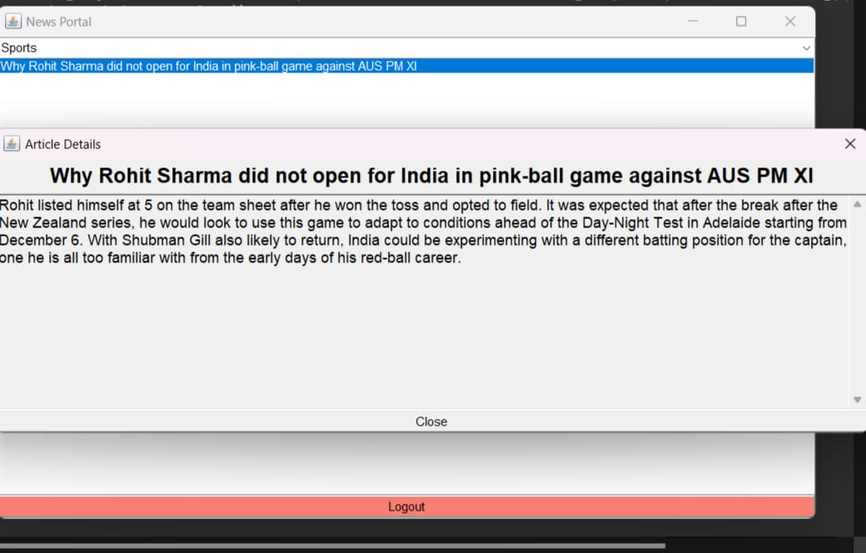
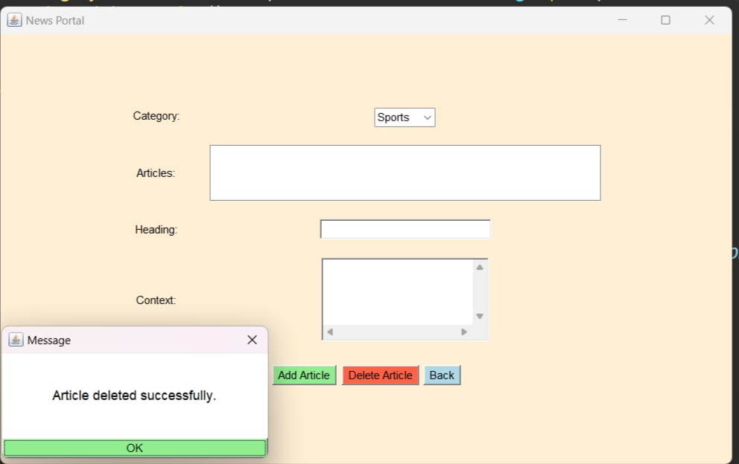
RESULTS AND DISCUSSION
2/7/20

Slide 12
QUERIES
How do I register?
Enter your name and password to create an account.
2. Can I view all the news ?
Yes, you can view all news by category after logging in.
3. Can a user add or delete news?
No , Only admins can add or delete the news.
2/7/20

Slide 13
THANK YOU
2/7/20

