Slide 1
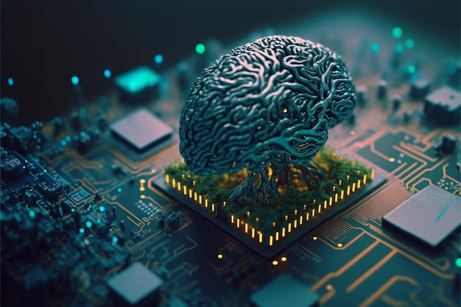



Data Science and Machine learning track.
By
Mal. Umar Ibrahim
Federal university Dutse
Miss Muhammad Fatima Adam
Federal university Dutse
Mal. Abubakar Yakubu Zandam
Federal university of Technology Babura

Slide 2

Why did I choose this track over the other four tracks in the bootcamp?

Slide 3

Where do I see myself after the bootcamp?

Slide 4
What is data science & machine learning?

Slide 5

Data Science: Unveiling the Secrets Hidden in Data
Data science is an exciting field that combines statistics, computer science, and domain expertise to uncover valuable insights from data.

Slide 6

Machine Learning: A Journey from Data to Decisions
Machine learning (ML) is a fascinating field within computer science that focuses on building algorithms that can learn from data and improve their performance over time, without explicit programming.

Slide 7
The entire journey
Week one
Week two
Week three
Week four
Introduction to machine learning
Python libraries for machine learning
Supervised machine learning:
Classification task
Regression task
Introduction to:
Github
Programming
Data Science
Jupyter Notebook, Google colab
Python basic syntax
project
Ways to handle errors in ML e.g underfitting, overfitting
Unsupervised learning:
clustering
Group project
Summary and conclusion
Python built in function
python libraries and their uses:
Pandas
Numpy
Matplotlib
Data preprocessing
EDA
Statistical tools in data visualization

Slide 8
Our expectation after the bootcamp:
Have basic understanding of Python
Become a data science and machine learning forerunner
Leverage your diverse academic background to apply your acquired knowledge.
Delve deeper into the world of AI

Slide 9


