Slide 1



Week 1_Day_3
Introduction to python for Machine learning
Mal. Umar Ibrahim
Federal university Dutse
Miss Muhammad Fatima Adam
Federal university Dutse
Mal. Abubakar Yakubu Zandam
Federal university of Technology Babura
Usman Yahaya

Slide 2
About This Course
🡪This module is part of the CRAI 2023 Bootcamp program offered by Federal University Dutse.
🡪It focuses on providing an introduction to Python programming tailored for machine learning applications.

Slide 3
Objectives
🡪Re/Introduce students to Python programming fundamentals.
🡪Build a solid foundation in Python for machine learning applications.
🡪Equip students with practical Python skills to prepare them for machine learning courses
within the CRAI Bootcamp 2023 program.

Slide 4
Table of Contents!
3: Control Structures
1: Introduction to Python
2:Variables and Data Structures
5: NumPy and Arrays
Conditional statements (if, elif, else)
Looping (for and while loops)
Controlling program flow
Understanding Python programming language
Setting up Python (IDEs, Jupyter Notebooks)
Basic Python syntax
Writing and executing your first Python program
4: Functions and Modules
Creating and using functions
Built-in Python functions
Importing and using modules
Building reusable code
Variables and data types (int, float, string, boolean)
Lists, tuples, and dictionaries
Working with data structures
Basic operations and methods
Creating and manipulating arrays
Basic array operations
Introduction to NumPy for numerical operations

Slide 5



01
Introduction

Slide 6
What is Python?
Python…
is a versatile and high-level programming language.
It is known for its simplicity and readability, making it an ideal choice for beginners.
Python is widely used in various fields, including web development, data science, and machine learning.
Python's extensive standard library and third-party packages make it a powerful tool for solving complex problems.
Throughout this course, we will explore the fundamentals of Python and how it is applied in the context of machine learning and data science.

Slide 7
Setting up Python (IDEs, Jupyter Notebooks)
Download Python: https://www.python.org/downloads/
Before we dive into Python programming, it's essential to set up your development environment.
IDEs (Integrated Development Environments) provide a user-friendly interface for writing and running Python code.
Jupyter Notebooks, on the other hand, offer an interactive and notebook-style environment, ideal for data exploration and documentation.
In this module, we will guide you through the process of installing Python and choosing the right development environment for your needs.

Slide 8
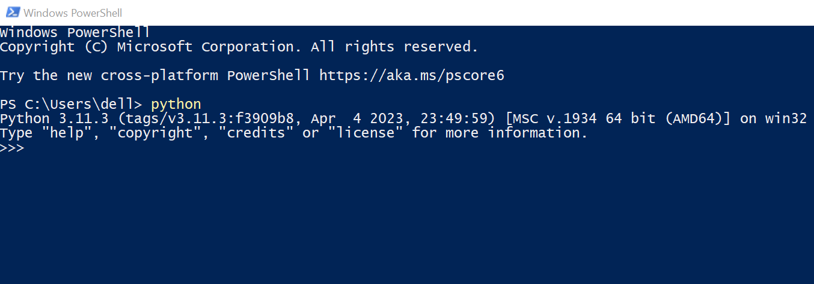
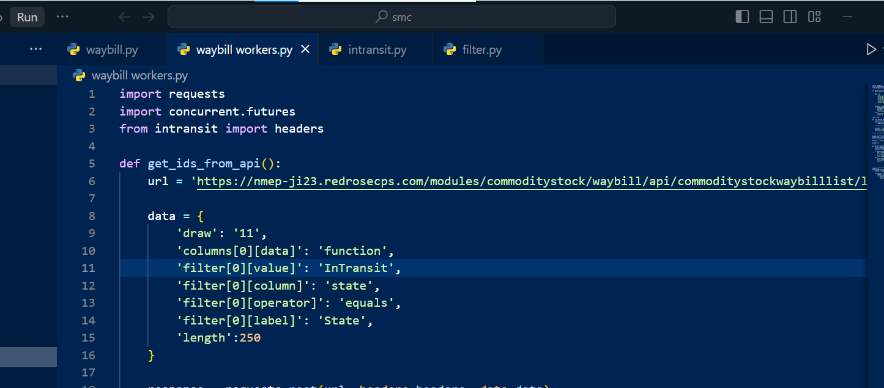
Ways to Run a Python Program?
Interactive Mode: You can run Python interactively by opening a terminal or command prompt and typing python.
Script Mode: Create Python scripts by writing code in a .py file and running it using the python command followed by the script's filename.
Integrated Development Environments (IDEs): IDEs like VS Code, and Jupyter Notebooks provide a comprehensive environment for writing, debugging, and running Python code efficiently.

Slide 9
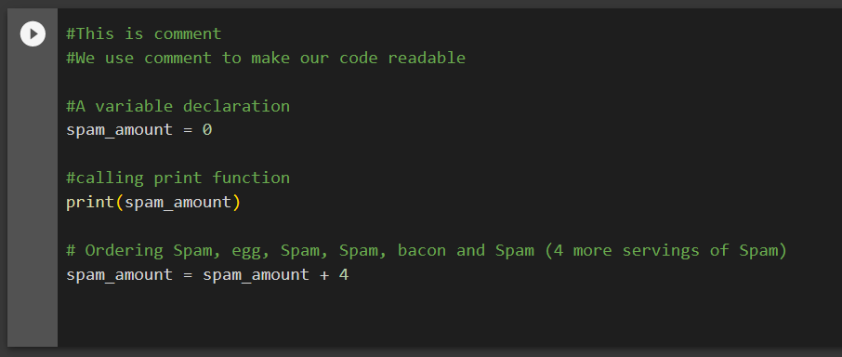

Writing and executing your first Python program using Colab
What is Colab?
Colab, or "Colaboratory", allows you to write and execute Python in your browser, with:
Zero configuration required
Access to GPUs free of charge
Easy sharing

Slide 10
02
Variables, Operators, and Data Structures

Slide 11
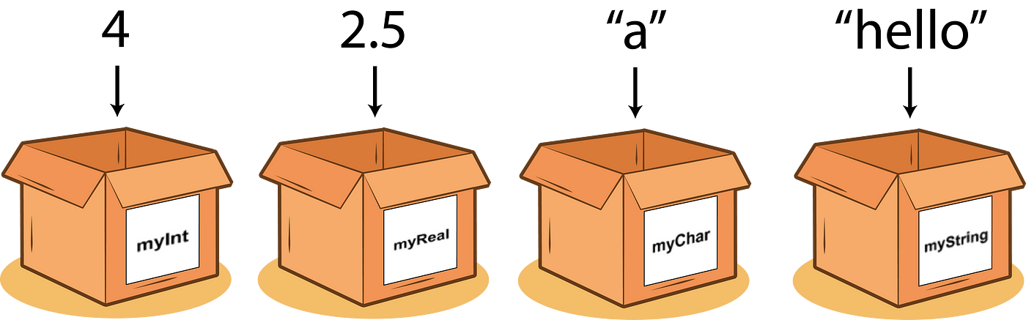
Variables
Python supports various data types, including:
int: Integers (e.g., 5, -10)
float: Floating-point numbers (e.g., 3.14, -0.5)
str: Strings (e.g., "Hello, World!")
bool: Boolean values (True, False)
In Python, variables are used to store data values.
Variables are created when you assign a value to them.
Python has dynamic typing, meaning you don't need to declare a variable's type explicitly.

Slide 12

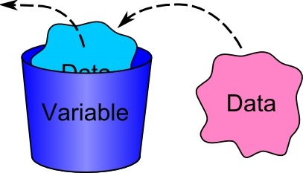
More on Variables
In Python, variables are used to store data values.
Variables are created when you assign a value to them.
Python has dynamic typing, meaning you don't need to declare a variable's type explicitly.

Slide 13
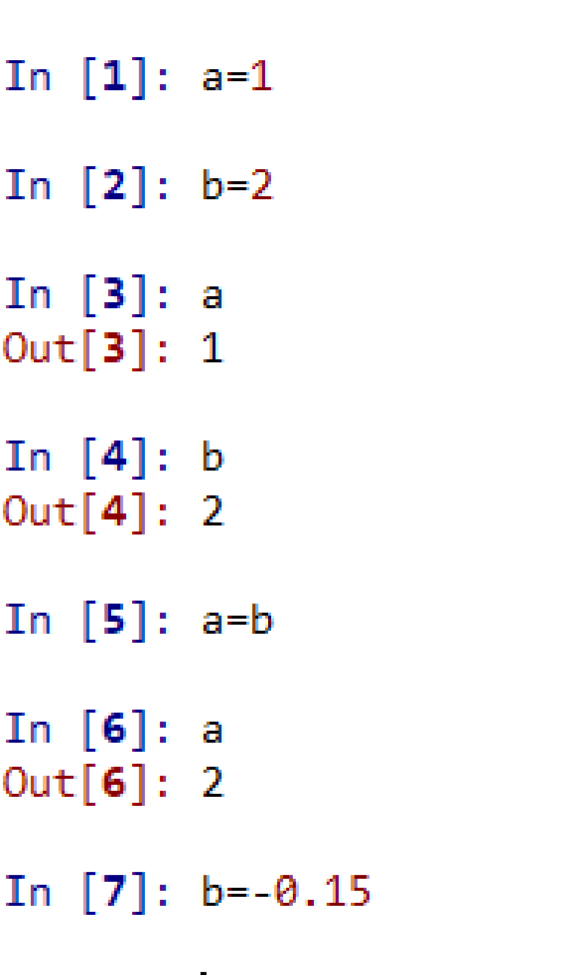
Creating Variables
In Python, you can create variables by assigning a value to them using the assignment operator (=).
Variable_Name = variable_data
Variable names must follow certain rules:
They can contain letters, numbers, and underscores.
They cannot start with a number.
Variable names are case-sensitive (e.g., myVar and myvar are different variables).
Variables can be reassigned at any time

Slide 14
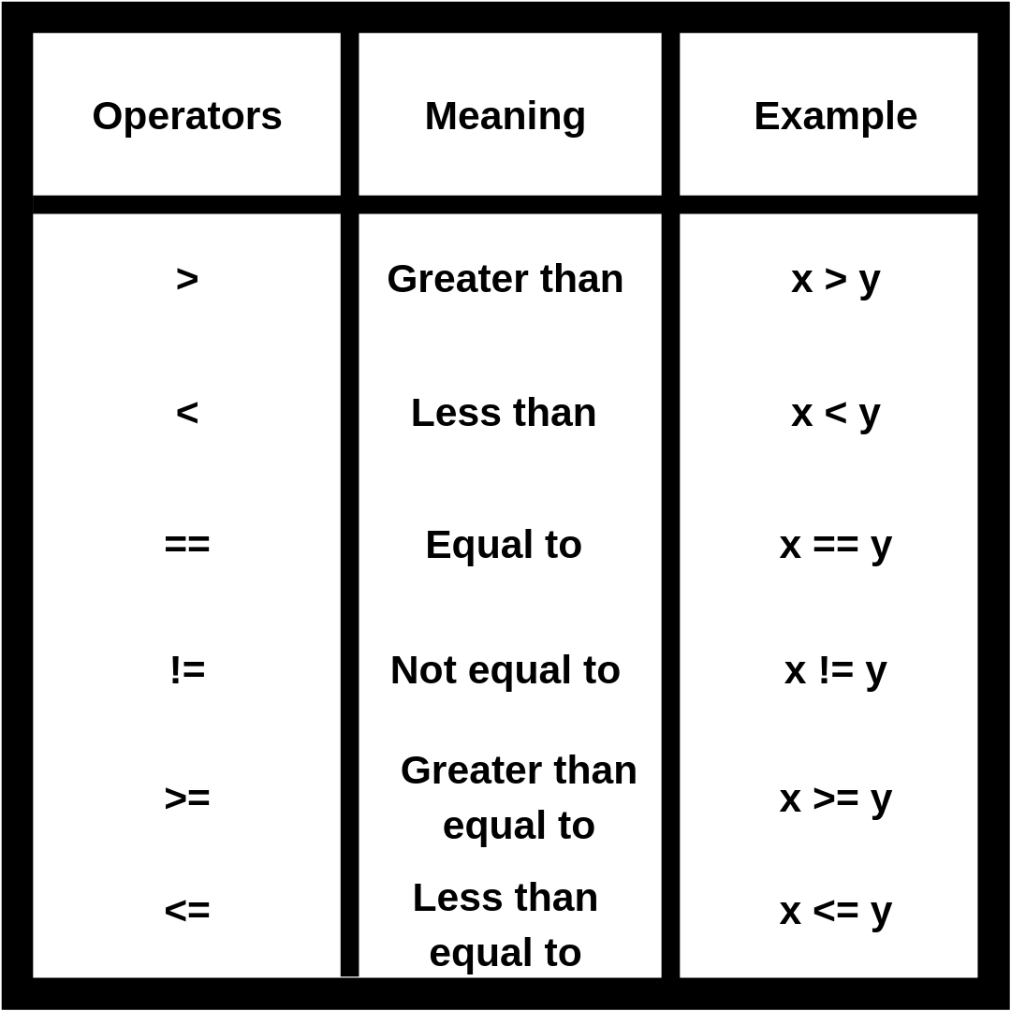
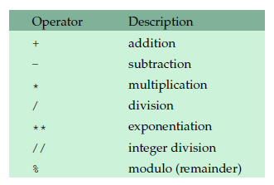

Arithmetic Operators
Comparison Operators
Python supports a wide variety of operators which act like functions, i.e.
they do something and return a value:

Slide 15
03
Data Structures

Slide 16
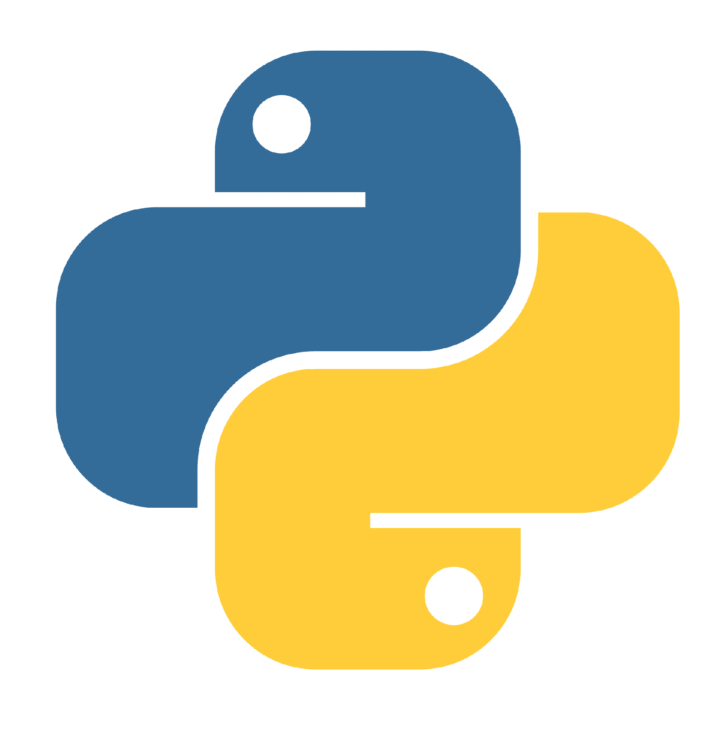
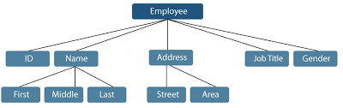
Data Structures
List
Tuples
Dictionaries
Data structures are used to store and organize multiple pieces of data.
Ordered, mutable collections of data.
Ordered, immutable collections of data.
Unordered collections of key-value pairs.
Python provides several built-in data structures

Slide 17
[List]
Common list operations include:
Appending elements with .append().
Example:
my_list.append(6)
Removing elements with .remove() or .pop().
Example:
my_list.remove(3)
Lists are one of the most commonly used data structures in Python.
They are ordered and mutable, which means you can change their contents.
Lists can contain elements of different data types.
Lists can be created by enclosing elements in square brackets [ ].
For example:
my_list = [1, 2, 3, 4, 5]
You can access individual elements in a list using indexing, with the first element at index 0.
For example:
first_element = my_list[0]

Slide 18

(Tuples)
Tuples are similar to lists but with a key difference: they are immutable.
Once you define a tuple, you cannot change its elements.
Tuples are often used for data that should not be modified.
Tuples are created by enclosing elements in parentheses ( ).
For example:
my_tuple = (1, 2, 3, 4, 5)
You can access individual elements in a tuple using indexing, just like with lists.
For example:
first_element = my_tuple[0]

Slide 19
Dictionaries
my_dict = {"name": "John", "age": 30, "city": "New York"}
name = my_dict["name"]
Creating and Using Dictionaries
Dictionaries are collections of key value pairs.
They are unordered and mutable, allowing for flexible data storage.
Each element in a dictionary is accessed by its key.
Dictionaries are commonly used to store and retrieve data associated with specific identifiers.
We'll explore how to create and work with dictionaries in Python..
Dictionaries are created by enclosing key-value pairs in curly braces {}
For example:
You can access values in a dictionary by specifying the key.

Slide 20
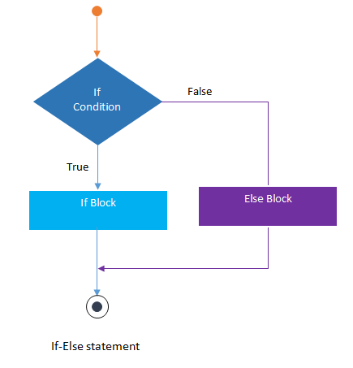
04
Control Structures
learn about conditional statements, looping, and how to control the flow of your Python programs.

Slide 21
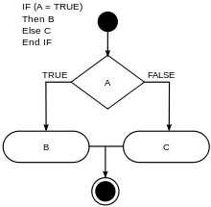
Conditional Statements in Python (if, elif, else)
Conditional statements allow you to make decisions in your Python programs.
In Python, you can use if, elif (short for "else if"),
and else to control the flow of your code based on conditions.
The if statement allows you to execute a block of code if a condition is true.
It's the fundamental building block of conditional logic in Python.

Slide 22

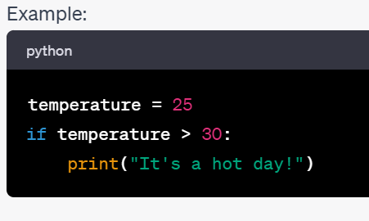
Using "if" Statements
if condition:
# Code to execute if the condition is true

Slide 23
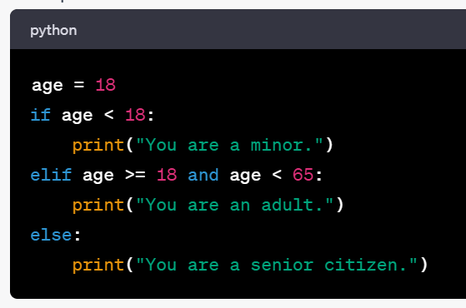
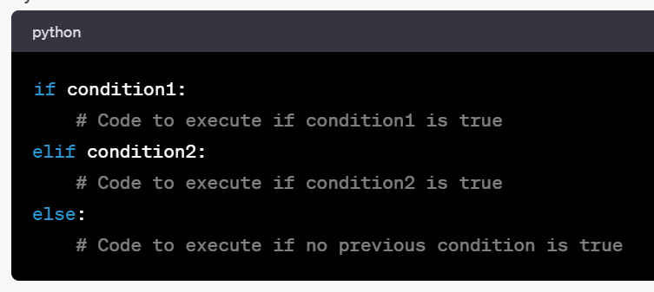
"elif" and "else" Statements
Example
"elif" (else if) and "else" statements for more complex conditional logic.
"elif" allows you to check multiple conditions sequentially
"else" provides a fallback option when no previous condition is true.

Slide 24
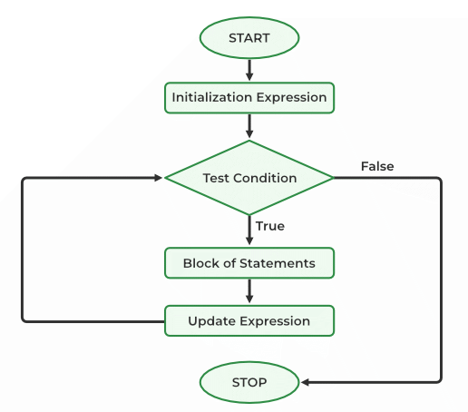
Loops
Loops allow you to execute a block of code repeatedly.
Python supports two primary types of loops: "for" loops and "while" loops.
"for" loops are used for iterating over sequences (e.g., lists, strings).
"while" loops continue execution as long as a specified condition is true.
We'll explore how to use these loops effectively.
loop is a sequence of instruction s that is continually repeated until a certain condition is reached.

Slide 25
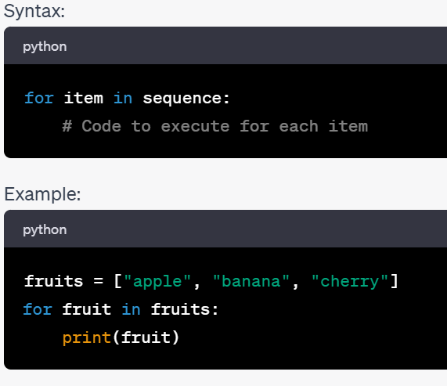
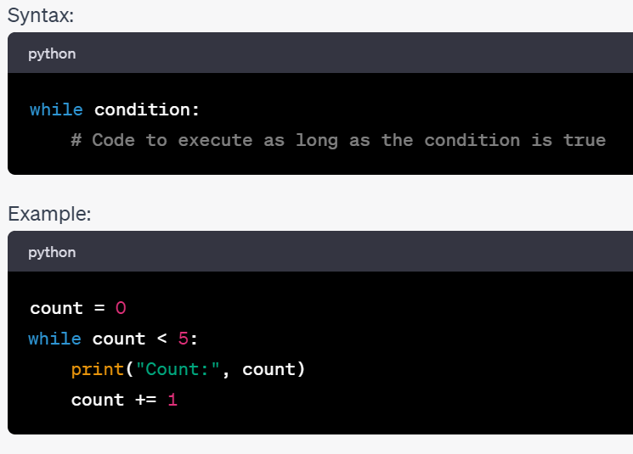
While Loop
For Loop

Slide 26
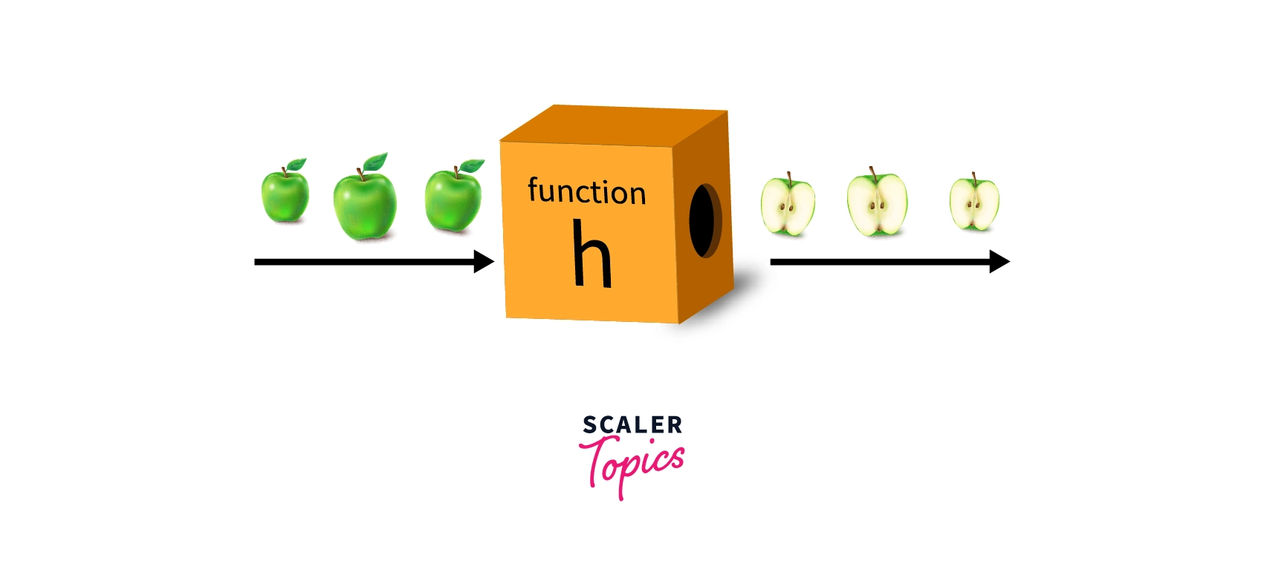
05
Functions and Modules
Building reusable code blocks, delve into built-in Python functions and importing external modules.

Slide 27
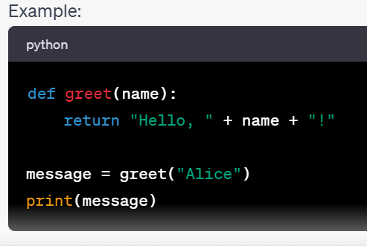
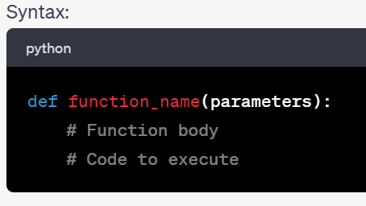
—Someone Famous
Functions
Functions are blocks of reusable code that perform specific tasks.
They allow you to organize your code, make it more readable,
and avoid repetition.
To create a function in Python, use the def keyword, followed by the function name and parentheses.

Slide 28
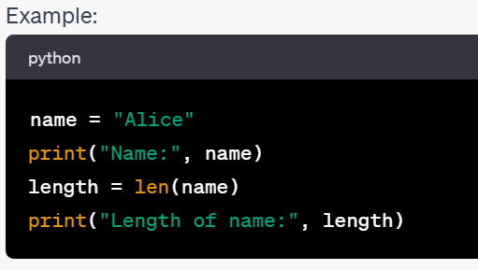
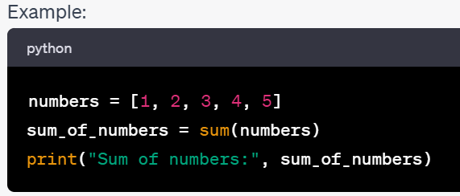
Built-in Functions
Python provides a wealth of built-in functions
that perform common tasks.
These functions can be used without the need for
defining them.
Examples of built-in functions include:
print(): Used to display output.
len(): Returns the length of a sequence (e.g., a list or a string).
sum(): return summation of list of tuple.

Slide 29
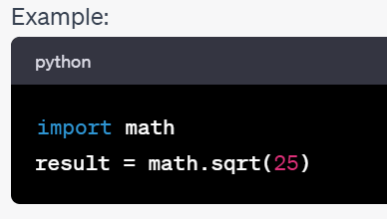
Importing and Using Modules
Python modules are collections of related functions and code that can be reused in different programs.
You can import modules using the import statement.
Importing modules allows you to access additional functionality not available in Python's built-in functions.
We can see all the names in module using the built-in function dir().

Slide 30
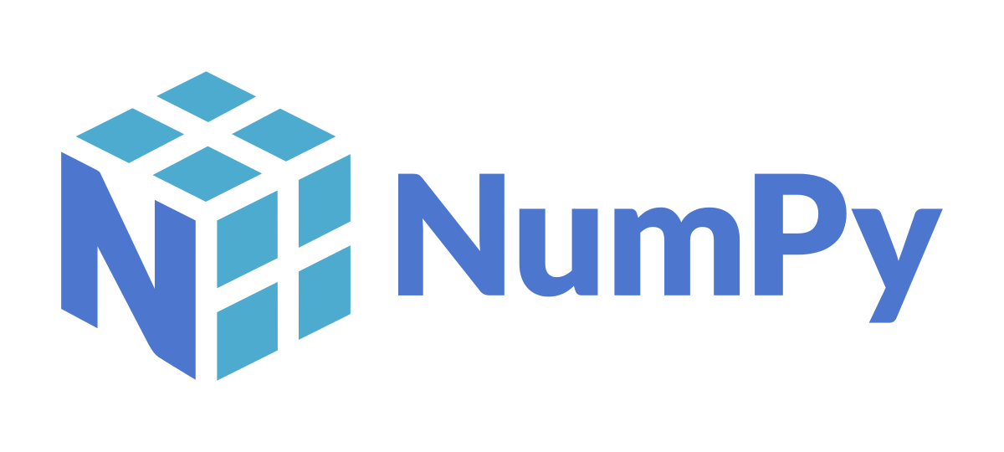

05
NumPy and Arrays
A fundamental library for numerical operations

Slide 31

NumPy, short for Numerical Python, is a powerful Python library for numerical and array-based operations. It provides support for large, multi-dimensional arrays and matrices, along with a collection of mathematical functions. NumPy is a fundamental library for data science, machine learning, and scientific computing. Numpy ndarray for creating multiple dimensional arrays NumPy-based algorithms are generally 10 to 100 times faster We'll explore its capabilities and how to get started with NumPy in our interactive python notebook.
NumPy

Slide 32
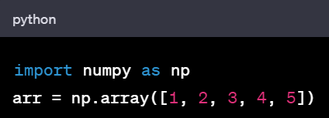
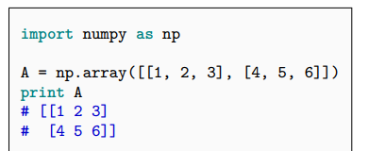
NDarray
NumPy adds a new data structure to Python(ndarray)
An N-dimensional array is multidimensional container of items of the same type and size.Defined by:
the shape of the array, and
the kind of item the array is composed of
The shape of the array is a tuple of N integers (one for each dimension)

Slide 33
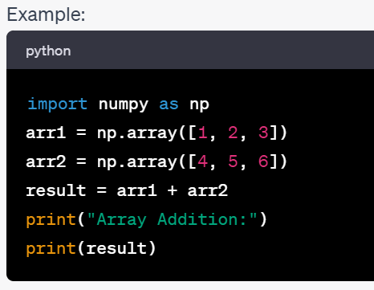
Basic Operations with NumPy Arrays
NumPy arrays support a wide range of mathematical and element-wise operations.
You can perform operations such as addition, subtraction, multiplication, and more on arrays.
NumPy simplifies complex numerical computations.

Slide 34
Official documentation http://docs.scipy.org/doc/ The NumPy book http://www.tramy.us/numpybook.pdf Example list http://www.scipy.org/Numpy_Example_List_With_Doc
NumPy documentation

Slide 35
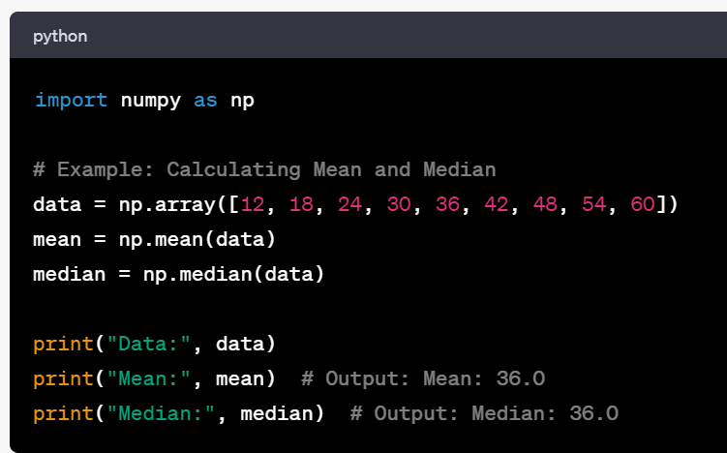


Slide 36

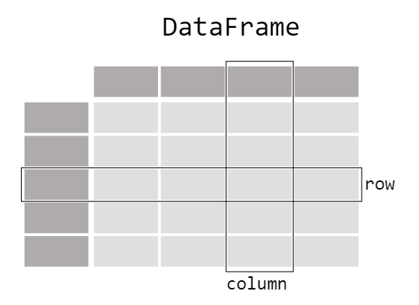
05
Panda
a Python library that provides easy-to-use data structures and data analysis tools.

Slide 37
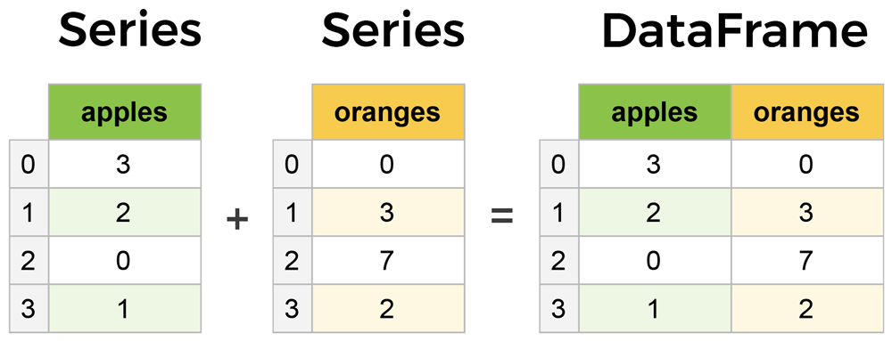
Series & DataFrames
The primary two components of pandas are the Series and DataFrame.
Series is essentially a column, and
DataFrame is a multi-dimensional table made up of a collection of Series.

Slide 38
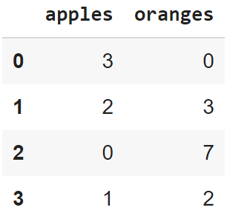
Creating a DataFrame from scratch
There are many ways to create a DataFrame from scratch, but a great option is to just use a simple dict. But first you must import pandas.
Let's say we have a fruit stand that sells apples and oranges. We want to have a column for each fruit and a row for each customer purchase. To organize this as a dictionary for pandas we could do something like:
And then pass it to the pandas DataFrame:
import pandas as pd
data = { 'apples':[3, 2, 0, 1] , 'oranges':[0, 3, 7, 2] }
df = pd.DataFrame(data)

Slide 39
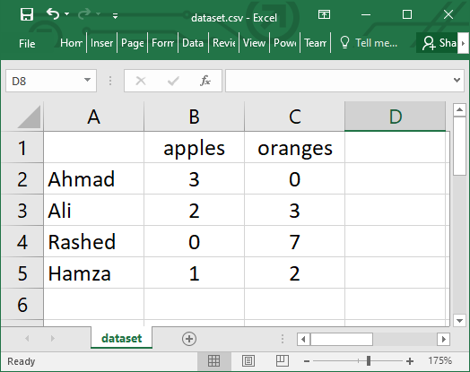
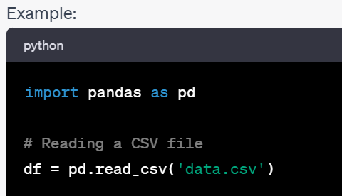
Reading data from a CSV file

Slide 40
Viewing your data
The first thing to do when opening a new dataset is print out a few rows to keep as a visual reference. We accomplish this with .head():
.head() outputs the first five rows of your DataFrame by default, but we could also pass a number as well: df.head(10) would output the top ten rows, for example.
To see the last five rows use .tail() that also accepts a number, and in this case we printing the bottom two rows.:
df.head()
df.tail(2)

Slide 41

Lab Session
Assignment

Slide 42
Thanks

Slide 43


