Slide 1
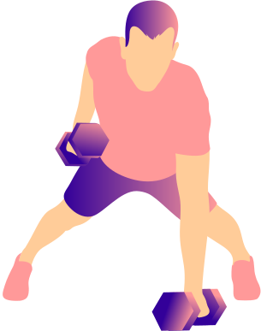
FITNESS
TRACKER
SHAFI BIN SAIF(2321624042)
SAHRIAR JOY(2013927642)

Slide 2







Slide 3
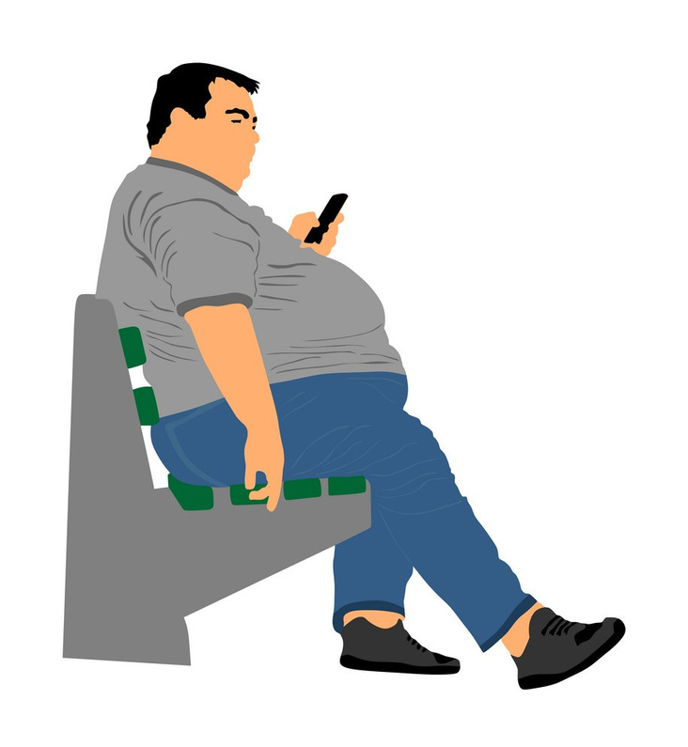
What These Do To Our Bodies?
Studies reveal that an increase in screen time correlates with sedentary behavior, a major risk factor for obesity(Tremblay et al., 2017). Platforms like Instagram and TikTok are highly engaging but often foster hours of scrolling and less time for movement..

Slide 4

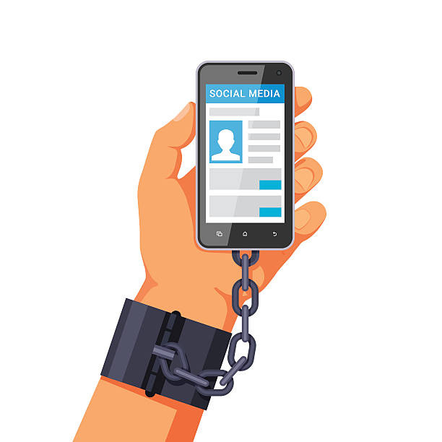
Why Can’t We Just Stop?
social media is designed to be addictive. Platforms like Facebook, Instagram, and TikTok employ algorithms to provide personalized content, releasing dopamine—a feel-good chemical—every time we receive likes, comments, or shares.

Slide 5
FITNESS
TRACKER
SHAFI BIN SAIF(2321624042)
SAHRIAR JOY(2013927642)

Slide 6

FITNESS TRACKER
Our Facilities
Login and Signup
Tracking Weight Gain
Tracking Weight Loss
Tracking Running Workouts

Slide 7
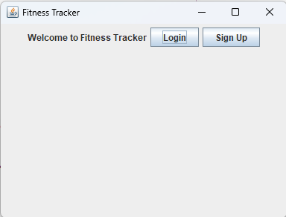
FITNESS TRACKER
LOGIN SCREEN
LOGIN
Registered Users can log in to access their information and track their progress
SIGN UP
This functionality is for new users who wish to register.

Slide 8
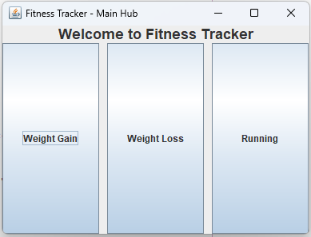
FITNESS TRACKER
MAIN HUB
Weight Gain
Lets the user access additional functionalities like setting goals for weight gain, seeing their progress and logging their daily weight
Weight Loss
Lets the user access additional functionalities like setting goals for weight loss, seeing their progress, and logging their daily weight
Running
Lets the user access additional functions like setting their running distance and starting their running workout

Slide 9

FITNESS TRACKER
Thank you For Attention

Slide 10
REFERENCES
TREMBLAY, M. S., LEBLANC, A. G., KHO, M. E., SAUNDERS, T. J., LAROUCHE, R., COLLEY, R. C., ... & CONNOR GORBER, S. (2017). SYSTEMATIC REVIEW OF SEDENTARY BEHAVIOR AND HEALTH INDICATORS IN SCHOOL-AGED CHILDREN AND YOUTH. INTERNATIONAL JOURNAL OF BEHAVIORAL NUTRITION AND PHYSICAL ACTIVITY, 8(1), 98. HTTPS://DOI.ORG/10.XXXXX
ALTER, A. (2017). IRRESISTIBLE: THE RISE OF ADDICTIVE TECHNOLOGY AND THE BUSINESS OF KEEPING US HOOKED. PENGUIN PRESS.

