Slide 1
Rs232 to ttl MH3232
https://daverobertson63.wordpress.com/2013/06/02/serial-port-mini-rs232-to-ttl-converter-adaptor-module-board-max3232-with-arduino/

Slide 2
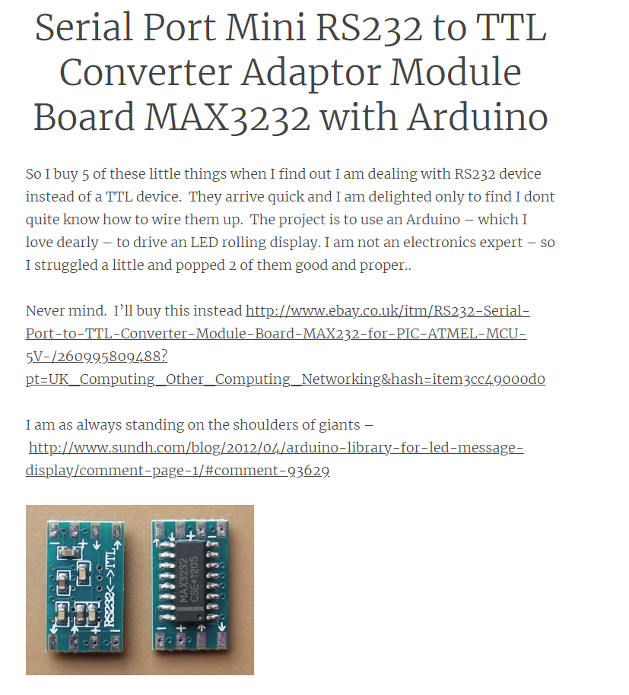

Slide 3
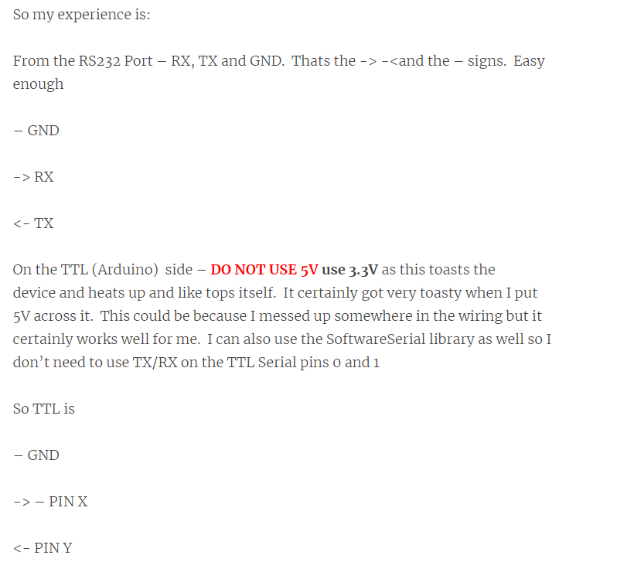

Slide 4

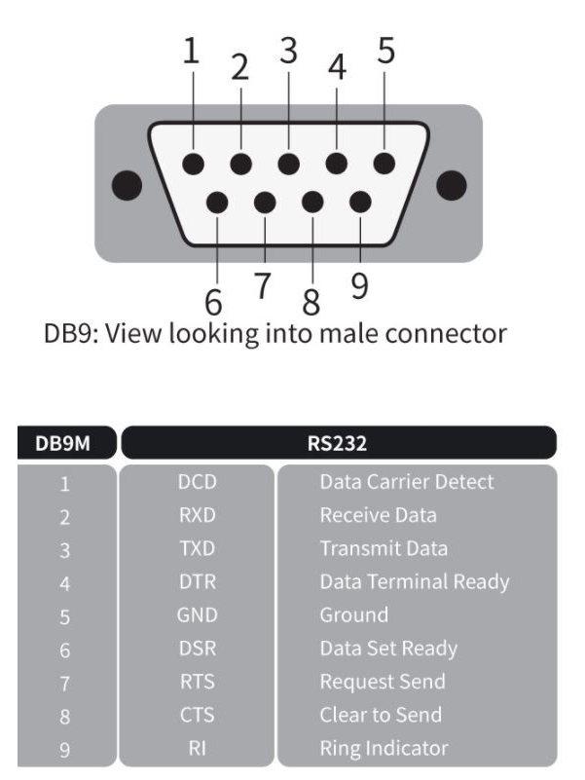

Slide 5
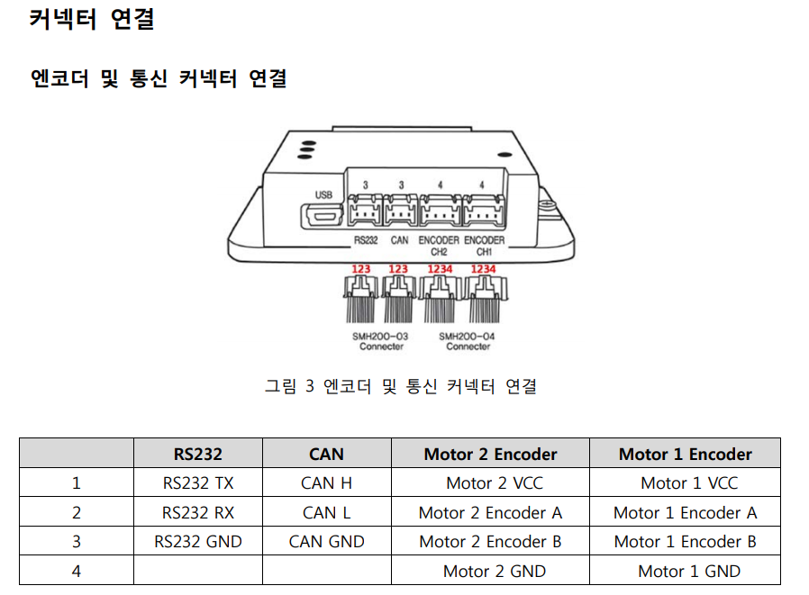

Slide 6
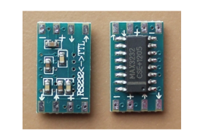
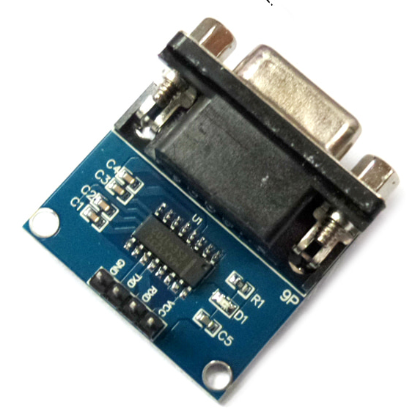

Slide 7
Diode
(>20A)
(1K,0.5W)
Resistor
MW-MDC24D100D
FUSE
Battery
12V
B+
B-
M1 +
M1 -
5V
MMOTOR 1
GND
Encoder CH1-1
AVR
MP3
module
Encoder CH1-2
5V
GND
M2 +
GND
M2 -
5V
MMOTOR 2
GND
TX
GND
Battery
12V
Encoder CH2-1
RX
TX
Encoder CH2-2
GND
RX
RS232 to TTL
Jetson Nano
5V-DC-DC convertor
MPU9250
(IMU)

