Slide 1
METEOROLOGICAL SATELLITE : SENSING PRINCIPLES, DATA COLLECTION AND ANALYSIS Project presented by Mr. YOUNKAP NINA Duplex Air Traffic Controller/Meng Degree in Computer Science Under the guidance of Mr TCHAMABO Urbain, Forecaster-Meng Degree in Meteorology Advance Training in Meteorological Instrumentation &Information System Batch No. –VIII ICITC INDIA METEOROLOGICAL DEPARTMENT New Delhi

Slide 2
OUTLINE
INTRODUCTION
BASIC PRINCIPLES OF SATELLITE REMOTE SENSING
CASE STUDY: GOES-R Series
GOES-R SERIES DATA COLLECTION AND VISUALISATION
SATELLITE DATA ANALYSIS
RESULTS
CONCLUSION AND FUTURE ENHANCEMENT

Slide 3
Introduction
Meteorological satellite has proved to be very useful in weather analysis and forecasting. Some of its applications are:
Satellite imageries are used by the forecasters as first-hand information along with synoptic chart analysis while issuing the forecast.
Atmospheric sounding, clouds precipitation, convergence and divergence in the atmosphere, thunderstorm formation, various convective activities, can be derived / forecasted with the help of satellite pictures and their analysis.
Cyclone formation, its intensity and movement (Track) can be monitored and predicted.

Slide 4
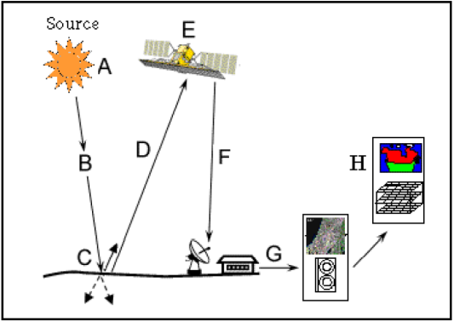
BASIC PRINCIPLES OF SATELLITE REMOTE SENSING
Definition
Step 1-Energy Source or Illumination (A)
Step 2-Radiation and the Atmosphere (B)
Step 3-Interaction with the Target (C)
Step 4-Recording of Energy by the Sensor (D)
Step 5-Transmission, Reception, and Processing (E)
Step 6-Interpretation and Analysis (F)
Step 7-Application (G)

Slide 5
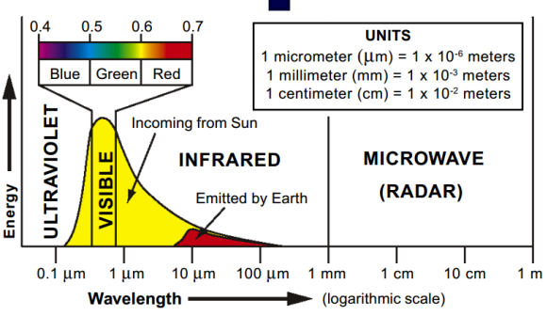
BASIC PRINCIPLES OF SATELLITE REMOTE SENSING
Electromagnetic Spectrum
UV [3-400 nm]
Vis [0.4-0.7 µm]
IR [0.7-100 µm]
MW [1 mm – 1m]

Slide 6
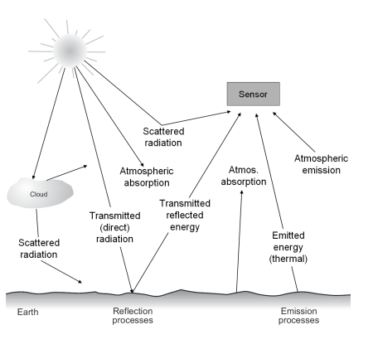
BASIC PRINCIPLES OF SATELLITE REMOTE SENSING
Interaction in the atmosphere

Slide 7
CASE STUDY: GOES-R Series
GOES project current status
GOES is a joint effort of NASA and the NOAA.
The GOES system currently consists of GOES-13, operating as GOES-East, in the eastern part of the constellation at 75°W longitude and GOES-15, operating as GOES-West, at 135 °W longitude.
These spacecraft help meteorologists observe and predict local weather events, including thunderstorms, tornadoes, fog, hurricanes, flash floods and other severe weather. In addition, GOES observations have proven helpful in monitoring dust storms, volcanic eruptions and forest fires.

Slide 8
CASE STUDY: GOES-R Series
GOES project current status
The benefits that directly enhance the quality of human life and protection of Earth’s environment include:
Supporting the search-and-rescue satellite aided system (SARSAT).
Contributing to the development of worldwide environmental warning services and enhancements of basic environmental services.
Improving the capability for forecasting and providing real-time warning of solar disturbances.
Providing data that may be used to extend knowledge and understanding of the atmosphere and its processes.

Slide 9
CASE STUDY: GOES-R Series
GOES-R Series Instruments
Earth-pointing :
Advanced Baseline Imager (ABI)
Geostationary Lightning Mapper (GLM)
Sun-pointing :
Extreme Ultraviolet and X-ray Irradiance Sensors (EXIS)
Solar Ultraviolet Imager (SUVI)
In-situ :
Magnetometer (MAG)
Space Environment In-Situ Suite (SEISS)

Slide 10
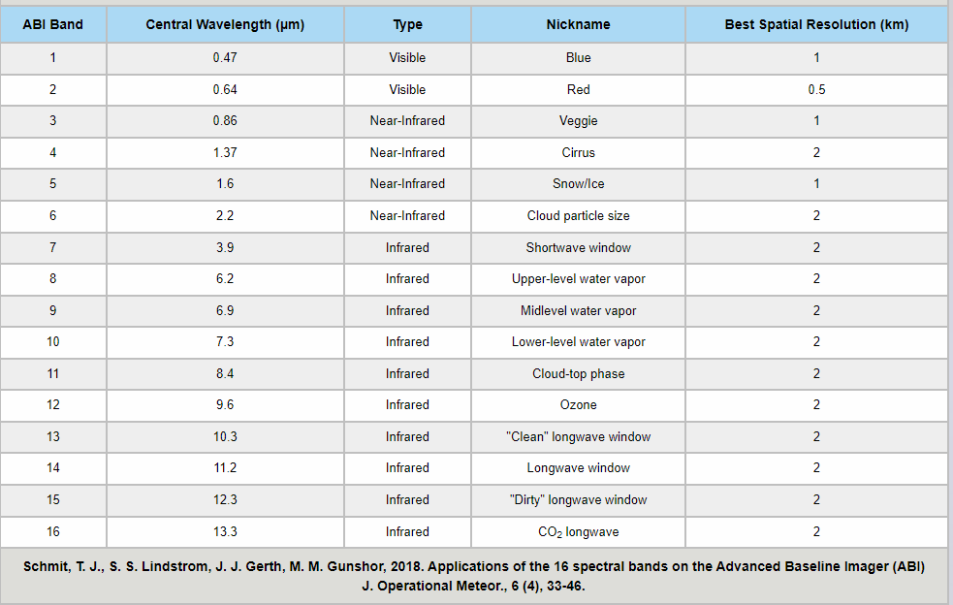
CASE STUDY: GOES-R Series
Advanced Baseline Imager (ABI)

Slide 11
CASE STUDY: GOES-R Series
ABI modes of operation
Full Disk : Hemispheric Coverage of 83° local zenith angle, temporal resolution of 5-15 minutes and spatial resolution of 0.5 to 2km.
Mesoscale : Provides coverage over a 1000x1000km box with a temporal resolution of 30 seconds, and spatial resolution of 0.5 to 2km.
Continental US/Pacific US : The CONUS and PACUS scans are performed every five minutes, The spatial resolution is 0.5 to 2km.
Flex Modes : The flex modes provide a full disk scan every 10 minutes (mode 6) or every 15minutes (mode 3), a CONUS/PACUS every five minutes, and two mesoscale domains every 60 seconds (or one sub-region every 30 seconds).)

Slide 12
CASE STUDY: GOES-R Series
GOES-R Data Products
Level 0 (L0) : are observation data received directly from the 6 satellite instruments.
Level 1b (L1b) : are calibrated and, where applicable, geographically corrected, L0 data. For ABI, the L1b product is Radiances. This is useful for users who require radiance units, instead of reflectance/brightness temperature (Kelvin) units.
Level 2+ Products : contain environmental physical qualities, such as cloud top height or land surface temperature.

Slide 13
CASE STUDY: GOES-R Series
GOES-R Data Products
Hurricane intensity estimation
Land surface albedo
Land surface bidirectional reflectance factor
Land surface temperature (skin)
Legacy vertical moisture profile
Legacy vertical temperature profile
Radiances
Rainfall rate/QPE
Reflected shortwave radiation: TOA
Sea and lake ice: age
Sea and lake ice: concentration
Sea and lake ice: motion
Sea surface temperature (skin)
Snow cover
Total precipitable water
Volcanic ash: detection and height

Slide 14
CASE STUDY: GOES-R Series
GOES-R Data Products
Aerosol detection (including smoke and dust)
Aerosol optical depth (AOD)
Aerosol particle size
Clear sky masks
Cloud layers/heights
Cloud and moisture imagery
Cloud optical depth
Cloud particle size distribution
Reflected shortwave radiation: TOA
Sea and lake ice: age
Sea and lake ice: concentration
Sea and lake ice: motion
Sea surface temperature (skin)
Snow cover
Total precipitable water
Volcanic ash: detection and height

Slide 15
GOES-R SERIES DATA COLLECTION AND VISUALISATION
Acces GOES-R series data files
Access data files from Amazon, Microsoft, OCC
Access data files from Google Cloud
Use Python to retrieve data from AWS

Slide 16
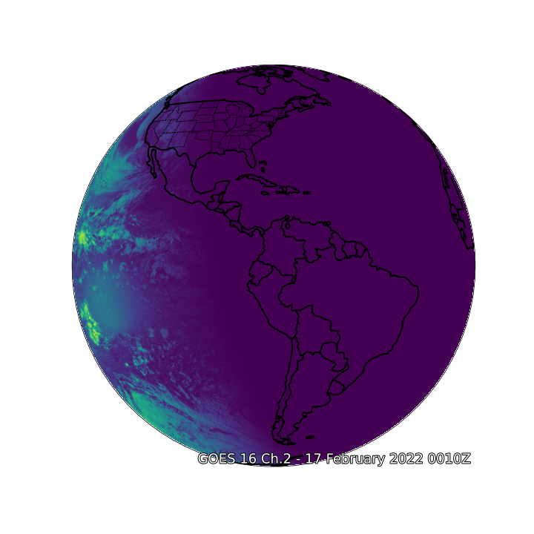
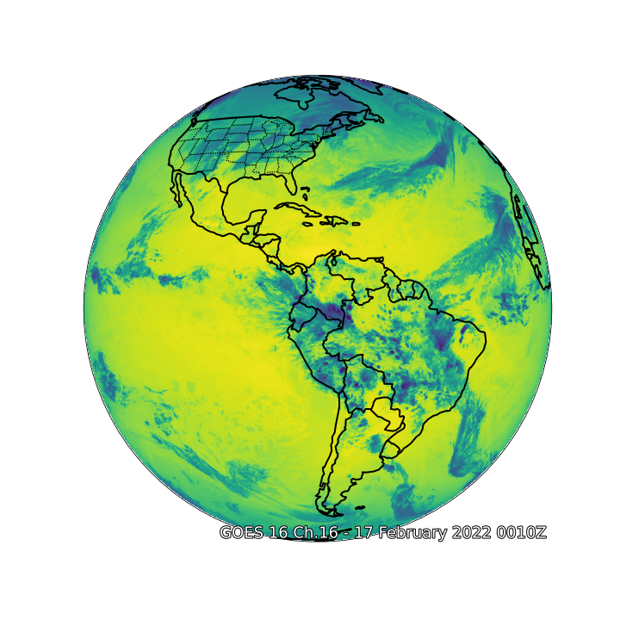
GOES-R SERIES DATA COLLECTION AND VISUALISATION
Visualise a single band ABI Channel image

Slide 17
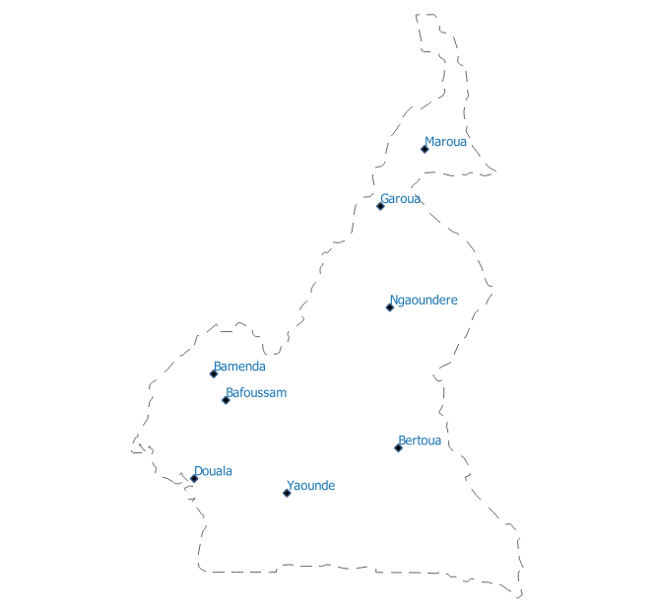
SATELLITE DATA ANALYSIS
Aviation meteorological stations in cameroon

Slide 18
SATELLITE DATA ANALYSIS
GLDAS data
The goal of the Global Land Data Assimilation System (GLDAS) is to ingest satellite- and ground-based observational data products, using advanced land surface modeling and data assimilation techniques, in order to generate optimal fields of land surface states and fluxes.

Slide 19
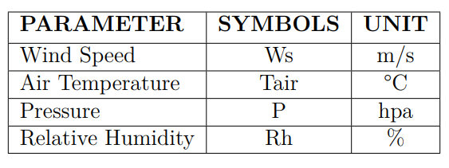
SATELLITE DATA ANALYSIS
Specific requirements
The requirements for the meteorological data at aviation station are:
The units at which GLDAS provide air temperature (K) and Pressure(Pa).
Further GLDAS provide specific humidity.

Slide 20
SATELLITE DATA ANALYSIS
GLDAS data
The goal of the Global Land Data Assimilation System (GLDAS) is to ingest satellite- and ground-based observational data products, using advanced land surface modeling and data assimilation techniques, in order to generate optimal fields of land surface states and fluxes.

Slide 21
SATELLITE DATA ANALYSIS
Analysis steps
Step 1 : Convert GLDAS air temperature from Kelvin to Deg C.
Step 2 : Convert the unit of GLDAS pressure from Pa to Milli bar (Mb).
Step 3 : Convert specific humidity to relative humidity following the description here.
Step 4 : Extract the Ws, Tair, P and Rh corresponding at our aviation meteorological stations
at observation time : 00:00, 03:00, 06:00, 09:00, 12:00, 15:00, 18:00 and 21:00 UTC.
Step 5 : Compare the results with data collected at the stations.

Slide 22
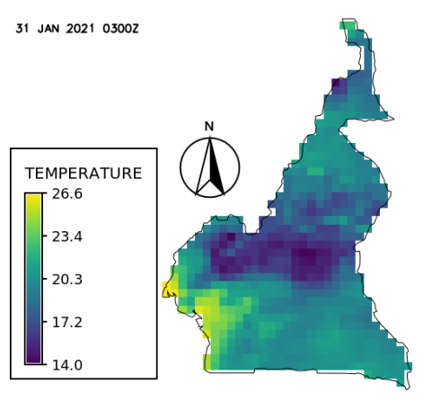
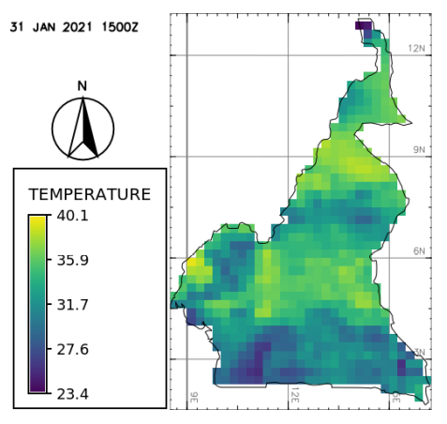
RESULTS
Temperature chart

Slide 23
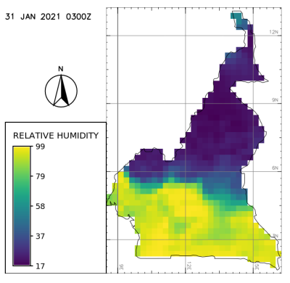
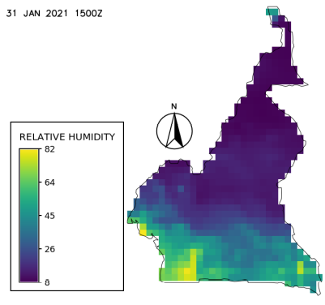
RESULTS
Relative Humidity chart

Slide 24
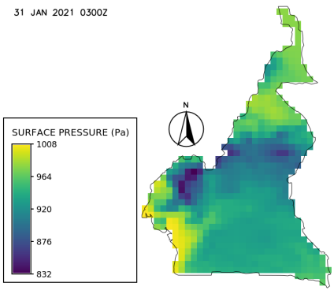
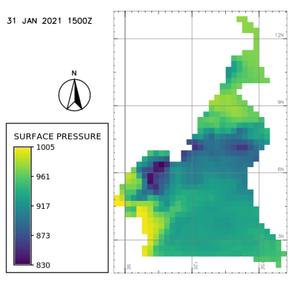
RESULTS
Surface Pressure chart

Slide 25
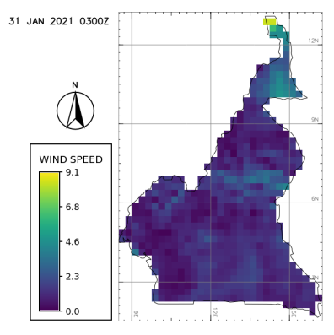
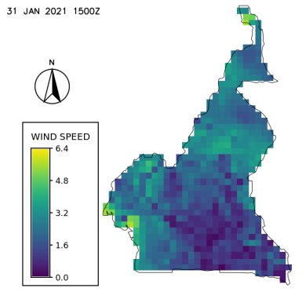
RESULTS
Wind speed chart

Slide 26
RESULTS
Aviation meteorological stations in Cameroon

Slide 27
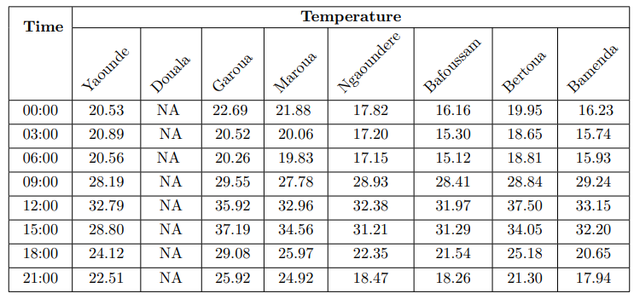
RESULTS
Stations temperature extracted from satellite data

Slide 28
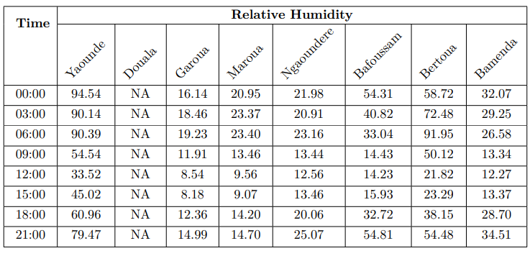
RESULTS
Stations relative humidity extracted from satellite data

Slide 29
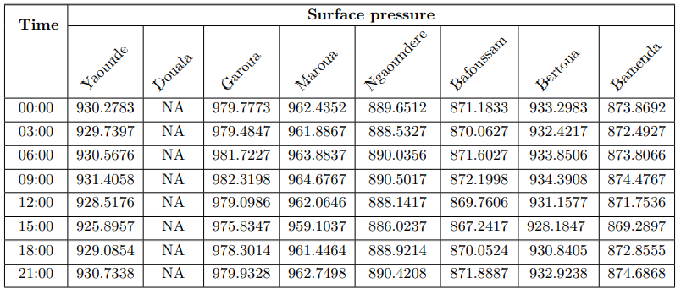
RESULTS
Stations surface pressure extracted from satellite data

Slide 30
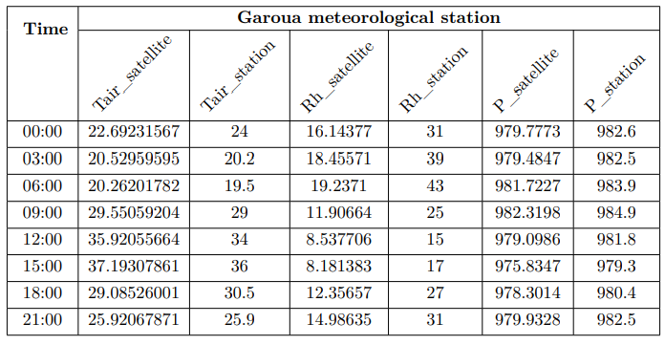
RESULTS
Camparison between satellite derived data and in situ data at Garoua station

Slide 31
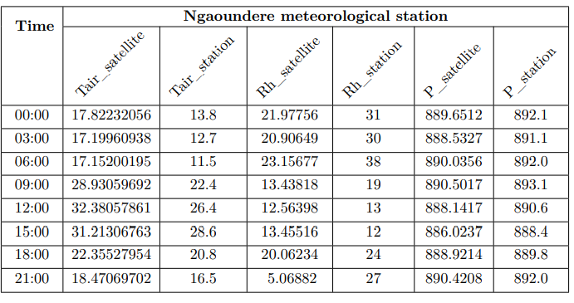
RESULTS
Camparison between satellite derived data and in situ data at Ngaoundre stations

Slide 32
RESULTS
Finding(Temperature)
On the whole the satellite over estimates the temperature,
At Garoua stations the difference is less than 1°C
At Ngaoundere station the difference is up to 6°C, that might be explained by the uneven landscape over Ngaoundere.
The difference is high from 6 to 12 AM, when the sun radiation is highest.

Slide 33
RESULTS
Finding(Relative humudity)
On the whole the Relative humidity is under estimated by the satellite
The difference of Relative humidity is more than 10% from 0 to 6 AM and less than 10% from 09:00 to 21:00 UTC

Slide 34
RESULTS
Finding(Surface prsessure)
On the whole the surface pressure is under estimated by the satellite, however the gap is greater in Garoua than in Ngaoundere
The pressure is under estimated, the difference of pressure has two minimum (at 6 and 18 AM) and two maximum (at 3 and 15 AM) , this refers to the daily cycle of the pressure

Slide 35
RESULTS
Finding(Surface prsessure)
On the whole the surface pressure is under estimated by the satellite, however the gap is greater in Garoua than in Ngaoundere
The pressure is under estimated, the difference of pressure has two minimum (at 6 and 18 AM) and two maximum (at 3 and 15 AM) , this refers to the daily cycle of the pressure

Slide 36
CONCLUSION AND FUTURE ENHANCEMENT
We found that on the whole the satellite over estimates temperature and under estimates pressure and relative humidity.
But due to the time allow for this project the comparison between satellite data and in situ data was limited to two stations (Ngaoundere and Garoua) and on a single day (31 January 2021).
These space and time limitation can not enable us to draw a global picture representative for the whole cameroon boundaries.

Slide 37
CONCLUSION AND FUTURE ENHANCEMENT
As enhancement for this work, we are planing to:
Extend our study space on the 19 meteorological stations (8 aviation and 11 agro) that compose the cameroon meteorolgical network ;
Extend our study time on the last 5, 10 and 30 years ;
Extend our study to others meteorological parameters required for agriculture (AETI, Net radiation, precipittation, NDVI , transpiration, PET, etc.)..

Slide 38
CONCLUSION AND FUTURE ENHANCEMENT
Given the fact that the installation, operation and maintenance of conventional or automatic weather station is expensive and unaffordable for many farmers. We aim to provide farmers with free weather data derived from publicly available satellites (Goes-R, Landsat, EumetSat, Modis etc.) to fufill their meteorological needs and support their business operations

Slide 39
ACKNOWLEDGEMENT
I am grateful to Mr. TCHAMABO Urbain, Forecaster - MEng Degree in Meteorology, who hasguided me on this project with his immense knowledge and experience.
I am grateful to officers and staffs of training section for the support extended throughout the training period.
I am grateful to Ms AFANE Bélinda Cyrielle, Local Coordinator - MEng Degree in Airport Management for her support.

Slide 40
Thank You

