Slide 1








Algorithmic choice relocates power
Research questions plus data artifacts collected (no results yet).
NO RESULTS TODAY
Algorithmic choice does not remove power - it relocates it.
Meeting focus: prioritize RQs and define what to recollect next.

Slide 2


System framing: pluggable services, new chokepoints
Takeaway: modular services relocate concentration.
discovery surfaces
feed generators
provider hosting
viewer
exposure outcomes
labelers
Discovery surfaces and provider hosting are key chokepoints.

Slide 3

Bluesky UI: feed marketplace (/feeds)
Takeaway: feeds are discoverable + selectable algorithmic timelines.
A. /feeds directory
A
C
Search feeds
B. Feed cards
B
Creator + likes
C. Trending widget
Defaults matter
Discovery risk

Slide 4

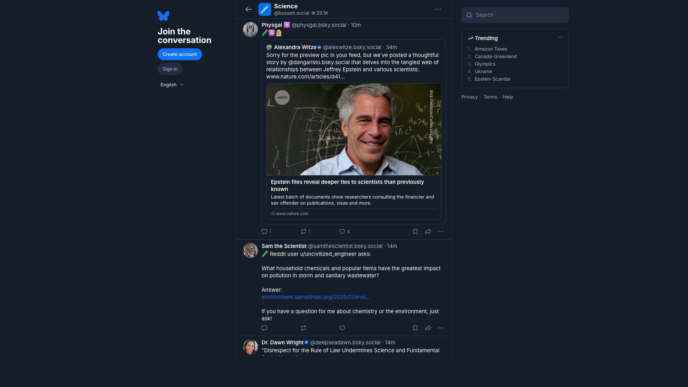
Bluesky UI: what a feed looks like
Takeaway: a feed page renders an algorithm into a timeline of posts.
A. Feed name
A
Demand signals
B. Timeline output
B
Exposure decisions
C. Post actions
Why we measure
Manipulation risk
C

Slide 5


Bluesky UI: starter packs (onboarding bundles)
Takeaway: starter packs bundle people (and sometimes feeds) for fast onboarding.
A. Pack title
A
Curated list
B. Join button
B
1-click onboarding
C. People cards
C
Curation questions
Measure exposure

Slide 6



Research questions (R1-R5)
Takeaway: security and privacy scope.
R1 Discovery chokepoints? governance.
R2 Provider buckets dominate? reliability.
R3 Same winners across feeds? manipulation.
R4 Labels vary by viewer? safety.
R5 Future experiment: gaming plus privacy attacks. extra guardrails.

Slide 7
Data artifacts collected (no results)
Discovery inputs
feed_generators_index.csv
starterpacks.csv
starterpack_feeds.csv
discovery_feed_inclusions.csv
popular_feeds.csv
Panel snapshots
feed_panel.csv
feed_items.csv.gz
posts.csv.gz
authors.csv.gz
post_labels.csv.gz
Trust and reproducibility
state.db
run_metadata.csv
run_summary.csv
manifest.csv
data_dictionary.csv
validation_report.csv
Join spine
feed_panel -> feed_items -> posts/authors
post_labels attaches by feed_uri, viewer_mode, post_uri, post_cid.
Result: joinable, reproducible, auditable artifacts.

Slide 8
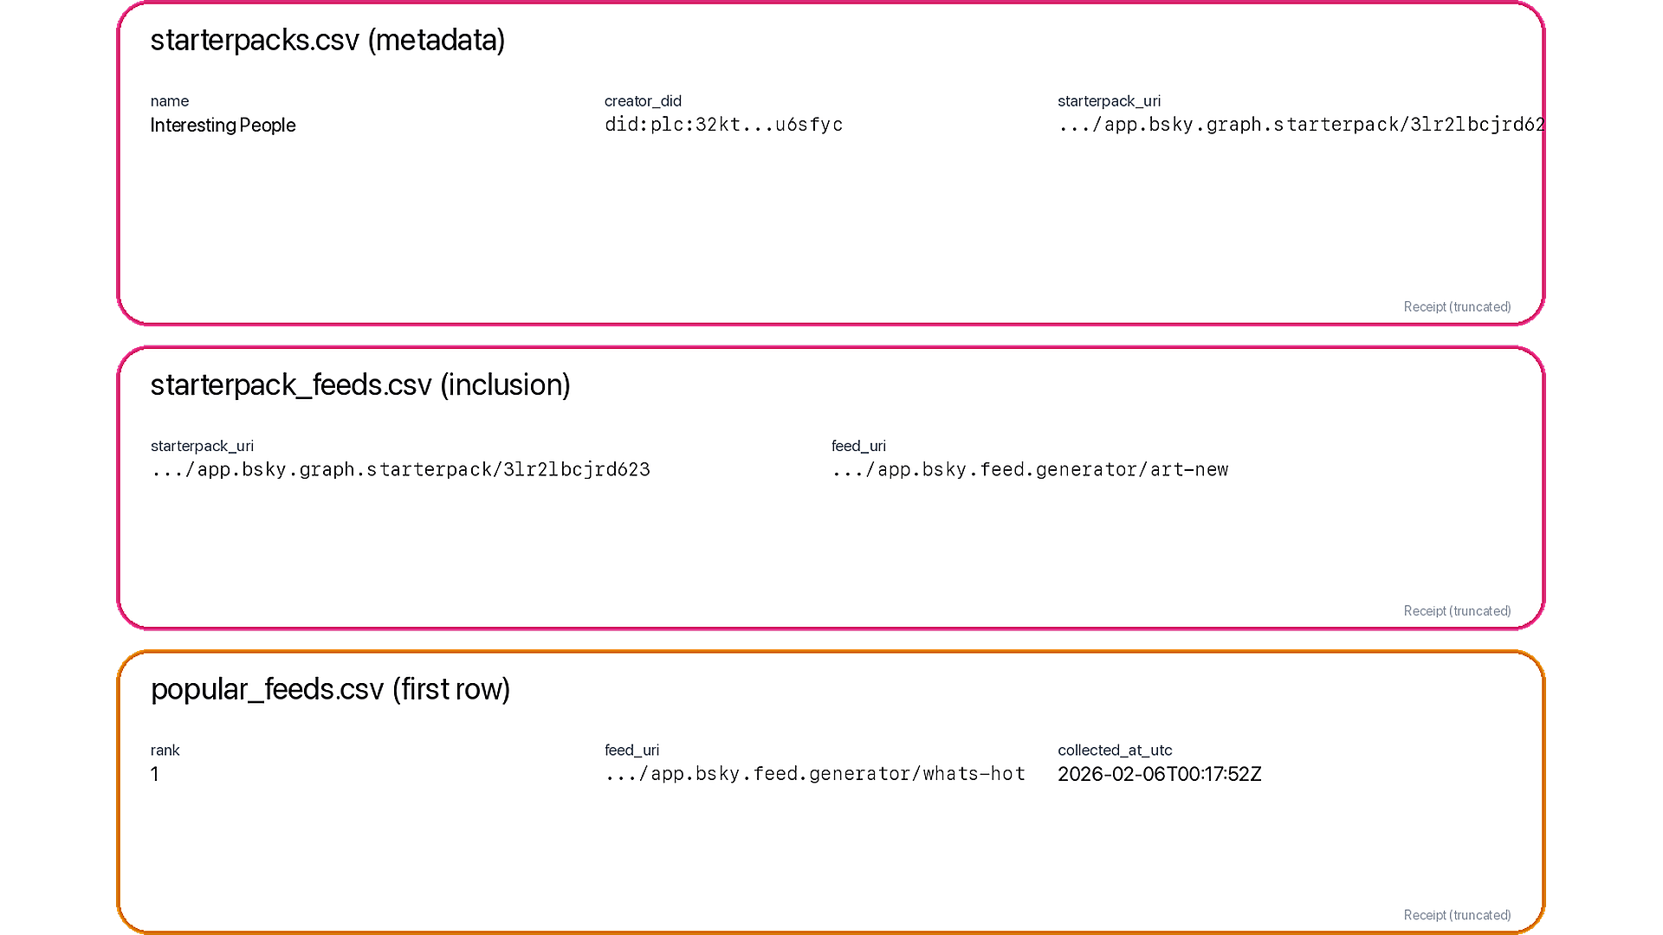
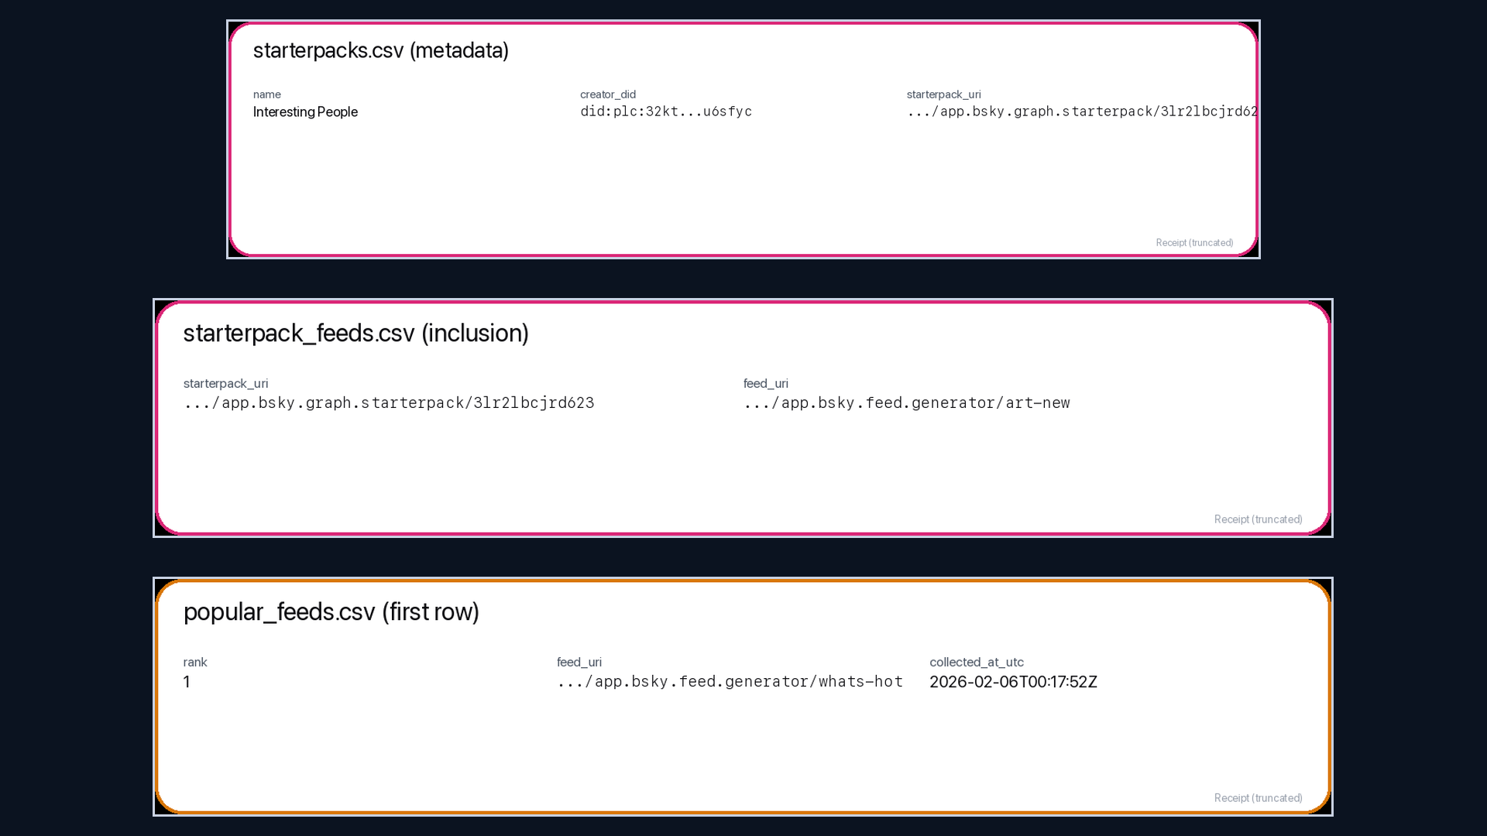
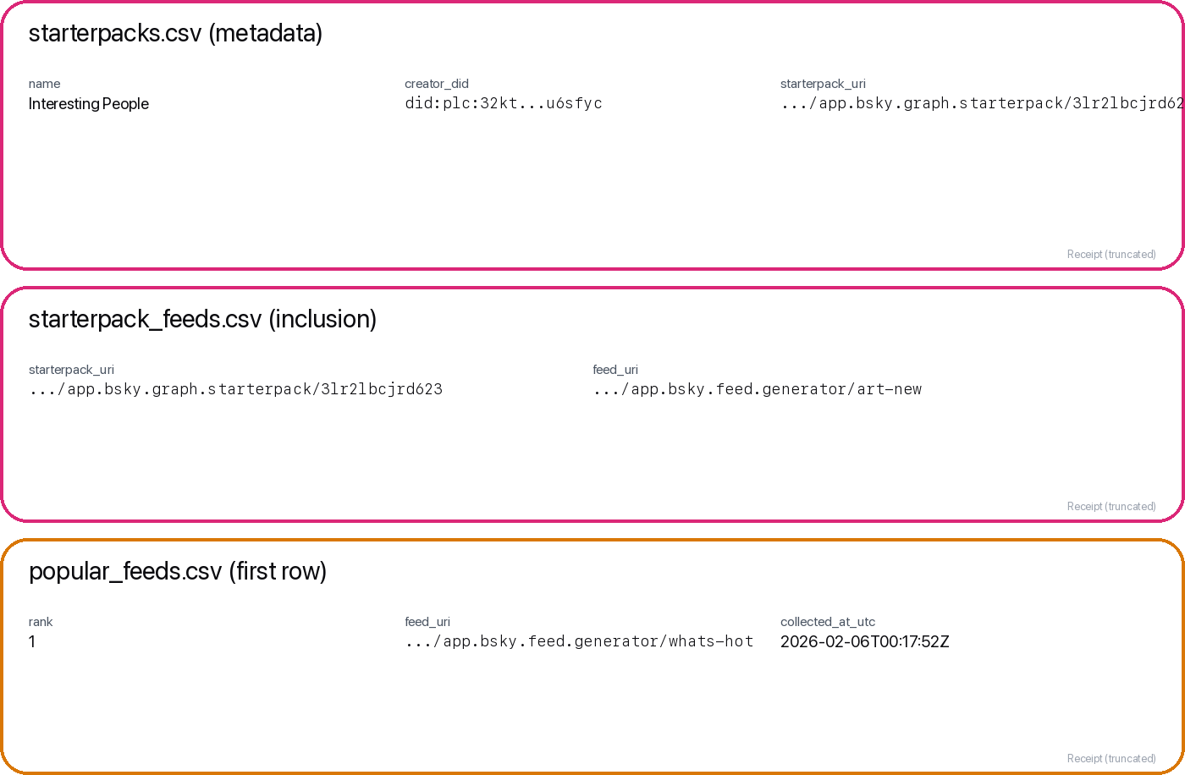
Data receipt: discovery surfaces (starter packs + popular list)
Takeaway: discovery is measurable via starter-pack inclusion and popular list ranks.
A. Starter packs
A
starterpacks + starterpack_feeds
B. Inclusion_count
slot_count (position-weighted)
B
C. Popularity_rank
Why it matters
Concentration + provider leverage
C

Slide 9
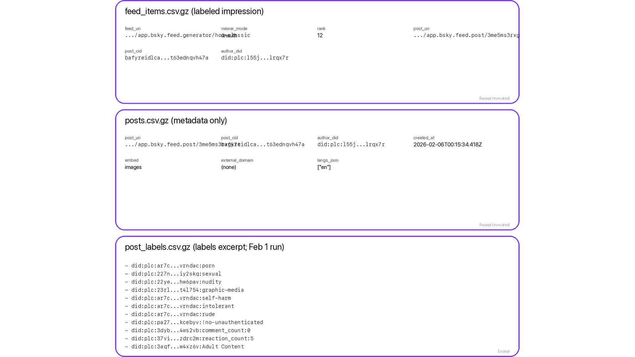
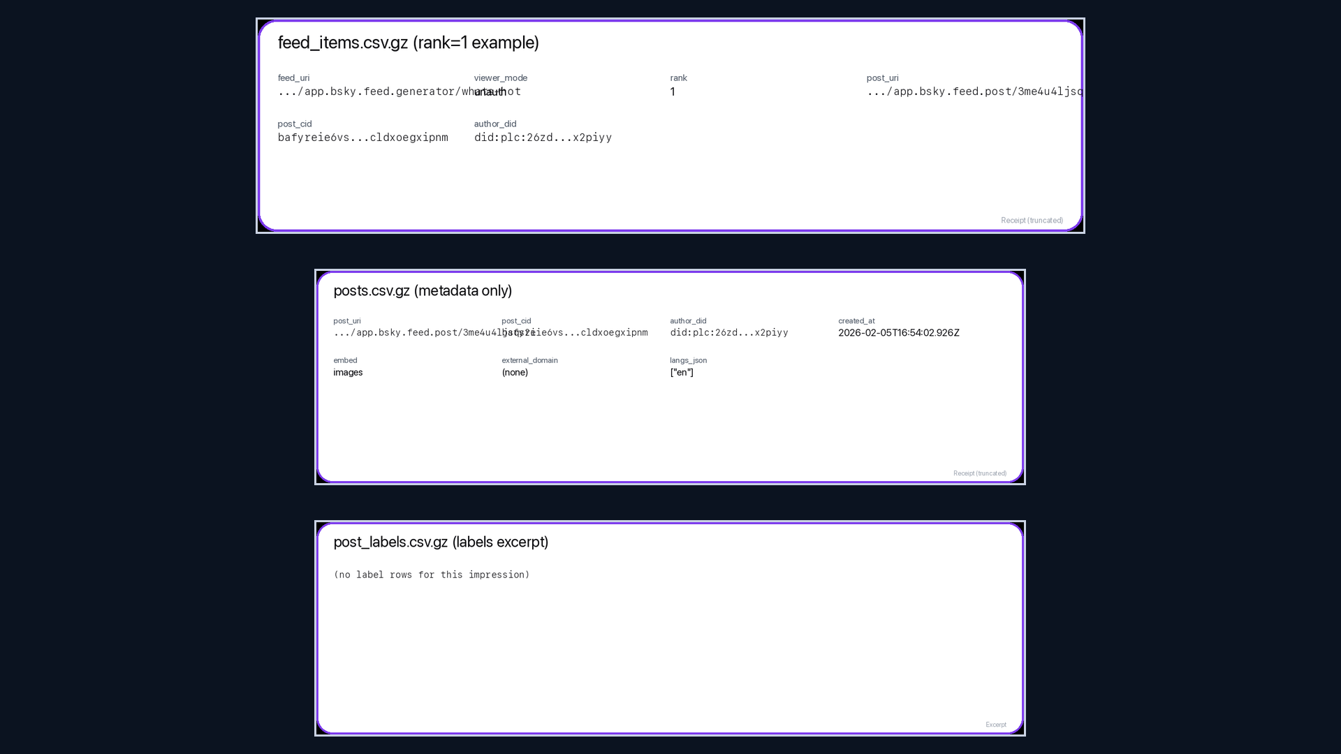
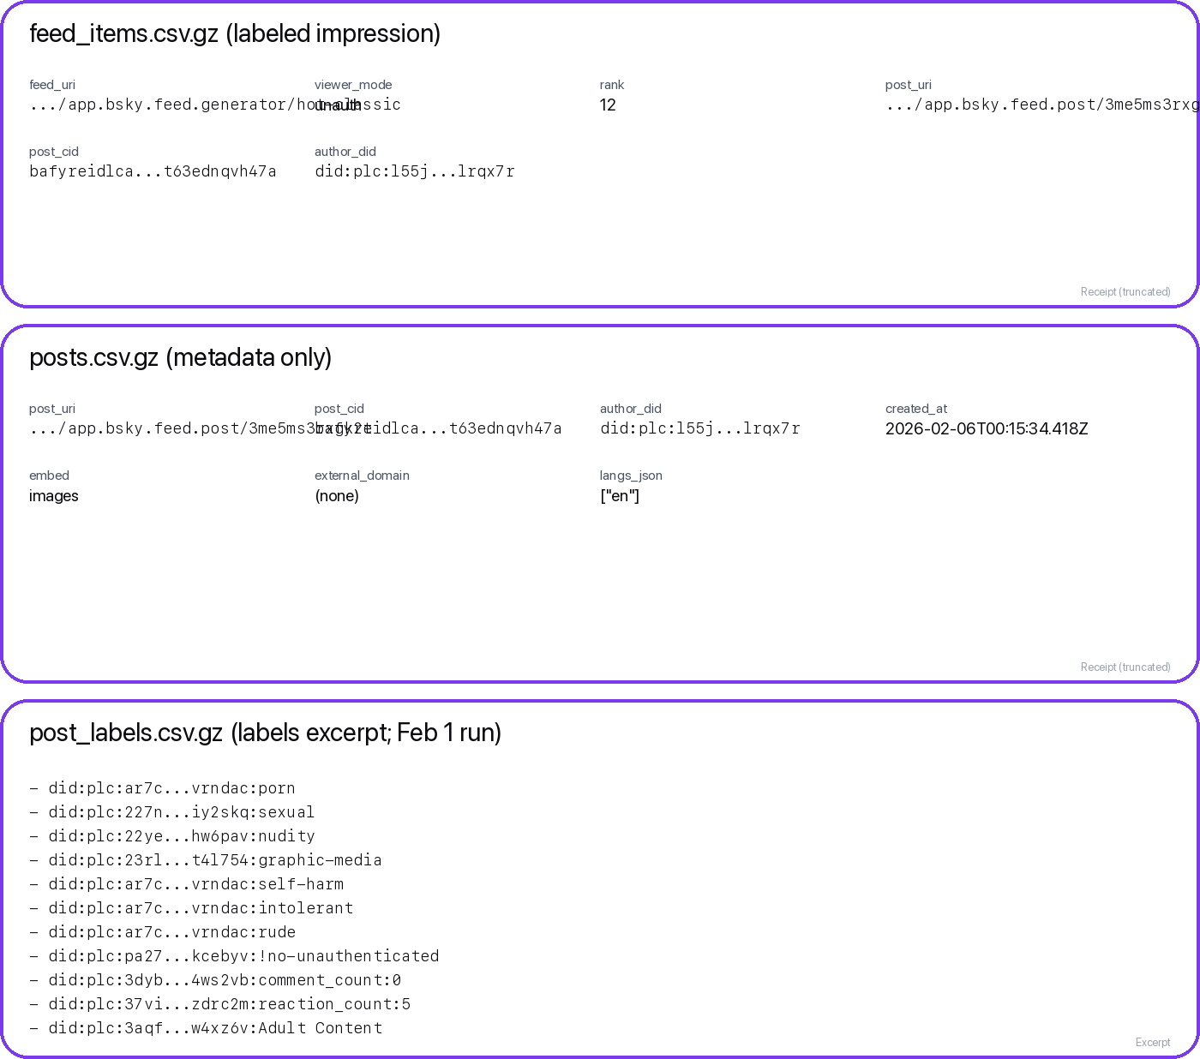
Data receipt: ranked exposure + risk labels
Takeaway: feed_items + posts + labels already support H1-H6 (cross-sectional).
A. feed_items row
A
(feed_uri, viewer_mode, rank)
B. posts row
text + links + langs
B
C. post_labels row
H6: risk exposure
Feed auditing / mitigations
C

Slide 10
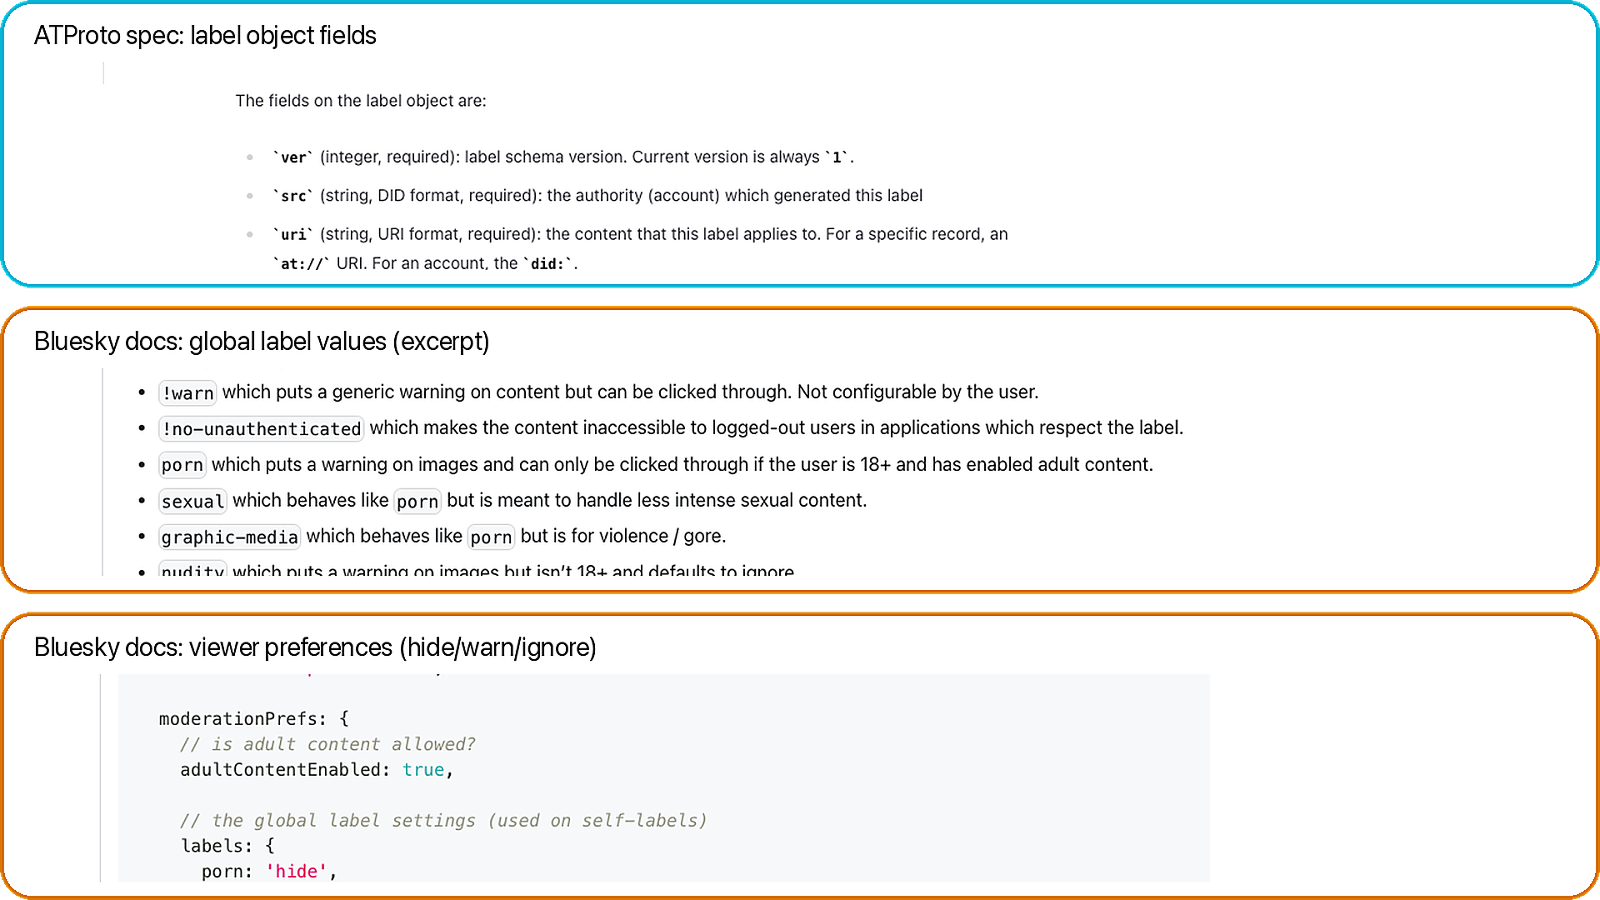
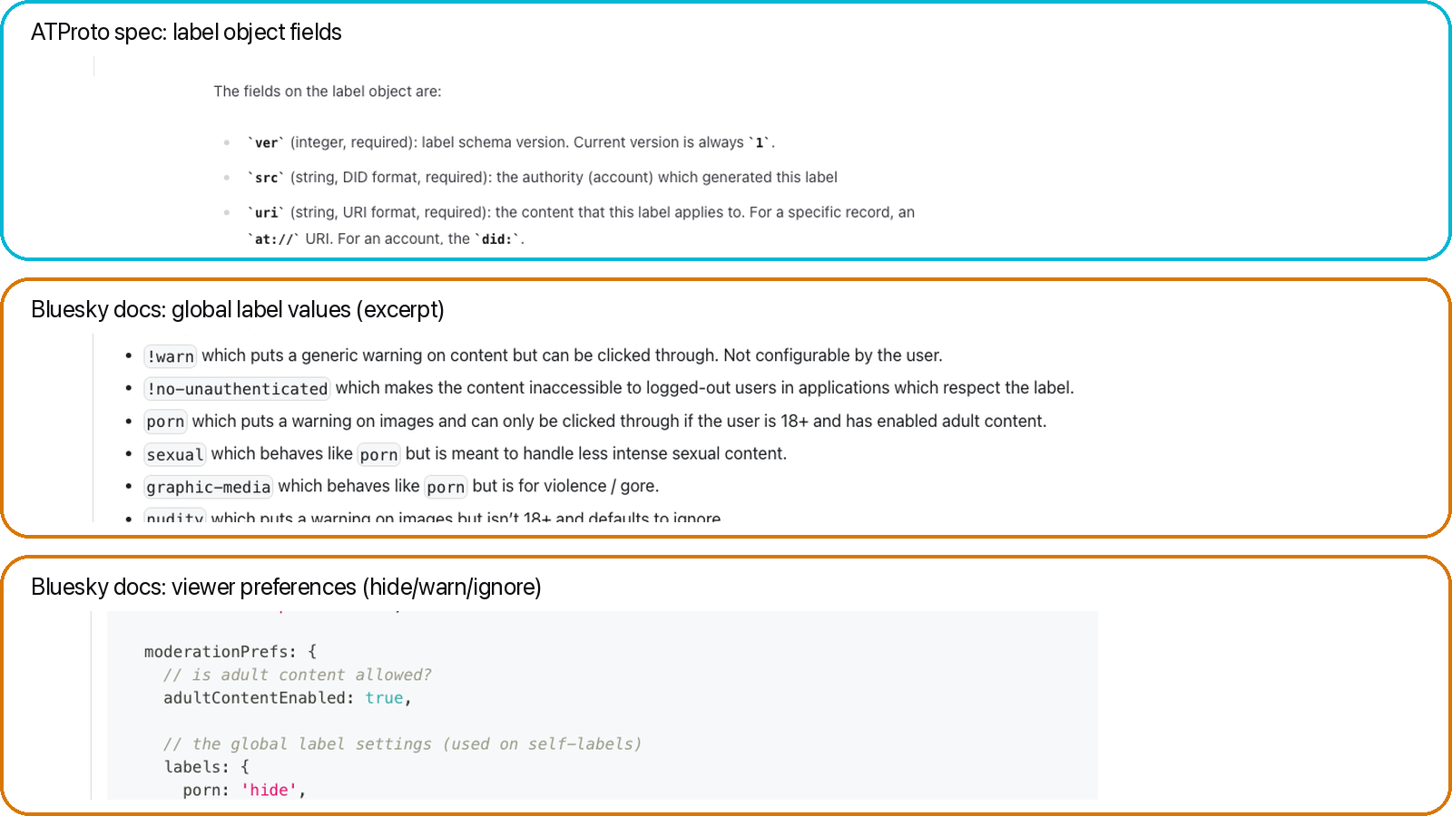
Data receipt: labels (schema + global values + prefs)
Takeaway: labels are structured safety signals; behavior depends on viewer prefs.
A. Label schema
A
(src, uri/cid, val, neg, cts)
B. Global values
protocol-defined strings
B
C. Viewer prefs
hide / warn / ignore
Docs grounding
C

Slide 11
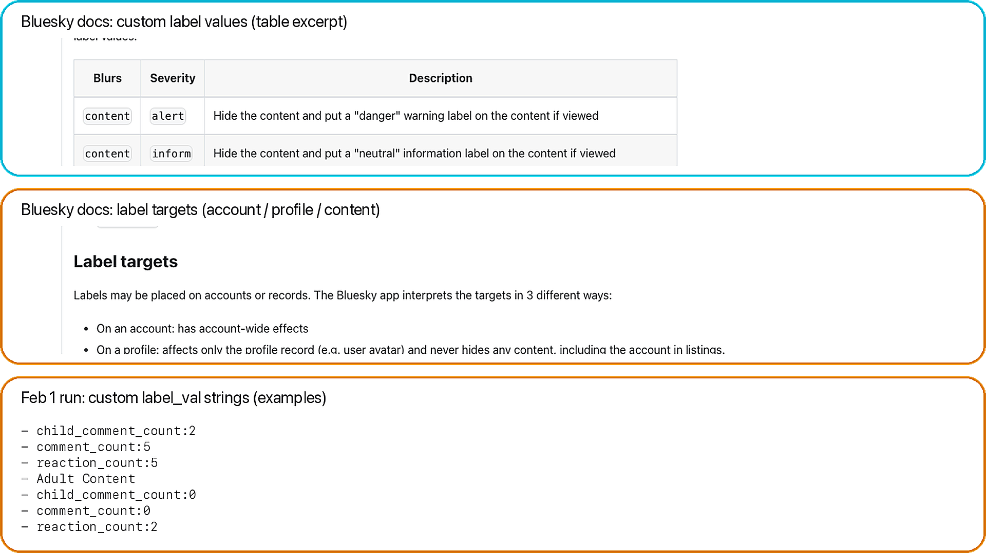
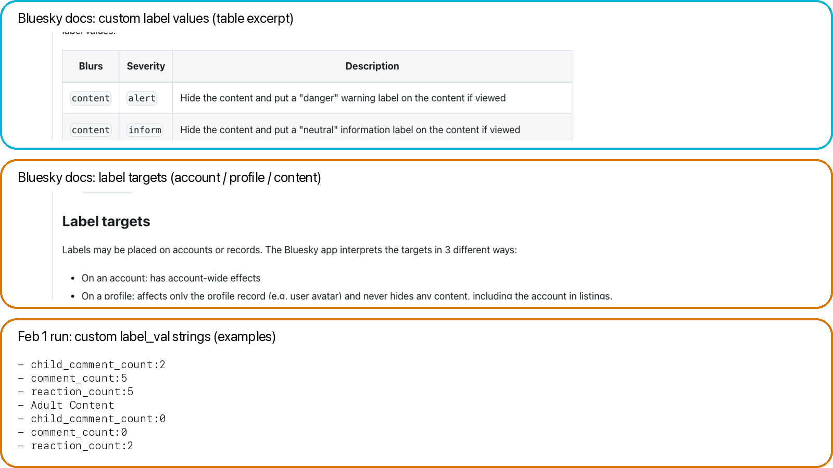
Data receipt: custom labels (definitions + targets)
Takeaway: labelers can define custom taxonomies; we preserve raw label_val strings.
A. Custom definitions
A
blur + severity + defaults
B. Label targets
account vs profile vs content
B
C. Observed values
dataset examples
Why it matters
C

Slide 12
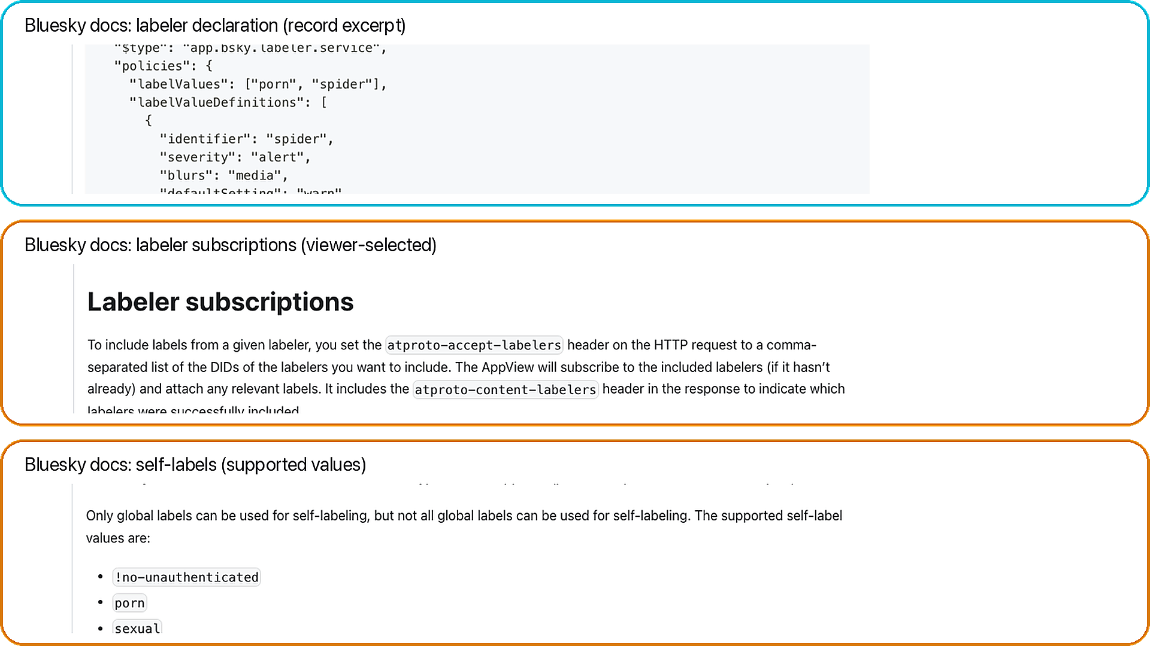
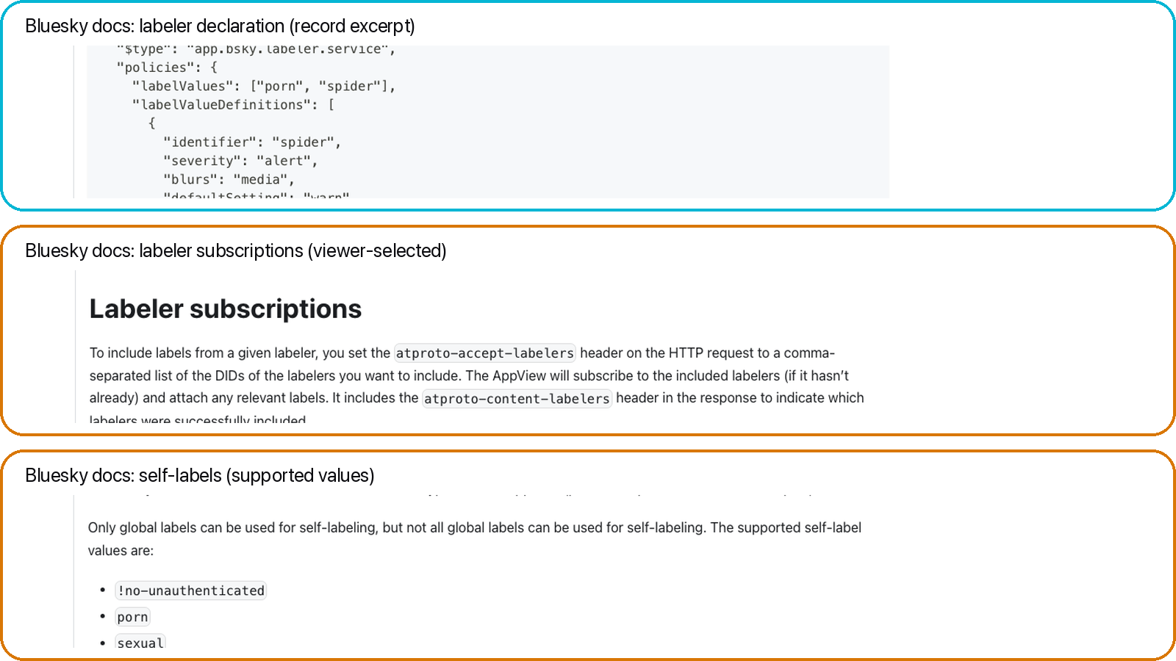
Data receipt: labelers (declarations + subscriptions + self-labels)
Takeaway: labels come from services; viewers choose which labelers to trust.
A. Declaration
A
values + policies
B. Subscriptions
viewer-selected
B
C. Self-labels
built-in values
Why it matters
C

Slide 13
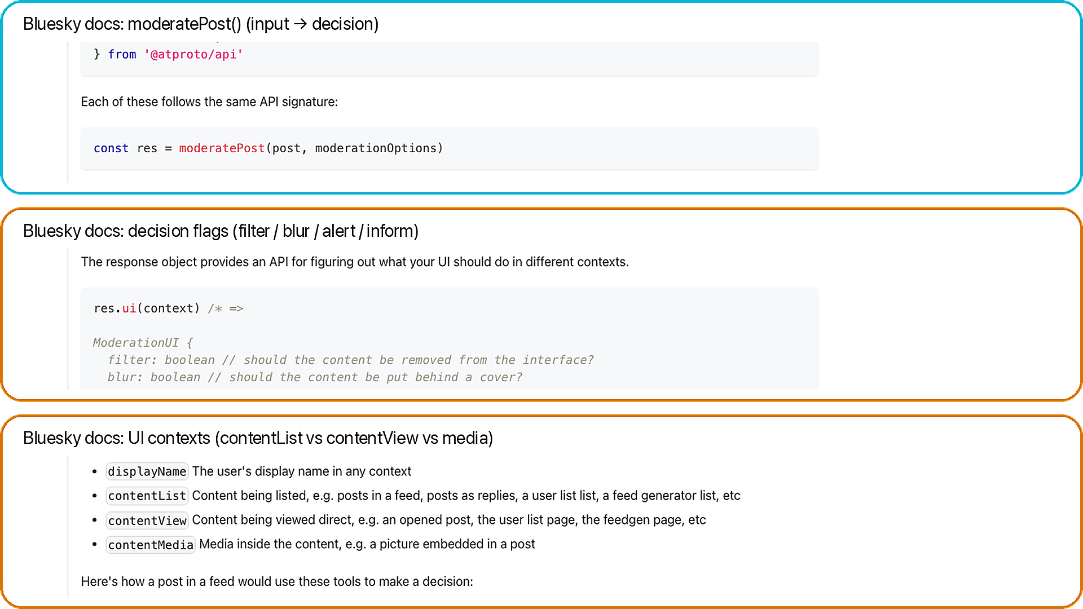
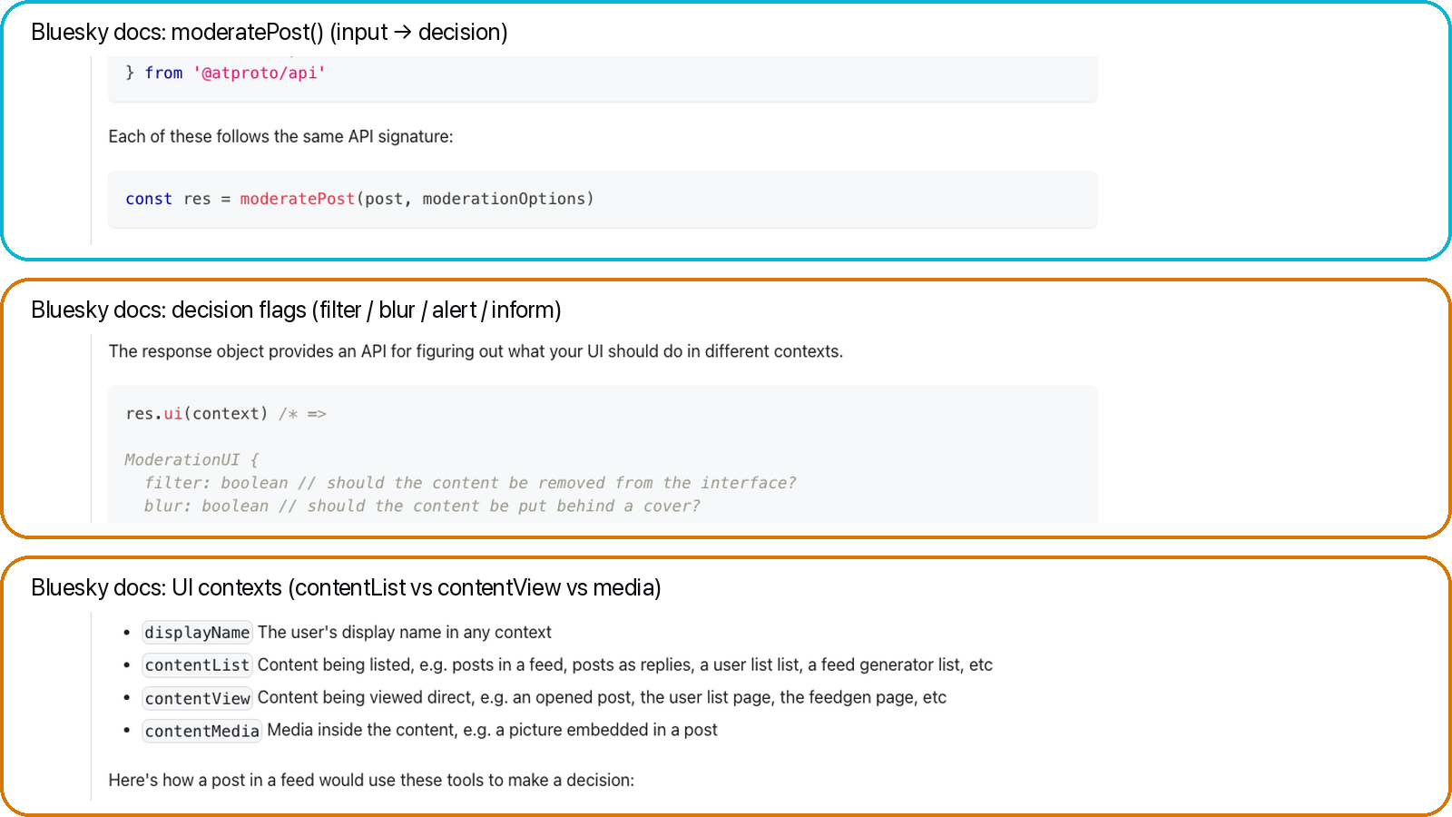
Data receipt: moderation decisions (flags + UI contexts)
Takeaway: the same label can blur/warn/filter depending on context + prefs.
A. moderatePost()
A
post + prefs → decision
B. Output flags
filter / blur / alert / inform
B
C. UI contexts
contentList vs view vs media
Docs grounding
C

Slide 14

Collection credibility (one slide)
Read-only XRPC summary
Relay + AppView reads.
GET-only in this run.
POST auth only if auth mode is used.
No posting actions.
7-stage pipeline
relay -> index -> packs -> popular -> enrich -> panel -> snapshot
Reproducibility: state.db, manifest.csv, data_dictionary.csv, validation_report.csv.

Slide 15
What this enables next + advisor asks
Ready measurements
RQ1: measure discovery concentration.
RQ2: map provider leverage.
RQ3: test same winner overlap.
RQ4: compare label variability.
What I need from you
Ask 1: priority RQs and venue fit.
Ask 2: recollect longitudinal, auth mode, or experiments?

Slide 16
Backup: API surfaces (names only)
Surface | Names
Relay | com.atproto.sync.listReposByCollection
AppView | getActorFeeds, getFeedGenerators, getStarterPack, getFeed, getProfiles
PDS/Auth | createSession, refreshSession (auth mode only)

Slide 17
Backup: folder layout + trust stamps
Run directory layout
01_state_db/
02_csv_exports/
03_postprocess_metrics/
04_logs/
05_manifest/
06_figures_preview/
07_archive_zip/
Trust stamps
run_metadata.csv
run_summary.csv
manifest.csv
data_dictionary.csv
validation_report.csv
state.db

Slide 18
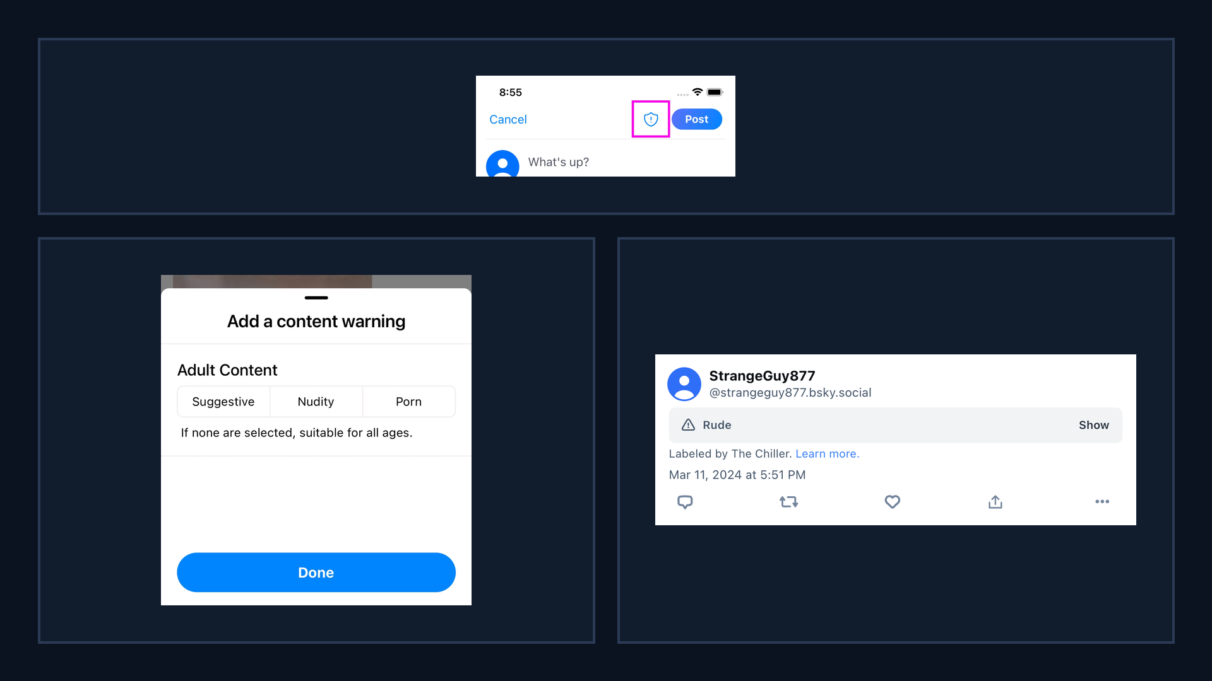
Bluesky UI: labeling surfaces (official)
Takeaway: labels are user-facing controls that shape what gets shown or filtered.
A. Self-label button
Composer surface
A
B. Content warning picker
Adult Content options
B
C
C. Labeled post banner
Attribution to labeler
Why it matters: filtering + exposure

Slide 19
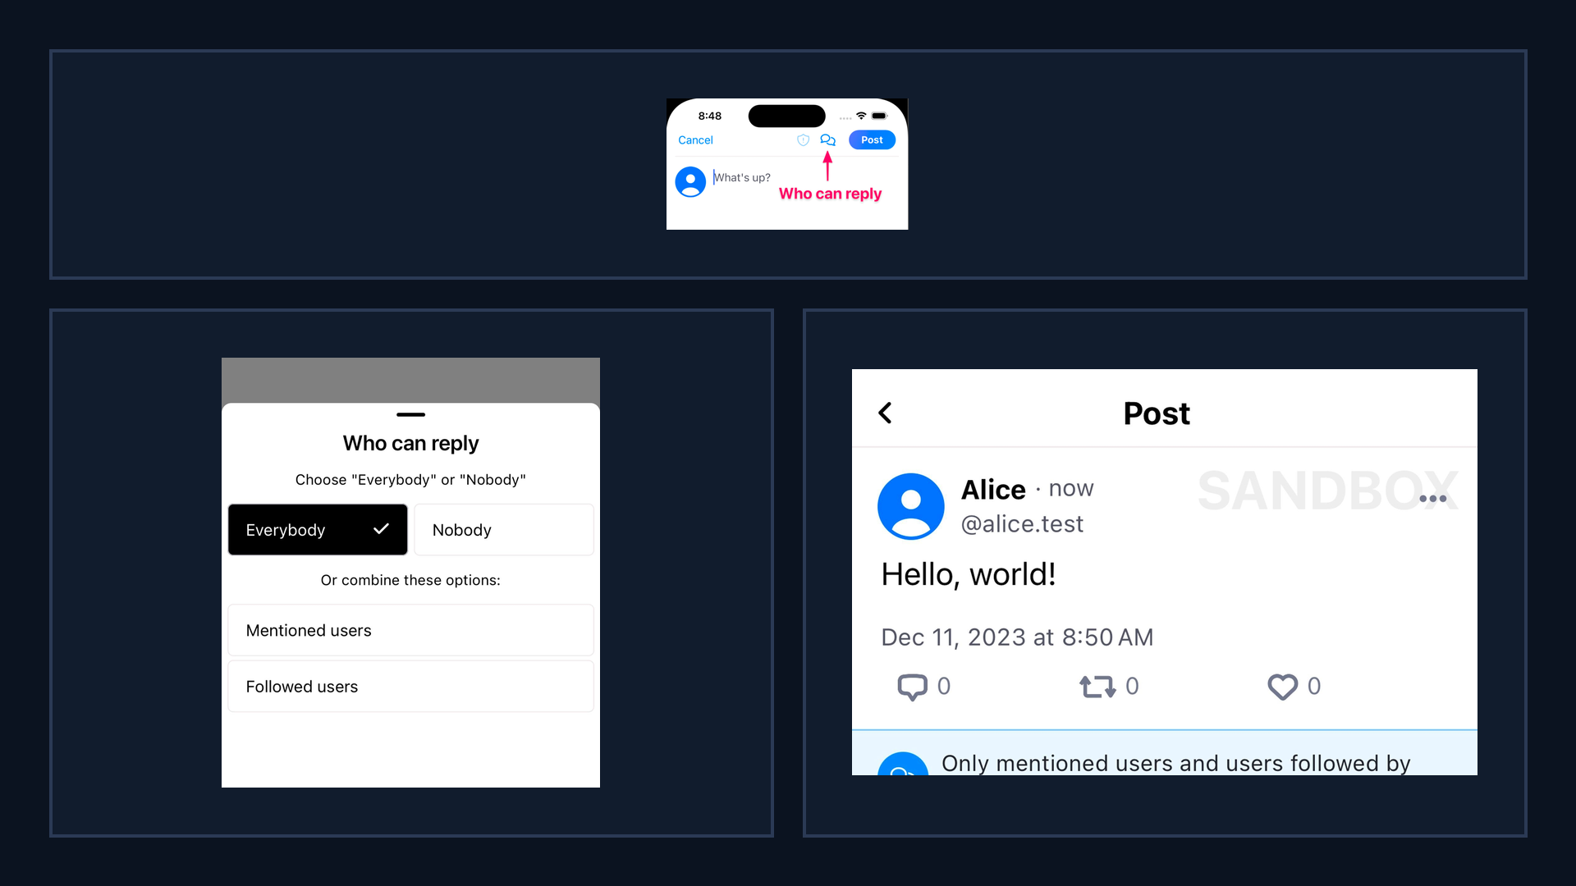
Bluesky UI: reply controls (official)
Takeaway: reply controls gate interaction, changing who can respond and what feedback loops form.
A. Reply controls button
Composer setting
A
B. Who can reply picker
Audience gating
B
C
C. Post notice
Visible constraint
Why it matters: interaction graphs

Slide 20
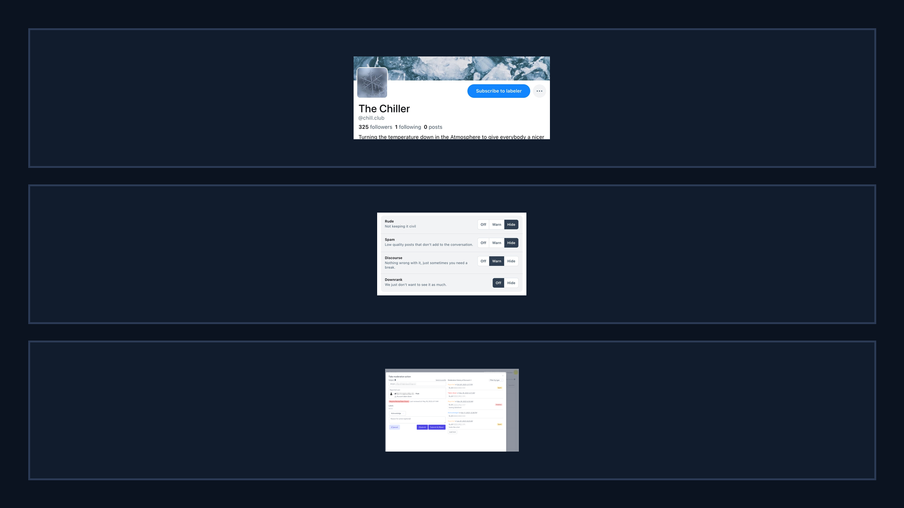
Bluesky UI: labelers + moderation tools (official)
Takeaway: moderation is modular—users can subscribe to labelers and tune label handling.
A. Subscribe to labeler
Third-party policies
A
B. Per-label controls
Off / Warn / Hide
B
C. Ozone moderation UI
Operational tooling
Why it matters: power shifts
C

Slide 21
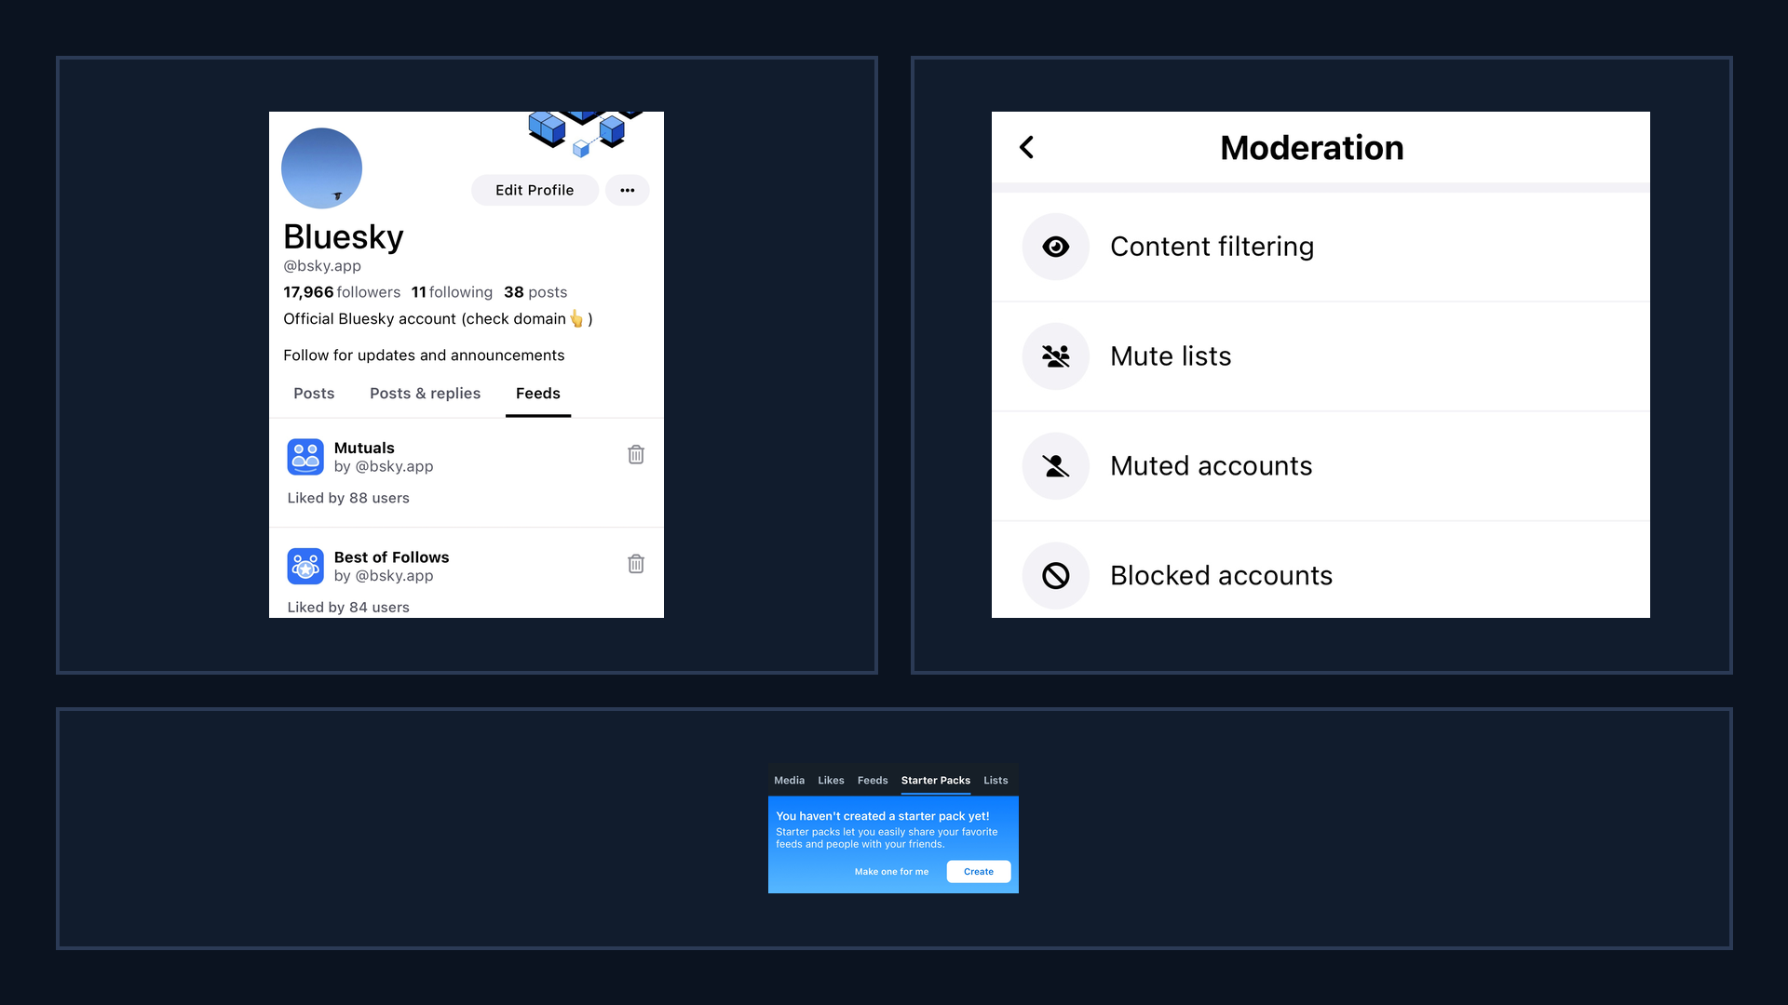
Bluesky UI: discovery surfaces (official)
Takeaway: discovery is shaped by navigation, defaults, and safety settings surfaced in the UI.
A. Custom feeds tab
Algorithm marketplace
A
B
B. Moderation menu
Filtering settings
C. Starter packs tab
Onboarding surface
Why it matters: defaults steer
C

Slide 22
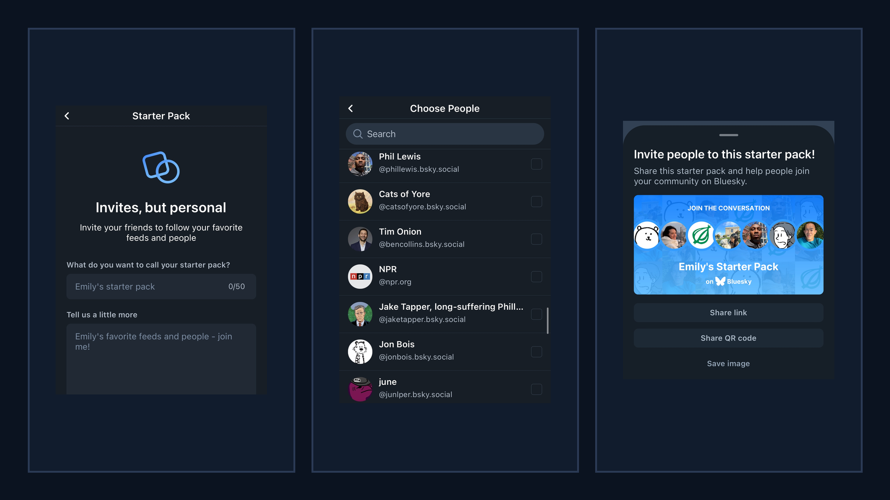
Bluesky UI: starter packs flow (official)
Takeaway: starter packs bundle people (and context) into a single shareable onboarding object.
A. Create starter pack
Name + description
A
B
C
B. Choose people
Curation choices
C. Share pack
Link / QR / image
Why it matters: bundled exposure

Slide 23
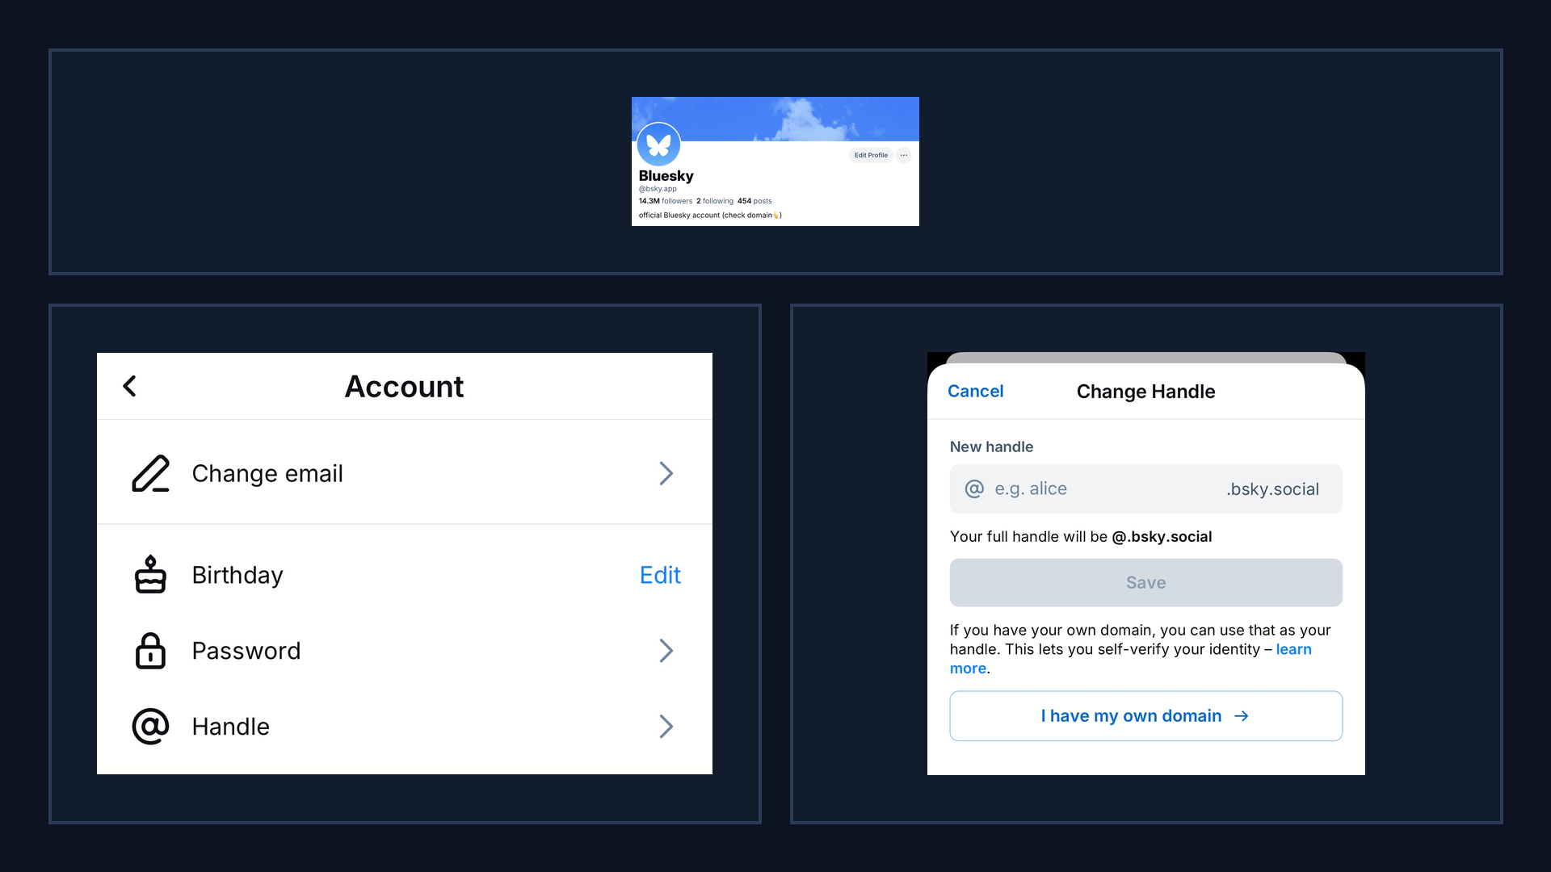
Bluesky UI: domain handles (surface → settings) (official)
Takeaway: domain handles connect identity and credibility to a verifiable control channel (DNS).
A. Domain handle profile
Trust signal
A
B. Settings: handle
Entry point
B
C
C. Use own domain
Verification flow
Why it matters: credibility

Slide 24
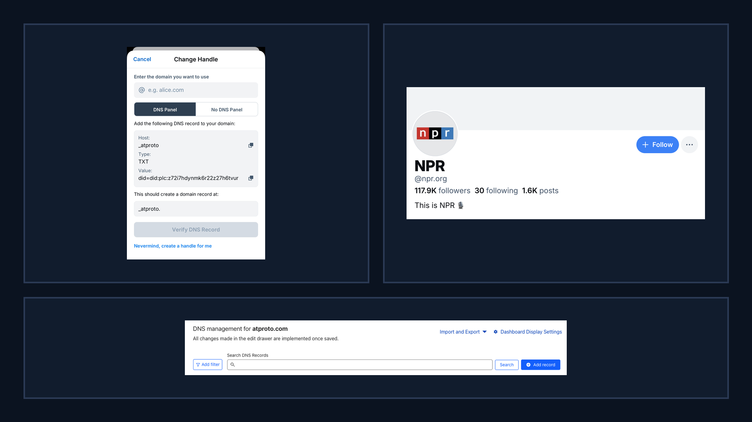
Bluesky UI: domain verification + examples (official)
Takeaway: verification relies on external DNS tooling, creating measurable and potentially gameable steps.
A. DNS TXT record
Proof-of-control
A
B
B. Domain handle example
@npr.org
C. DNS management UI
External dependency
Why it matters: measurable steps
C

