Slide 1
Algorithmic choice relocates power
BLUESKY RQs + DATA
NO RESULTS TODAY
Research questions plus data artifacts collected (no results yet).
FEB 2026

Slide 2

System framing: pluggable services, new chokepoints
BLUESKY RQs + DATA
Takeaway: modular services relocate concentration.
viewer
discovery surfaces
feed generators
provider hosting
exposure outcomes
labelers
Discovery surfaces and provider hosting are key chokepoints.
FEB 2026

Slide 3

Bluesky UI: feed marketplace (/feeds)
BLUESKY RQs + DATA
Takeaway: feeds are discoverable + selectable algorithmic timelines.
A. /feeds directory
A
C
Search feeds
B
B. Feed cards
Creator + likes
C. Trending widget
Defaults matter
Discovery risk
FEB 2026

Slide 4
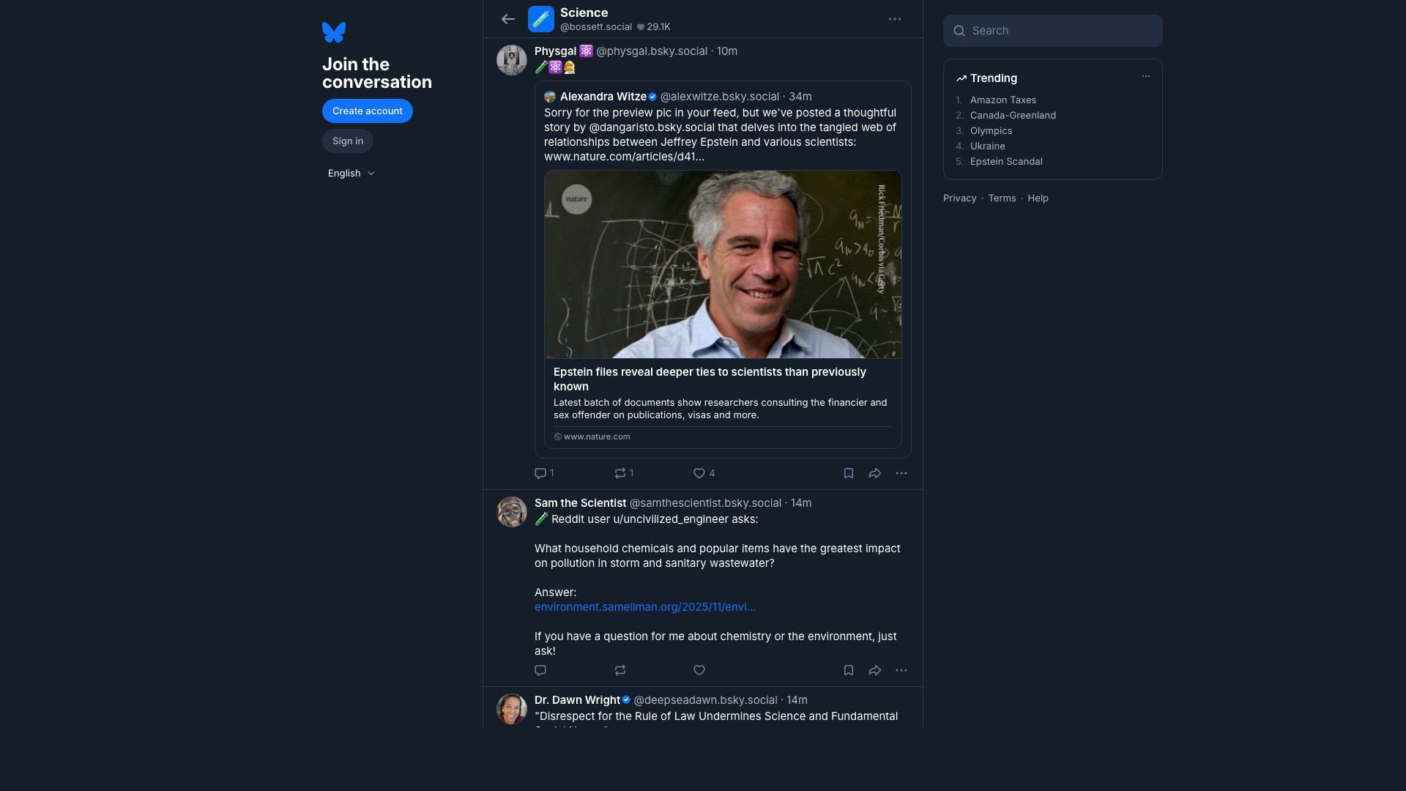
Bluesky UI: what a feed looks like
BLUESKY RQs + DATA
Takeaway: a feed page renders an algorithm into a timeline of posts.
A. Feed name
A
Demand signals
B
B. Timeline output
Exposure decisions
C. Post actions
C
Why we measure
Manipulation risk
FEB 2026

Slide 5

Bluesky UI: starter packs (onboarding bundles)
BLUESKY RQs + DATA
Takeaway: starter packs bundle people (and sometimes feeds) for fast onboarding.
A. Pack title
A
Curated list
B
B. Join button
1-click onboarding
C
C. People cards
Curation questions
Measure exposure
FEB 2026

Slide 6
Research questions (R1-R5)
01
05
02
03
04
Takeaway: security and privacy scope.
R1 Discovery chokepoints? governance.
R5 Future experiment: gaming plus privacy attacks. extra guardrails.
R2 Provider buckets dominate? reliability.
R3 Same winners across feeds? manipulation.
R4 Labels vary by viewer? safety.

Slide 7
Data artifacts collected (no results)
Takeaway: artifacts are joinable, reproducible, and auditable.
01
02
03
04
Discovery inputs
Panel snapshots
Trust and reproducibility
Join spine
feed_generators_index.csv • starterpacks.csv • starterpack_feeds.csv • …
feed_panel.csv • feed_items.csv.gz • posts.csv.gz • …
state.db • run_metadata.csv • run_summary.csv • …
feed_panel -> feed_items -> posts/authors • post_labels attaches by feed_uri, viewer_mode, post_uri, post_cid. • Result: joinable, reproducible, auditable artifacts.

Slide 8
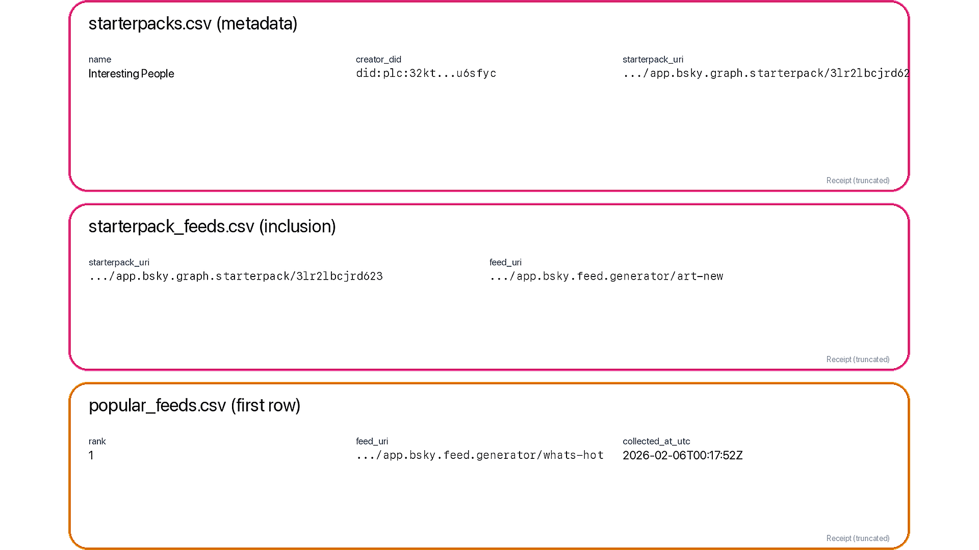
Data receipt: discovery surfaces (starter packs + popular list)
BLUESKY RQs + DATA
Takeaway: discovery is measurable via starter-pack inclusion and popular list ranks.
A. Starter packs
A
starterpacks + starterpack_feeds
B. Inclusion_count
B
slot_count (position-weighted)
C. Popularity_rank
Why it matters
C
Concentration + provider leverage
FEB 2026

Slide 9
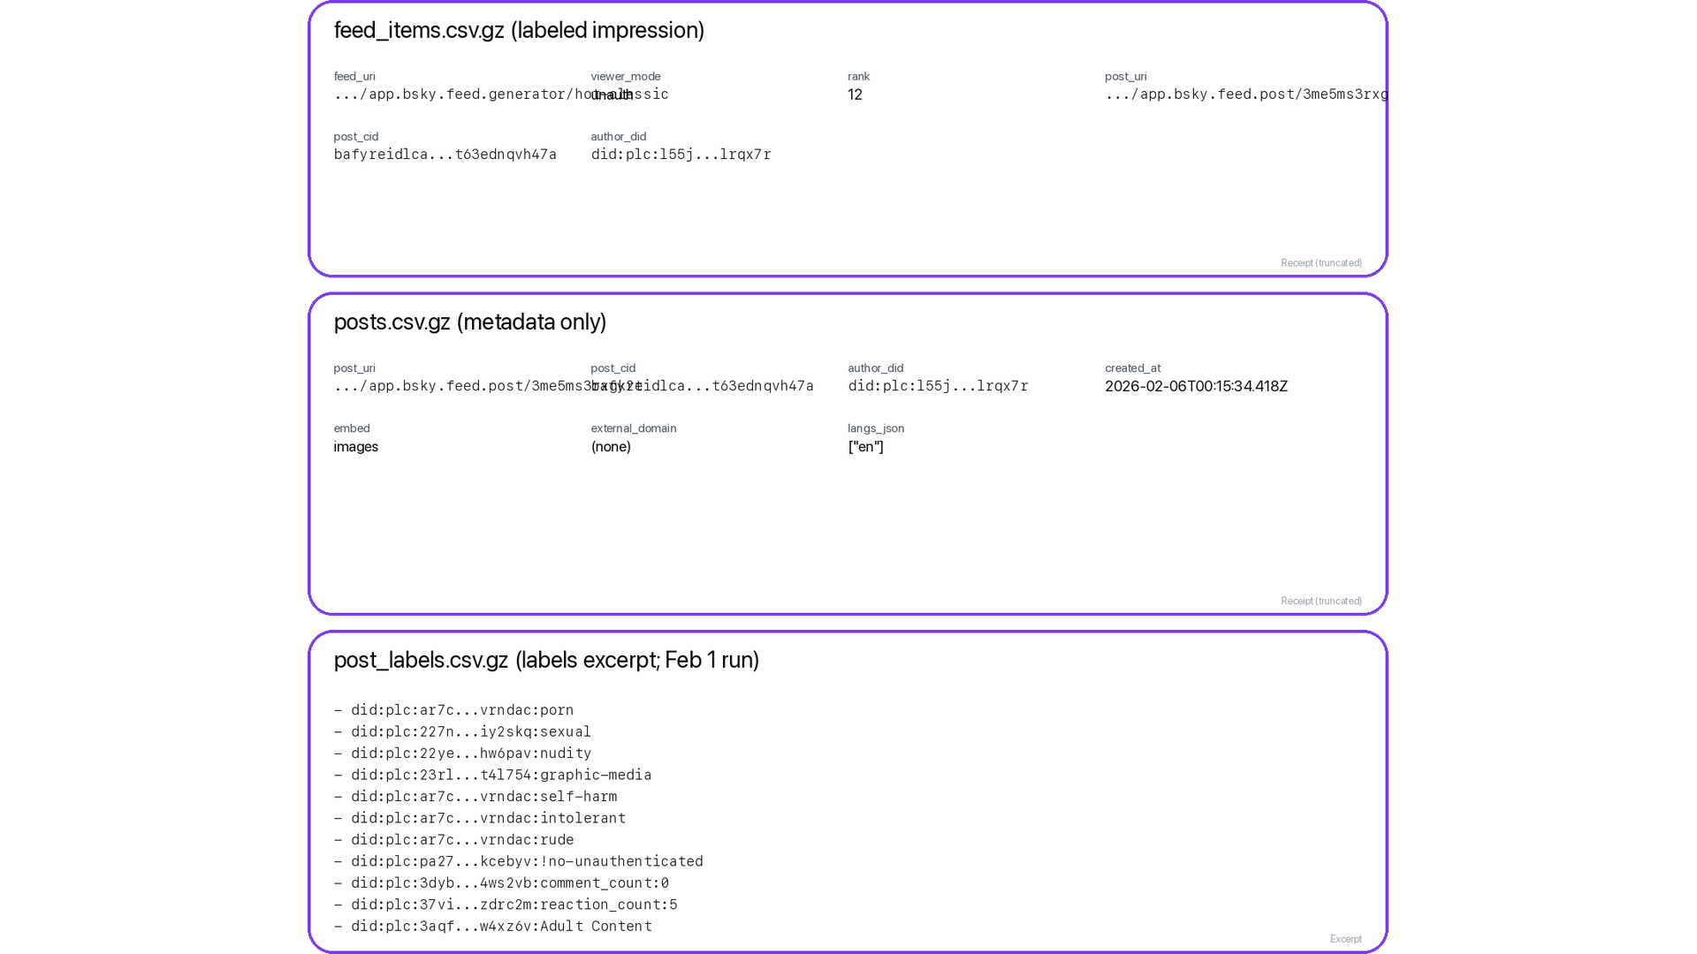
Data receipt: ranked exposure + risk labels
BLUESKY RQs + DATA
Takeaway: feed_items + posts + labels already support H1-H6 (cross-sectional).
A. feed_items row
A
(feed_uri, viewer_mode, rank)
B. posts row
B
text + links + langs
C. post_labels row
C
H6: risk exposure
Feed auditing / mitigations
FEB 2026

Slide 10
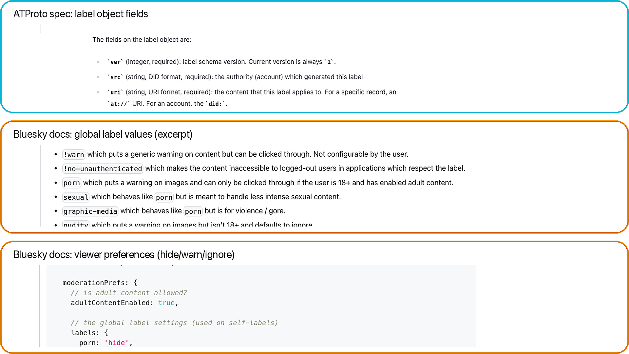
Data receipt: labels (schema + global values + prefs)
BLUESKY RQs + DATA
Takeaway: labels are structured safety signals; behavior depends on viewer prefs.
A. Label schema
A
(src, uri/cid, val, neg, cts)
B. Global values
B
protocol-defined strings
C. Viewer prefs
hide / warn / ignore
C
Docs grounding
FEB 2026

Slide 11
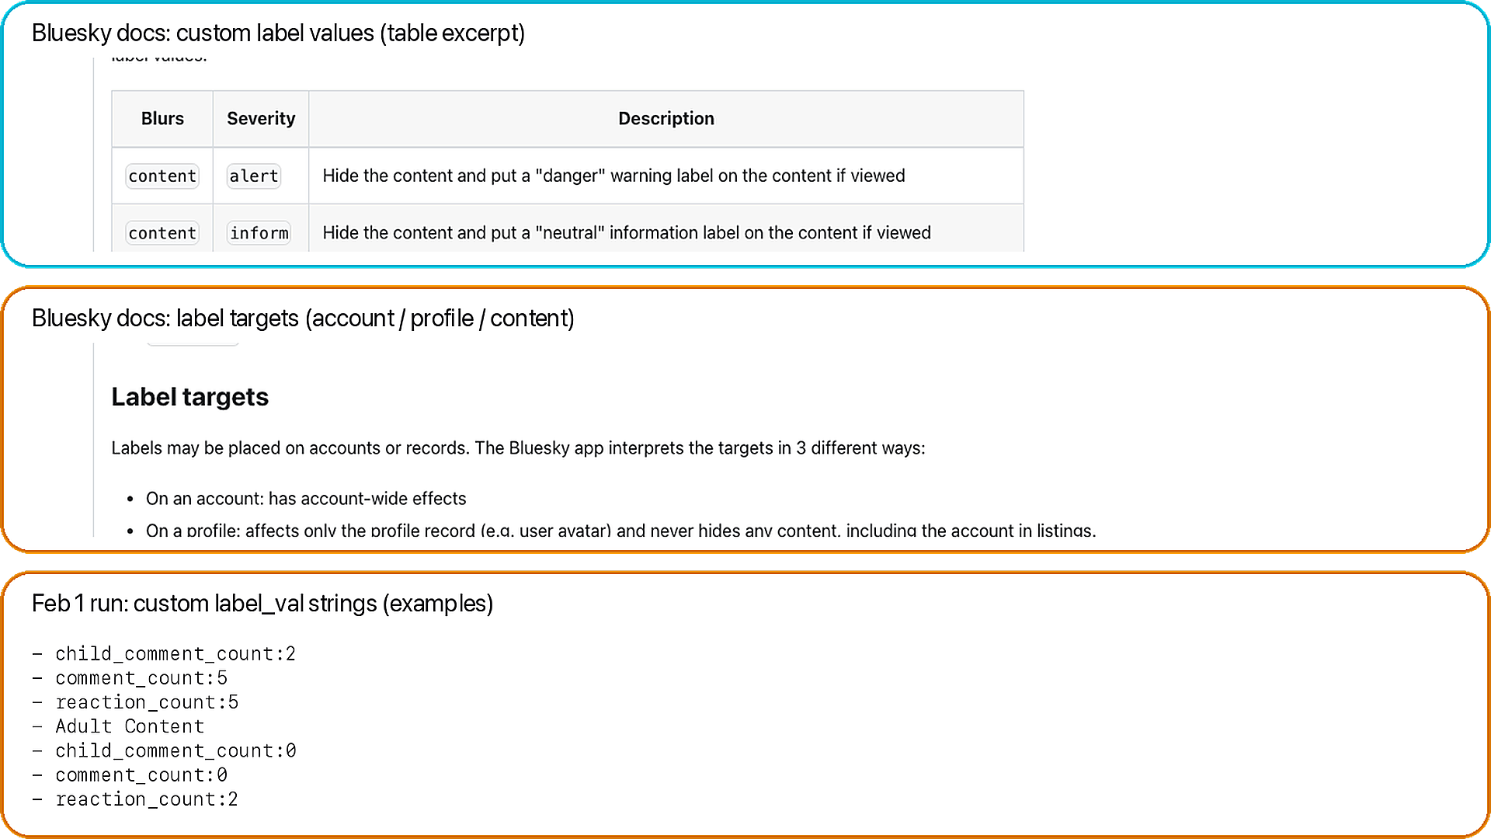
Data receipt: custom labels (definitions + targets)
BLUESKY RQs + DATA
Takeaway: labelers can define custom taxonomies; we preserve raw label_val strings.
A. Custom definitions
A
blur + severity + defaults
B. Label targets
B
account vs profile vs content
C. Observed values
dataset examples
C
Why it matters
FEB 2026

Slide 12
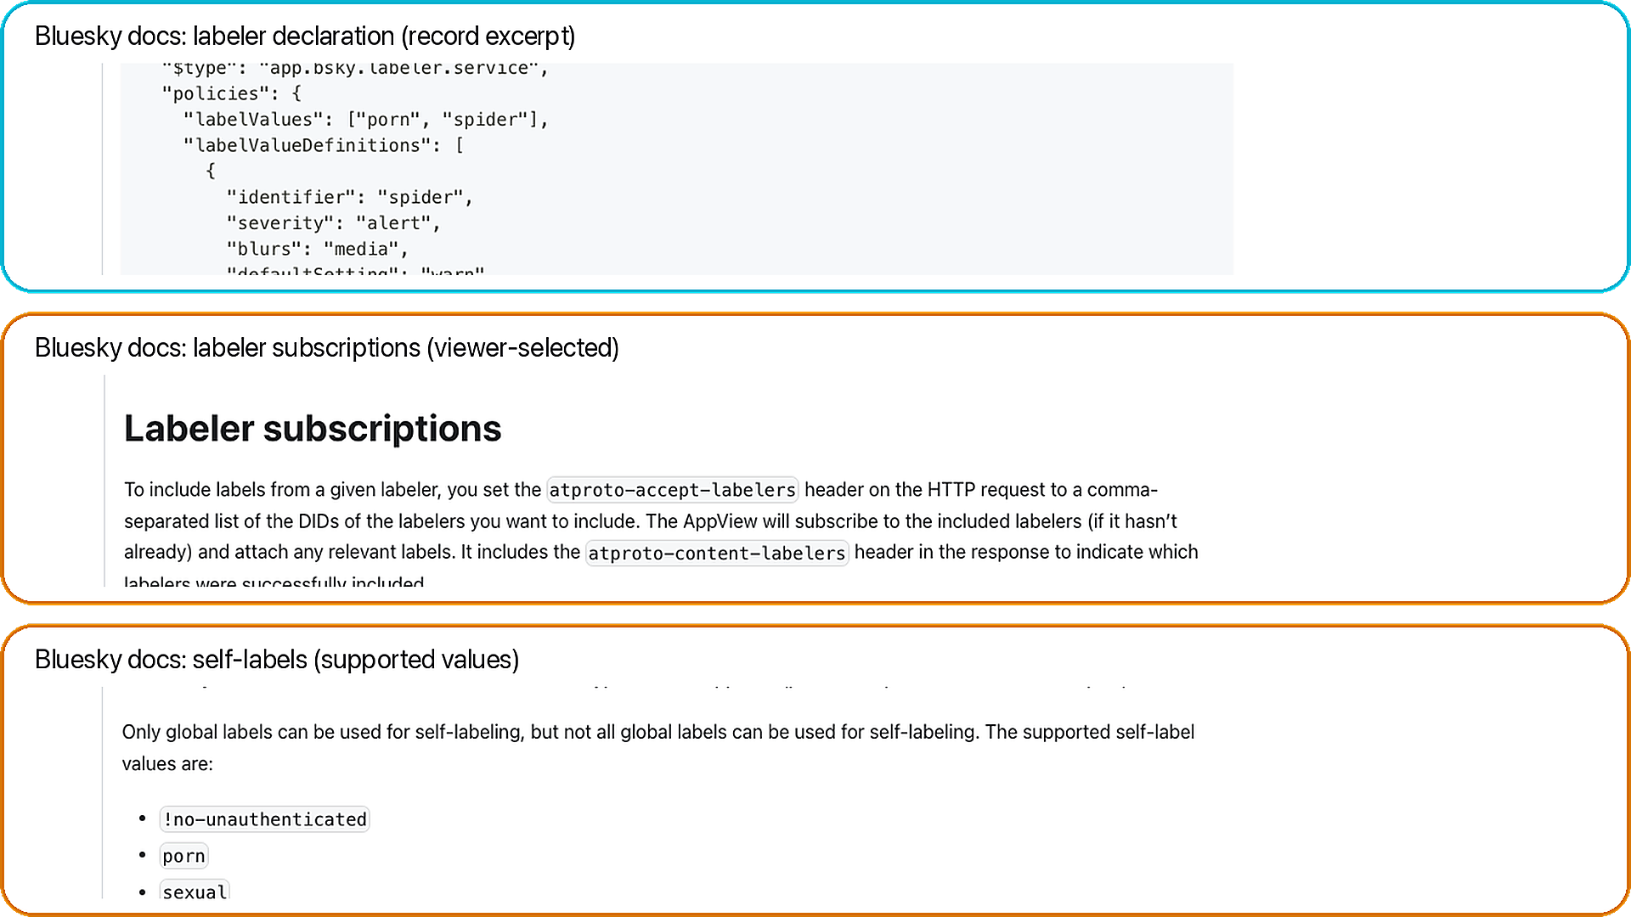
Data receipt: labelers (declarations + subscriptions + self-labels)
BLUESKY RQs + DATA
Takeaway: labels come from services; viewers choose which labelers to trust.
A. Declaration
A
values + policies
B. Subscriptions
B
viewer-selected
C. Self-labels
built-in values
C
Why it matters
FEB 2026

Slide 13
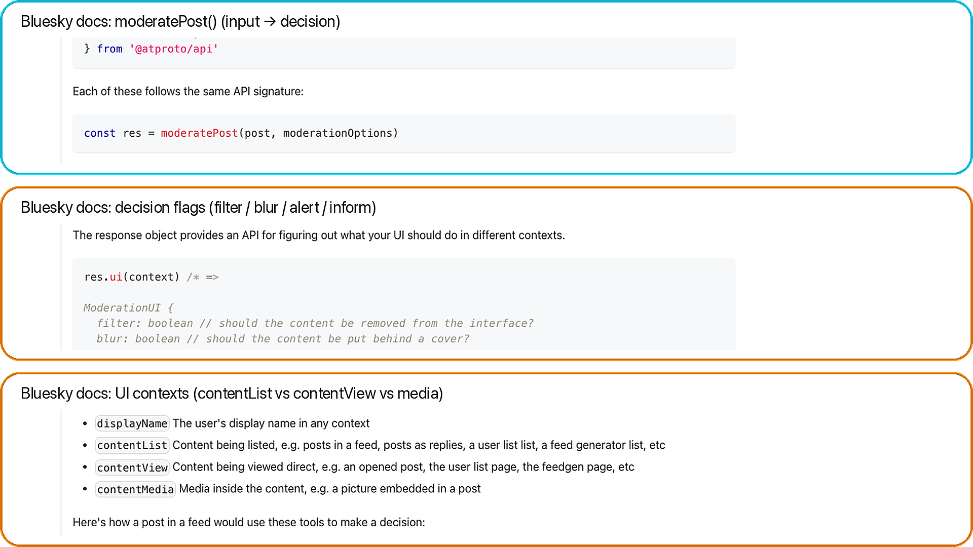
Data receipt: moderation decisions (flags + UI contexts)
BLUESKY RQs + DATA
Takeaway: the same label can blur/warn/filter depending on context + prefs.
A. moderatePost()
A
post + prefs → decision
B. Output flags
B
filter / blur / alert / inform
C. UI contexts
contentList vs view vs media
C
Docs grounding
FEB 2026

Slide 14
Collection credibility (one slide)
BLUESKY RQs + DATA
Read-only XRPC summary
• Relay + AppView reads.
• GET-only in this run.
• POST auth only if auth mode is used.
• No posting actions.
7-stage pipeline
• relay -> index -> packs -> popular -> enrich -> panel -> snapshot
• Reproducibility: state.db, manifest.csv, data_dictionary.csv, validation_report.csv.
FEB 2026

Slide 15
What this enables next + advisor asks
BLUESKY RQs + DATA
Ready measurements
• RQ1: measure discovery concentration.
• RQ2: map provider leverage.
• RQ3: test same winner overlap.
• RQ4: compare label variability.
What I need from you
• Ask 1: priority RQs and venue fit.
• Ask 2: recollect longitudinal, auth mode, or experiments?
FEB 2026

Slide 16
Appendix: official Bluesky UI screens
BLUESKY RQs + DATA
• Screenshots are official (for backup/citation).
• Each slide uses A/B/C chips + callouts.
• Animations: chips cascade, then A → B → C.
FEB 2026

Slide 17
Appendix: how to read the callouts
BLUESKY RQs + DATA
• A/B/C badges map to highlighted regions in the screenshot.
• Chip text summarizes the surface + why it matters.
• Use these as optional backup in the meeting.
FEB 2026

Slide 18
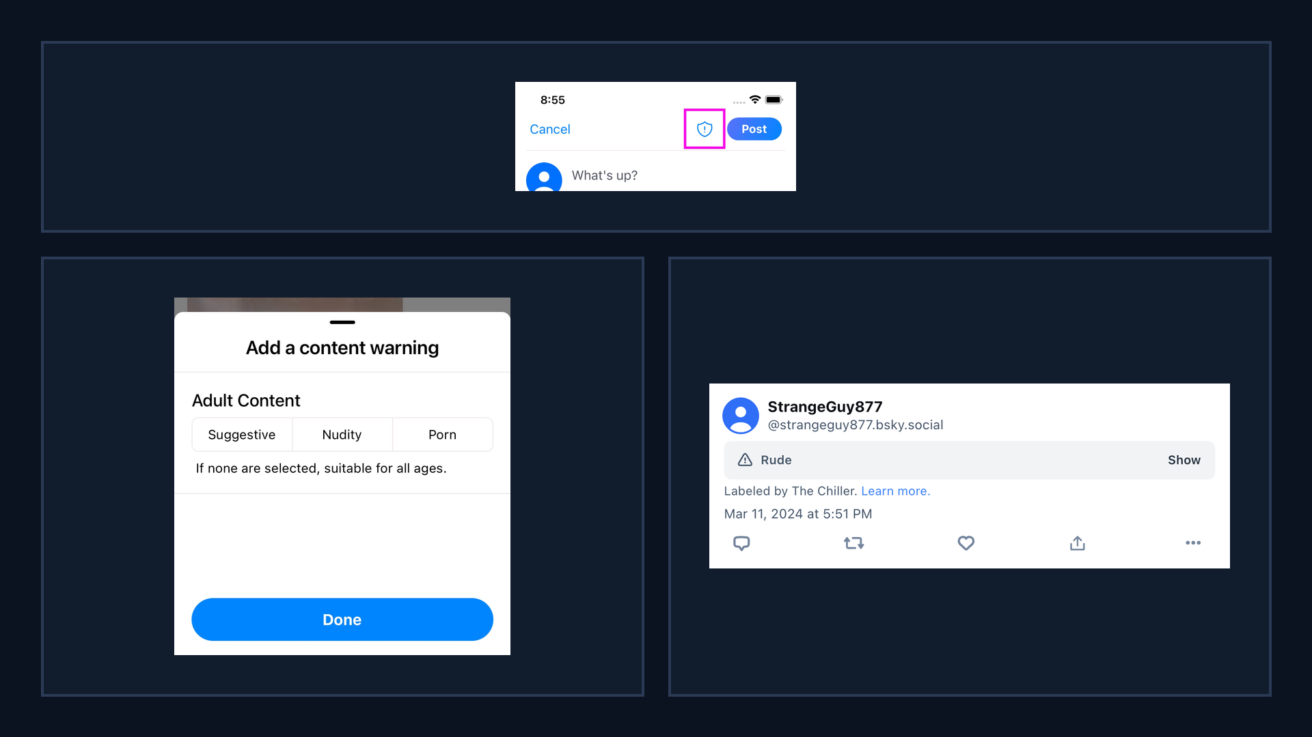
Bluesky UI: labeling surfaces (official)
BLUESKY RQs + DATA
Takeaway: labels are user-facing controls that shape what gets shown or filtered.
A. Self-label button
A
Composer surface
B. Content warning picker
B
C
Adult Content options
C. Labeled post banner
Attribution to labeler
Why it matters: filtering + exposure
FEB 2026

Slide 19
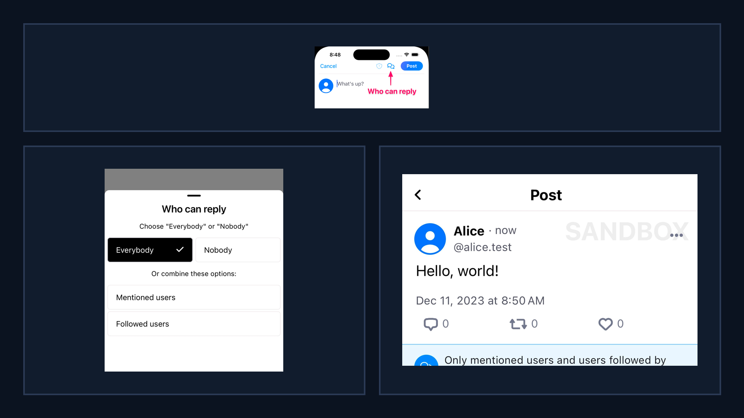
Bluesky UI: reply controls (official)
BLUESKY RQs + DATA
Takeaway: reply controls gate interaction, changing who can respond and what feedback loops form.
A. Reply controls button
A
Composer setting
B. Who can reply picker
B
C
Audience gating
C. Post notice
Visible constraint
Why it matters: interaction graphs
FEB 2026

Slide 20
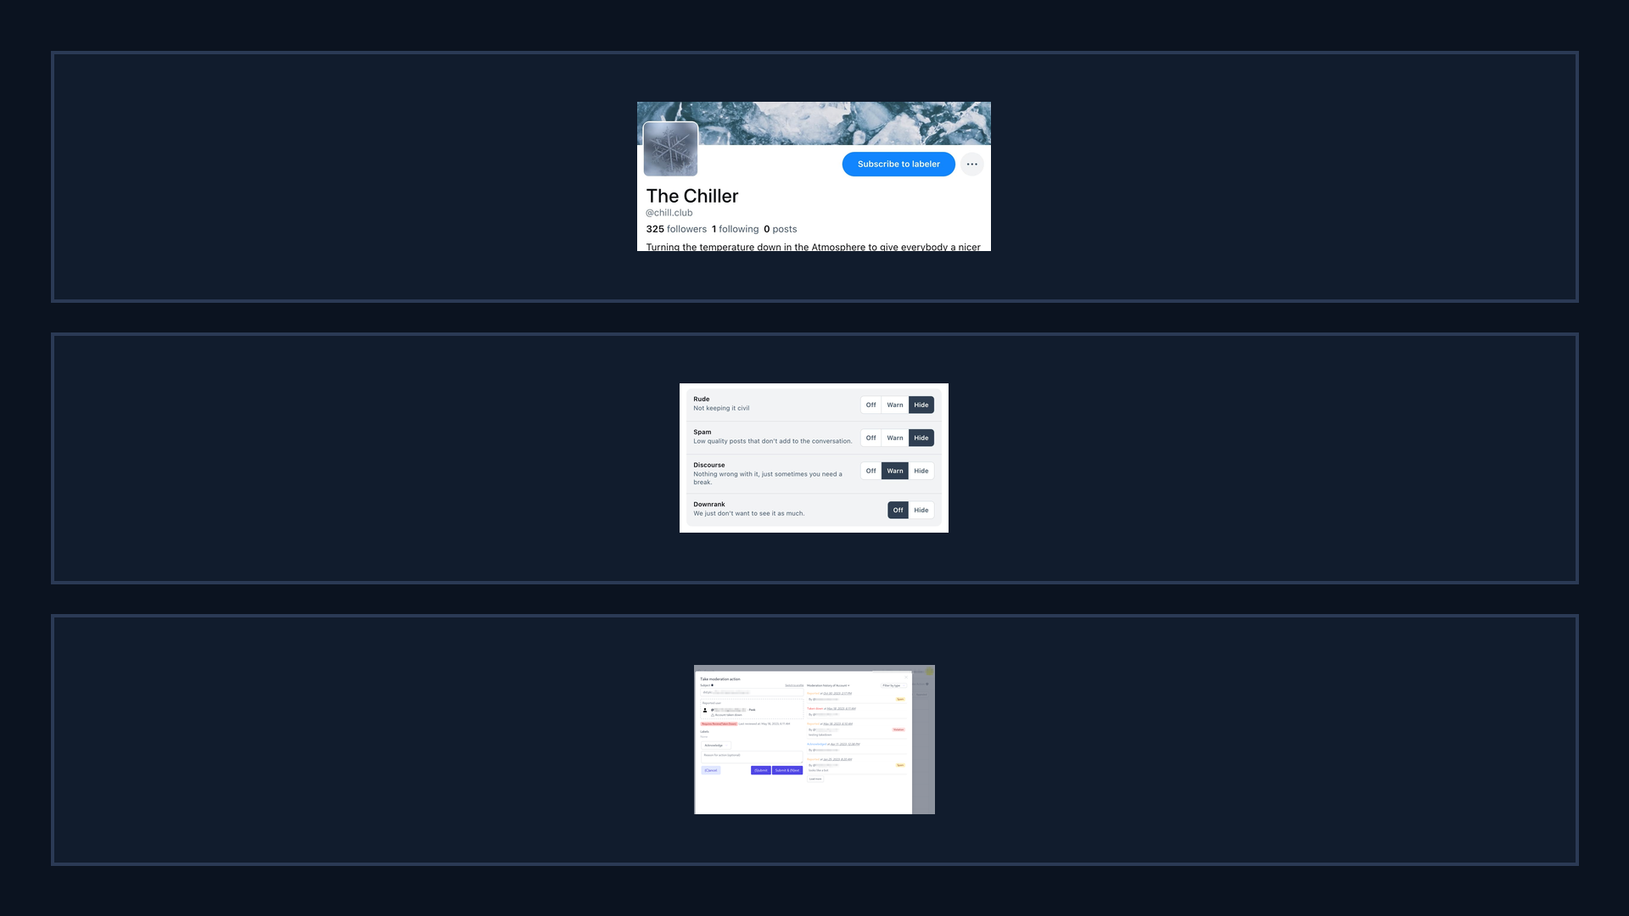
Bluesky UI: labelers + moderation tools (official)
BLUESKY RQs + DATA
Takeaway: moderation is modular—users can subscribe to labelers and tune label handling.
A. Subscribe to labeler
A
Third-party policies
B. Per-label controls
B
Off / Warn / Hide
C. Ozone moderation UI
C
Operational tooling
Why it matters: power shifts
FEB 2026

Slide 21
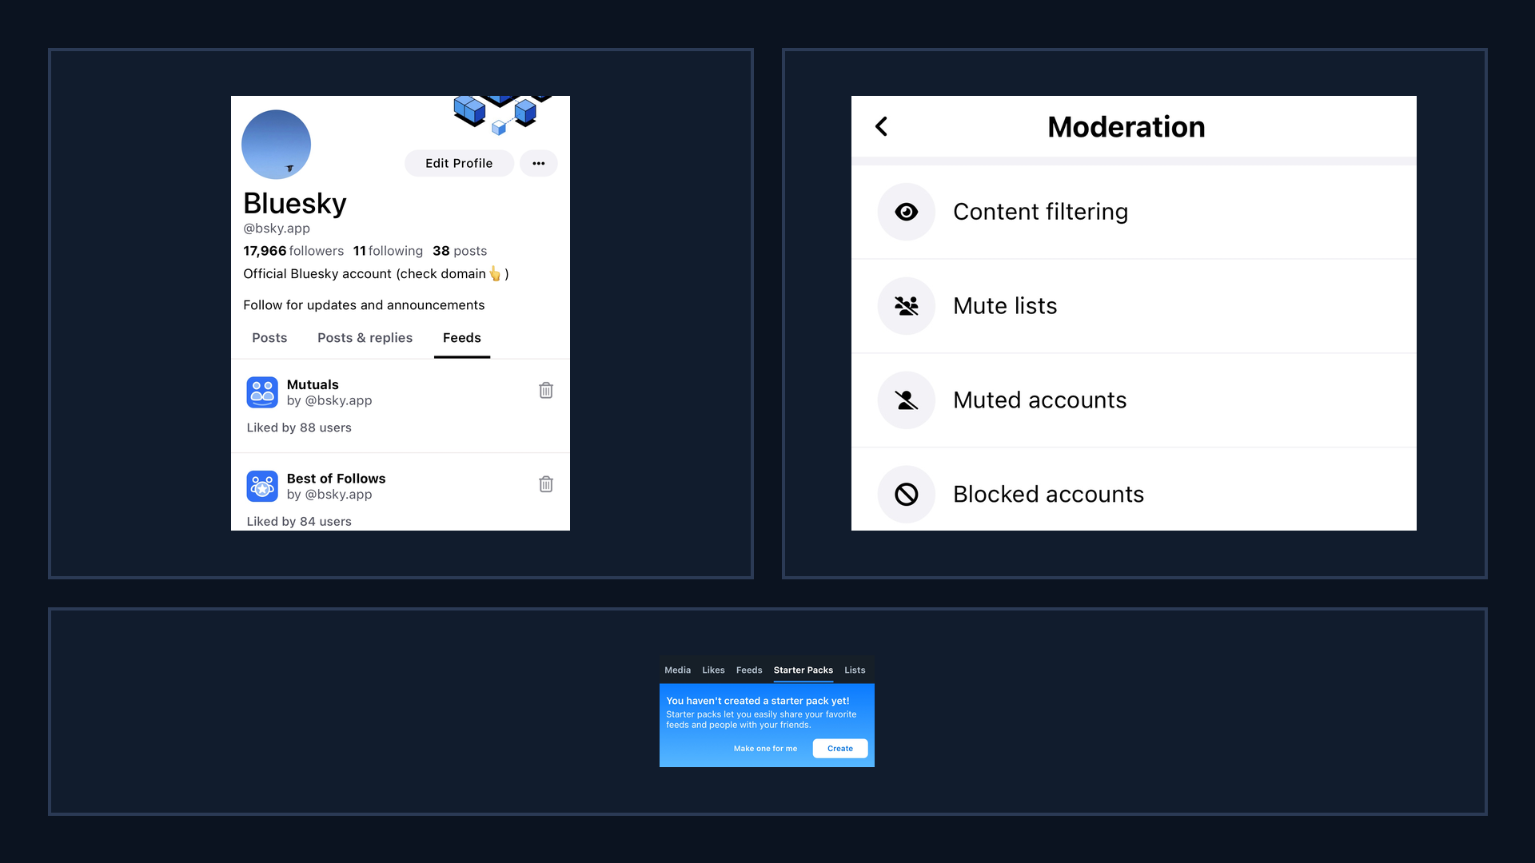
Bluesky UI: discovery surfaces (official)
BLUESKY RQs + DATA
Takeaway: discovery is shaped by navigation, defaults, and safety settings surfaced in the UI.
A. Custom feeds tab
A
B
Algorithm marketplace
B. Moderation menu
Filtering settings
C. Starter packs tab
Onboarding surface
C
Why it matters: defaults steer
FEB 2026

Slide 22
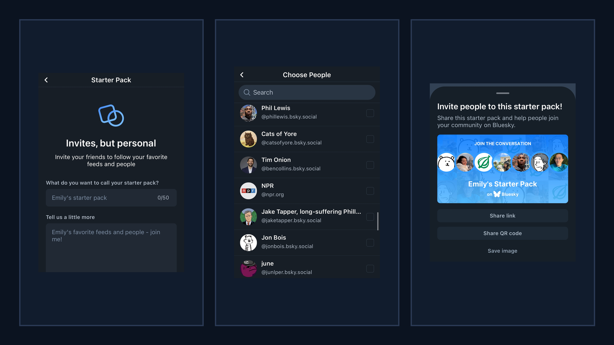
Bluesky UI: starter packs flow (official)
BLUESKY RQs + DATA
Takeaway: starter packs bundle people (and context) into a single shareable onboarding object.
A. Create starter pack
A
B
C
Name + description
B. Choose people
Curation choices
C. Share pack
Link / QR / image
Why it matters: bundled exposure
FEB 2026

Slide 23
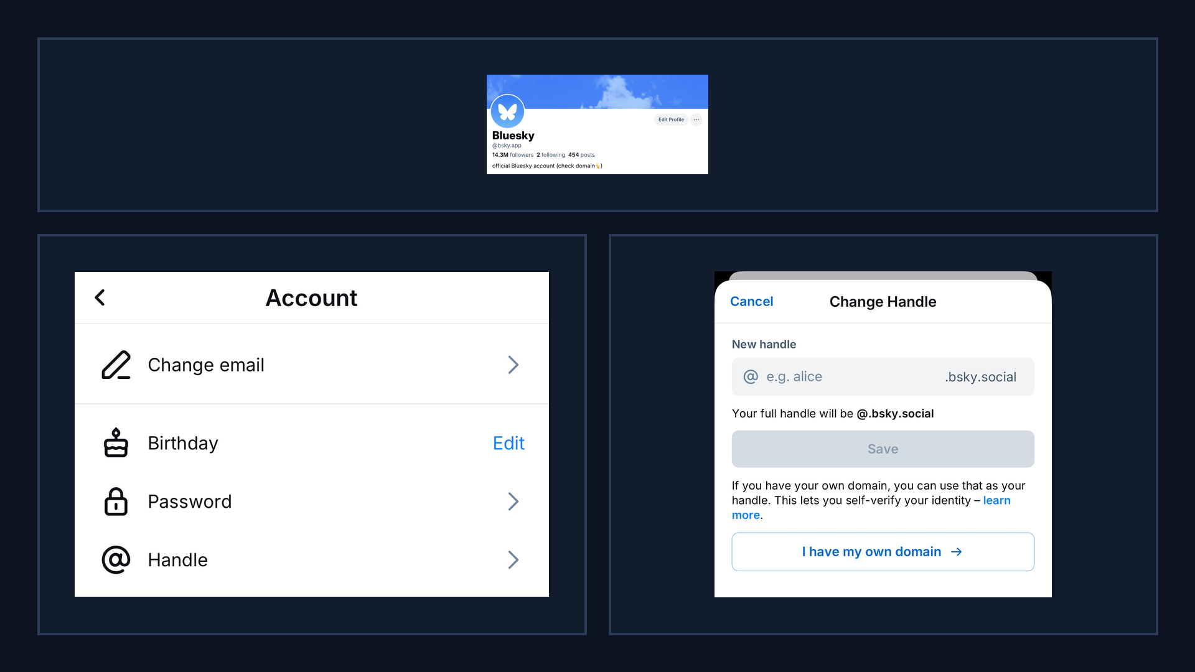
Bluesky UI: domain handles (surface → settings) (official)
BLUESKY RQs + DATA
Takeaway: domain handles connect identity and credibility to a verifiable control channel (DNS).
A. Domain handle profile
A
Trust signal
B. Settings: handle
B
C
Entry point
C. Use own domain
Verification flow
Why it matters: credibility
FEB 2026

Slide 24
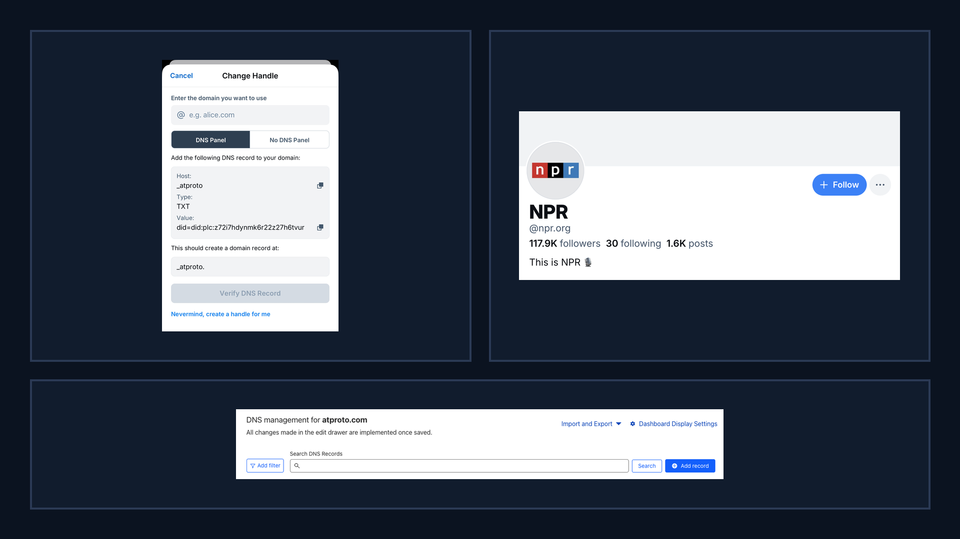
Bluesky UI: domain verification + examples (official)
BLUESKY RQs + DATA
Takeaway: verification relies on external DNS tooling, creating measurable and potentially gameable steps.
A. DNS TXT record
A
B
Proof-of-control
B. Domain handle example
@npr.org
C. DNS management UI
External dependency
C
Why it matters: measurable steps
FEB 2026

