Slide 1

Collecting Bluesky Feed Data
A step-by-step, read-only pipeline
(Endpoints + resumability)
Cross-sectional snapshot
Focus: how we discover feeds, snapshot ranked results, and export analysis-ready datasets.

Slide 2
The ecosystem we’re measuring
Step 0
Four building blocks — revealed one-by-one
1) Actor (account)
A Bluesky account (handle + DID).
Actors create posts, feeds, and starter packs.
Everything else in the pipeline is about: discovering feeds → selecting a panel → snapshotting ranked outputs.

Slide 3
The ecosystem we’re measuring
Step 0
Four building blocks — revealed one-by-one
1) Actor (account)
2) Feed generator (custom feed)
A Bluesky account (handle + DID).
Actors create posts, feeds, and starter packs.
An algorithm that returns a ranked list of posts.
Identified by an AT-URI (at://…/app.bsky.feed.generator/…).
Everything else in the pipeline is about: discovering feeds → selecting a panel → snapshotting ranked outputs.

Slide 4
The ecosystem we’re measuring
Step 0
Four building blocks — revealed one-by-one
1) Actor (account)
2) Feed generator (custom feed)
A Bluesky account (handle + DID).
Actors create posts, feeds, and starter packs.
An algorithm that returns a ranked list of posts.
Identified by an AT-URI (at://…/app.bsky.feed.generator/…).
3) Starter pack (discovery surface)
A curated bundle that can include accounts and feeds.
We treat it as a “where people find feeds” signal.
Everything else in the pipeline is about: discovering feeds → selecting a panel → snapshotting ranked outputs.

Slide 5
The ecosystem we’re measuring
Step 0
Four building blocks — revealed one-by-one
1) Actor (account)
2) Feed generator (custom feed)
A Bluesky account (handle + DID).
Actors create posts, feeds, and starter packs.
An algorithm that returns a ranked list of posts.
Identified by an AT-URI (at://…/app.bsky.feed.generator/…).
3) Starter pack (discovery surface)
4) Feed item (a post + rank)
A curated bundle that can include accounts and feeds.
We treat it as a “where people find feeds” signal.
When you “view a feed”, you get a ranked list of posts.
That ranked list is the core thing we snapshot.
Everything else in the pipeline is about: discovering feeds → selecting a panel → snapshotting ranked outputs.

Slide 6
How we talk to Bluesky
HTTP
HTTP XRPC requests = host + method + parameters
GET
https://public.api.bsky.app/xrpc/app.bsky.feed.getFeed?feed=at://…&limit=50&cursor=…
Same pattern for every endpoint we call.
Host
“Which service am I asking?”
• AppView (public): views of feeds, posts, profiles
• Relay: network index used for enumeration
Now that we know how requests look, we can map every pipeline stage to a small set of endpoints.

Slide 7
How we talk to Bluesky
HTTP
HTTP XRPC requests = host + method + parameters
GET
https://public.api.bsky.app/xrpc/app.bsky.feed.getFeed?feed=at://…&limit=50&cursor=…
Same pattern for every endpoint we call.
Host
Method
“Which service am I asking?”
• AppView (public): views of feeds, posts, profiles
• Relay: network index used for enumeration
A stable API name describing what you fetch.
Example: app.bsky.feed.getFeed = “return a ranked feed view”.
We keep slides non-code: method names are the “API surface”.
Now that we know how requests look, we can map every pipeline stage to a small set of endpoints.

Slide 8
How we talk to Bluesky
HTTP
HTTP XRPC requests = host + method + parameters
GET
https://public.api.bsky.app/xrpc/app.bsky.feed.getFeed?feed=at://…&limit=50&cursor=…
Same pattern for every endpoint we call.
Host
Method
“Which service am I asking?”
• AppView (public): views of feeds, posts, profiles
• Relay: network index used for enumeration
A stable API name describing what you fetch.
Example: app.bsky.feed.getFeed = “return a ranked feed view”.
We keep slides non-code: method names are the “API surface”.
Parameters typically control paging + filtering (e.g., feed URI, limit, cursor).
Now that we know how requests look, we can map every pipeline stage to a small set of endpoints.

Slide 9
How we talk to Bluesky
HTTP
HTTP XRPC requests = host + method + parameters
Optional auth header
Authorization: Bearer <session JWT> (only for viewer_mode = auth)
GET
https://public.api.bsky.app/xrpc/app.bsky.feed.getFeed?feed=at://…&limit=50&cursor=…
Same pattern for every endpoint we call.
Host
Method
“Which service am I asking?”
• AppView (public): views of feeds, posts, profiles
• Relay: network index used for enumeration
A stable API name describing what you fetch.
Example: app.bsky.feed.getFeed = “return a ranked feed view”.
We keep slides non-code: method names are the “API surface”.
Parameters typically control paging + filtering (e.g., feed URI, limit, cursor).
Now that we know how requests look, we can map every pipeline stage to a small set of endpoints.

Slide 10
Where our data comes from
A + B
Two network services + an optional authenticated viewer context
Relay (network index)
What it’s good for
Quickly enumerate accounts that contain specific record types.
We use it to discover:
Feed generator creators
com.atproto.sync.listReposByCollection
collection = app.bsky.feed.generator
Starter pack creators
com.atproto.sync.listReposByCollection
collection = app.bsky.graph.starterpack
In every case, we only read data (GET). Authentication is used only to view feeds as a logged-in user.

Slide 11
Where our data comes from
A + B
Two network services + an optional authenticated viewer context
Relay (network index)
AppView (public API)
What it’s good for
What it’s good for
Quickly enumerate accounts that contain specific record types.
We use it to discover:
Hydrated views: feeds, starter packs, posts, and profiles.
We use it to:
Feed generator creators
• app.bsky.feed.getActorFeeds → list feeds created by an actor
• app.bsky.graph.getStarterPack / getActorStarterPacks → unpack discovery
• app.bsky.unspecced.getPopularFeedGenerators → popular ranking
• app.bsky.feed.getFeedGenerators → metadata hydration
• app.bsky.feed.getFeed → the ranked feed snapshot
• app.bsky.actor.getProfiles → author stats
com.atproto.sync.listReposByCollection
collection = app.bsky.feed.generator
Starter pack creators
com.atproto.sync.listReposByCollection
collection = app.bsky.graph.starterpack
Public host: https://public.api.bsky.app
In every case, we only read data (GET). Authentication is used only to view feeds as a logged-in user.

Slide 12
Where our data comes from
A + B
Two network services + an optional authenticated viewer context
Relay (network index)
AppView (public API)
What it’s good for
What it’s good for
Quickly enumerate accounts that contain specific record types.
We use it to discover:
Hydrated views: feeds, starter packs, posts, and profiles.
We use it to:
Feed generator creators
• app.bsky.feed.getActorFeeds → list feeds created by an actor
• app.bsky.graph.getStarterPack / getActorStarterPacks → unpack discovery
• app.bsky.unspecced.getPopularFeedGenerators → popular ranking
• app.bsky.feed.getFeedGenerators → metadata hydration
• app.bsky.feed.getFeed → the ranked feed snapshot
• app.bsky.actor.getProfiles → author stats
com.atproto.sync.listReposByCollection
collection = app.bsky.feed.generator
Starter pack creators
com.atproto.sync.listReposByCollection
collection = app.bsky.graph.starterpack
Public host: https://public.api.bsky.app
Why we do this
Optional: authenticated viewer mode
Some feeds personalize ranking for a logged-in viewer.
We snapshot feeds twice: unauth + auth (when available).
In every case, we only read data (GET). Authentication is used only to view feeds as a logged-in user.

Slide 13
What the dataset captures
Goal
A “one-time photograph” of how feeds rank posts
We build a fixed panel of feeds, then take a ranked snapshot of each feed.
Think: “what does this feed show right now?”
Key idea: the “ranked list of posts” is our primary observation unit.

Slide 14
What the dataset captures
Goal
A “one-time photograph” of how feeds rank posts
We build a fixed panel of feeds, then take a ranked snapshot of each feed.
Think: “what does this feed show right now?”
Viewer mode A: unauthenticated
Calls the public AppView API (no login).
Viewer mode B: authenticated
Uses a login session to view feeds as a user.
Key idea: the “ranked list of posts” is our primary observation unit.

Slide 15
What the dataset captures
Goal
A “one-time photograph” of how feeds rank posts
We build a fixed panel of feeds, then take a ranked snapshot of each feed.
Think: “what does this feed show right now?”
Viewer mode A: unauthenticated
For every feed snapshot we store…
Calls the public AppView API (no login).
Ranked impressions
feed → (rank, post URI, reason)
Post metadata
text, embeds, counts, timestamps
Viewer mode B: authenticated
Author profiles
Uses a login session to view feeds as a user.
followers / posts counts, display name
Labels
moderation labels attached to posts or authors
Key idea: the “ranked list of posts” is our primary observation unit.

Slide 16
Pipeline overview
Story
Discover feeds → pick a panel → snapshot rankings → export datasets
Click to reveal each stage
1
Index feed generators
Build a global feed catalog
Next: we’ll walk through each stage with the exact API calls and what gets stored.

Slide 17
Pipeline overview
Story
Discover feeds → pick a panel → snapshot rankings → export datasets
Click to reveal each stage
1
2
Index feed generators
Discover via starter packs
Build a global feed catalog
Feeds people see while onboarding
Next: we’ll walk through each stage with the exact API calls and what gets stored.

Slide 18
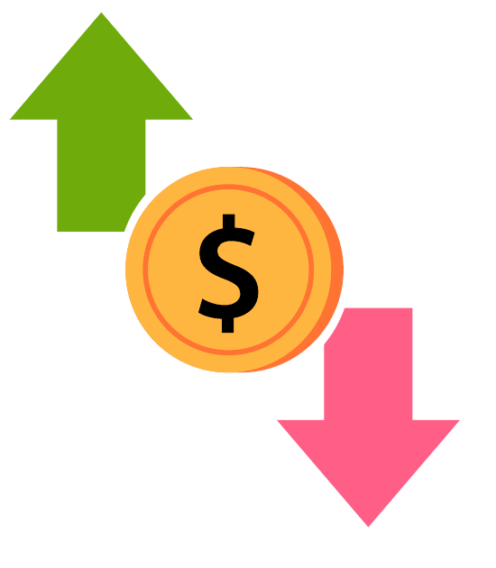
Pipeline overview
Story
Discover feeds → pick a panel → snapshot rankings → export datasets
Click to reveal each stage
1
2
3
Index feed generators
Discover via starter packs
Collect popular feeds
Build a global feed catalog
Feeds people see while onboarding
A ranked “top feeds” list
Next: we’ll walk through each stage with the exact API calls and what gets stored.

Slide 19
Pipeline overview
Story
Discover feeds → pick a panel → snapshot rankings → export datasets
Click to reveal each stage
1
2
3
4
Index feed generators
Discover via starter packs
Collect popular feeds
Hydrate feed metadata
Build a global feed catalog
Feeds people see while onboarding
A ranked “top feeds” list
Fill gaps for “touched” feeds
Next: we’ll walk through each stage with the exact API calls and what gets stored.

Slide 20
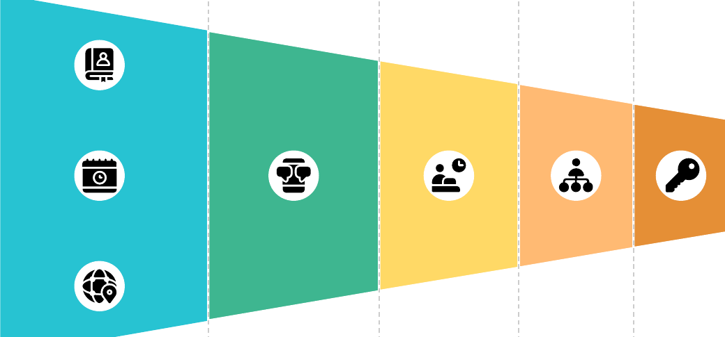
Pipeline overview
Story
Discover feeds → pick a panel → snapshot rankings → export datasets
Click to reveal each stage
1
2
3
4
Index feed generators
Discover via starter packs
Collect popular feeds
Hydrate feed metadata
Build a global feed catalog
Feeds people see while onboarding
A ranked “top feeds” list
Fill gaps for “touched” feeds
5
Build the feed panel
Discovery + popular + less-known
Next: we’ll walk through each stage with the exact API calls and what gets stored.

Slide 21
Pipeline overview
Story
Discover feeds → pick a panel → snapshot rankings → export datasets
Click to reveal each stage
1
2
3
4
Index feed generators
Discover via starter packs
Collect popular feeds
Hydrate feed metadata
Build a global feed catalog
Feeds people see while onboarding
A ranked “top feeds” list
Fill gaps for “touched” feeds
5
6
Build the feed panel
Snapshot each feed
Discovery + popular + less-known
Ranked posts (unauth + auth)
Next: we’ll walk through each stage with the exact API calls and what gets stored.

Slide 22
Pipeline overview
Story
Discover feeds → pick a panel → snapshot rankings → export datasets
Click to reveal each stage
1
2
3
4
Index feed generators
Discover via starter packs
Collect popular feeds
Hydrate feed metadata
Build a global feed catalog
Feeds people see while onboarding
A ranked “top feeds” list
Fill gaps for “touched” feeds
5
6
7
Build the feed panel
Snapshot each feed
Hydrate authors + export
Discovery + popular + less-known
Ranked posts (unauth + auth)
Profiles + CSV datasets
Next: we’ll walk through each stage with the exact API calls and what gets stored.

Slide 23
Stage 1 — Index feed generators
1/7
Goal: build a global catalog of custom feeds
Input
Relay: “who has feed-generator records?”
We enumerate accounts that contain records of type:
app.bsky.feed.generator
From here on, we only work with feed URIs and hydrated “views” from AppView.

Slide 24
Stage 1 — Index feed generators
1/7
Goal: build a global catalog of custom feeds
Input
API calls (read-only)
Relay: “who has feed-generator records?”
1) com.atproto.sync.listReposByCollection
• collection = app.bsky.feed.generator
2) app.bsky.feed.getActorFeeds (per actor)
We enumerate accounts that contain records of type:
app.bsky.feed.generator
From here on, we only work with feed URIs and hydrated “views” from AppView.

Slide 25
Stage 1 — Index feed generators
1/7
Goal: build a global catalog of custom feeds
Input
API calls (read-only)
Relay: “who has feed-generator records?”
1) com.atproto.sync.listReposByCollection
• collection = app.bsky.feed.generator
2) app.bsky.feed.getActorFeeds (per actor)
We enumerate accounts that contain records of type:
app.bsky.feed.generator
Output
Feed Generator Catalog
One row per feed generator (URI + metadata).
This becomes the backbone for all later stages.
at://…
From here on, we only work with feed URIs and hydrated “views” from AppView.

Slide 26
Stage 2 — Discover feeds via starter packs
2/7
Goal: capture “feeds surfaced to users” during discovery/onboarding
Starter packs
A starter pack is a curated bundle.
Packs can include accounts and (sometimes) custom feeds.
We treat every included feed as a “discovery surfaced” signal.
Now we have two candidate pools: (a) global catalog, (b) discovery-surfaced feeds.

Slide 27
Stage 2 — Discover feeds via starter packs
2/7
Goal: capture “feeds surfaced to users” during discovery/onboarding
Starter packs
A starter pack is a curated bundle.
API calls (read-only)
Packs can include accounts and (sometimes) custom feeds.
We treat every included feed as a “discovery surfaced” signal.
1) Relay: listReposByCollection
• collection = app.bsky.graph.starterpack
2) AppView: getActorStarterPacks (per actor)
3) AppView: getStarterPack (per pack)
Now we have two candidate pools: (a) global catalog, (b) discovery-surfaced feeds.

Slide 28
Stage 2 — Discover feeds via starter packs
2/7
Goal: capture “feeds surfaced to users” during discovery/onboarding
Starter packs
A starter pack is a curated bundle.
API calls (read-only)
Packs can include accounts and (sometimes) custom feeds.
We treat every included feed as a “discovery surfaced” signal.
1) Relay: listReposByCollection
• collection = app.bsky.graph.starterpack
2) AppView: getActorStarterPacks (per actor)
3) AppView: getStarterPack (per pack)
Output
Discovery-surfac​ed feeds
inclusion
count
A list of feed URIs that appear inside starter packs, plus an inclusion count.
(Used later to prioritize discovery exposure.)
Now we have two candidate pools: (a) global catalog, (b) discovery-surfaced feeds.

Slide 29
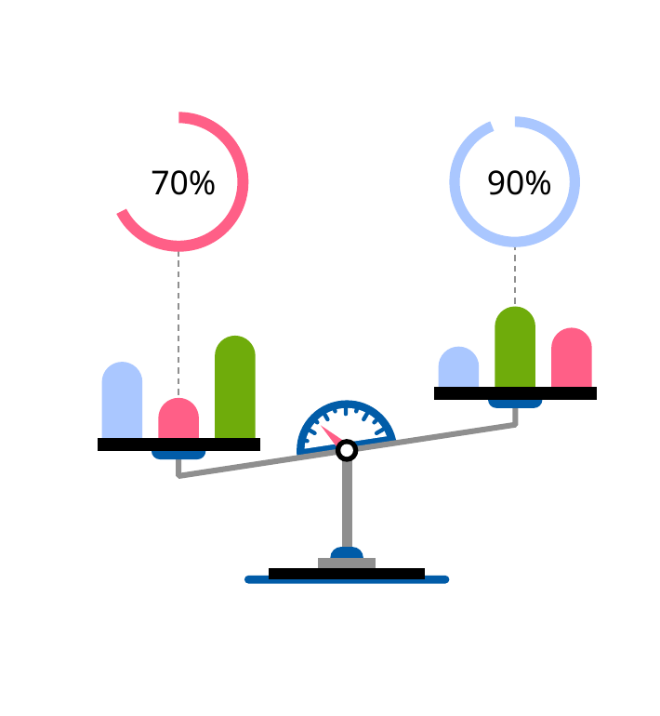
Stage 3 — Collect popular feeds
3/7
Goal: capture a “top feeds” ranking from AppView
Input
AppView provides a ranked list of popular feed generators.
We page through it until we reach our target size.
Now we have three signals: (1) global catalog, (2) discovery surfaced, (3) popularity ranking.

Slide 30
Stage 3 — Collect popular feeds
3/7
Goal: capture a “top feeds” ranking from AppView
Input
AppView provides a ranked list of popular feed generators.
We page through it until we reach our target size.
API call
Output: Popular feed list
app.bsky.unspecced.getPopularFeedGenerators
1
Returns: (feed URI, metadata) in ranked order
2
3
4
Now we have three signals: (1) global catalog, (2) discovery surfaced, (3) popularity ranking.

Slide 31
Stage 4 — Hydrate feed metadata
4/7
Goal: make sure every “touched” feed has complete metadata
Touched feeds
We only hydrate feeds we actually use.
Touched = feeds from starter packs ∪ popular list ∪ current panel.
This stage keeps the pipeline bounded: we hydrate only the feeds that matter for our snapshot.

Slide 32
Stage 4 — Hydrate feed metadata
4/7
Goal: make sure every “touched” feed has complete metadata
Touched feeds
API call
We only hydrate feeds we actually use.
app.bsky.feed.getFeedGenerators
Touched = feeds from starter packs ∪ popular list ∪ current panel.
Fetches metadata in batches:
name, description, creator, service DID, etc.
This stage keeps the pipeline bounded: we hydrate only the feeds that matter for our snapshot.

Slide 33
Stage 4 — Hydrate feed metadata
4/7
Goal: make sure every “touched” feed has complete metadata
Touched feeds
API call
We only hydrate feeds we actually use.
app.bsky.feed.getFeedGenerators
Touched = feeds from starter packs ∪ popular list ∪ current panel.
Fetches metadata in batches:
name, description, creator, service DID, etc.
Output
Enriched feed catalog
Now each feed has the metadata we need for sampling and reporting (e.g., provider / service identity).
This stage keeps the pipeline bounded: we hydrate only the feeds that matter for our snapshot.

Slide 34
Stage 5 — Build the feed panel
5/7
Goal: choose a fixed set of feeds we will snapshot
Candidate pools
Discovery surfaced
Popular ranking
Long tail
The panel is intentionally fixed before snapshotting so later steps are comparable and reproducible.

Slide 35
Stage 5 — Build the feed panel
5/7
Goal: choose a fixed set of feeds we will snapshot
Candidate pools
Selection rules
• Discovery: top by starter-pack inclusion count
• Popular: top by popularity rank (excluding discovery)
• Less-known: provider-balanced sampling
Discovery surfaced
Popular ranking
Long tail
The panel is intentionally fixed before snapshotting so later steps are comparable and reproducible.

Slide 36
Stage 5 — Build the feed panel
5/7
Goal: choose a fixed set of feeds we will snapshot
Candidate pools
Selection rules
• Discovery: top by starter-pack inclusion count
• Popular: top by popularity rank (excluding discovery)
• Less-known: provider-balanced sampling
Discovery surfaced
Popular ranking
Long tail
Feed panel
The fixed set of feeds we snapshot.
panel.csv
The panel is intentionally fixed before snapshotting so later steps are comparable and reproducible.

Slide 37
Stage 6 — Snapshot each feed
6/7
Goal: fetch a ranked list of posts for each feed (unauth + auth)
For each feed in the panel…
Input: feed URI
at://<did>/app.bsky.feed.generator/<rkey>
The snapshot is tied to (feed URI, viewer mode, timestamp). That’s what makes comparisons meaningful.

Slide 38
Stage 6 — Snapshot each feed
6/7
Goal: fetch a ranked list of posts for each feed (unauth + auth)
For each feed in the panel…
Input: feed URI
Viewer modes
at://<did>/app.bsky.feed.generator/<rkey>
unauth
auth
Two snapshots per feed (when auth is available).
The snapshot is tied to (feed URI, viewer mode, timestamp). That’s what makes comparisons meaningful.

Slide 39
Stage 6 — Snapshot each feed
6/7
Goal: fetch a ranked list of posts for each feed (unauth + auth)
For each feed in the panel…
Input: feed URI
Viewer modes
at://<did>/app.bsky.feed.generator/<rkey>
unauth
auth
Two snapshots per feed (when auth is available).
API call (AppView)
Parameters: feed, limit, cursor (paged until we collect N posts)
app.bsky.feed.getFeed
The snapshot is tied to (feed URI, viewer mode, timestamp). That’s what makes comparisons meaningful.

Slide 40
Stage 6 — Snapshot each feed
6/7
Goal: fetch a ranked list of posts for each feed (unauth + auth)
For each feed in the panel…
Input: feed URI
Viewer modes
at://<did>/app.bsky.feed.generator/<rkey>
unauth
auth
Two snapshots per feed (when auth is available).
API call (AppView)
Parameters: feed, limit, cursor (paged until we collect N posts)
app.bsky.feed.getFeed
Output: ranked impressions
#1
#2
#3
#4
#5
post URI
post URI
post URI
post URI
post URI
The snapshot is tied to (feed URI, viewer mode, timestamp). That’s what makes comparisons meaningful.

Slide 41
Stage 6 — What we store from each snapshot
6/7
We normalize one feed response into a few analysis-friendly tables
Impressions
One row per ranked item:
• feed URI
• viewer mode
• rank
• post URI + CID
• (optional) reason
This structure keeps analysis simple: impressions tie everything together, posts/authors/labels are reusable dimensions.

Slide 42
Stage 6 — What we store from each snapshot
6/7
We normalize one feed response into a few analysis-friendly tables
Impressions
Posts
One row per ranked item:
• feed URI
• viewer mode
• rank
• post URI + CID
• (optional) reason
One row per unique post:
• text + timestamps
• embeds (links/images)
• engagement counts
• language + facets
This structure keeps analysis simple: impressions tie everything together, posts/authors/labels are reusable dimensions.

Slide 43
Stage 6 — What we store from each snapshot
6/7
We normalize one feed response into a few analysis-friendly tables
Impressions
Posts
Labels
One row per ranked item:
• feed URI
• viewer mode
• rank
• post URI + CID
• (optional) reason
One row per unique post:
• text + timestamps
• embeds (links/images)
• engagement counts
• language + facets
Normalized label facts:
• label source
• value
• negation flag
• URI (if any)
This structure keeps analysis simple: impressions tie everything together, posts/authors/labels are reusable dimensions.

Slide 44
Stage 6 — What we store from each snapshot
6/7
We normalize one feed response into a few analysis-friendly tables
Impressions
Posts
Labels
One row per ranked item:
• feed URI
• viewer mode
• rank
• post URI + CID
• (optional) reason
One row per unique post:
• text + timestamps
• embeds (links/images)
• engagement counts
• language + facets
Normalized label facts:
• label source
• value
• negation flag
• URI (if any)
Snapshot status
Per (feed, viewer mode):
• collected_at
• item count
• success flag
This structure keeps analysis simple: impressions tie everything together, posts/authors/labels are reusable dimensions.

Slide 45
Stage 7 — Hydrate author profiles
7/7
Goal: fetch lightweight profile stats for authors seen in our snapshots
Input
All unique authors from feed snapshots
We extract author DIDs from impressions, then hydrate profiles in batches.
At this point, the snapshot is complete: feeds → ranked posts → authors → labels.

Slide 46
Stage 7 — Hydrate author profiles
7/7
Goal: fetch lightweight profile stats for authors seen in our snapshots
Input
API call
All unique authors from feed snapshots
app.bsky.actor.getProfiles
We extract author DIDs from impressions, then hydrate profiles in batches.
Batch fetch: handle, display name, follower counts, post counts…
At this point, the snapshot is complete: feeds → ranked posts → authors → labels.

Slide 47
Stage 7 — Hydrate author profiles
7/7
Goal: fetch lightweight profile stats for authors seen in our snapshots
Input
API call
All unique authors from feed snapshots
app.bsky.actor.getProfiles
We extract author DIDs from impressions, then hydrate profiles in batches.
Batch fetch: handle, display name, follower counts, post counts…
Output
Author table
Now every impression can be joined to author stats for analysis.
At this point, the snapshot is complete: feeds → ranked posts → authors → labels.

Slide 48
Resumability + outputs
B
One canonical state DB, deterministic exports
One state database
SQLite is the single source of truth for the entire run.
It stores: discovered feeds, the panel, every snapshot, posts, labels, and authors — so a run can resume safely.
Cursor checkpoints
Done markers
Idempotent writes
End reminder: the deck focuses on collection mechanics; analysis comes later using the exported tables.

Slide 49
Resumability + outputs
B
One canonical state DB, deterministic exports
One state database
SQLite is the single source of truth for the entire run.
It stores: discovered feeds, the panel, every snapshot, posts, labels, and authors — so a run can resume safely.
Cursor checkpoints
Done markers
Idempotent writes
Exports
Analysis-ready CSVs
• feed catalog
• starter pack → feed inclusions
• popular feed ranking
• feed panel
• feed snapshots (impressions + posts + labels)
• authors
csv/
… + manifest + data dictionary
End reminder: the deck focuses on collection mechanics; analysis comes later using the exported tables.

Slide 50
Resumability + outputs
B
One canonical state DB, deterministic exports
One state database
Why this matters
SQLite is the single source of truth for the entire run.
A snapshot is reproducible, auditable, and easy to analyze.
It stores: discovered feeds, the panel, every snapshot, posts, labels, and authors — so a run can resume safely.
Cursor checkpoints
Done markers
Idempotent writes
Exports
Analysis-ready CSVs
• feed catalog
• starter pack → feed inclusions
• popular feed ranking
• feed panel
• feed snapshots (impressions + posts + labels)
• authors
csv/
… + manifest + data dictionary
End reminder: the deck focuses on collection mechanics; analysis comes later using the exported tables.

Slide 51
Wrap-up
From open APIs → to a clean, resumable snapshot dataset
Data sources
Pipeline
Deliverables
Relay (index) + AppView (hydrated views)
+ optional authenticated viewer mode
Discover feeds → pick a panel → snapshot rankings
→ hydrate authors → export tables
Impressions + posts + labels + authors
(with stable CSV schemas)
Q&A-ready: each stage maps cleanly to a small set of public HTTP endpoints.

