Slide 1

Bluesky Data Collection Pipeline
From XRPC endpoints → analysis-ready datasets
Data collection • read-only • step-by-step

Slide 2
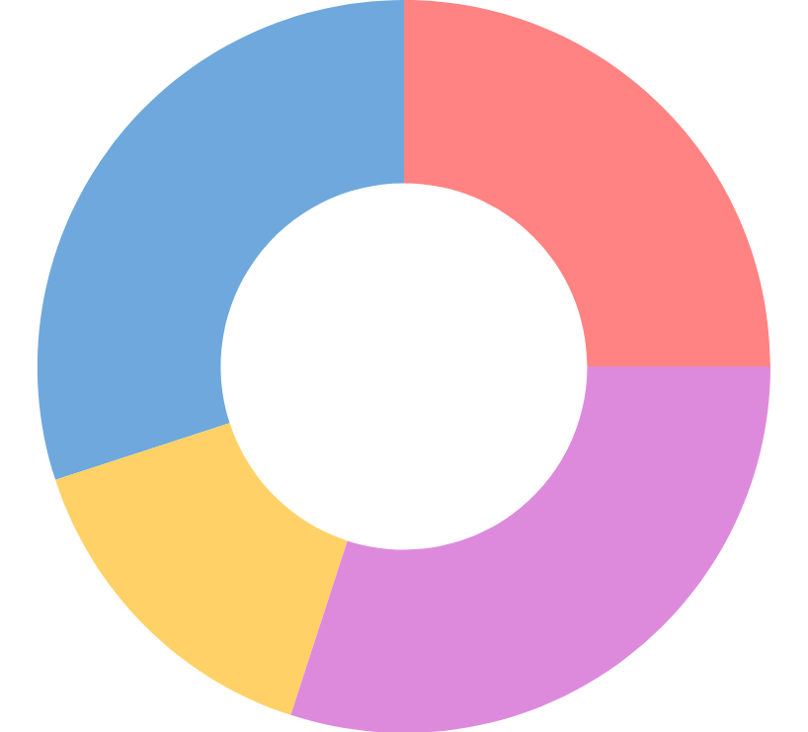
What are we trying to capture?
A snapshot of the open feed ecosystem — from discovery → exposure.
1
Map the ecosystem
Which feed generators exist, and who hosts them?

Slide 3
What are we trying to capture?
A snapshot of the open feed ecosystem — from discovery → exposure.
1
2
Map the ecosystem
Which feed generators exist, and who hosts them?
Observe discovery surfaces
Which feeds show up in starter packs and “popular” lists?

Slide 4
What are we trying to capture?
A snapshot of the open feed ecosystem — from discovery → exposure.
1
2
3
Map the ecosystem
Which feed generators exist, and who hosts them?
Observe discovery surfaces
Which feeds show up in starter packs and “popular” lists?
Capture ranked exposure
What posts appear at the top of each feed (unauth vs auth)?

Slide 5
Bluesky APIs in one idea: XRPC over HTTP
Every API call is an HTTP request to a method ID (an NSID).
https://{host}/xrpc/{method}

Slide 6
Bluesky APIs in one idea: XRPC over HTTP
Every API call is an HTTP request to a method ID (an NSID).
https://{host}/xrpc/{method}
GET /xrpc/app.bsky.feed.getFeed?feed=at://…&limit=100&cursor=…

Slide 7
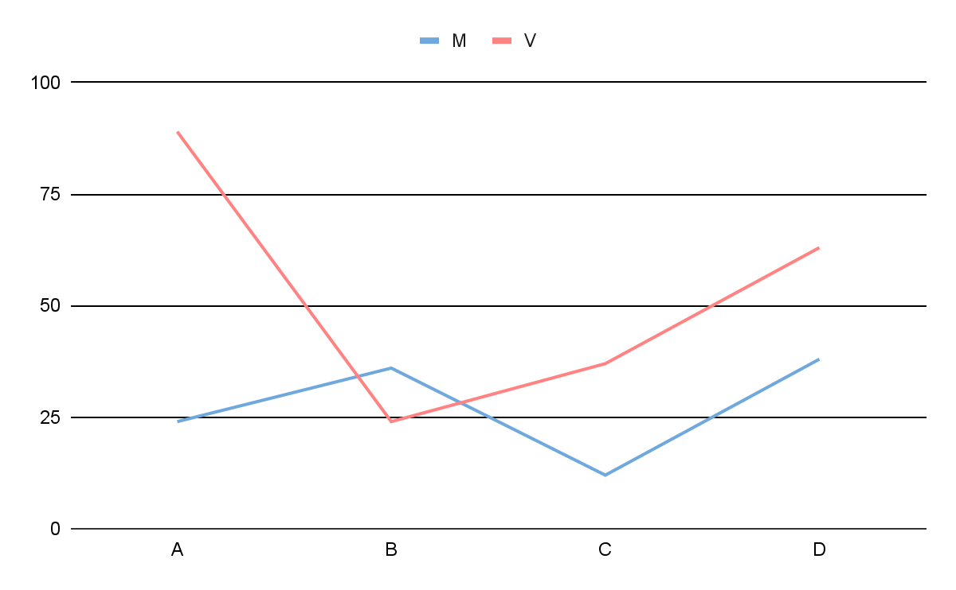
Bluesky APIs in one idea: XRPC over HTTP
Every API call is an HTTP request to a method ID (an NSID).
https://{host}/xrpc/{method}
GET /xrpc/app.bsky.feed.getFeed?feed=at://…&limit=100&cursor=…
Queries = GET
Read data (cacheable).
Procedures = POST
Used for actions like creating a session.
In this pipeline: reads + session only

Slide 8
Where requests go
Different hosts serve different slices of the protocol.
Relay
Collector
Bulk enumeration (actor DIDs)
relay host

Slide 9
Where requests go
Different hosts serve different slices of the protocol.
Relay
AppView
Collector
Bulk enumeration (actor DIDs)
Read APIs (feeds, profiles)
relay host
public AppView

Slide 10
Where requests go
Different hosts serve different slices of the protocol.
Relay
AppView
PDS
Collector
Bulk enumeration (actor DIDs)
Read APIs (feeds, profiles)
Session APIs (auth context)
relay host
public AppView
user PDS
Most of the pipeline is AppView reads; Relay is for discovery; PDS is for auth.

Slide 11
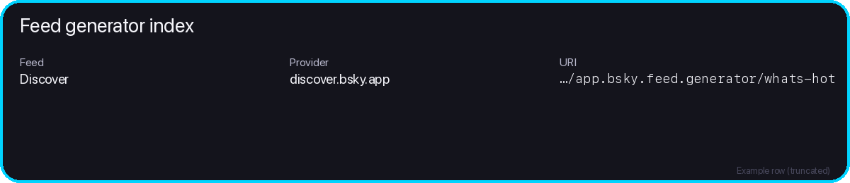
The run behind this story
A single unauth run turns public APIs into analysis-ready datasets.
Viewer context
Anchors (minimal)
auth_mode: unauth run_id: 88b597ae…edbbd1967
Panel: 6,000 feeds Captured: ~600k ranked impressions
Exports (conceptual)
• Feed generator index • Starter packs + inclusions • Popular feed list • Feed panel • Ranked impressions • Posts (metadata) • Authors (profiles)
(Example: one row from the index)

Slide 12

Collector design principles
Make the data run reproducible, gentle, and easy to resume.
Read-only
Only GET reads + session creation. No likes, no reposts, no writes.
1

Slide 13
Collector design principles
Make the data run reproducible, gentle, and easy to resume.
Read-only
Only GET reads + session creation. No likes, no reposts, no writes.
1
Rate-limited
Client-side pacing so we don’t overwhelm hosts.
2

Slide 14
Collector design principles
Make the data run reproducible, gentle, and easy to resume.
Read-only
Only GET reads + session creation. No likes, no reposts, no writes.
1
Rate-limited
Client-side pacing so we don’t overwhelm hosts.
2
Result: clean snapshots you can explain and rerun.
Resumable
A single state DB checkpoints progress and avoids duplicates.
3

Slide 15
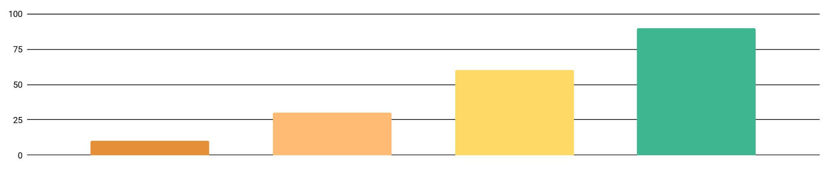
Pipeline overview
One run turns public APIs into analysis-ready datasets.
Relay scan
1
Enumerate candidate actors

Slide 16
Pipeline overview
One run turns public APIs into analysis-ready datasets.
Relay scan
Feed index
1
2
Enumerate candidate actors
Hydrate feed generators

Slide 17
Pipeline overview
One run turns public APIs into analysis-ready datasets.
Relay scan
Feed index
Starter packs
1
2
3
Enumerate candidate actors
Hydrate feed generators
Extract feeds from packs

Slide 18
Pipeline overview
One run turns public APIs into analysis-ready datasets.
Relay scan
Feed index
Starter packs
Popular
1
2
3
4
Enumerate candidate actors
Hydrate feed generators
Extract feeds from packs
Ranked popular feed list

Slide 19
Pipeline overview
One run turns public APIs into analysis-ready datasets.
Relay scan
Feed index
Starter packs
Popular
Enrich
1
2
3
4
5
Enumerate candidate actors
Hydrate feed generators
Extract feeds from packs
Ranked popular feed list
Batch hydrate missing metadata

Slide 20
Pipeline overview
One run turns public APIs into analysis-ready datasets.
Relay scan
Feed index
Starter packs
Popular
Enrich
Panel
1
2
3
4
5
6
Enumerate candidate actors
Hydrate feed generators
Extract feeds from packs
Ranked popular feed list
Batch hydrate missing metadata
Select feeds to snapshot

Slide 21
Pipeline overview
One run turns public APIs into analysis-ready datasets.
Relay scan
Feed index
Starter packs
Popular
Enrich
Panel
Snapshot
1
2
3
4
5
6
7
Enumerate candidate actors
Hydrate feed generators
Extract feeds from packs
Ranked popular feed list
Batch hydrate missing metadata
Select feeds to snapshot
Ranked posts + authors + CSV
Next: we’ll zoom into each stage (click…)

Slide 22
Stage 1 — Build a feed generator index
Goal: discover feed generators and store canonical metadata.
actor DIDs → did:plc:…
Relay enumeration
Find actors that publish feed generator records.
XRPC: com.atproto.sync.listReposByCollection
collection = app.bsky.feed.generator cursor pagination

Slide 23
Stage 1 — Build a feed generator index
Goal: discover feed generators and store canonical metadata.
actor DIDs → did:plc:…
Relay enumeration
Find actors that publish feed generator records.
AppView hydration
For each actor, list its published feeds.
XRPC: com.atproto.sync.listReposByCollection
XRPC: app.bsky.feed.getActorFeeds
collection = app.bsky.feed.generator cursor pagination
actor = DID cursor pagination

Slide 24
Stage 1 — Build a feed generator index
Goal: discover feed generators and store canonical metadata.
actor DIDs → did:plc:…
Relay enumeration
Find actors that publish feed generator records.
AppView hydration
For each actor, list its published feeds.
Feed generator views
Extract key metadata per feed.
• feed URI (at://…) • creator DID • service DID / provider • display name + description
XRPC: com.atproto.sync.listReposByCollection
XRPC: app.bsky.feed.getActorFeeds
collection = app.bsky.feed.generator cursor pagination
actor = DID cursor pagination

Slide 25
Stage 1 — Build a feed generator index
State DB
Goal: discover feed generators and store canonical metadata.
actor DIDs → did:plc:…
Feed generator index (resumable + deduped)
Relay enumeration
Find actors that publish feed generator records.
AppView hydration
For each actor, list its published feeds.
Feed generator views
Extract key metadata per feed.
Input to later stages
• feed URI (at://…) • creator DID • service DID / provider • display name + description
XRPC: com.atproto.sync.listReposByCollection
XRPC: app.bsky.feed.getActorFeeds
collection = app.bsky.feed.generator cursor pagination
actor = DID cursor pagination

Slide 26
Stage 2 — Starter packs (discovery surface)
Goal: learn which feeds are recommended together, and how often.
Find starter packs
Two ways to get starter pack URIs.
starter pack URIs
Option A: searchStarterPacks
Option B: relay enumeration

Slide 27
Stage 2 — Starter packs (discovery surface)
Goal: learn which feeds are recommended together, and how often.
Find starter packs
Two ways to get starter pack URIs.
Hydrate pack
Fetch pack details and nested items.
starter pack URIs
Option A: searchStarterPacks
XRPC: app.bsky.graph.getStarterPack
Option B: relay enumeration

Slide 28
Stage 2 — Starter packs (discovery surface)
Goal: learn which feeds are recommended together, and how often.
Find starter packs
Two ways to get starter pack URIs.
Hydrate pack
Fetch pack details and nested items.
starter pack URIs
Option A: searchStarterPacks
XRPC: app.bsky.graph.getStarterPack
Option B: relay enumeration
Extract feed URIs
Walk the payload and collect at://…/app.bsky.feed.generator/…
at://…/feed.generator/abc at://…/feed.generator/def at://…/feed.generator/ghi

Slide 29
Stage 2 — Starter packs (discovery surface)
Goal: learn which feeds are recommended together, and how often.
Find starter packs
Two ways to get starter pack URIs.
Hydrate pack
Fetch pack details and nested items.
starter pack URIs
Option A: searchStarterPacks
XRPC: app.bsky.graph.getStarterPack
Option B: relay enumeration
Extract feed URIs
Walk the payload and collect at://…/app.bsky.feed.generator/…
at://…/feed.generator/abc at://…/feed.generator/def at://…/feed.generator/ghi
State DB
Starter packs catalog + feed inclusion edges
Discovery signal

Slide 30
Stage 3 — Popular feeds (ranking surface)
Goal: capture the platform’s “popular feed generators” list as a ranked signal.
Call the popular endpoint
Request a page of popular feed generator URIs.
XRPC: app.bsky.unspecced.getPopularFeedGenerators
limit + cursor pagination

Slide 31
Stage 3 — Popular feeds (ranking surface)
Goal: capture the platform’s “popular feed generators” list as a ranked signal.
Call the popular endpoint
Request a page of popular feed generator URIs.
1 at://…/feed.generator/… 2 at://…/feed.generator/… 3 at://…/feed.generator/… …
XRPC: app.bsky.unspecced.getPopularFeedGenerators
limit + cursor pagination
Ranked feed URIs

Slide 32
Stage 3 — Popular feeds (ranking surface)
Goal: capture the platform’s “popular feed generators” list as a ranked signal.
Call the popular endpoint
Request a page of popular feed generator URIs.
1 at://…/feed.generator/… 2 at://…/feed.generator/… 3 at://…/feed.generator/… …
DB
Persist rank + time
XRPC: app.bsky.unspecced.getPopularFeedGenerators
limit + cursor pagination
Ranked feed URIs

Slide 33
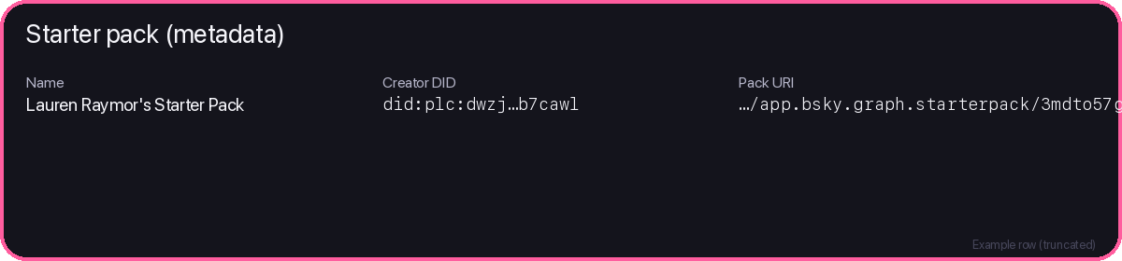
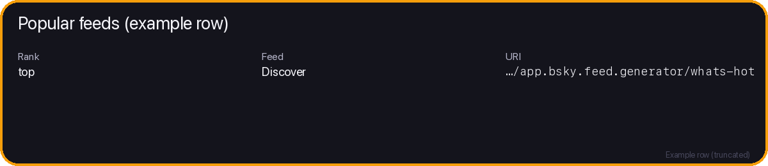
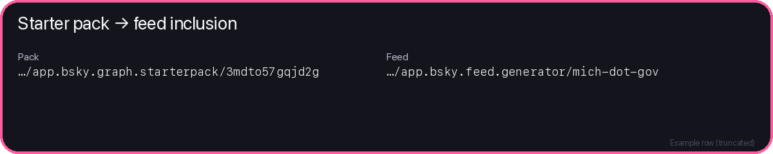
Discovery leaves artifacts
Starter packs and popular lists become joinable tables (IDs we reuse later).
Starter packs
Popular feeds
Stores a ranked list we can sample from for the panel.
We also aggregate pack inclusions into a feed-level ranking.

Slide 34
Stage 4 — Enrich feed metadata (batch hydration)
Goal: ensure every feed we touch has complete metadata for analysis.
Touched feeds (starter packs ∪ popular ∪ panel)
List of feed URIs

Slide 35
Stage 4 — Enrich feed metadata (batch hydration)
Goal: ensure every feed we touch has complete metadata for analysis.
Touched feeds (starter packs ∪ popular ∪ panel)
Batch hydrate feeds
Request feed generator views in batches (e.g., 25 at a time).
XRPC: app.bsky.feed.getFeedGenerators
List of feed URIs

Slide 36
Stage 4 — Enrich feed metadata (batch hydration)
Goal: ensure every feed we touch has complete metadata for analysis.
Touched feeds (starter packs ∪ popular ∪ panel)
Batch hydrate feeds
Request feed generator views in batches (e.g., 25 at a time).
XRPC: app.bsky.feed.getFeedGenerators
List of feed URIs
Enriched fields:
State DB
• service DID / provider bucket • display name / description • creator DID (…plus other feed metadata)

Slide 37
Stage 5 — Build the feed panel
Goal: choose a fixed set of feeds to snapshot (coverage + diversity).
Feed panel
A reproducible list of feeds we snapshot.

Slide 38
Stage 5 — Build the feed panel
Goal: choose a fixed set of feeds to snapshot (coverage + diversity).
Feed panel
A reproducible list of feeds we snapshot.
Discovery-surfaced
Feeds most included in starter packs
Popular
Top of the popular list
Less-known
Provider-balanced long tail sample

Slide 39
Stage 5 — Build the feed panel
Goal: choose a fixed set of feeds to snapshot (coverage + diversity).
Feed panel
State DB
A reproducible list of feeds we snapshot.
Store the panel with selection reason + rank.
Discovery-surfaced
Feeds most included in starter packs
Popular
Top of the popular list
Less-known
Provider-balanced long tail sample
Panel is fixed before snapshotting

Slide 40
Stage 6 — Snapshot feeds (ranked impressions)
Goal: capture “what shows up” at the top of each selected feed.
Feed panel
For each feed…

Slide 41
Stage 6 — Snapshot feeds (ranked impressions)
Goal: capture “what shows up” at the top of each selected feed.
Feed panel
For each feed…
viewer: unauth
viewer: auth (optional)
Two snapshots can differ because feeds may personalize.

Slide 42
Stage 6 — Snapshot feeds (ranked impressions)
Goal: capture “what shows up” at the top of each selected feed.
Fetch ranked items
Call getFeed and page through results.
Feed panel
For each feed…
viewer: unauth
viewer: auth (optional)
XRPC: app.bsky.feed.getFeed
Two snapshots can differ because feeds may personalize.
feed URI + limit + cursor stop after top K posts

Slide 43
Stage 6 — Snapshot feeds (ranked impressions)
Goal: capture “what shows up” at the top of each selected feed.
Impressions
rank + post id + context
Fetch ranked items
Call getFeed and page through results.
Feed panel
Posts
text, embeds, counts
For each feed…
viewer: unauth
viewer: auth (optional)
XRPC: app.bsky.feed.getFeed
Two snapshots can differ because feeds may personalize.
feed URI + limit + cursor stop after top K posts
Labels
post/author labels
Saved into the state DB per feed + viewer mode.

Slide 44
Stage 6 — Snapshot feeds (ranked impressions)
Goal: capture “what shows up” at the top of each selected feed.
Impressions
rank + post id + context
Fetch ranked items
Call getFeed and page through results.
Feed panel
Posts
text, embeds, counts
For each feed…
viewer: unauth
viewer: auth (optional)
XRPC: app.bsky.feed.getFeed
Two snapshots can differ because feeds may personalize.
feed URI + limit + cursor stop after top K posts
Labels
post/author labels
Result: one cross-sectional snapshot of ranked exposure.
Saved into the state DB per feed + viewer mode.

Slide 45
What we store from each snapshot
Think: impressions (where) + posts (what) + labels (signals).
Impressions
feed URI viewer mode rank (1..K) post URI + CID collected time

Slide 46
What we store from each snapshot
Think: impressions (where) + posts (what) + labels (signals).
Impressions
feed URI viewer mode rank (1..K) post URI + CID collected time
Posts
author DID + handle createdAt, text reply / quote refs embeds (images, links) engagement counts

Slide 47
What we store from each snapshot
Think: impressions (where) + posts (what) + labels (signals).
Impressions
feed URI viewer mode rank (1..K) post URI + CID collected time
Posts
author DID + handle createdAt, text reply / quote refs embeds (images, links) engagement counts
Labels
post labels author labels raw JSON preserved (normalized for analysis)
This is enough to compute fairness / exposure metrics later.

Slide 48
What the collected data lets us ask
Fairness-style questions about discovery, exposure, and safety signals.
H1 Discovery concentration
Do a few feeds dominate starter pack inclusion?

Slide 49
What the collected data lets us ask
Fairness-style questions about discovery, exposure, and safety signals.
H1 Discovery concentration
Do a few feeds dominate starter pack inclusion?
H2 Provider leverage
Which hosting providers get the most exposure?

Slide 50
What the collected data lets us ask
Fairness-style questions about discovery, exposure, and safety signals.
H1 Discovery concentration
Do a few feeds dominate starter pack inclusion?
H2 Provider leverage
Which hosting providers get the most exposure?
H3 Exposure concentration
How concentrated are ranked impressions?

Slide 51
What the collected data lets us ask
Fairness-style questions about discovery, exposure, and safety signals.
H1 Discovery concentration
Do a few feeds dominate starter pack inclusion?
H2 Provider leverage
Which hosting providers get the most exposure?
H3 Exposure concentration
How concentrated are ranked impressions?
H4 Feed overlap
How similar are feeds in what they show?

Slide 52
What the collected data lets us ask
Fairness-style questions about discovery, exposure, and safety signals.
H1 Discovery concentration
Do a few feeds dominate starter pack inclusion?
H2 Provider leverage
Which hosting providers get the most exposure?
H3 Exposure concentration
How concentrated are ranked impressions?
H4 Feed overlap
How similar are feeds in what they show?
H5 Exposure vs author size
Do larger authors get outsized exposure?

Slide 53
What the collected data lets us ask
Fairness-style questions about discovery, exposure, and safety signals.
H1 Discovery concentration
Do a few feeds dominate starter pack inclusion?
H2 Provider leverage
Which hosting providers get the most exposure?
H3 Exposure concentration
How concentrated are ranked impressions?
H4 Feed overlap
How similar are feeds in what they show?
H5 Exposure vs author size
Do larger authors get outsized exposure?
H6 Label risk signals
Which labels appear in ranked posts, and where?
These metrics are computed from the same state DB / CSV exports.

Slide 54
Stage 7 — Hydrate author profiles
Goal: add basic context about the authors who appeared in snapshots.
Unique author DIDs
did:plc:… did:plc:… …

Slide 55
Stage 7 — Hydrate author profiles
Goal: add basic context about the authors who appeared in snapshots.
Unique author DIDs
did:plc:… did:plc:… …
Batch fetch profiles
Lookup profiles in batches (e.g., 25 actors at a time).
XRPC: app.bsky.actor.getProfiles

Slide 56
Stage 7 — Hydrate author profiles
Goal: add basic context about the authors who appeared in snapshots.
Unique author DIDs
did:plc:… did:plc:… …
Batch fetch profiles
Lookup profiles in batches (e.g., 25 actors at a time).
DB
XRPC: app.bsky.actor.getProfiles
Store: handle, display name, followers / follows / posts counts.

Slide 57
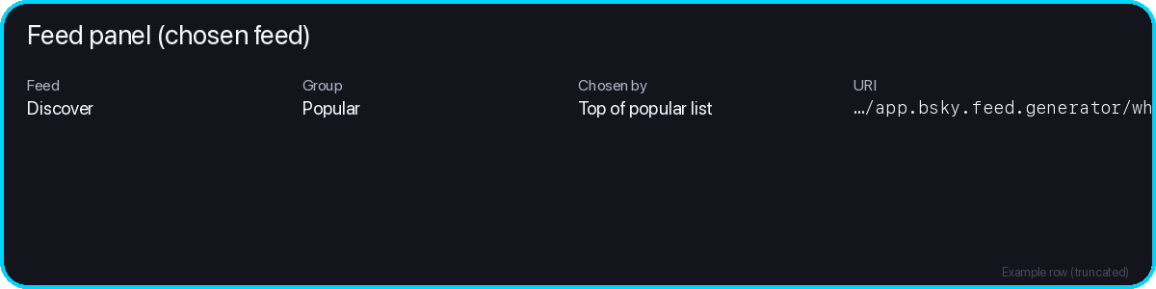
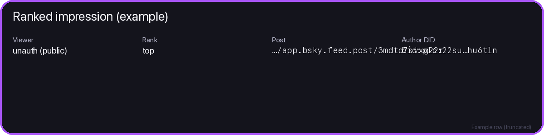
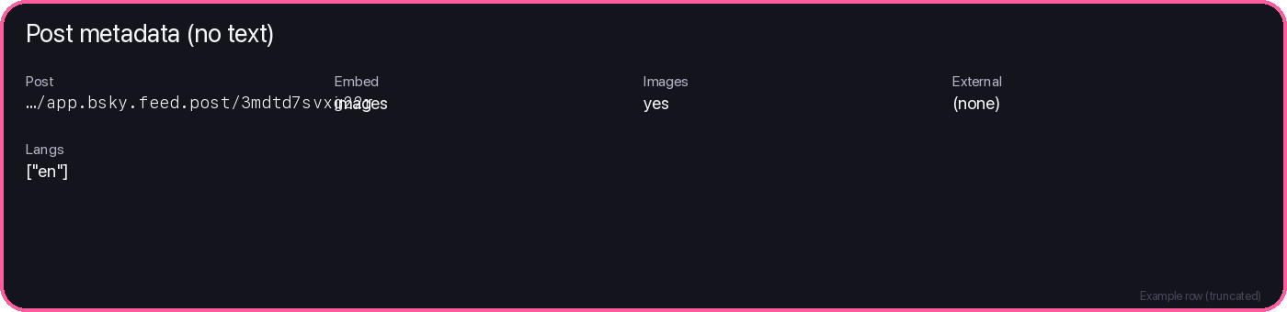
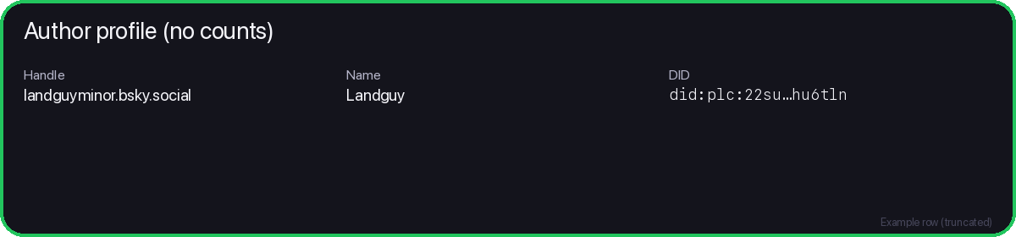
One stitched example (keys line up)
Panel entry → ranked impression → post metadata → author profile (no post text).

Slide 58
Outputs
At the end of the run, everything is exported for analysis.
CSV exports
State DB
single source of truth
posts • impressions • authors starter packs • popular • …

Slide 59
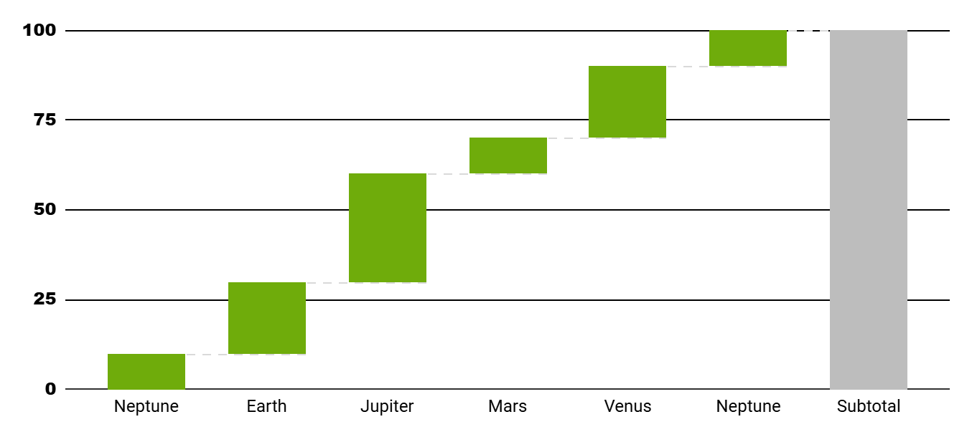
Outputs
At the end of the run, everything is exported for analysis.
CSV exports
Manifest
File list + hashes for reproducibility.
State DB
single source of truth
posts • impressions • authors starter packs • popular • …
Data dictionary
Column meanings and types.

Slide 60
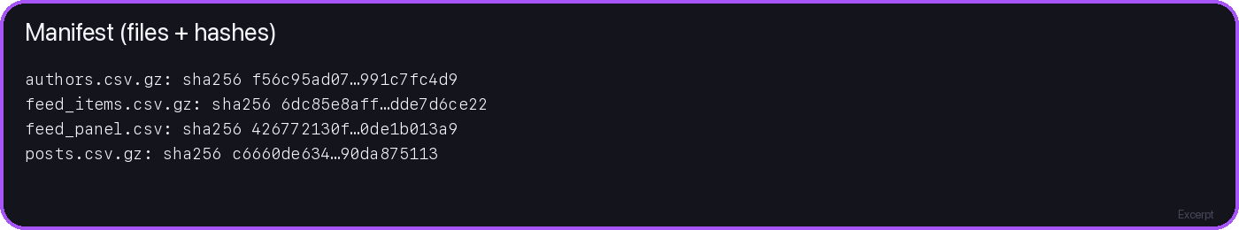
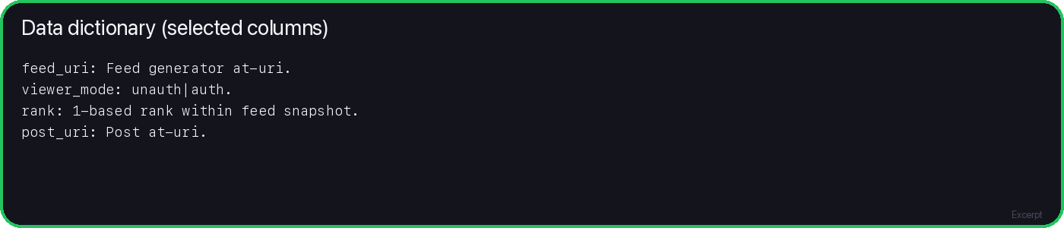
Reproducible outputs
Every export is hashed; every column is documented.

Slide 61
Appendix — API matrix
Key endpoints used by the data collection pipeline.
Stage
XRPC method
Host
Auth
Pagination / batching
Discovery
com.atproto.sync.listReposByCollection
Relay
No
cursor
Feed index
app.bsky.feed.getActorFeeds
AppView
No
cursor
Starter packs
app.bsky.graph.searchStarterPacks
AppView
No
cursor
Starter packs
app.bsky.graph.getActorStarterPacks
AppView
No
cursor
Starter packs
app.bsky.graph.getStarterPack
AppView
No
—
Popular
app.bsky.unspecced.getPopularFeedGenerators
AppView
No
cursor
Enrich
app.bsky.feed.getFeedGenerators
AppView
Optional
batch (e.g., 25)
Snapshot
app.bsky.feed.getFeed
AppView
Optional
cursor
Hosts: Relay for enumeration • AppView for reads
Authors
app.bsky.actor.getProfiles
AppView
No
batch (e.g., 25)

Slide 62

Appendix — Session endpoints
Only used to create / refresh an auth context.
com.atproto.server.createSession
POST identifier + app password → access JWT + refresh JWT
com.atproto.server.refreshSession
POST bearer refresh JWT → new access JWT
Host: user PDS (e.g., bsky.social)
Auth snapshots use the access JWT

Slide 63
Sources & assets
Docs used for endpoint semantics + request structure:
• Bluesky HTTP Reference (docs.bsky.app)
• AT Protocol HTTP API (XRPC) spec (atproto.com)
• Visual elements adapted from the provided Slidesgo infographics templates

