Slide 1


Algorithmic Choice in Bluesky
Responsible ranking + security in an open feed ecosystem
Measured: discovery → panel → 600,651 ranked impressions (Feb 1-2, 2026)

Slide 2

Algorithmic choice ≠ decentralized power
• Feeds + labelers turn ranking/moderation into a marketplace.
• Discovery + hosting create chokepoints + new attack surfaces.
Thesis: pluralism shifts power to discovery + infrastructure.

Slide 3

Bluesky’s open feed ecosystem
Ranking + moderation become third-party services (a marketplace).
Client
Discovery
Feed generators
Labelers
→
→
→
Starter packs + popular lists
Third-party ranking
Safety labels + actions
Chokepoints emerge where users find feeds + who hosts them. [ICWSM’24 10.1609/icwsm.v18i1.31293]

Slide 4

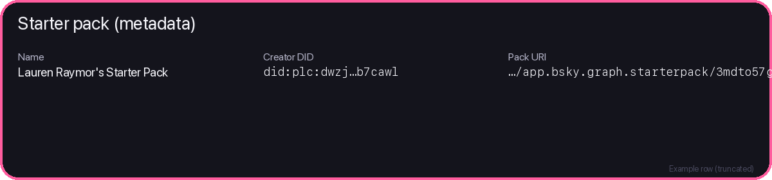
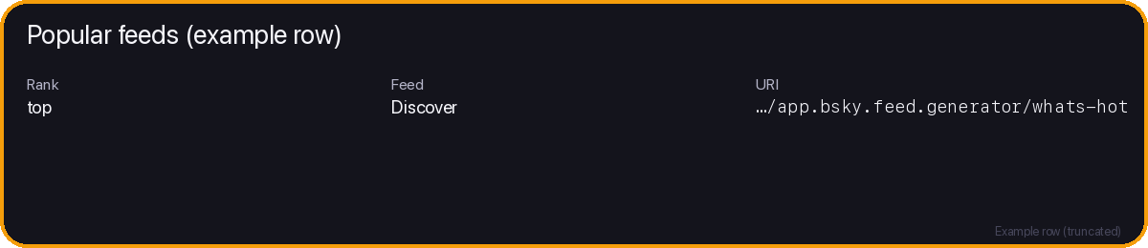
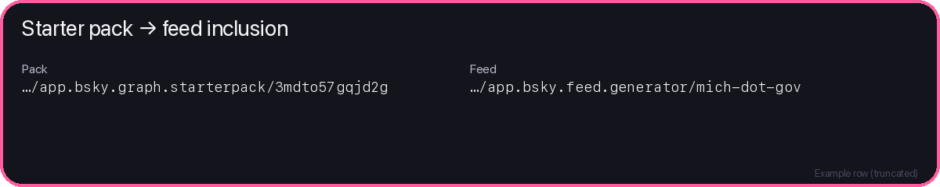
Discovery is measurable (not anecdotes)
Starter packs + popular feeds are explicit lists that seed attention.
Starter packs (onboarding bundles)
Popular feeds (in-app list)
These surfaces seed attention → panel sampling. [ICWSM’25 10.1609/icwsm.v19i1.35810]

Slide 5
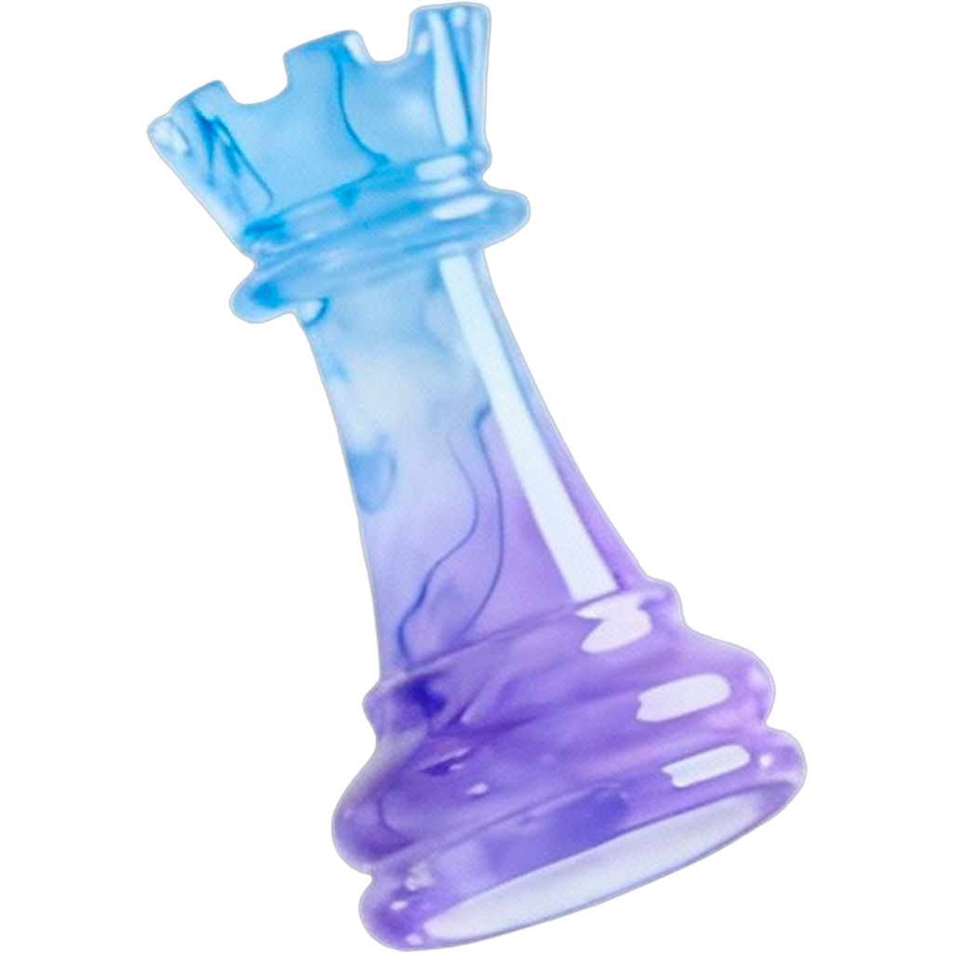




What we measured (H1-H6)
Discovery → provider leverage → exposure → overlap → rich-get-richer → safety labels
H1 Discovery concentration
H2 Provider leverage
H3 Exposure concentration
Do a few feeds dominate starter-pack inclusion?
Which providers get outsized discovery?
How concentrated is exposure?
H4 Feed overlap
H5 Exposure vs author size
Do feeds show the same posts?
Do larger authors get outsized exposure?
H6 Risk exposure variability (labels)

Slide 6

Problem: responsible ranking meets open markets
• Users choose algorithms - but discovery chooses defaults.
• Responsible ranking needs: security, fairness, safety, accountability.

Slide 7

Threat model: marketplace adversaries
• Malicious feeds/rankers can steer exposure or surface explicit content.
• Growth gaming + label gaps enable evasion, bias, and targeting.
[NDSS’21 10.14722/ndss.2021.24525; USENIX Sec’23 10.5555/3620237.3620333]

Slide 8
Our contributions (S&P tone)
• Threat model for ranking+moderation marketplaces.
• Reproducible measurement + evidence + mitigations (H1-H6).

Slide 9

Methods credibility (read-only snapshot)
Discovery → fixed panel → ranked impressions → joinable tables
1
Relay scan
2
Feed index
3
Starter packs
4
Popular
Enumerate candidate actors
→
Hydrate feed generators
→
Extract discovery signals
→
Capture ranking surface
Read-only XRPC to Relay/AppView (only POST is session auth/refresh).

Slide 10
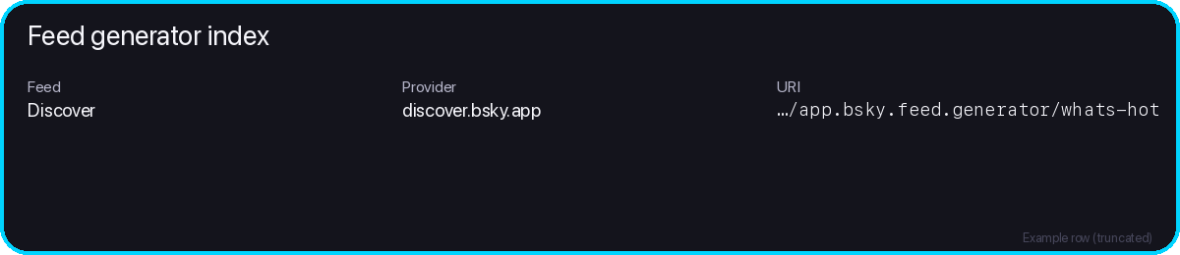
The run behind this story
Run settings (minimal)
Anchors (2 numbers)
viewer: unauth (public AppView)
Panel size: 6,000 feeds
window: 2026-02-01T09:04:54Z → 2026-02-02T08:23:24Z
Captured: 600,651 ranked impressions
run_id: 88b597ae…bd1967
Every stage leaves a trace (exports)
• Feed generator index
• Starter packs + inclusions
• Popular feed list
• Feed panel
• Ranked impressions
• Posts (metadata) + authors
Keys line up: feed_uri / post_cid / author_did

Slide 11
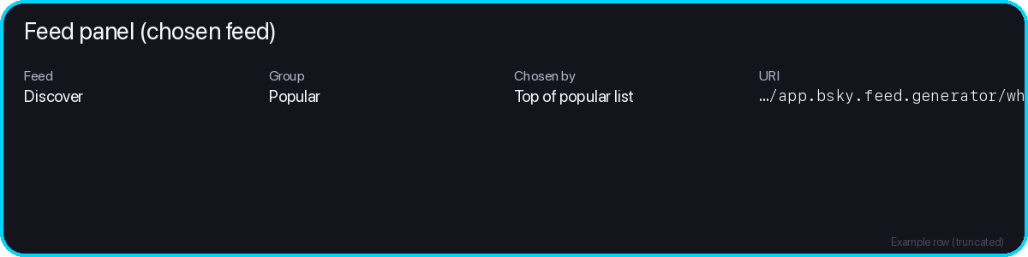
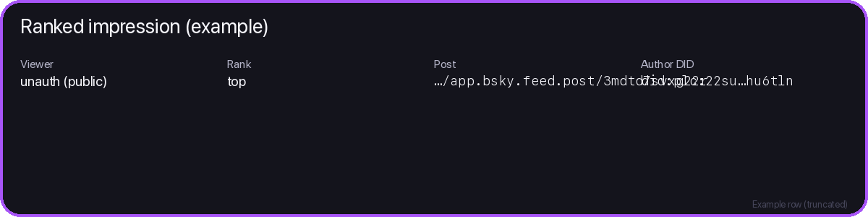
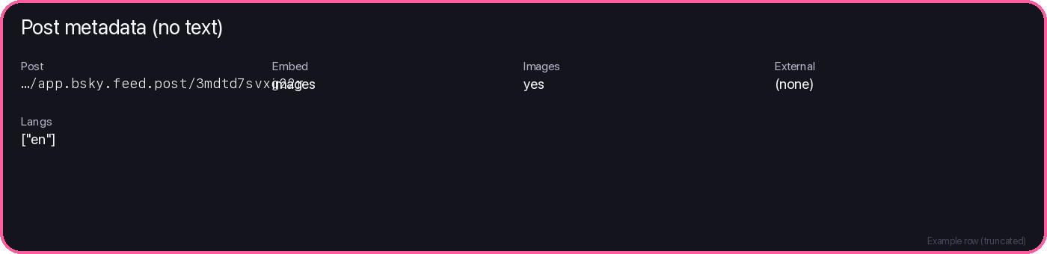
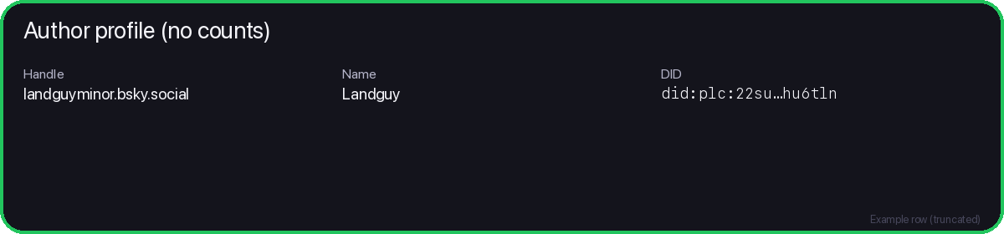
Adversary playbook: 4 ways markets get gamed
Market incentives create predictable attack patterns.
Capture/poison starter packs + popular lists.
Sybil + engagement pumps to climb ranks.
Discovery poisoning
Growth gaming
3rd-party policies steer exposure by design.
Coverage gaps + inconsistent semantics.
Malicious rankers
Label gaps/evasion

Slide 12
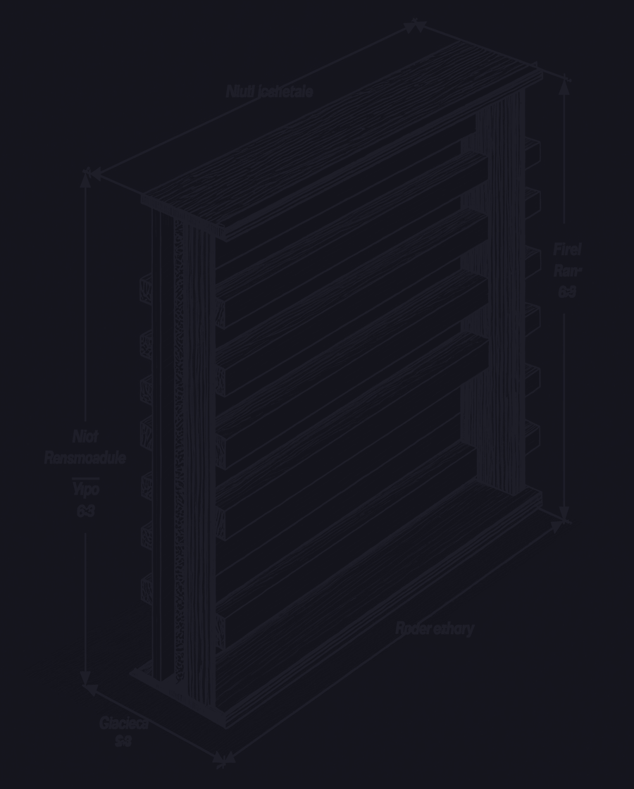
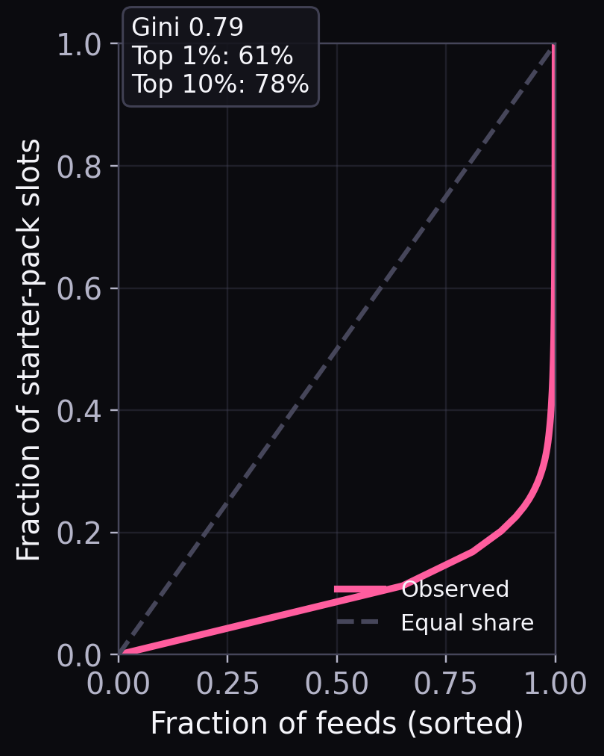
H1 - Discovery slots are concentrated
Top 1% share of starter-pack slots
61%
Defaults become gatekeepers → cheaper discovery capture.
[ICWSM’25 10.1609/icwsm.v19i1.35810]

Slide 13
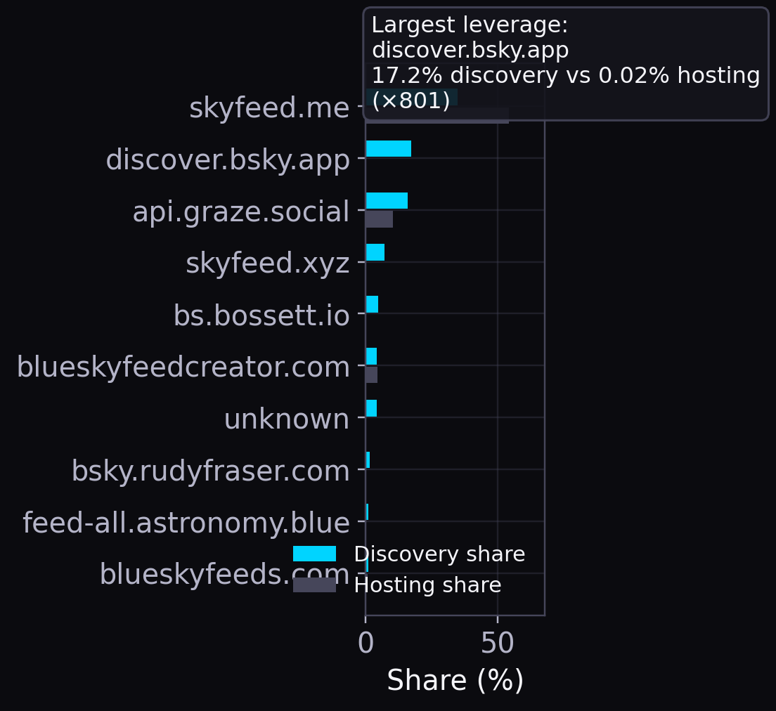
H2 - Discovery creates provider leverage
Max leverage: discovery share vs hosting footprint
×801
Hosting chokepoints become targets → ecosystem-wide risk.

Slide 14
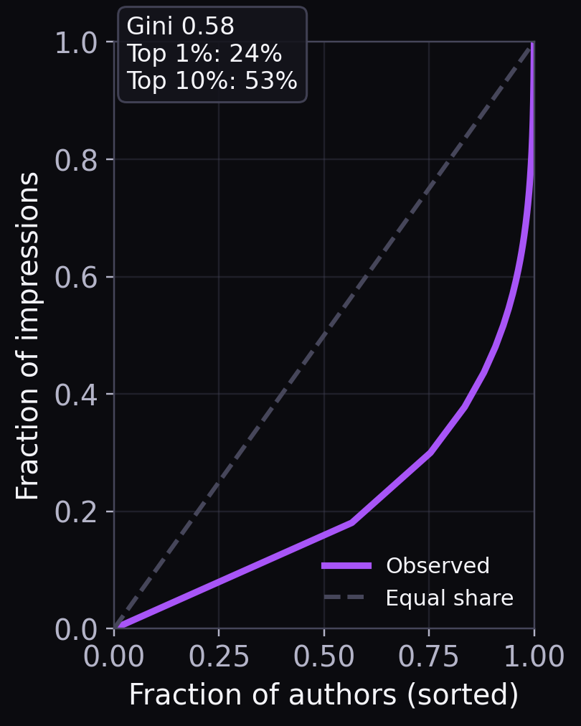
H3 - Exposure is concentrated among authors
Top 10% of authors get this share of impressions
53%
Concentrated exposure lowers manipulation/targeting cost.

Slide 15
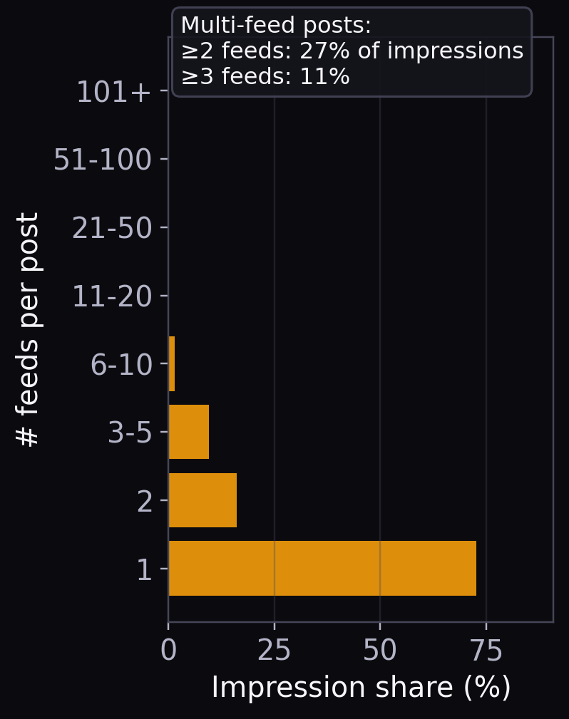
H4 - Many feeds show the same posts
Share of impressions for posts in ≥2 feeds
27%
Overlap amplifies winners → pluralism without diversity.

Slide 16
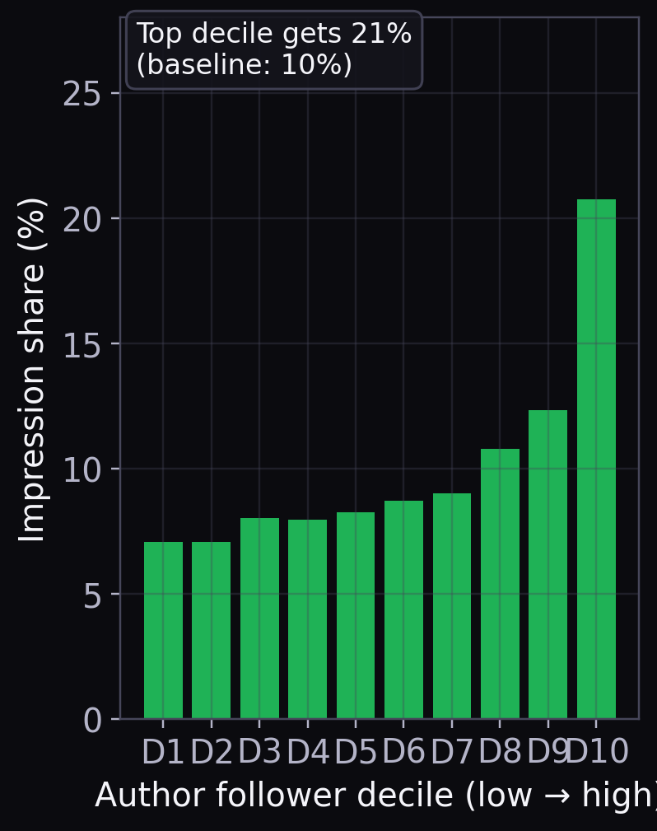
H5 - Bigger accounts get outsized exposure
Top follower decile gets this share of impressions
21%
Popularity bias reappears → unfair + gameable outcomes.
[KDD’21 10.1145/3447548.3467376]

Slide 17
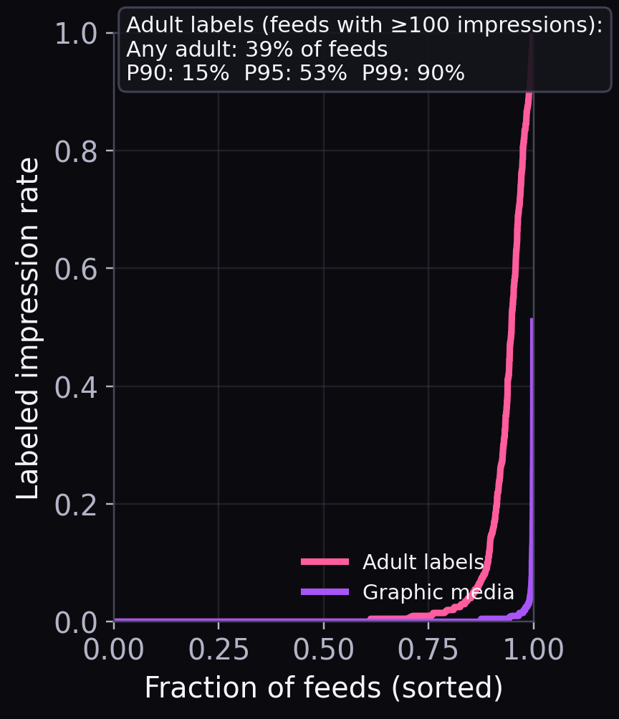
H6 - Safety label exposure varies by feed
Feeds (≥100 impressions) with any adult labels
39%
Safety boundaries depend on feed choice → uneven risk.
[NAACL’22 10.18653/v1/2022.naacl-main.431]

Slide 18
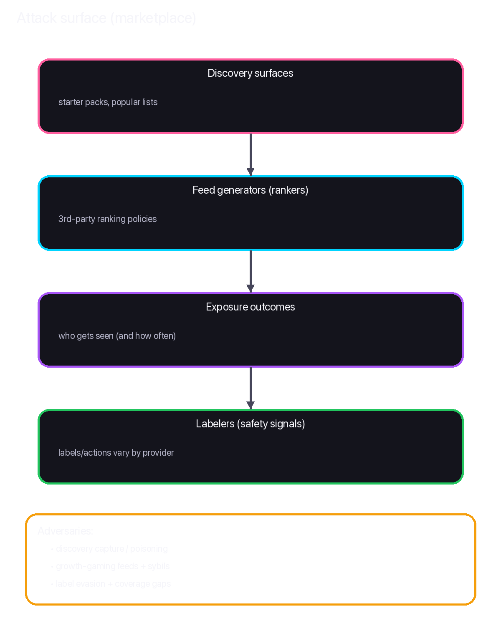
Security implications: a new attack surface
• Concentrated discovery reduces attack cost.
• 3rd-party rankers can be adversarial → marketplace-wide audit + guardrails.
[NDSS’21 10.14722/ndss.2021.24525; CCS’21 10.1145/3460120.3484770]

Slide 19

Privacy: third-party services can profile
Request patterns + outputs can reveal preferences and identity.
GET
https://…/xrpc/app.bsky.feed.getFeed?feed=at://…&cursor=…
What a service sees
Why it matters
• IP + timing + feed URI (and viewer DID if auth) • repeated queries + outputs reveal preferences
• profiling / tracking + output leakage • cross-service linkage risk
[CCS’21 10.1145/3460120.3484770]

Slide 20

Implication: decentralized moderation is fragile
• Label semantics are subjective → disagreement across labelers.
• Feed choice can bypass/amplify safety boundaries (coverage gaps + bias).
[NAACL’22 10.18653/v1/2022.naacl-main.431; Findings ACL’22 10.18653/v1/2022.findings-acl.176]

Slide 21
Mitigation: discovery transparency + diversification
• Publish logs for starter packs + popular lists.
• Diversify defaults + detect manipulation (growth + overlap spikes).

Slide 22
Mitigation: auditable feed marketplace
Logs + reproducible snapshots enable accountability
Add audit hooks around discovery, ranking, and labelers.
Why this matters
Expose stable identities + policies so clients can warn and researchers can audit.
Choice only helps if users can compare risk, diversity, and trust.
Transparency logs
Audit APIs
Reproducible snapshots
What to disclose (minimal)
• provider identity + hosting footprint
• discovery surfaces (who promoted what)
• ranking output summaries (exposure / overlap)
• labeler policies + coverage
• incident response + takedown hooks

Slide 23

Mitigation: “feed nutrition labels” (user-facing)
• Show provider, overlap, and exposure concentration at a glance.
• Show label exposure + applied labelers (warnings/filters/defaults).

Slide 24
Mitigation: labeler interoperability + secure sharing
• Standardize vocabularies + transparency for labeler policies.
• Secure/private sharing + multi-labeler consensus to resist poisoning.
[IEEE S&P’22 10.1109/SP46214.2022.9833647]

Slide 25
Takeaways
• Algorithmic choice shifts power to discovery + infrastructure.
• Open markets create new adversarial surfaces + inequalities.
Questions?

Slide 26


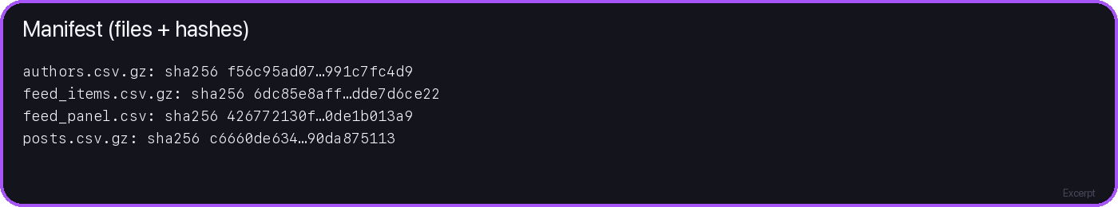
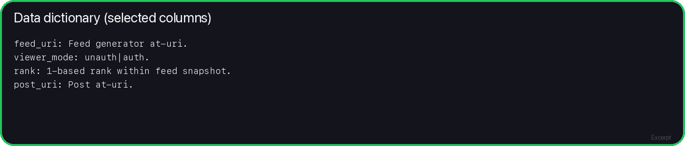
References (venue-filtered, 2021-2025)
CCS / IEEE S&P / NDSS / USENIX Sec / WWW / CSCW / ICWSM / ACL / KDD
Decentralization + discovery
Ranking + security + labels

