Slide 1
葡萄酒品質預測
學號:M093040003
姓名:趙云珮

Slide 2
Outline
• Task
• Dataset
• 結果分析

Slide 3
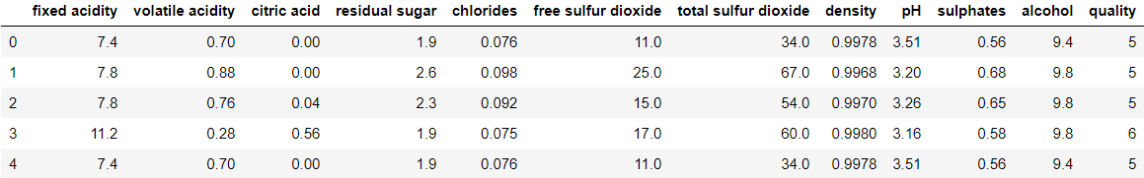
Task
根據features來預測葡萄酒的品質。
fixed acidity | volatile acidity | citric acid | residual sugar | chlorides | free sulfur dioxide | total sulfur dioxide | density | pH | sulphates | alcohol | quality
固定酸度 | 揮發性酸度 | 檸檬酸 | 殘糖 | 氯化物 | 游離二氧化硫 | 總二氧化硫 | 密度 | pH | 硫酸鹽 | 酒精 | 品質
Notes:
'residual sugar', 'free sulfur dioxide','total sulfur dioxide', 'fixed acidity',
citric acid' 'chlorides','sulphates','volatile acidity', 'alcohol',

Slide 4
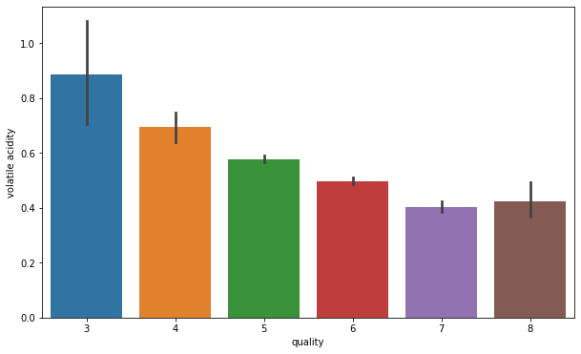
Volatile acidity(揮發性酸度)
Notes:
#**volatile acidity

Slide 5
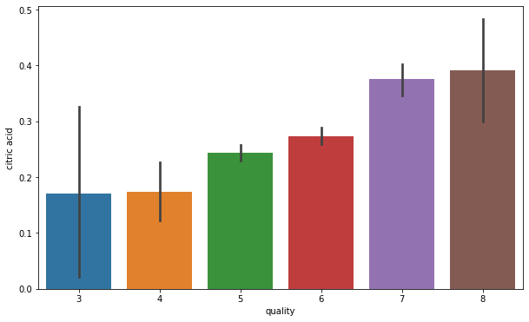
Citric acid(檸檬酸)
Notes:
# Composition of citric acid go higher as we go higher in the quality of the wine

Slide 6
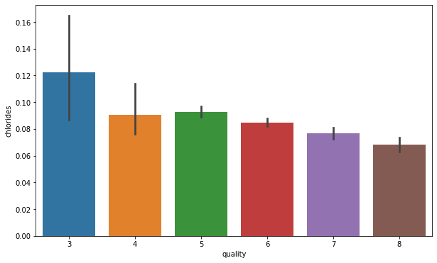
Chloride(氯化物)
Notes:
#Composition of chloride also go down as we go higher in the quality of the wine

Slide 7
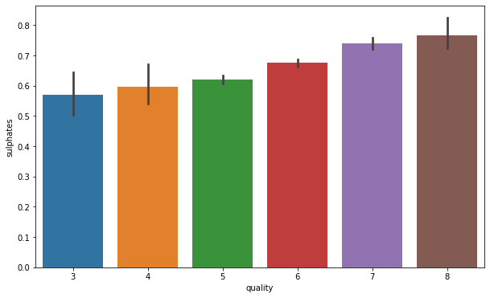
Sulphates(硫酸鹽)
Notes:
#Sulphates level goes higher with the quality of wine

Slide 8
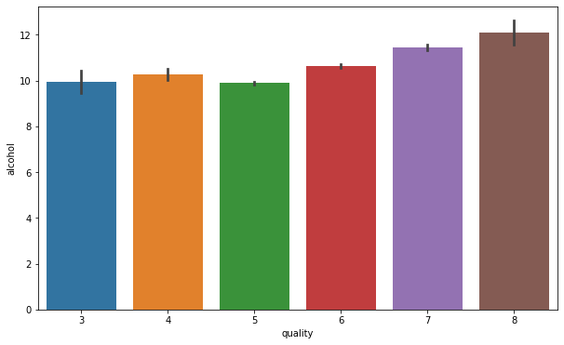
Alcohol(酒精)
Notes:
#**alcohol

Slide 9
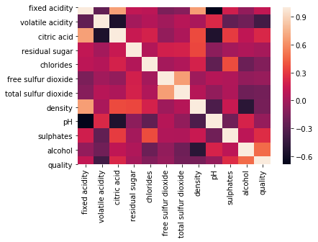
Notes:
The strongly correlated items are :
1.fixed acidity(固定酸度) and citric acid(檸檬酸). 2.free sulphur dioxide(游離二氧化硫) and total sulphor dioxide(總二氧化硫). 3.fixed acidity(固定酸度) and density.4.alcohol and quality.
so, from above points there is a clear inference that alcohol is the most important characteristic to determine the quality of wine.
The weekly correlated items are :
1.citric acid(檸檬酸) and volatile acidity(揮發性酸度). 2.fixed acidity(固定酸度) and ph. 3.density and alcohol.
These are some relations which do not depend on each other at all.

Slide 10
Dataset
Wine:1599 records
Training set:75%
Testing set:25%
Notes:
葡萄酒品質預測
輸入變量（基於理化測試）：1-固定酸度2-揮發性酸度3-檸檬酸4-殘留糖5-氯化物6-游離二氧化硫7-總二氧化硫8-密度9-pH 10-硫酸鹽11-醇輸出變量（基於感官數據）：12-質量（得分在0到10之間）
1 - fixed acidity
2 - volatile acidity
3 - citric acid
4 - residual sugar
5 - chlorides
6 - free sulfur dioxide
7 - total sulfur dioxide
8 - density
9 - pH
10 - sulphates
11 - alcohol Output variable (based on sensory data):
12 - quality (score between 0 and 10)

Slide 11
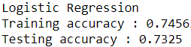
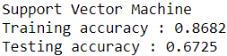
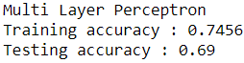
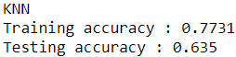
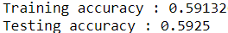
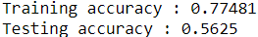
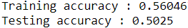
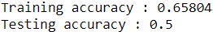
結果分析
 | Logistic Regression | Support Vector Machine | Multi Layer Perceptron | KNN
二分類
多分類

