Slide 1
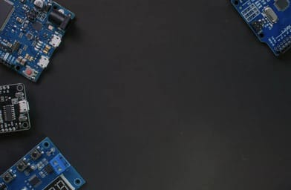

AgroSphere: An IoT-Based Data Acquisition and Backend Dataset Generation Framework for Smart Farming
A Research Report
Submitted by: YASH RAJ DASH Roll No: 122EC0126
Guided By: Prof. Santosh Kumar Das
Department: Electronics and Communication Engineering Institution: National Institute of Technology, Rourkela Session: 2022-2026

Slide 2
Problems / Challenges
Environmental and Agricultural Challenges: Climate variability, water scarcity, soil degradation, and unpredictable weather affect crop yield and quality.
Technology Barriers: Small farmers face difficulty adopting smart farming due to the high cost and complexity of existing systems.
Sensor Hardware Issues: Synchronizing multiple sensors with varied interfaces (analog, digital, UART) using Arduino microcontrollers.
Data Quality and Real-time Communication: Ensuring stable, accurate sensor data acquisition and reliable Wi-Fi communication to cloud backend.
Power Supply and Field Conditions: Maintaining hardware operation in outdoor field environments with stable power and weatherproofing.
Software Challenges: Creating efficient Arduino firmware to manage sensor readings, calibration, data packaging (JSON), and error handling.

Slide 3
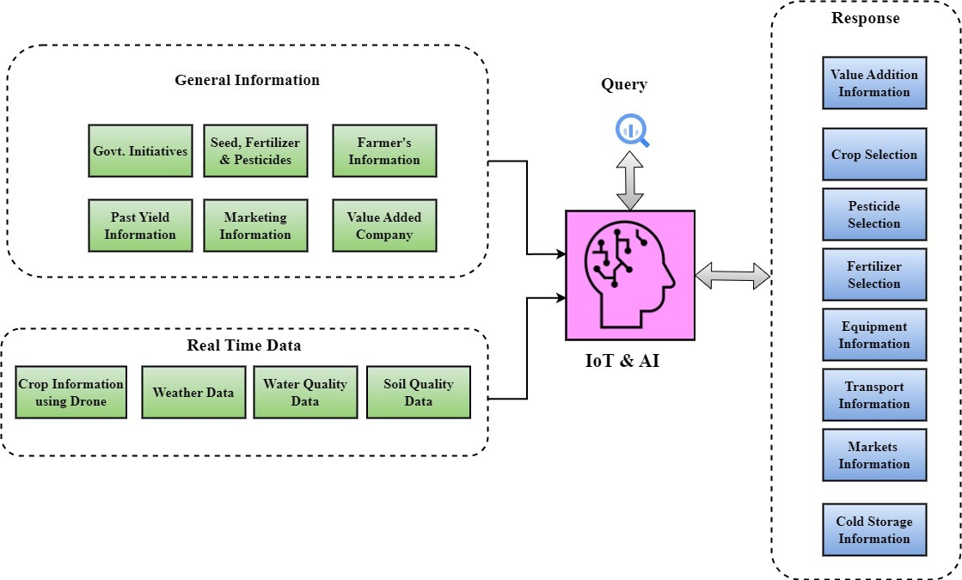
System Architecture of AgroSphere
Data Acquisition: The system collects both general/static information (government policies, market trends, past yields, seed/fertilizer/pesticide options, and farmer records) and real-time field data (from drones, weather stations, water and soil quality sensors).
Central Processing (IoT): All gathered data is sent to a central AI engine, which can also process farmer queries directly. This engine uses both historical and live information to analyze conditions and determine best practices.
Decision Support & Response: The system delivers tailored recommendations and actionable responses—including crop, fertilizer, and pesticide selection, as well as information on value addition, equipment, logistics, and marketing—to support farmers at every step from cultivation to market.
Figure 1: Integrated Data Processing and Response Architecture for Smart Agriculture

Slide 4
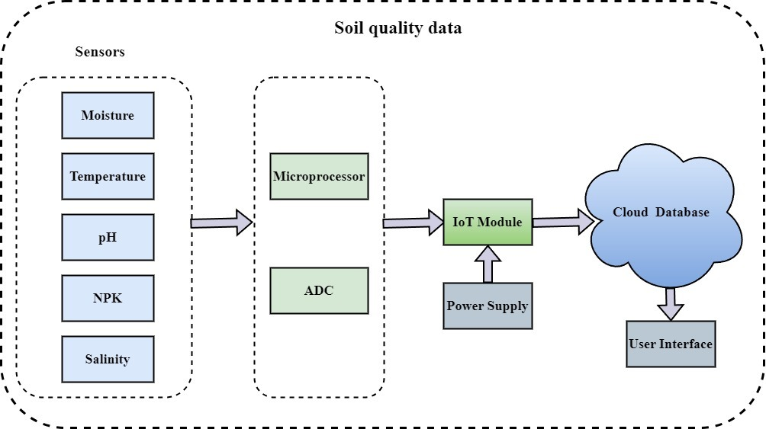
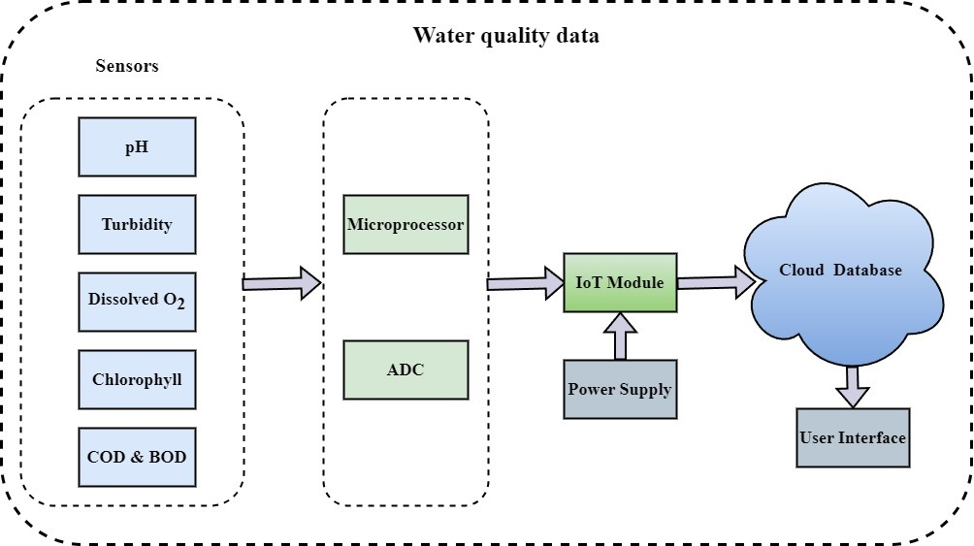
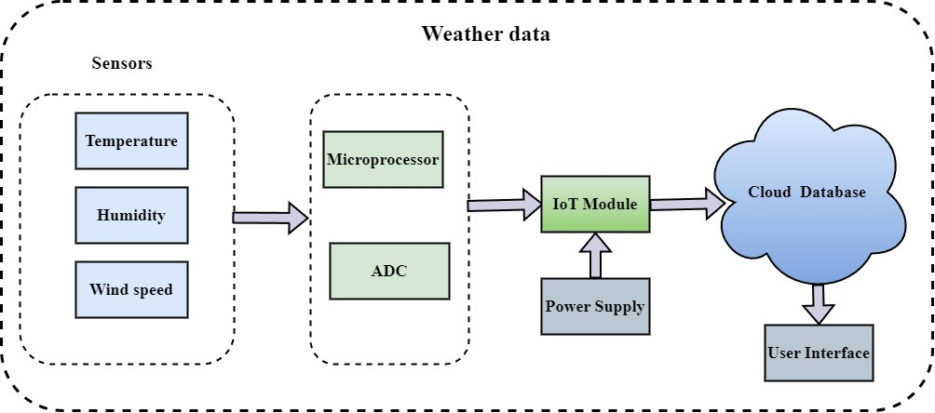
Hardware Components
Figure 2: Soil Quality Components
Figure 3: Water Quality Components
Figure 4: Weather Quality Components

Slide 5
WORKING MECHANISM
1. Data Collection
Sensors deployed in the field continuously measure key environmental and soil parameters such as temperature, humidity, moisture, pH, and nutrient levels (NPK).Additionally, farmers can manually input information related to crop type, irrigation schedules, and local observations . These combined datasets create a comprehensive, real-time understanding of field conditions and crop health.
2. Data Analysis
All collected data is transmitted to the AI-enabled backend, where it undergoes preprocessing, filtering, and validation. Machine learning models then analyze the data to identify trends, detect anomalies, and generate personalized recommendations . The system also predicts weather-related risks and provides alerts related to irrigation, fertilization, or disease possibilities.
3. Farmer Support
The processed insights are delivered to the farmer through a user-friendly mobile or web application. The platform presents easy-to-understand dashboards, forecasts, and alerts, enabling farmers to make quick and informed decisions . This includes guidance on optimal watering times, crop suitability, nutrient correction, and best market timing.
4. Marketplace Engagement
Once crops are ready for sale, the system connects farmers to a digital marketplace . Here, farmers can list their produce, compare real-time market prices, and sell directly to buyers . This ensures transparency, reduces middlemen, and allows farmers to gain fair and improved pricing for their harvest

Slide 6
System Implementation
Hardware Development: Designed Arduino-based sensor nodes with multiple sensors (soil moisture, pH, NPK, turbidity, rainfall) to capture key parameters.
Firmware Implementation: Developed firmware in Arduino IDE for synchronized sensor data acquisition, calibration, packaging data as JSON for cloud upload, and managing Wi-Fi connectivity including robust error handling.
Cloud and AI Integration: Transmitted data over Wi-Fi to a cloud backend running REST APIs, structured databases, and ML models for crop recommendation and monitoring.
User Interface: Developing a web dashboard for real-time visualization and actionable insights accessible to farmers.
Iterative Testing and Calibration: Conducted extensive hardware calibration and software debugging using Arduino serial monitor and network debugging tools.

Slide 7
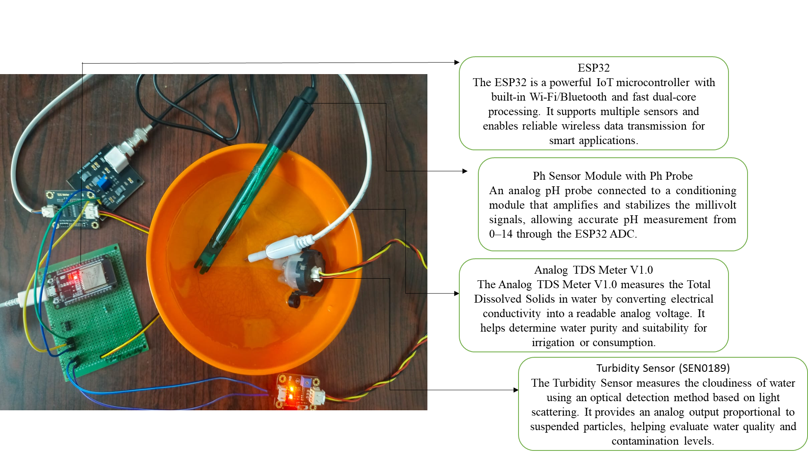
Example Experimental Setup (Water Quality Monitoring)

Slide 8
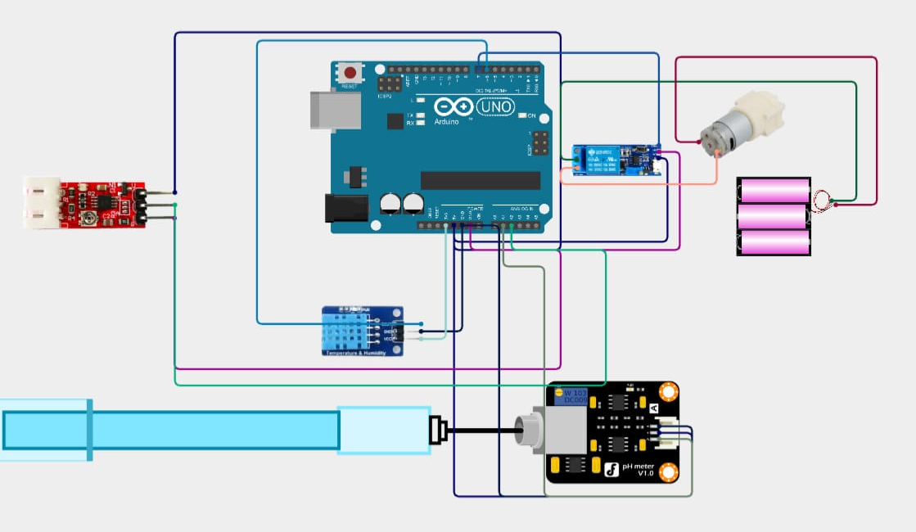
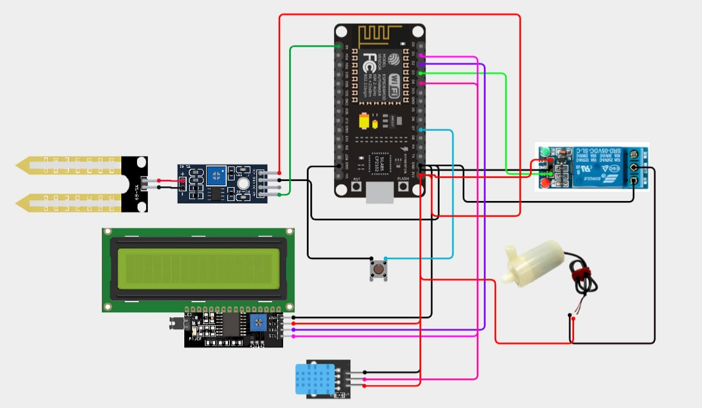
This is an Arduino UNO based water quality + motor control system.
Components Visible:
Arduino UNO
Turbidity sensor (red module, left)
DHT sensor (blue module)
pH meter module (bottom right)
Relay module (right side)
DC motor / pump
External battery pack
This is an ESP8266 / ESP32 based soil quality + display system.
Components:
ESP board
Soil moisture sensor
16x2 LCD display (I2C)
Relay module
Water pump
DHT sensor
Push button

Slide 9
Data Acquisition & Firmware
The firmware was developed using Arduino IDE. The system performs periodic sampling of all sensors at fixed time intervals . The data acquisition process includes:
Sensor polling sequence to avoid timing conflicts
ADC reading and conversion to physical units
Filtering using moving average technique
JSON packet formation
HTTP POST transmission to backend
Non-blocking programming techniques were implemented to handle multiple sensor protocols simultaneously. This prevents delay-based blocking and improves synchronization between analog, digital, and UART sensors.
To improve communication reliability, the firmware includes:
Automatic Wi-Fi reconnection
Transmission acknowledgment verification
Exponential backoff retry logic
Local data buffering during disconnections
This ensures minimal packet loss even under unstable field network conditions.

Slide 10
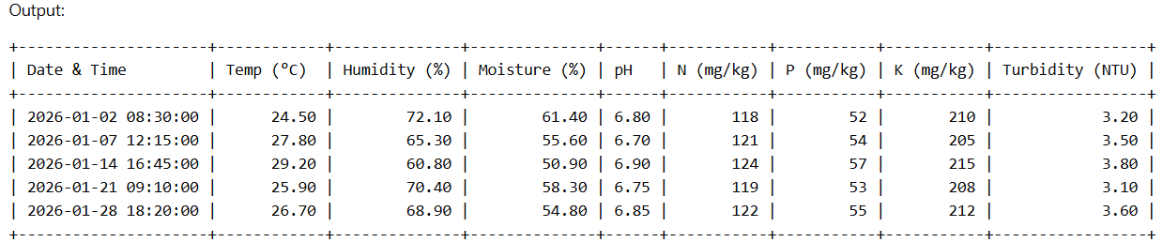
Results – Focused on Data Acquisition Performance
Experimental testing was conducted under controlled and semi-field conditions to evaluate sensor acquisition accuracy and backend logging reliability.
Data Acquisition Observations:
• ADC readings remained stable after applying moving average filtering. • pH calibration reduced measurement deviation significantly. • RS485 communication with NPK sensor showed stable data transmission without packet corruption. • Multi-sensor synchronization was successfully achieved without timing conflicts.
Communication Performance:
• Average transmission latency remained within acceptable limits under stable Wi-Fi conditions. • Wi-Fi reconnection logic successfully restored connectivity after simulated disconnections. • Local buffering prevented data loss during temporary network outages.

Slide 11
ISSUES FACED
Solutions Implemented
Inconsistent Sensor Readings: Variations in soil, water, and environmental sensor outputs due to noise, calibration drift, and environmental interference.
Multi-Protocol Handling Difficulty: Managing UART, I2C, Analog, and RS485 sensors together increased firmware complexity and timing conflicts.
Wi-Fi Disconnections: Unstable field network conditions caused frequent packet drops and interrupted data transmission to the cloud.
Field Power Stability Issues: Outdoor deployment led to voltage fluctuations, moisture exposure, and occasional brown-outs in the ESP32 node.
Sensor Calibration & Data Filtering: Applied two-point calibration, moving-average filters, and signal smoothing to stabilize and improve measurement accuracy.
Optimized Firmware Architecture: Implemented non-blocking code, structured sensor polling, and protocol-specific drivers to ensure reliable multi-sensor operation.
Robust Wi-Fi Reconnect Logic: Added automatic reconnection, exponential backoff, local data buffering, and periodic network health checks.
Outdoor-Ready Power Conditioning: Used voltage regulators, surge protection, waterproof enclosures, and stable 5V/3.3V supply modules to improve field reliability.

Slide 12
CONCLUSION
FUTURE WORK
The developed AgroSphere system successfully integrates multi-sensor data acquisition using ESP32 for soil, water, and weather monitoring.
Real-time data processing and wireless transmission enable efficient decision-making for farmers.
Sensor readings (soil NPK, moisture, pH, water turbidity, weather conditions) help evaluate field conditions accurately.
The system demonstrates reliability, low cost, and ease of implementation for precision agriculture.
Results confirm that IoT-based smart farming significantly improves resource utilization and farm productivity.
The modular design allows easy expansion to additional sensors and automation units.
Adoption of long-range communication protocols like LoRaWAN/NB-IoT for large farm deployments.
Addition of advanced sensors (EC sensor, camera for disease detection).
Development of a mobile app/dashboard with alerts, recommendations, and historical data visualization.
Field testing in real farms to validate performance, improve calibration, and collect broader datasets.

Slide 13
THANK YOU

