Slide 1

Smart Waste Management System
National Institute of Technology, Rourkela
Guided By:-
Prof. Sobhan Kanti Dhara & Prof. A.K Sahoo
Submitted By:-
Satyajit Barik (122EC0123),
Yash Raj Dash (122EC0126),
Kedarnath Jani (122EC0129)

Slide 2
Project Overview & Abstract:-
The Problem: Inefficient waste collection and lack of automated sorting.
The Solution: A dual-approach system combining:
Real-time Monitoring: Arduino-based sensors for bin fill levels.
Automated Classification: Deep learning models to identify waste types.
Key Achievement: 89% accuracy in predicting bin status and 72% accuracy in waste image classification.
Focus on automation and smart decision-making.

Slide 3
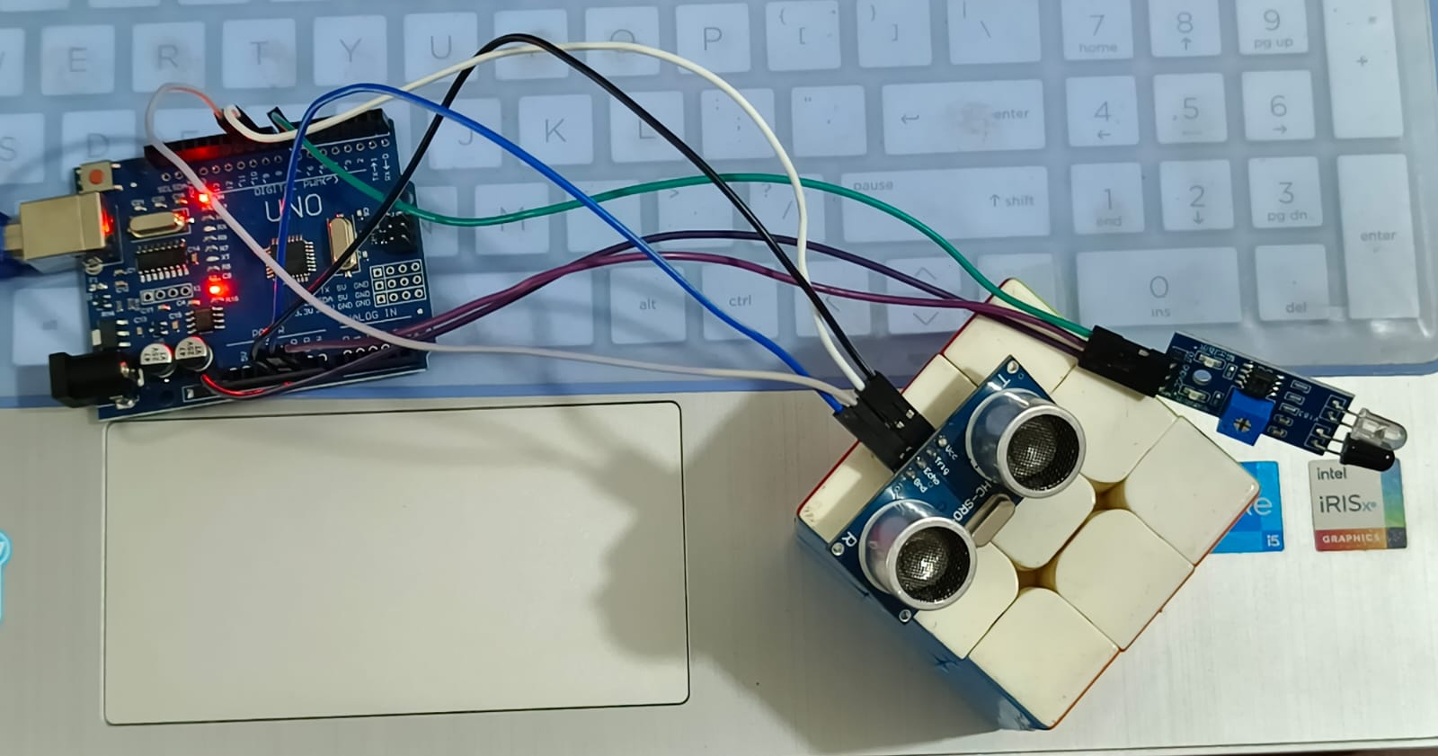
Part 1: Sensor-Based Bin Monitoring
Objective: To measure bin fullness and detect object presence in real-time.
Core Hardware:
Arduino Board: The central processing unit.
Ultrasonic Sensor: Measures distance to the waste surface to calculate volume.
Infrared (IR) Sensor: Detects if a person or object is near the bin.
Update Interval: System outputs data every 5 seconds.

Slide 4
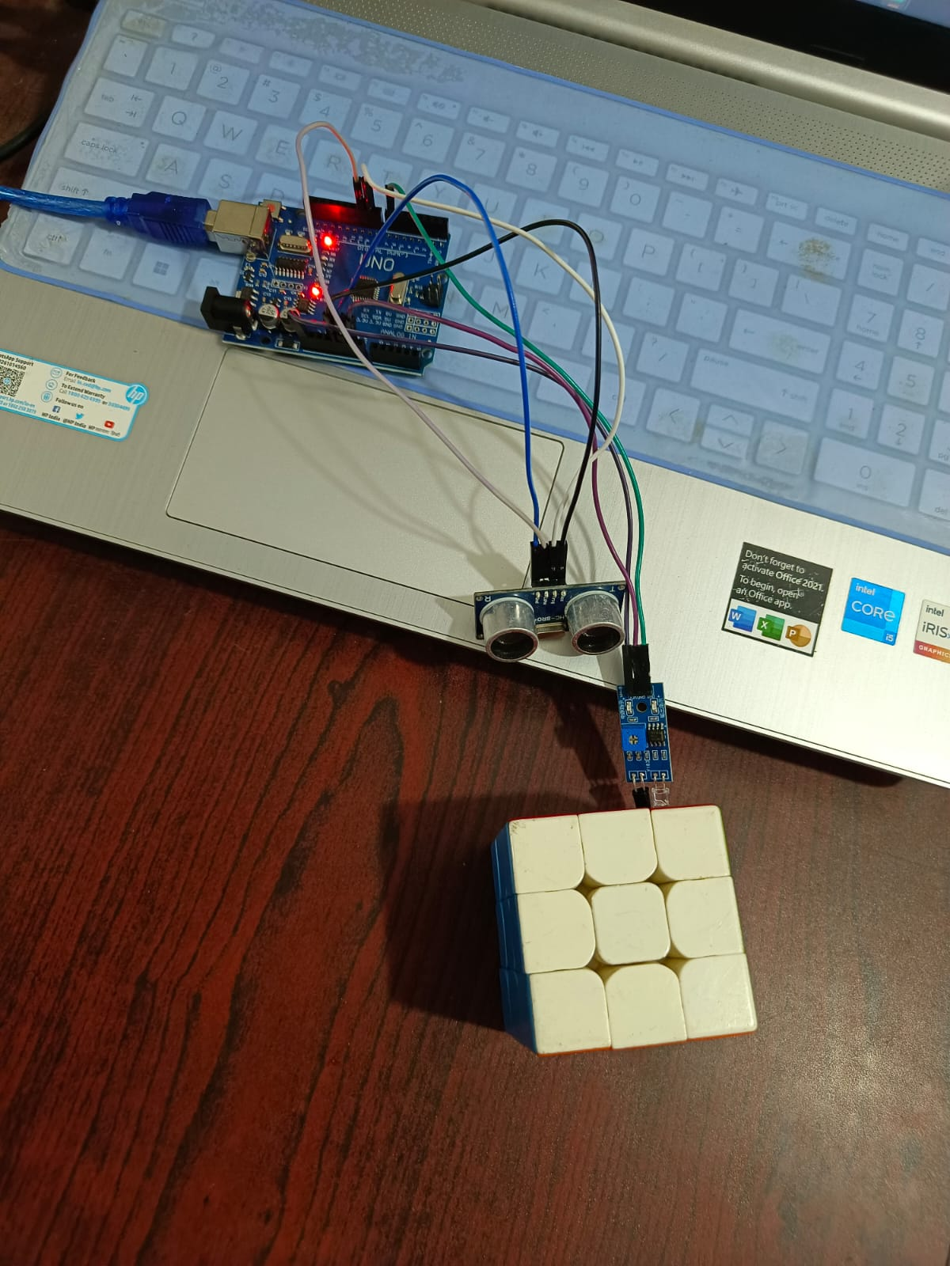
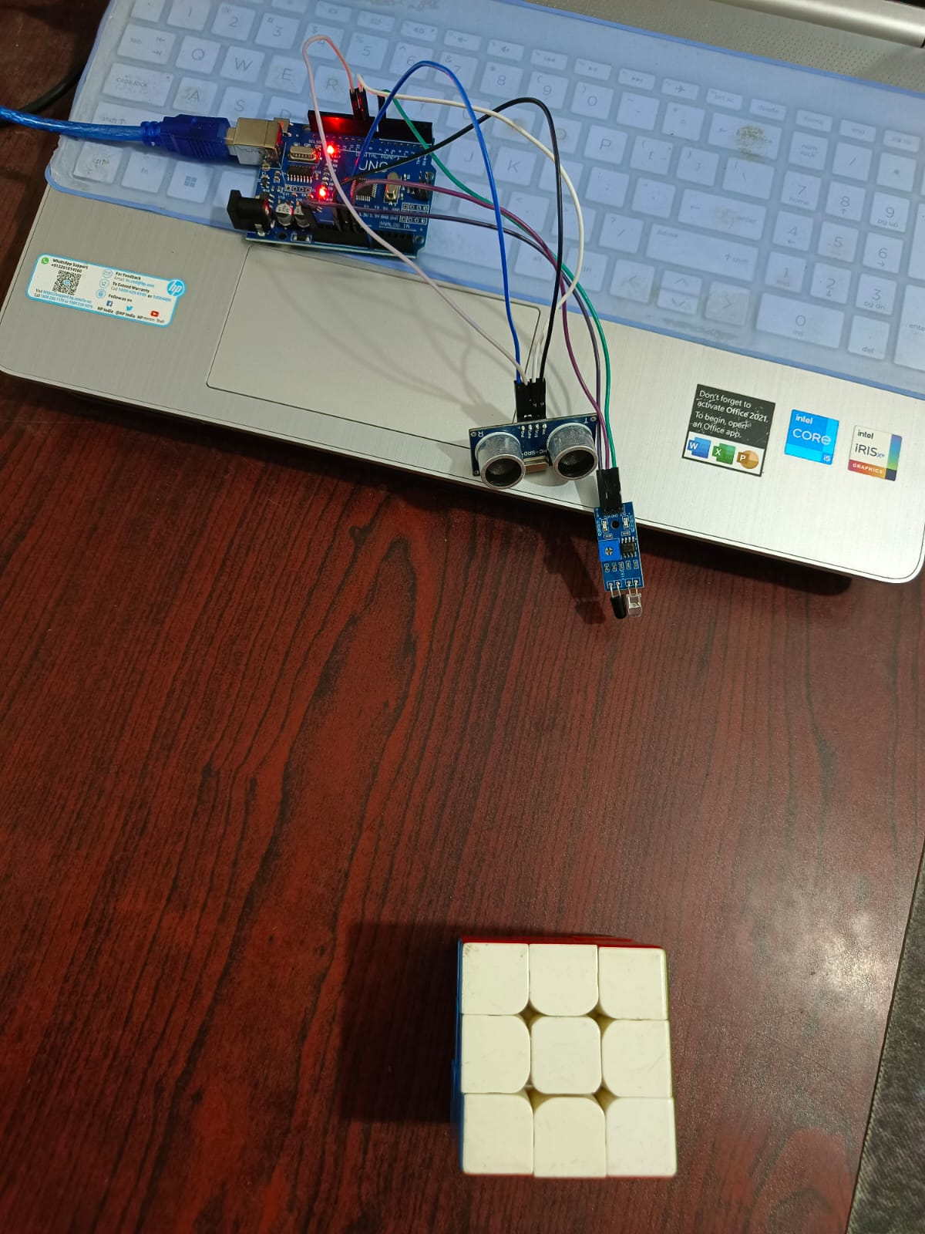
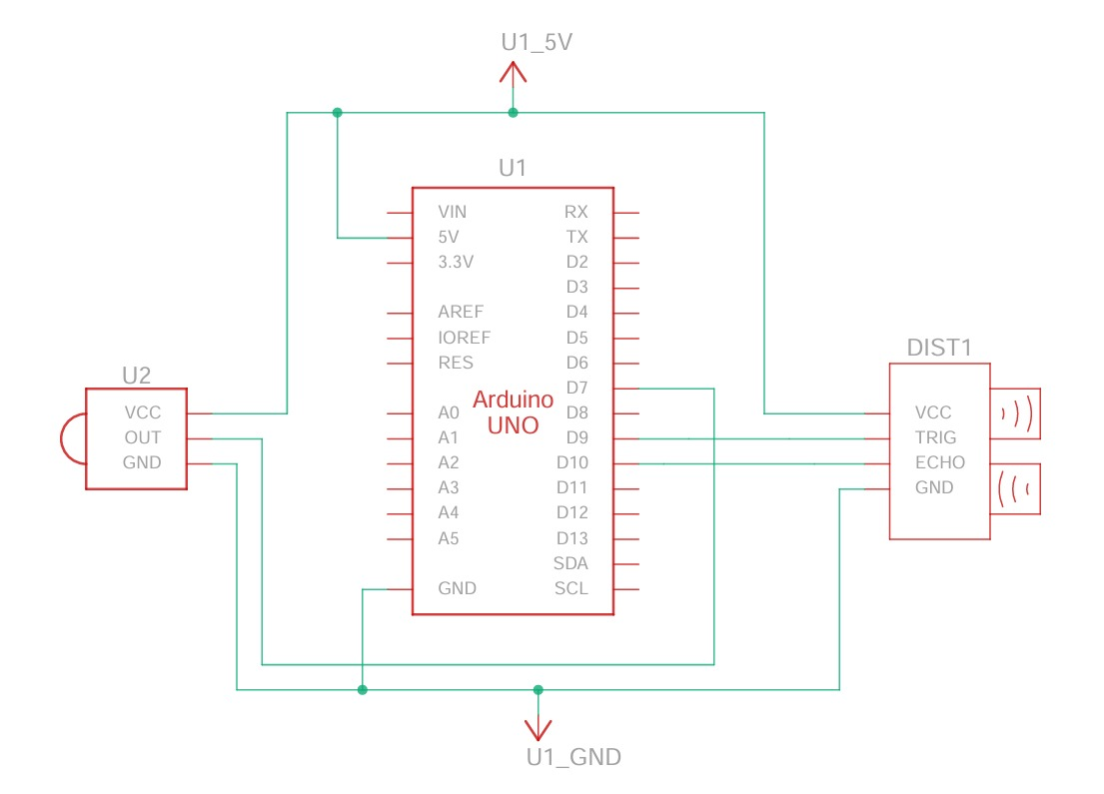
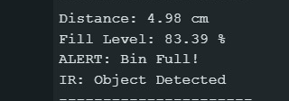
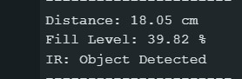
Figure:-Circuit Diagram
Result :-
The system accurately measures bin fill level and triggers an alert when it exceeds the threshold.
Arduino processes inputs from ultrasonic and IR sensors to monitor bin status and detect objects.

Slide 5
Smart Waste Management System Predictive Route Optimization using IoT Sensor Data
Problem:-Current systems do not use real-time data, so they cannot predict which bins need urgent attention, resulting in both wasted resources and overflowing bins.
Solution:
A Machine Learning-based system that uses ultrasonic sensor data to predict when a bin will reach critical capacity, enabling optimized and need-based collection.
Hardware Efficiency:
The system is designed to minimize cost by eliminating the need for a Volume Sensor (VS) and relying only on fill-level data derived from ultrasonic sensors.

Slide 6
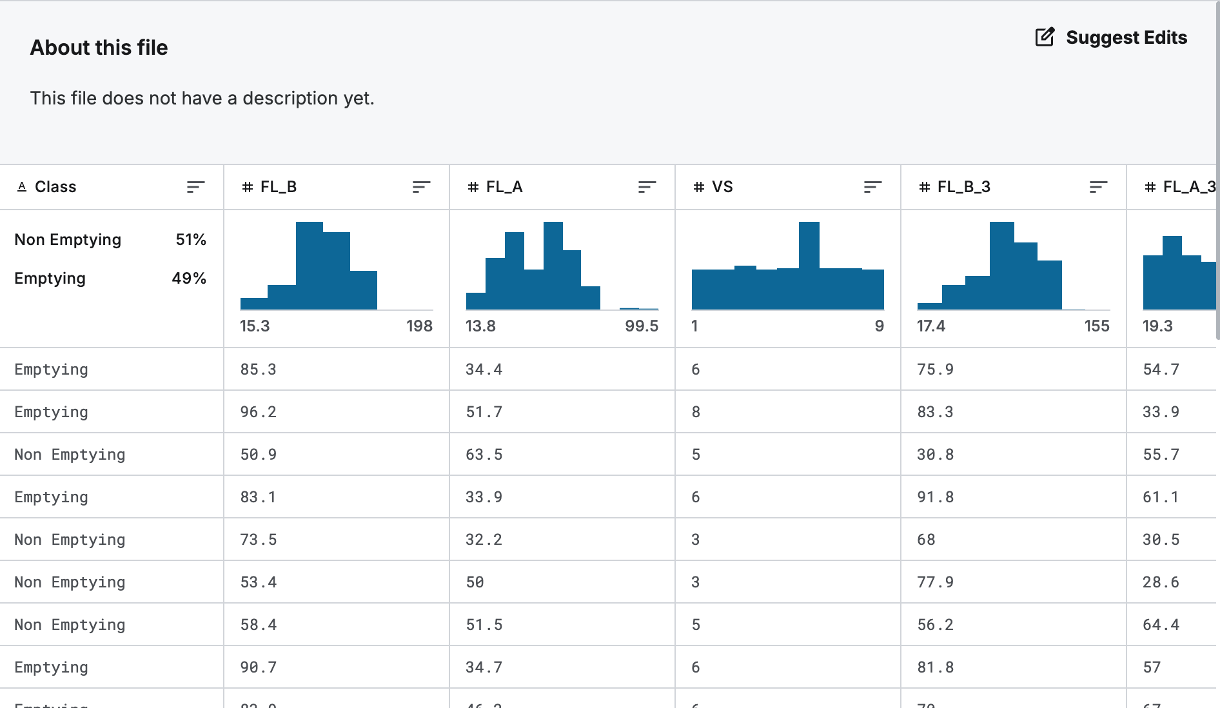
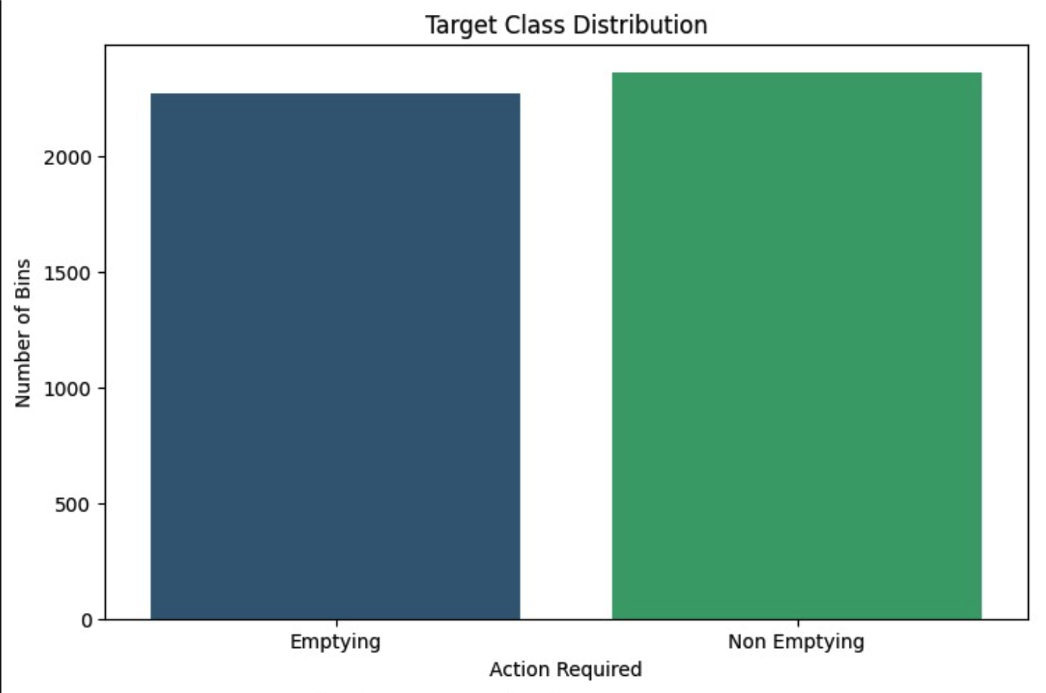

Data Inputs & Feature Engineering:-
Core Sensor Inputs:
FL_B (Fill Level Before): Current bin capacity (%)
FL_A (Fill Level After): Capacity after a time interval
FL_B_3: Fill level 3 hours earlier
FL_B_12: Fill level 12 hours earlier
These inputs provide both current and historical context.
Feature Engineering (Fill Rate):-A derived feature is calculated to capture the rate of waste accumulation:
Impact:-This helps the model prioritize bins dynamically. For example:
A bin at 50% but filling rapidly is more critical
A bin at 70% but stable is less urgent
$$\text{Fill} \text{Rate}=FL_{A}−FL_{B}$$

Slide 7
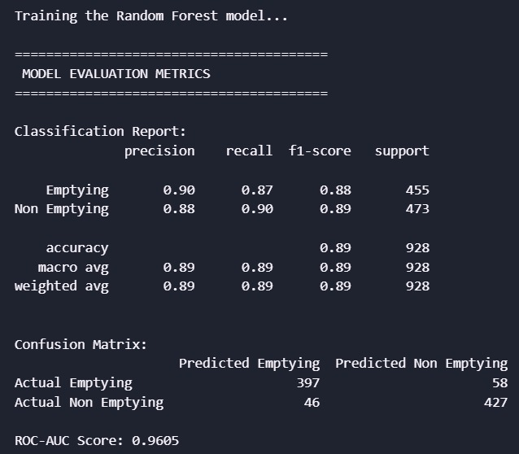
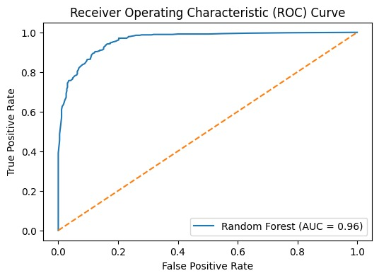
Algorithm & Hyperparameters
The Random Forest Engine
Why Random Forest:Ultrasonic sensor readings can be noisy due to obstructions or environmental factors. Random Forest, an ensemble learning method, reduces this noise by averaging predictions from multiple decision trees.
Key Hyperparameters:-
n_estimators = 100
Uses 100 decision trees to improve prediction stability and reduce variance.
class_weight = 'balanced'
Adjusts for class imbalance by giving more importance to rare but critical events (e.g., bin overflow).
random_state = 42
Ensures reproducibility by fixing randomness, making the model consistent across runs and deployments.

Slide 8
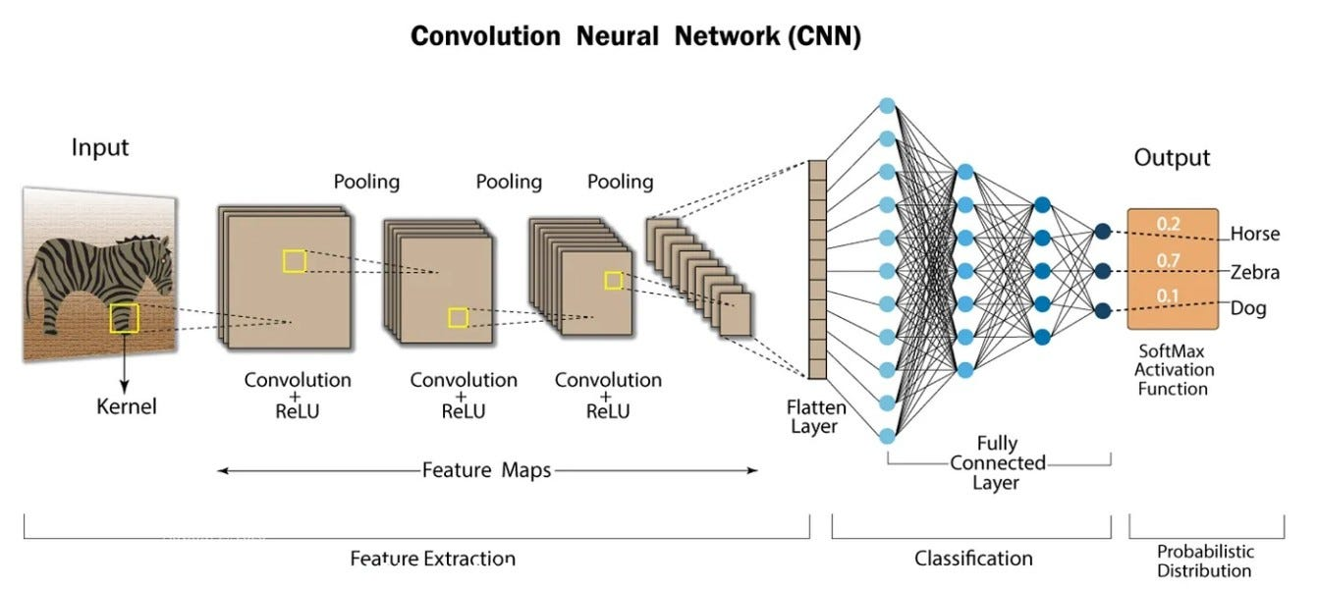
Waste Classification
Approach B: Custom CNN vs. Transfer Learning
Dataset Overview: 2,527 images across 6 classes: Cardboard, Glass, Metal, Paper, Plastic, and Trash.
The Models Tested:
Custom CNN: Built from scratch with 4 convolutional layers(Filters: 32 ->64 -> 128 -> 256)
Activation Function: ReLU
Max Pooling layers (reduce dimensions)
Flatten layer (convert to 1D vector)
Dense Layer (256 neurons)
Dropout (0.5 to prevent overfitting)
Output Layer (6 classes using Softmax)
MobileNetV2: Pre-trained transfer learning model.
EfficientNetB0: Pre-trained transfer learning model.

Slide 9
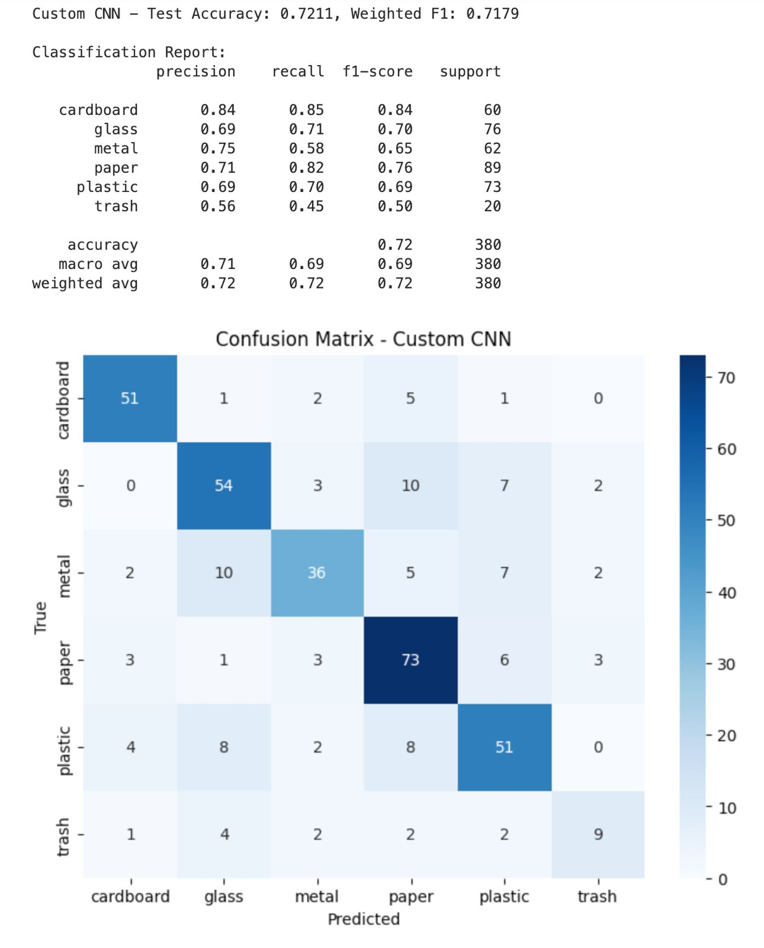
Model Comparison & Results
Model:-
Custom CNN:-72.0% Accuracy.
MobileNetV2:-28.2% Accuracy.
EfficientNetB0:-23.4% Accuracy.
The Custom CNN achieved the highest accuracy of 72.11%, while the pre-trained models (MobileNetV2 and EfficientNetB0) failed significantly, with accuracies as low as 23.4%.
Custom CNN learns waste features from scratch, so it can correctly identify all six types, unlike pre-trained models which were biased toward “paper”.

Slide 10
Practical Workflow
Detection: IR sensor senses a user approaching.
Capture: An integrated camera takes a photo of the waste item.
Identification: The Custom CNN classifies the waste type for sorting.
Monitoring: Ultrasonic sensors track bin capacity.
Logistics: The Random Forest model determines emptying urgency to optimize collection routes.

Slide 11
Future Improvements:
Conclusion:-
Fine-tuning: Train base layers instead of freezing them.
Data Augmentation: Increase image count for the "trash" category to fix imbalance.
Hybrid Sensing: Integrate weight sensors for better accuracy.
Feasibility: Automated waste sorting is viable using custom-designed CNNs.
Efficiency: Using sensor-based Random Forest models provides highly reliable (89%) logistics data.
Impact: This hybrid system can significantly optimize collection routes and improve global recycling rates.

Slide 12
Thank you

