Slide 1






REST API
Request
URI: http://localhost:3000/museum
(MongoDB)
Request URI (HTTP)
Response
app.js
app.use
museum.js
{
info_img: http://localhost:30 00/public/...
“info:…”
}
Response URI (HTTP)
Application

Slide 2
API
Request
URI: http://localhost:3000/museum
(local)
Request URI (HTTP)
Response
app.js
app.use
museum.js
{
info_img: http://localhost:30 00/public/...
“info:…”
}
Response URI (HTTP)
Application

Slide 3


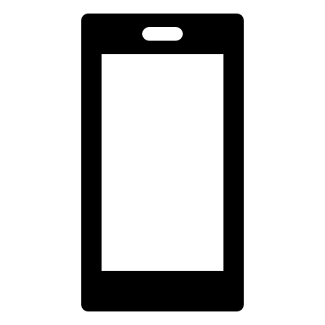
REST API
(MongoDB)
Native plugin
installation
ionic3API_v2
-npm install
-call number plugin
-BarcodeScanner
-import module
API
(local)
Build
-config.xml
-app name
-widget id
-<allow-navigation href=“*” />
-Install plugin
-whitelist
-%ionic cordova build android -release

