Slide 1

Variational Shape Approximation
Presenter
Mumbai Indians
Ninad Kamat
Akash Sambrekar
Rahul Patil
Notes:
This is a fixed Carnegie Mellon image.
Place your cursor on the white text above and type in your text.
Main title: 40 pt. Times, Upper & lower case.
Presenter: 16 pt. Helvetica oblique
Name: 16 pt. Helvetica Bold
Presenters Title: 16 pt. Helvetica light

Slide 2
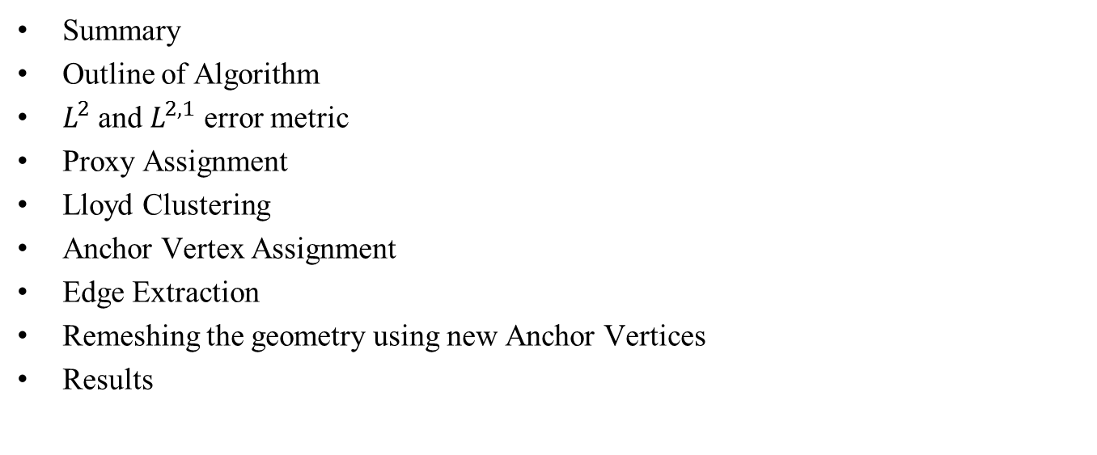
Outline
Summary
Outline of Algorithm
$L^{2}$ and $L^{2,1}$ error metric
Proxy Assignment
Lloyd Clustering
Anchor Vertex Assignment
Edge Extraction
Remeshing the geometry using new Anchor Vertices
Results

Slide 3
Summary

Slide 4
Algorithm Outline
Reading STL file
Store connectivity
Perform Lloyd Clustering
Add New Anchor Vertices
Extract New Edges
Make Anchor Vertices
New Triangulation
Store new connectivity
Write STL file

Slide 5
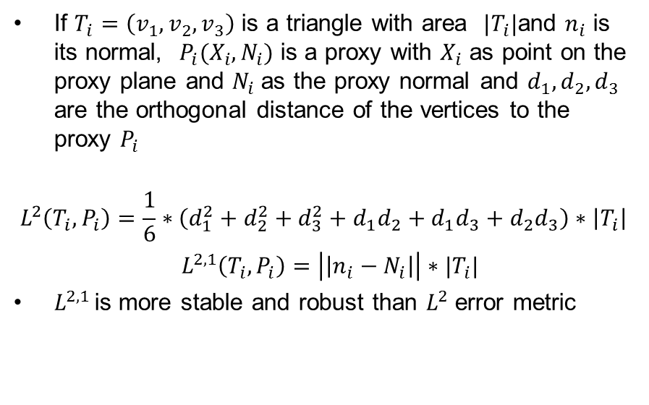

$L^{2}$ and $L^{2,1}$ Error Metric
If $T_{i}=\left(v_{1},v_{2},v_{3}\right)$ is a triangle with area ${|T}_{i}|$and $n_{i}$ is its normal, $P_{i}(X_{i},N_{i})$ is a proxy with $X_{i}$ as point on the proxy plane and $N_{i}$as the proxy normal and $d_{1},d_{2},d_{3}$ are the orthogonal distance of the vertices to the proxy $P_{i}$
$$L^{2}\left(T_{i},P_{i}\right)=\frac{1}{6}∗\left(d_{1}^{2}+d_{2}^{2}+d_{3}^{2}+d_{1}d_{2}+d_{1}d_{3}+d_{2}d_{3}\right)∗\left|T_{i}\right|$$
$L^{2,1}\left(T_{i},P_{i}\right)=\left|\left|n_{i}−N_{i}\right|\right|∗|T_{i}|$
$L^{2,1 }$is more stable and robust than $L^{2}$ error metric

Slide 6
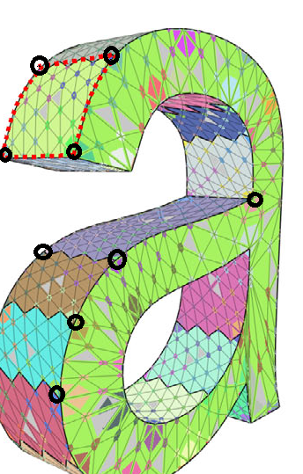
Anchor Vertex Assignment
What is an Anchor Vertex?
Find vertices where 3 or more proxy planes meet
Find average of projections of this vertex on its neighboring proxies
Issue a pointer to the original vertex to maintain connectivity
Sanity Check!
Each proxy should have three or more Anchor vertices linked to it

Slide 7
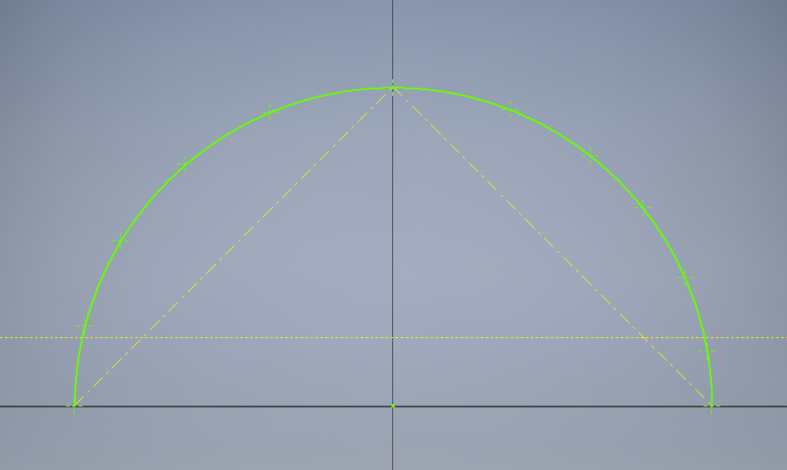
Edge Extraction: Adding more Anchor Vertices
Reason
To accurately approximate the boundary arc of each proxy
To ensure accurate triangulation of approximant mesh faces
Approach
For each proxy, find all the vertices on the boundary arc
Initiate simple chord subdivision algorithm to approximate the boundary arc
Add new anchor vertices during subdivision

Slide 8
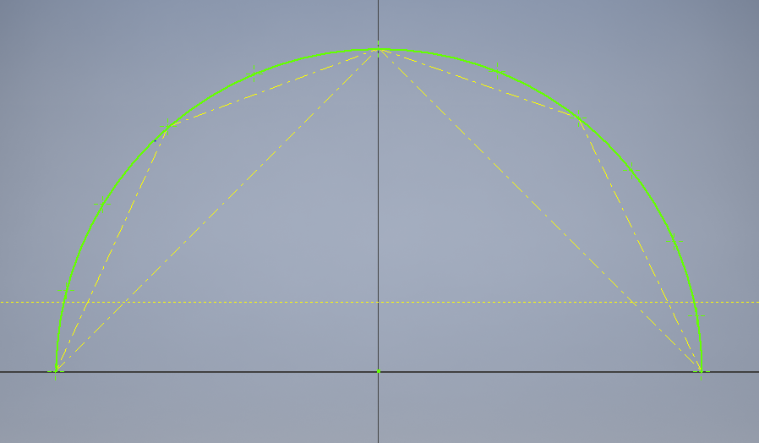
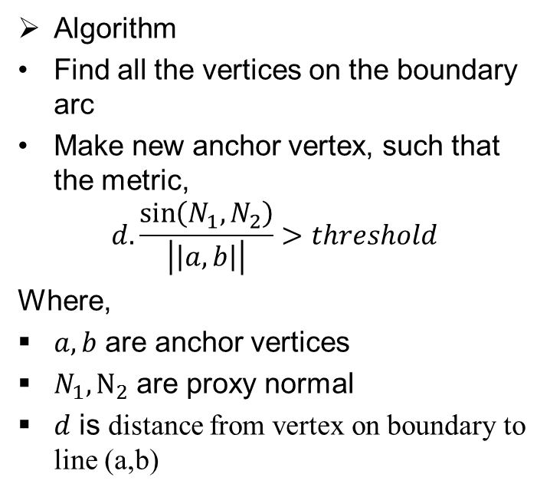
Edge Extraction: Chord Subdivision Algorithm
Algorithm
Find all the vertices on the boundary arc
Make new anchor vertex, such that the metric,
$$d.\frac{\sin\left(N_{1},N_{2}\right)}{\left|\left|a,b\right|\right|}>threshold$$
Where,
$a,b$ are anchor vertices
$N_{1},N_{2}$ are proxy normal
$d$ is distance from vertex on boundary to line (a,b)

