Slide 1
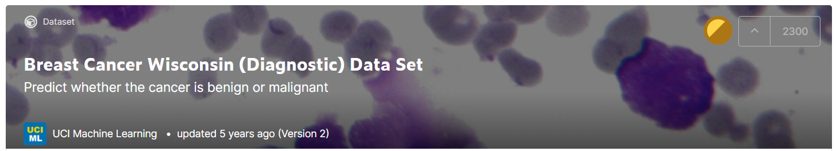
To Diagnose Malignant or Benign Tumor with the Image Feature of Cell Nuclei
https://www.kaggle.com/uciml/breast-cancer-wisconsin-data/tasks?taskId=299
Notes:
http://pages.cs.wisc.edu/~olvi/uwmp/cancer.html#diag

Slide 2
Outline
The aim of the study
The feature of the data
Results of six models
Conclusion and discussion

Slide 3
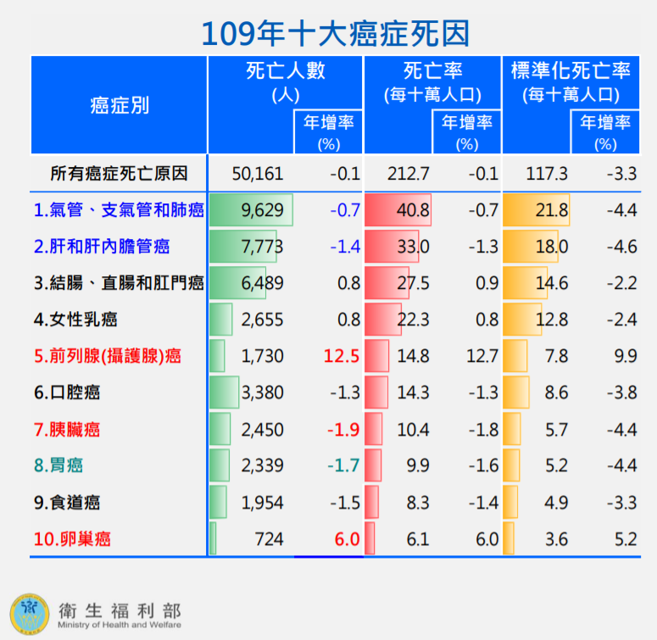
The Aim of the Study
Through images, we can speed up the diagnosis and reduce the cost.

Slide 4
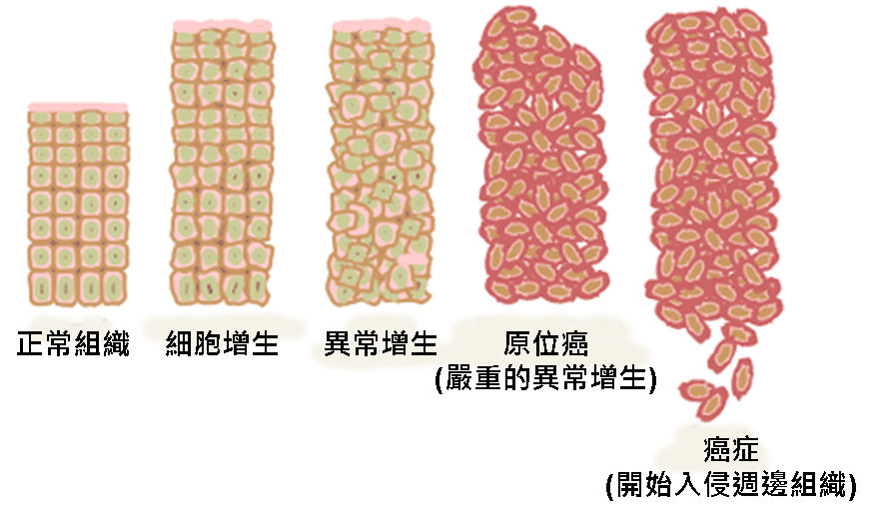
The Changes From Normal to Cancerous Tissue
https://zh.wikipedia.org/wiki/%E7%99%8C%E7%97%87

Slide 5
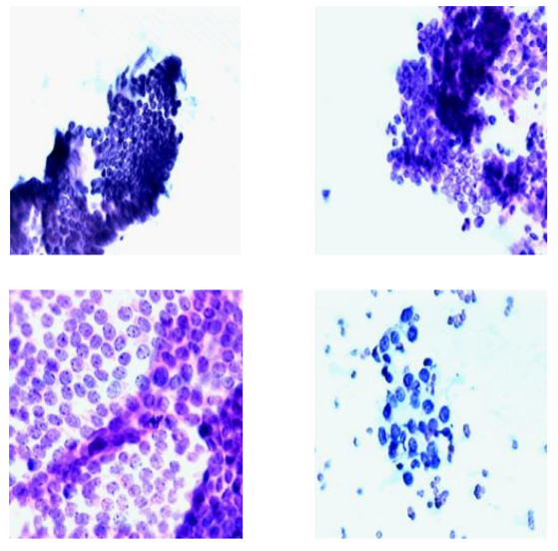
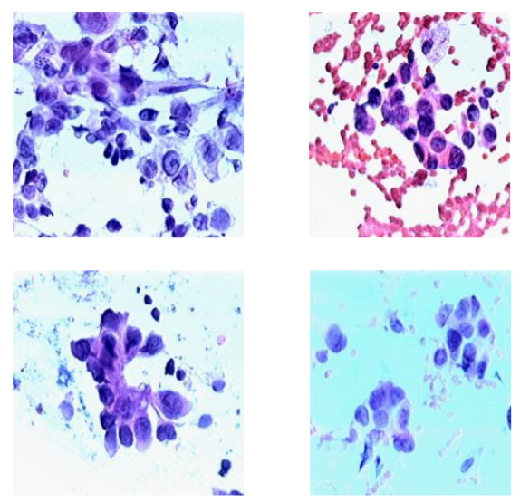
The Differences Between Benign and Malignant Samples
Benign
Malignant
Classification and Diagnostic Prediction of Breast Cancers via Different Classifiers | International Scientific and Vocational Studies Journal ArşivCilt 2, Sayı 2

Slide 6
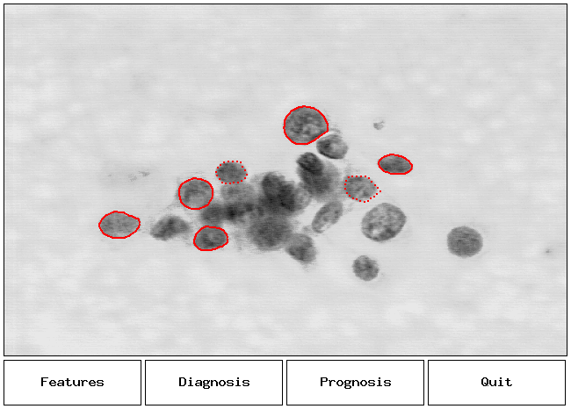
The Feature of Raw Data
id | 樣本ID
diagnosis | M (惡性)；B (良性)
radius_mean | 半徑（從中心到周邊點的平均距離）
texture_mean | 紋理
perimeter_mean | 周長
area_mean | 面積
smoothness_mean | 平滑度
compactness_mean | 緊湊性（周長^2/面積 - 1.0）
concavity_mean | 凹度（輪廓凹入部分的嚴重程度）
concave points_mean | 凹點（輪廓凹入部分的數量）
symmetry_mean | 對稱性
fractal_dimension_mean | 碎形維數
http://pages.cs.wisc.edu/~street/saves/xcyt1.gif

Slide 7
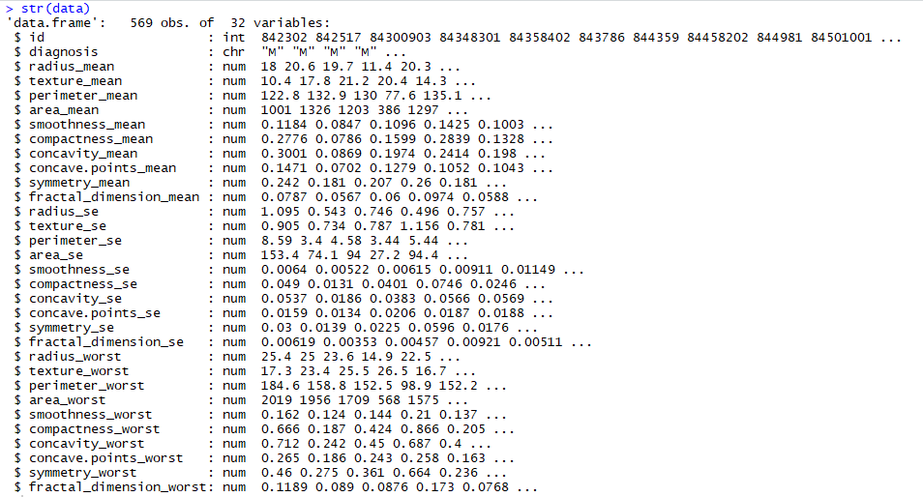
The Feature of Raw Data
平均值
標準誤差
最大值
Notes:
標準誤是用於衡量樣本均值和總體均值的差距

Slide 8
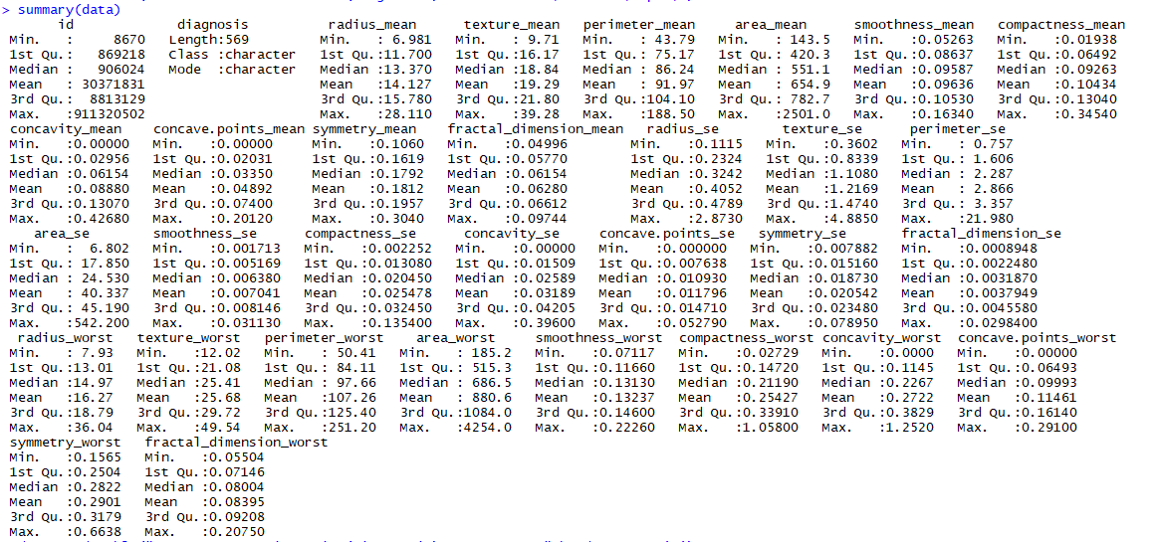
The Feature of Raw Data

Slide 9
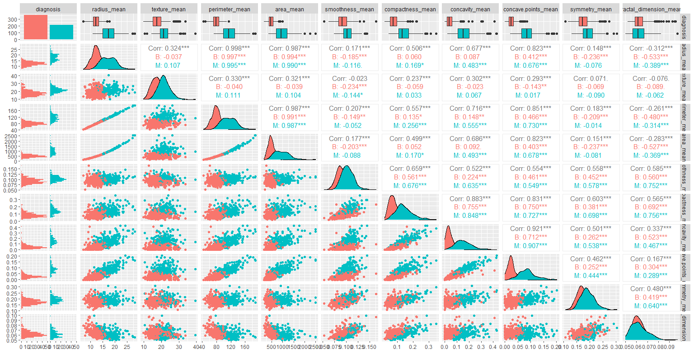
The Distributions of Raw Data-Mean
Benign-0
Malignant-1

Slide 10
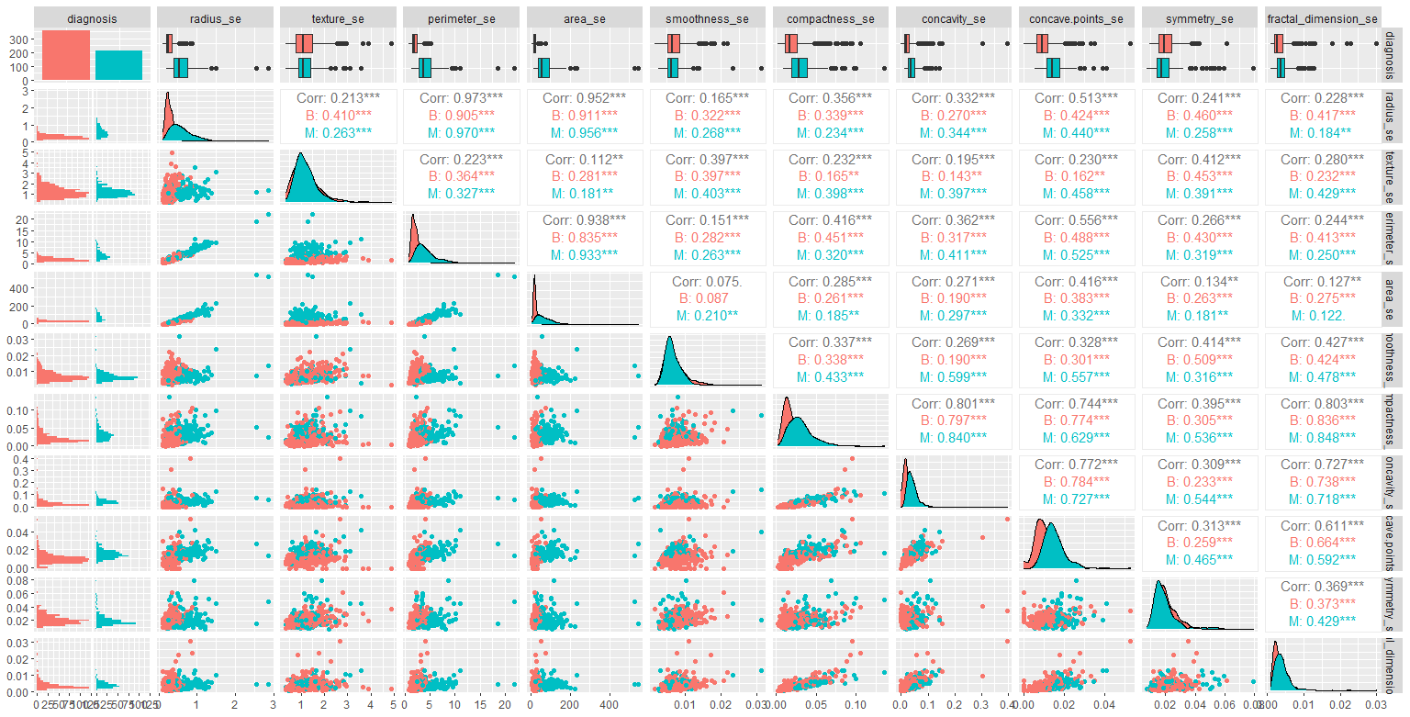
The Distributions of Raw Data-SE
Benign-0
Malignant-1

Slide 11
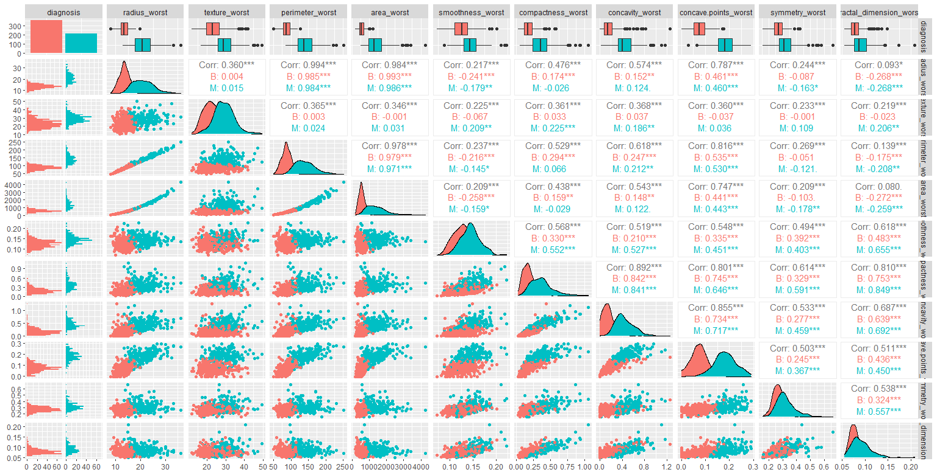
The Distributions of Raw Data-Worst
Benign-0
Malignant-1

Slide 12
Progress
Dataset
Training (80%), Testing (20%)
Cross Validation (k fold=10)
Model
Logistic Regression
stepAIC to reduce the number of variant
LDA
SVM
KNN
CART
Random Forest
Evaluate
AUC
Notes:
SVM (小樣本，非線性與多維度的資料)
RandomForest(隨機森林演算法在面對變數具有多元共線性或者不平衡資料（Unbalanced data）的情況時是倍受青睞的演算法。)

Slide 13

Data Preprocess
Select Columns
Split Data
Normalization
Transfer Data Type
Column “Diagnosis”
B/M (chr) >> 0/1 (factor)
Train: 80%
Test : 20%
Train: 80% > sd/mean
Remove “id”
Seed 1234
X’ $=\frac{x−train_mean }{train_sd }$
 | B | M | Total
Train | 283 / 62.2% | 172 / 37.8% | 455 | 79.96%
Test | 74 / 64.91% | 40 / 35.09% | 114 | 20.04%
Raw | 357 / 62.74% | 212 / 37.26% | 569 | 100.00%

Slide 14
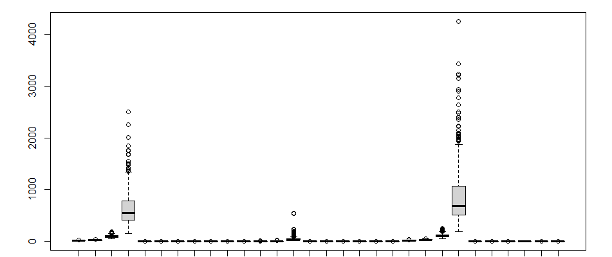
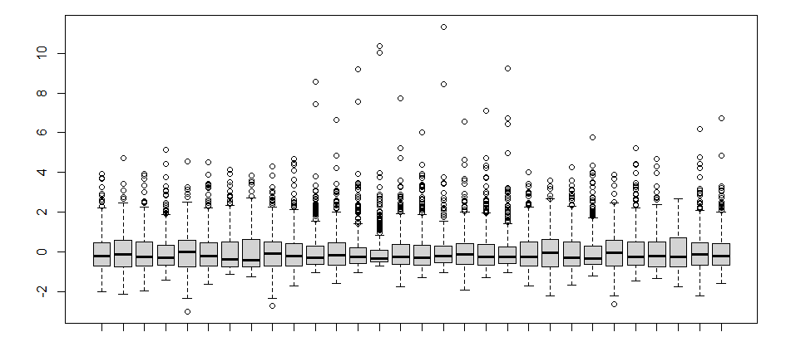
The Result of Normalization
Train_Raw
Train_Normalized
radius_se
area_se
radius_se
area_se
area_mean
texture_se
radius_worst
area_worst
area_mean
texture_se
radius_worst
area_worst
radius_mean
perimeter_se
concavity_se
radius_mean
perimeter_se
concavity_se
symmetry_se
symmetry_se
texture_mean
smoothness_se
texture_worst
concavity_worst
texture_mean
smoothness_se
texture_worst
concavity_worst
perimeter_mean
concavity_mean
perimeter_worst
symmetry_worst
perimeter_mean
concavity_mean
perimeter_worst
symmetry_worst
symmetry_mean
compactness_se
symmetry_mean
compactness_se
smoothness_mean
concave points_se
smoothness_worst
smoothness_mean
concave points_se
smoothness_worst
compactness_mean
fractal_dimension_se
compactness_worst
compactness_mean
fractal_dimension_se
compactness_worst
concave points_mean
concave points_worst
concave points_mean
concave points_worst
fractal_dimension_mean
fractal_dimension_worst
fractal_dimension_mean
fractal_dimension_worst

Slide 15
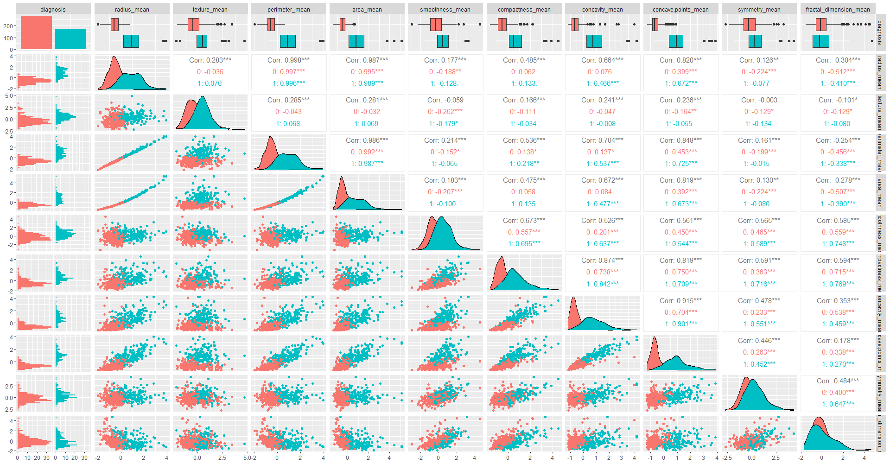
The Distributions of Train Data-Mean
Benign-0
Malignant-1

Slide 16
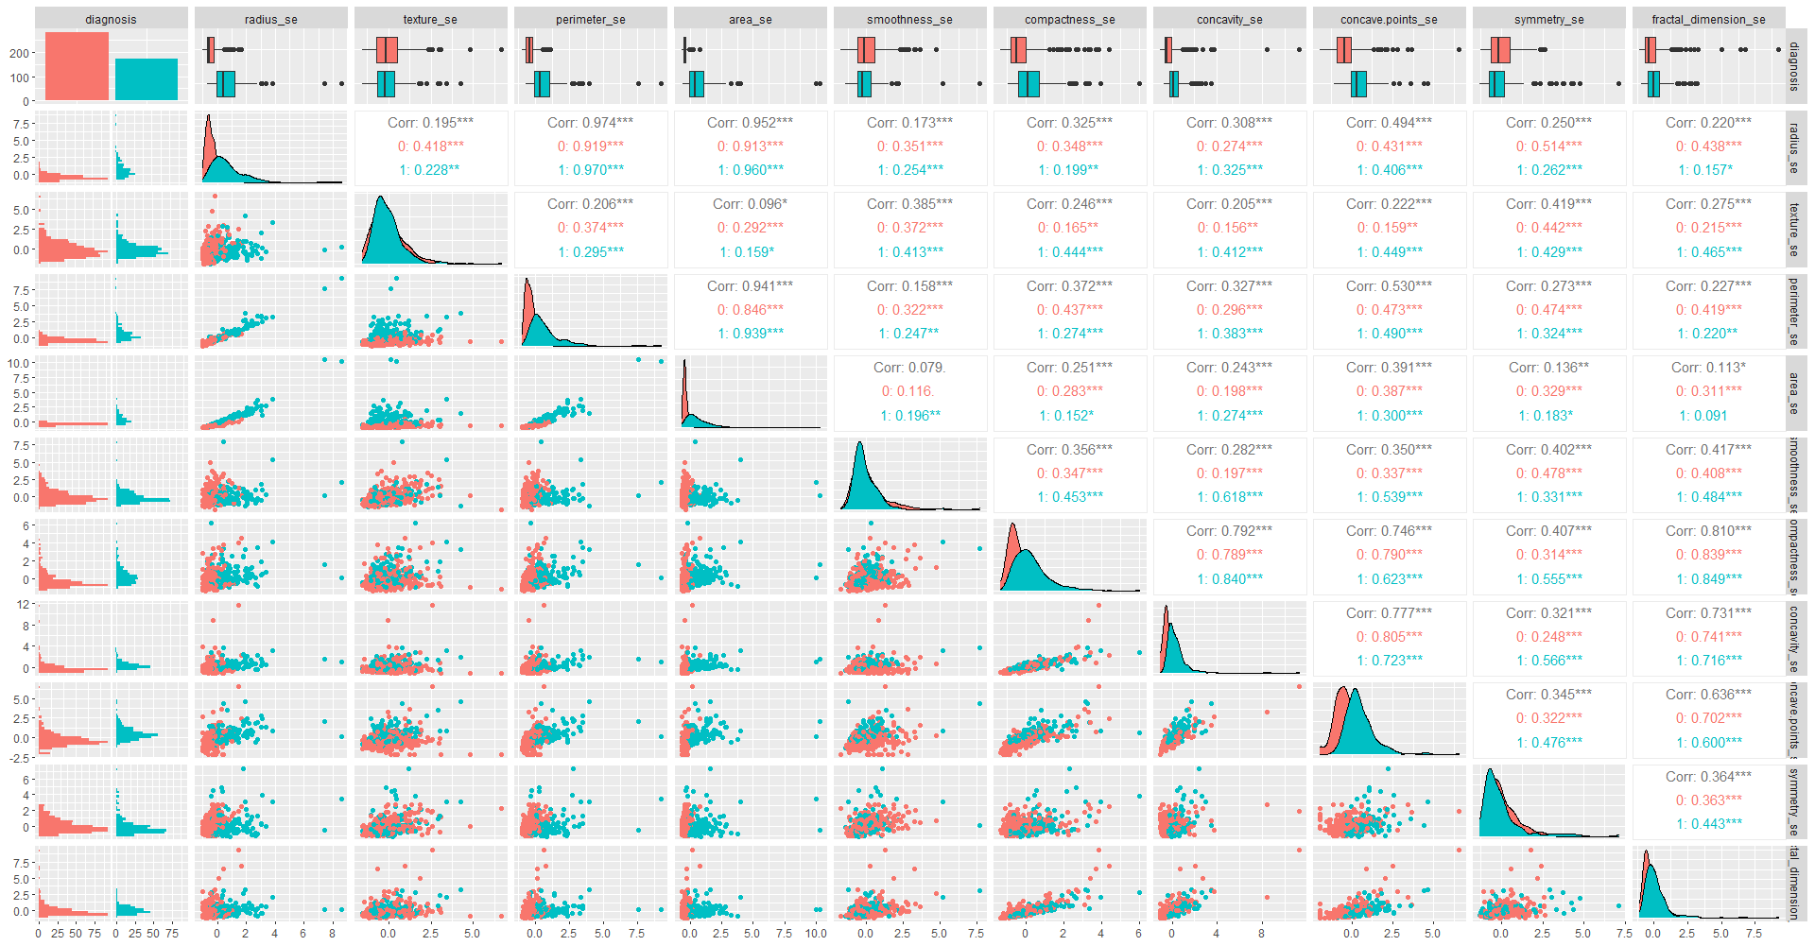
The Distributions of Train Data-SE
Benign-0
Malignant-1

Slide 17
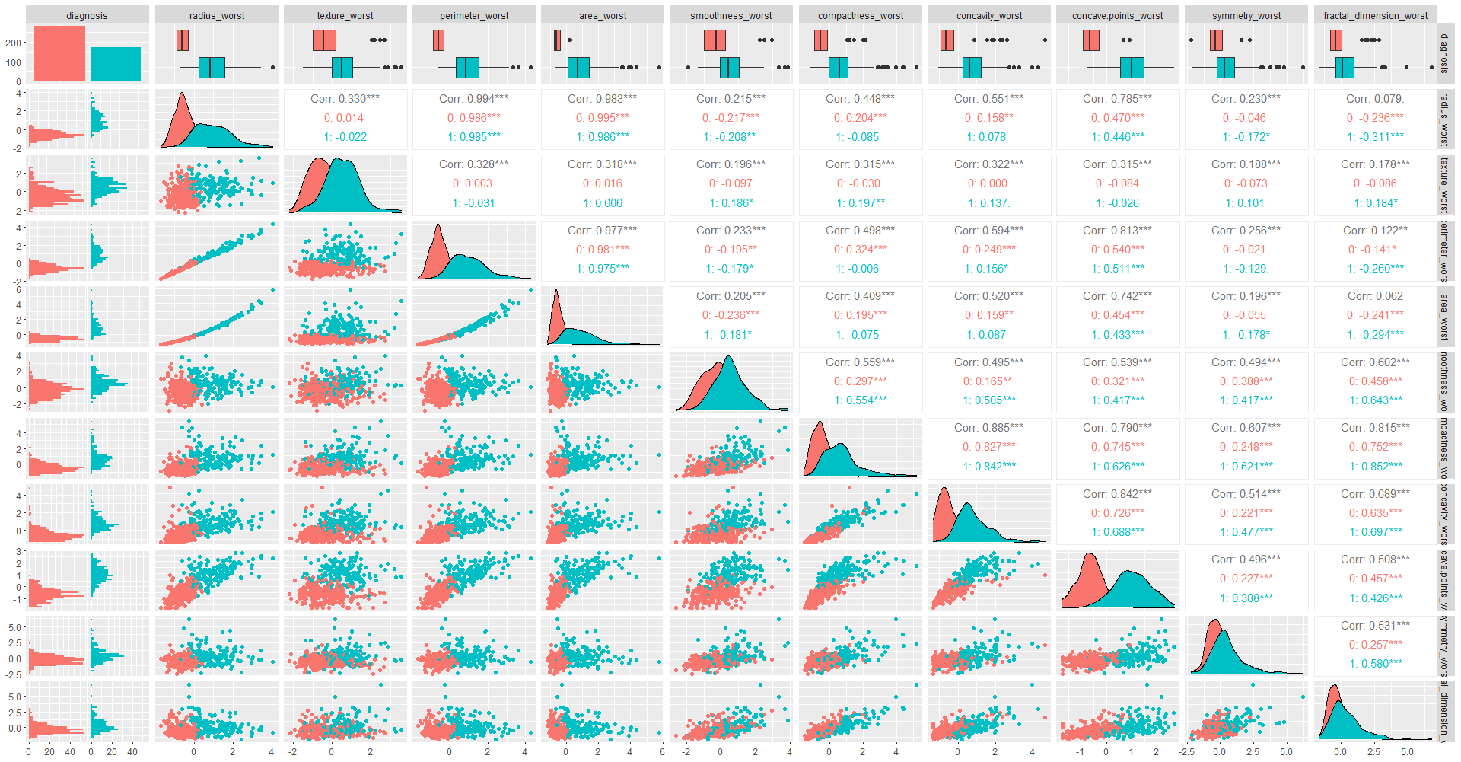
The Distributions of Train Data-Worst
Benign-0
Malignant-1

Slide 18
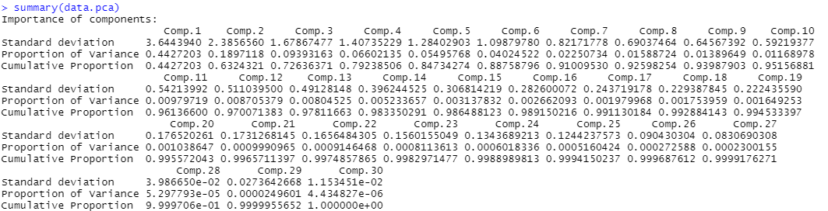
PCA of Train Data

Slide 19
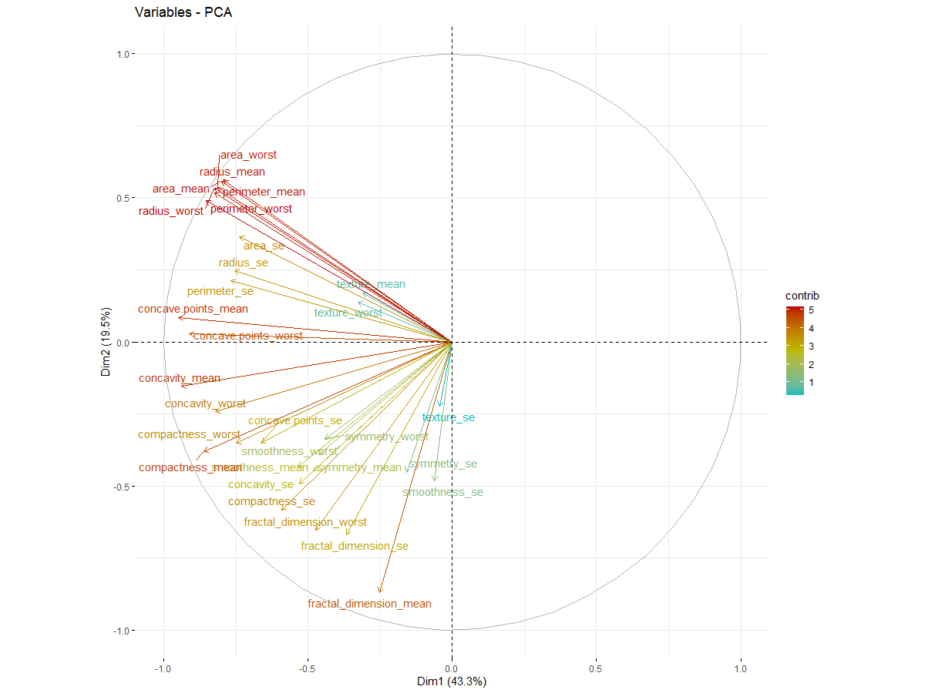
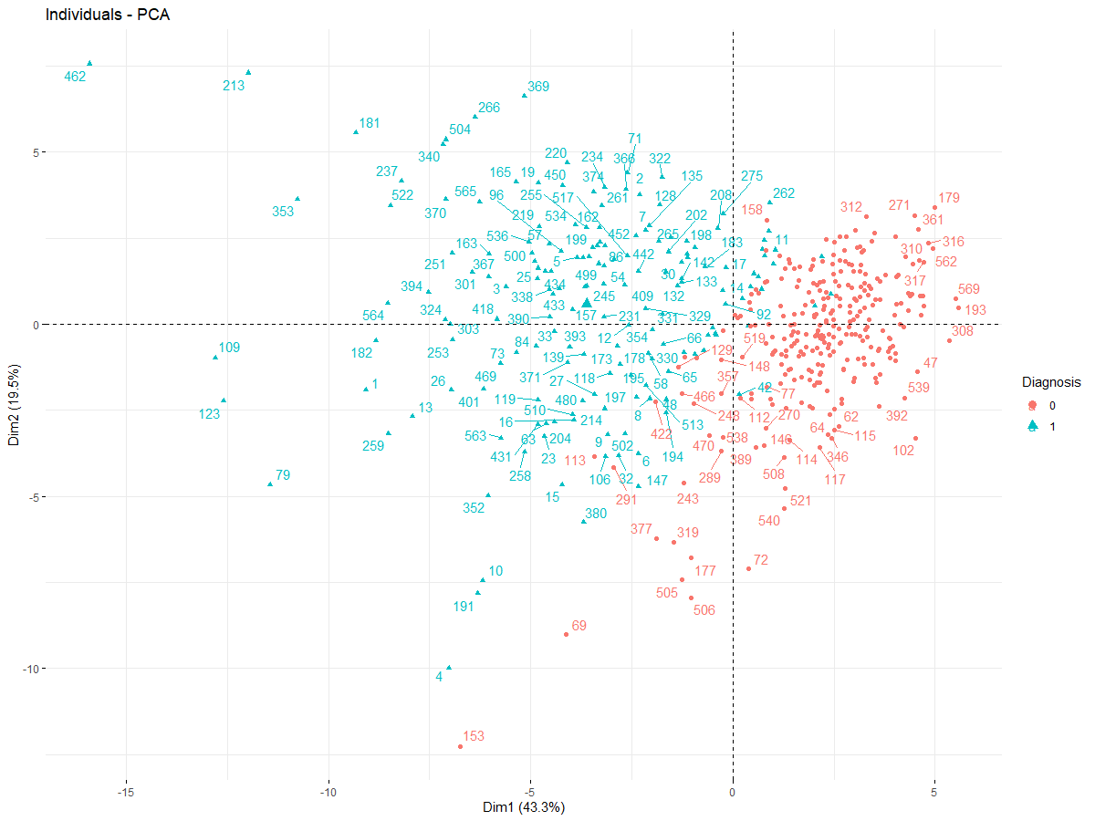
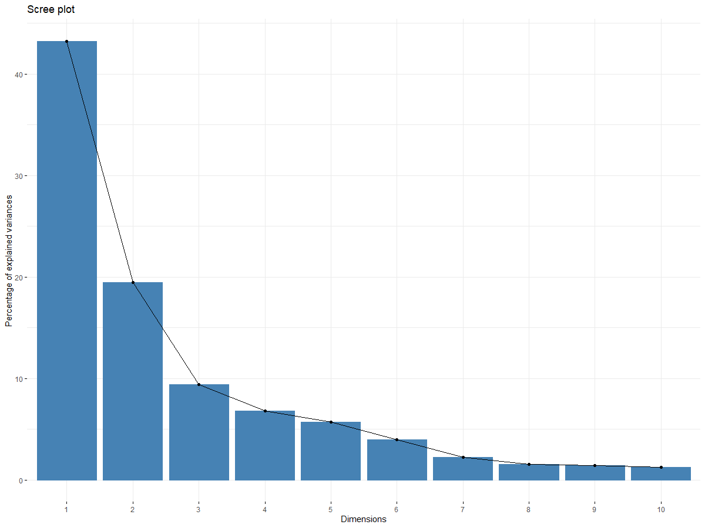
PCA of Train Data

Slide 20
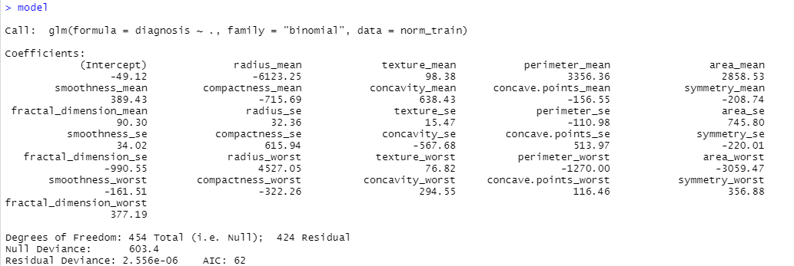

Logistic Regression
AUC=0.960473
Notes:
A ROC curve is a plot of the true positive rate (Sensitivity) in function of the false positive rate (100-Specificity) for different cut-off points of a parameter.

Slide 21
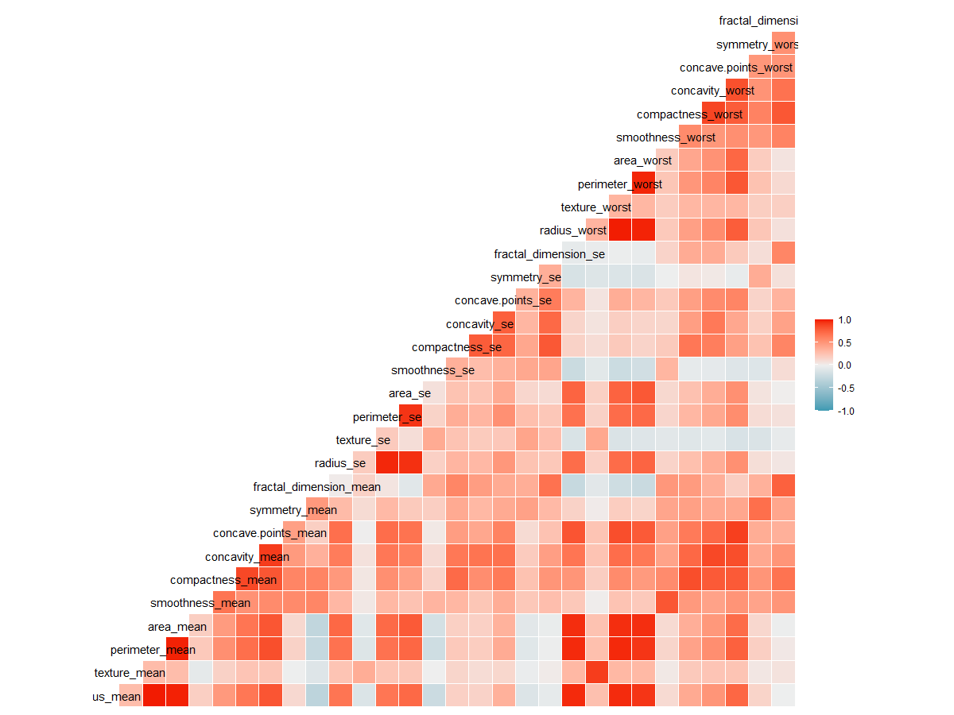

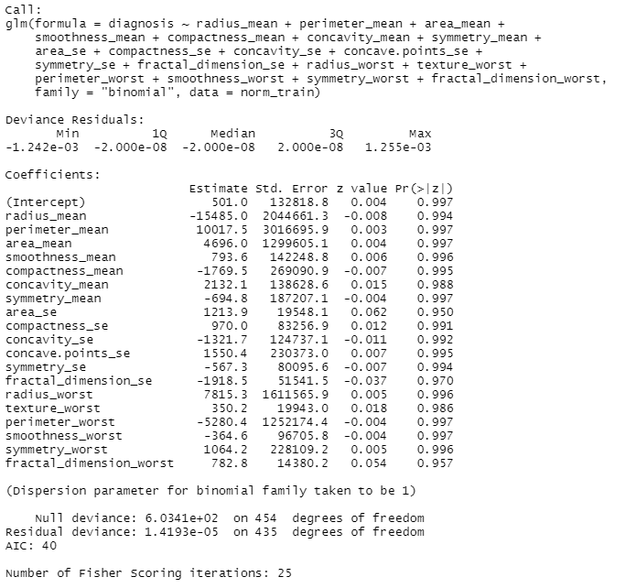

Logistic Regression-with stepAIC
AUC=0.9402027
Notes:
AIC (變數越少-越簡單，模型fit越好AIC越小)

Slide 22
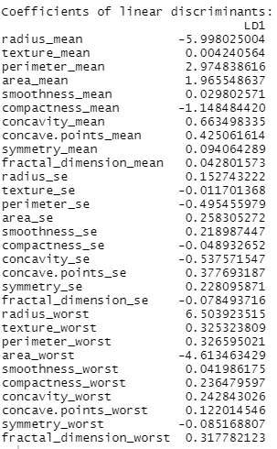

LDA
AUC=0.9557432

Slide 23
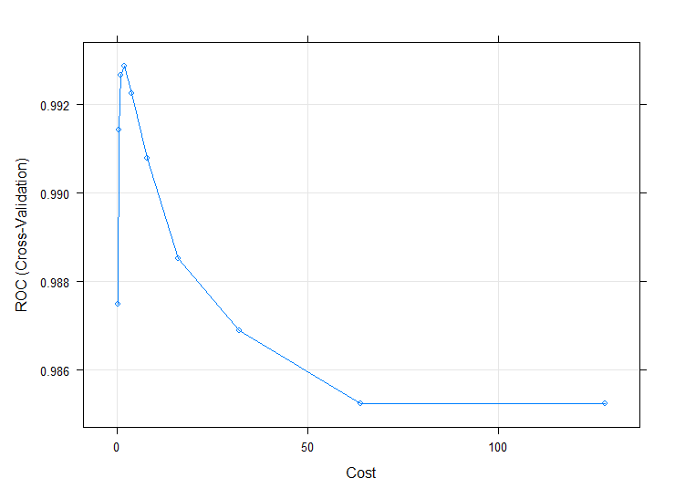
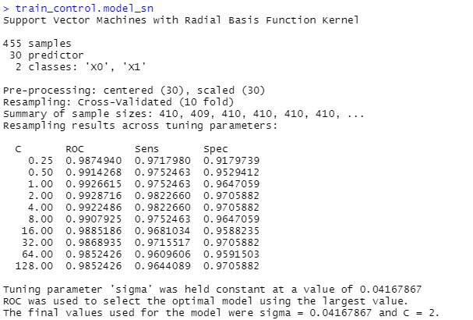

Support vector machine (SVM)
AUC=0.9807432

Slide 24
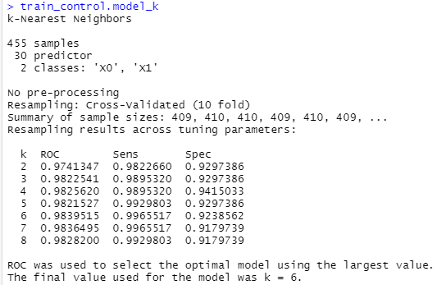
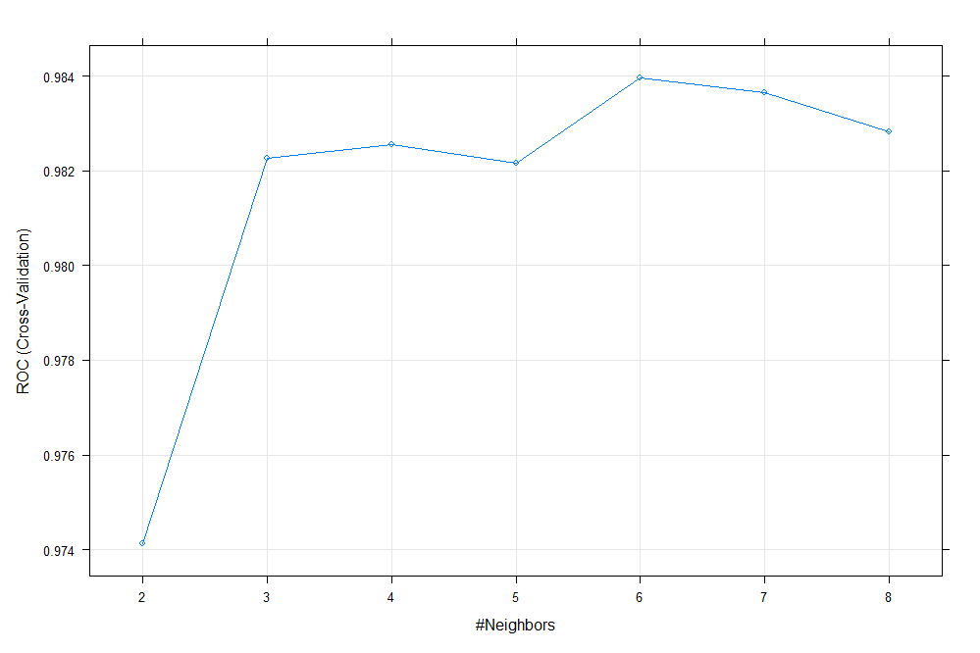

KNN
AUC=0.9422297

Slide 25
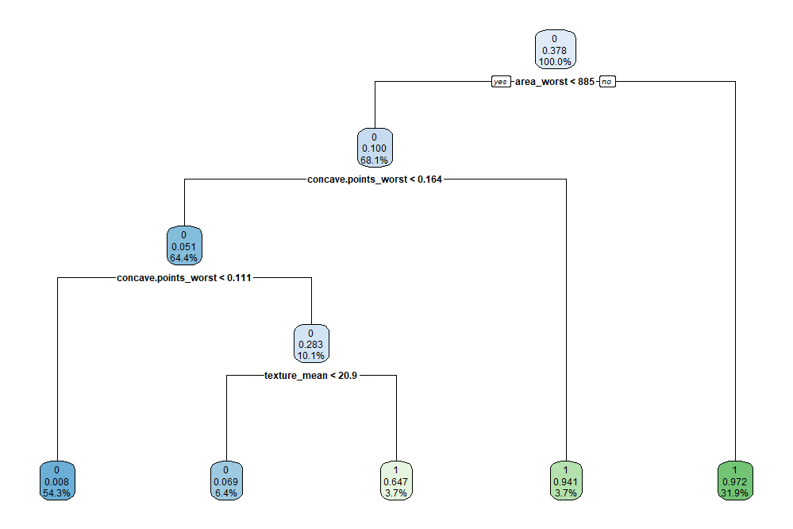

CART
 | B (0) | M (1)
Train | 283 / 62.2% | 172 / 37.8%
AUC=0.9277027
Notes:
中間值為屬於1的機率 (>0.5即顯示1 表示1為大宗)

Slide 26
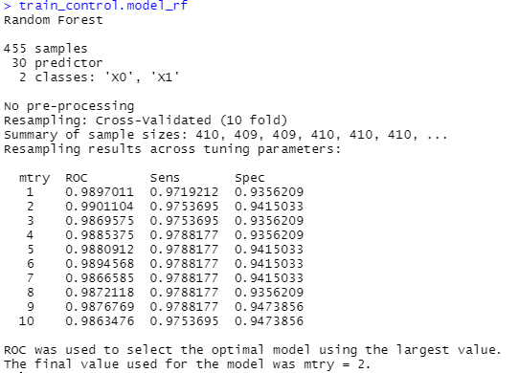
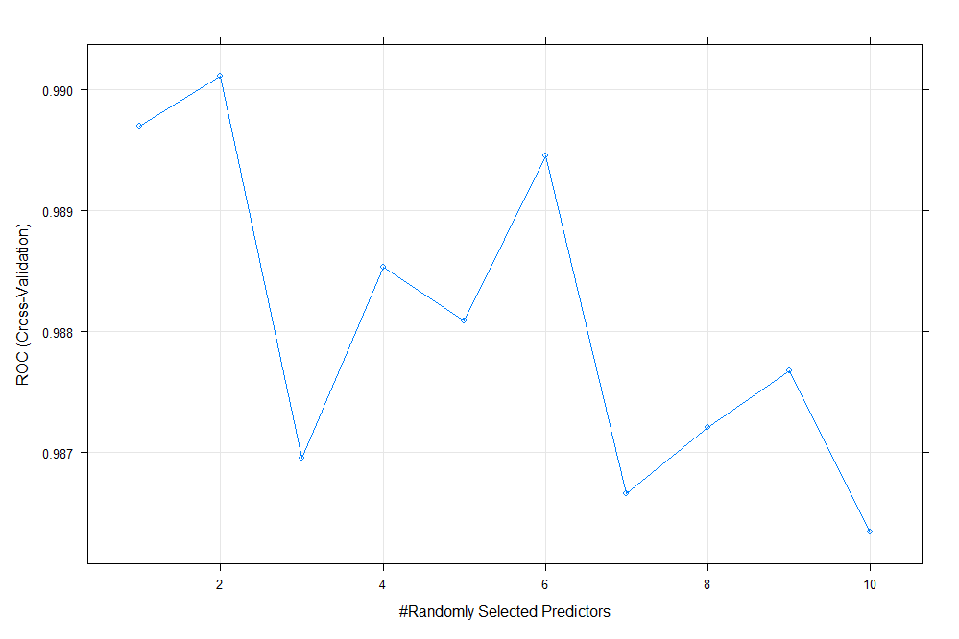

Random Forest
AUC=0.9614865

Slide 27
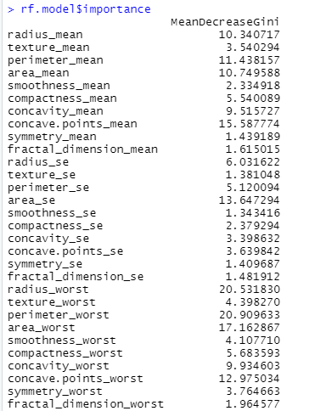
The Important Variants of CART and Random Forest
CART

Slide 28
Conclusion and Discussion
Conclusion
 | TN | TP | FN | FP | Sensitivity | Specificity | FPR | FNR | AUC
Logistic Regression | 70 | 39 | 1 | 4 | 97.50% | 94.59% | 5.41% | 2.50% | 96.05%
Logistic Regression_stepAIC | 67 | 39 | 1 | 7 | 97.50% | 90.54% | 9.46% | 2.50% | 94.02%
LDA | 73 | 37 | 3 | 1 | 92.50% | 98.65% | 1.35% | 7.50% | 95.57%
SVM | 73 | 39 | 1 | 1 | 97.50% | 98.65% | 1.35% | 2.50% | 98.07%
KNN | 71 | 37 | 3 | 3 | 92.50% | 95.95% | 4.05% | 7.50% | 94.22%
CART | 67 | 38 | 2 | 7 | 95.00% | 90.54% | 9.46% | 5.00% | 92.77%
Random Forest | 72 | 38 | 2 | 2 | 95.00% | 97.30% | 2.70% | 5.00% | 96.15%
Discussion
Radius related (area, perimeter) and concavity points contribute most of the result.
The result was consistent with the following reference.
Significance of nuclear morphometry in benign and malignant breast aspirates | Int J Appl Basic Med Resv.3(1); Jan-Jun 2013PMC3678677
The variants of standard error may be removed.
Reduce the number of variants may be a possible way.

