Slide 1


Visual Question Answering (VQA) System
Video Understanding of ML Classes
Radek Holik , Yujie Wu, Sheng-Han Yueh, Pinxue Lin
Welcome to our presentation on visual question answering. Discover how machines learn to answer questions about the world we see around us.

Slide 2
What is Visual Question Answering?
Definition
Importance
Visual Question Answering (VQA) is a field of artificial intelligence that involves teaching computers how to take an image and respond to questions about it.
VQA has useful real-world applications such as image captioning, photo retrieval, and accessibility for people with visual impairments.

Slide 3
What is Our Project?
Our project aims to develop a sophisticated visual question-answering model capable of generating question-answer pairs using both audio and images as input. The audio data encompasses recordings of educational lectures, specifically from Dr. Youshan Zhang's machine learning courses, while the images correspond to the PowerPoint presentations displayed during these lectures. It's worth noting that the dataset we're utilizing is uniquely collected by ourselves, stemming from the instructional content delivered by Dr. Youshan Zhang.

Slide 4
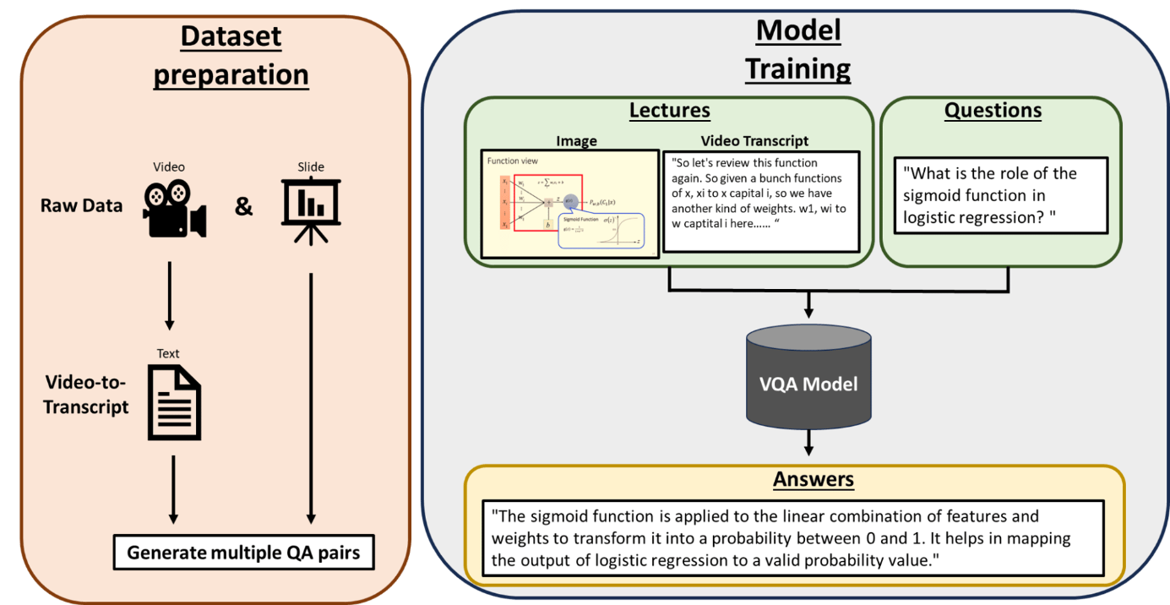
Workflow

Slide 5
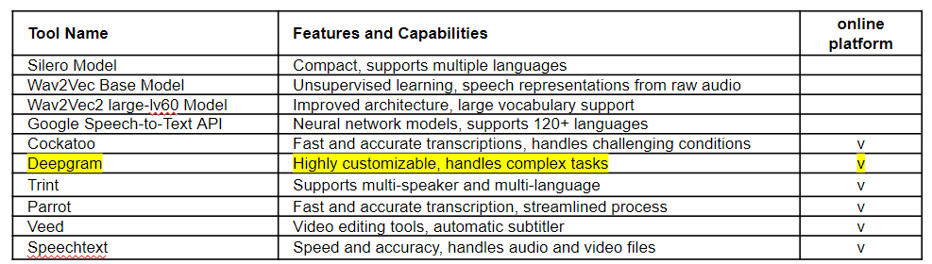
Data Collection
In the initial project phase, we experimented with over 10 different methods to extract audio from videos, ultimately selecting Deepgram for its transcription capabilities. Although the recording quality was subpar, manual corrections were applied. We then focused on creating ten sets of questions and answers for each slide, ensuring they aligned with slide topics and transcriptions. This meticulous process forms the basis of our dataset for training the visual question-answering model.
Speech-to-Text Tools​

Slide 6
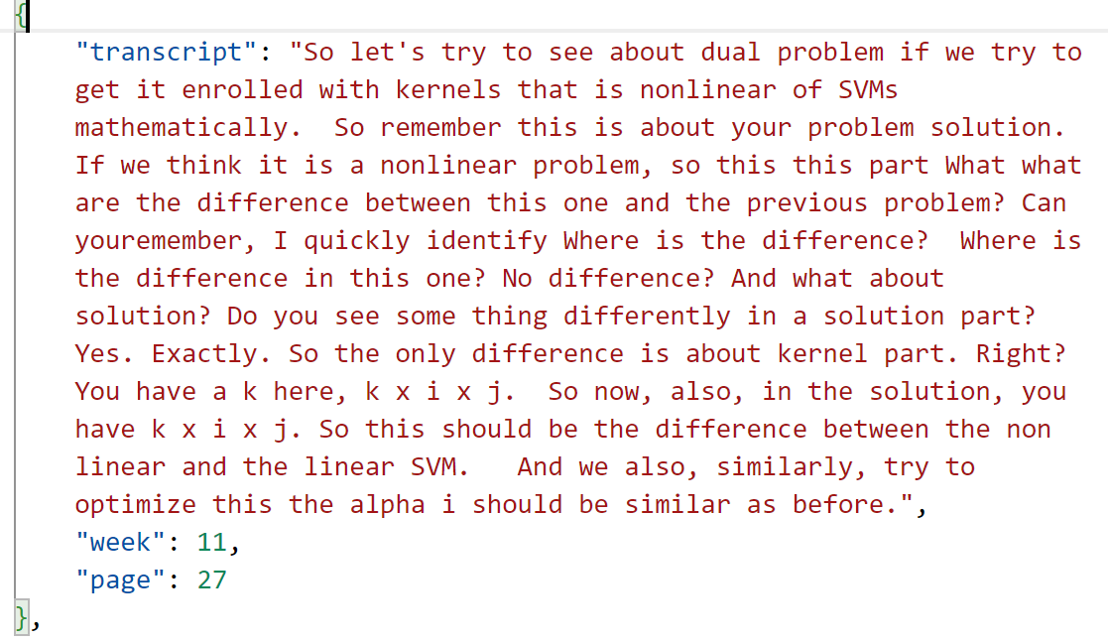
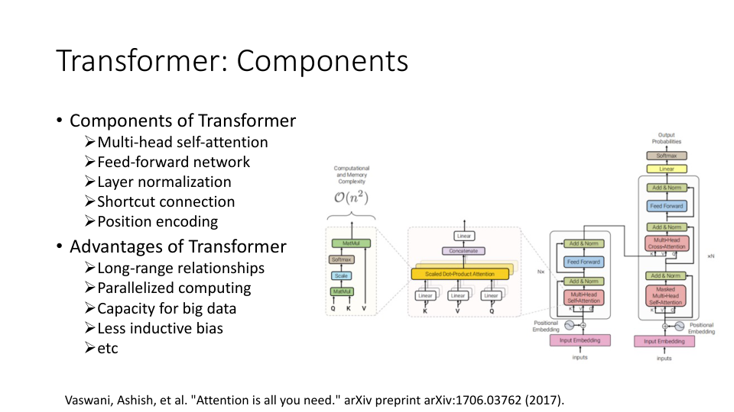
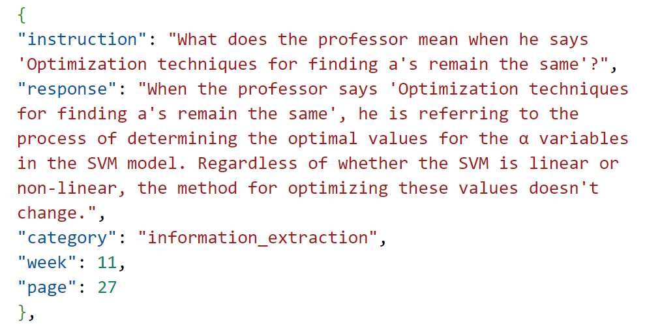
Data Collection
Transcript
Slide Image
QA Pair
X10

Slide 7
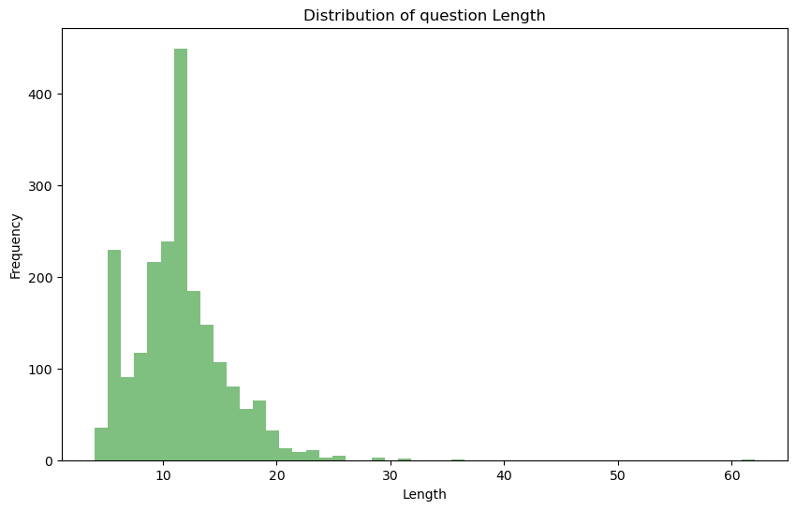
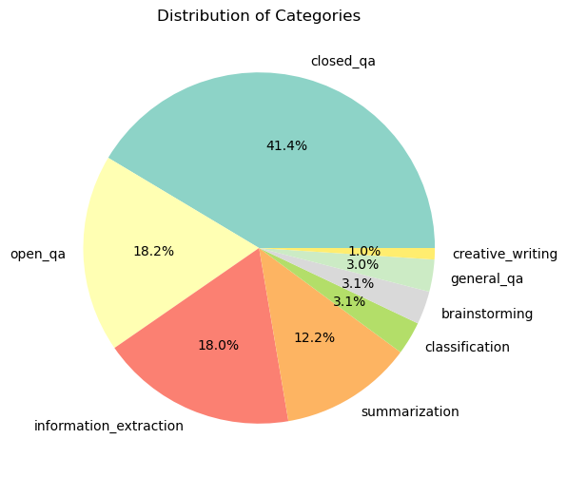
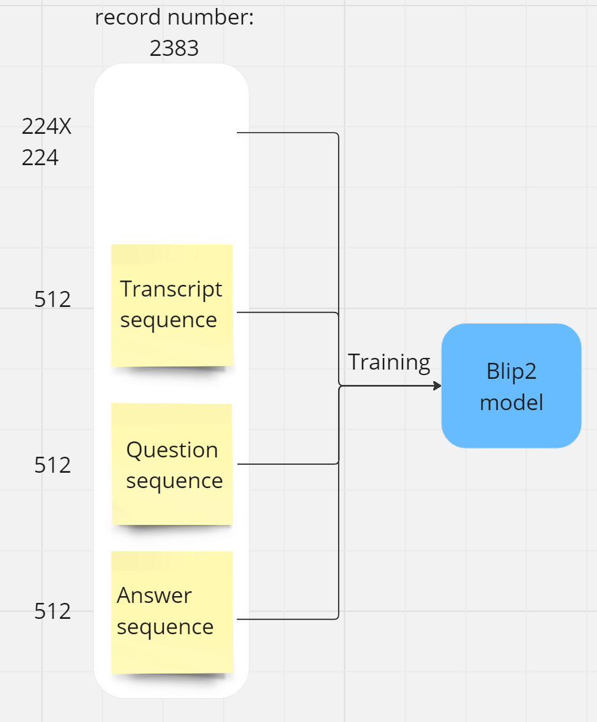

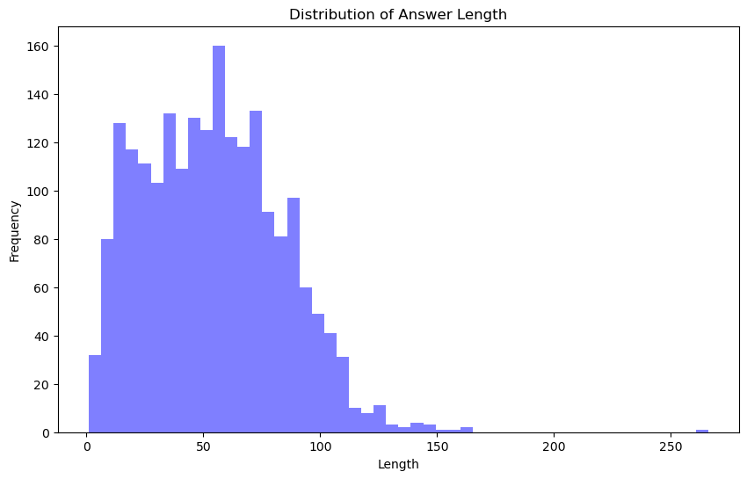
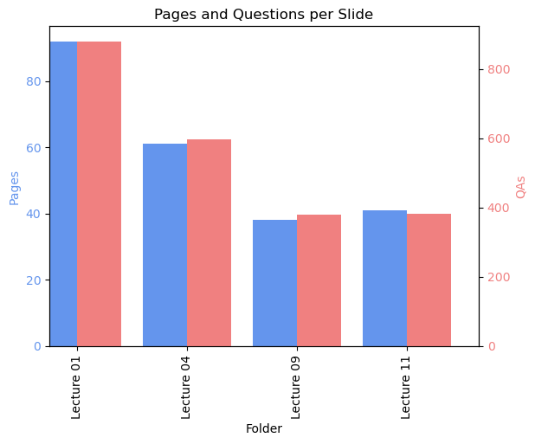
Dataset Summary

Slide 8

The Components of Visual Question Answering
1
Computer Vision
2
Natural Language Processing
The program must be able to analyze the image and understand the content.
The algorithm must be able to accurately interpret the meaning of the question.
3
Machine Learning
The program must use deep learning models to train on datasets of the images and their associated questions and answers.

Slide 9
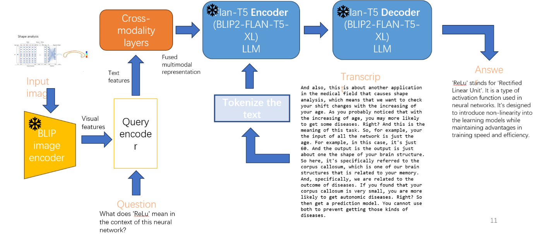
Multimodal machine learning model
BLIB-2 (Bootstrapping Language-Image Pre-training) Model ~ 11 Billion Parameters (~ 10GB)

Slide 10
Multimodal machine learning
Multimodal machine learning is a field that combines different types of data, like images and audio, to create smarter AI models. In our project, it means using both lecture recordings (audio) and PowerPoint slides (images) to help the model understand and answer questions better. This approach mimics how humans use multiple senses to understand things. Machine learning model architectures differ depending on the fusion strategy. There are 3 predominant methods for performing multimodal machine learning, based on 3 distinct types of information fusion:
Early Fusion
Intermediate/Joint Fusion
Late/Decision Fusion
Obviously, the strategy of our multi-modal is early fusion.

Slide 11
BLIP image encoder (blip module):
BLIP is a model that is able to perform various multi-modal tasks including Visual Question Answering, Image-Text retrieval (Image-text matching) and Image Captioning. This is a Transformer-based encoder pretrained on large image datasets to encode an image into a sequence of visual features. It is equivalent to the image encoder in CLIP which is a product of OpenAi and serves as the visual input representation.
Query encoder (query_proj):
The text query is processed by a specific module that converts it into a sequence of token embeddings. This crucial aspect of the model has been selected by the BLIP-2 developers, although they have not publicly disclosed the details of this module's architecture. Despite this, the module's role remains pivotal in transforming textual input into a format that the model can comprehend and utilize effectively.

Slide 12
Flan-T5 decoder (t5):
This is a pretrained T5 decoder model that takes the multimodal context representations and generates the text response. Flan-T5, which achieve strong few-shot performance even compared to much larger models, such as PaLM 62B, was trained to generate natural language captions conditioned on image and text. And this model is initialized with pretrain weight.

Slide 13

Hyperparameters:
loss_fn = nn.CrossEntropyLoss()
optimizer = AdamW(model.parameters(), lr = 5e-5, betas = (0.9, 0.98), weight_decay = 0.01)
Creates a Cosine Annealing learning rate scheduler which will decay the learning rate over epochs in a cosine curve rather than stepped decay.
T_max = 5: The period of the cosine learning rate schedule. With 10 epochs, this will decay over 2 cycles.
lr_scheduler = CosineAnnealingLR(optimizer, T_max = 5)
num_epochs = 10
accumulation_steps = 20

Slide 14
Challenges in Our Project:
Gathering and curating a custom dataset, particularly combining audio from course recordings with images from PowerPoint presentations, can be time-consuming and resource-intensive. However, having a unique and tailored dataset can also contribute to the uniqueness and effectiveness of your model.
Creating a robust visual question-answering model that effectively utilizes both audio and image data requires building a complex architecture. Balancing the complexity while ensuring model interpretability and performance can be a demanding task.
Training intricate models, especially those that involve multimodal data, can be computationally intensive and time-consuming. Optimizing training processes and exploring strategies like distributed training or transfer learning can help alleviate this challenge.

Slide 15
Thank you!

