Slide 1
Regular Research Seminar
E2E with Diffusion Model Planning
Jan 29th
2025298007
SuHan Yoon

Slide 2
TABLE OF CONTENTS
Research Goal & Workflow
Exploring Diffusion-based papers
Training DiffusionDrive v2
Training Diffusion-Planner
Developed MLOps Infrastructure

Slide 3
main research directions for E2E autonomous driving based on my analysis
Research Goal & Workflow
Explainable E2E with LLM/VLM
Use VLM & LLM to generate semantic explanations of driving decisions
Goal: improve transparency and human understanding
Perception Backbone Modification
Investigate different backbone architectures for perception
Analyze their impact on E2E driving performance
Planning Head Inference Strategy
Modify the planning head architecture and inference mechanism
Apply reinforcement learning-based fine-tuning to improve planning decisions
My Interest
1

Slide 4
Motivation: Why Diffusion-based Planning?
Research Goal & Workflow
Diffusion models have demonstrated outstanding performance in generating complex structured outputs, particularly in image generation tasks (e.g., Nano Banana, Sora, Stable Diffusion).
Unlike conventional planning methods that rely on direct regression or candidate selection, diffusion-based planning enables multimodal trajectory generation and uncertainty modeling.
The denoising-based generation process makes diffusion models well-suited for producing structured trajectories and paths.
Furthermore, diffusion-based planners are more amenable to reinforcement learning fine-tuning compared to existing planning approaches such as VAD and UniAD, allowing direct optimization of planning quality.
2

Slide 5
Auto regressive vs Diffusion-based Generation
Research Goal & Workflow
Conventional Autoregressive (Regression-based)
Predicts outputs sequentially (one step at a time)
Tends to produce mean predictions under multimodal distributions
Error accumulates over time
Limited ability to generate diverse trajectories
Diffusion-based Generation
Refines the entire trajectory simultaneously through denoising
Generates structured trajectories by sampling from a distribution
Preserves global consistency
Enables multimodal and robust planning
Auto Regressive's Loss Rate
3

Slide 6
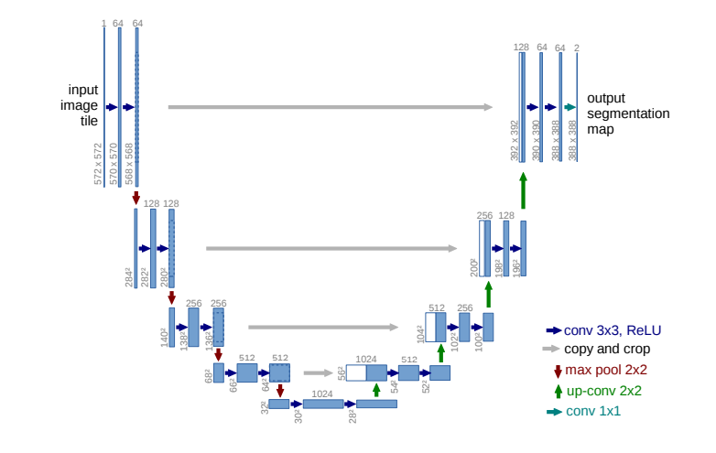
Two Axes of DiffusionDrive: U-Net and Transformer
Research Goal & Workflow
Concept (Architecture & Principle)
U-Net is a CNN-based encoder–decoder architecture with skip connections.
It performs denoising on spatial representations by learning both global and local features through downsampling and upsampling.
Planning is formulated as a spatial reconstruction (denoising) problem.
Input / Output Representation
Input: BEV map (2D grid) with noisy anchor paths
Output: Refined collision-free path
Noise → Clean Path
Learning Strategy (Anchor-based Refinement)
Instead of generating paths from scratch, U-Net refines predefined anchor trajectories through iterative denoising.
Anchors provide spatial references, enabling stable and efficient path generation.
Advantages
Requires relatively less training data compared to transformer-based models
Efficient inference due to CNN-based computation
Well-suited for spatial path generation in BEV space
Enables fast and stable local path planning
4

Slide 7
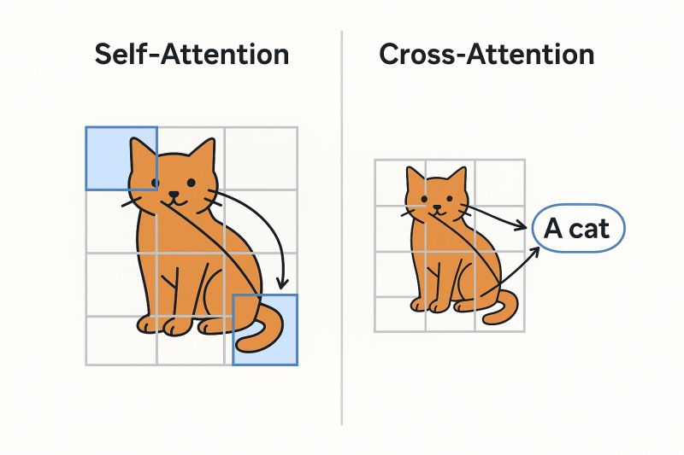
Two Axes of DiffusionDrive: U-Net and Transformer
Research Goal & Workflow
Concept (Definition)
Transformer is the core deep learning architecture underlying large language models (LLMs).
It represents inputs as tokens and models their relationships using attention mechanisms.
Architecture & Principle
Uses self-attention to model relationships among trajectory tokens
Uses cross-attention to incorporate contextual information
Enables joint reasoning over multiple inputs without spatial constraints
Advantages for Autonomous Driving
Can jointly consider:
spatiotemporal information
vehicle states
perception features
high-level commands
Enables more accurate and consistent trajectory generation
Limitation
Computationally expensive due to attention operations
Unlike U-Net, there is no established anchor-based mechanism for reducing search space in autonomous driving planning
5

Slide 8
Comparison of Diffusion Models Based on U-Net and Transformer
Research Goal & Workflow
Aspect | U-Net-based Diffusion | Transformer-based Diffusion
Computation Cost | Fast inference with anchor-based refinement | Relatively high computational cost
Customization | Limited flexibility for architectural modification | Highly flexible and extensible architecture
Path / Trajectory Quality | Spatially valid local paths | Temporally consistent and context-aware trajectories
Representation | Spatial map (BEV, grid-based path) | Sequence of trajectory tokens
Reasoning Capability | Focused on local spatial structure | Capable of temporal and causal reasoning
Scalability | Efficient for real-time local planning | Suitable for complex multimodal planning
*These two approaches pursue different design philosophies, and it remains unclear which is universally superior.

Slide 9
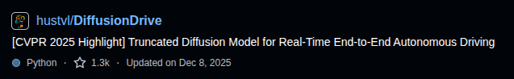
Introduce MY Base Source Code _ DiffusionDrive
Research Goal & Workflow
Title : DiffusionDrive
Overview
DiffusionDrive is one of the most representative U-Net-based diffusion planning frameworks.
It evolves from previous works: SparseDrive → DiffusionDrive → DiffusionDriveV2.
Design Philosophy
Focuses on optimization-oriented planning rather than large-scale model expansion
Emphasizes:
small model size
low training data requirement
fast inference speed
real-time performance

Slide 10
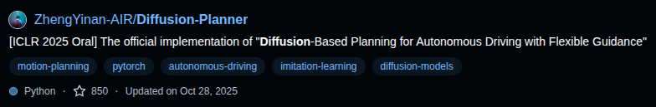
Introduce MY Base Source Code 2 _ Diffusion-Planner
Research Goal & Workflow
Title : Diffusion-Planner
Overview
Diffusion-Planner is a representative Transformer-based diffusion model for end-to-end trajectory planning.
Research Focus
Focuses on planning in end-to-end autonomous driving
Assumes perception (e.g., BEV representation) is already provided
Investigates trajectory generation and decision-making in complex driving scenarios
Dataset & Evaluation Environment
Evaluated on the nuPlan dataset
Uses closed-loop simulation for realistic planning evaluation

Slide 11
Introduce MY Base Source Code's Feature
Research Goal & Workflow
DiffusionDrive
Key Feature : Computationally efficient and lightweight architecture
Research Focus : Investigation of optimization strategies and reinforcement learning approaches for diffusion-based autonomous driving
Diffusion-Planner
Key Feature : Support for complex and flexible planning algorithms
Research Focus : Development of high-dimensional planning models integrating LLMs, VLMs, vehicle dynamics, and relative motion reasoning

Slide 12






My experiments Work Flow
Research Goal & Workflow
Learning Tools
Learning Code
MLOps
PC1.
4090
Diffusion-Planner
Preprocessed images
Visualize & Distribute
.pt
PC2.
H100
Check points
DiffusionDrive
Git Version
Drive : Data storge
Tag & Save
Versioning & Storge
Git : Code storge

Slide 13
Dvc & DataBricks
Research Goal & Workflow
MLflow (Databricks)
Used for experiment tracking and result visualization.
Manages metrics, models, and training logs in a centralized platform.
DVC (Data Version Control)
Integrated with GitHub for version control of both code and data.
Tracks and versions:
Preprocessed images
Training datasets
Model checkpoints
Experimental results
Objective
To build a portfolio that enables full reproduction of experiments.
All experimental settings, code, and results can be understood and verified from the portfolio alone.

Slide 14
Research Goal
Research Goal & Workflow
Research Contribution Levels
Major Contribution
Reinforcement learning–based fine-tuning
Modification of core algorithms
Minor Contribution
Network architecture and parameter tuning
Engineering-oriented optimizatio
Current Research Direction
Focus on methods from:
Computer Vision
Large Language Models (LLMs)
Rather than directly targeting autonomous driving–specific approaches
Goal
To surpass the benchmark scores reported in each reference paper
Ensure fair comparison under identical experimental settings
Demonstrate measurable performance improvements

Slide 15
Next Experiment
Research Goal & Workflow
DiffusionDrive
Apply latent DDPM/DDIM-based image preprocessing methods.
Modify existing diffusion optimization algorithms used in prior work.
Investigate alternative optimization strategies for efficiency and performance improvement.
DiffusionPlanner
Reduce computational cost of Transformer-based architectures by combining CNN + Transformer models.
Explore LLM-based High-Level Control (HLC) for planning and decision-making.
Design lightweight and high-dimensional planning frameworks.

