Slide 1
Regular Research Seminar
E2E with Diffusion Model Planning
Feb 27th
2025298007
SuHan Yoon

Slide 2
FEB calendar
JAN
FEB
MAR
APR
MAY
JUN
JUL
AUG
SEP
OCT
NOV
DEC
mon | tue | wed | thu | fri | sat | sun
 |  |  |  | 18 | 19 | 1
2 | 3 | 4 | 5 | 6 | 7 | 8
9 | 10 | 11 | 12 | 13 | 14 | 15
16 | 17 | 18 | 19 | 20 | 21 | 22
23 | 24 | 25 | 26 | 27 Today | 28
Train Diffusion-Planner
Train DriveTransformer
H/W Setting for RAVEE
Lenture of Hanyang
Univercity

Slide 3
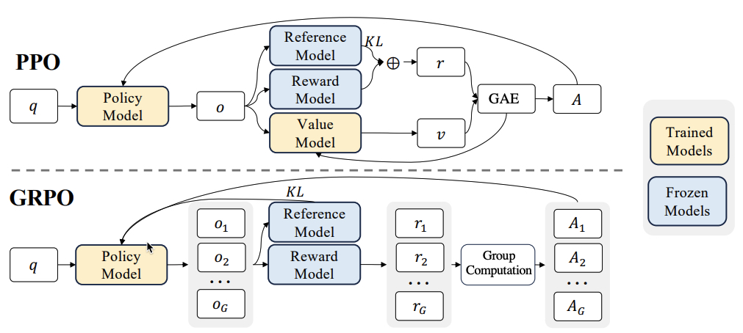
Sanity Check for Fine Tuning
Diffusion-Planner
What is Sanity Check
A verification process to confirm whether GRPO training is feasible.
GRPO removes the Value Model and instead samples multiple outputs per query, then computes advantages by relative comparison within the group.
Since sampled outputs differ each iteration, advantages naturally vary accordingly.
Method
Run 10 iterations and check if results converge to 100% failure or success, confirming the reward signal and pipeline work correctly.
1

Slide 4
Sanity Check for Fine Tuning
Diffusion-Planner
Result
Overall metrics such as collision rate and compliance rate were successfully evaluated.
However, detailed metrics like lateral error and curvature error are not provided, making it difficult to determine which specific behaviors to improve through reinforcement learning.
Therefore, the evaluation methodology will be redesigned to include fine-grained metrics and re-conducted.
1

Slide 5
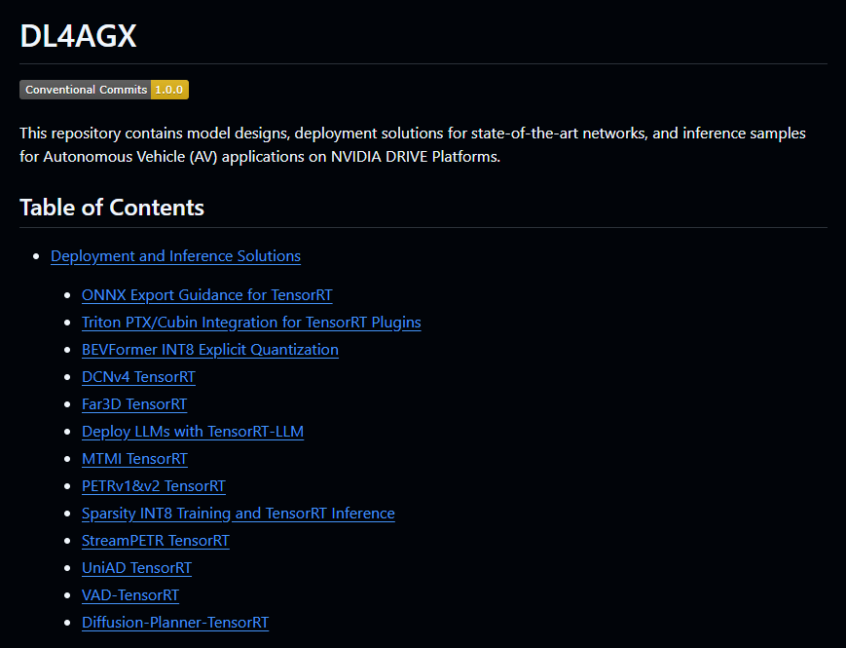
Model Quantization
Plan to quantize GenAD and Diffusion-Planner to TensorRT using NVIDIA's DL4AGX toolkit.
Since VAD-TensorRT is already supported and GenAD shares a similar architecture with VAD, quantization is expected to be feasible. This is aimed at resolving the FPS bottleneck in the RAVEE project for real-vehicle E2E deployment.
2

Slide 6
Autoware Pull Request
While away from Autoware development, significant updates have been made to the platform.
Plan to port the existing VAD + RuleBased code to the latest Autoware version, refactor it into a clean HLC-based package, and submit an official Pull Request to the Autoware repository.
2

Slide 7
기초회로 실험 계획
총 수업 수
OT(1) + 실험 14 + 기말고사
평가 방법
각 주마다 예비,결과 보고서 및 정해진 조에서 ppt 발표
단, ppt 발표는 필수 x
실험 내용
주차 | 교재 범위 및 과제물
2 | 실험 1
3 | 실험 2
4 | 실험 3
5 | 실험 5
6 | 실험 7
7 | 실험 10
8 | 실험 14
9 | 실험 16
10 | 실험 4
11 | 실험 6
12 | 실험 8
13 | 실험 18
14 | 실험 20
3

