Slide 1
Regular Research Seminar
E2E with Diffusion Model Planning
Apr 3rd
2025298007
SuHan Yoon

Slide 2
TABLE OF CONTENTS
Technical Survey
Alpamayo Fine-Tuning
---
Engineering
Autoware Optimization
GenAD quantization & TensorRT build
GenAD integration on Autoware & performance evaluation
---
Research
GRPO(Reinforcement Learning) Diffusion-Planner
---
1

Slide 3
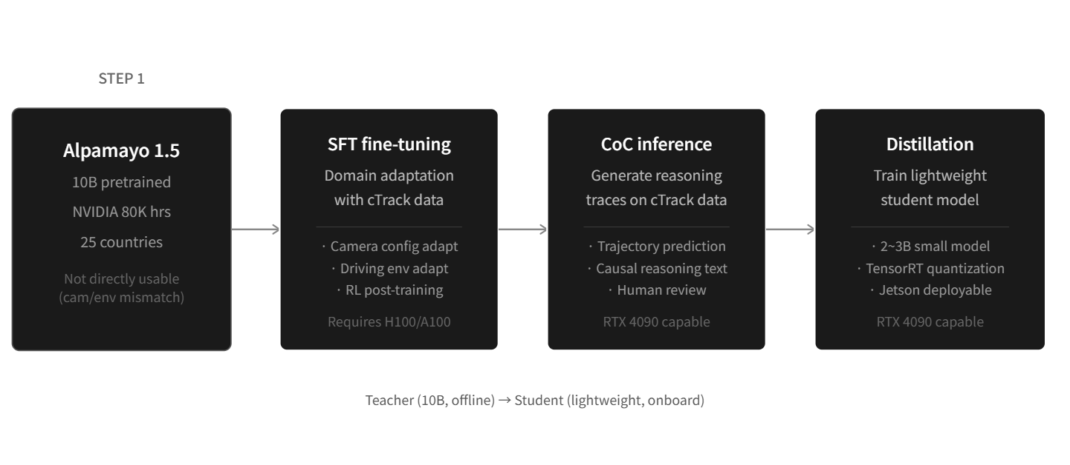
How to use alpamayo
Technical Survey - Alpamayo Fine-Tuning
2

Slide 4
What is sft, coc?
Technical Survey - Alpamayo Fine-Tuning
SFT (Supervised Fine-Tuning)
A method to update pretrained model weights using expert demonstration data
Input: multi-camera images + egomotion history
Output: trajectory + reasoning trace
Essentially Behavior Cloning, but learns "why" not just "what"
Alpamayo provides ready-to-run SFT scripts for domain adaptation
CoC (Chain of Causation)
A structured causal reasoning label format (not a dataset)
Evolution of CoT (Chain of Thought) for autonomous driving
Enforces explicit causal structure: Observation → Cause → Condition → Action
Example: "Motorcycle waiting at red light (cause) → left lane clear (condition) → decelerate and change to left lane (action)"
3M CoC traces included in NVIDIA Physical AI AV Dataset
3

Slide 5
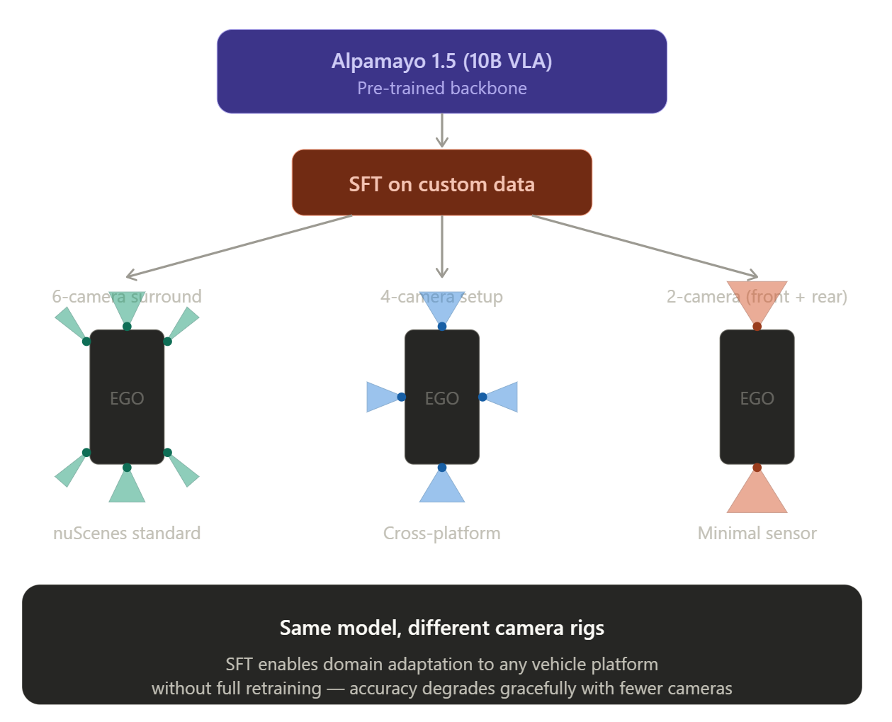
Flexible multi-camera support
Technical Survey - Alpamayo Fine-Tuning
Flexible multi-camera support
Alpamayo 1.5 decouples the model from a fixed sensor rig. A single pre-trained VLA backbone adapts to different camera counts (6→4→2) via SFT, enabling cross-platform deployment with graceful accuracy degradation.
4

Slide 6
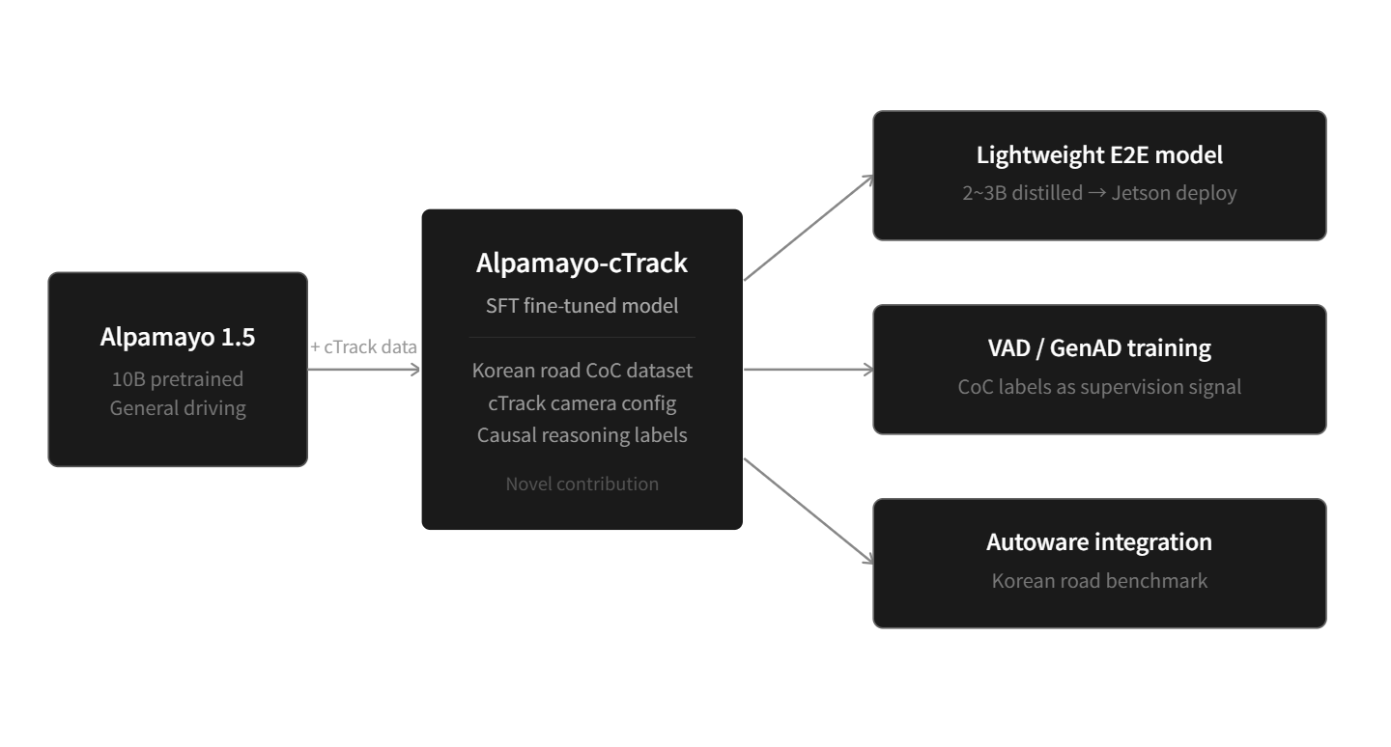
conclusion
Technical Survey - Alpamayo
Alpamayo 1.5 supports flexible camera configurations, allowing direct application to C_Track vehicles without matching the original NVIDIA sensor rig. Through SFT, we can adapt the 10B model to Korean road environments and C_Track-specific camera setups.
This produces "Alpamayo-C_Track" — a domain-adapted model that generates CoC reasoning labels on our own driving data. No existing open dataset provides Korean road scenes with causal reasoning annotations.
The resulting dataset enables three downstream paths: distillation into a lightweight onboard model, supervision signal for E2E models (VAD/GenAD), and Korean road benchmarking for Autoware integration.
5

Slide 7
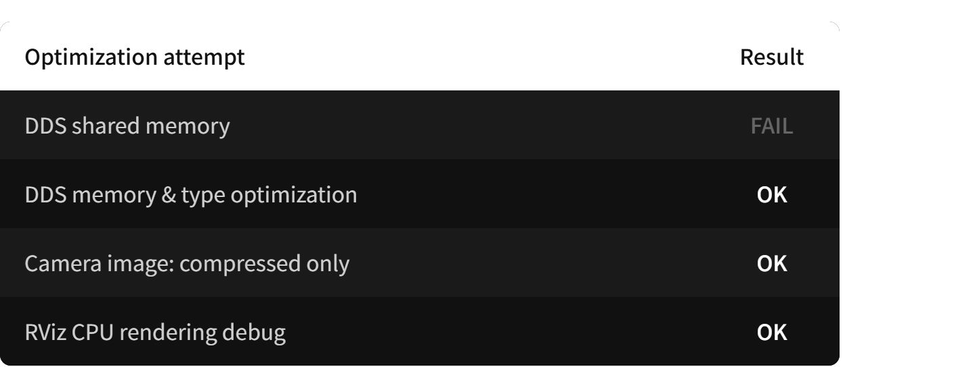
Engineering - Autoware
Autoware Optimization
Configured Autoware to optimal state before full-scale deployment. Resolved memory bottleneck caused by localhost, eliminating bottleneck and fixing low RViz FPS issue.
6

Slide 8
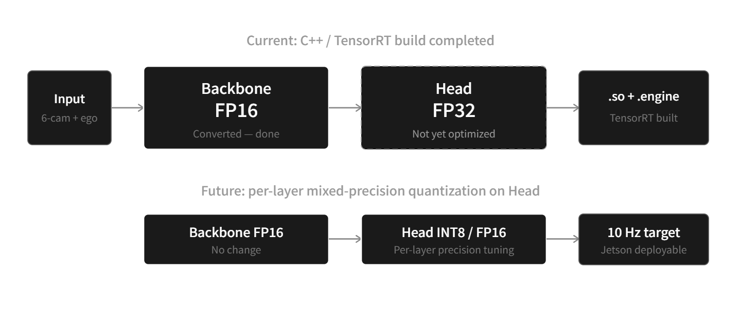
Engineering - Quantomize
GenAD Quantization
Successfully quantized the GenAD Head (main planning module) and completed building the .so library and TensorRT engine. This enables performance evaluation of the GenAD model on embedded platforms.
7

Slide 9
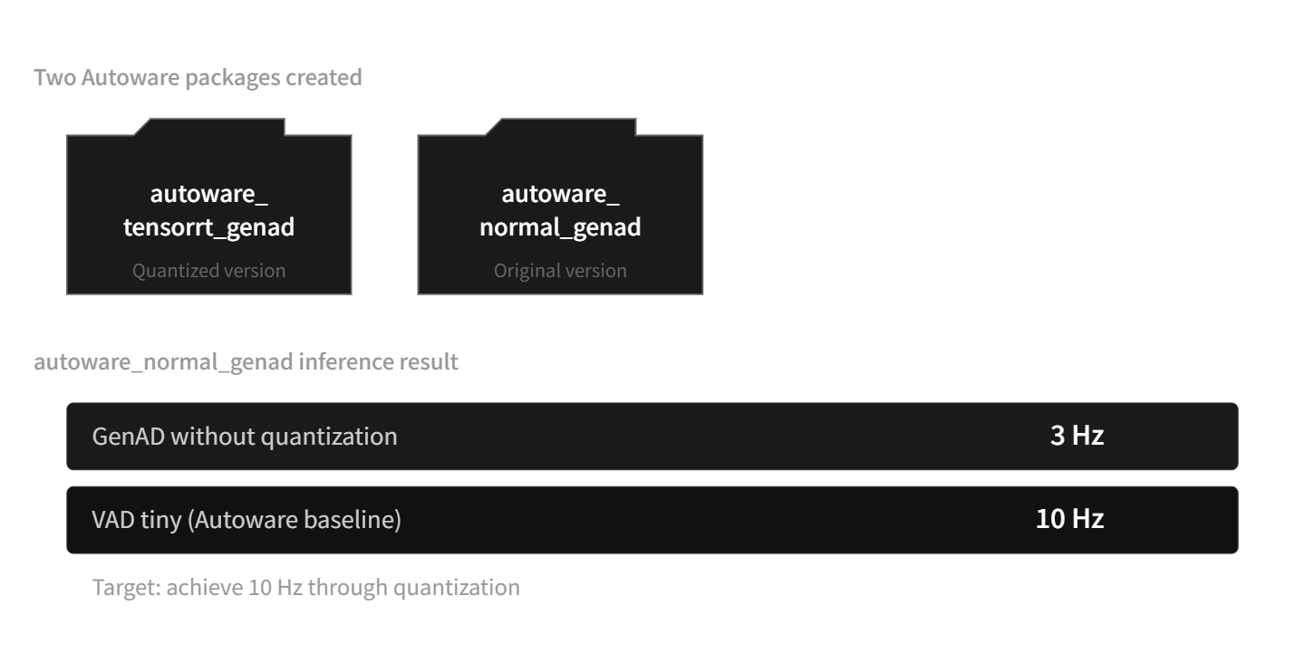
Engineering - Quantomize
Normal GenAD Integration & Evaluation
Created two Autoware packages for GenAD evaluation: autoware_tensorrt_genad (quantized) and autoware_normal_genad (original).
The unquantized GenAD runs at 3 Hz, while VAD tiny (Autoware baseline) achieves 10 Hz. The goal is to reach 10 Hz through TensorRT quantization.
8

Slide 10
Main Research - DiffusionPlanner
GRPO Fine-Tuning: Loss Collapse at Epoch 2
Modified the RL approach from backpropagating through the entire model (hidden layers) to updating only the output layer weights, reducing computational cost while preserving pretrained representations.
However, the loss drops sharply at epoch 2, indicating potential reward hacking or gradient instability. Currently investigating the root cause and exploring solutions.
9

