Slide 1
IN-STK5000 PROJECT 1 Diabetes classification for automatic decision-making
Amir, Cornelius, Espen & Torstein

Slide 2
Structure
01
02
03
04
Building a scenario
Data analysis & processing
Feature selection
Classification & evaluation

Slide 3
01
Building a scenario

Slide 4

Building a scenario
Overview dataset:
Small dataset (520 rows)
Each row represents an individual
Medical record
Collected by hospitals
Variables are information regarding the individual
General information: Age, Gender, Height, Weight, etc.
Medical information: Medical diagnoses, etc.
Target variable: Diabetes

Slide 5
Data-driven decision making
More complex relationship to a disease
Analyze multiple features at once
Find best models

Slide 6
Scenario
Self screening for school children on diabetes related features to detect risk of diabetes, and encourage individuals with a high risk to engage in a clinical check with their doctor
Recommend at risk students to see a doctor
X features you can self report
Score > y → go check in with your doctor

Slide 7
Overview scenario
Target:
Self screening → Efficient & easy
Detect diabetes & risk of diabetes
Target group:
School children → detect diabetes early
Benefit:
Diabetes is costly for society
Our scenario
School system
Detect Diabetes early
Prevention and awareness
Less cost of collection

Slide 8
Overview scenario
Goal
Send as many of the at risk people to a clinical check
High recall:
Want small proportion of false negative
Rather alert more people with low risk of diabetes than not alerting people with high risk of diabetes

Slide 9
Concerns
Privacy
Sensitive information - medical records
Identity - Gender, Doctor, Occupation, etc.
Biases
Skewed dataset
Adults
White
With a complex medical record
Large proportion with diabetes

Slide 10
Mitigate concerns
Should not be able to identify people from dataset
Remove sensitive information/features
Doctor
Occupation
Race
More data
Important
Better prediction
Anonymize data further

Slide 11
02
Data analysis & processing

Slide 12

Data analysis & processing
Initial data analysis
520 entries (patients)
24 variables
Multi-valued categorical variables
Binary categorical variables
Continuous variables
Target value: Diabetes
binary: “yes”/”no”
0.87% of data is missing
0 to 7 missing values for each variable
95 individuals have missing values
1 to 3 per individual
13 individuals with 2 or more missing values

Slide 13

Interesting findings
Interesting findings:
Differences in the data for each variable
Reasoning: data from different hospitals
Examples:
“Yes”/”No” or “yes”/”no”
Height measured in cm or m
TCep - whether the individual has had tattoos or cosmetic enhancing procedures
Initially seems like an irrelevant variable
Close to homogenous in terms of race (99% white)

Slide 14
Initial data cleanup
Initial data cleanup:
Convert all reported string entries to lower case letters:
“Yes”/”No” → “yes”/”no”: Only lowercase letters entries
Remove individuals with 2 or more missing values
13 rows/individuals
Dataset: 520 entries → 507 entries

Slide 15
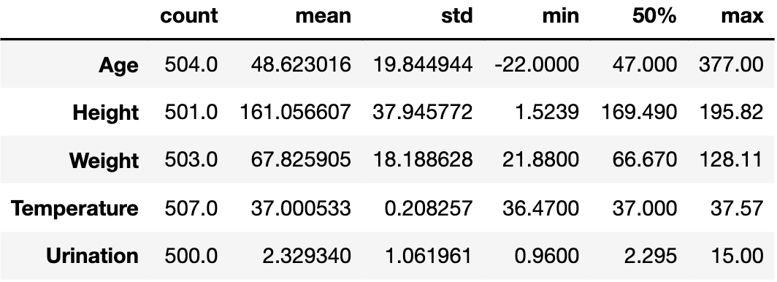
Outliers
Categorical variables - hard to find outliers
Numerical variables
Temperature low variance: mean, max, min, 50% all close to each other

Slide 16
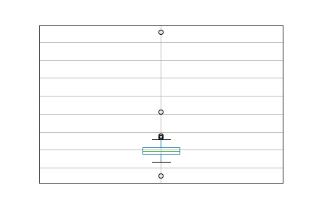
Age:
min value = - 22
max value = 377
3 Outliers: - 22, 155, 377
No reliable explanation
Remove outliers
dataset:
507 entries → 504 entries

Slide 17
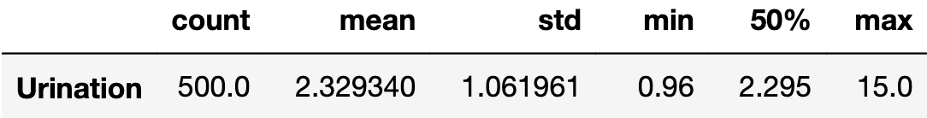
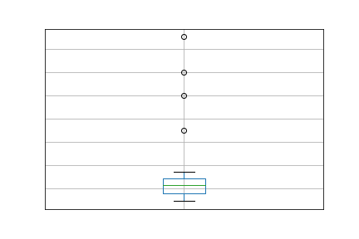
Urination:
max value 15.0
15 L seems like a lot per day
4 outliers:
7.0, 10.0, 12.0, 15.0
See no clear reason → remove
Dataset:
504 entries → 500 entries
Urination

Slide 18
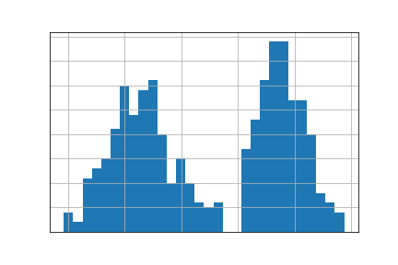
Urination
After removing outliers
Bi distribution
No values between 2.37 & 2.55
clear cut off between distributions
Diabetes ratio
low - urination = 25.8% diabetes
high - urination = 80.9% diabetes
Clear difference
Manipulation
Urination → Urination_high
Cutoff at urination = 2.4
Urination Bi distribution

Slide 19
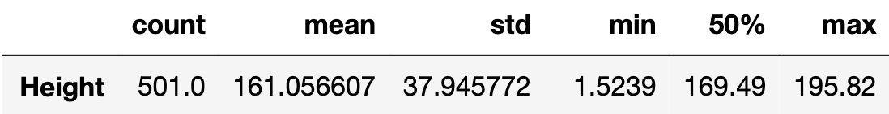
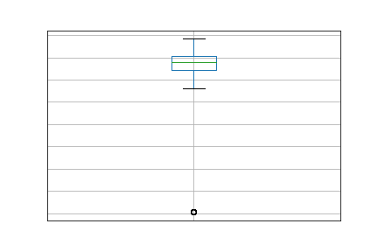
Height:
min value = 1.5239
max value = 195.82
Different scales - cm & m
No values between 2.00 and 130.00
Below 2.00 = meters
Above 130.00 = cm
Converting m to cm
Multiply all values below 2.00 by 100
Height

Slide 20
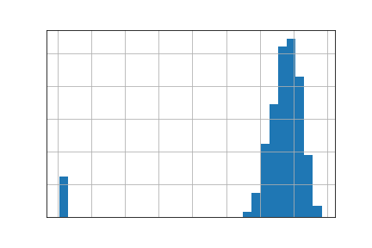
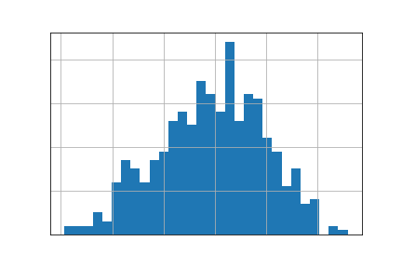
Height before transformation
Height after transformation

Slide 21
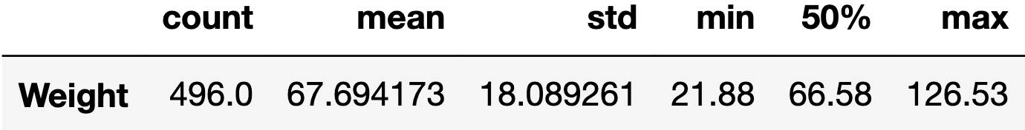
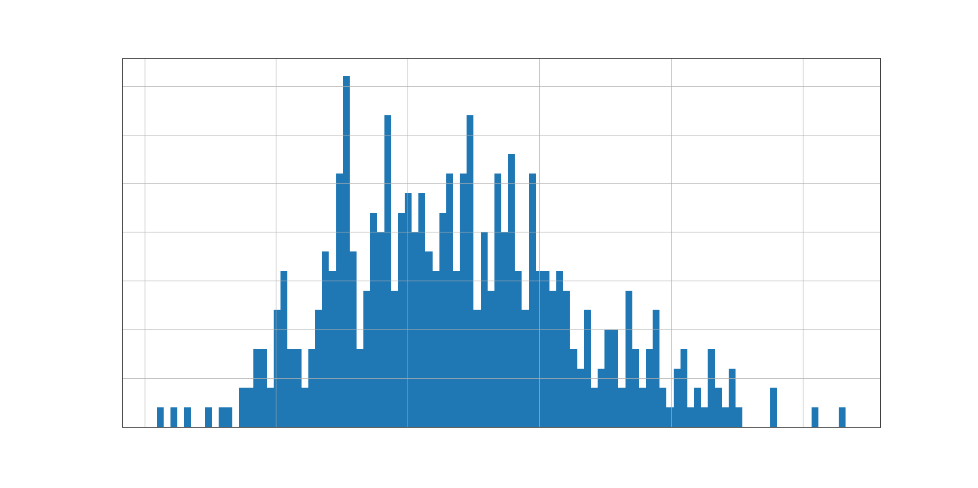
Weight:
Complicated case:
min value = 21.88
Unrealistic
Possible reasons:
Children: no individuals below the age of 16
Amputations: consequence of diabetes
Incorrect reporting
Different scales

Slide 22
Convert to BMI:
BMI = kg/m
Create a cut off for underweight people
BMI does not take gender into account, or age above 18 years old
NHI lists BMI <= 16 as underweight degree 3 (most extreme case)
Our cut off = BMI < 15
Eliminate 24 individuals
Dataset:
500 entries → 476 entries
What about overweight people?
More likely to weight 120kg than 20kg
Heavy people can have a lot of muscles
Did not use Z-score or other outlier detection methods because that would cut off more heavy than underweight people
2

Slide 23
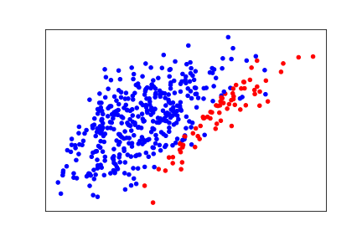
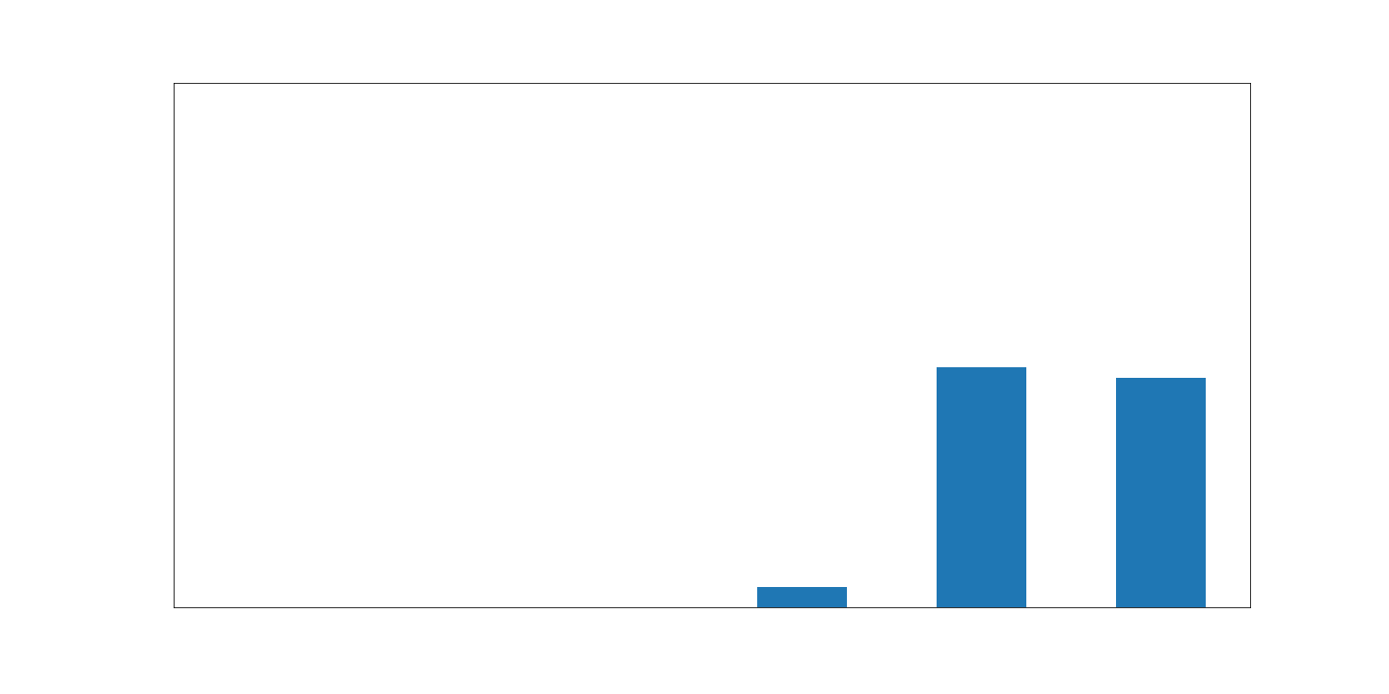
Obesity:
1 missing value
BMI have a clear relationship with Obesity
Easy to fill using a BMI/Obesity cut off
BMI >= 30 → Obese
For individual with missing Obesity value:
Obesity = “yes” if BMI >= 30
Obesity = “no” if BMI < 30
Height vs weight
Red = Diabetes positive
Fraction of obese people in BMI class
BMI = 30 → ~ 100% obese

Slide 24
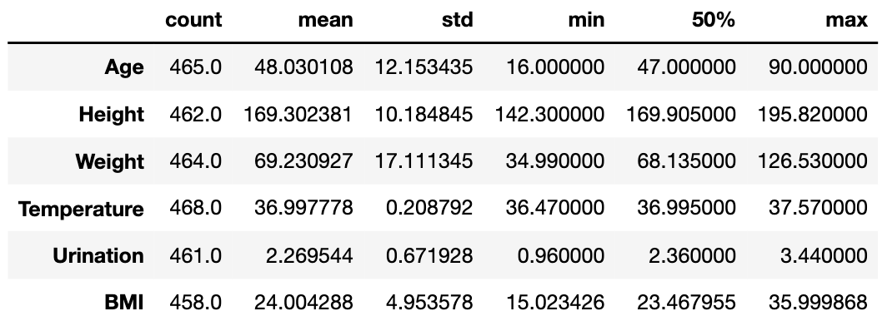
Dataset overview after outlier removal
Continuous data look good
476 individuals
Still some missing values

Slide 25
Missing values
Race:
99% white individuals
Assumption: the last 1% has no significant impact
Too few entries: consider non-white people outliers and remove
Dataset:
476 entries → 468 entries

Slide 26
Deleting rows with missing values:
Delete rows with missing values in the following variables (numerical and multi-categorical):
Age (3 missing values)
Gender (2 missing values)
Height (6 missing values)
Weight (4 missing values)
GP (7 missing values)
Occupation (2 missing values)
Exists method to fill:
prediction on age, gender, weight → predict height
combinations of these
occupation based on age (retired)
Cost greater than reward to implement such methods
Entries still affected by missing data : 24
Dataset:
468 entries → 444 entries

Slide 27
Correlation - Methods
Three primary correlation measurements used as a guideline
Chi-square test - Nominal variables vs Nominal variables
ANOVA f-test - Numeric variables vs Nominal variables (without rank)
Pearson’s correlation - Numeric variables vs Numeric variables
Chi-square hypothesis test:
H₀ — that the nominal variable is independent of the nominal variable
H_{A} — that the nominal variable is dependent on the nominal variable
ANOVA hypothesis test:
H₀ — that the numeric variable is independent of the nominal variable
H_{A} — that the numeric variable is dependent on the nominal variable
Pearson correlation coefficient
Coefficient ranging from -1 to 1

Slide 28
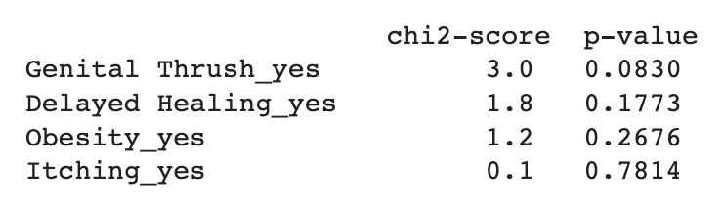
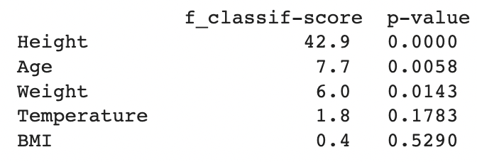
Correlation - Features vs target
Variables that cannot be excluded from being independent from the target variable with - Significance level: 0.05:
The chi-square test: four nominal variables
The ANOVA f-test: Temperature and BMI

Slide 29
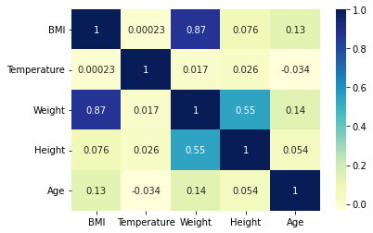
Correlation - Features vs features
We use Pearson’s correlation to check between numeric features
Matrix shows high correlation between:
Weight and BMI
Height and Weight

Slide 30
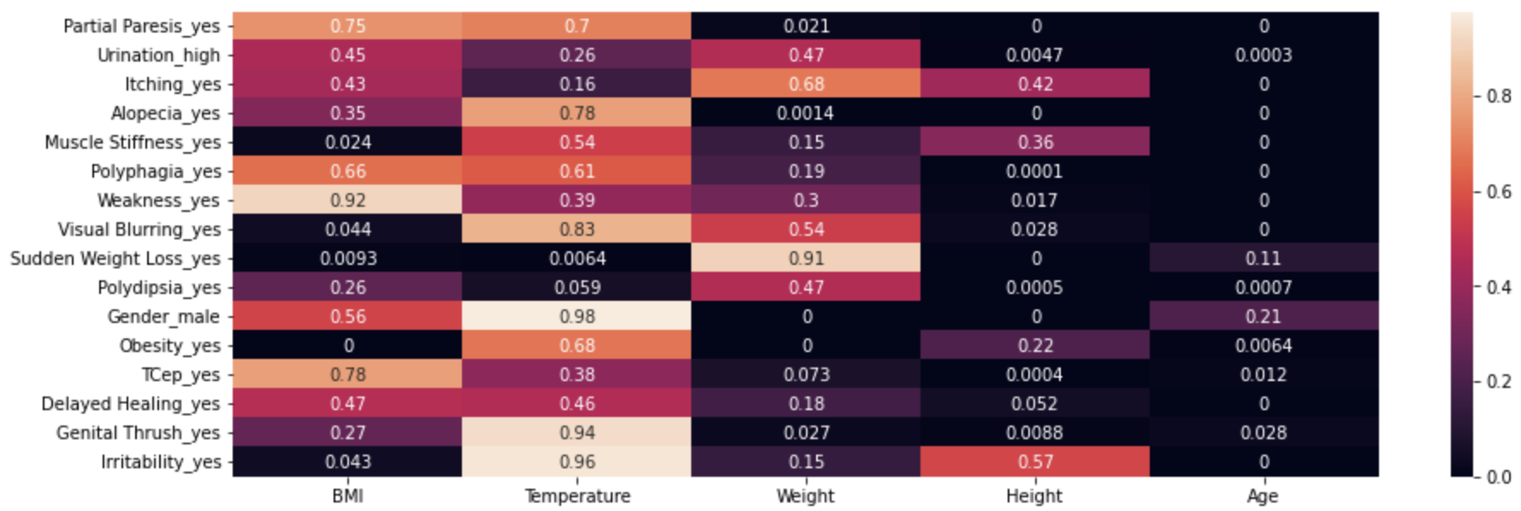
Correlation - Features vs features
ANOVA f-test to check significant correlation between numeric and nominal features: Displaying p-values
Black squares indicate possible dependence

Slide 31
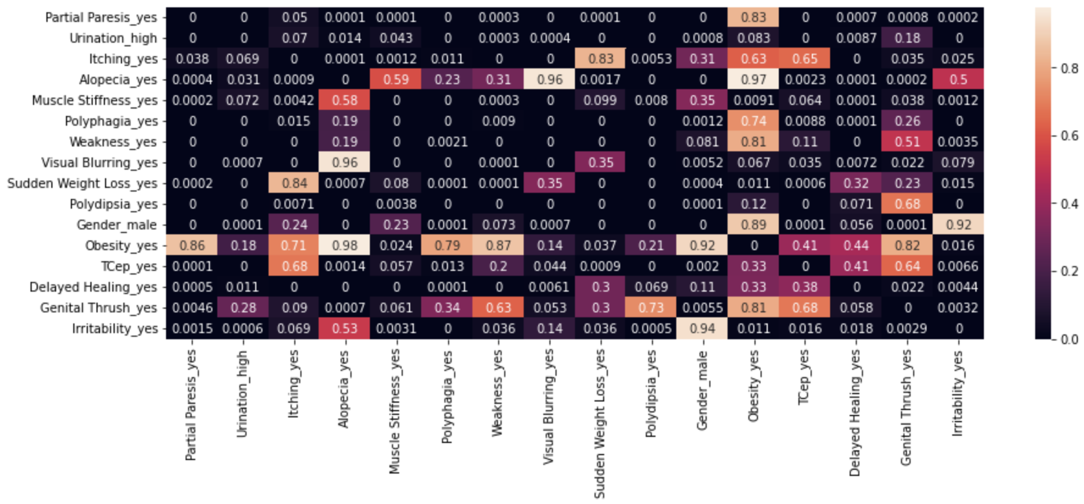
Correlation - Features vs features
Chi-square test to check significant correlation between nominal features: Displaying p-values
Black squares indicate possible dependence

Slide 32
03
Feature selection

Slide 33
Feature selection
Selecting features - procedure
Initial dataset - 23 predictive features for Diabetes
Removed race due to homogeneous dataset
Add BMI as alternative indicator for Obesity
23 potential predictive features for Diabetes
5 steps to remove features

Slide 34
5 step feature removal procedure
Not correlated with Diabetes
Spurious correlation
Privacy & fairness concerns
STEP 2
STEP 4
STEP 1
STEP 3
STEP 5
Low variance
Features correlated with each other

Slide 35
Selecting features - Variables removed
The following variables were removed in each step:
Step 1 - No correlation between feature and target:
Muscle Stiffness
Genital Thrush
Delayed Healing
Obesity, Itching
Temperature
BMI

Slide 36
Selecting features - Variables removed
The following variables were removed in each step:
Step 2 - Correlation between features:
Polydipsia - High correlation with Urination_high
Backed by high chi-square value relative to other features
Age - Correlation with multiple other features
Additionally, age is not productive for our use case, since we are targeting our product at school children, that is a homogenous group age wise
Height - Correlation with multiple other features
Especially weight

Slide 37
Selecting features - Variables removed
The following variables were removed in each step:
Step 3 - Spurious correlation
TCEP - Has high correlation with diabetes, we can look for causation by doing a hypothesis test.
The hypothesis test yielded a p-value of 4.8e-27 indicating causality.
Reverse causality: having diabetes would lead to less likelihood of having a tattoo/cosmetic procedure
Patients with diabetes have a higher risk of NOT healing properly after having a tattoo or cosmetic surgery
Simply spurious correlation

Slide 38
Selecting features - Variables removed
The following variables were removed in each step:
Step 4 - Low variance
Temperature (Already removed in step 1)

Slide 39
Selecting features - Variables removed
The following variables were removed in each step:
Step 5 - Privacy & fairness concerns
GP - Privacy
No strong reason why your GP (Doctor) should have an impact
Supported by findings that most GP's have similar diabetes/patient rate
Wouldn’t be relevant for our business case anyway
Occupation - Privacy
Target demographic for the product is children in school ages - no occupation

Slide 40
Selecting features - Variables selected
After applying our 5 step procedure we end up with the following subset of features:
Alopecia_yes
Gender_male
Irritability_yes
Partial Paresis_yes
Polyphagia_yes
Sudden Weight Loss_yes
Urination_high
Visual Blurring_yes
Weakness_yes
Weight
10 features
9 categorical - binary
1 numeric

Slide 41
04
Classification & evaluation

Slide 42
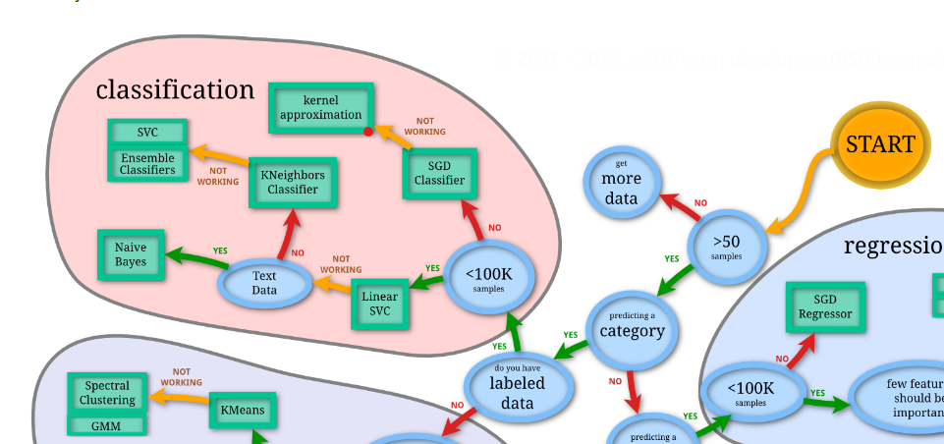
Choice of classifier
Few features and limited data
Performance and explainability are two factors that contribute to the decision.
Suitable classifiers: support-vector-machine, a classification tree or k-nearest-neighbors.
A neural network might give higher performance, but is difficult to interpret, and needs a lot of data / many features.
Source: https://scikit-learn.org/stable/tutorial/machine_learning_map/index.html

Slide 43
Choice of classifier
We chose the following 5 classifiers:
Linear Support Vector Machine
Multi-Layer Perceptron (2 layers, small)
Multi-Layer Perceptron (4 layers, large)
k-Nearest Neighbors, k=30
Decision Tree Classifier

Slide 44
Evaluating our classifier - Performance
Performance
Metric for performance: F_{β}-score
Weighting precision & recall
F₂-score suitable as recall is more important than precision
Specifically, 2x
Punish False Negatives harder
We prefer sending to many people to the doctor, to not detecting real cases
Train-test split
We use 80% of data for training, and reserve 20% for testing
Baseline: predict randomly based on target: 63% accurate

Slide 45
Initial performance
Classifier | Accuracy | Precision | Recall | F1-score | F2-score
Linear SVM | 0.876 | 0.877 | 0.950 | 0.912 | 0.934

Slide 46
Initial performance
Classifier | Accuracy | Precision | Recall | F1-score | F2-score
Linear SVM | 0.876 | 0.877 | 0.950 | 0.912 | 0.934
MLP, small | 0.933 | 0.922 | 0.983 | 0.952 | 0.970
MLP, large | 0.989 | 1.000 | 0.983 | 0.992 | 0.987
kNN, k=30 | 0.876 | 0.877 | 0.950 | 0.912 | 0.934
Tree | 0.910 | 0.894 | 0.983 | 0.937 | 0.964

Slide 47
Initial performance
Classifier | Accuracy | Precision | Recall | F1-score | F2-score
Linear SVM | 0.876 | 0.877 | 0.950 | 0.912 | 0.934
MLP, small | 0.933 | 0.922 | 0.983 | 0.952 | 0.970
MLP, large | 0.989 | 1.000 | 0.983 | 0.992 | 0.987
kNN, k=30 | 0.876 | 0.877 | 0.950 | 0.912 | 0.934
Tree | 0.910 | 0.894 | 0.983 | 0.937 | 0.964

Slide 48
Initial performance - features chosen
Classifier | F2-score | # feat | Features
Linear SVM | 0.934 | 3 | Gender_male, Irritability, Urination_high
MLP, small | 0.970 | 5 | Gender_male, Irritability, Partial Paresis, Sudden Weight Loss, Urination_high
MLP, large | 0.987 | 7 | Alopecia, Gender_male, Irritability, Partial Paresis, Polyphagia, Sudden Weight Loss, Visual Blurring
kNN, k=30 | 0.934 | 3 | Gender_male, Irritability, Urination_high
Tree | 0.964 | 10* | Alopecia, Gender_male, Irritability, Partial Paresis, Polyphagia, Sudden Weight Loss, Visual Blurring, Weakness, Weight, Urination_high
*) all features were used

Slide 49
Initial performance - features chosen
Classifier | F2-score | # feat | Features
Linear SVM | 0.934 | 3 | Gender_male, Irritability, Urination_high
MLP, small | 0.970 | 5 | Gender_male, Irritability, Partial Paresis, Sudden Weight Loss, Urination_high
MLP, large | 0.987 | 7 | Alopecia, Gender_male, Irritability, Partial Paresis, Polyphagia, Sudden Weight Loss, Visual Blurring
kNN, k=30 | 0.934 | 3 | Gender_male, Irritability, Urination_high
Tree | 0.964 | 10* | Alopecia, Gender_male, Irritability, Partial Paresis, Polyphagia, Sudden Weight Loss, Visual Blurring, Weakness, Weight, Urination_high
*) all features were used

Slide 50
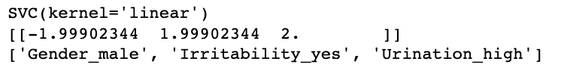
Initial performance - coefficients (SVM)
This means:
Women: if you are either irritable or have high urination levels: see a doctor
Men: if you have high urination: see a doctor
Else, no need

Slide 51
Evaluating our classifier - Fairness
We have four variables that can give fairness issues
Race
Gender
GP
Occupation
We will only look at gender fairness
Rate of FN and FP should be similar for both genders
In our case we’re more sensitive to FN
This is evaluated on the test set

Slide 52
Evaluating our classifier - Fairness
Classifier | FN Female | FN Male | Rate of FN (female)
Linear SVM | 0 | 3 | 0%
MLP, small | 0 | 1 | 0%
MLP, large | 2 | 1 | 66.6%
kNN, k=30 | 2 | 1 | 66.6%
Tree | 0 | 1 | 0%

Slide 53
Anonymization
We previously removed some features for privacy purposes
We now further anonymize the dataset using differential privacy
Benefits: robust to linkage attacks
Toss a coin, 50-50: keep response or generate random entry
This gives ln(3)-differentially private data
Centralized model of differential privacy: we handle the anonymization
In a future study, you could do it decentralized (data is anonymized on reporting)
This is more sensitive to the amount of data, however
We use the best feature set from each model, and re-run the experiment after anonymizing the data

Slide 54
Evaluating our classifier - Anonymization
Classifier | Original F2-score | New F2-score | New recall
Linear SVM | 0.934 | 0.912
MLP, small | 0.970 | 0.788
MLP, large | 0.987 | 0.724
kNN, k=30 | 0.934 | 0.702
Tree | 0.964 | 0.707

Slide 55
Evaluating our classifier - Anonymization
Classifier | Original F2-score | New F2-score | New recall
Linear SVM | 0.934 | 0.912
MLP, small | 0.970 | 0.788
MLP, large | 0.987 | 0.724
kNN, k=30 | 0.934 | 0.702
Tree | 0.964 | 0.707

Slide 56
Evaluating our classifier - Anonymization
Classifier | Original F2-score | New F2-score | New recall
Linear SVM | 0.934 | 0.912 | 1.000
MLP, small | 0.970 | 0.788 | 0.767
MLP, large | 0.987 | 0.724 | 0.783
kNN, k=30 | 0.934 | 0.702 | 0.883
Tree | 0.964 | 0.707 | 0.633

Slide 57
Evaluating our classifier - Conclusion
Considering anonymization, the best classifier seems to be the Linear SVM, which was durable to losing data via the anonymization process
Linear SVM does predict all diabetes cases, however
The features set it uses is just 3: Gender_male, Irritability, Urination_high
This does seem low, but we did see in data analysis that urination had a massive impact
The others are known to perform well with more data, so future data collection should still consider a few alternatives
Our recommendation for future data collection is to collect the 10 features we had before the start of classification (slide 41)
Even after anonymization our best classifier is ~0.9 F2-score
Again, note the recall issues

Slide 58
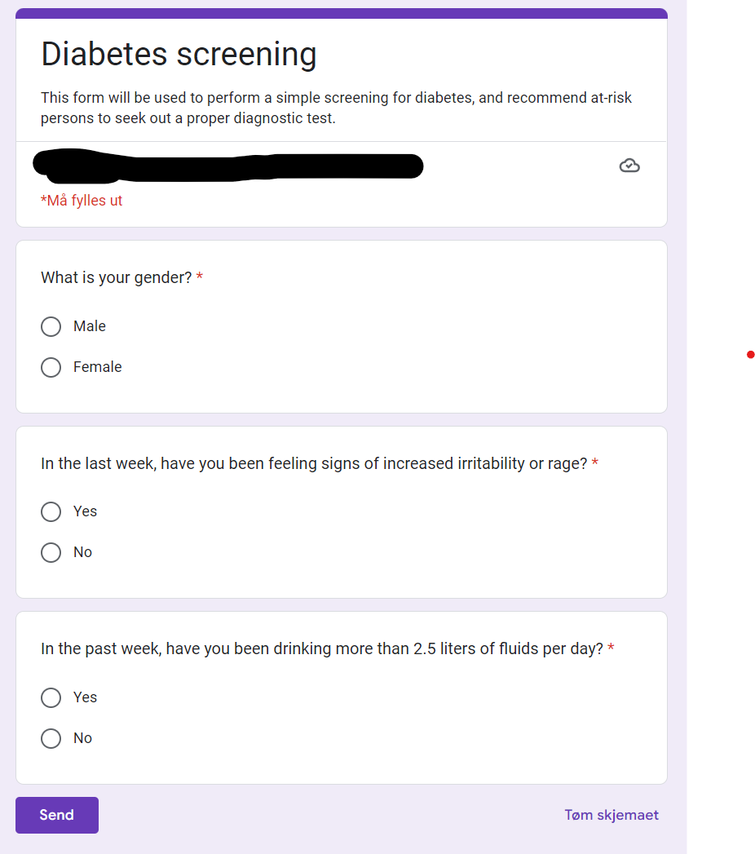
Example of use - web form

