Slide 1

magnUS-Snakemen

Slide 2
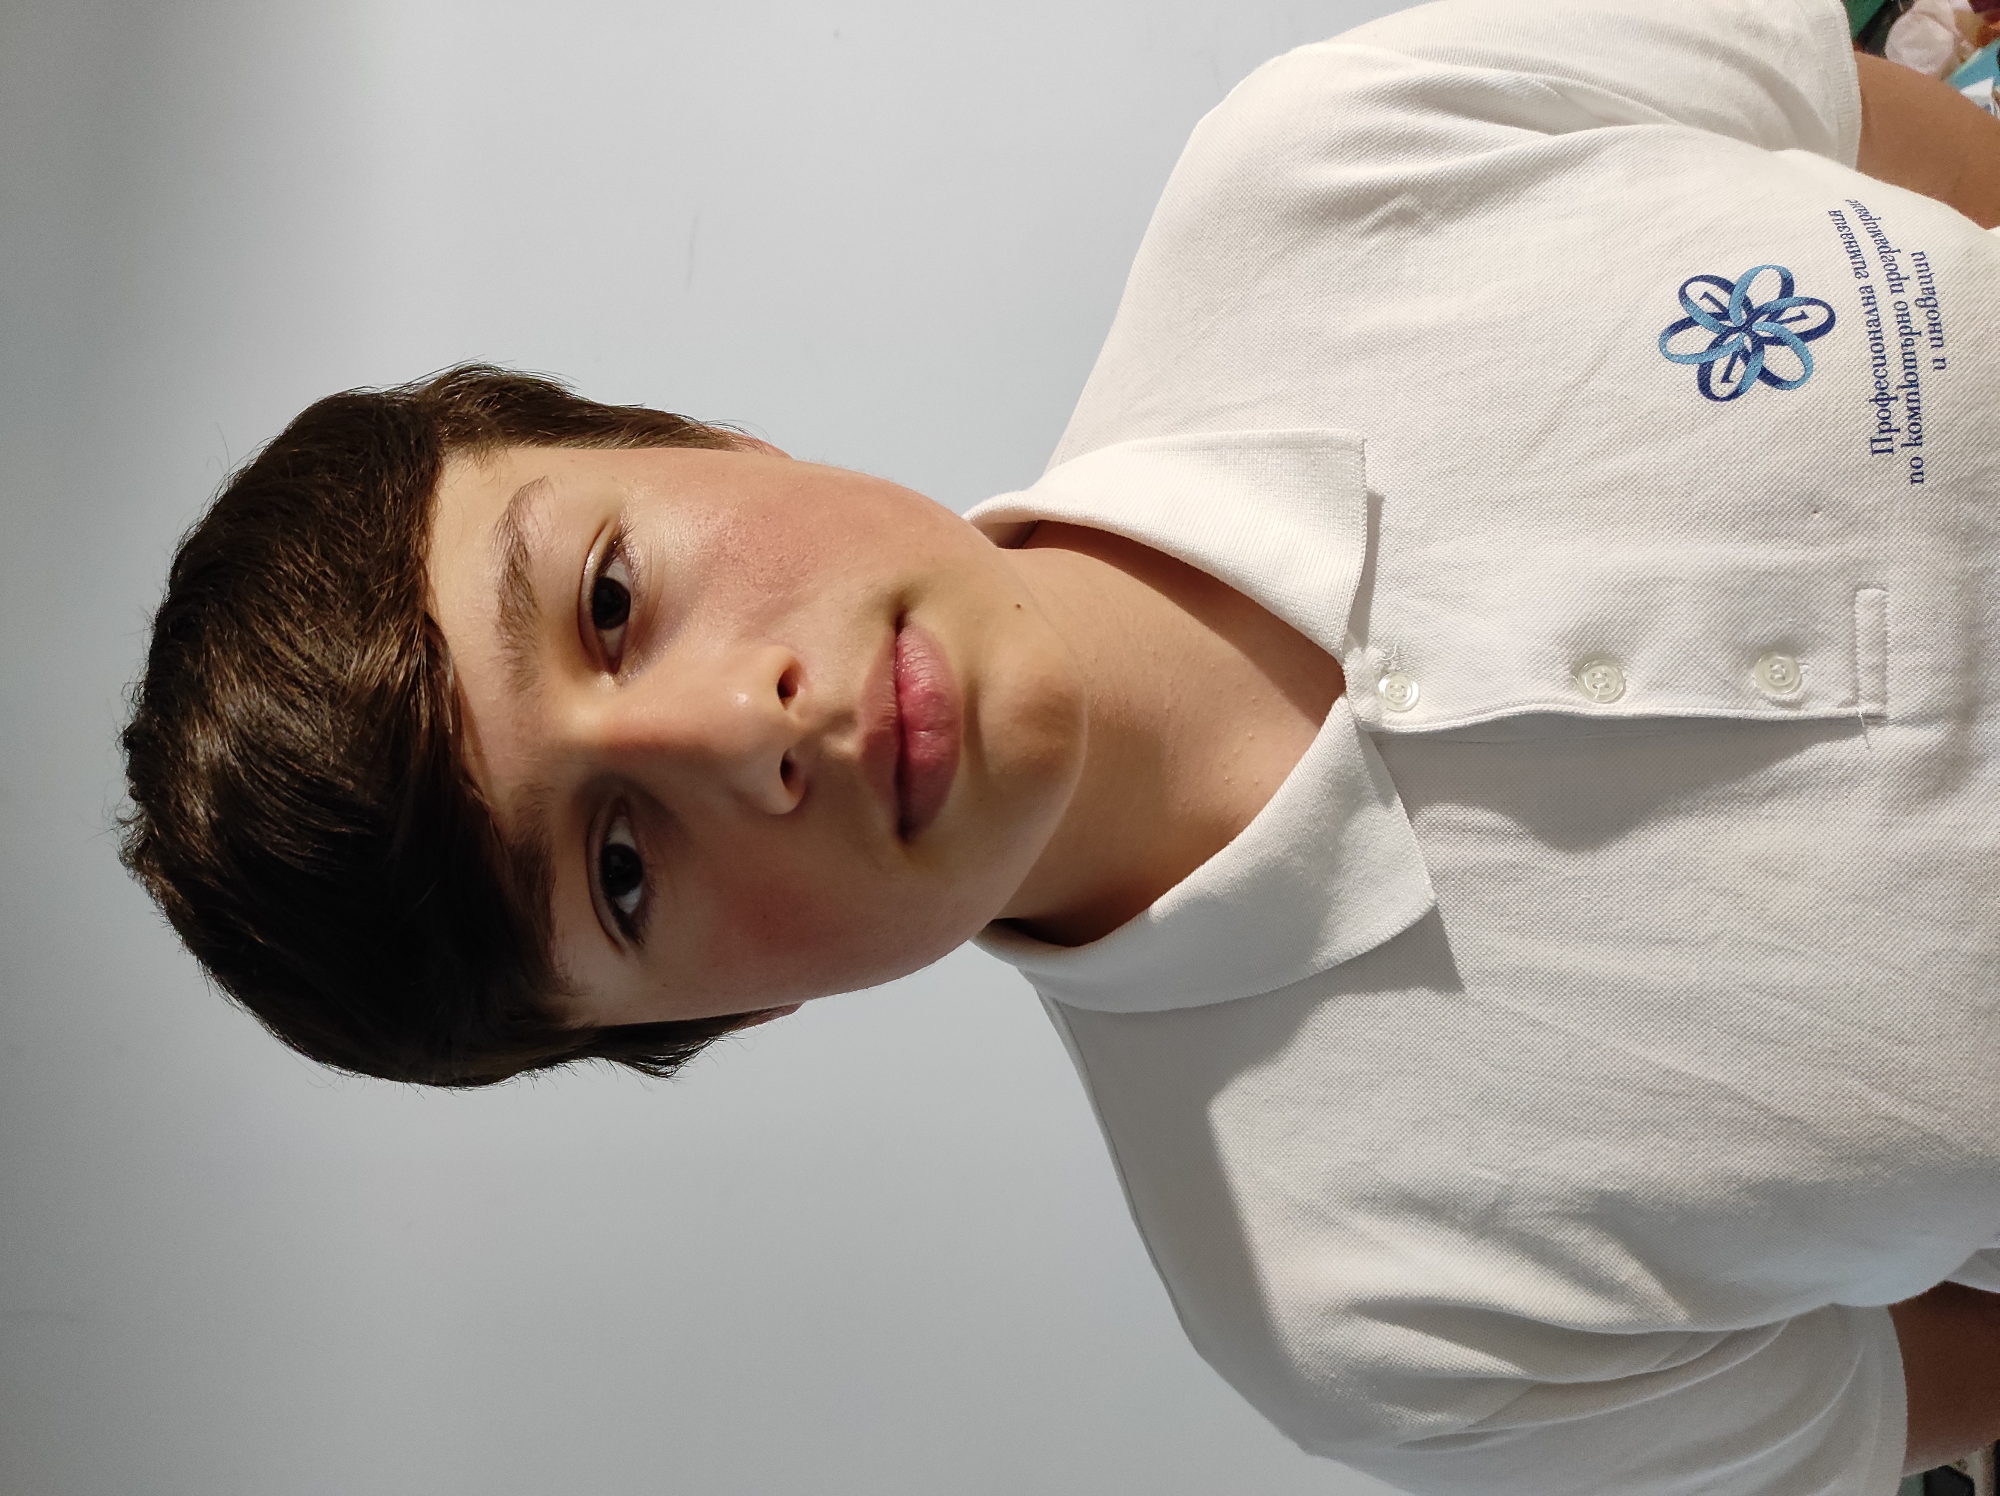
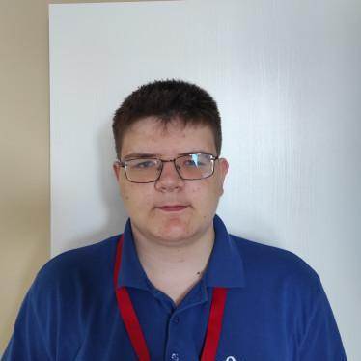
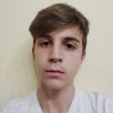
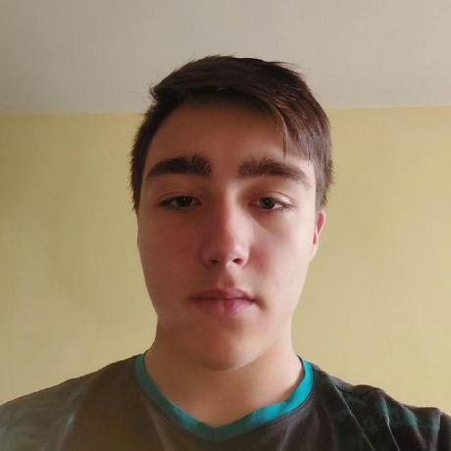
The Team
Yordan Stoyanov Scrum Trainer
Petar Matsaliev Backend Developer
Stefan Hristov Backend Developer
Daniil Furnika Quality Assurance

Slide 3
Work Stages
01
02
03
04
05
Organizing and Forming the Team
Forming the Main Concept
Planning and Distributing Roles
Intensive Work
Presentation

Slide 4





Used technology and languages

Slide 5
Enough Talking! Now let’s get to the application!

