Slide 1
Elasticsearch Tool Demo
Presented by: Zack Harnett & Jenna Wise

Slide 2
Key Concepts
Node
A single running instance of Elasticsearch
Cluster
Collection of one or more nodes
Can index and search across all nodes in a cluster
Document
Collection of fields in a specific manner defined in JSON format
Belongs to a type unique UID

Slide 3
Key Concepts
Index
Collection of different types of documents and their properties
Type/Mapping
Collection of documents sharing a set of common fields present in the same index
Shard
Horizontally subdivided indexes in a node
Contains all properties of a document with less JSON objects than an index

Slide 4
About
RESTful search engine that is built for the cloud.
Completely sharded with a configurable number of shards.
Document oriented search
Nearly real time search
Atomic isolation for each operation for consistency and durability
Easy scalability

Slide 5
Use Cases
Classical full text search
Fuzzy searches (spell checker)
Auto completion (family of suggesters)
Analytics with Kibana and Logstash
Visualizations
Aggregations
Machine learning coming soon!
Multi-tenancy
General purpose document store
https://www.elastic.co/blog/found-uses-of-elasticsearch

Slide 6
Notable Users
The New York Times
Search for 164 years of published articles
Microsoft
Search on Azure and powering Social Dynamics
GitHub
Search in GitHub
IBM
Operational log analysis engine for Bluemix Apps
https://www.elastic.co/use-cases.

Slide 7
Install Elasticsearch
Install or check for Java 7 or higher
Download Elasticsearch
https://www.elastic.co/downloads/elasticsearch
Extract file to preferred path
Elasticsearch is now installed there
https://www.tutorialspoint.com/elasticsearch/elasticsearch_installation.htm

Slide 8
Run Elasticsearch
cd to the Elasticsearch bin folder
Run elasticsearch.bat using elasticsearch command
If could not reserve enough space for KB object heap,
add _Java_Options_ with value –Xmx512M –Xms256M to system path
If JAVA_HOME is not set,
add JAVA_HOME with value path to your Java JDK to system path
Browse to http://localhost:9200/ to check if the server is running
https://www.tutorialspoint.com/elasticsearch/elasticsearch_installation.htm

Slide 9
Install HTTP Client
Interact with Elasticsearch’s JSON base REST API using an HTTP Client (curl, Sense, RESTClient, Kibana)
The following examples will be done using Fiddler
https://www.telerik.com/download/fiddler
Installation of Fiddler is simple in Windows
Double click on the downloaded EXE
Follow the Launcher steps for installation

Slide 10
Adding/Deleting Data
To index a JSON object make a POST request to the REST API at http://localhost:9200/<index>/<type>/[<id>]/ with a JSON request body
To delete any index, type, or id JSON object make a DELETE request to the REST API at http://localhost:9200/<index>/<type>/[<id>]/ with a empty request body
http://joelabrahamsson.com/elasticsearch-101/

Slide 11
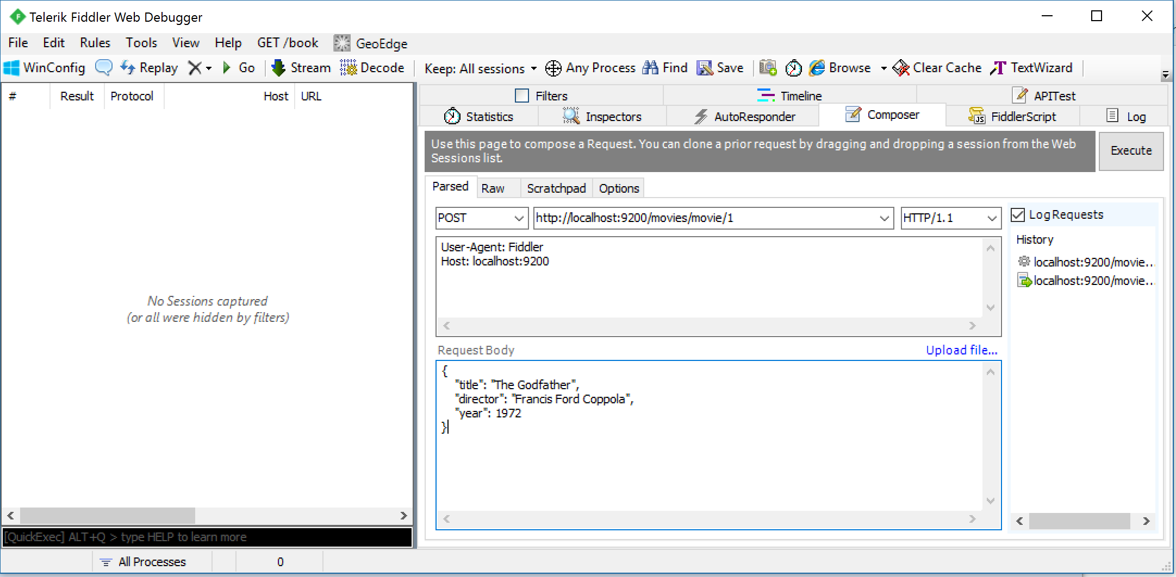
Index is movies, type is movie, and id is 1

Slide 12
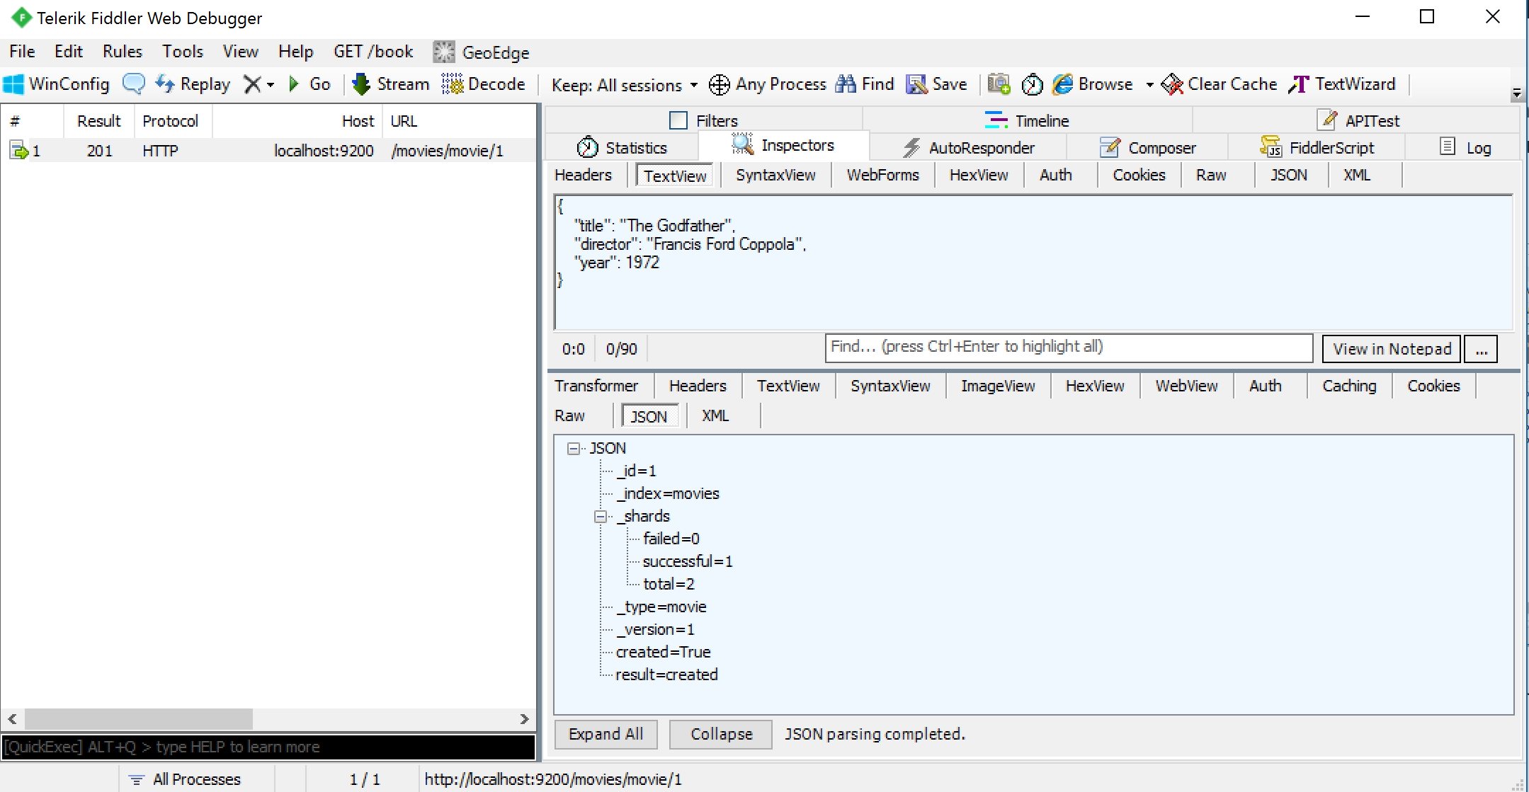
The Inspectors tab in Fiddler shows the request response

Slide 13
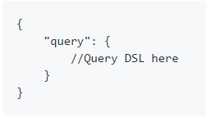
Basic Searching
Make requests using POST http://localhost:9200/<index>/<type>/_search
The request body should look like
Where Query DSLs are specialized JSON syntax found in the Search APIs for Elasticsearch

Slide 14
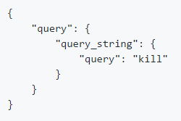
Basic Searching
For example,
Making POST http://localhost:9200/movies/movie/_search request with the request body below
Searches for the word kill in all of the movie type documents

Slide 15

Making HTTP Requests Demo Video
https://youtu.be/60UsHHsKyN4?list=PLw5h0DiJ-9PDStvJYc1LOZiEm1ehlEKLP

