Slide 1
Randoop
Java test generation
Mark freedman
Brandon Latronica
YSU - CSCI5802
Spring 2017

Slide 2
Intro…
“Begin at the beginning," the King said, very gravely, "and go on till you come to the end: then stop.”
- Lewis Carroll, Alice in Wonderland
As stated by it's creators: Do you love writing unit tests to find bugs in your programs? Or, would you prefer that the tests were written for you automatically?
Randoop is a program that automatically generates JUnit test files for Java classes. Randoop outputs two kinds of tests:
Error-Revealing Tests: Tests that detect bugs in the current code
Regression Tests: Tests that a program still performs correctly after changes
Usually, the user fixes all errors that appear in error-revealing tests and then will rerun Randoop until it does not generate any error-revealing tests.
Claim to fame:. Randoop has revealed previously-unknown errors even in widely-used libraries including Sun's and IBM's JDKs and a core .NET component.

Slide 3
Installation…
To install randoop, a user simply has to do the following:
Go to https://randoop.github.io/randoop/ (Hey, it's a github project page!)
Click the button to download the latest release, and get the "randoop-all" version of the zip file.
Uncompress randoop and make note of it's filepath.
Make sure java’s JRE AND JDK are installed.
Test it by typing in the following: java -ea -classpath "linux/windows file path and name to randoop.jar" randoop.main.Main help

Slide 4
Running Randoop…
To run Randoop, we use a command-line command similar to this example:
java -classpath bin;RANDOOP_PATH\randoop-all-3.0.10.jar randoop.main.Main gentests -testclass=guessapp.GuessLogic
The command can be broken down into the following components:
java - Calls the JVM environment
-classpath - Adds a classpath to the java environment. For this program specifically, we are going to add the path to randoop-all-3.0.10 and the path to the class files being tested.
randoop.main.Main - Invokes Randoop's main class
gentests - The command that generates unit tests
testclass=<classname> - Specifies the class that Randoop will generate tests
Notes:
Note - If the class being tested is part of a package, the classpath always contains the directory where you would expect to see the first part of the package name as a subdirectory. When entering the desired class in testclass, it should be fully qualified by the package name (e.g. guessapp.GuessLogic).

Slide 5
Command-line options…
Randoop includes several command-line options that allows the user to tailor the way Randoop runs and modify the test files output by Randoop. The following list includes a few examples
--junit-output-dir=<classpath> - Change the destination of the generated test files
--dont-output-tests=<boolean> - Run test generation without output
--timelimit=<int> - Forces Randoop to stop generate tests after a period of time
--outputlimit=<int> - Limits the number of regression and error-revealing tests
--omitmethods=<regex> - Prevents tests being generated for methods whose name matches the regular expression given
--inputlimit=<int> - Limits the number of test method candidates generated internally
--forbid-null=<boolean> - Forbids Randoop from using null as input to methods or constructors
--testsperfile=<int> - Limits the number of tests to write to each JUnit file
--error-test-basename=<string> - Choose the base name of the JUnit file containing error- revealing tests
--regression-test-basename=<string> - Choose the base name for the JUnt file containing regression tests

Slide 6
Use Case 1…
GuessApp : a simple game that generates a random number between 1 and 10 and records how long it takes for the user to guess the correct number.
The first use case was run on the GuessLogic class in the GuessApp project. The command used to invoke Randoop on GuessLogic.class is listed below:
java -classpath C:\randoop-3.0.10\randoop-all-3.0.10.jar;GuessApp\build\classes randoop.main.Main gentests --testclass=guessapp.GuessLogic

Slide 7
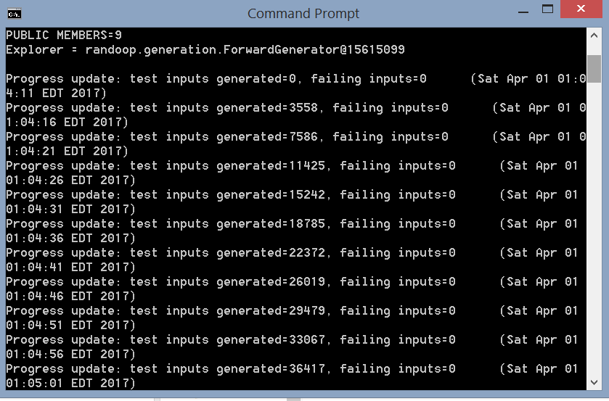
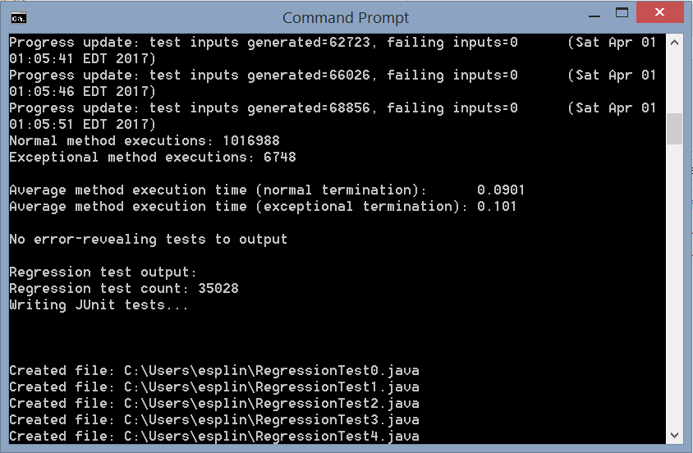
Use Case 1…
The first thing Randoop did was generate test inputs for each of the test files. By the end, Randoop had generated:
1016988 normal method executions
6748 exceptional method executions.
The average method execution time for normal termination was 0.0901
Average method execution time for exceptional termination was 0.101.
Number of regression tests created was 35028
……

Slide 8
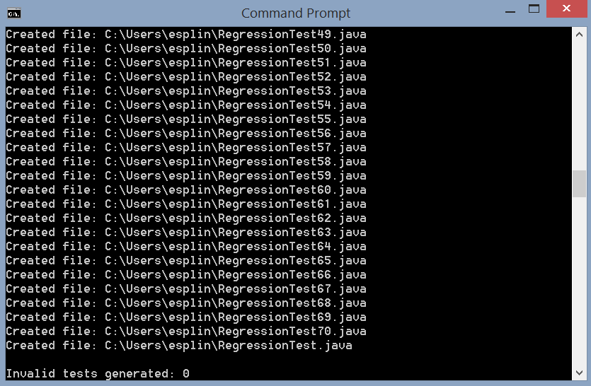
Use Case 1…
Randoop generate 71 test files and placed them in the bin folder of the GuessApp project.
RegressionTest.java invokes the series of other number regression files using @Runwith annotation .

Slide 9
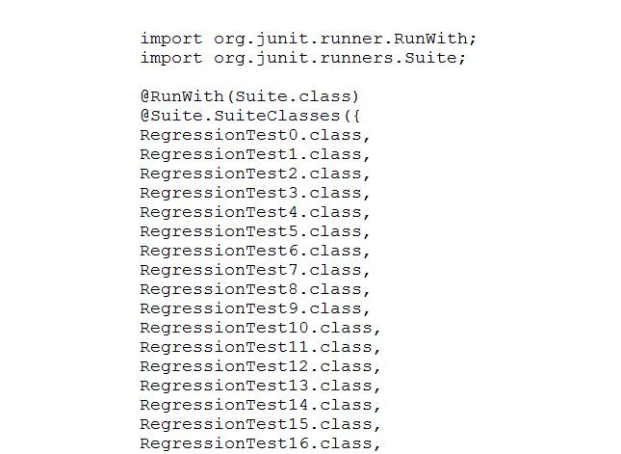
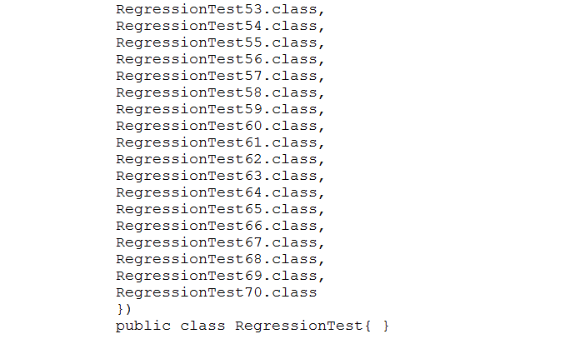
Use Case 1…
The contents of the previously mentioned RegressionTest.java file.
……

Slide 10
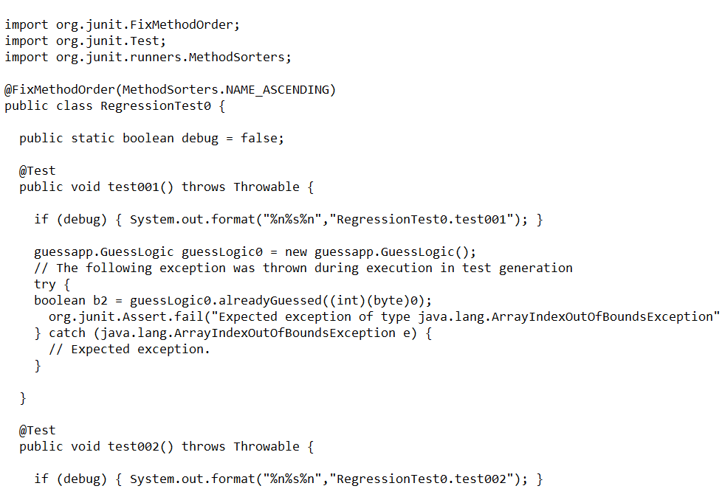
Use Case 1…
Example generated test.
Assert*() checks that a value creates an ArrayIndexOutofBounds exception.

Slide 11
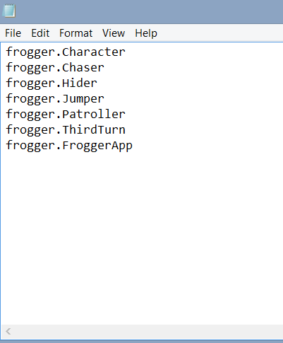
Use Case 2…
Frogger project: a game that emulates the original Frogger aracade game.
Instead having to enter multiple testclass=<classname> commands, a user can create a textfile that includes all of the class files that the user wants to use to create test files. The text file testclasses.txt is listed.
All the user has to do is place the textfile into the designate classpath and invoke the file using the command --classlist=<textfile>.
java -classpath C:\randoop-3.0.10\randoop-all-3.0.10.jar;Frogger\build\classes randoop.main.Main gentests --classlist=classlist.txt --omitmethods=frogger.Jumper.act

Slide 12
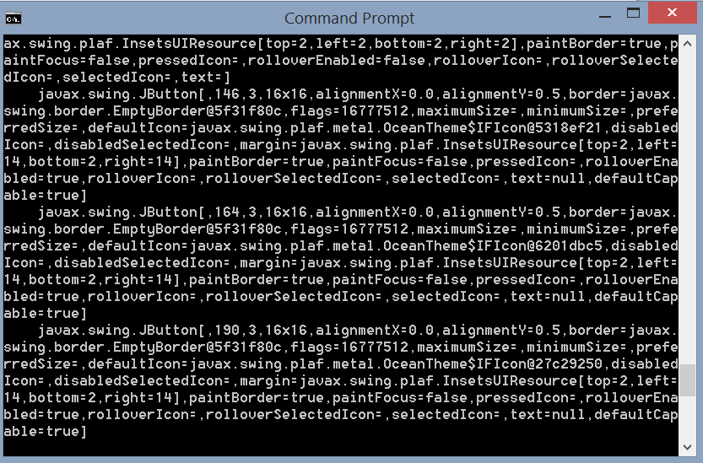
Use Case 2…
Note: We omitted the act method in Jumper.class because the method was nondeterministic and could not have test generated.
Randoop first generated test input. It also opened all of the GUI components.

Slide 13
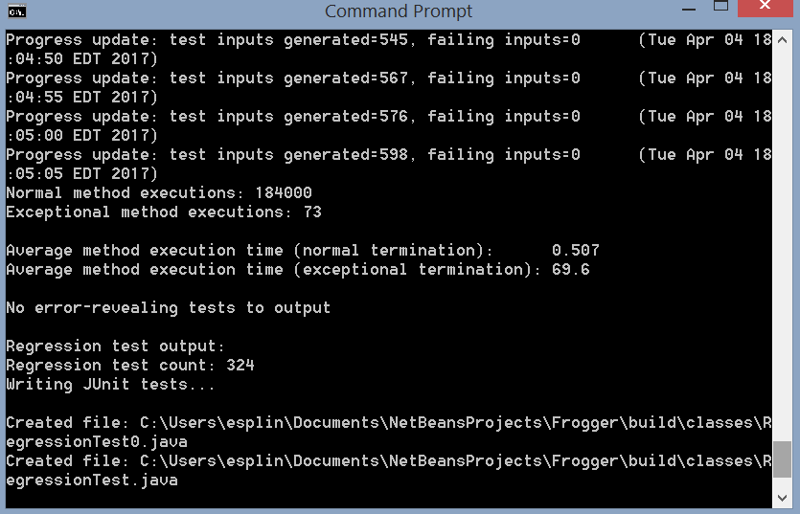
Use Case 2…
Randoop generated:
184000 normal method executions
73 exceptional method executions
Average method execution time for normal termination was 0.507
Average method execution time for exceptional termination was 69.6
Number of regression tests created was 324.

Slide 14
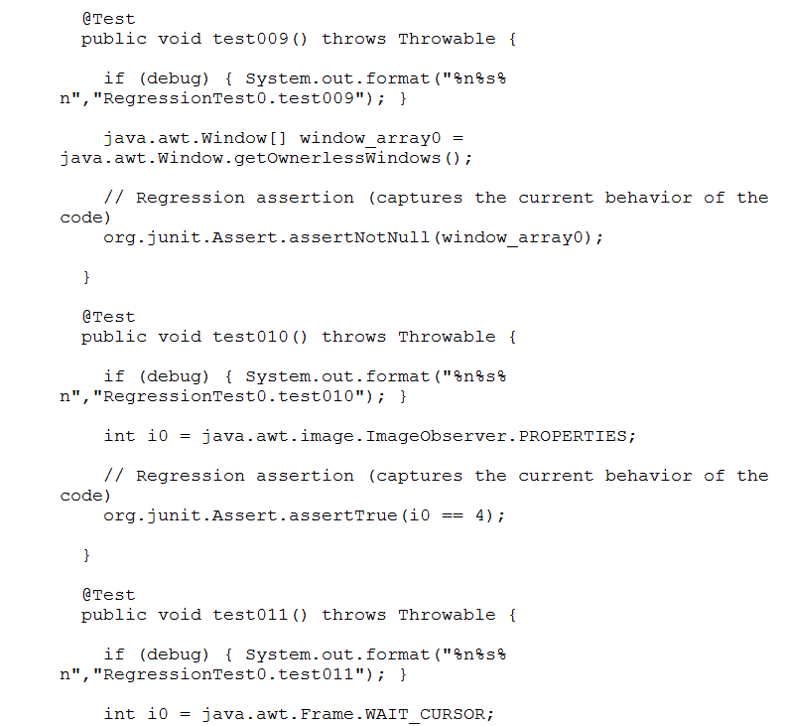
Use Case 2…
RegressionTest0.java is very similar to the test files generated for use case 1. The main differences from the last use case is that some of the test methods are used to test the Java visual objects. This is done in several ways such as testing that the cursor location is in the bounds of the JWindow or that VolatileImage objects do not lose their contents during execution.

Slide 15
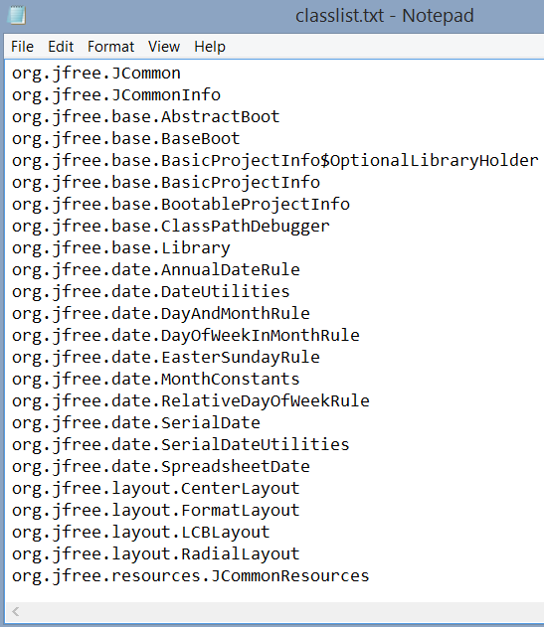
Use Case 3…
JfreeChart: is a comprehensive free chart library for the Java platform.
Create a classlist.text that contains the names from the file JCommon-1.0.23.jar library and generate test files by running the command below:
There are 131 class names in total for JFreeChart.
Note: We limited the number of tests per file to ten in order to keep the number of test methods per file manageable.
java -classpath jfreechart-1.0.19\lib\jcommon-1.0.23.jar;C:\randoop-3.0.10\randoop-all-3.0.10.jar randoop.main.Main gentests --classlist=classlist.txt --testsperfile=10

Slide 16
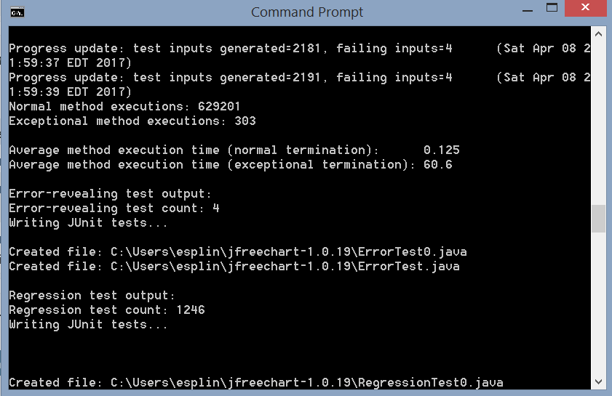
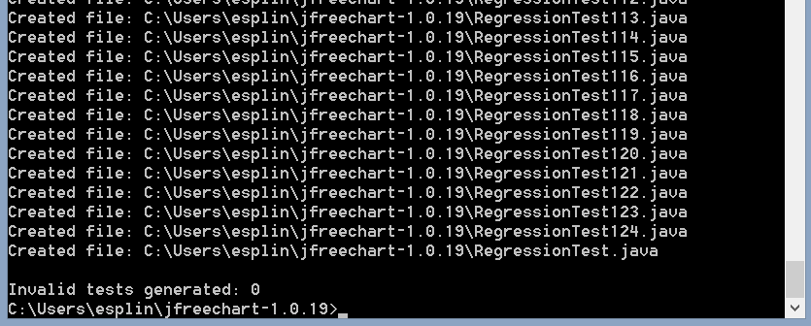
Use Case 3…
Randoop generated:
The program generated several Java Visual windows when generating inputs. The program also, oddly enough, tried to send a file to my printer several times while generating inputs.
Randoop generated 629201 normal method executions.
303 exceptional method executions.
Average method execution time for normal termination was 0.12s
Average method execution time for exceptional termination is 60.6s
The program created 4 error-revealing tests and created 1 ErrorTest files.
The program created 1246 regression tests and created 125 error test files.
……

Slide 17
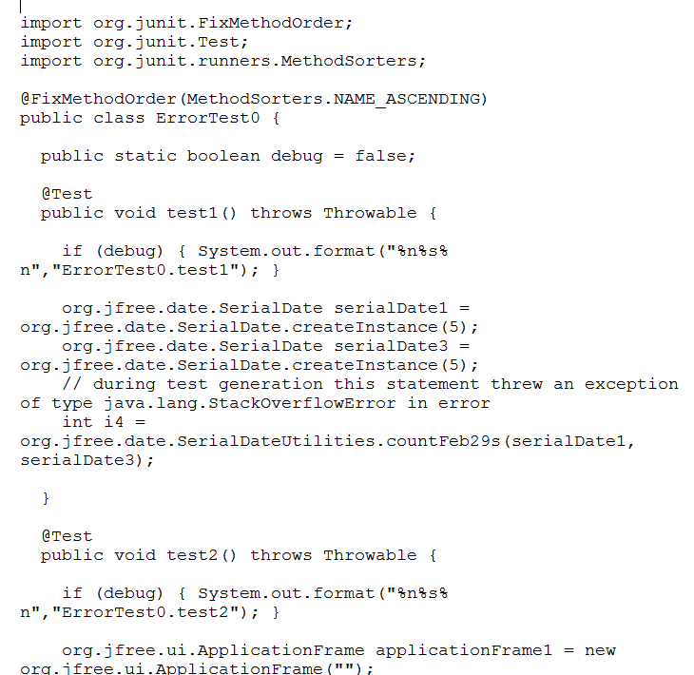
Use Case 3…
Like the regression tests, ErrorTest.java is a single class that uses a @Runwith annotation to invoke ErrorTest0.java. RegressionTest.java also contains a class that uses the @RunWith annotation to invoke the other 125 regression tests.
The error-revealing tests include comments telling the user what error caused the test to fail during generation. For example, test2() in ErrorTest0 includes the comment:
// during test generation this statement threw an exception of type java.lang.NullPointerException in error
If JFreeChart was still under development, we would find the source of these exceptions, edit the source code, and rerun Randoop to see if the program generates these errors again.

Slide 18
Tool Evaluation…
We have decided to evaluate the Randoop program based on the following criteria:
Ease of Use: Randoop does not include a GUI component. User must proficient in using the command line.
Options: Randoop does not include a GUI component. User must proficient in using the command line.
Adaptability: Randoop is unable to generate test files for nondeterministic or set static …..( )
Efficiency: Randoop is able to generate a large number of tests very quickly, the program is able to generate test in literally less than a second.

Slide 19
Tool Evaluation…
Installation: Randoop is very easy to install, all the user has to do is unzip the main folder and place it in a directory.
Learning Curve: Randoop does not have a broad set of documentation and can sometimes be difficult to construct a randoop command.
Scalability: In order to generate tests for multiple classes, the user has to create a text file that lists all of the class files. The larger the project, the longer it takes the user to create this text file.

Slide 20
Tool Evaluation…
Overall, while the program does require some command-line knowledge and has a steep learning curve, the efficiency and customizability of the program makes it a very convenient way to generate JUnit tests. The program is especially good at generating tests files for java libraries. The program is easy to install as well, so it is very easy for a user to download the program and try it out for themselves.

